Slide 1

Year 5 – Holly
‘Our Wonderful World’
Curiosity
Broadmindedness
Creativity
Responsibility
Enjoying Life
Sense of Belonging
Mrs O’Goan

Slide 2

Bikeability
6 children will take part per day
Bring in a bike and helmet
Spring term
Your child will take part for one day during that week.
Additional information will be sent out nearer to the time.

Slide 3
Y5 Curriculum

Slide 4
History and Geography
Autumn | Spring | Summer
Democracy Roman Empire and its impact on Britain | Can we save our animals? Conservation Location study: Asia | Britain’s Settlements Britain’s settlement by Anglo-Saxons and Scots

Slide 5

Music lessons
Music lessons will take place on a Tuesday afternoon
Please ensure that instruments are brought in every Tuesday!

Slide 6



Maths
Autumn | Spring | Summer
Number and place value Addition and subtraction Multiplication and division Fractions | Multiplication and division Decimals and percentages Measurement – perimeter and area Statistics – graphs and tables | Geometry – properties of shape Geometry – position and direction Decimals Negative numbers Measurement – converting units Measurement – capacity and volume

Slide 7






English - writing
Autumn 1 & 2 | Spring 1 & 2 | Summer 1 & 2
Outcome - Flashback narrative Key text – Escape from Pompeii | Outcome – Journey story Key text – The Hunter | Outcome – Biography Key text – The Darkest Dark
Outcome – Traditional tale Key text- The Lost Happy Endings | Outcome – Hybrid leaflet (informative/persuasive) Key text – Can we save the tiger? | Outcome – Information text Key text – Radiant Child

Slide 8


English - reading
Reading can be the key to unlock the curriculum and reading across the curriculum develops skills, problem solving, creative thinking and vocabulary.
Reading for pleasure enables children to explore unknown worlds, inspires creativity, allows children to visit and learn about new places and empowers children to develop their own reading habits and environments.
Please bring reading diaries in every day and strive for 5 times a week.
Links to Y5 recommended reads:
https://www.thereaderteacher.com/year5
https://images.scholastic.co.uk/assets/a/c5/0e/creating-a-reading-spine-hand-out-2137908.pdf (Pages 28-28)
https://schoolreadinglist.co.uk/reading-lists-for-ks2-school-pupils/suggested-reading-list-for-year-5-pupils-ks2-age-9-10/

Slide 9
Discuss thoughts, feelings and opinions.
Discussing characters (feelings, actions, traits and relationships.)
Discussing likes and dislikes with explanations.
Discuss vocabulary
Book Talk
Discuss authorial choices.
Using text and imagery to make inferences
Making predictions based on what has been read.
Links to other texts/similarities and differences.
Discussing setting (mood, atmosphere and descriptors.)

Slide 10
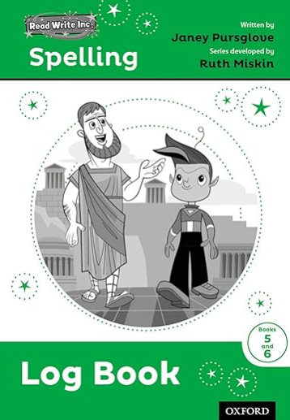
English - SPAG
Spellings:
Will be logged in RWI log books (new spelling patterns and statutory Y5/6 spellings.) Please bring these in each day.
Spag.com:
Logins will be stuck into reading diaries.
Enables children to revise/consolidate spelling and grammar rules from previous year groups and to recap new rules and content taught in Y5.

Slide 11
Homework – Set Monday for following Monday
Reading – ‘strive for 5’
TTRS – 15 minutes
Spellings – words recorded in logbook from spelling lesson in school.
SPaG.com test
Thank you in advance for supporting your child’s learning at home!

Slide 12
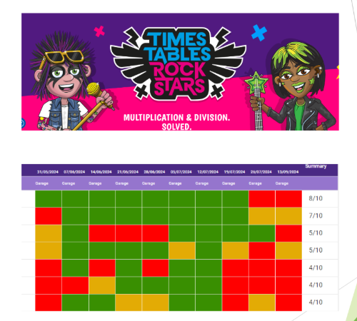
TTRS
15 minutes per week
minimum for homework.
Gig once a month in school
will determine which times
tables will be set.
Y5/6 5 minutes Garage 10
minutes Studio
We will track how often it
is completed.

Slide 13
Thank you in advance for supporting!
We are so looking forward to working with our Y5s this year.
If you have any questions, please do not hesitate to contact.
Additional information and communication
Weekly newsletter sent by email and on the website.
Email admin@childerthornton.cheshire.sch.uk and this can be passed along to us.

