Slide 1
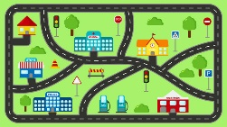
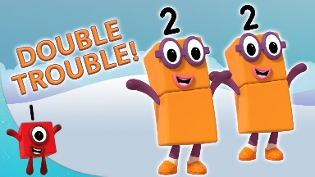
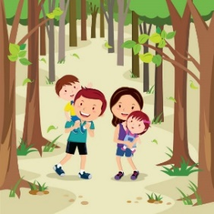

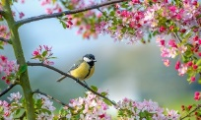
Reception Home Learning Challenge
Week 1
Go for a woodland walk (or to a park with some tall trees!). The children need to recognise the difference between areas in their own environment and that of a similar environment elsewhere. We have been looking at similarities and differences between woodlands and rainforests. Look at a local park or woodland and see if you can identify any features from the checklist. Talk about what would be on the checklist if we lived in a different country with a jungle or rainforest! Can you make a rainforest/jungle checklist?
Week 2
Maps
This week we are looking at maps of our local area to identify woodland areas and maps of the world to identify Rainforests and Jungles.
Help your child to create their own map, showing some of the features they pass regularly e.g. shop, church, houses, playground. You can add your own drawings too!
Week 3
Maths
We are learning doubles and practising visualising them as arrangements so we can subitise them quickly. Use the butterfly outlines and create doubles by adding the same number of spots to each wing. Practise saying the stem sentences on the sheet.
Here are some activities you can do with your child at home to help their learning.
Week 5
Spring Walk and Picture
We have been looking at the changes happening in the natural world. Go for a walk and see what changes you can see. Create a picture to show a Spring scene. You could include lots of items from your checklist.
Week 4
Family History
The children need to be able to talk about events which happened before they were born. Talk with your child about important events in your families life which happened before they were born e.g. sibling was born, a family wedding, a grandparents job. Choose three events, draw a picture for each and add a few notes from your discussions.
Our theme this half term is Jungles and Rainforests

