Slide 1



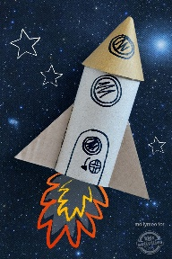
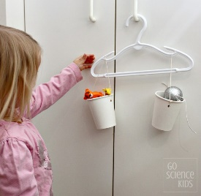
Reception Home Learning Challenge
Week 4
Due2nd Feb
Maths – we have been using our ‘fast eyes’ to recognise small quantities in different arrangements as quickly as possible.
See if you can cut out the subitising cards and use them as flash cards. See how fast you can recognise each arrangement. Can you describe the arrangement?
See if you can make your own subitising cards in your book using spots/stickers/pictures.
Week 1
Due 12th Jan
Create a winter picture using any materials you have (paint, coloured paper, old pieces of materials etc.) Think about what the natural world looks like and what animals might be outside.
Tell your parent/carer about how the world changes in winter. (Parent/Carer please write your child's words in the speech bubble attached).
Week 2
due 19th Jan
Gravity
This week we learnt that everything that goes up has to come back down! Have a look around your house and see if you can find any toys or games that work because of gravity. (E.g. bat and balls) draw a picture in your book of any that you find.
Week 3
due 26th Jan
We have been learning the story The Way Back Home by Oliver Jeffers. You can watch the story being told here
https://www.youtube.com/watch?v=y5yYd6IssGg
Can you cut out the pictures and match them to the sentences. Your child might need some help to read the sentences!
Our theme this half term is Space
Here are some activities you can do with your child at home to help their learning.
Week 5
due 9th Feb
Create a model of anything to do with space (rocket, spaceship, planet, alien).
Draw a plan in your book and create your chosen item using boxes from your recycling/materials you have in your house.
Week 6
due after half term
Maths – comparing mass
The children have been learning to compare the weight of objects from around the classroom.
See if you can create your own set of balances and measure the weight of items from around the house. See separate paper for more information.

