Slide 1
The Wonderful Lake District ☺☺☺

Slide 2
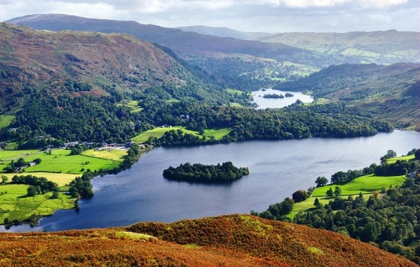
The Lake District is England’s largest national park, and is in the North-West of England. It’s full of beautiful lakes and mountains, waiting for you to discover.

Slide 3
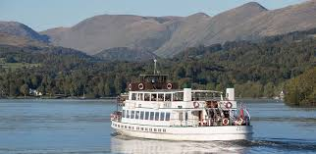
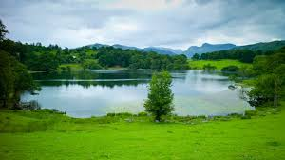
Take a nice and calming cruise or rent some water sports gear, to go on our great lakes (Lake Windermere, Ullswater, Coniston, and Derwentwater).

Slide 4
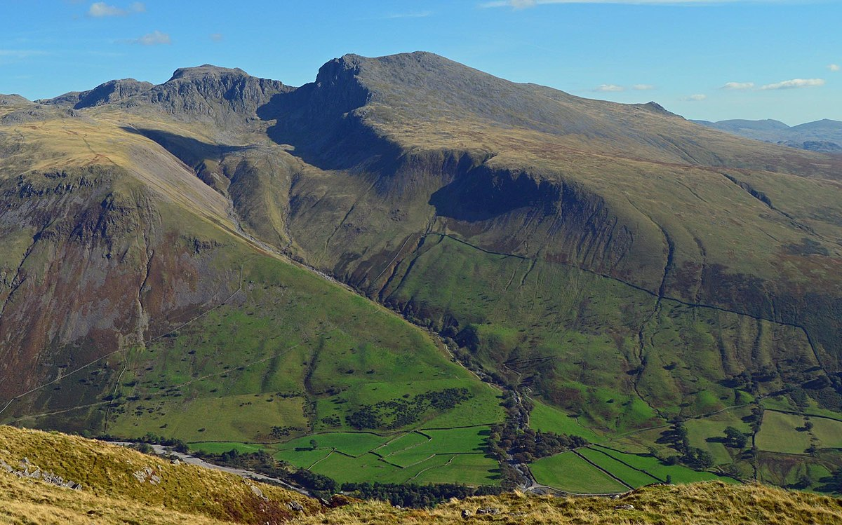
Or you can take a hike on our magnificent mountains. Scafell Pike is the highest mountain in the Lake District, and it’s full of wonderful secrets.

Slide 5
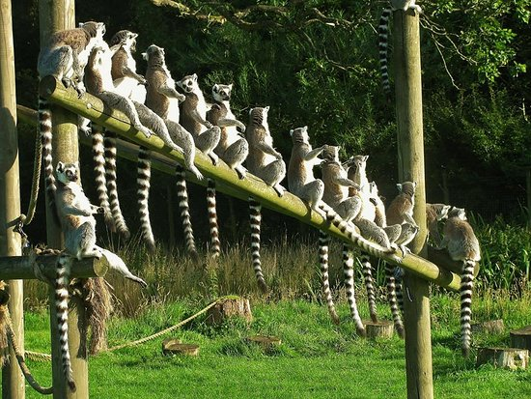
We even have an exotic animal park full with amazing different creatures such as ring-tailed lemurs(lots of them), red panders, elephants, otters, bold eagles, meerkats, rhinos and lots of other exiting animals.

Slide 6
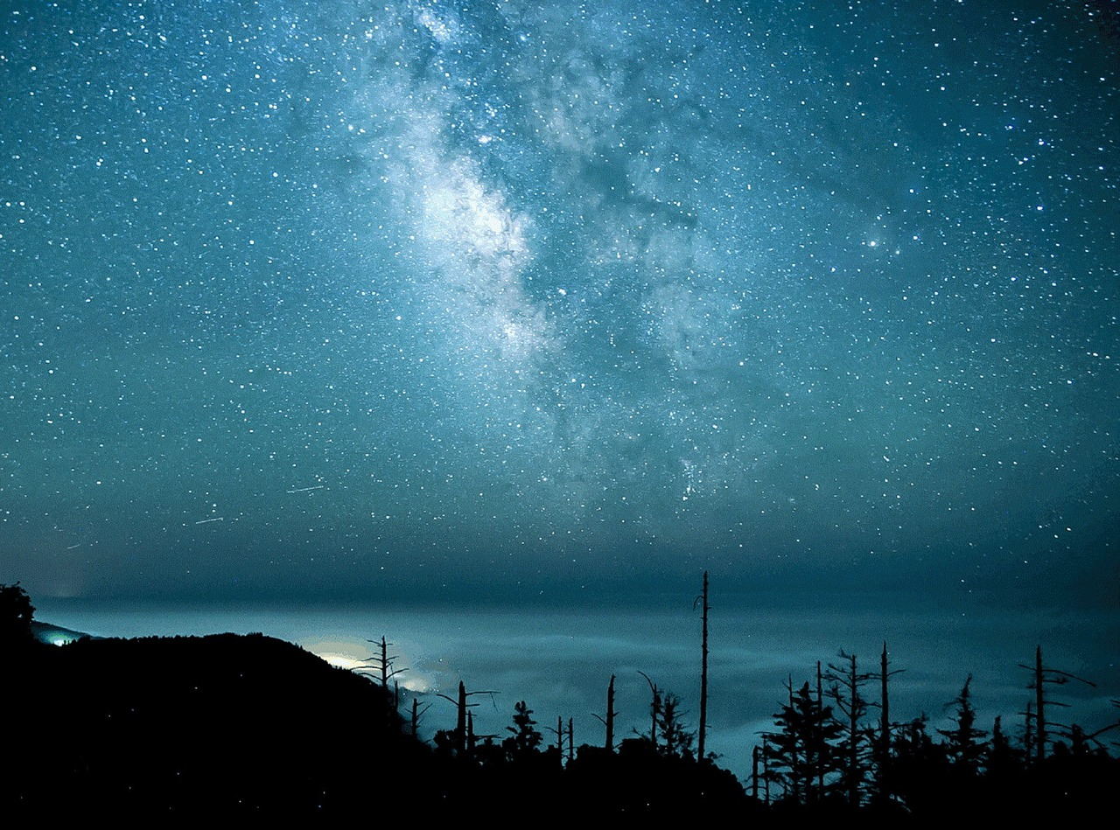
In the Lake District, we have some of the darkest skies in the country. Our skies are perfect for stargazing, so take a look at the curious stars in the night sky.

Slide 7
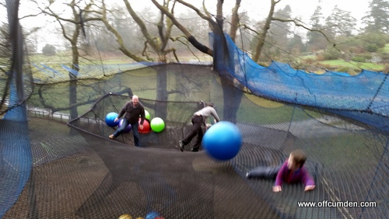
We have lots of exiting activities for family and friends like, tree top nets. Tree top nets are 1,500m of giant trampoline, filled with walkways, slides, and tunnels made out of the netting.

Slide 8
Thank you for watching my slide on the Lake District
By Lucie

