Slide 1
Winston Churchill

Slide 2
Winston Churchill information
Winston Churchill, was
Born :November 30th1874 in Oxfordshire, England.
Died :24th January 1965 in, London England.
Occupation :Prime Minister of Great Britain.
Best Known For :Standing up to the Germans in World War ||.
All true!!☺

Slide 3
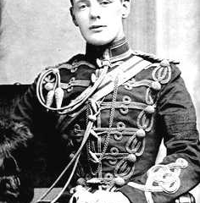
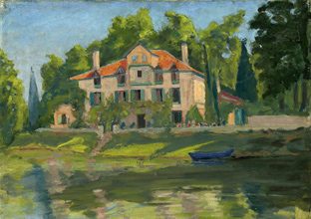
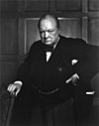
Churchill Jobs ( lot of them!!)
These are his other jobs
These are some of his jobs
These are some other jobs
orator
Painter
Visual artist
This is one of his paintings
Author
Statesperson
Armey officer
Prim Minister (on 2 occasions)
Sailor
journalist
Historian

Slide 4
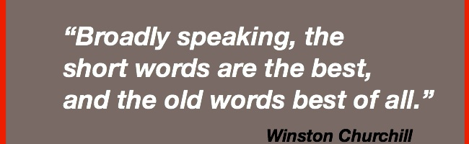
Winston had a famous quote that he said in World War|| that went like this, “ We shall defend our island what ever it takes, we shall fight on the beaches , we shall fight on the landing grounds, we shall fight in the fields and the streets, we shall fight in the hills ; we shall never surrender!”

Slide 5

When he ended the 2nd World War for Europe, it was an amazing day, and it is now known as .V.E day on the 8th May.
This year (2020) it’s a very special .V.E day because, it’s the 75th anniversary!!

Slide 6
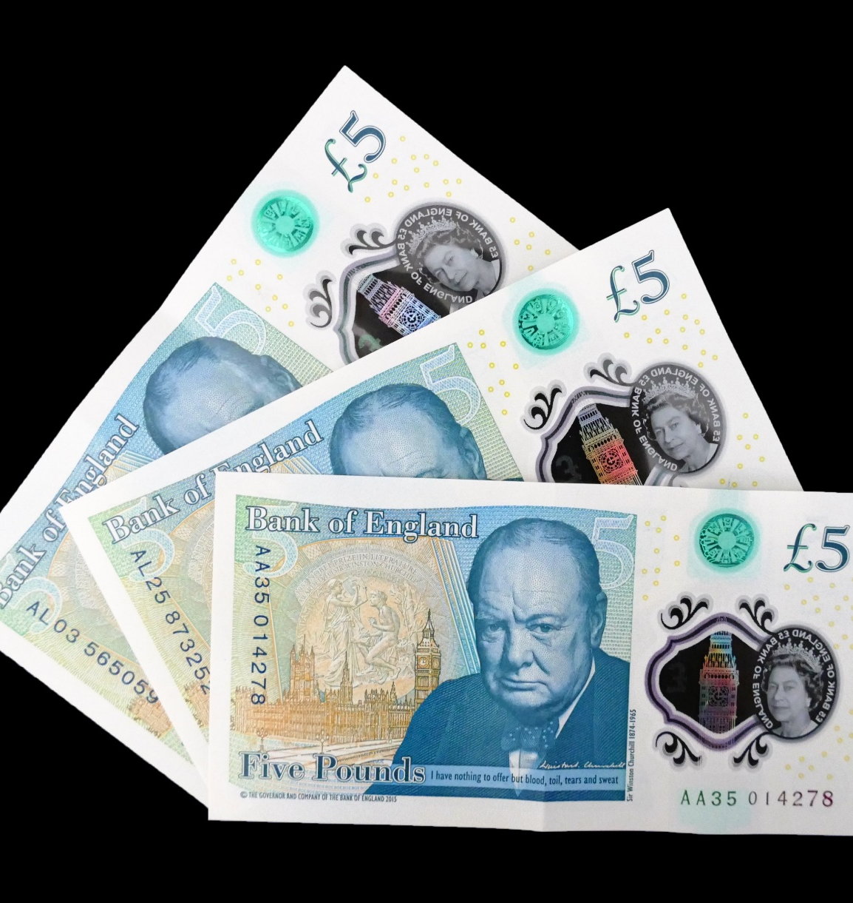
Five Pound Note (£5)
In April 2013, the Bank of England chose to replace Elizabeth Fry with Winston Churchill on the next £5 note in2016.
The sentence under him on a £5 note says, “I have nothing to offer but blood ,toil ,tears and sweat.”

Slide 7
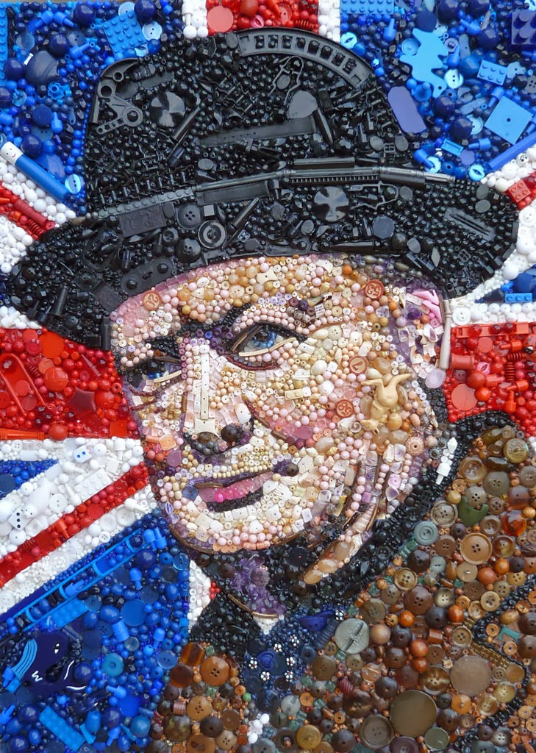
Thank you for watching my Winston Churchill power point I hope you liked it
STAY SAFE!!

