Slide 1
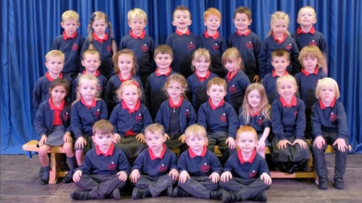
Hello Swallows
We are the Koala Tribe of Longton Primary School
Notes:
Hello Swallows we are pleased to meet you

Slide 2
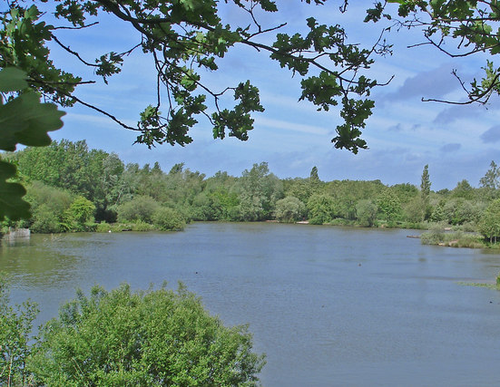
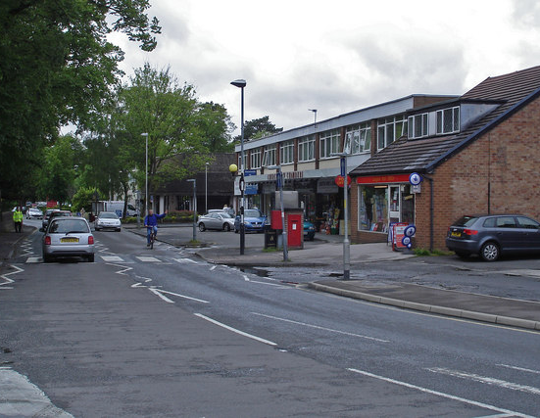
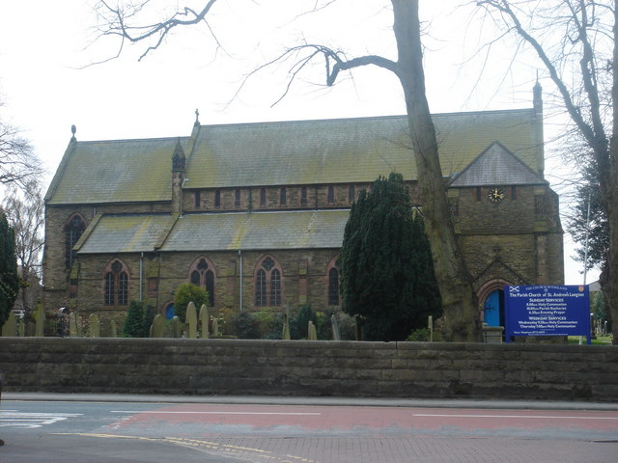
We would like to tell you about our school which is in the village of Longton 4 miles from Preston
This Photo by Unknown Author is licensed under CC BY-SA
Notes:
Our school is in the village of Longton near Preston. We have some shops, churches, parks and the Brickcroft which is a nature reserve

Slide 3
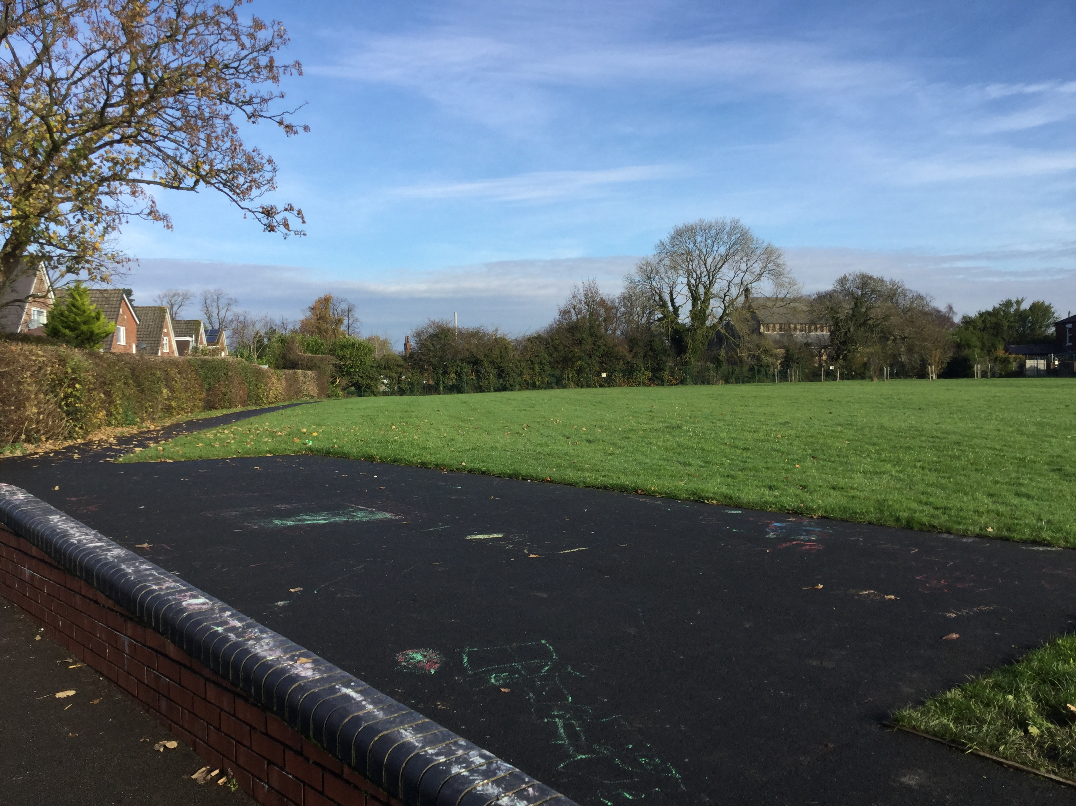
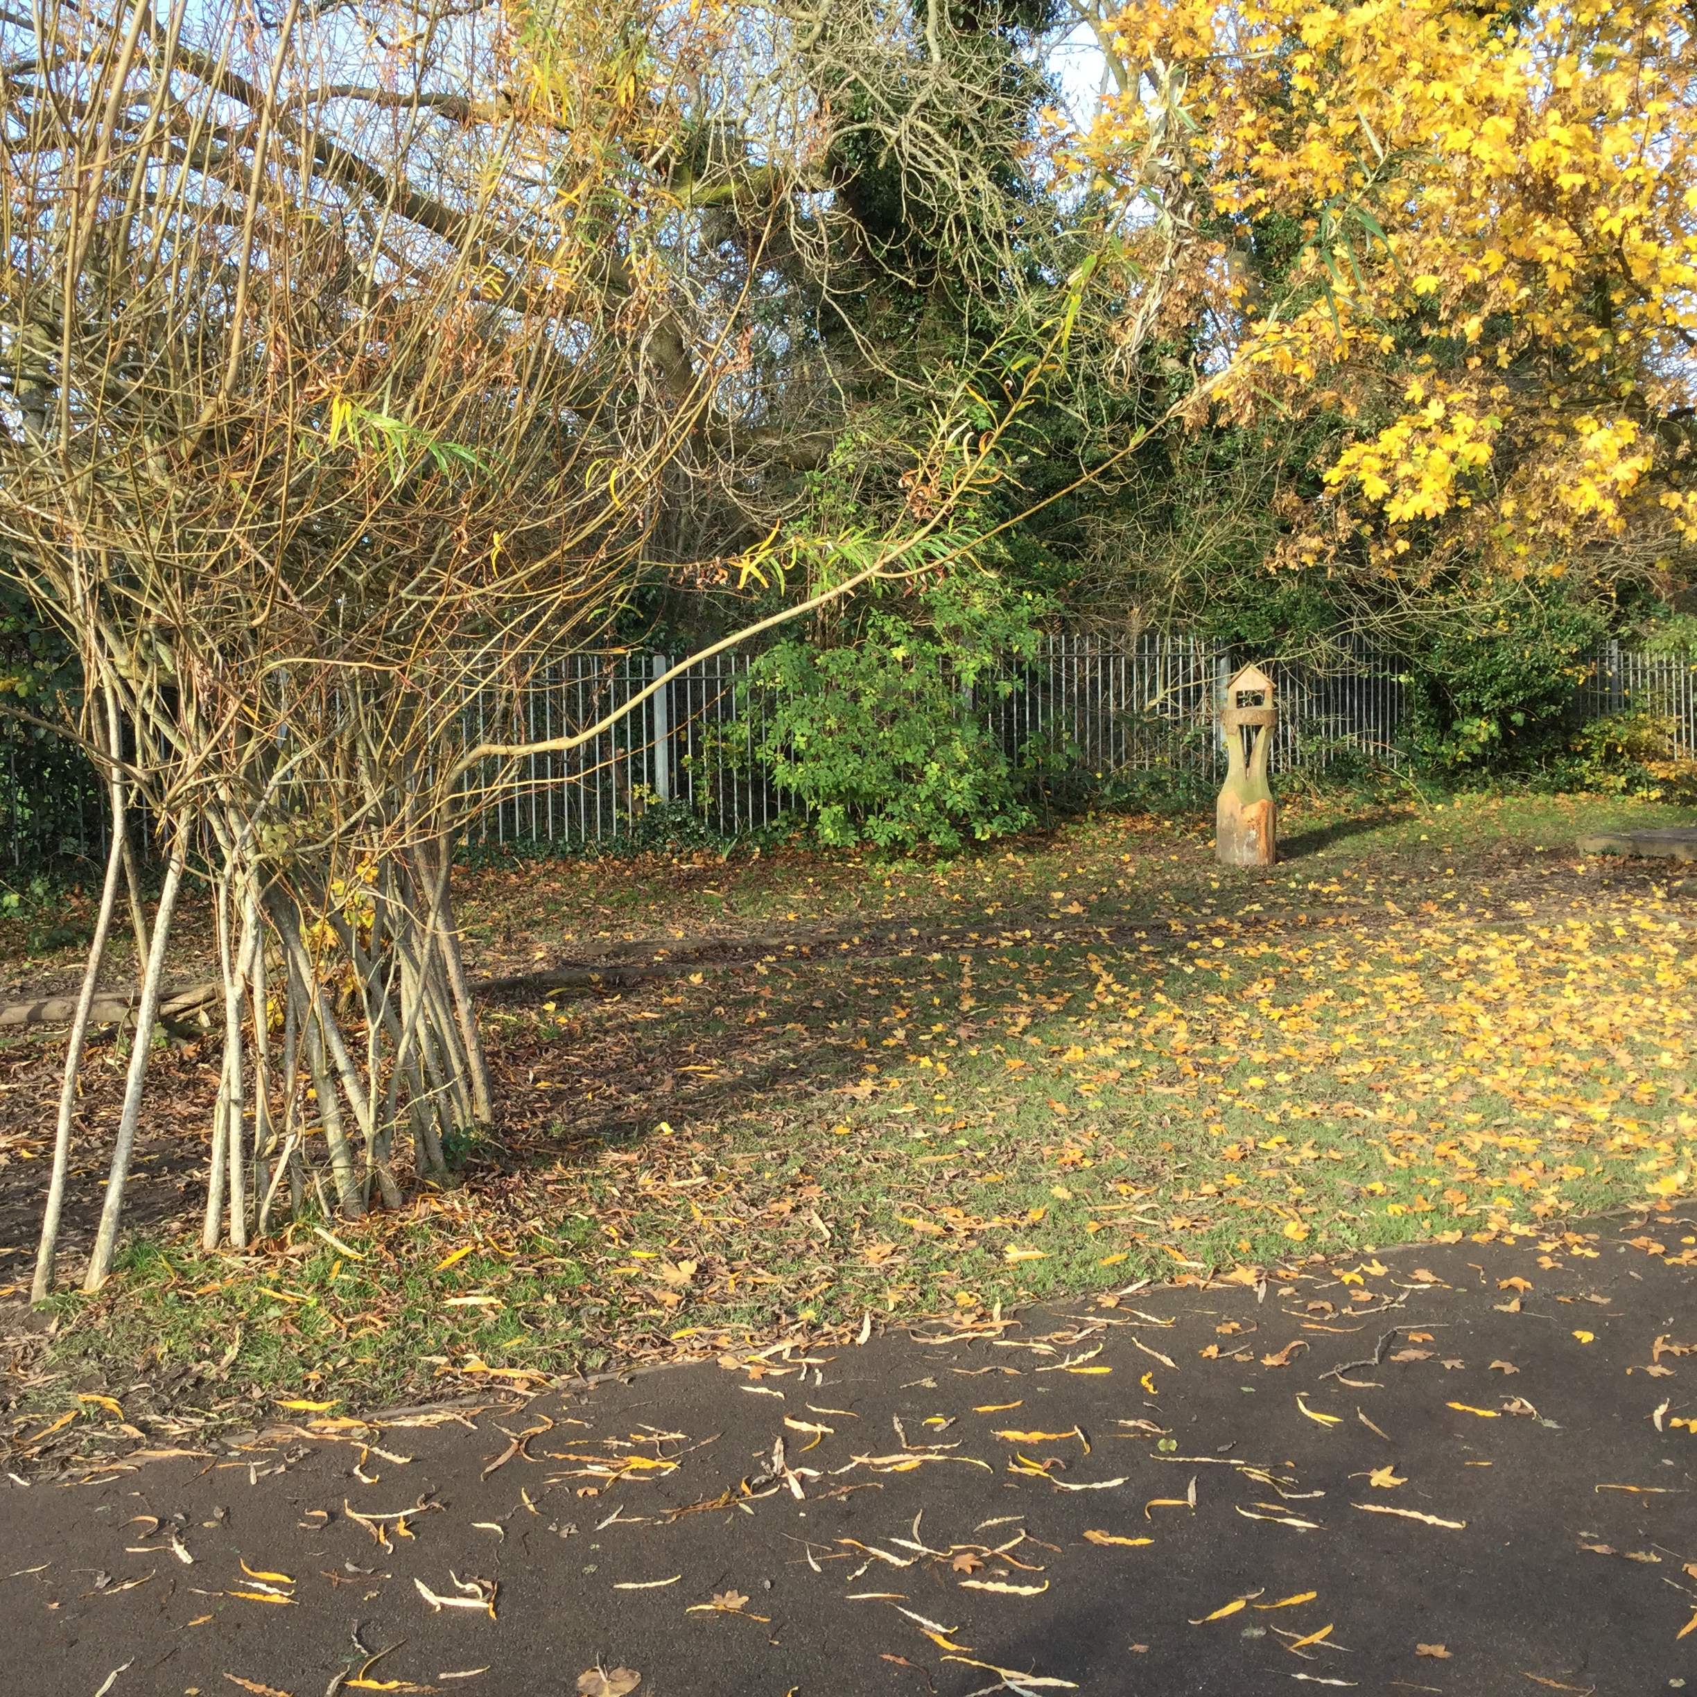
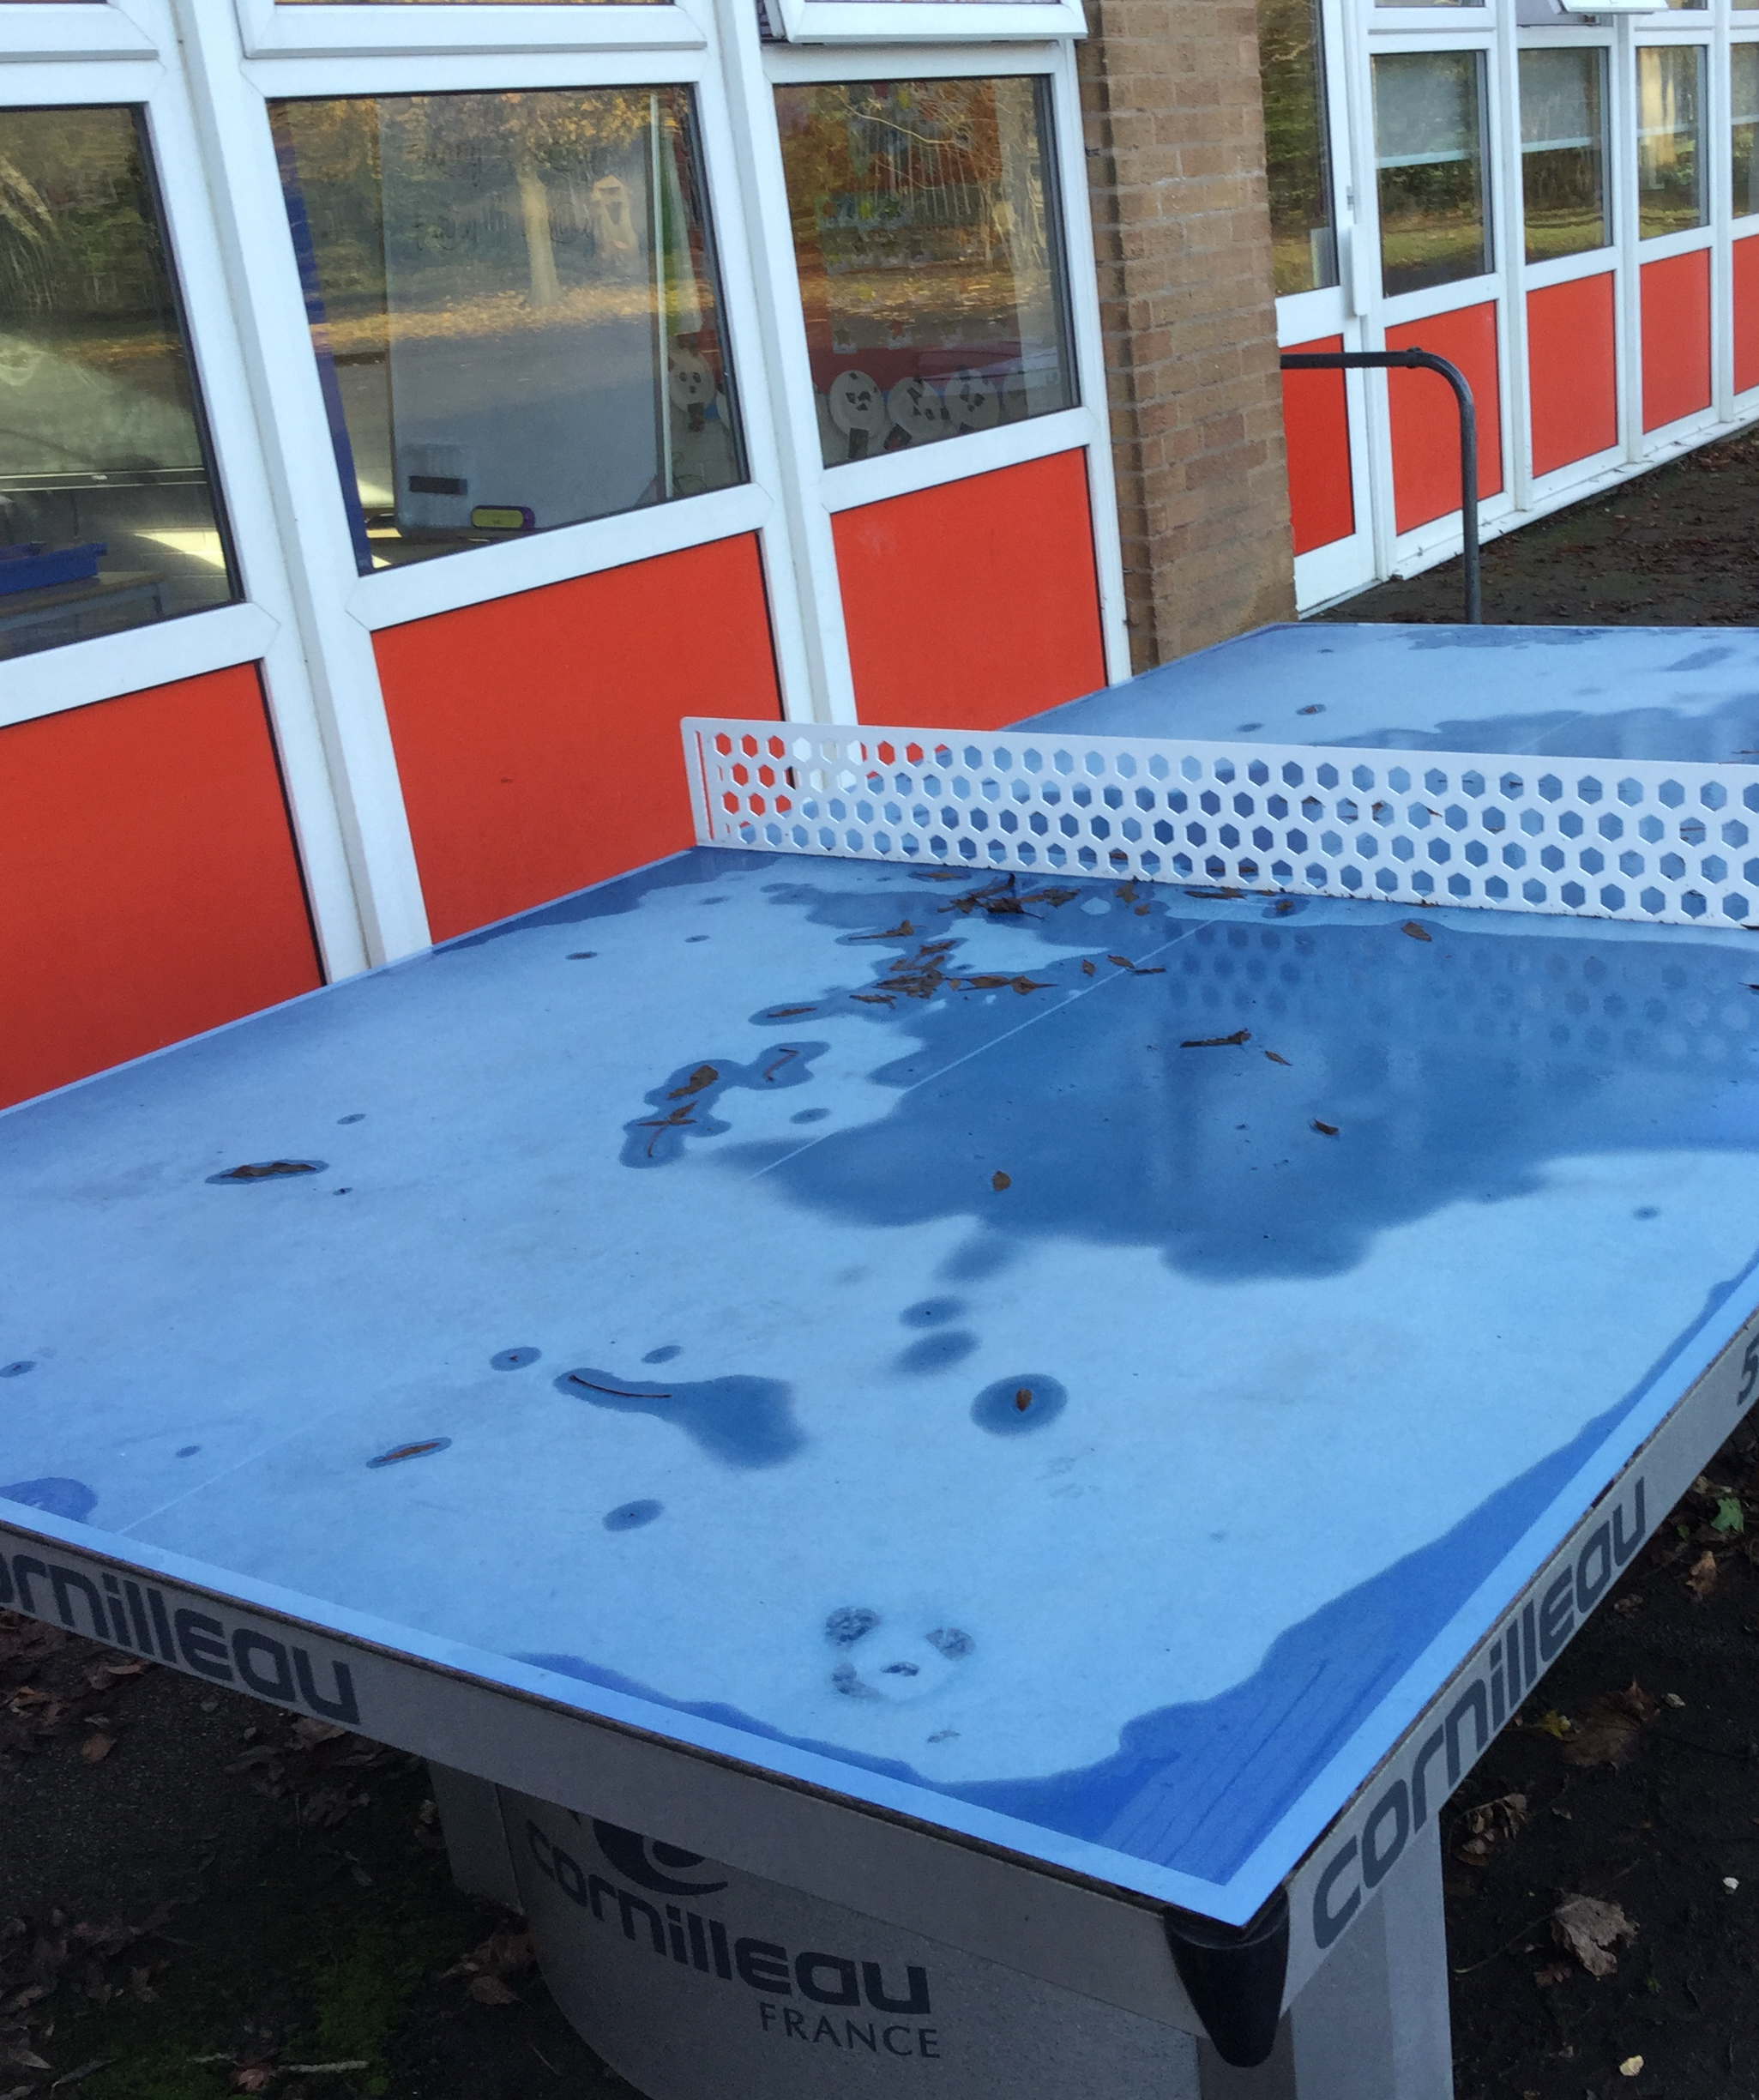
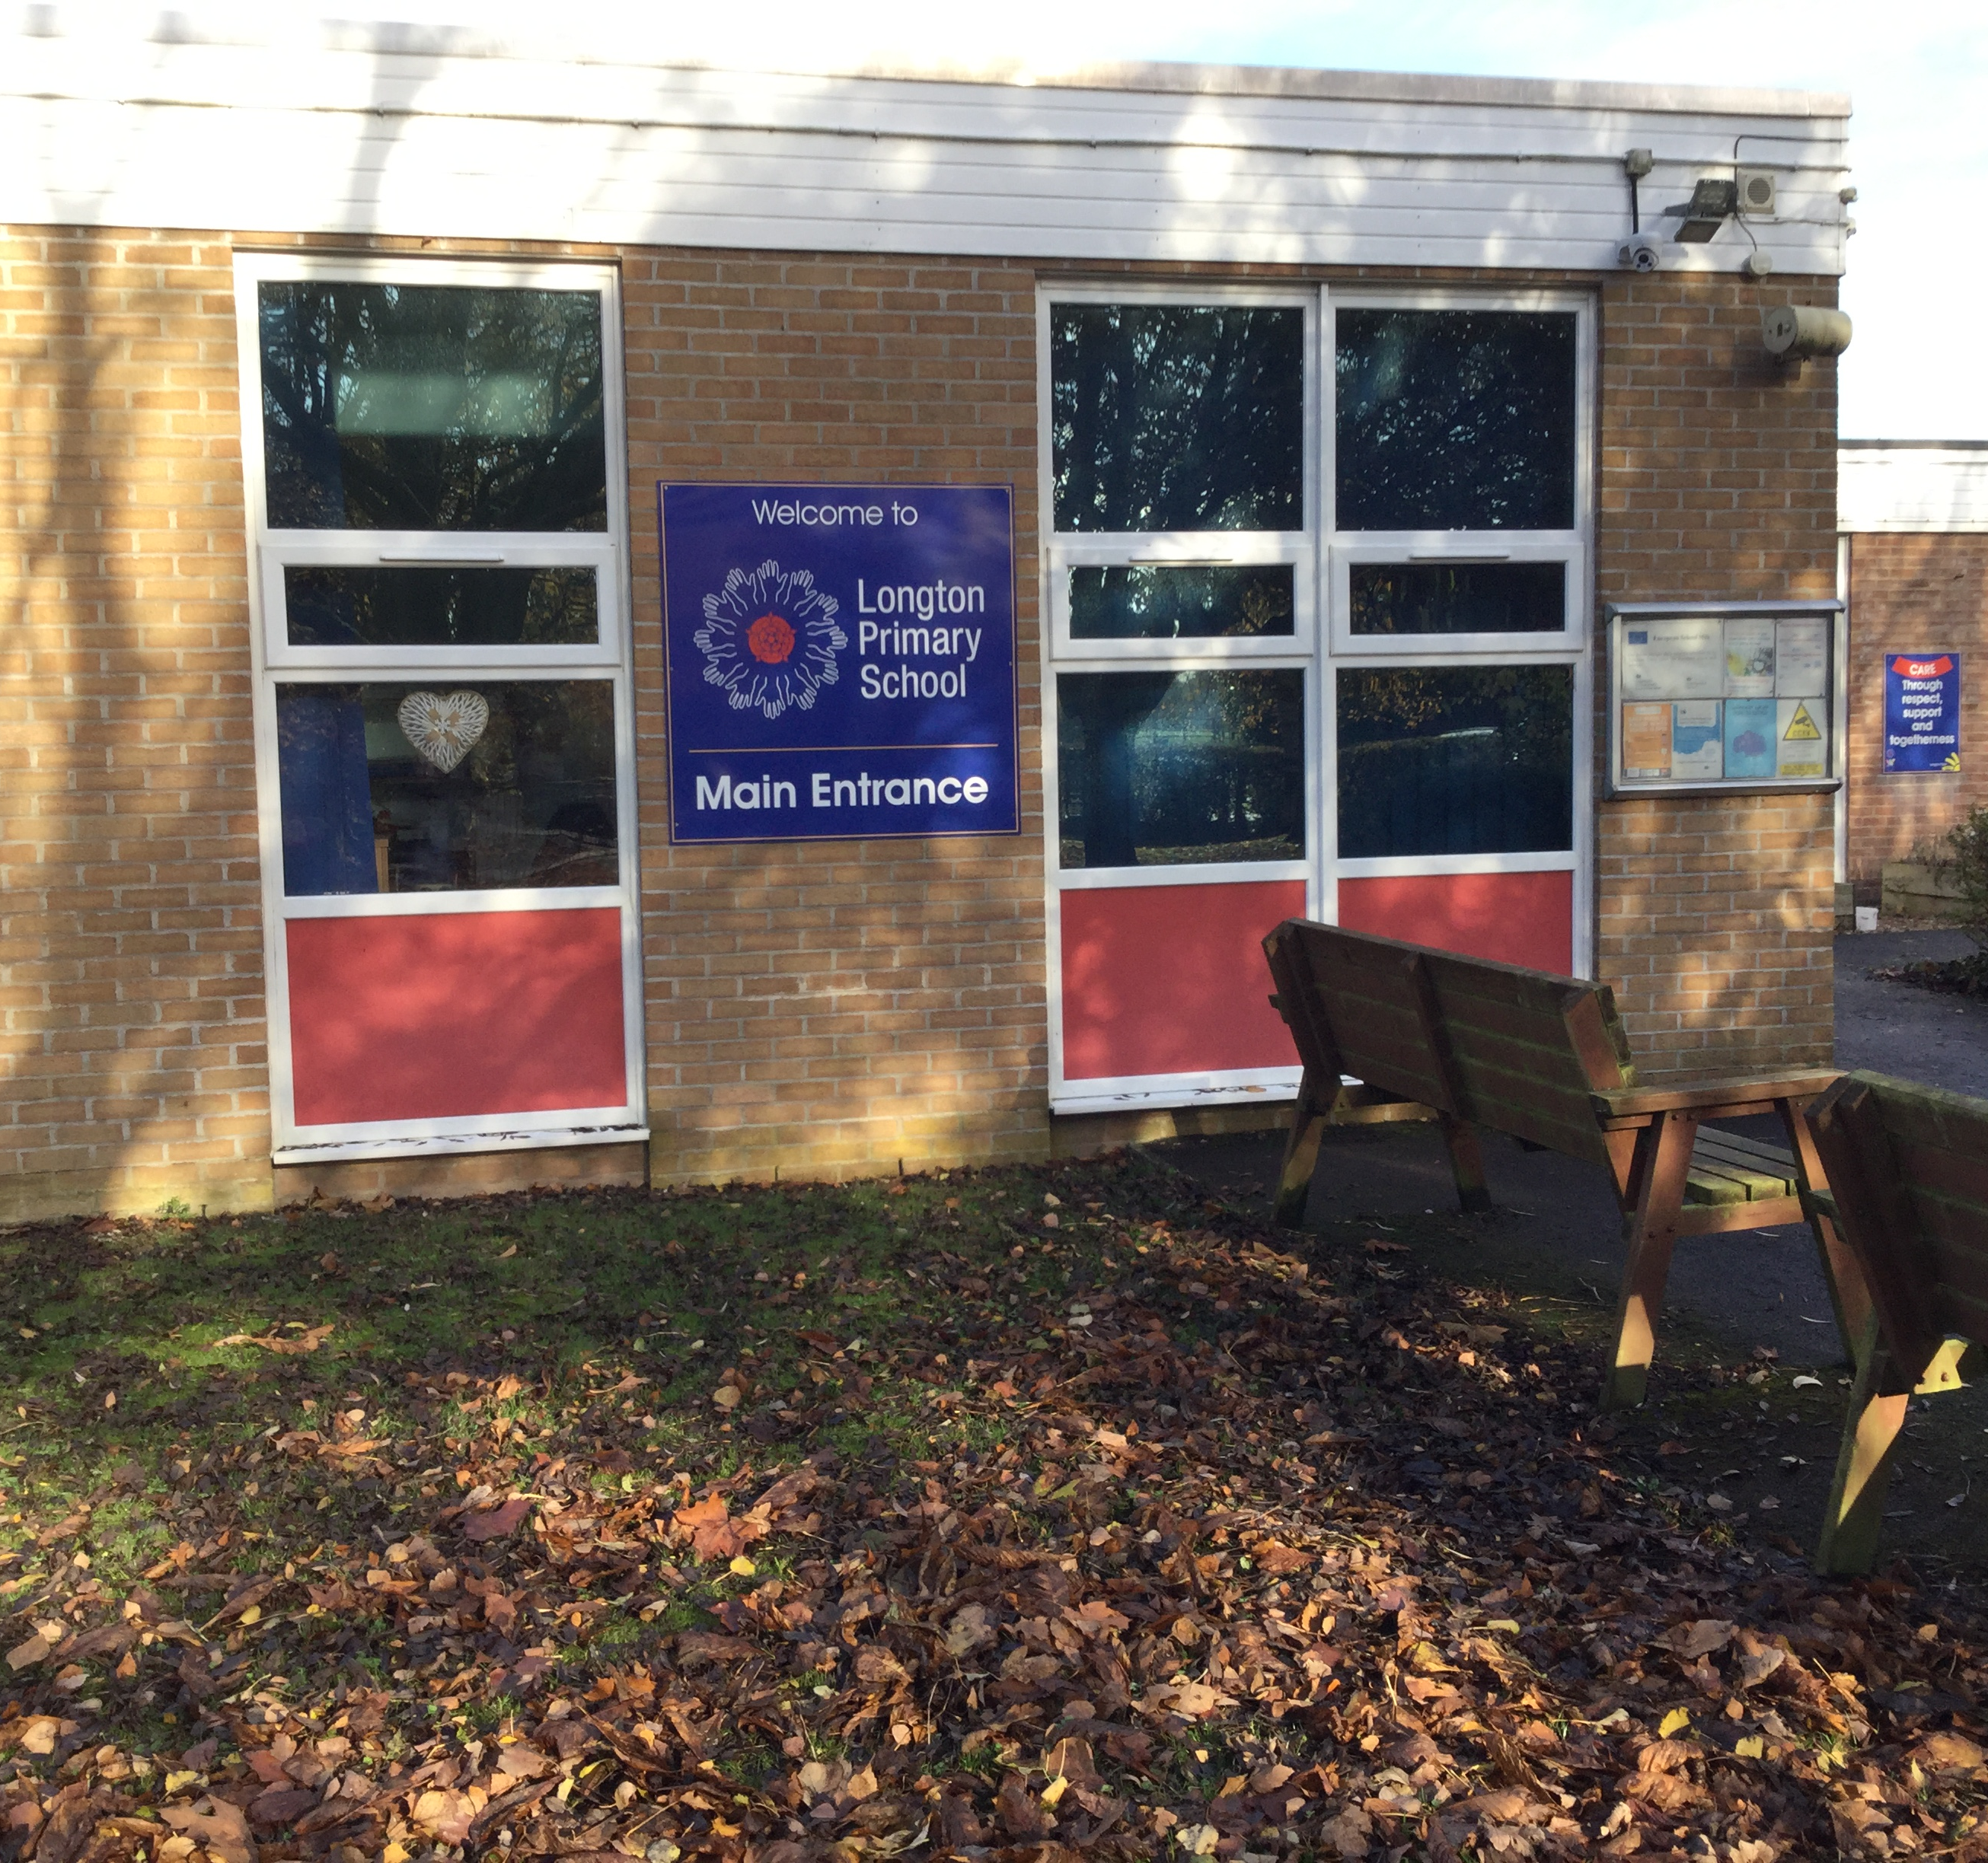
OUTSIDE
Notes:
Our school grounds are very nice. We have a field with a track round it
We have table tennis tables, a ball cage and a bog garden

Slide 4
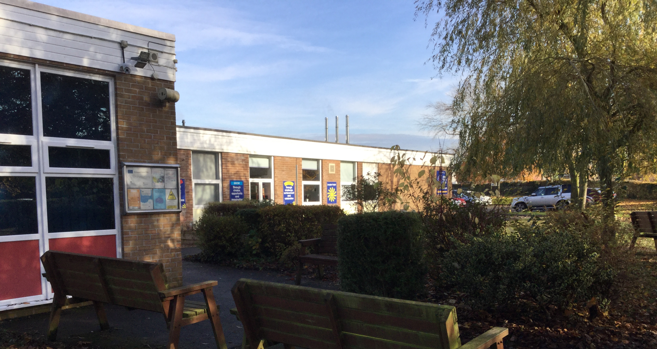
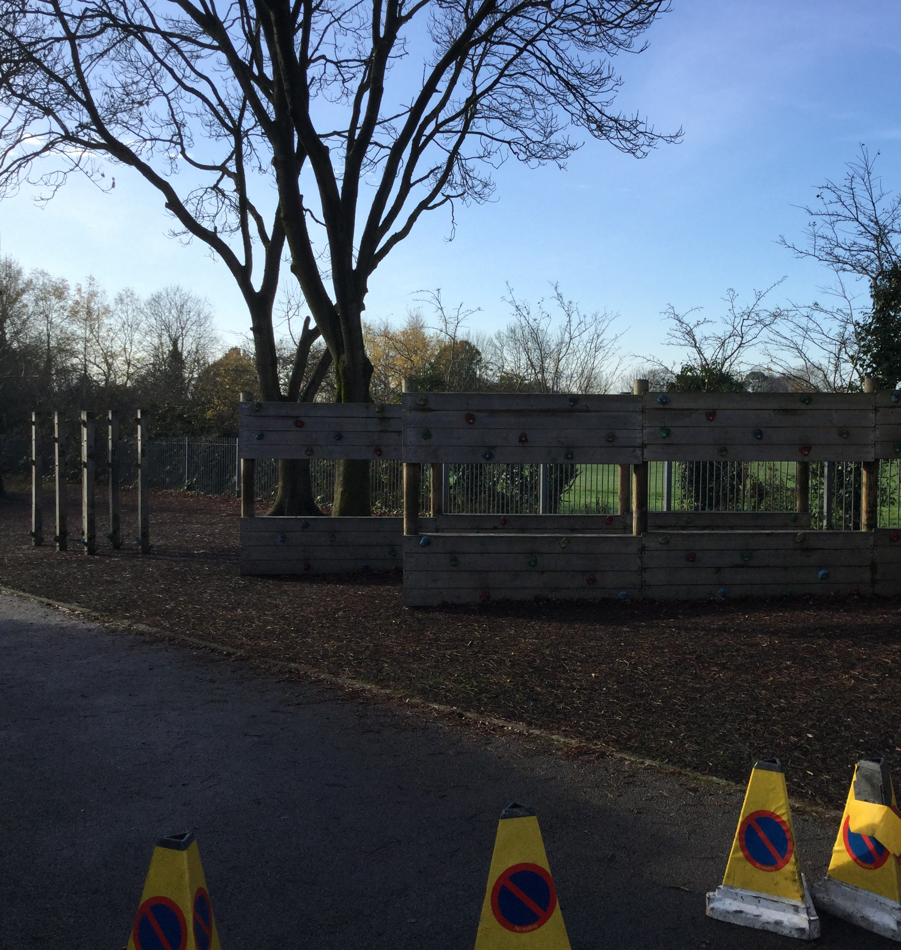
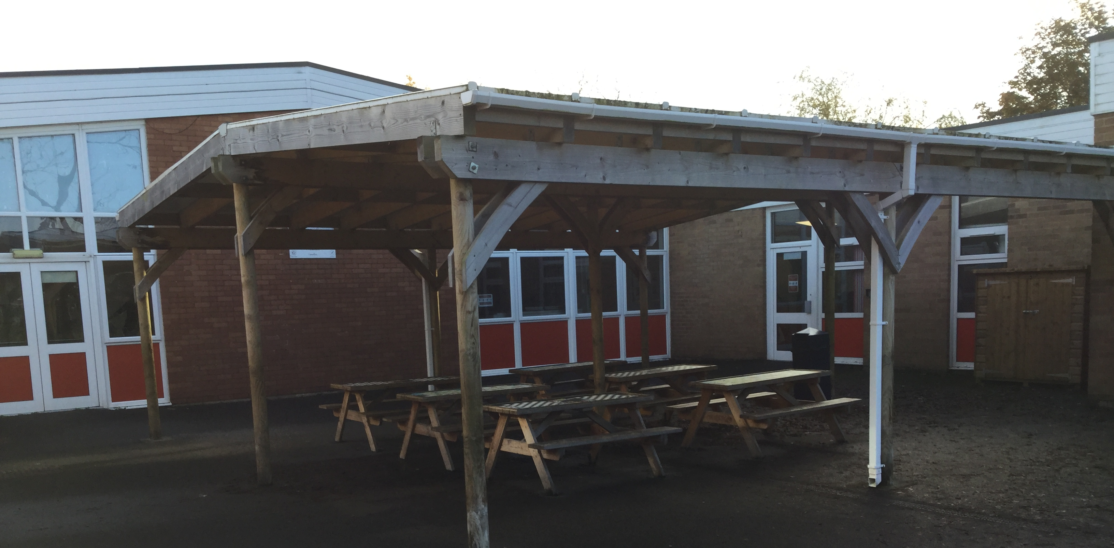
Notes:
Children at Longton enjoy using the climbing walls and picnic benches

Slide 5
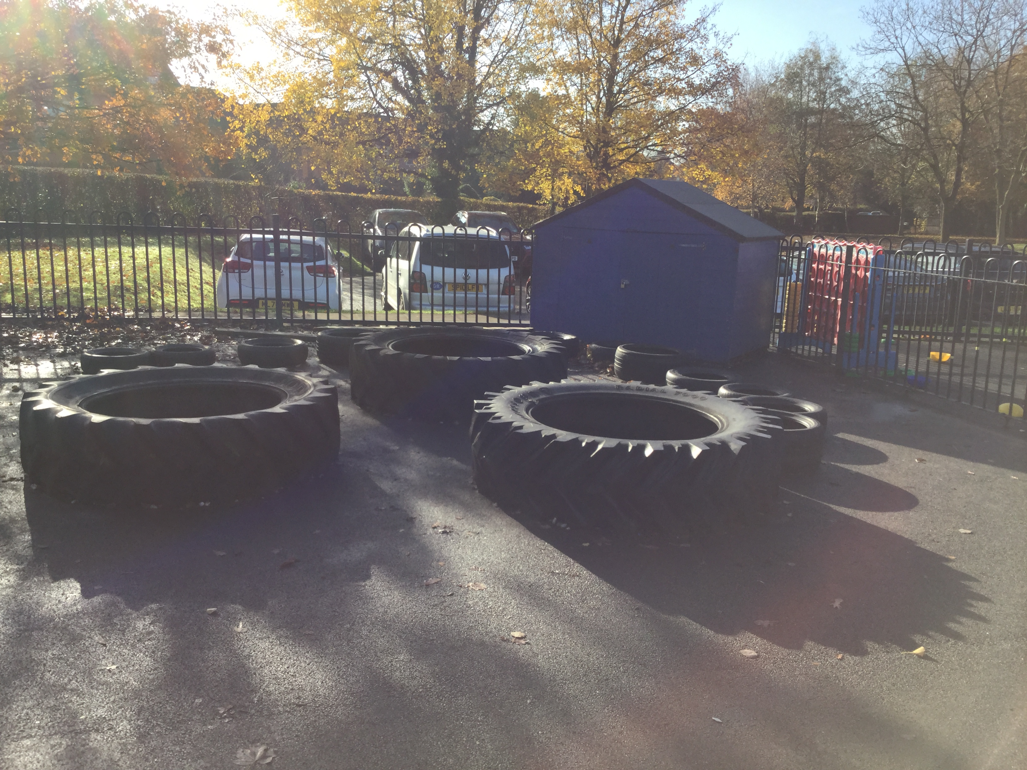
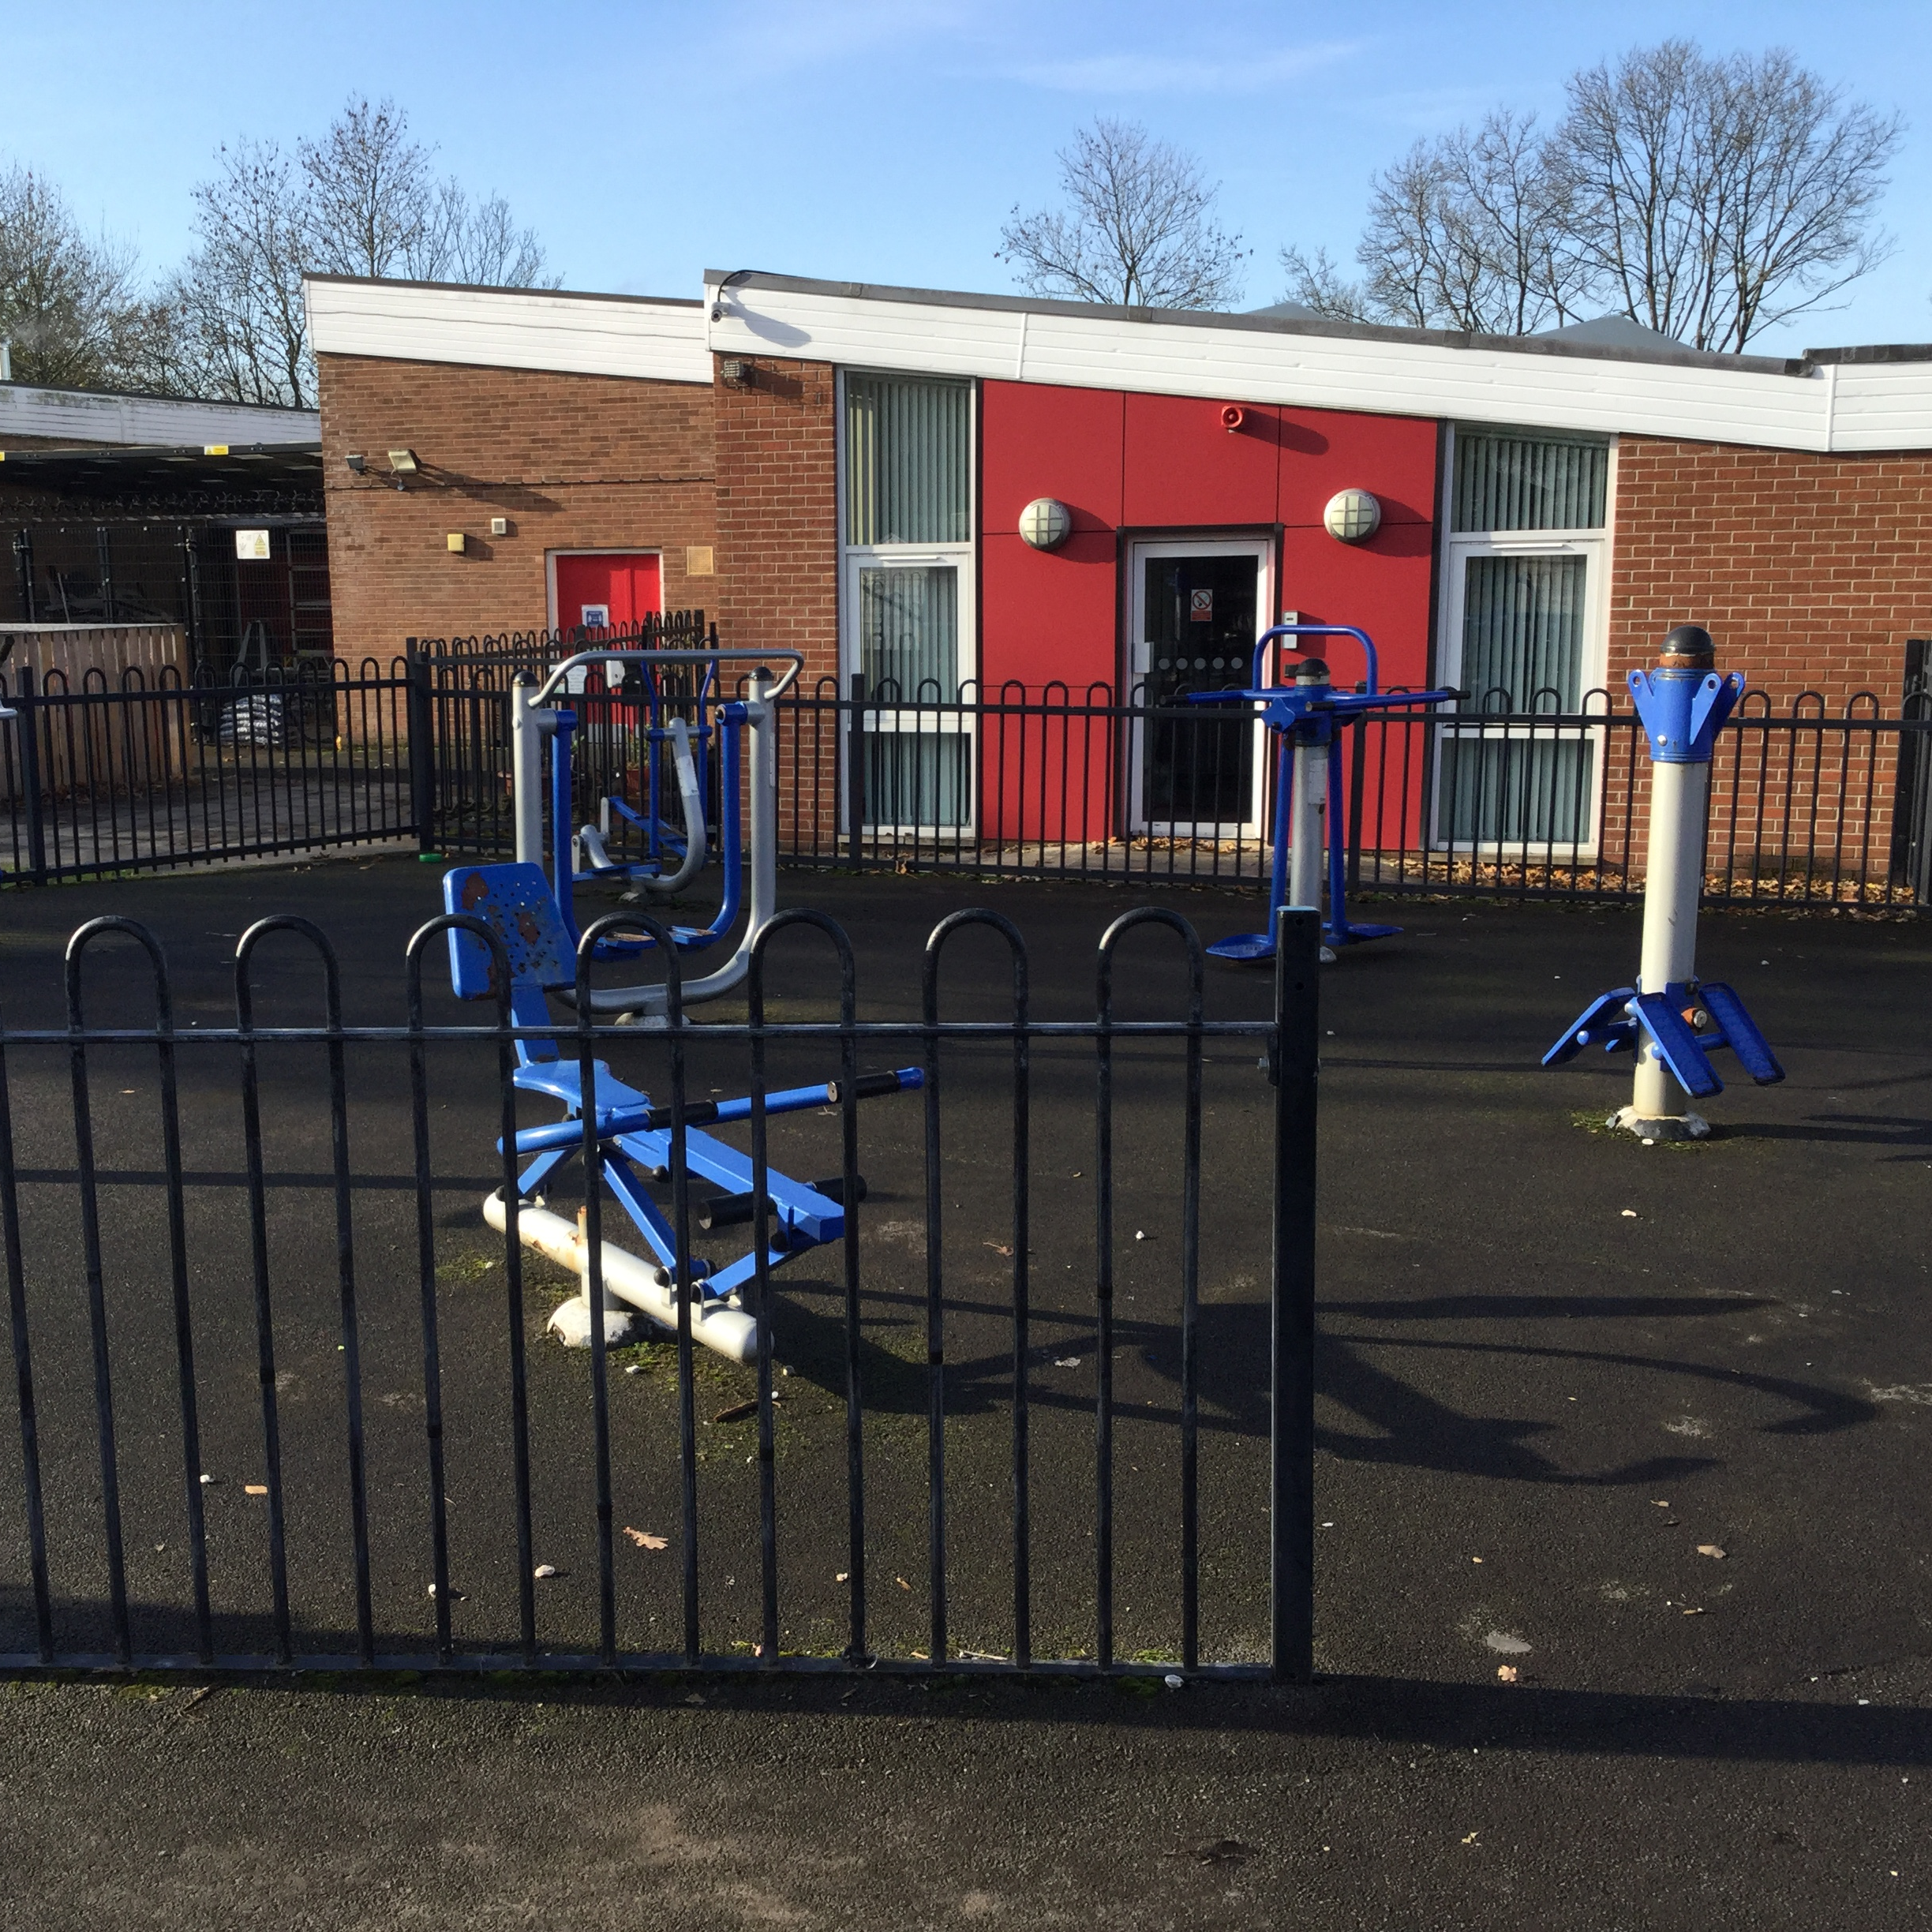
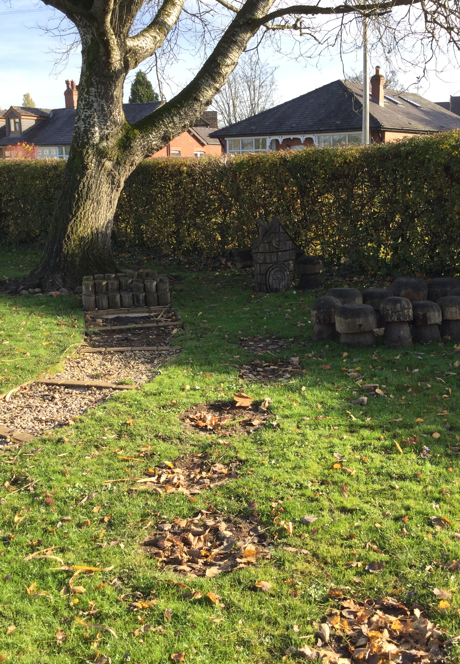
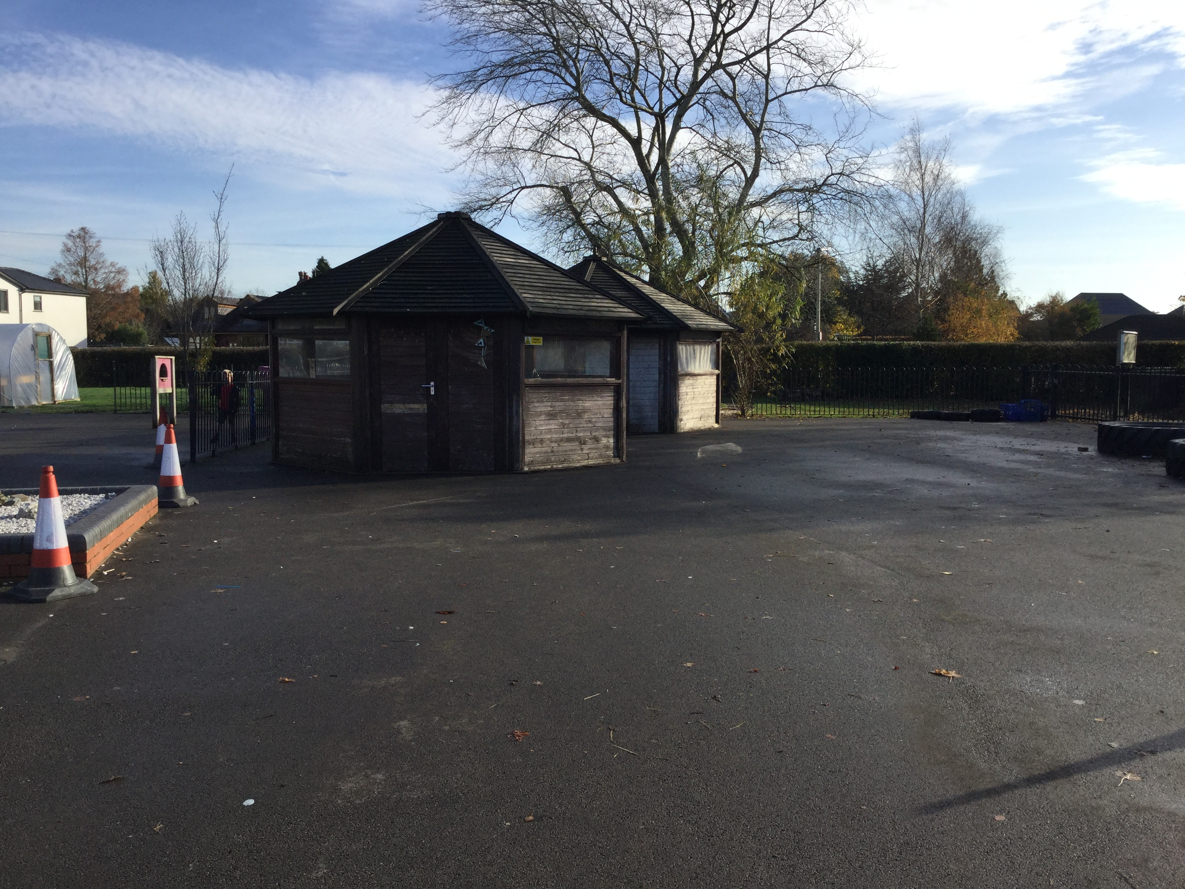
Our Playground
Notes:
This is the Year 1 and 2 playground

Slide 6
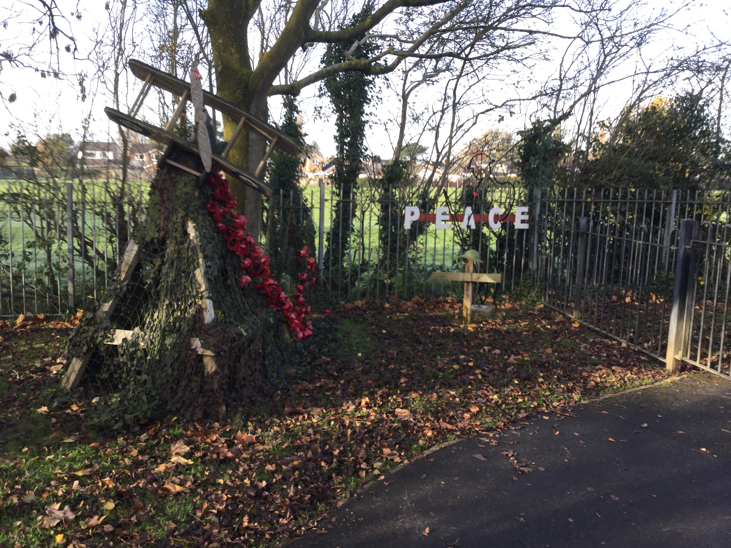
The Peace Corner
Notes:
Our peace garden is a very special place and tomorrow we will go there to remember all of the people who have died in wars

Slide 7
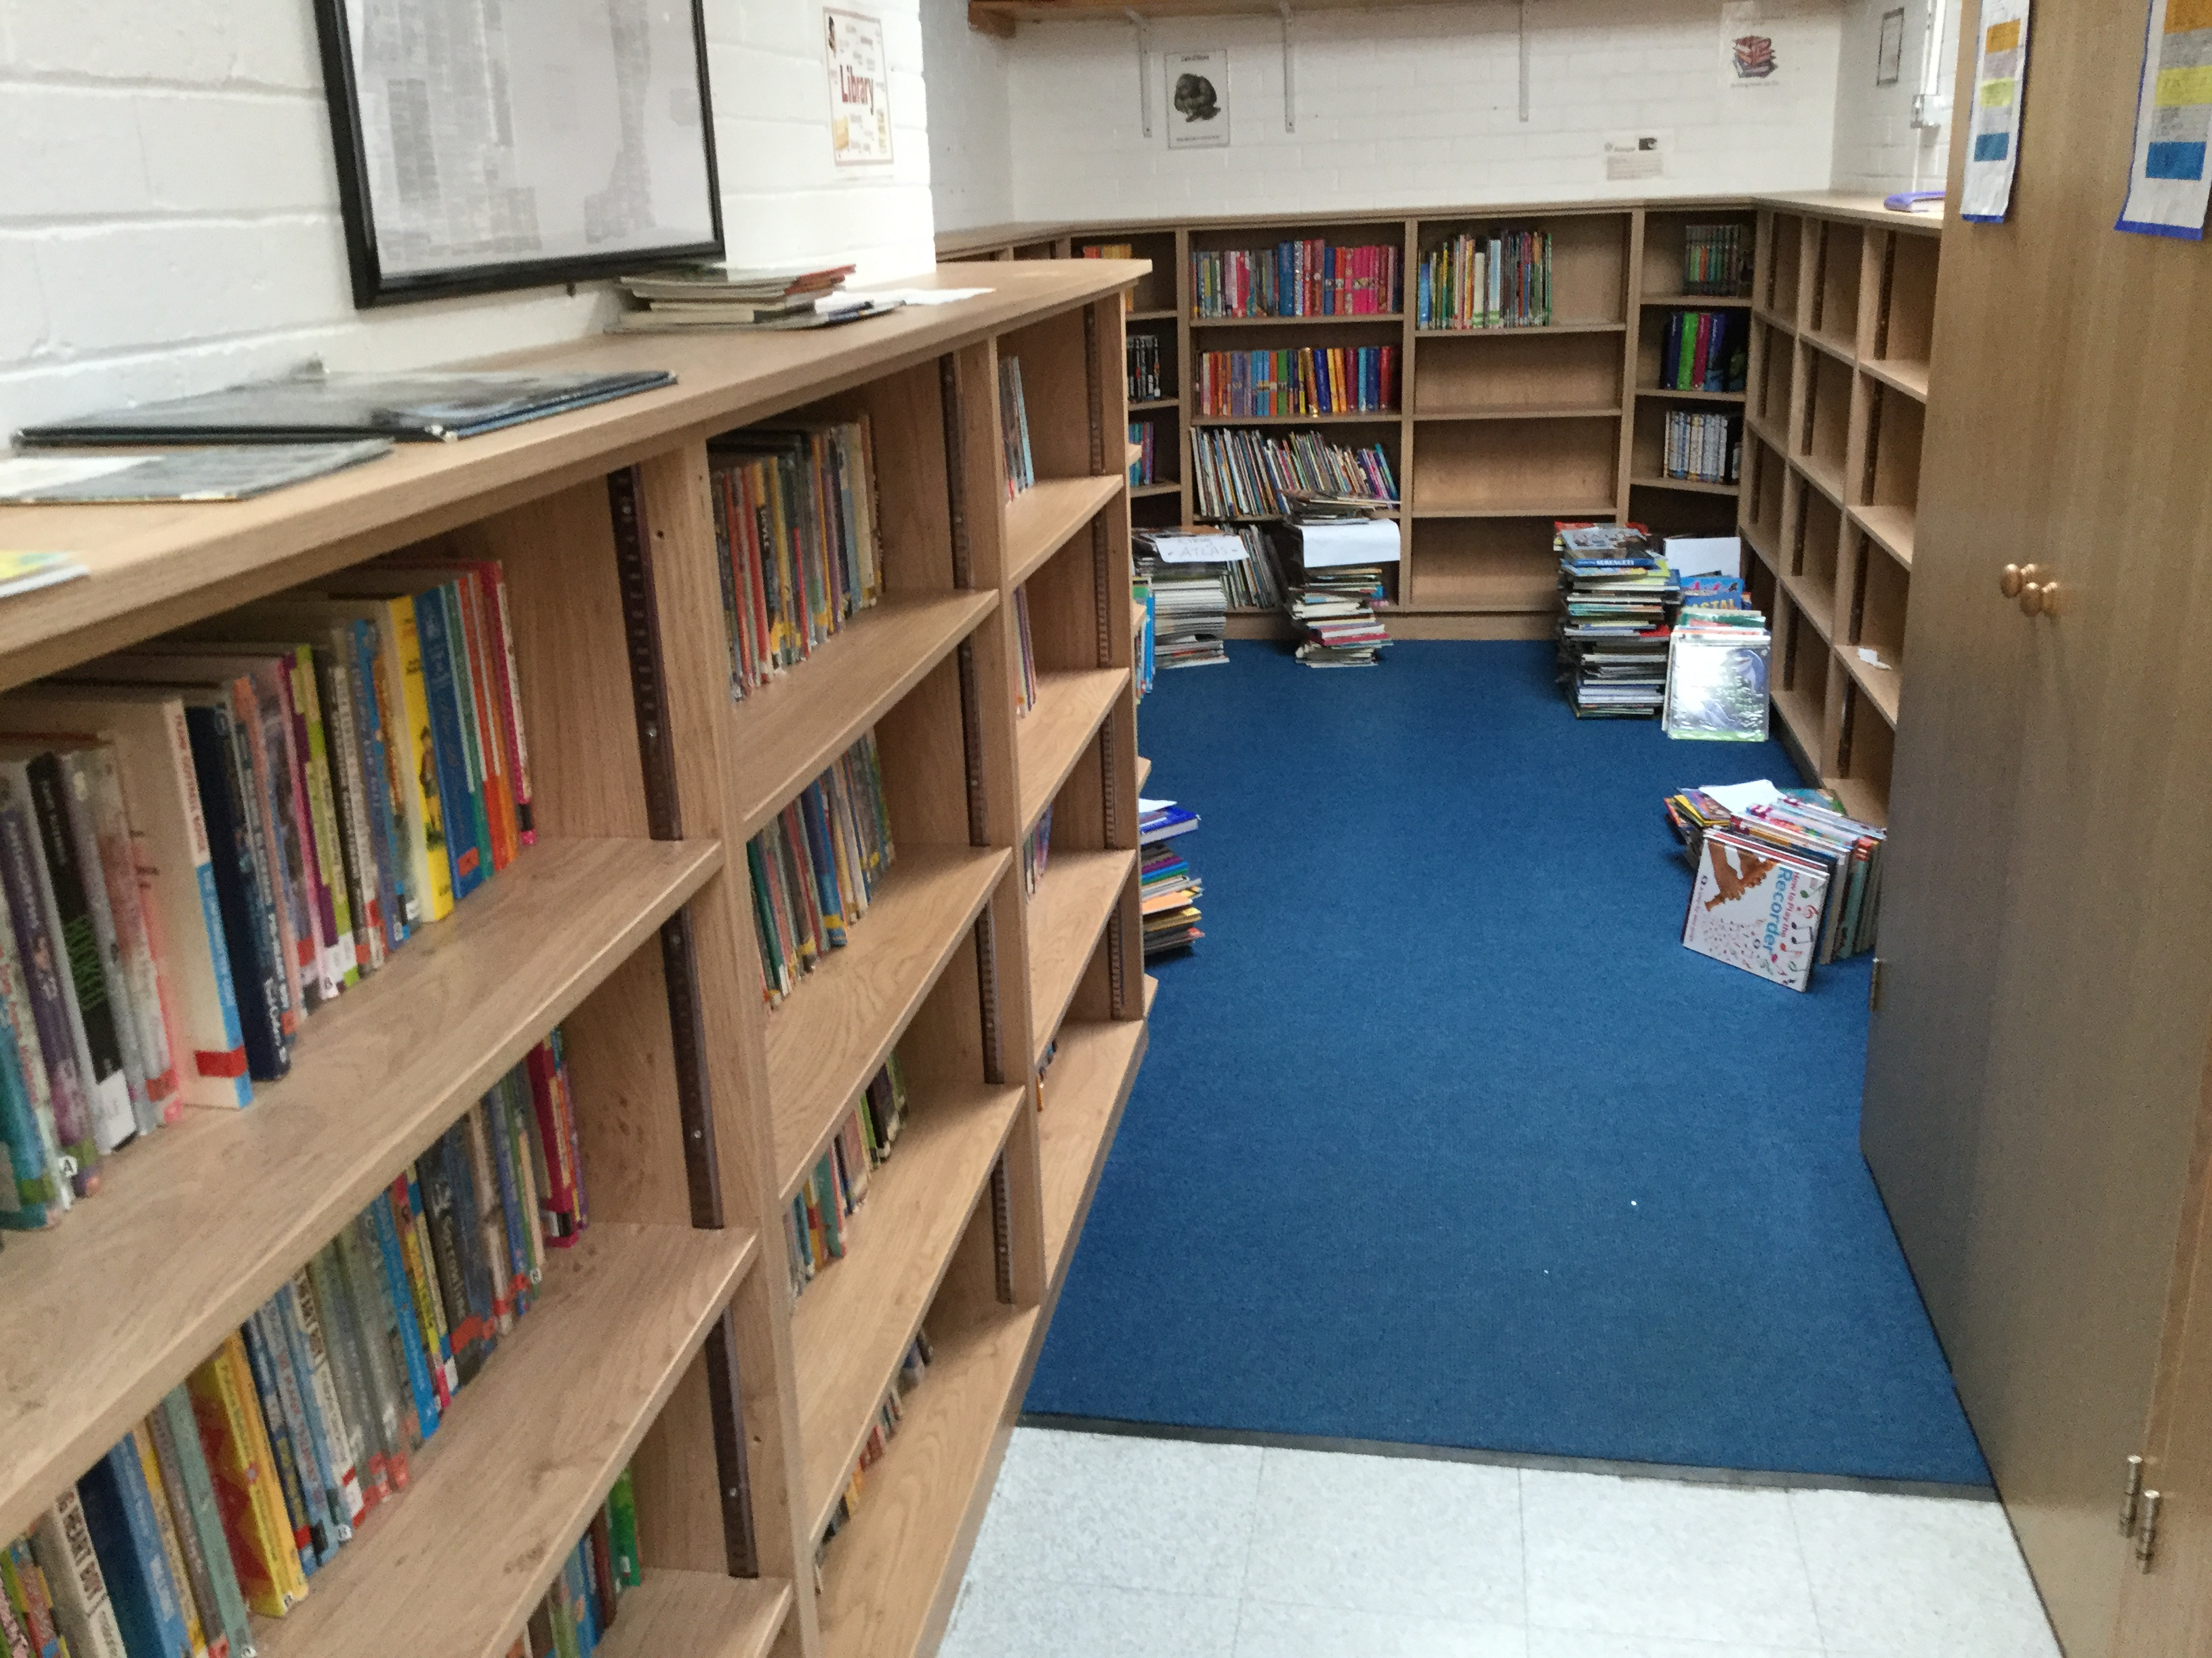
Inside - Our Library has had new shelves put in during half term
Notes:
Our library is having a make over and has lots of new shelves

Slide 8
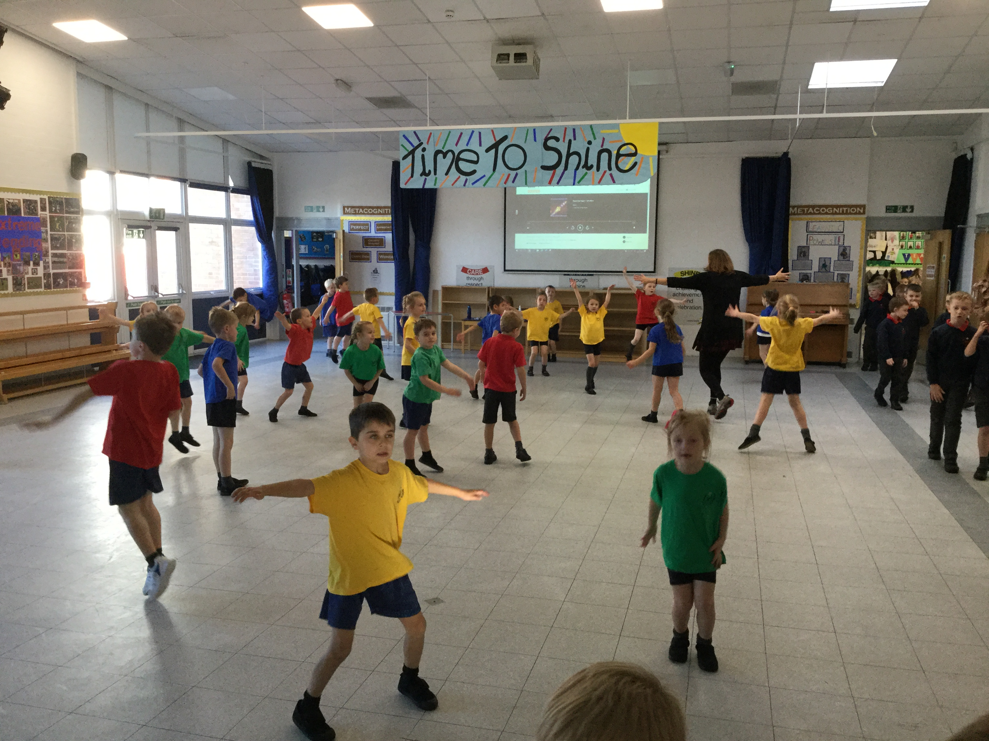
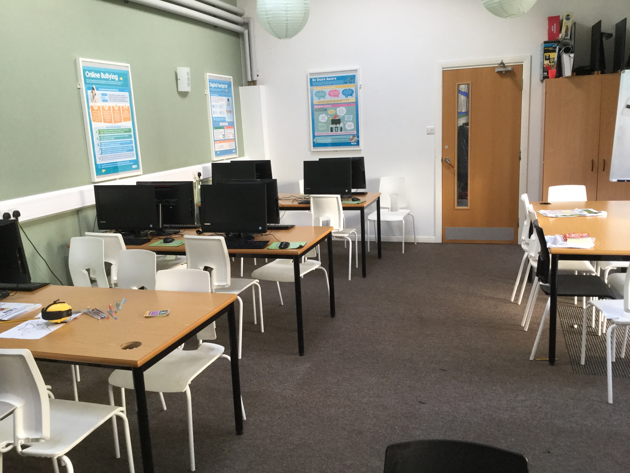
Notes:
The hall is where we do PE, eat our lunches, have assembly and do our performances
We use the computer room with our computing teacher

Slide 9
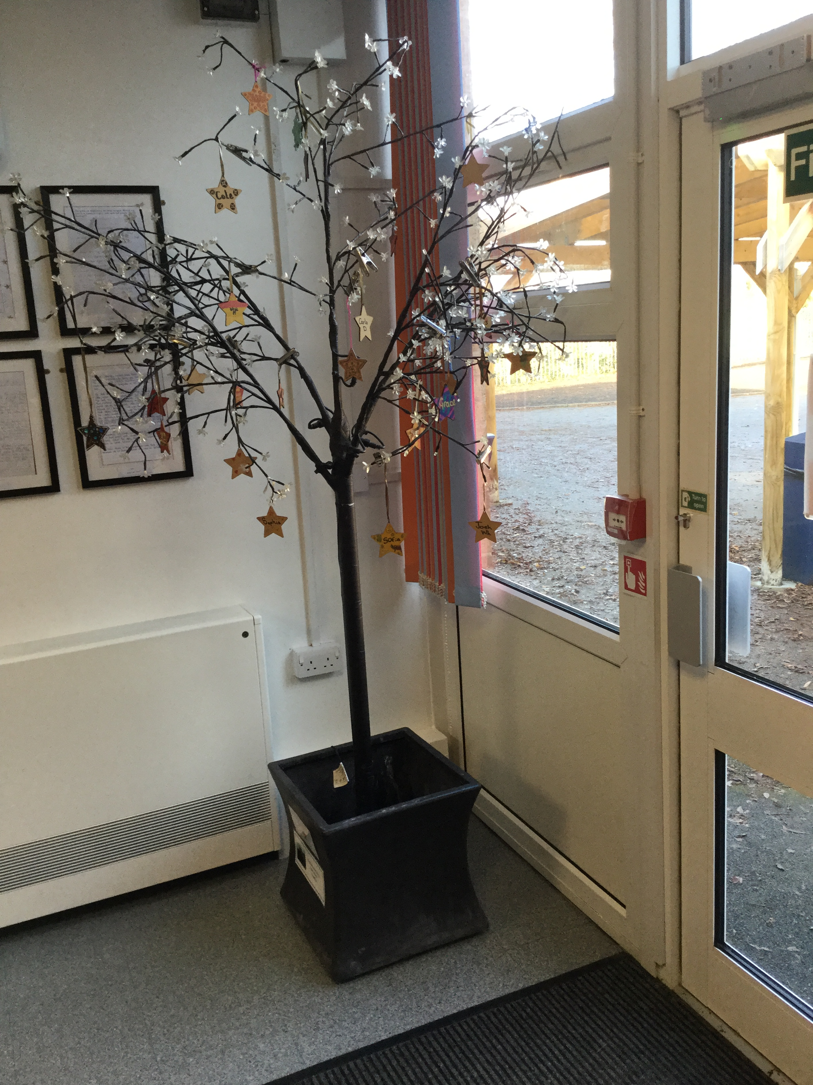
Gold Star Tree
Notes:
If we do special work we may get a team point or a silver star
When you get 12 silver stars you get a gold star and you hang a special star on the tree

Slide 10
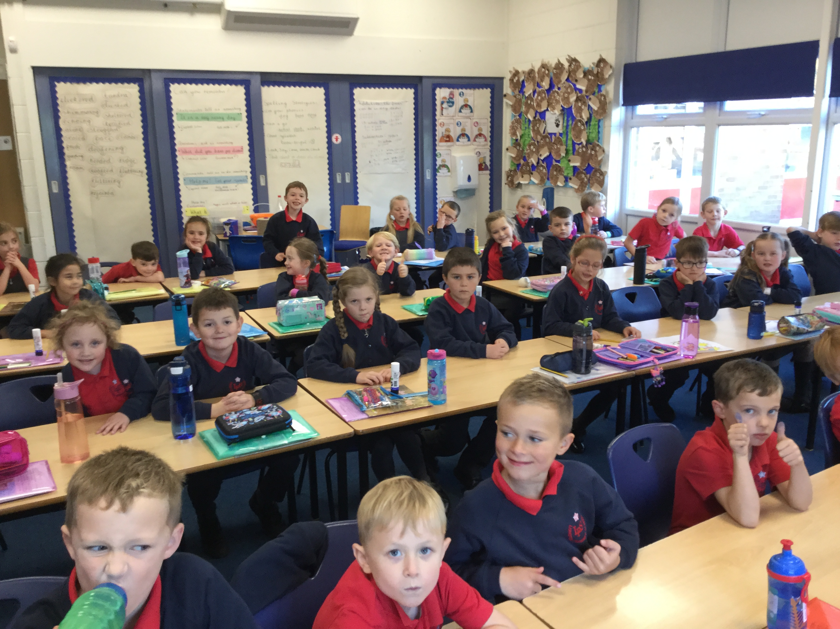
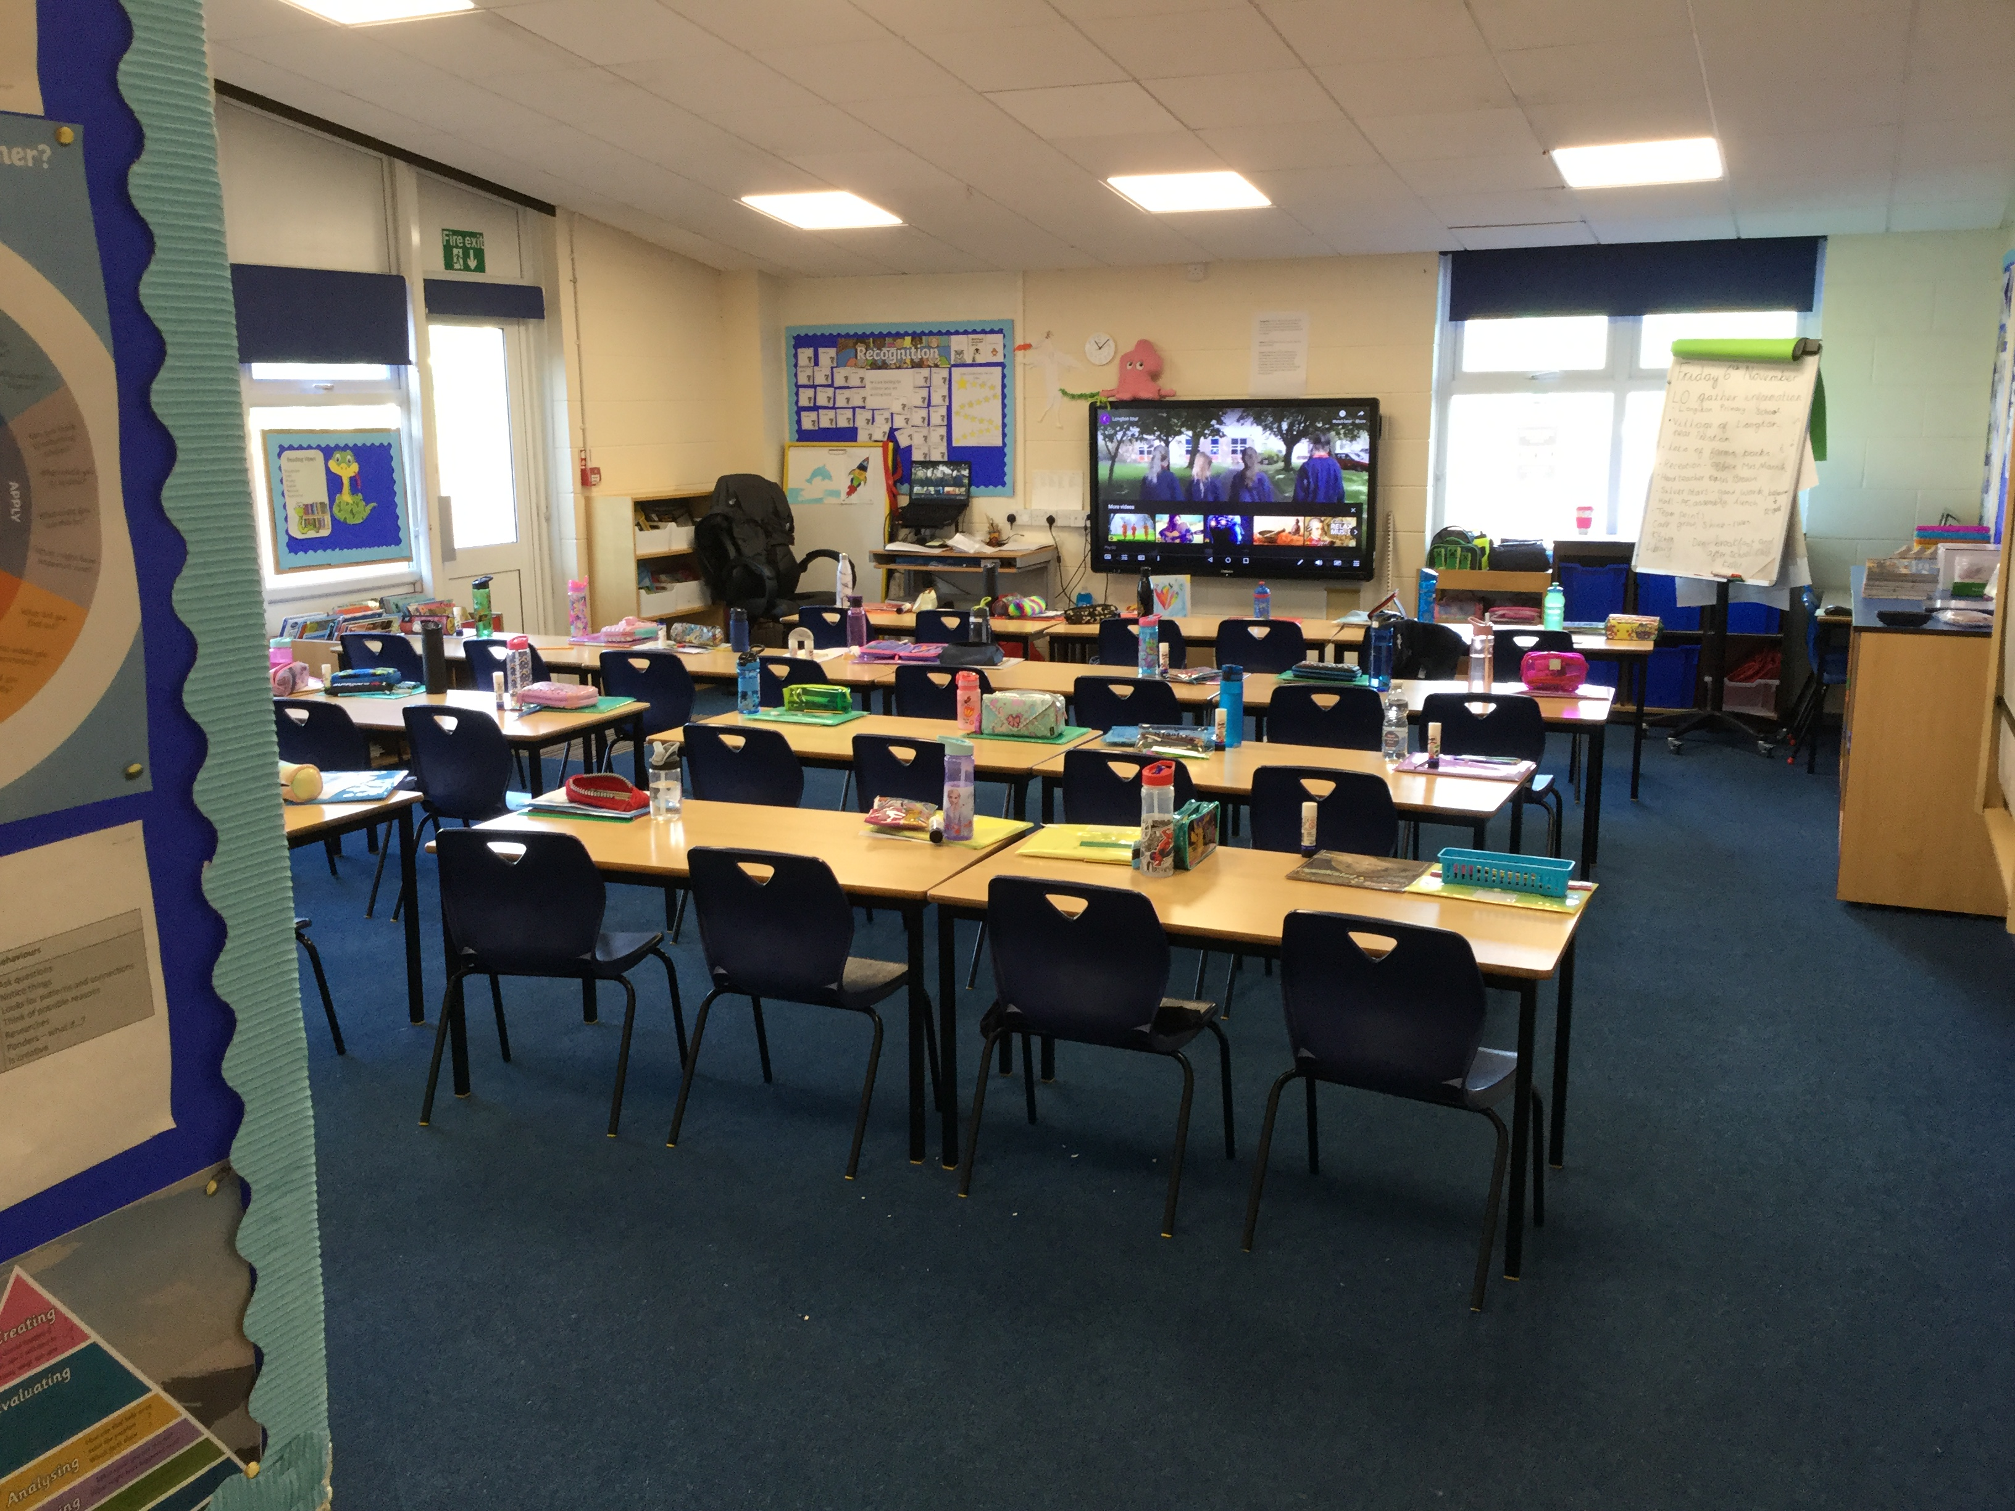
Covid Changes
Notes:
Covid has changed some things in school
We now sit in rows
We use Google Classroom to have our assemblies in class

Slide 11
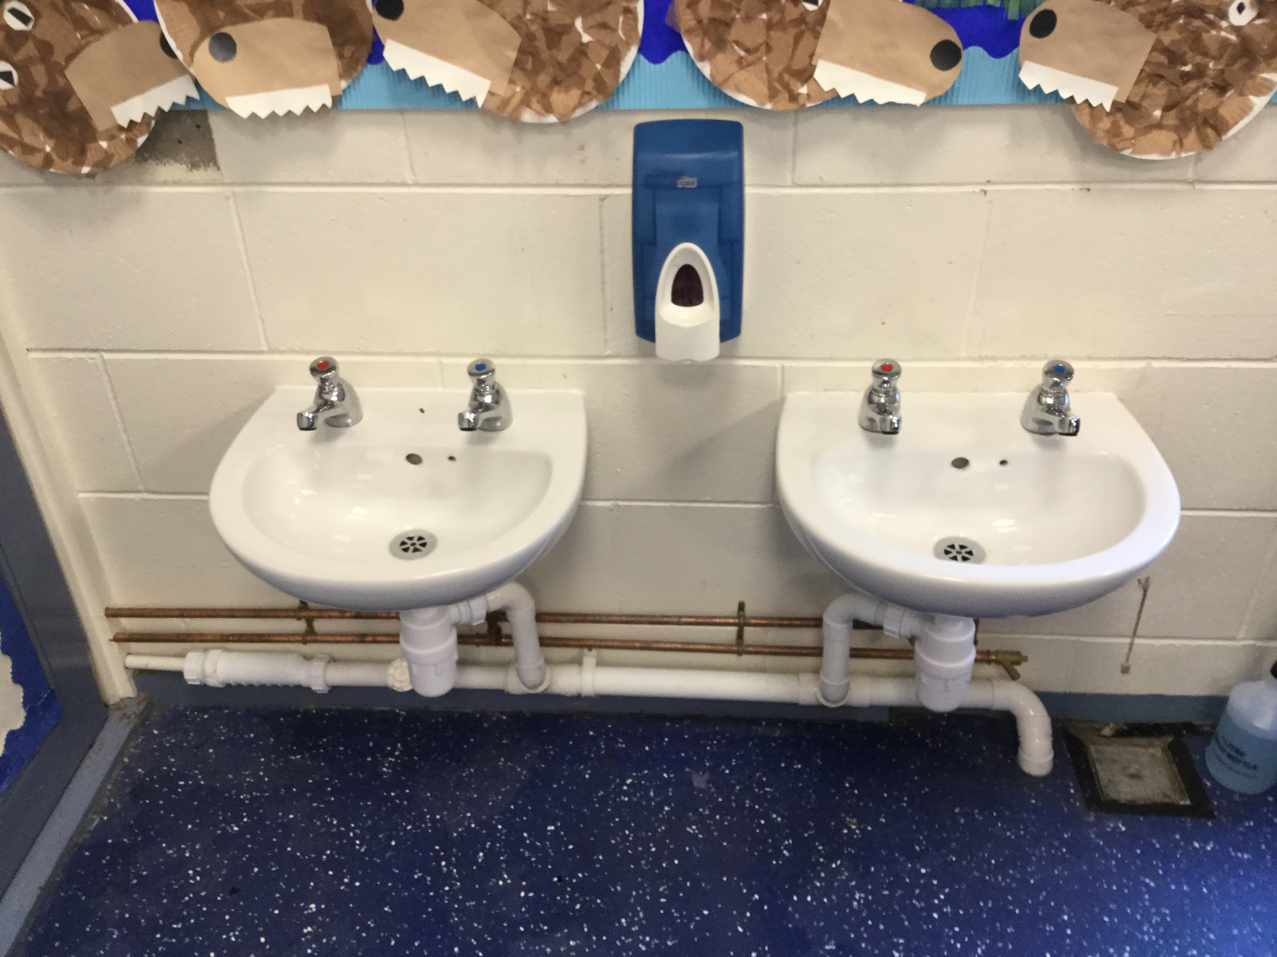
Notes:
During Lockdown sinks were fitted in our classroom

Slide 12
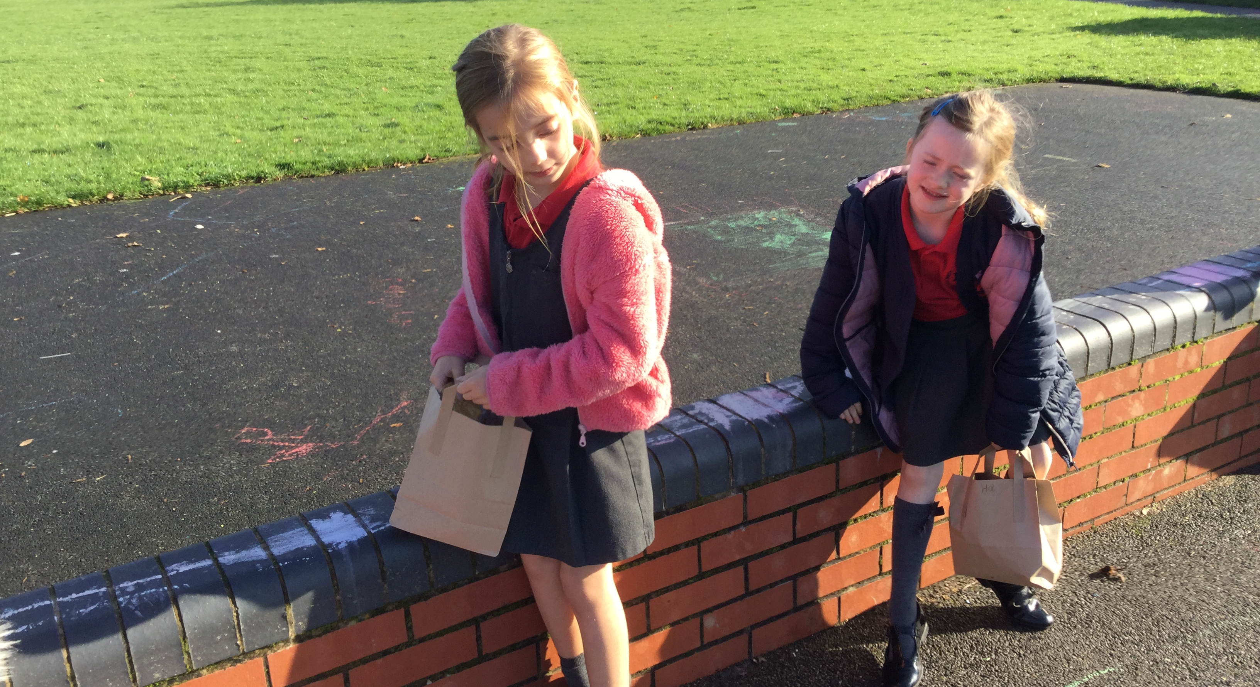
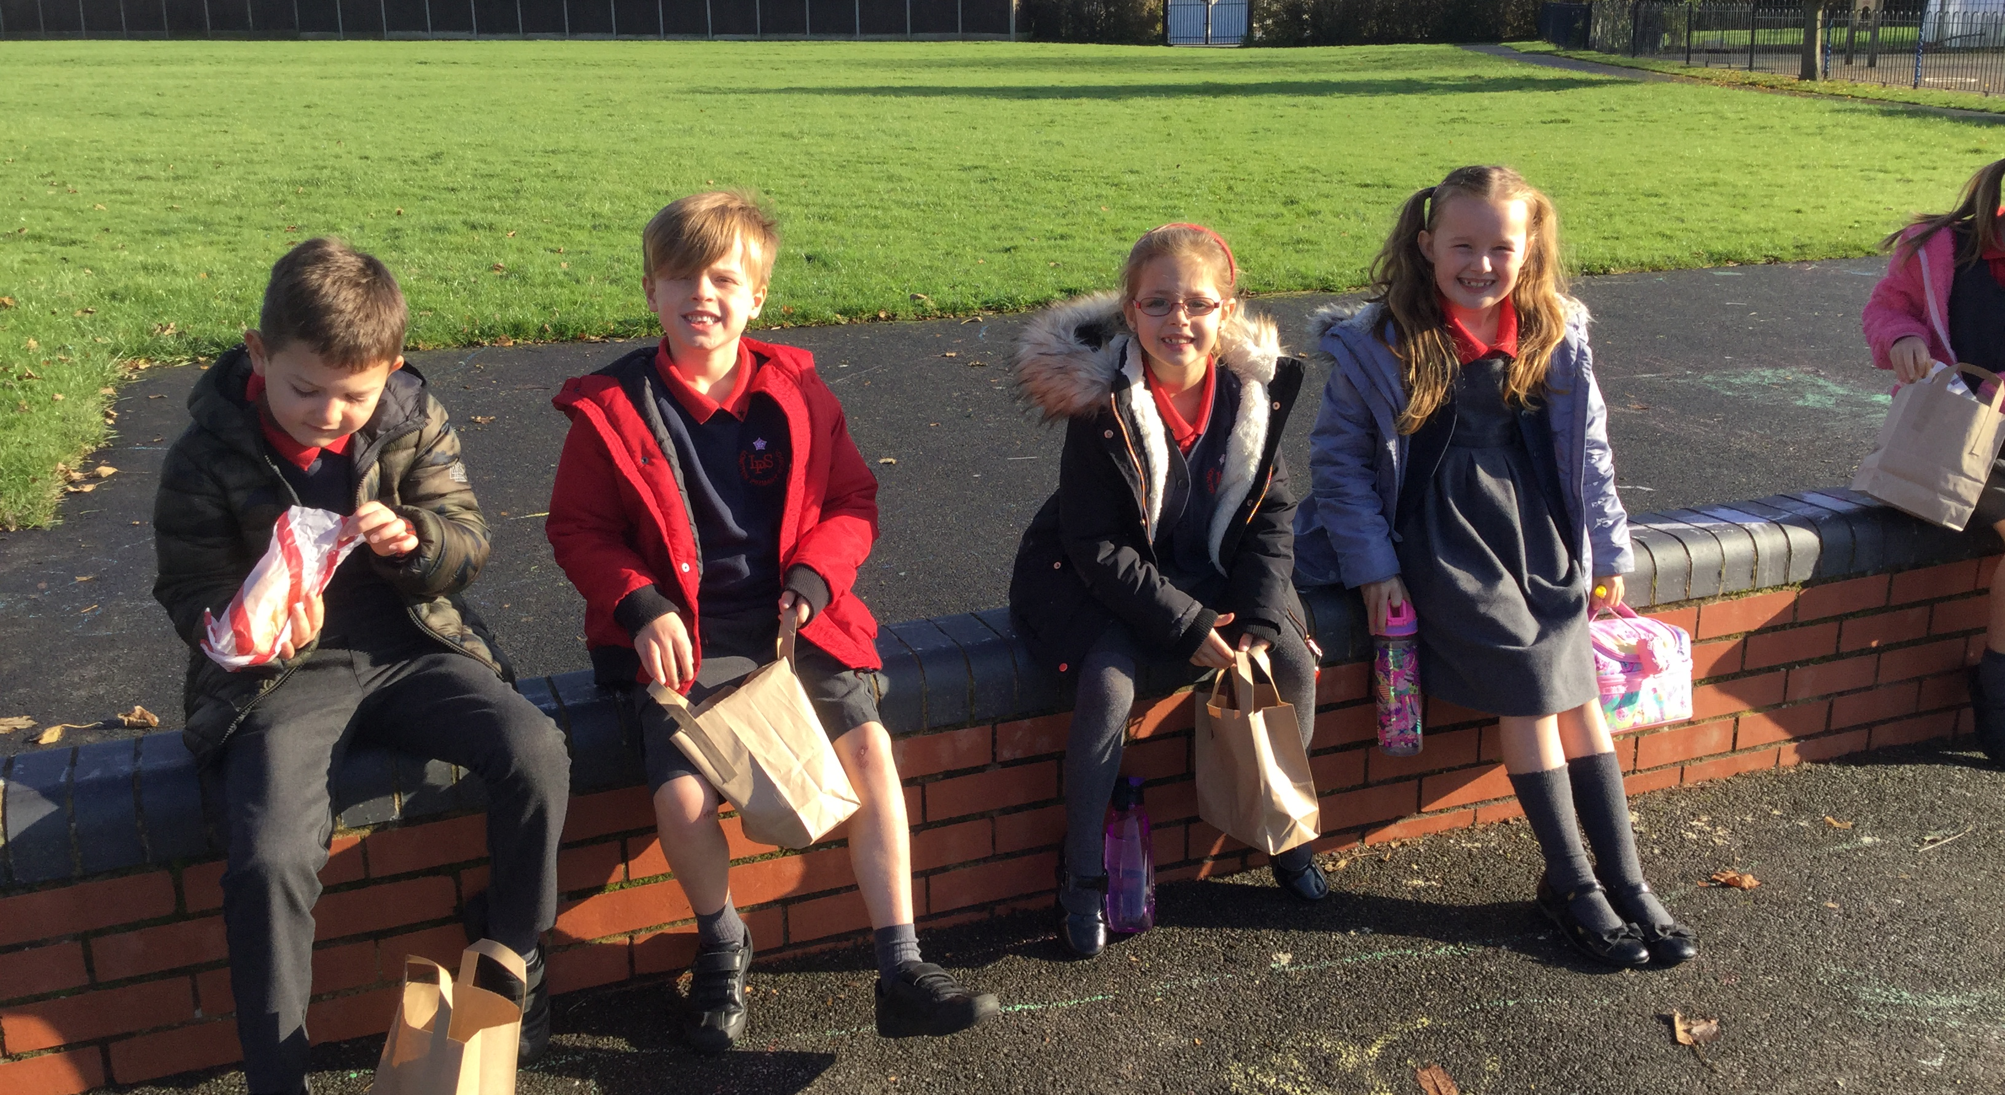
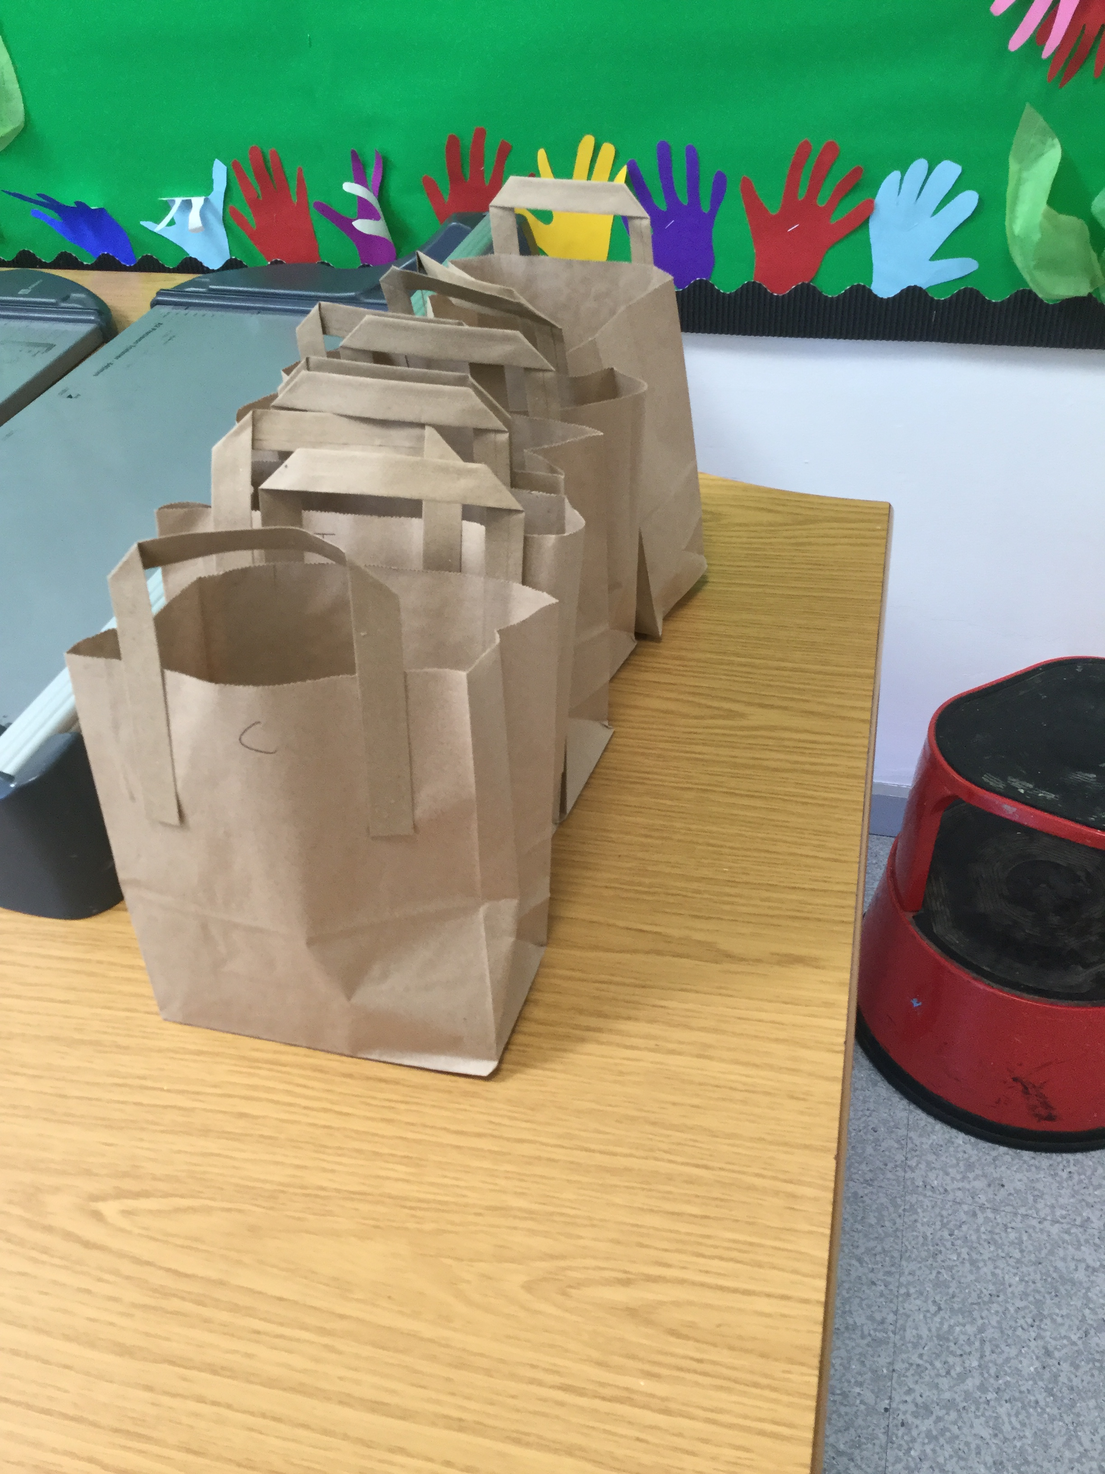
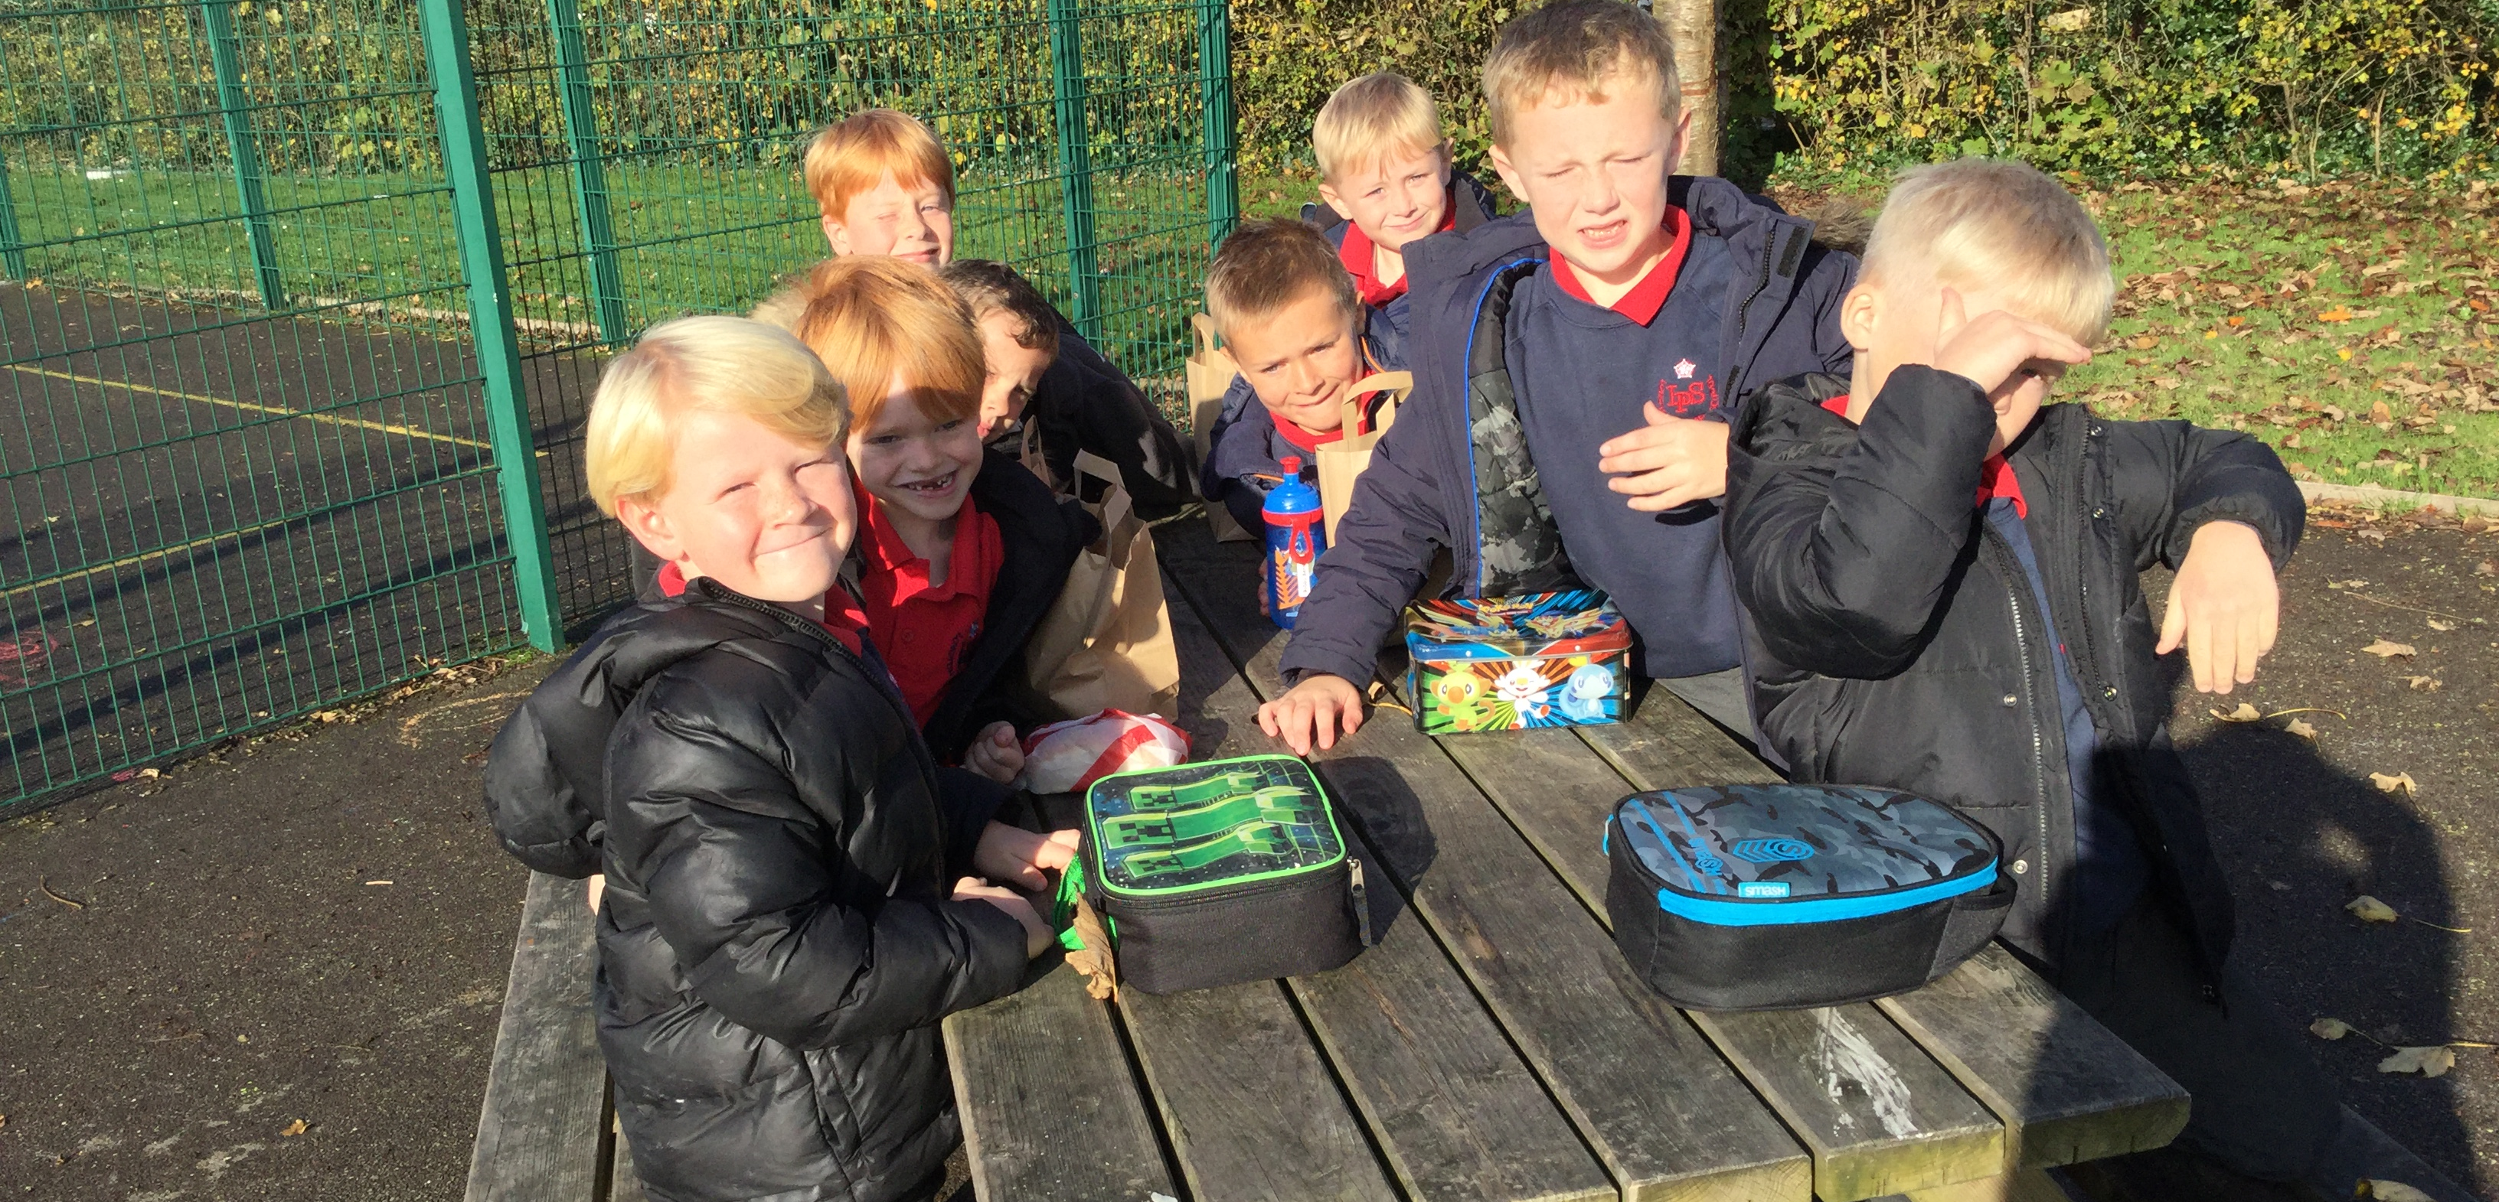
Notes:
School dinners come in little bags and if it is dry we have a picnic lunch every day

Slide 13
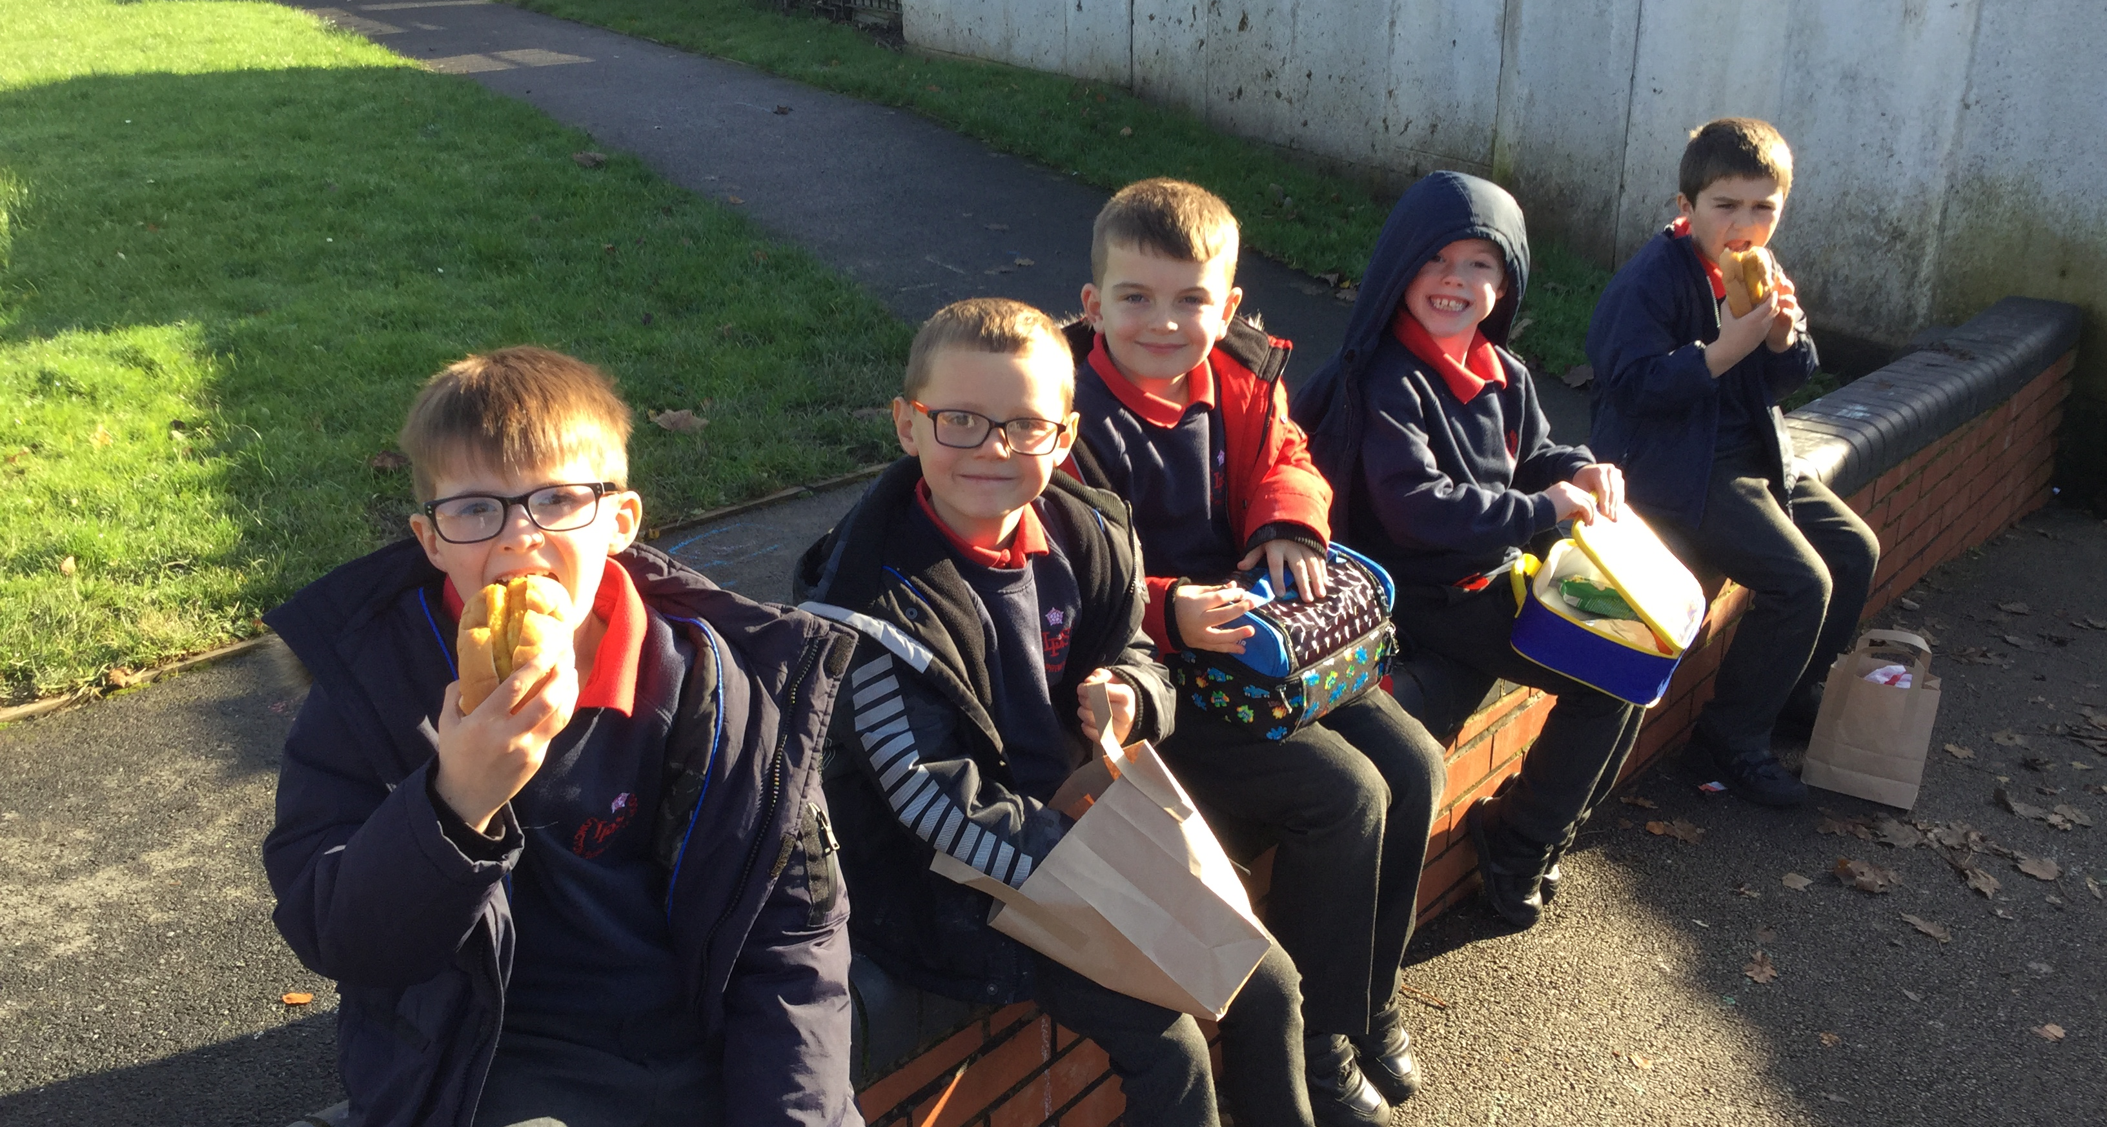
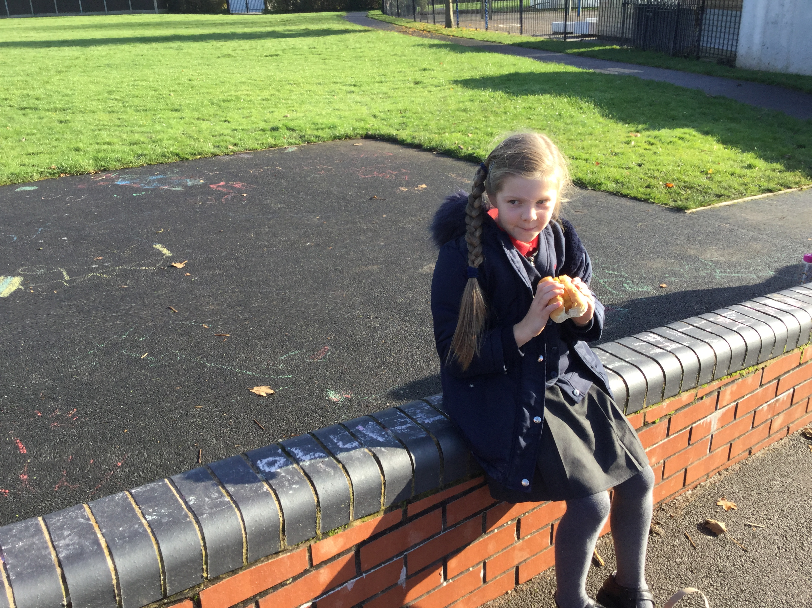
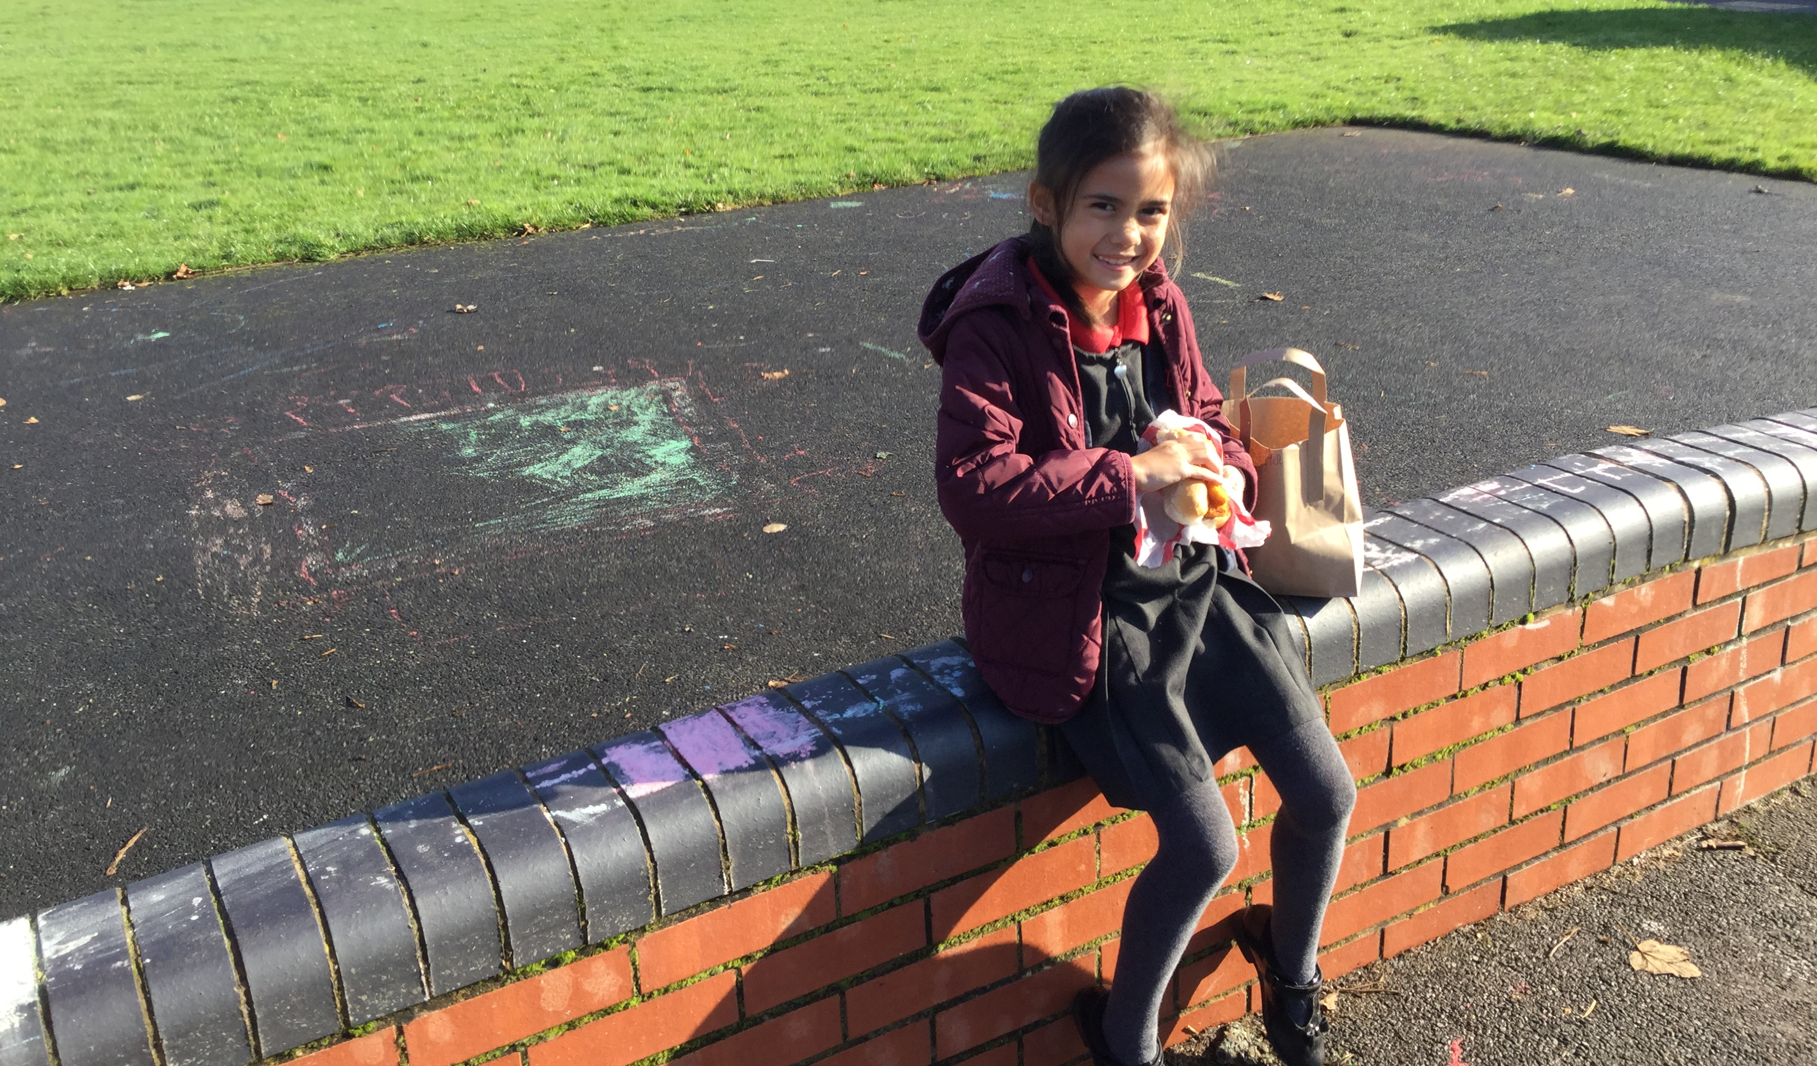
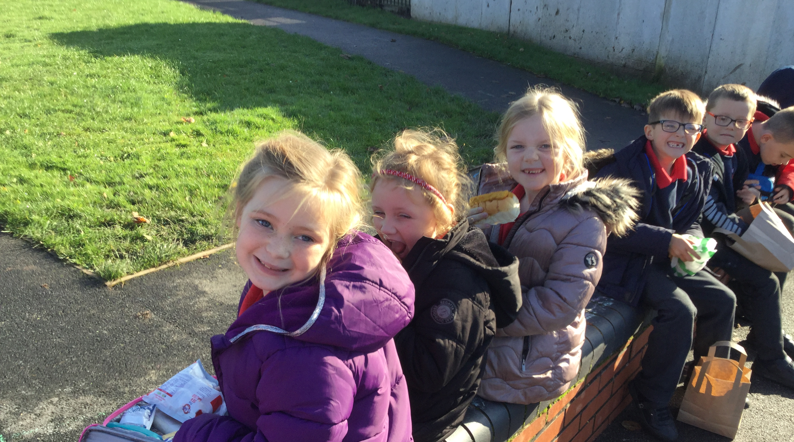
Notes:
We are really happy to be back at school with all of our friends.
When we came back in June we were in bubbles of 15, now we are all back together

Slide 14
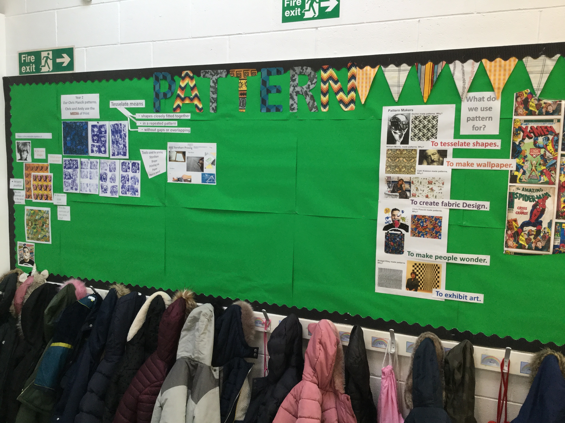
We love doing art with Mrs May
Notes:
We wanted to show you our art display, we love art

Slide 15
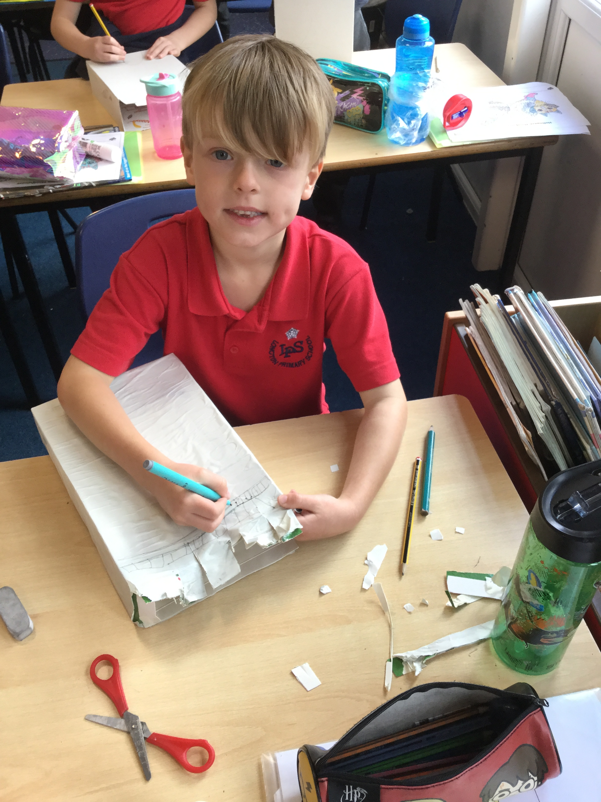
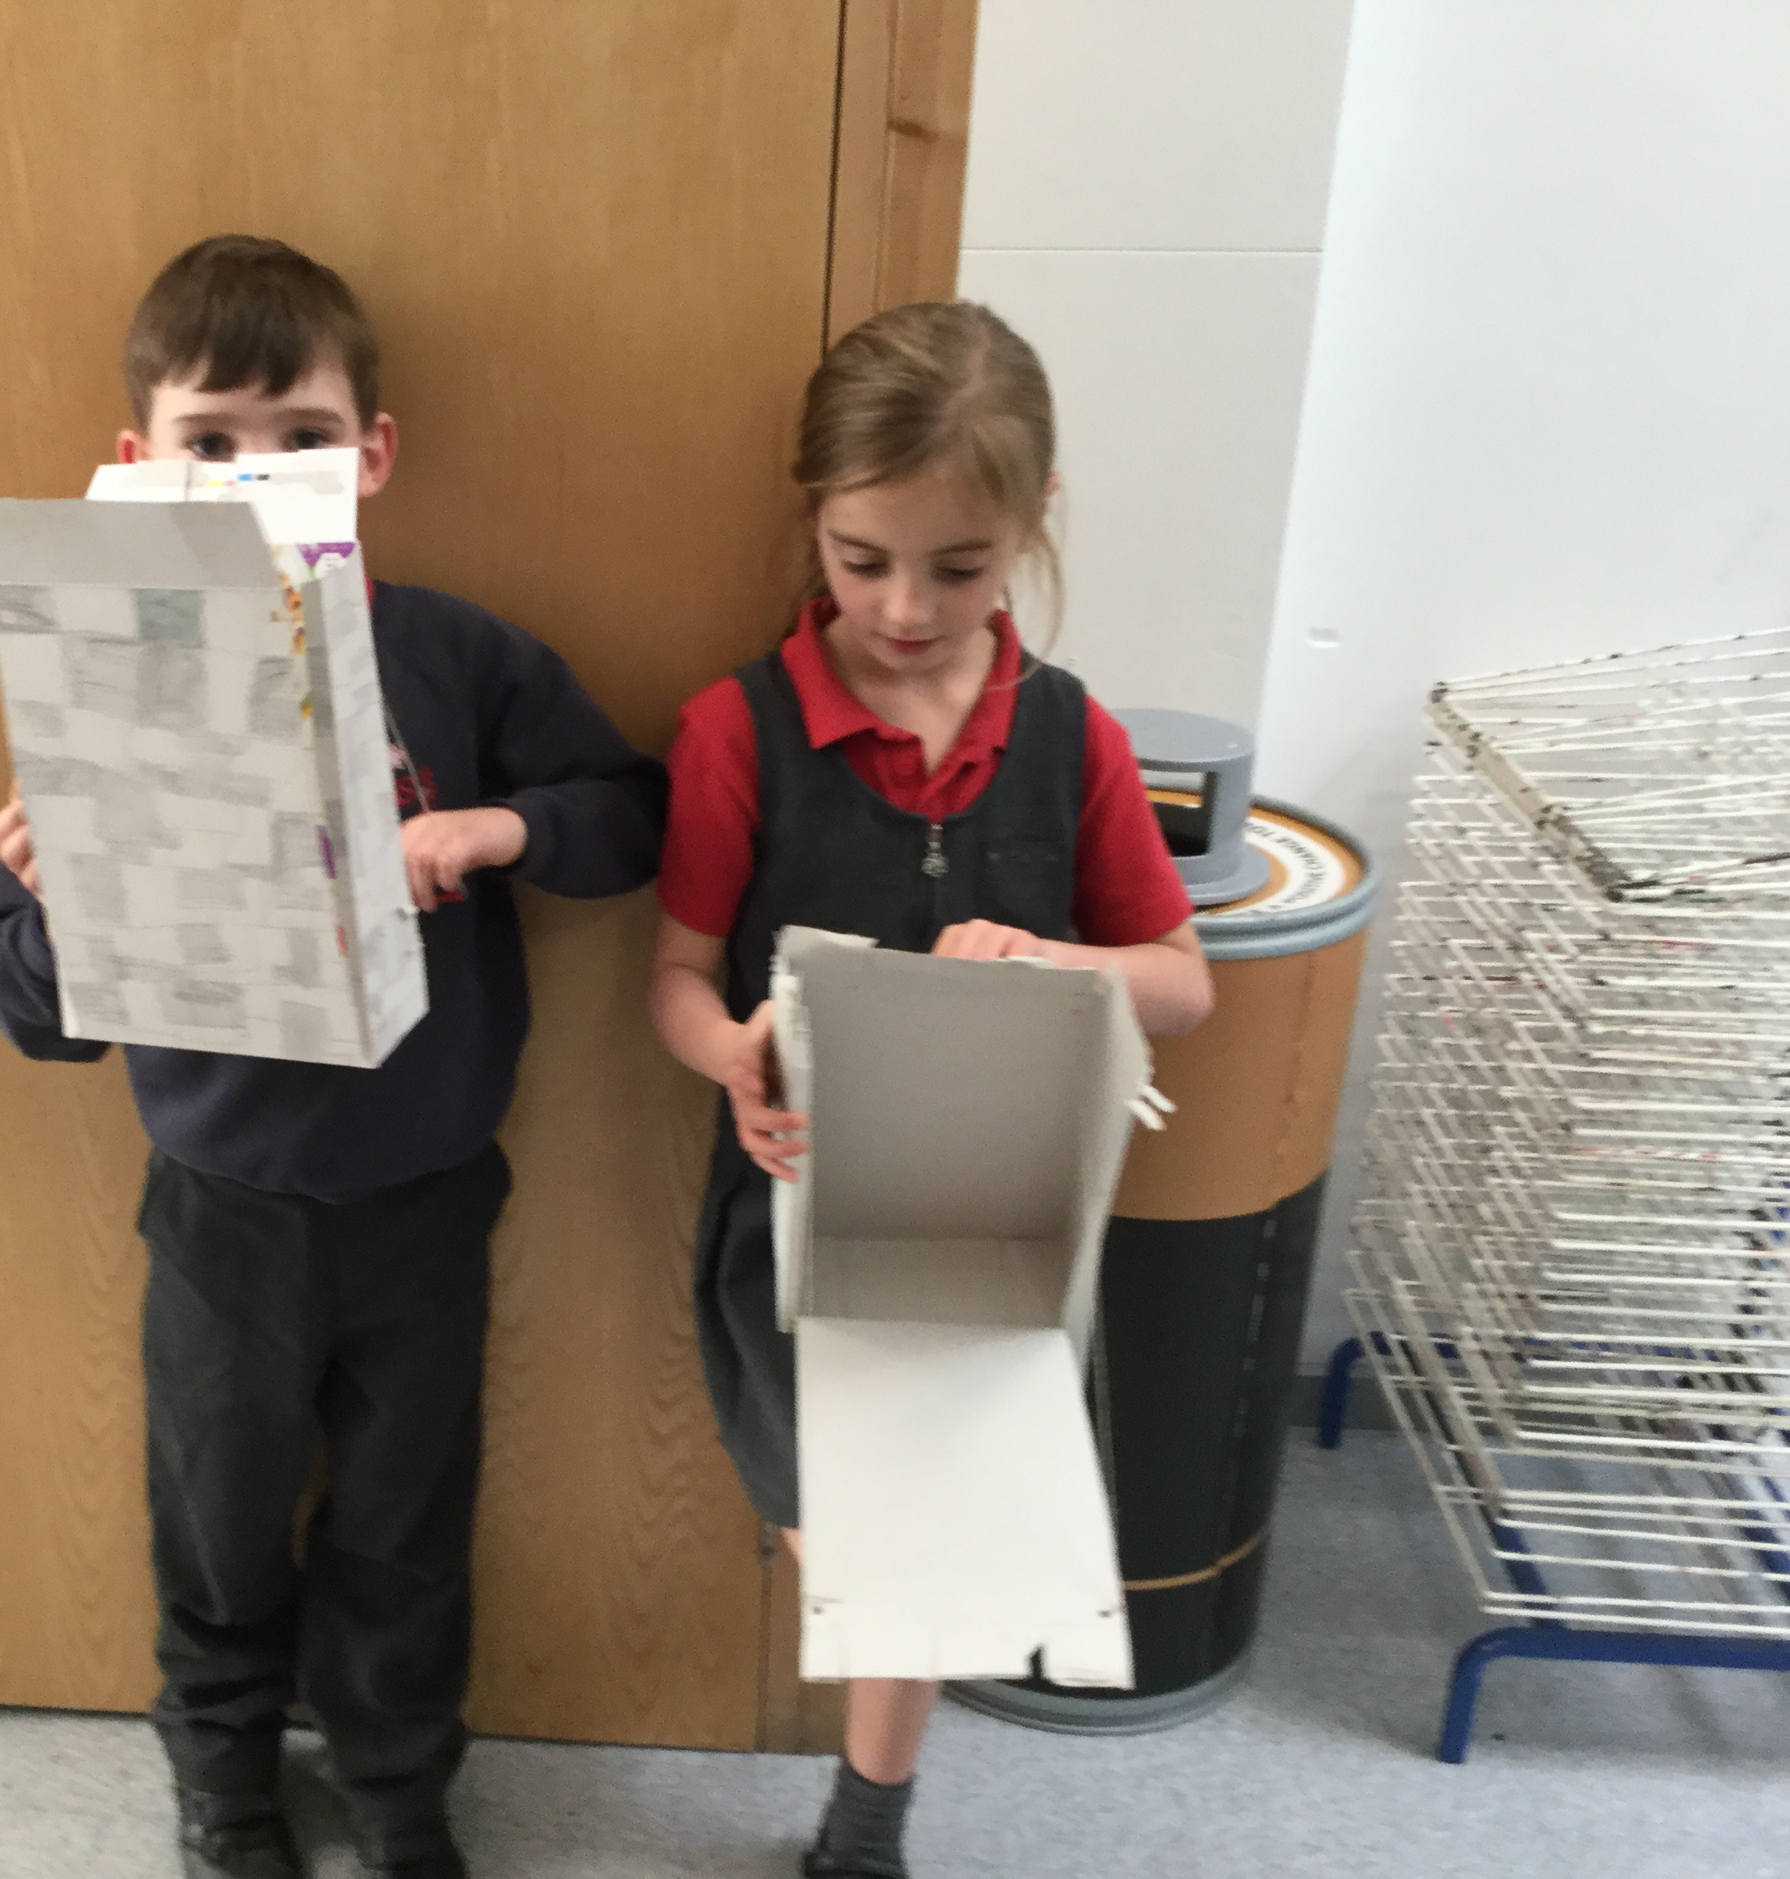
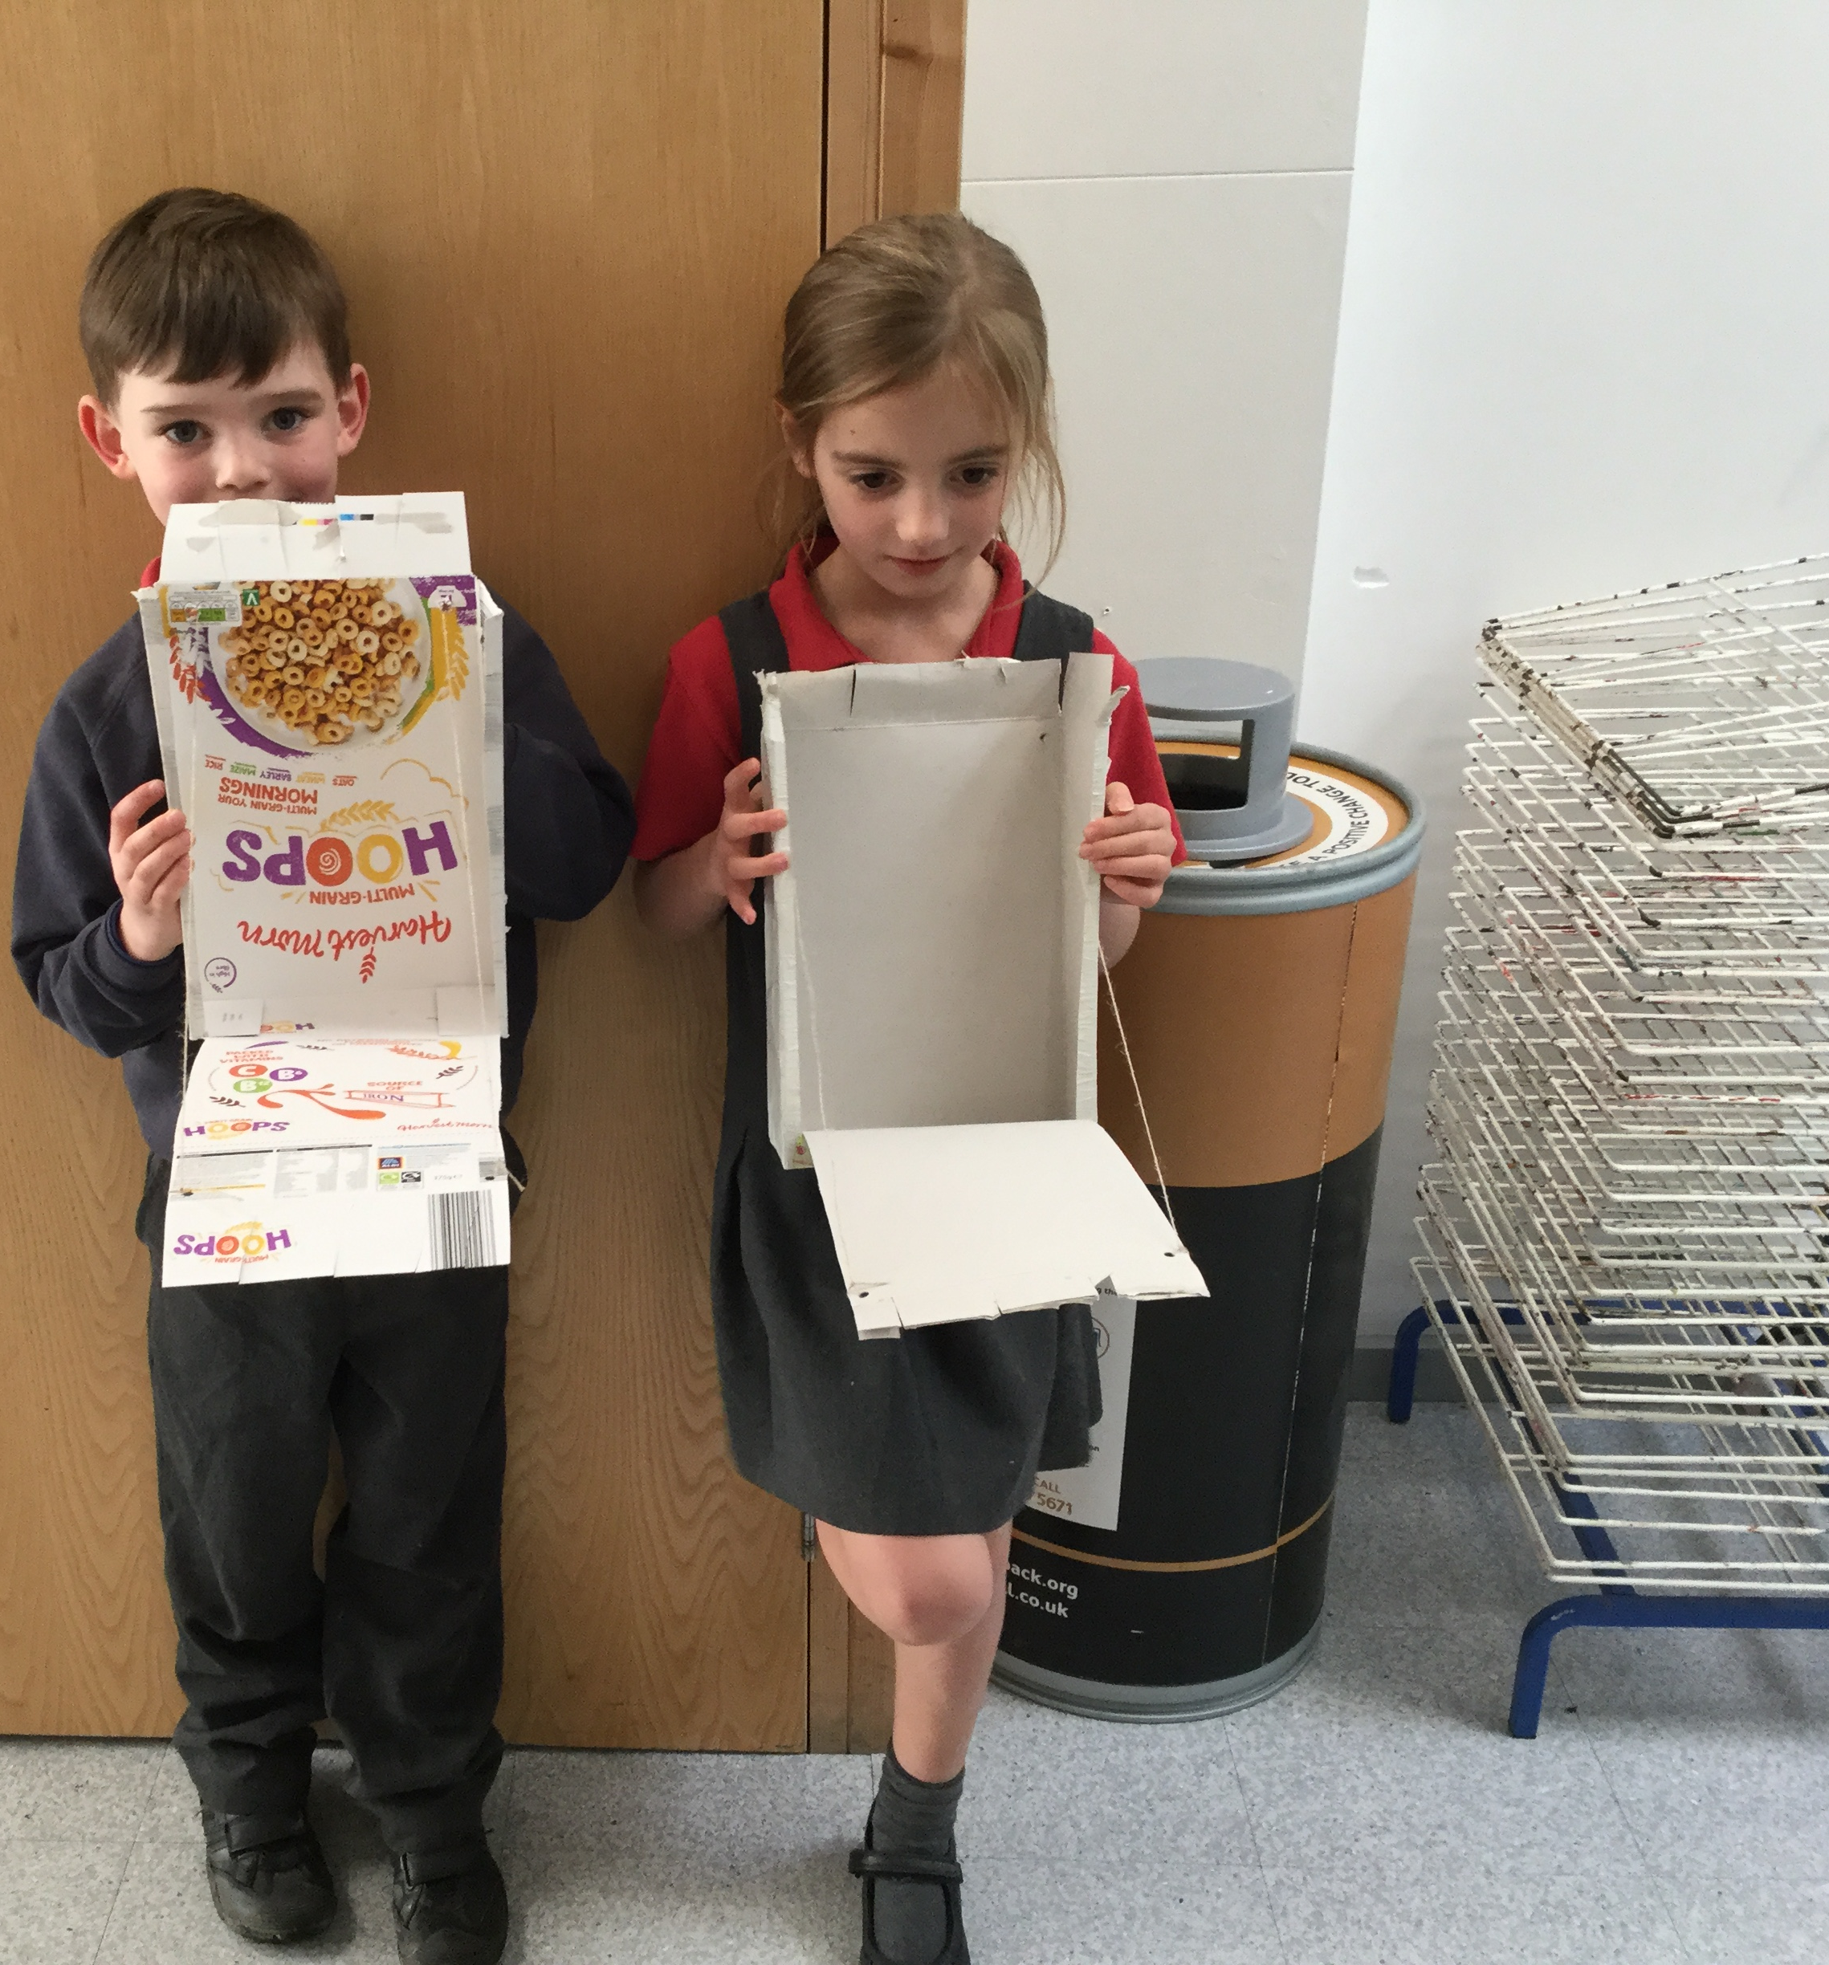
We have enjoyed …
Notes:
We are enjoying learning
Learning about famous women in history was great
Making castles with a moving drawbridge has been one our favourite things this term

Slide 16
Our Questions
How may children are there in your school?
What time do you have playtime?
How may classes are there in your school?
What are your favourite lessons?
Did you do home learning during the first lock down?

Slide 17
The Future…
Write letters
Draw pictures for each other
Arrange another online meeting
Look at each others' blogs
Meet up when we are allowed to

