Slide 1




Harvest Assembly 2020
Welcome to our harvest festival assembly for 2020. This year as we cant be in church, we will gather together in our classrooms and share thoughts of Harvest.
Our first song is ‘Harvest Samba’

Slide 2

Harvest Samba
https://www.youtube.com/watch?v=NTdIrlTlXks

Slide 3
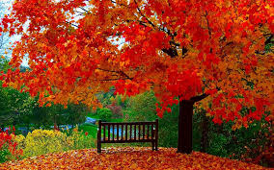
Heads Team
It’s that time of year again when summer is over and the weather starts to turn. It’s always great to celebrate this beautiful season of Autumn. Year 2 will now read a poem all about Autumn.

Slide 4
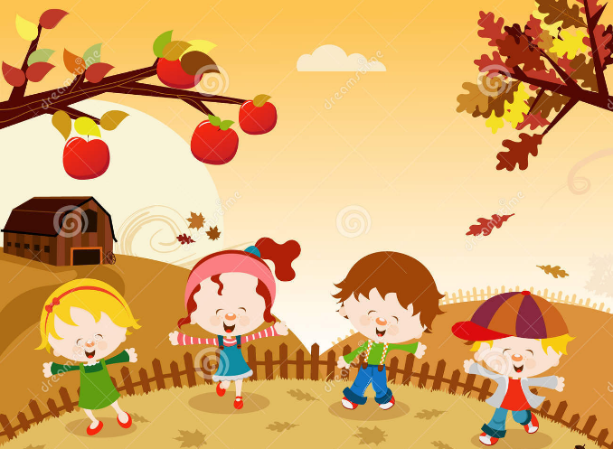
Year 2 – The Summer is Over
The summer is over,
It’s that time of year,
When swallows fly south to the sun.
Now cold winds are blowing,
And autumn is here;
The warm days are over and done.
Whirling and twirling,
Aloft on the breeze,
The bright autumn leaves flutter down.
Gold, red and amber,
They fall from the trees,
To brighten the country and town.
A bountiful harvest
Of berries and grain,
The gold autumn sunshine will bring.
The hedgehog is tucked up,
All safe from the rain,
Cosy and warm till the spring…

Slide 5
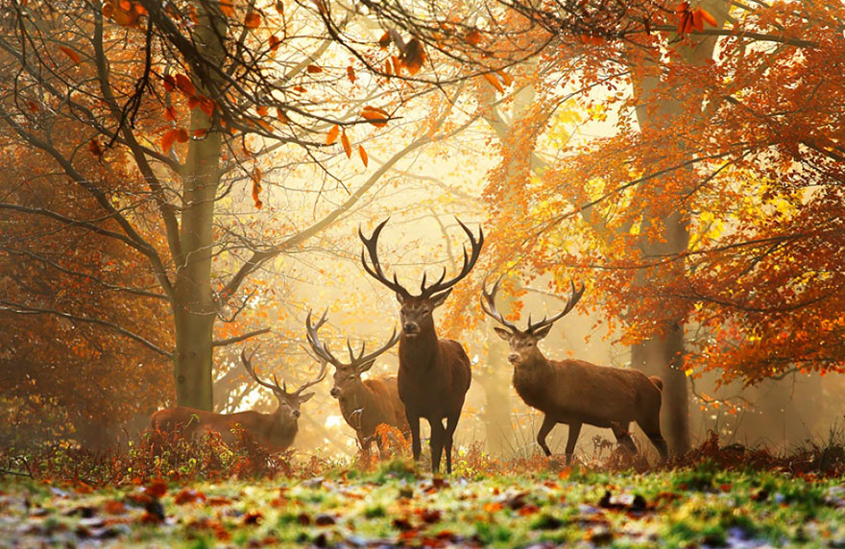
Please can year 3 read their own poems about Harvest

Slide 6
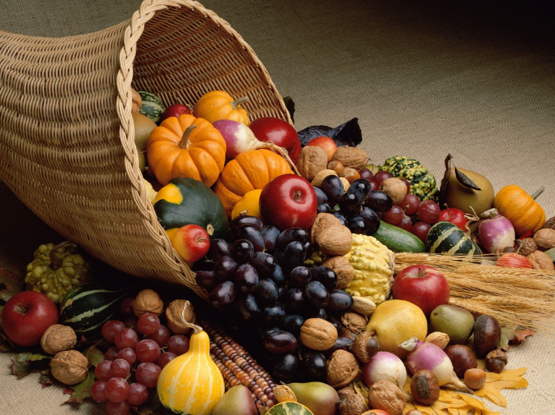
Heads Team/Year 6 – the farmers work so hard throughout the year to sow the seeds and grow their crops, sometimes they have the help of the trusty Scarecrow to help protect their crops from any bird who fancies a tasty snack in the fields.

Slide 7
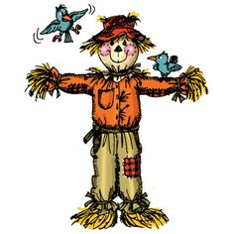
Heads Team –Longton Scarecrows have come into school to sing a song about Scarecrows
Reception and Year 1 – Sing Dingle Dangle Scarecrow
https://www.youtube.com/watch?v=CtRgy-8Q0SE

Slide 8
Heads Team /Year 6 – Thankyou scarecrows can year 4 share their poem – Say hello to Autumn
Colours are swirling,
Twisting and twirling,
All blowing free,
Dancing with glee.
Thanks for the bounty
In every county,
Good things we see,
For you and for me.
Farmers are reaping,
Hedgehogs are sleeping,
Crops everywhere
Are gathered with care.
Berries are growing,
Ripe fruits are glowing,
Apple and pear -
Good things to share.
Chill winds are blowing,
Summer is going,
Birds fill the sky,
Away they will fly.
Golden leaves falling,
Wild geese are calling,
Hello to autumn,
To summer, goodbye.

Slide 9
Heads Team – Year 5 will tell us about their thoughts of Autumn

Slide 10

Heads Team – Time to shine is this years ethos for school. But what does it mean and how does it relate to Autumn and Harvest time and the next school year ahead.

Slide 11
Heads team – Thank you Year 6.
Heads Team -As we thank God at harvest for what we have, so we pray for those who have very little.
Please put your hands together and close your eyes for our prayer.
Dear God,
Each season brings something new for us to see and enjoy,
With sunny days and rainy days our crops grow larger.
Fruit and vegetables ripen ready for us to harvest.
Thank you for all of the food we have to eat.
Let us remember people who may not have enough.
Help us to be kind to others in our thoughts, words and deeds.
Amen

Slide 12

Heads Team – with the uncertainty of what this year has brought and what enfolds in front of us, thoughts for the UK and the rest of the world are always with us, lets finish with a song and put our hands together, as we have the whole world in our hands.
https://www.youtube.com/watch?v=ODftYTD3Rbs

