Slide 1
Look at this PowerPoint

Slide 2
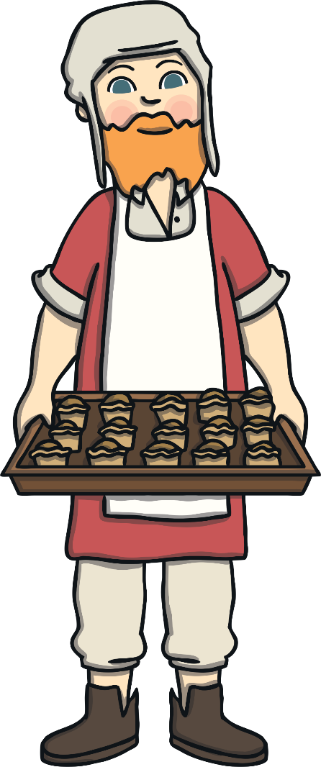
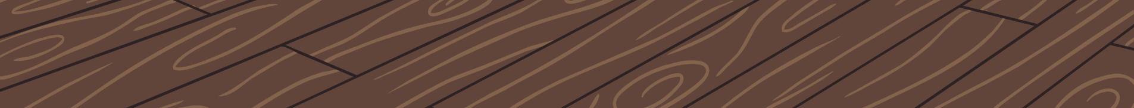
The Great Fire of London
The famous ‘Great Fire of London’ started on Sunday the 2nd of September 1666 in a baker’s shop on Pudding Lane. The baker was called Thomas Farriner.

Slide 3
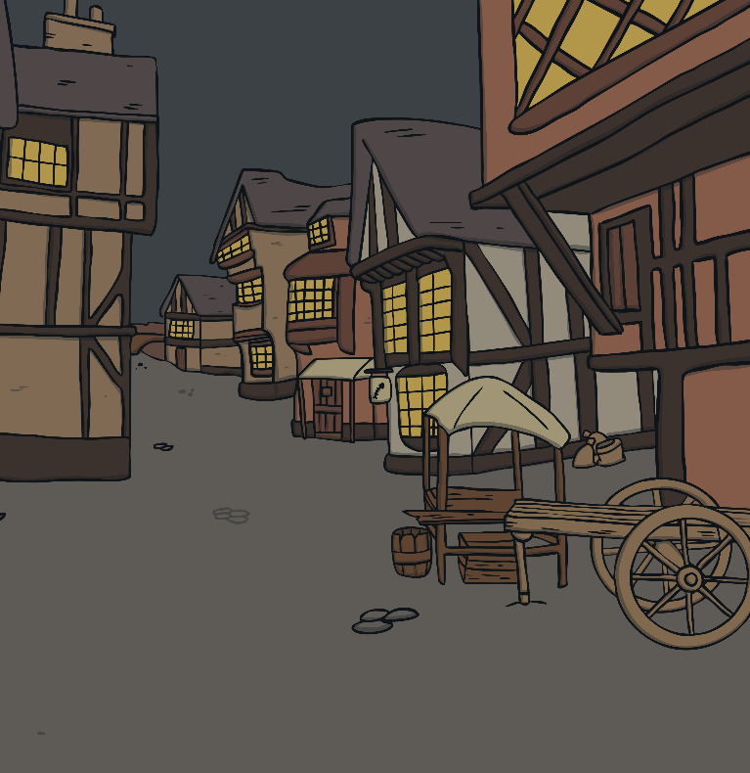
The Great Fire of London
In 1666, most of London’s buildings were made from wood.
They were also packed tightly together in narrow rows.

Slide 4
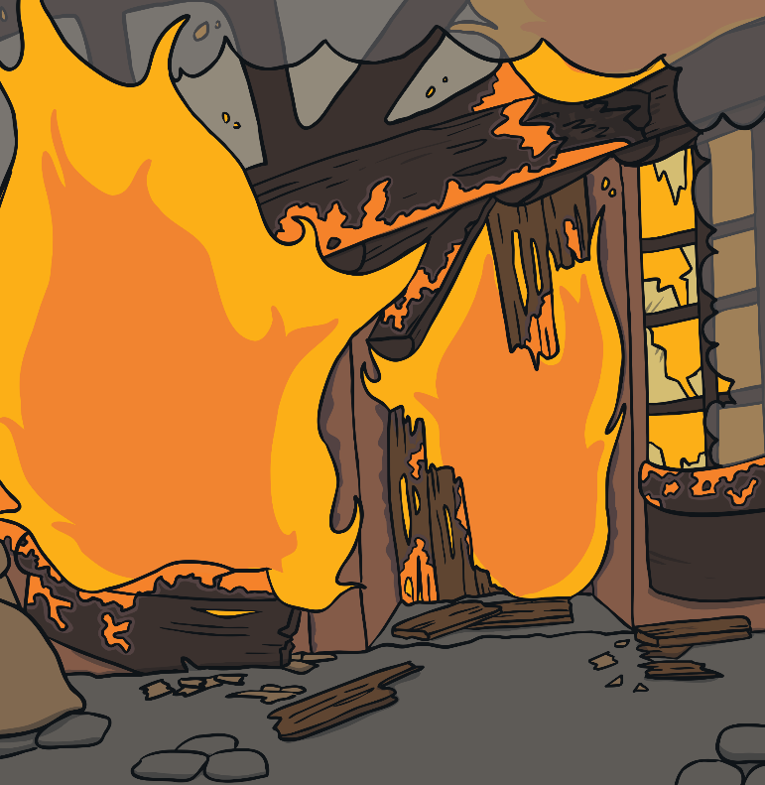
The Great Fire of London
This meant that they burnt very easily and quickly.
The wind also helped carry the fire!

Slide 5
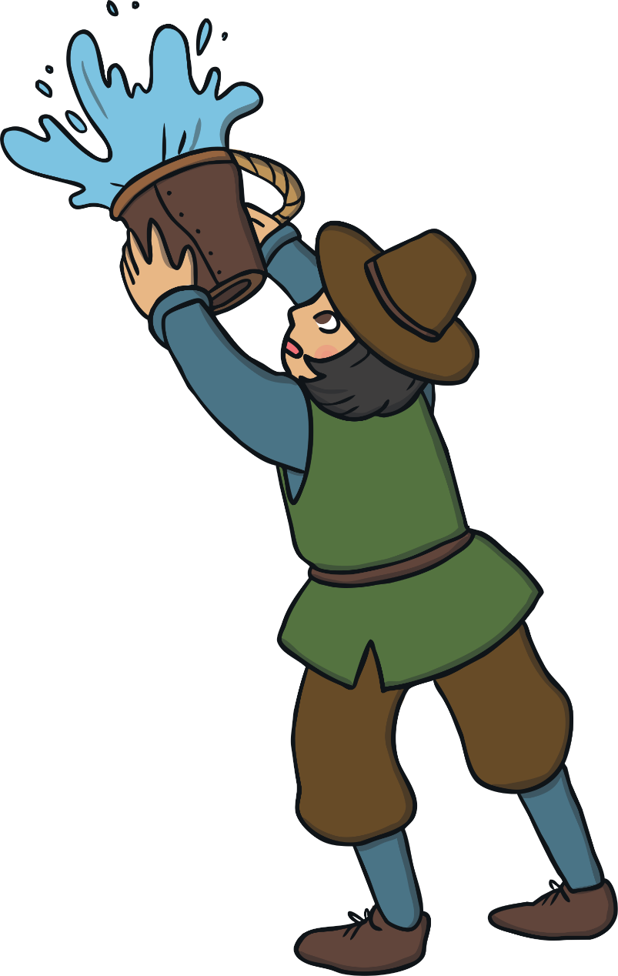
The Great Fire of London
Fire services never used to exist so citizens had to try and put the fire out! They used leather buckets filled with water and axes. They tried their best but were unable to battle the flames.

Slide 6
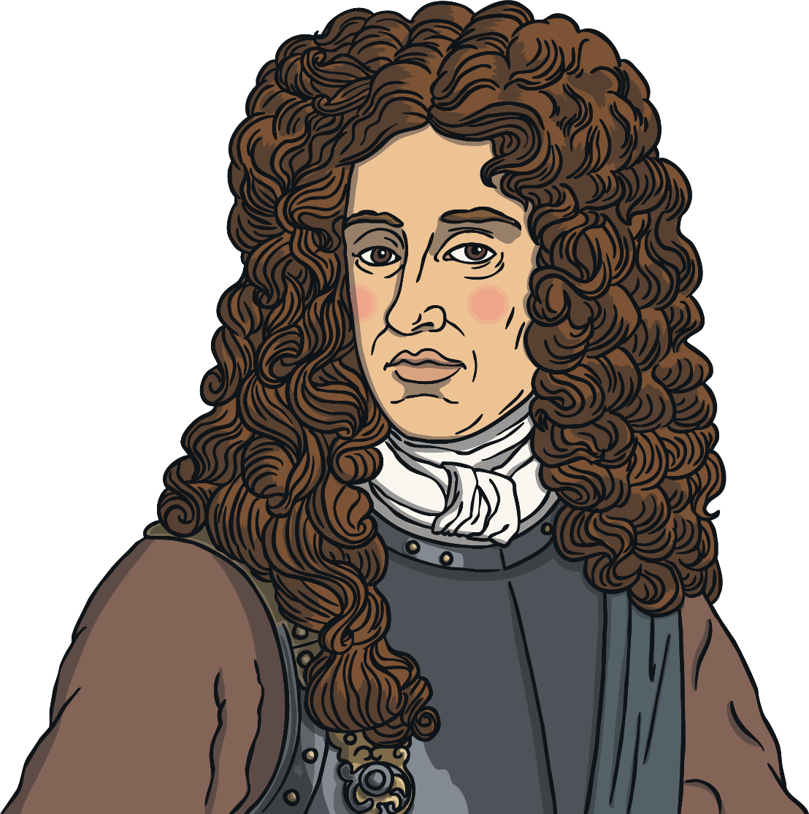
The Great Fire of London
On Wednesday The Duke of York (the future King James II) ordered that houses be destroyed using gunpowder ahead of the fire to stop the fire from spreading even further. This plan succeeded and by Thursday, the fire had been extinguished.

Slide 7
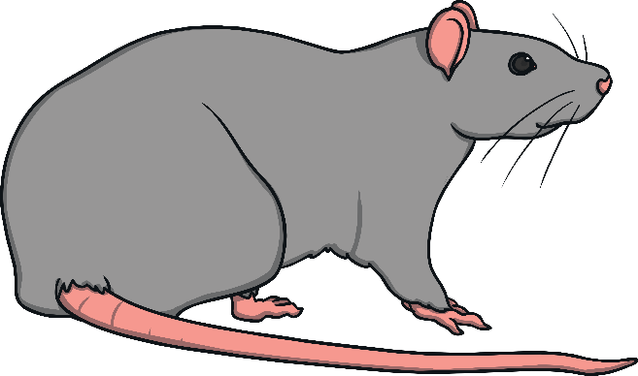
The Great Fire of London
The disaster made London a better and safer city.
Streets were widened and buildings were made stronger, more fireproof and out of brick instead of wood.
A lot of rats carrying the black plague were also killed off.

Slide 8
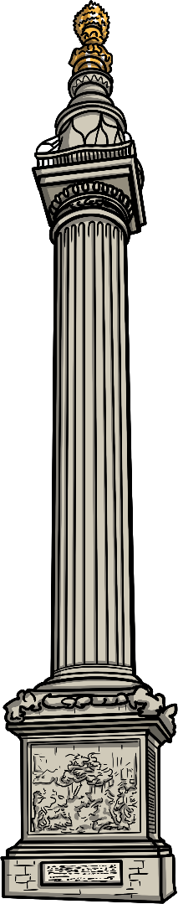

The Great London Fire
The Monument to the Great Fire of London was erected.
The monument still remains in place today so that no one will ever forget what happened.

Slide 9
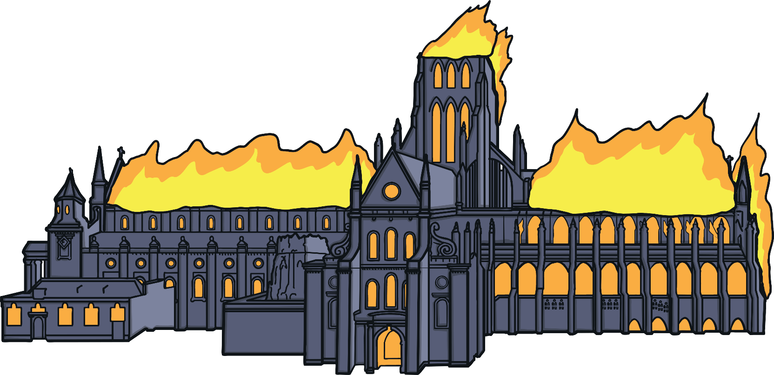
The Great London Fire
Even the smallest fire can be dangerous within a few minutes. Make sure you always have a fire escape planned. If a fire starts, stay calm and leave immediately.

Slide 10
Task
You have watched a video clip and looked at this PowerPoint
What was the same in the two accounts?
What was different?
Why do you thnk accounts of the same event are sometimes different ?

