Slide 1

Today we are thinking about relationships
Thank you for being my friend.
What is a friend?

Slide 2
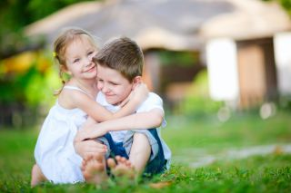
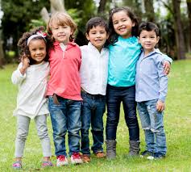
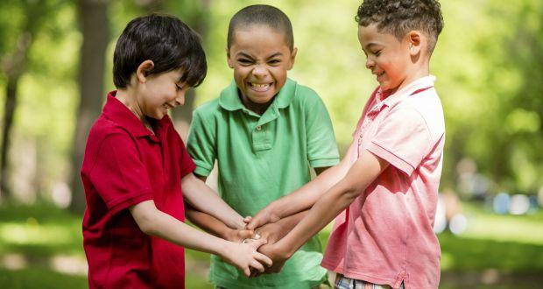
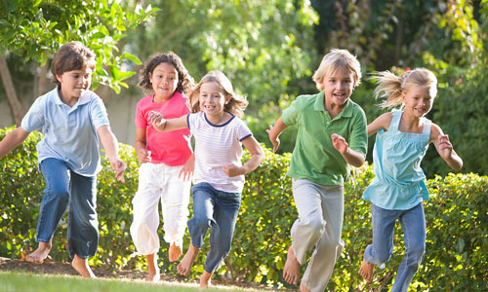
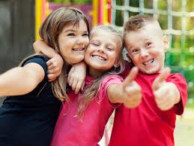
Calm me – we will light a candle and listen to a piece of music and we are going to think about what a friend is.
https://www.youtube.com/watch?v=nzQWmAwNNCw

Slide 3
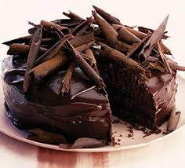
Doesn’t it look delicious
What ingredients would we put into making a chocolate cake?
What would happen if we left something out?

Slide 4
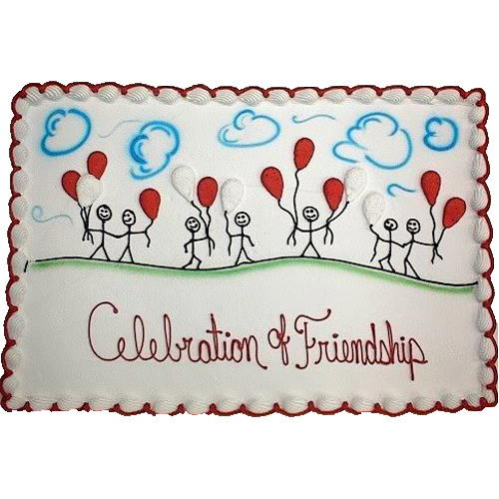
Friendships and relationships don’t just happen. In the same way this cake didn’t just happen, it has taken lots of ingredients and a lot of work to make it this lovely.
We are now going to work as a class to create a recipe for friendship.
A pinch of…
A spoonful of…
A sprinkling of….

Slide 5
Time to think
Can we build a friend or make a friend . What would we want our friend to be like.
https://www.youtube.com/watch?v=3JIpIsgHqV0

