Slide 1
Hothersall Lodge
Lancashire

Slide 2
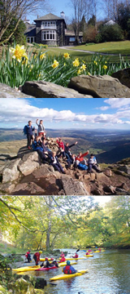
Dates : Wednesday 11th – Friday 13th March 2020
Adults attending:
Miss Reynolds, Mr Brown, 1 more TBC

Slide 3
Day 1
Meet in school hall at 8.50 with case/bag containing clothes and other items
They come to school dressed ready for activities, dressed in warm clothes ( not jeans) as after lunch we will begin our activities.
Will need a packed lunch to eat just after we arrive- preferably in a plastic box to reuse each day. Also a water bottle that they can refill.
You are welcome to stay in the hall until we depart to wave off your child.
Any medication identified in the medical form must be handed to myself in a plastic bag with the child’s name, name of medication and clear instructions of use. No medication will be left with your child but if they need it will be always available for them.

Slide 4
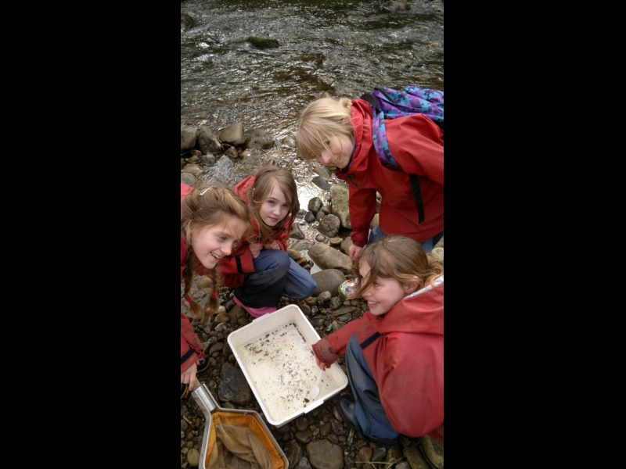

Slide 5
Activities that we will take part in
Orienteering- Beacon Fell
River study activities- Brock Bottoms
Survival – On site
Team challenges- On site
After hours fun activities

Slide 6



Slide 7
Daily routine
Every morning children will have a variety of options for breakfast and they will be encouraged to find something they like for the busy day ahead.
Lunch items will be available for them to create their own sandwiches and packed lunch every day.
Evening meals will be served by the staff , however children will take turns in preparing and clearing away the plates and accessories.

Slide 8



Slide 9
Kit List
Plenty of: Complete changes of clothes
Old, thick jumpers (fleeces are particularly good)
Pairs of old tracksuit bottoms or similar. Note that jeans are not ideal
Pairs of thick socks
3 Pairs of shoes (1 pair for indoors, eg slippers, 1 pair for outdoors, 1 old pair of trainers for use on the court)
See the kit list provided for full details

Slide 10


Slide 11
The following should be brought if group members already possess them or can borrow them:
Walking Boots
Wellingtons Small Rucksack
Waterproof top and trousers
All other specialist equipment will be provided by Hothersall Lodge

Slide 12
Rooms at Hothersall Lodge
The sleeping arrangements are dormitories – one for boys and one for girls. In some areas there are bunk beds and some singles.
There is a boy and girl corridor and neither groups are allowed in the areas of the other.
Before we go we will talk about privacy, different needs and getting on so as to avoid any issues while we are there.
We will endeavour to make sure they are in pairs with some of their friends.

Slide 13


Slide 14
Last day
Children will be required to pack their bags, tidy their rooms and strip their bedding ready for preparation for the next guests.
We will have an activity in the morning, lunch and then set off home to arrive back at school by approximately three o’clock.
Your children will be tired and ready to collect with their washing at that time.
I recommend that you pack your child with some plastic bags to put in any damp/muddy clothes.

Slide 15
Extras
No electrical equipment at all! No tablets, iPads, iPods, Mobile phones, DS’s etc
Camera’s may be taken as long as children take FULL responsibility but they can only use them in the house – not on the activities. But we will take plenty of photos to share with you, so there is no need.
There is a small tuck shop where children can purchase souvenirs of their trip ranging from 50p to £5. Please don’t bring too much money as it will only get lost.
Staff always take lots of photographs and will ensure you all receive copies.

Slide 16
Next steps:
Complete medical form, if not done already, and return it to school as soon as possible
Take copy of the kit list
Speak to me if any concerns
Any Questions ?

