Slide 1
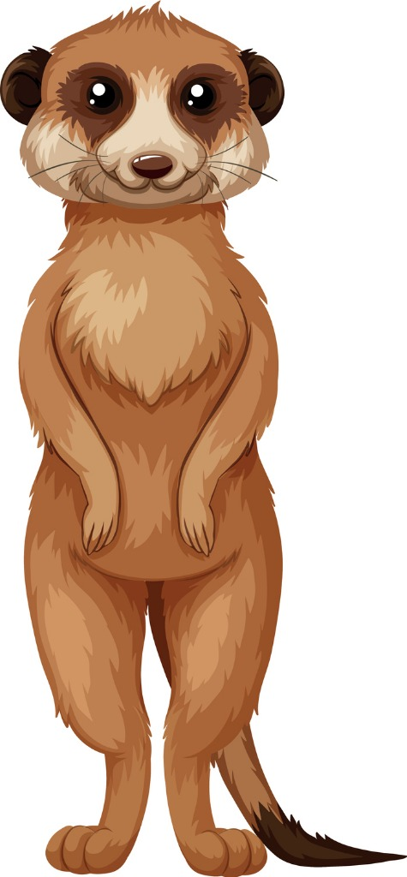
Welcome to Year 3
Mrs Catterall
Mrs Atkinson

Slide 2
Lessons in Year 3
Spelling activity every morning
Register, dinner register, toast order
Grammar, Punctuation, Spelling
Guided reading
Maths
English
Reading for pleasure
Handwriting
Topic/PE/Jigsaw/RE/Swimming
Community Volunteers
Music/Choir – Mrs Bolton
French – Mrs Robinson
Computing – Mrs Forrest

Slide 3

Toast
Children need to have responsibility for their own toast money. It is up to them to remember to order it in a morning, if they forget there will be no toast.
Reading Books
Mrs Doherty takes the children out in groups to choose a new reading book on a Wednesday afternoon. Guided Reading in class – groups.
Homework
Sent home on a Thursday / Friday for it to be returned by the Tuesday. Maths and English, please feel free to help and support them with it. Maths - there are usually 3 sections. Only have to do 1. Choose the level right for them. Please complete homework in pencil.

Slide 4
Swimming
Children will start swimming this week. Girls hair needs to be tied up. No earrings in on a Thursday. If they do wear them they must be able to take them out themselves.
Times tables
Times table Rock stars – on the computer. Each child will be given a password so they can login at home and practise. It can be done on a tablet or PC but must go through the website not the App.
Spelling
Year 3 / 4 statutory word list. Children are expected to be able to spell all of these words by the end of year 4. While we do not have weekly spelling tests I would like them to practise them at home.

Slide 5
a b c d e f g h i j k l m n o p q r s t u v w x y z
The quick brown fox jumps over the lazy dog

Slide 6
Support from home
Times tables – in every way possible.
Handwriting – letter formation, joins, speed.
Reading speed, fluency, understanding of the vocabulary.
Spelling the year 3/4 statutory words
Telling the time.

Slide 7
School Website
www.longton.lancs.sch.uk
Blog
Letters
Knowledge organisers
National curriculum – overview of the year
End of year expectations

