Slide 1
Edinburgh
Wednesday June 12th to Friday June 14th

Slide 2
Staff
Miss Leigh
Mrs Woolley
Mrs Fletcher
Mr Brown

Slide 3
Transport
Please arrive at school about 8 - 8.10am. Register will be at 8.15am
We will leave school at 8.30am
Tyrells is our coach company and will we transporting us between venues in Edinburgh.
Friday – We will be leaving Edinburgh around 12:30pm
Aim to be back at school at 6pm
We will take comfort breaks as and when they are needed.

Slide 4
Attractions
Edinburgh Castle
Royal Yacht Britannia
Royal National Museum of Scotland
Palace of Holyroodhouse
Scottish Parliament
Evening walk and trip to the park
Harry Potter movie night (PG only)
Children will take part in a variety of tours, workshops and guided sessions.

Slide 5
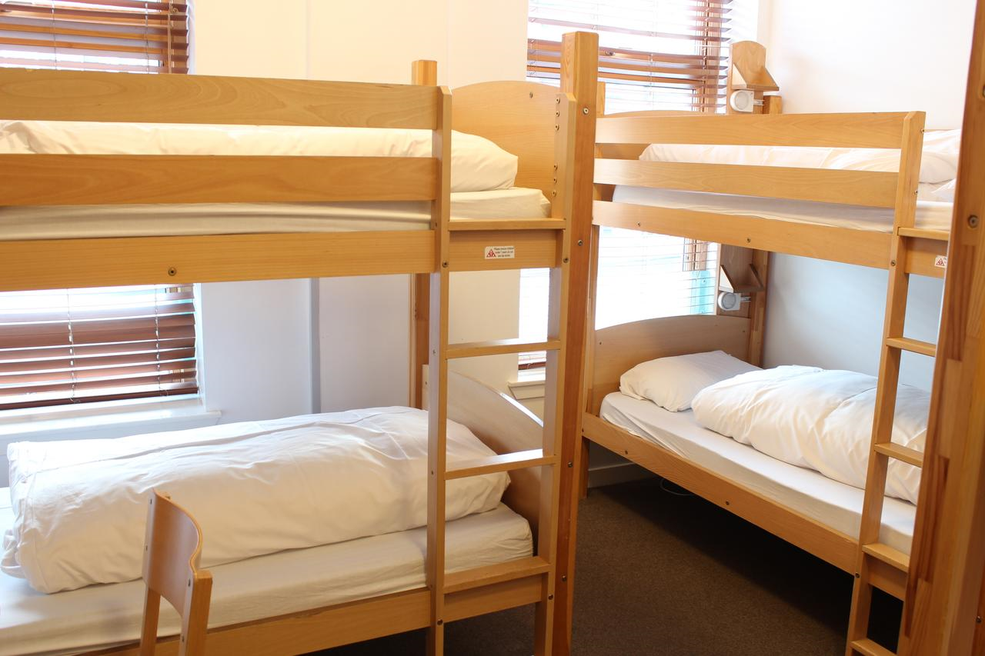
Accommodation
Edinburgh Central Hostel
Rooms of 4, 5, or 6. Single Gender
En suite facilities in each room
Rooms are locked and secured
Staff rooms are on the same floor and positioned close by

Slide 6
Food
Please send your child with a Packed lunch and refillable drinks bottle on Wednesday. This should be in their day pack.
Evening meals and Breakfasts are at the hostel.
Lunches we will organise depending on our location and the weather- these could include Subway, Greggs, Chip shop, Nando’s etc.
They don’t need any sweets for evenings/movie night.

Slide 7
Money
Children may bring up to £10 spending money for souvenirs.
They will be responsible for looking after it.

Slide 8
Packing
Please check the weather and consider clothing accordingly
Suggested – 2 complete changes of clothes, night clothes, spare pair of shoes, toiletries, towel, sun cream/hat, waterproof coat or jacket.
Day pack and refillable water bottle
No Phones
No electrical items
Don’t forget comfort items – book, teddy,
Children will need to be able to lift their own bag and take it to their room.

Slide 9
Medicines
Please put any medication in a labelled bag with clear instructions of when to give children their medicine and the dosage required. Hand to Miss Leigh prior to departure.
Don’t forget travel sickness tablets or bands if necessary.
We will have a first aid kit with us at all times.

Slide 10
Keeping in touch
No news is good news
We will use Twitter to update you on our journey, arrival in Edinburgh and departure.
We will endeavour to keep you up to date on how our day is going with regular Tweets but no promises….we hope to be having a blast.

Slide 11
Any Questions?

