Slide 1
Good Afternoon
Our reading and phonics journey.

Slide 2
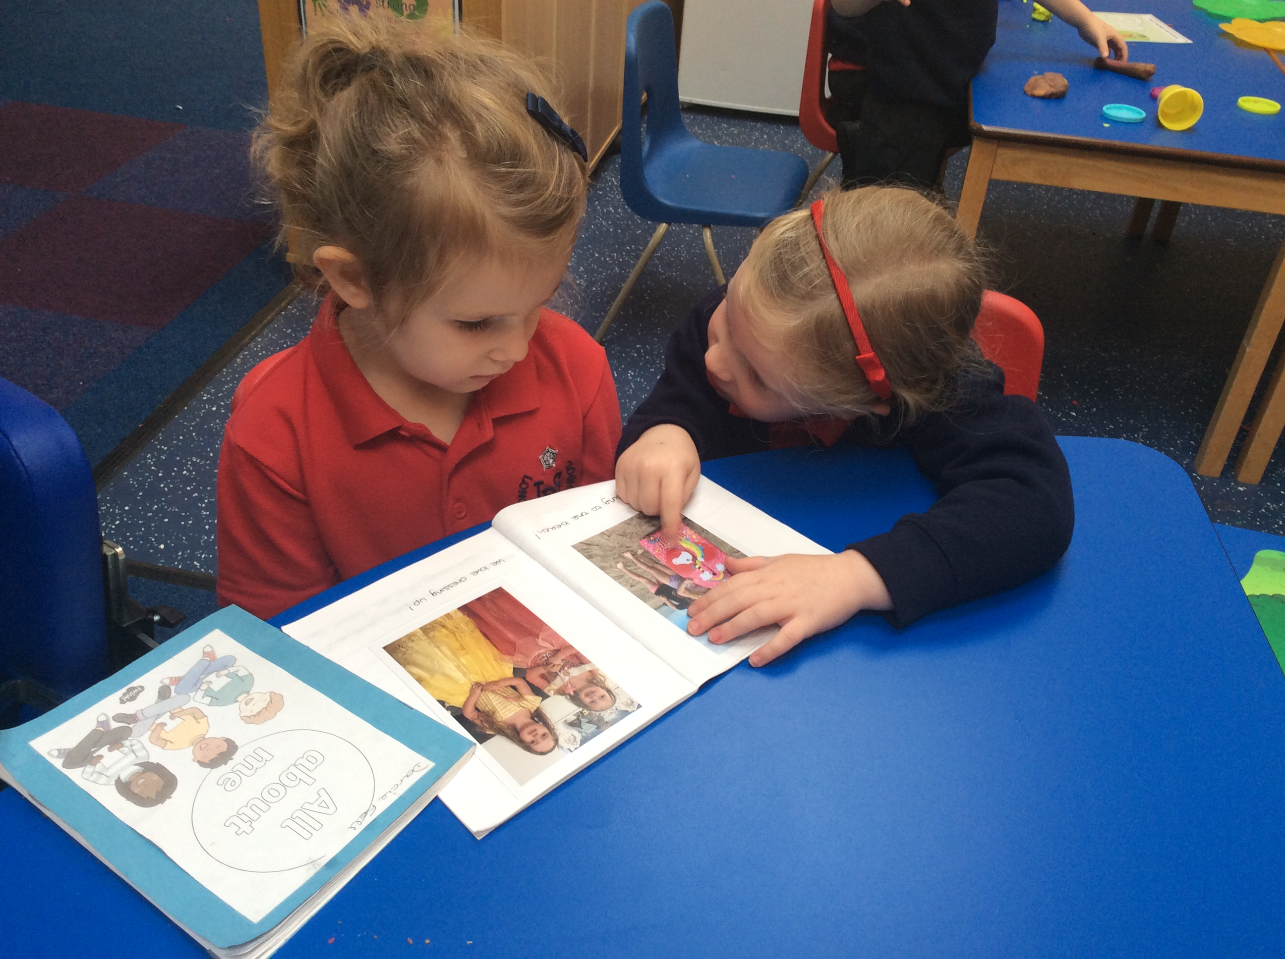
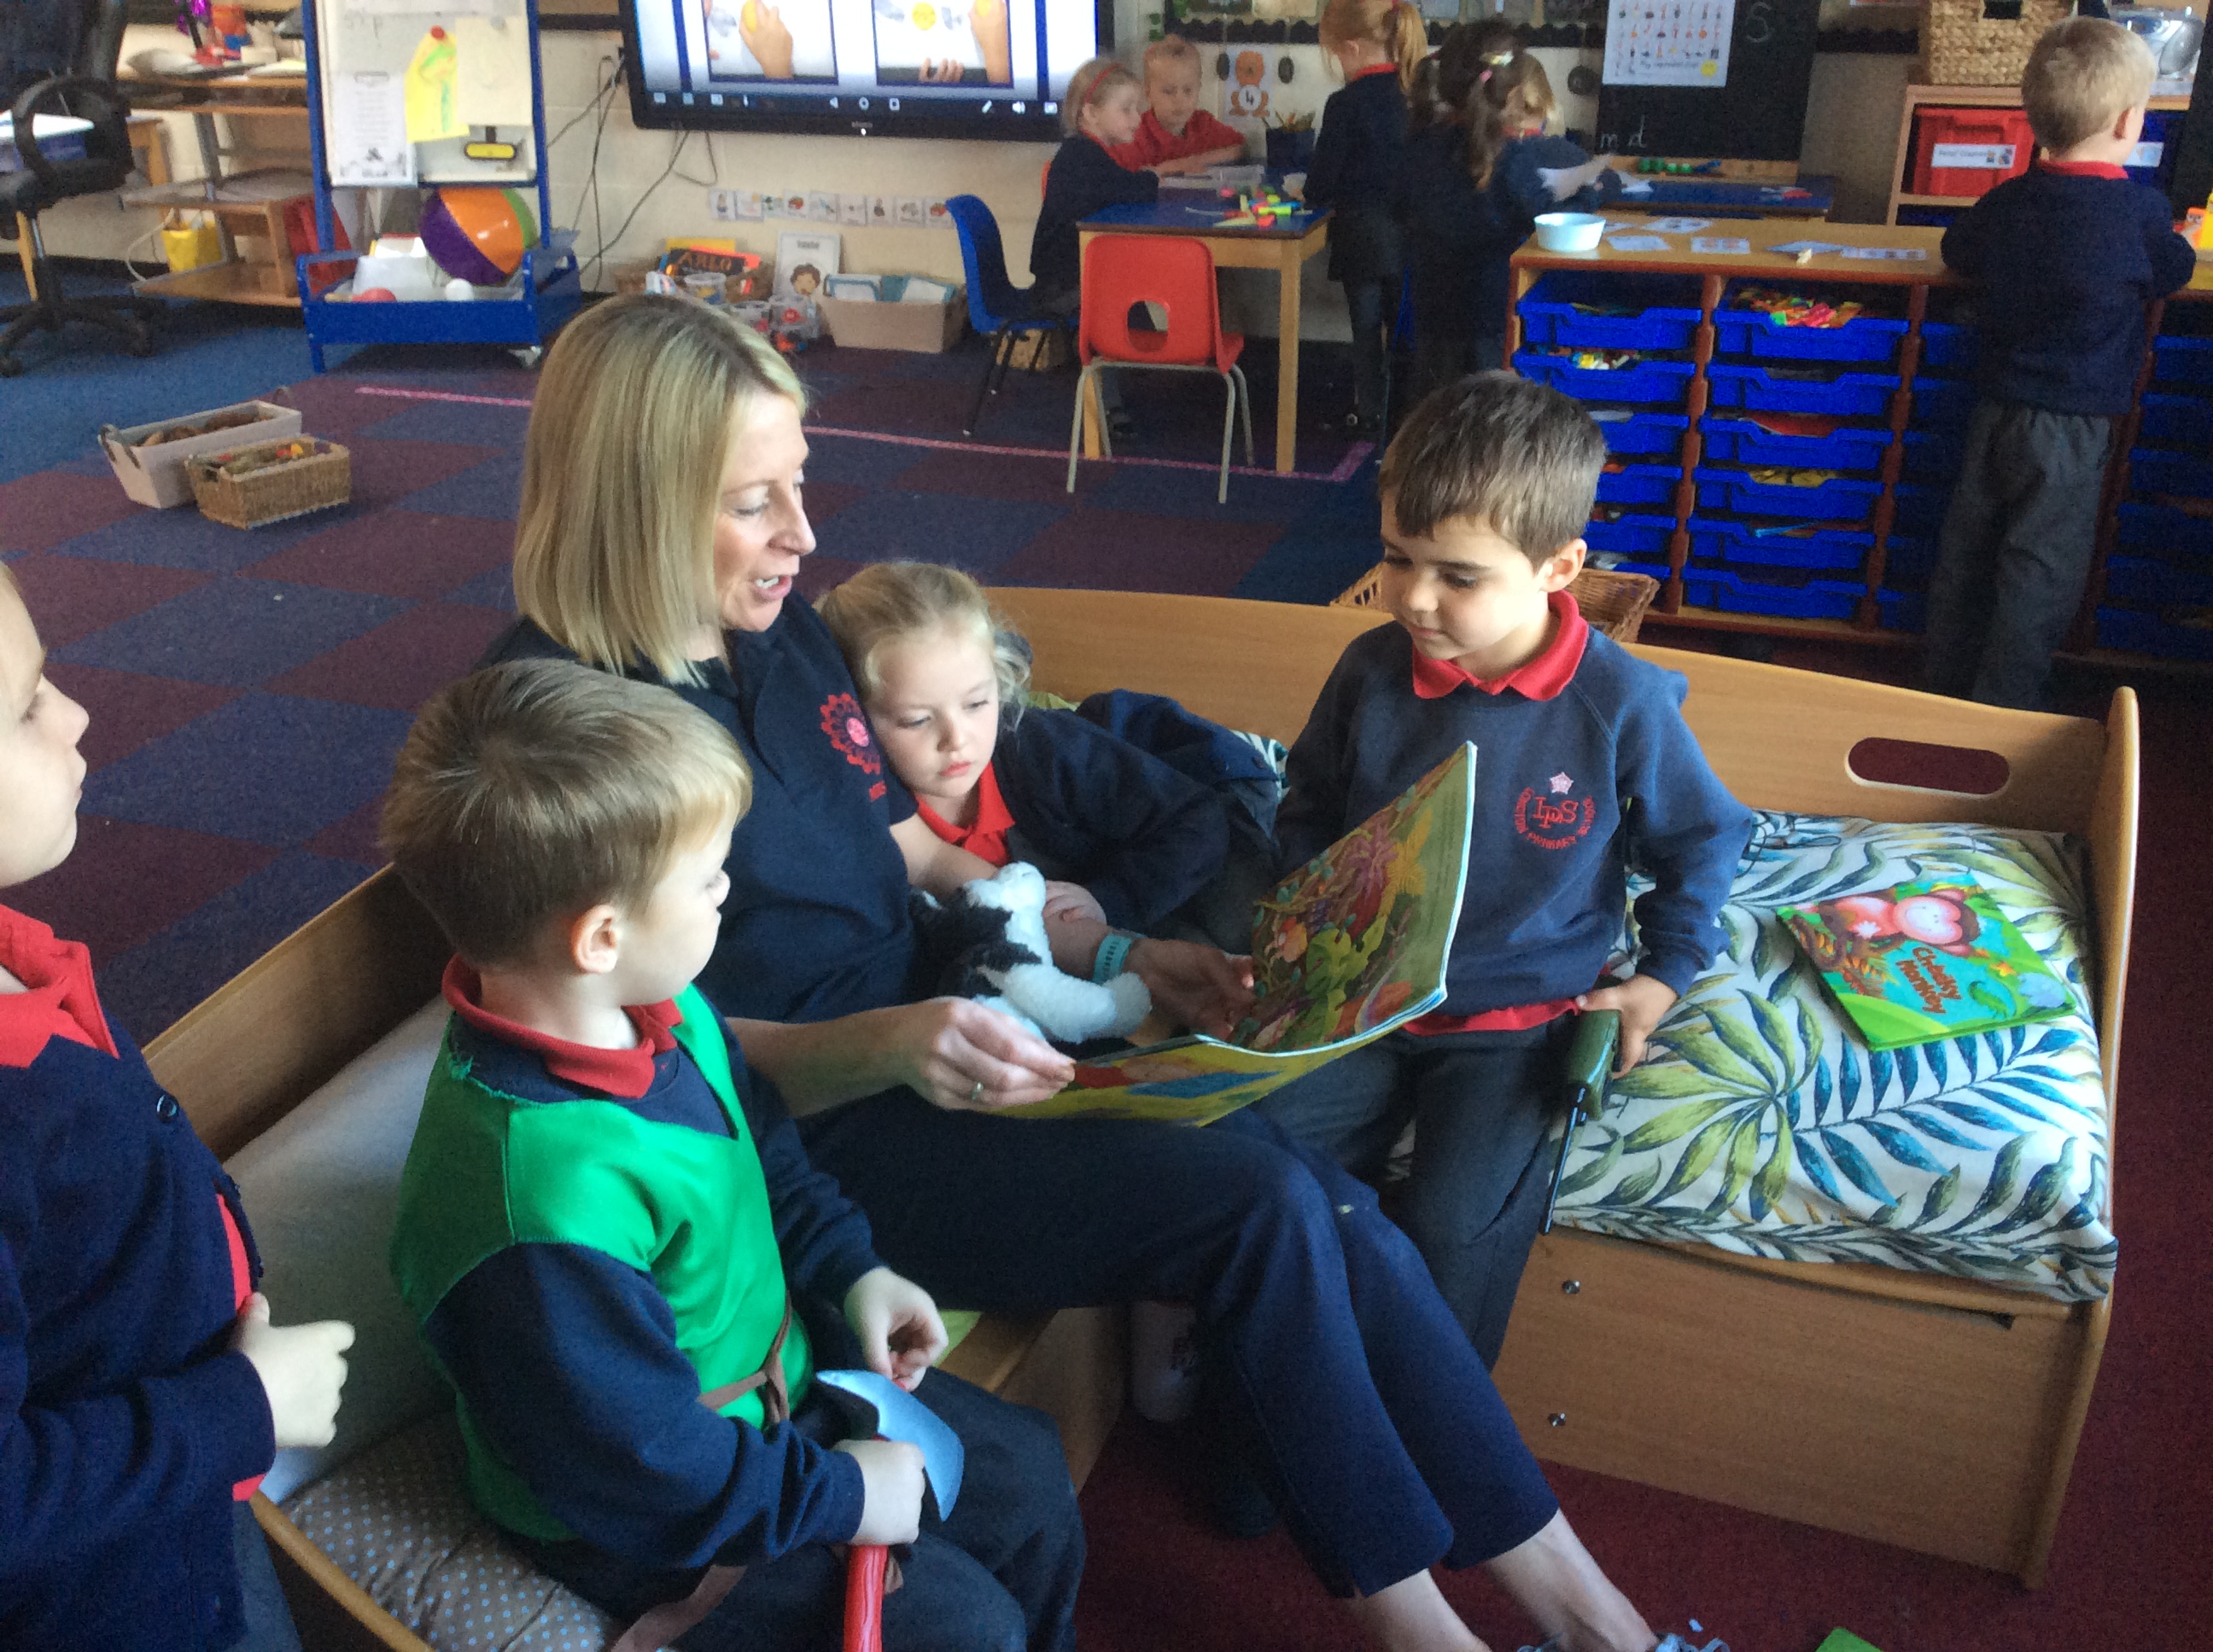
Reading and Phonics
In school we have a range of reading opportunities. The lions read together as a class, read individually, read in games and activities and also in guided reading which will be introduced before Christmas - (small groups to develop word reading and comprehension skills)

Slide 3
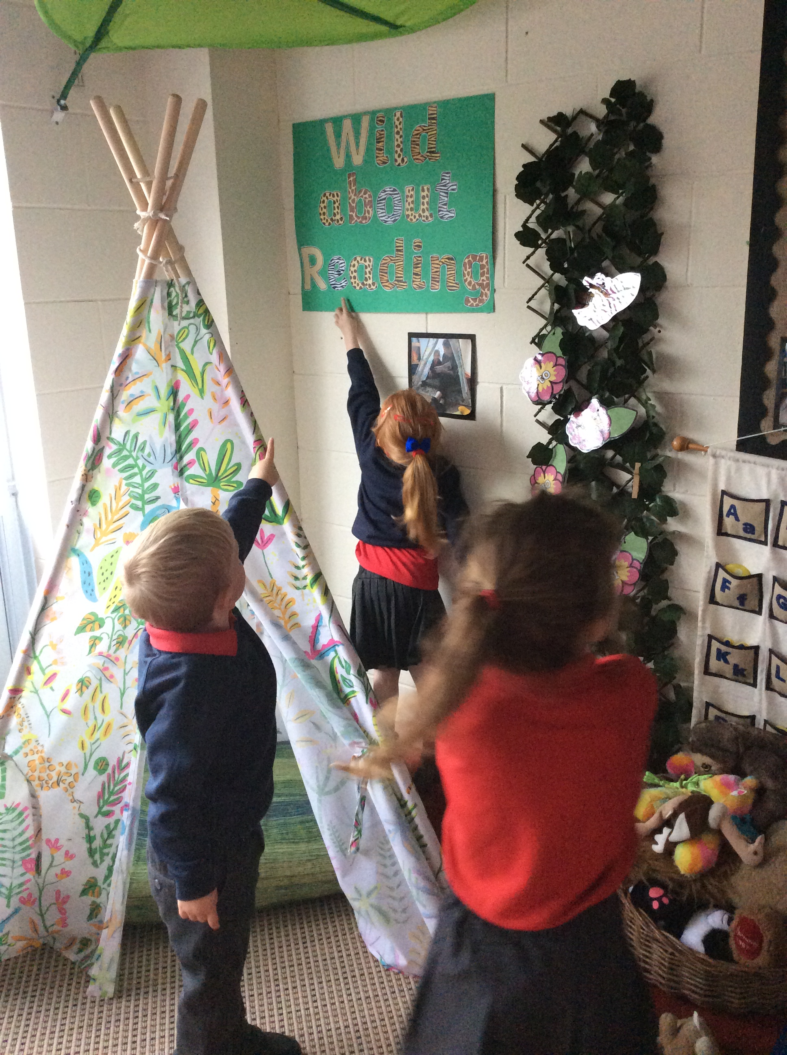
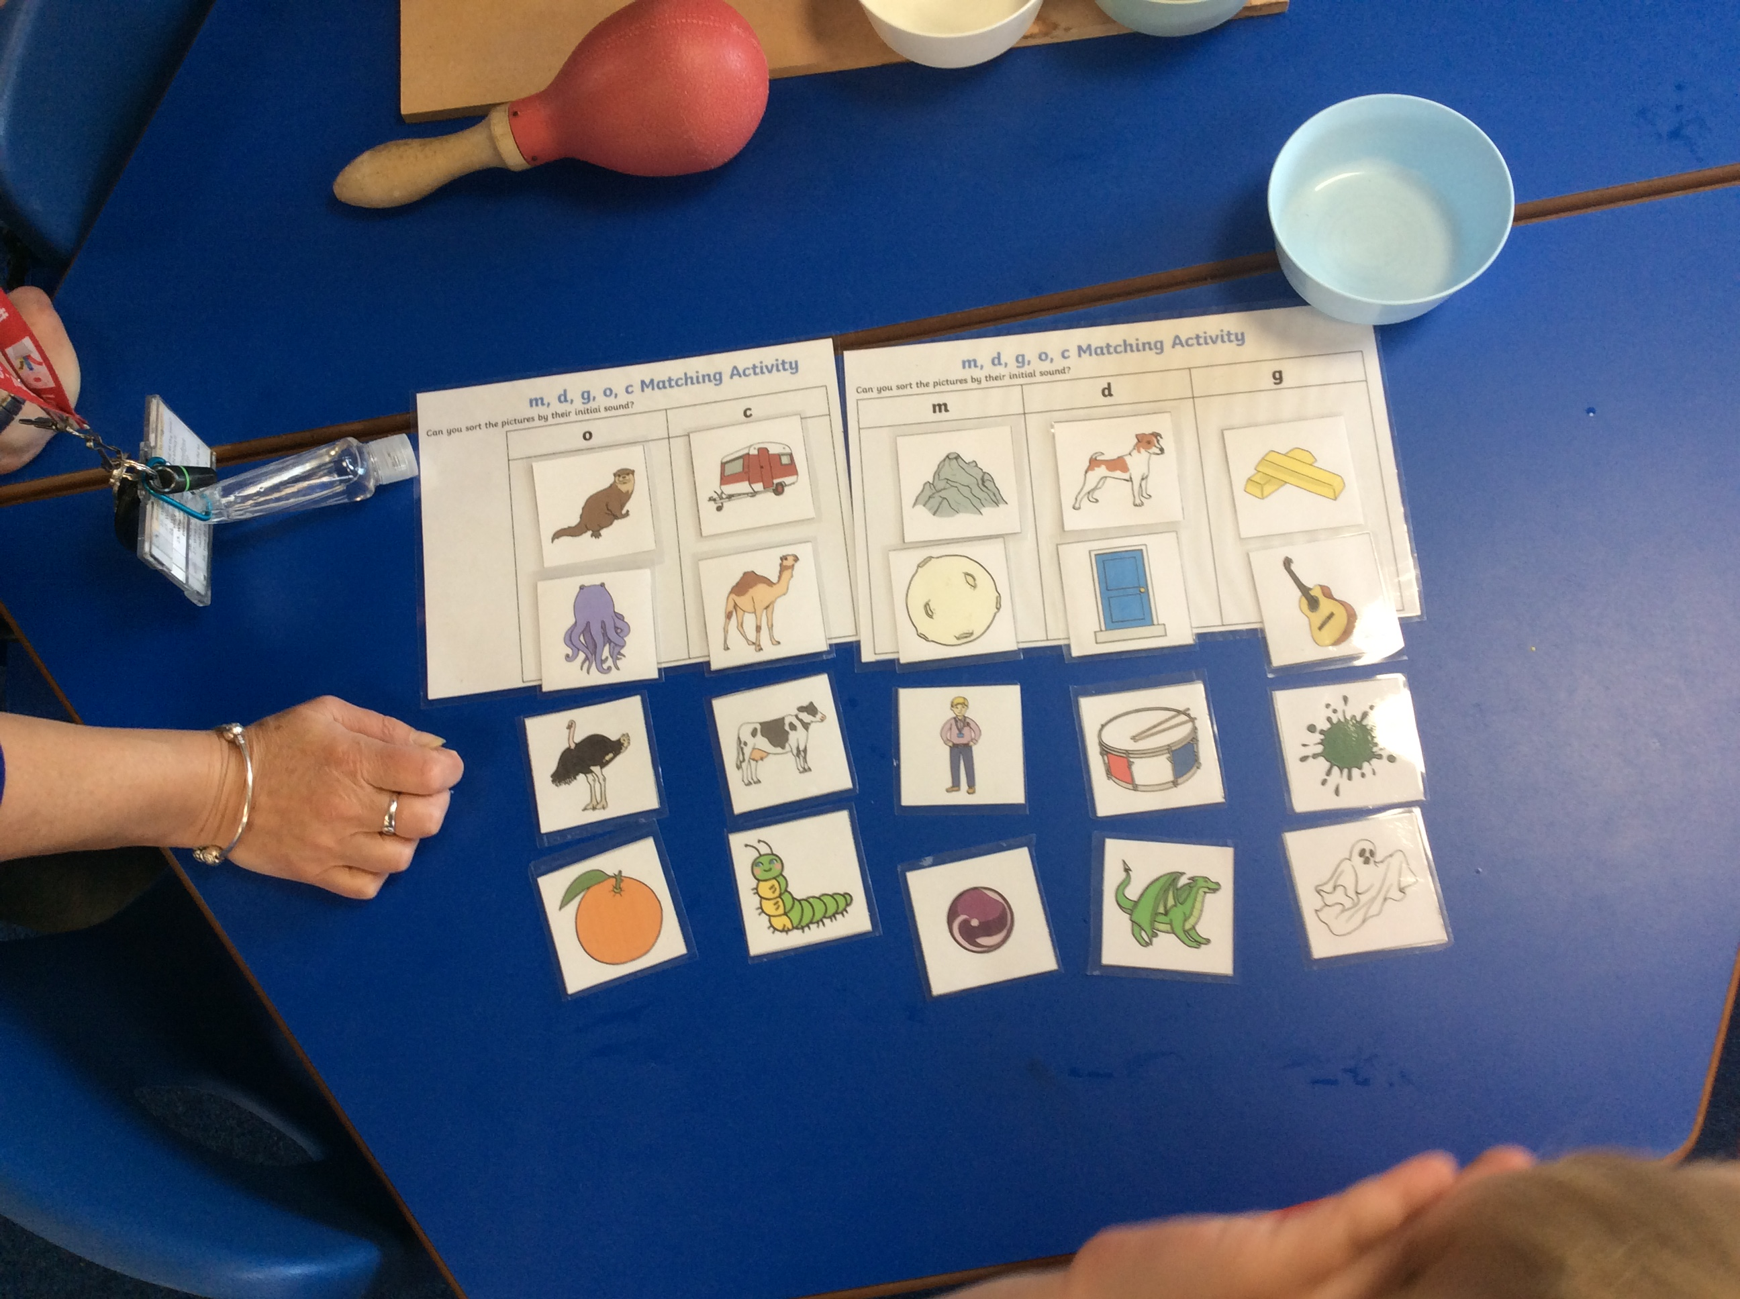
Phonics
Each day the children have a phonics session: letters and sounds are introduced, also the process of blending sounds, segmenting words and recognising tricky words.
(Please check book bags daily for new sounds and words added)

Slide 4
Phonics
Sounds – s-a-t-p-i-n-m-d-g-o-c-k-ck-e.
Tricky words – the – to – go – no – I.
High frequency words – a – as – at – is – it – in – an – am – dad – did – and – got – on – not – can – get – mum – up – put.

Slide 5

Phonics
Grapheme - Written letters or a group of letters which represent one single sound (phoneme) - a, l, sh, air, ck.
Phoneme - A single sound that can be made by one or more letters – s, k, z, oo, ph, igh.
Blending - Saying the individual sounds that make up a word and then blending the sounds together to say the word used when reading.

Slide 6
At home.
At home we ask for your support to help your child with their reading.
The most important thing to remember is that reading needs to be enjoyable! At this stage the love of stories and the use of their imagination is what we hope to ignite.
Make a reading space
Make it fun
Be seen reading
Practise phonemes on a daily basis

Slide 7
At home.
You can also help your child by exposing them to a range of different reading experiences. You might share a story, a poem, look at a comic or listen to a story through headphones.
Use the local library.

Slide 8
School Reading Books.
Your child may bring home a book without text. Picture books are very important, they provide an opportunity for you to talk with your child about the pictures and allow the child to make up their own words for the story after it has been revisited several times.
There will be a story card to accompany your book with a structured story for you to read as your child turns the pages.

Slide 9
School Reading Books.
Once your child is ready, they will be introduced to books with some simple text. These books will be linked to support their phonic knowledge and the sounds they are learning. They will include some ‘tricky words’ – words that cannot be sounded out.
Read daily and write a short comment in the reading record book.

Slide 10
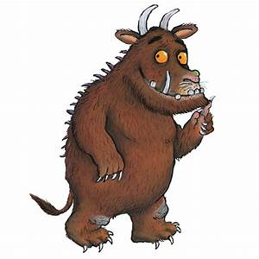
Things to talk about
Discuss characters – favourite / least favourite!
Talk about the setting.
Encourage children to join in with repeated phrases
Model good listening
Encourage children to make predictions
Talk about the beginning / middle / end.

Slide 11
Important Information
Books will be changed on a Tuesday , but please send them in the book bag each day along with the reading record book.
https://literacytrust.org.uk/information/what-is-literacy/what-phonics/

Slide 12
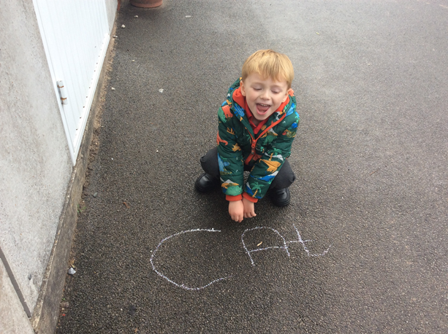
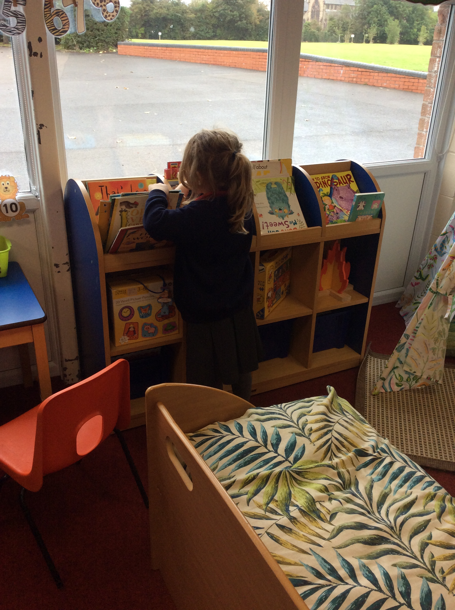
Questions
Timing
How much?
Can we share the reading?
What if my child has already read the book from school before?

Slide 13
And finally …
At the back of the reading record book are passwords for ‘Reading Eggs’ and ‘Mathletics’. These are two online platforms that we encourage you to use at home. Homework tasks may also be set on these.
Homework will be sent out on a Thursday and posted using google classrooms. Please send this back either electronically through google classroom or as a paper copy in your child's book bag on the following Tuesday.

