Slide 1


Welcome to Year 5

Slide 2

Contents
Adults your children will be working with
Curriculum for this half term
Trips this year
Things to do at home
Questions

Slide 3
Adults
Miss Reynolds
Mrs Grey
Miss Dawson
Mrs Bolton

Slide 4
Curriculum
Highly topic led
Independent learning promoted
Gaining responsibility
WW1 year theme
Wonder word of the year

Slide 5

Trips this year
WW1 themed – Museum of Lancs & Infantry Barracks 12/9/18
Tarleton Academy Christmas show – 5/12/18
Hothersall Lodge Residential – 13/3/19 – 15/3/19 (Info evening held in Jan)
Brickcroft Spring Grammar walk TBC
Summer trip TBC – production related (Lights, Camera, Action)

Slide 6
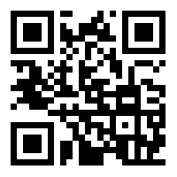
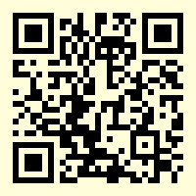
Things to do at home
Spelling frame
Reading – take turns, question everything, make predictions
Spelling – www.spellingframe.co.uk
Times tables – www.topmarks.co.uk/maths-games/hit-the-button
Homework – learning to be more independent (Given on Thursday, to be in by Tuesday)
Hit the button

Slide 7
Bits and bobs & Questions
P.E – Tuesday morning and Friday afternoon
Reading books changed on a Thursday afternoon
Classdojos
Class blog

