Slide 1
Fractions in Year 4

Slide 2
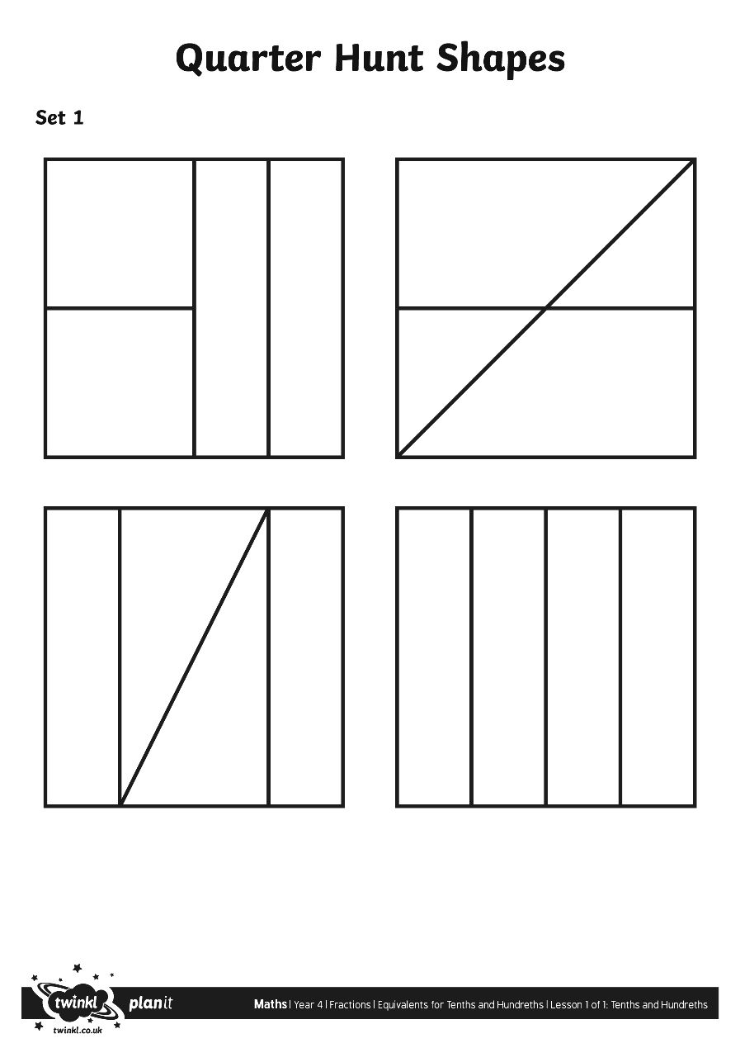
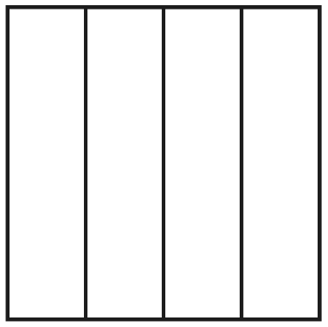
Quarter Hunt
Which of these images represents a quarter?
Is a quarter because the whole square is split into 4 equal sized pieces. It is split in half and each half is split in half again.
Is a quarter because the whole square is split into 4 equal sized pieces. The 2 rectangles together make half and the remaining half is split in half again.
Is not a quarter because the 4 pieces are not equal sizes.
Is a quarter because the whole square is split into 4 equal sized pieces.

Slide 3
Square Exercise
This shows the children in a physical way about equivalent fractions
Counter Exercise

Slide 4
Counter Exercise
Get 3 counters 2 the same colour 1 different
How many are counters altogether, what fractions are of each colour?
Repeat the pattern underneath and do the same

Slide 5
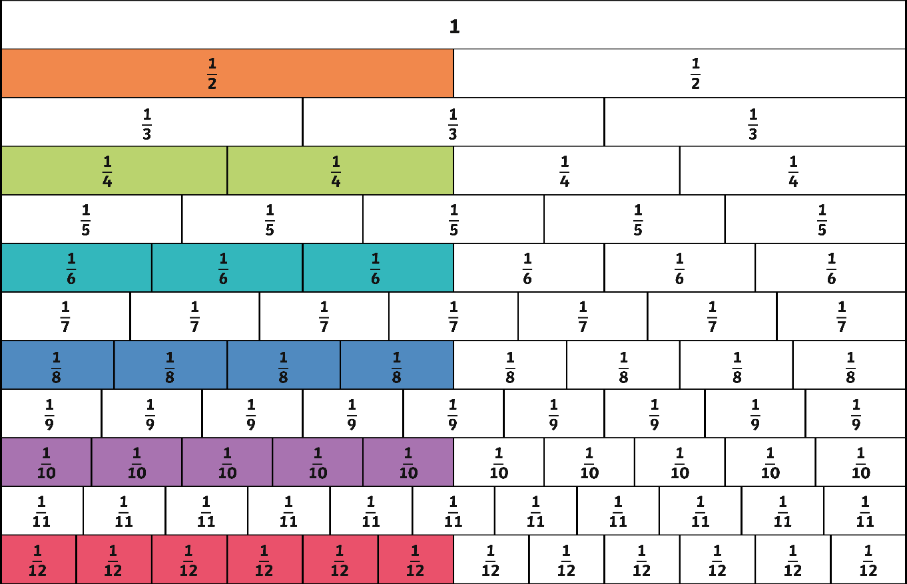
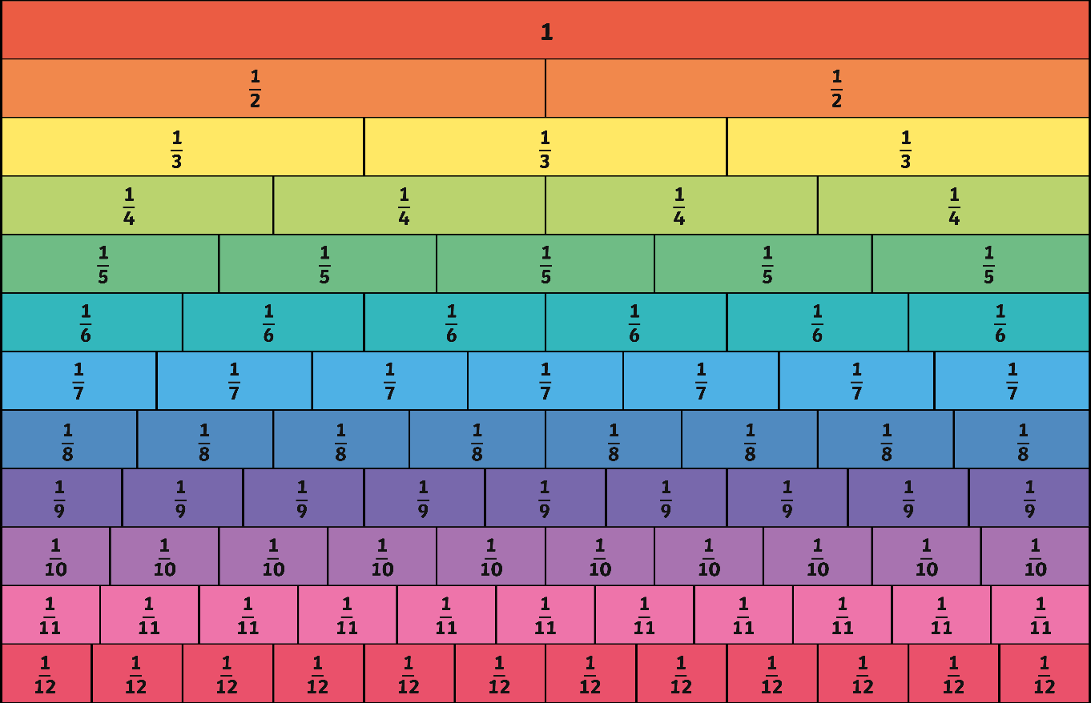
Equivalent Fractions
Which other fractions are the same size as one half?
Equivalent fractions are equal to the same size or amount of the whole.
All of the selected fractions are equivalent to ½ so
1
=
2
=
3
=
2
4
6
4
=
5
=
6
8
10
12

Slide 6
Equivalent fraction activity
Find the pairs
Memory game
Snap

Slide 7
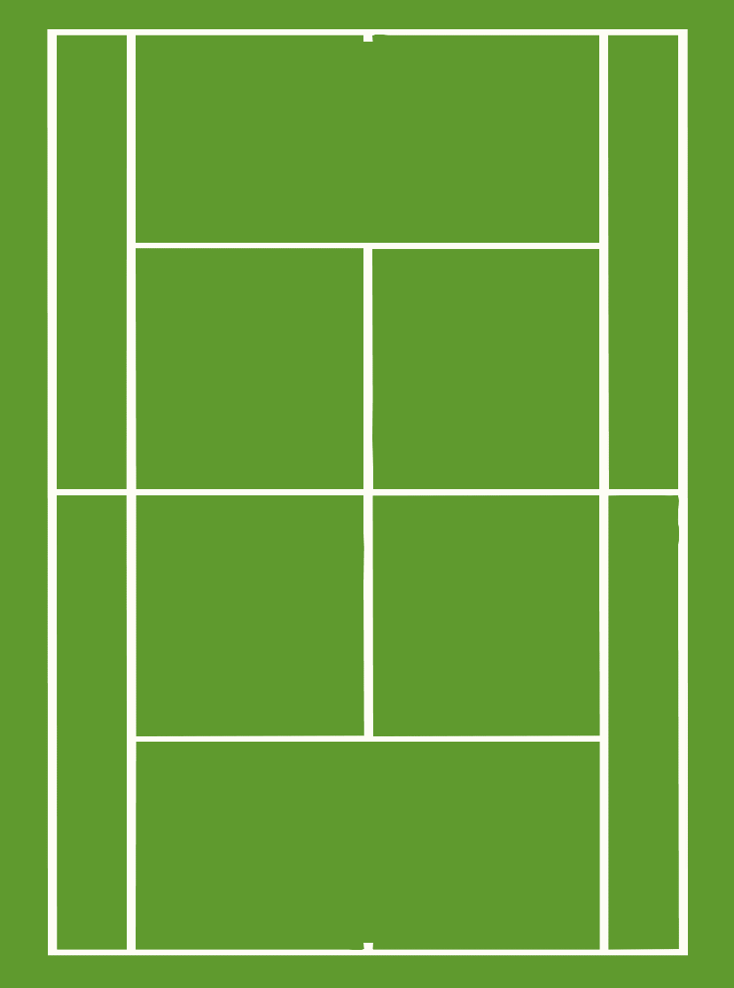
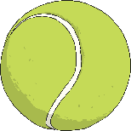

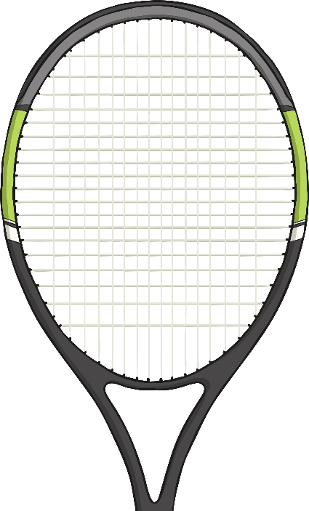
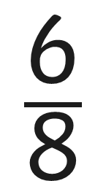

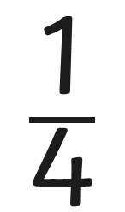

Equivalents Tennis
To warm up for the match, you have one minute to find as many fractions as you can that are equivalent to
Start

Slide 8
Adding and Subtracting Fractions

Slide 9











Fraction Bars
Draw a fraction bar to represent .
Add so that your fraction bar shows + .
so + = .
Draw fraction bars to solve each of these calculations:
or 1
What do you notice about the numerators and denominators when you add the fractions?

Slide 10






Beyond the Whole
Solve these calculations:

Slide 11
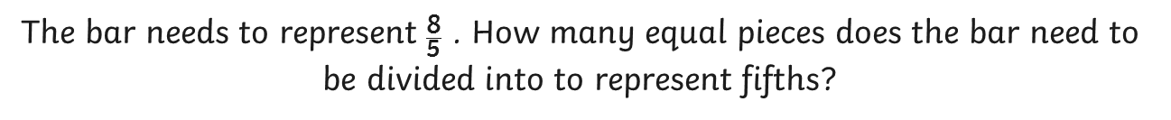
Fraction Bars
If we don’t have enough fifths to be able to colour in 8 of them, what do we need to do?
How many more fifths do we need to colour in?

Slide 12


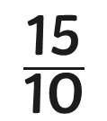
Fraction Bars
Draw fraction bars to represent:

Slide 13

Subtracting Fractions
How many of the equal pieces need to be coloured in?
How many of the pieces need to be taken away?
How many eighths are left?

Slide 14






Subtracting Fractions
Draw fraction bars to subtract:
What do you notice about the numerator and denominator in each subtraction?

