Slide 1


Slide 2
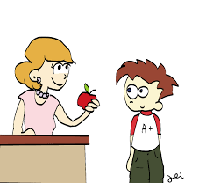


Who will be teaching your children?
Mrs Woolley
Mrs Fletcher
Mr Pearson

Slide 3



Tuesday
Earrings must be taken out for PE or plasters provided from home if ears are newly pierced
Friday
After school starting next week 30th September
Wednesday
Thursday

Slide 4

Homework will come home on Wednesdays and it must be handed in the following Tuesday.
Please encourage your children to do their homework as independently as possible. It will always be linked to something we have been doing in class.
If there are any problems just write a note in the book and I will get back to you.

Slide 5

Reading is very important and we appreciate the time and effort you as parents put in to supporting this at home.
Reading the words fluently and with expression is important but it is also important to ask your child questions about what they have read. Also ask them why they think certain things have happened in the story and to give opinions about what they have read.
Please try to do some reading at least four times during the week and make comments in the blue reading records.

Slide 6

The school day is long and very full. Your children work hard from the minute they come into the classroom until the minute they leave.

Slide 7

We apologise if you have grumpy children at bedtime .

Slide 8

We have very high expectations of the children in terms of their behaviour and learning.

Slide 9


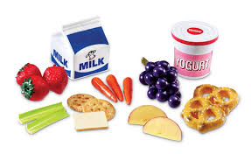
What can we bring to school?

Slide 10
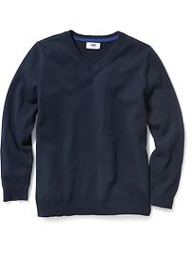
Uniform
Please can all uniform be named. With over 200 children in school it is impossible to reunite nameless sweatshirts and cardigans with their owners.

Slide 11

SAT’s
These tests will take place in May 2017.
There will be a meeting nearer the time to go through the format.

Slide 12

Our aim is to have happy children

