Slide 1
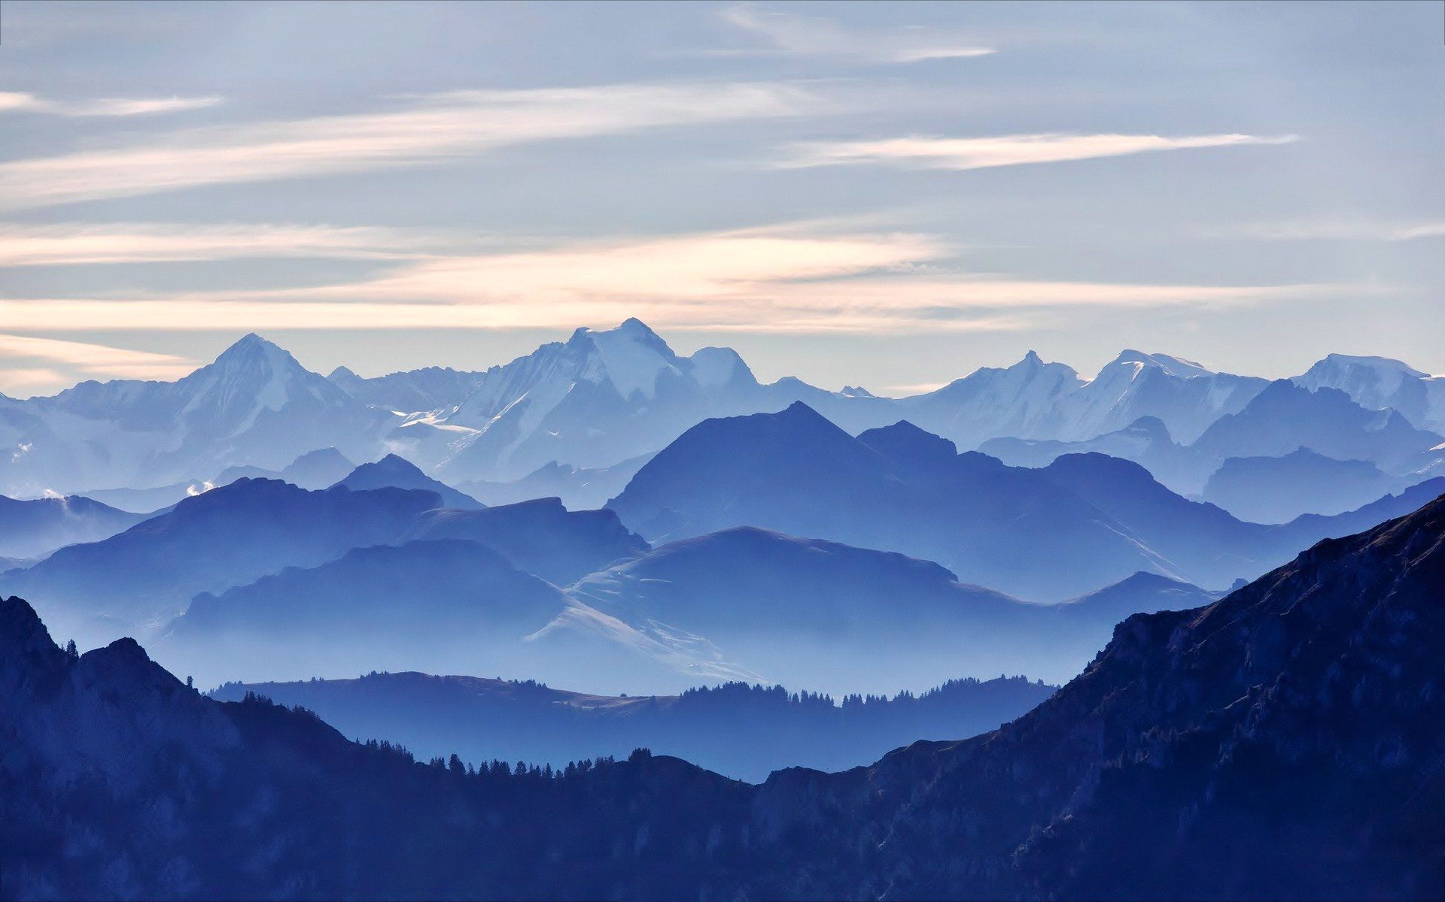
Mountain Project
Name of mountain range | e.g. The Alps, The Andes
Location of mountain range | Continent and countries they are in
Key features | Length and width of mountain range, and what is the highest peak?
How they were formed | Are they fold mountains or fault block mountains?
Labelled diagram of the mountains range, with key features of one mountain | Lesson three will support you with this.
Climate | What’s the weather like within the mountain range? Could you make a short weather forecast as if you were on the mountain?
Getting prepared | Decide what you would include in your survival bag for a trek up the Himalayan Mountain Range. You may only take 10 items for you to carry personally. What will you need? Explain your choices and why you feel they will help you to survive
Be an explorer! | Write a diary entry as if you were a mountain explorer. What amazing things would you see and discover?
Get creative | Make a stop motion animation of an expedition up across the mountain range. Create a collage of the mountain range Make a 3D model of the mountain range Create a short drama piece about trekking across the mountain range, and ask someone to film it
This term, both at home and at school, we have been learning about mountains. Your geography activity for the last few weeks of term is to create a project on a mountain range of your choice.
You can choose to present your final project in any way you wish. For example, you may choose to do a labelled illustration, a model, an information sheet or a narrate PowerPoint (like the ones the teachers have been making). Remember, even if you are coming into school, you still cannot take anything additional into school, but you can still email photos and other files. We’d love to see what you produce!
Use the following guide, and the lessons on the website, to support your project planning.

