Slide 1


Learning the Springfield way!
L | To write a book review based on The Man Who Bought a Mountain To listen to and discuss a range of fiction which I might not choose to read myself To explore themes within and across texts e.g. loss, friendship To recommend books to peers with reasons for my choices
T | Write a book review of The Man Who Bought a Mountain
S | I can review a book with reasons for choices I can explore themes within a text I can discuss fiction which I may not choose to read myself

Slide 2
Why would we write book reviews?
To share our opinion of books
To recommend a book that we liked
To encourage others to read

Slide 3
Look at some reviews on this website
What do you think?
Could you write your own book review?
What features do you like best?
https://www.spaghettibookclub.org/

Slide 4
Book Review
Your task is to write a book review about The Man Who Bought A Mountain. To plan this, you could think about:
The title and author
The type of story it is
The setting and main characters
The main plot (or storyline)
The key message the story portrays
How you feel about the story
Your star rating – how many stars out of 5?

Slide 5
Check you have included…
The title and author
The type of story it is
The setting and main characters
The main storyline (don’t give away the ending!)
The key message the story portrays
How you feel about the story
Rating out of 5 stars
Here is a checklist to use to help you include all the features.

Slide 6
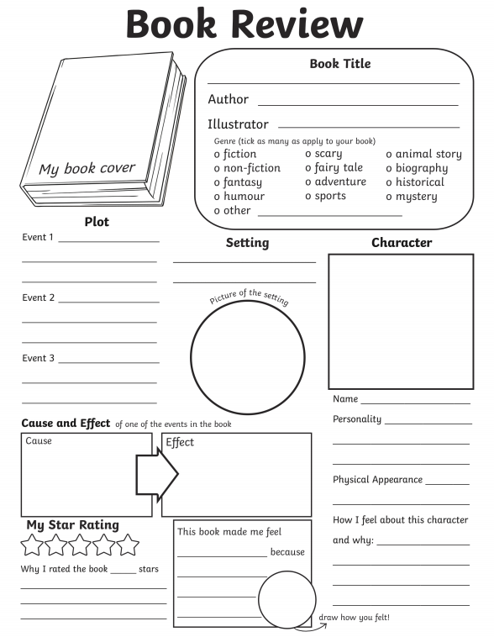
Here is an example of the layout of a Book Review which you may want to use.
Alternatively, take the examples from Spaghetti Book Club and use these formats instead.

Slide 7
Learning the Springfield way!
L | To write a book review based on The Man Who Bought a Mountain To listen to and discuss a range of fiction which I might not choose to read myself To explore themes within and across texts e.g. loss, friendship To recommend books to peers with reasons for my choices
T | Write a book review of The Man Who Bought a Mountain
S | I can review a book with reasons for choices I can explore themes within a text I can discuss fiction which I may not choose to read myself

