Slide 1
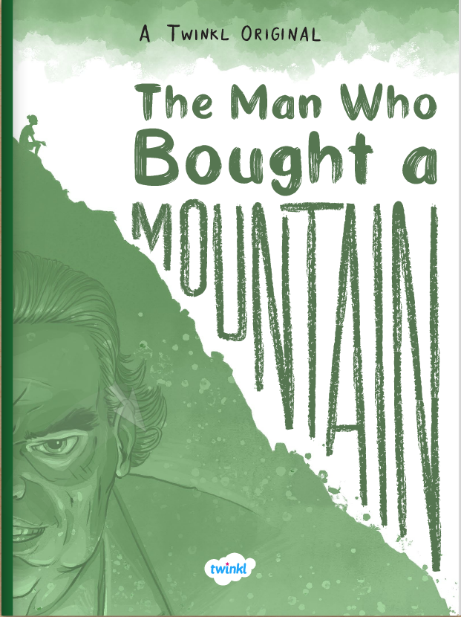

The Man Who Bought a Mountain
PDF

Slide 2

Learning the Springfield way!
L | To understand what you read by: Checking that what you are reading makes sense to you Inferring character thoughts Understanding author techniques Making predictions
T | Read chapter 6 – check predictions Mixed skills The Big Question
S | I understand what I have read in the sixth and final chapter of the story I can relate, retrieve and explore I can compare relationships throughout the story

Slide 3
Read chapter 6
Think about these questions while you read.
1. What consequences have occurred as a result of the landslide?
2. Do you think Yash’s reaction towards Goldlaw is fair?
3. What does Goldlaw say and do in response?

Slide 4
What consequences have occurred as a result of the landslide?
Buildings broken
Villagers had fled and sought refuge
Debris scattered through fields
Driver of a truck injured
Rock and mud all over the village
Crane fallen into a farmer’s house
Dust
Children crying
2. Do you think Yash’s reaction towards Goldlaw is fair?
This is a matter of opinion! My opinion is YES, because Goldlaw is ruining his home!
3. What does Goldlaw say and do in response?
Goldlaw admits he was wrong and does not continue to destroy the mountain.
Check your predictions. Were they correct? How are they different?

Slide 5
Mixed Skills
How can you tell that Goldlaw was not used to apologising? Retrieve
What do you think is meant by the phrase ‘the mountains will move you’? Relate/Explore
Which other significant phrase from the sage is repeated in this final section? Retrieve
4. Do you think that this story has a hero? If so, who? Explain your answer using the text to help you.

Slide 6
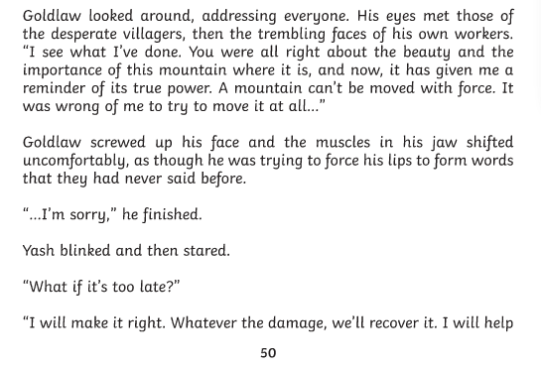
1. How can you tell that Goldlaw was not used to apologising? Retrieve
‘Goldlaw screwed up his face and the muscles in his jaw shifted uncomfortably, as though he was trying to force his lips to form words that they had never said before.’

Slide 7
2. What do you think is meant by the phrase ‘the mountains will move you’? Relate/Explore
Have you ever heard someone say, ‘I feel so moved!’ It means they have been touched emotionally by something.
This phrase means that mountains will move you in terms of emotion – you will grow to love them even if you don’t believe they are much use to begin with, as we see through the eyes of Mr Goldlaw.
The sage is wise and knows that mountains cannot be moved, but waits for Yash to find this out for himself.

Slide 8
3. Which other significant phrase from the sage is repeated in this final section? Retrieve
One pebble at a time

Slide 9
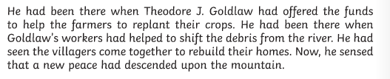
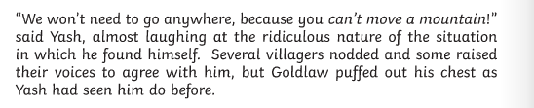

4. Do you think that this story has a hero? If so, who?
Explain your answer using the text to help you.
This, is also a matter of opinion!
I think Yash is the hero:
He is there throughout every important event in the story
He speaks truthfully and tries all he can to convince the villagers and Mr Goldlaw not to go ahead with the plans.
He never loses his kind nature, even when he is frustrated and upset. His reactions are described so carefully to make us feel empathy towards him.

Slide 10
The Big Question
How has Yash and Goldlaw’s relationship changed? Compare the relationship throughout the story, using evidence to support your answer.

Slide 11
Learning the Springfield way!
L | To understand what you read by: Checking that what you are reading makes sense to you Inferring character thoughts Understanding author techniques Making predictions
T | Read chapter 6 – check predictions Mixed skills The Big Question
S | I understand what I have read in the sixth and final chapter of the story I can relate, retrieve and explore I can explore relationships between characters

