Slide 1
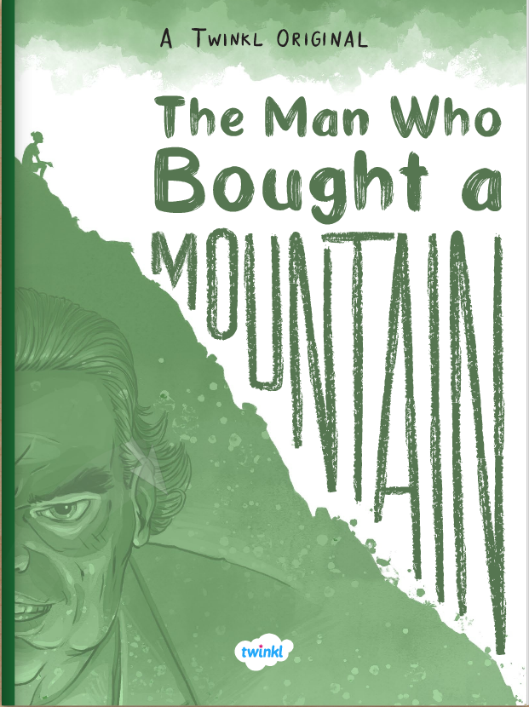

The Man Who Bought a Mountain
PDF

Slide 2

Learning the Springfield way!
L | To understand what you read by: Checking that what you are reading makes sense to you Inferring character thoughts Understanding author techniques Making predictions
T | Read chapter 5 of our story The Man Who Bought a Mountain Write down any words you are unsure of – use a dictionary to learn their meanings Mixed skills Prediction for chapter 6
S | I understand what I have read in the fifth chapter of the story I can infer, retrieve, define and explore I can make predictions

Slide 3
Read chapter 5

Slide 4
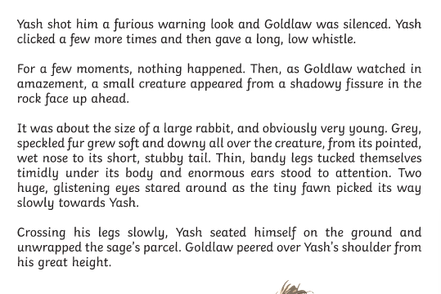
Are there any words you are unsure of?
fissure

Slide 5
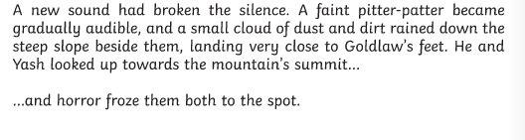
Mixed Skills
a) Why does Yash shake his head at Mr Goldlaw?
b) What does this tell us about how Yash feels about Mr Goldlaw’s comment? Infer/Retrieve
2. ‘He stepped lithely away.’ In this phrase, the word lithely is closest in meaning to
Gracefully
Awkwardly
Heavily Define
3. Here, the author has used ellipses. Ellipses are used for three purposes in writing.
a) What are the three purposes?
b) Which one is used at this part in the story? Explore

Slide 6
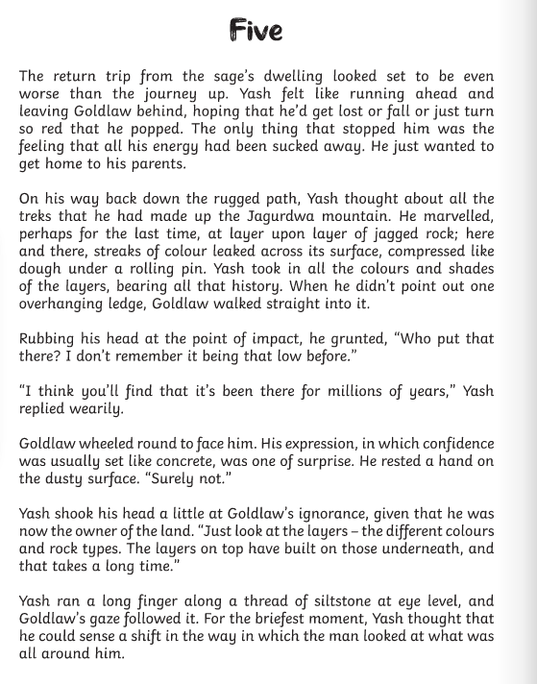
a) Why does Yash shake his head at Mr Goldlaw? b) What does this tell us about how Yash feels about Mr Goldlaw’s comment?
Yash shakes his head because Goldlaw is ignorant to the parts of the mountain that Yash cherishes.
Yash feels frustrated about this because he feels the mountain is very sacred but Goldlaw does not see it in the same light, and has not paid attention to its beauty and detail.

Slide 7
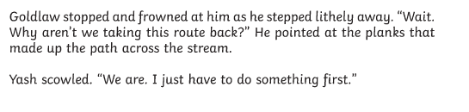
2. ‘He stepped lithely away.’ In this phrase, the word lithely is closest in meaning to
Gracefully
Awkwardly
Heavily
Gracefully

Slide 8
3. Here, the author has used ellipses. Ellipses are used for three purposes in writing. a) What are the three purposes? b) Which one is used at this part in the story?
a) To create suspense
To signal a passing of time
To demonstrate a natural pause in a speaker’s dialogue
b) To create suspense

Slide 9
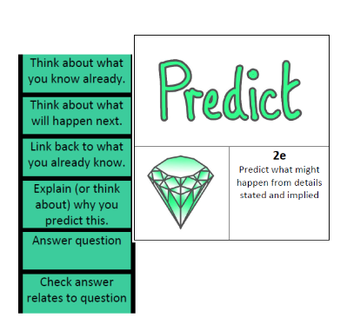
Challenge: Make a prediction!
See if you can make some predictions for chapter 6.
Who has just said, ‘Come along, Yashaswin?’
How much of the mountain do you think has been destroyed?
Do you think Goldlaw might change his mind?
Jot these predictions down, and we can come back to them later!

Slide 10
Learning the Springfield way!
L | To understand what you read by: Checking that what you are reading makes sense to you Inferring character thoughts Understanding author techniques Making predictions
T | Read chapter 5 of our story The Man Who Bought a Mountain Write down any words you are unsure of – use a dictionary to learn their meanings Mixed skills Prediction for chapter 6
S | I understand what I have read in the fifth chapter of the story I can infer, retrieve, define and explore I can make predictions

