Slide 1
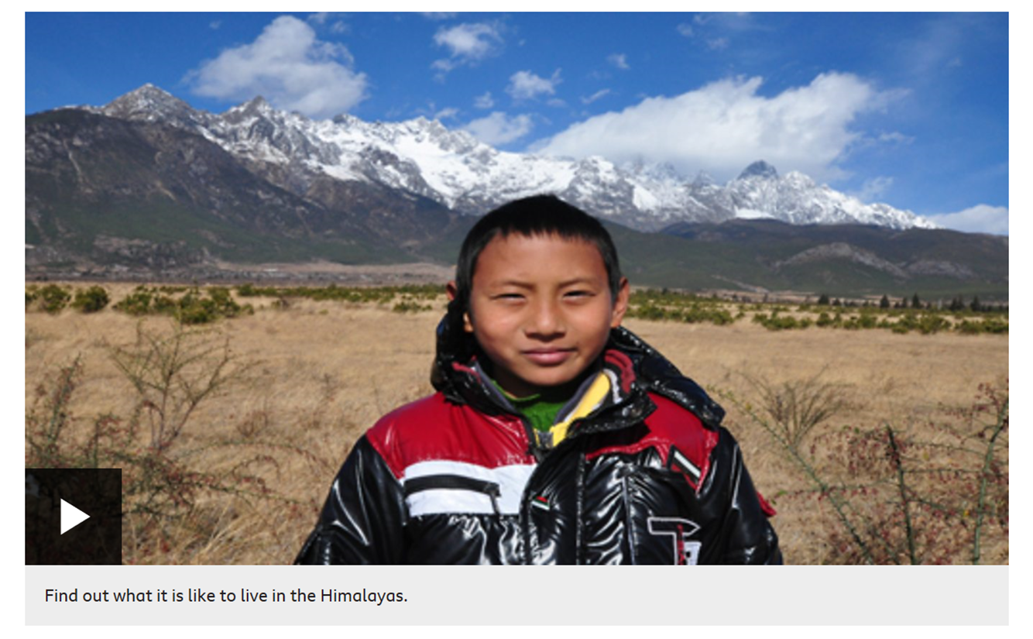

What might it be like to live on a mountain? - Challenge
Imagine you lived near a mountain like Wang Yuxi. How different would your life be?
Write a reflective piece on what life could be like living near – or on - a mountain.
You can be as creative as you want in your presentation. Let’s discuss some ideas.

