Slide 1
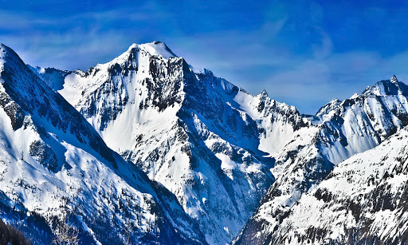

Year 5 Mountains
Session 2 – How Mountains are formed

Slide 2
Learning the Springfield way!
Lo | To describe the key features of mountains and how they are formed.
T | Recap on mountain ranges Layers of the Earth Types of mountains Quick Quiz!
S | I can describe the layers of the Earth I can describe how the four main types of mountains are formed I can describe the main features of a mountain

Slide 3
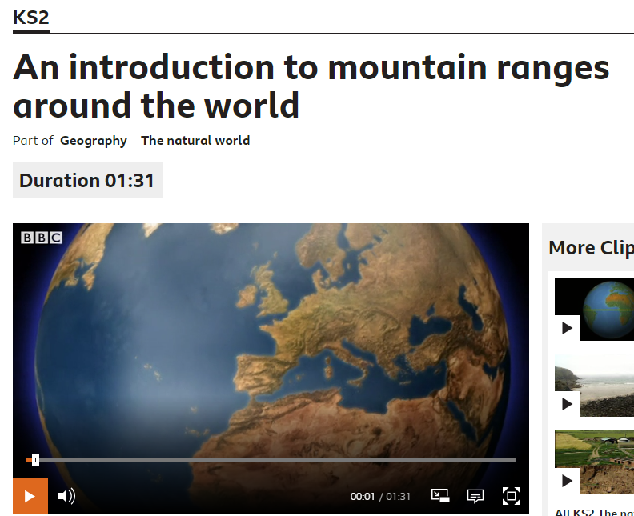
Recap on Mountain Ranges
Watch this clip to recap on mountain ranges across the world.
Listen out for the answers to these questions:
From which countries from North to South do the Rockies stretch?
What is the distance that the Andes stretch across South America?
What does the word Himalaya mean?

Slide 4
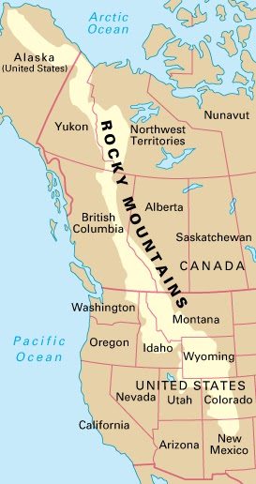
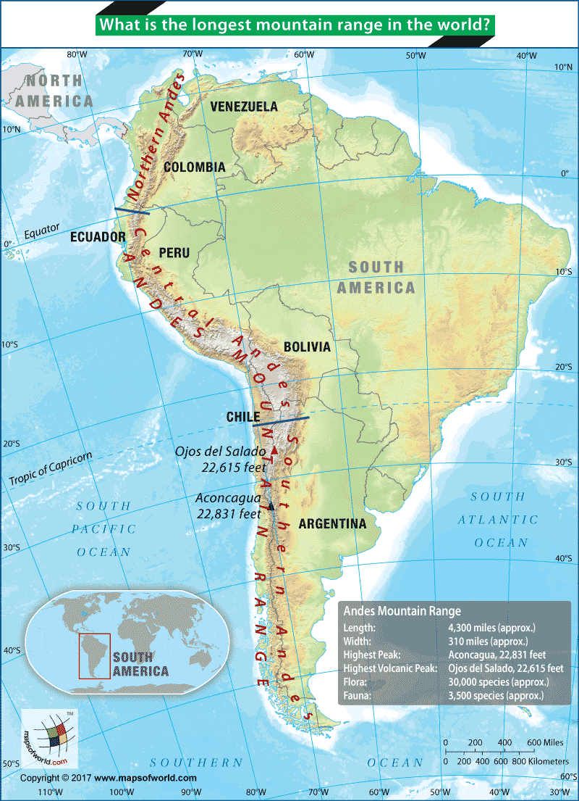
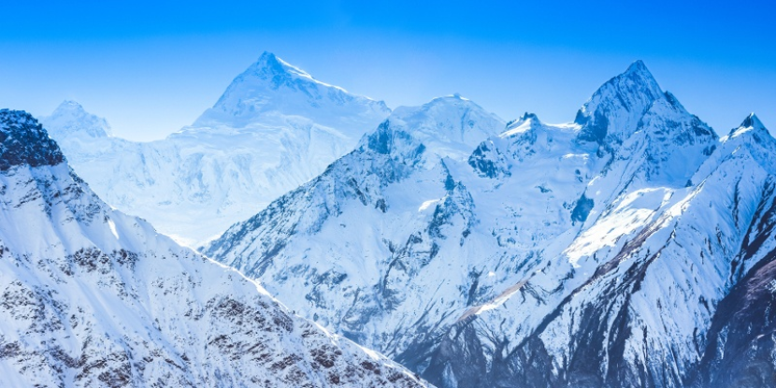
Recap on Mountain Ranges - Answers
1. The Rockies stretch from New Mexico in the South to Alaska in the North
2. The Andes stretch 6400km (from Argentina in the South to Venezuela in the North)
3. The word “Himalaya” means The Home of Snow

Slide 5

The Layers of the Earth
Before we can understand how mountains are formed, we need to understand the Earth’s structure
Thinking Time
Whilst watching, think about the following:
What is the top layer of the Earth called?
Can you name the other three layers?
Click to watch a video about the layers of the Earth

Slide 6
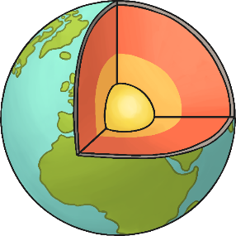
Can You Remember What’s
under Your Feet?
Can you join the words to the correct layers?
inner core
mantle
crust
outer core

Slide 7
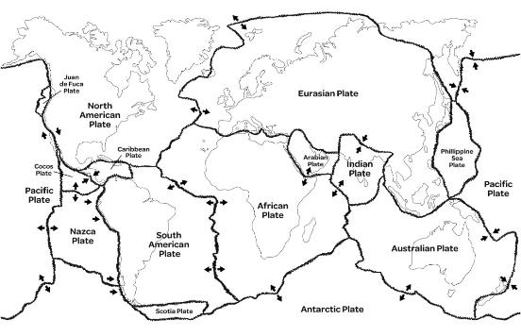
Mountain formation
The Earth’s crust is made out of giant slabs of rock (called plates), which float about on the mantle underneath.
They move as a result of currents of heat that rise and fall within the mantle.
The plates move very slowly, as if they were on a giant conveyor belt.

Slide 8
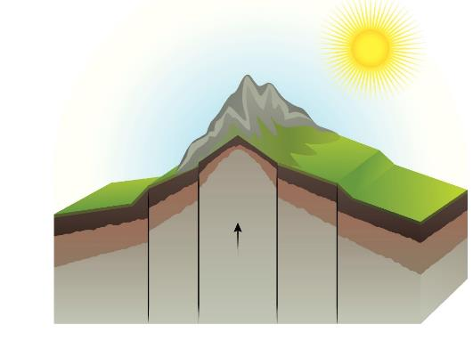
Mountain formation
Mountains are formed by slow but gigantic movements of the earths crust.
The crust is made up of 6 huge slabs called plates which fit together like a jigsaw puzzle.
Sometimes the crust smashes together, buckles or breaks into huge blocks.
Sometimes magna or erosion force mountains to form.
When two of these massive plates collide, land may be pushed upwards or folded. Ta-da! There’s your mountain.

Slide 9
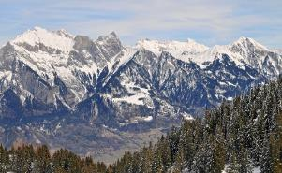
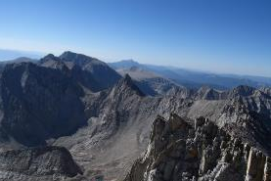
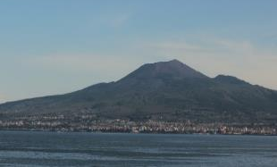
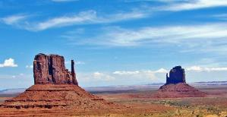
Different Types of Mountains
There are 4 main types of mountains:
fold mountains
fault-block mountains
volcanic mountains
dome mountains
Each one is formed differently.

Slide 10
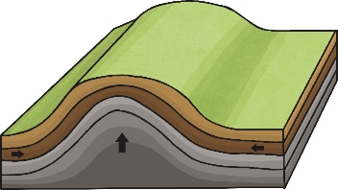

Fold Mountains
Fold mountains occur when tectonic plates collide.
The edges of the plates crumple as they are pushed together.
The rock of the Earth’s surface is pushed up to create mountains.
The Alps are fold mountains.
Photo courtesy of Tambako the (@flickr.com) - granted under creative commons licence – attribution

Slide 11
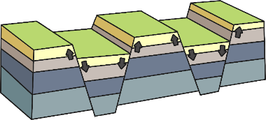

Fault-block Mountains
When cracks in the Earth’s surface open up, large chucks of rock can be pushed up while others are pushed down.
This creates mountains with a long slope on one side, and a sharp drop on the other.
The Sierra Nevada mountains
in California, USA are
fault-block mountains.
Photo courtesy Ken Lund (@flickr.com) - granted under creative commons licence – attribution

Slide 12
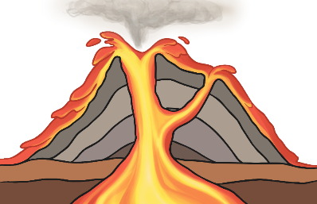
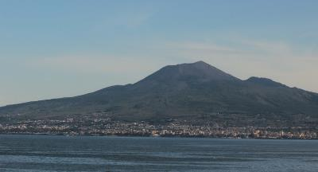
Volcanic Mountains
Volcanic mountains are formed around volcanoes.
Volcanic mountains are made of layers of ash and cooled lava.
Mount Vesuvius, Italy is a volcanic mountain.
Photo courtesy of DragonGhost19 (@flickr.com) - granted under creative commons licence – attribution

Slide 13
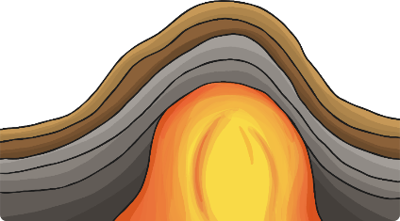
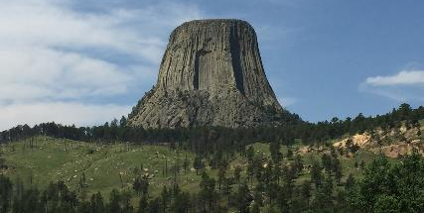
Dome Mountains
Dome mountains are smooth and round-looking.
They are formed when magma is forced up between the crust and the mantle, but doesn’t ever flow out.
The magma makes the land bubble up like a balloon.
Devils Tower, USA
is a dome mountain.
Photo courtesy of inkknife_2000 @flickr.com) - granted under creative commons licence – attribution

Slide 14


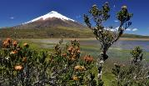
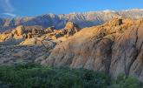
End of Lesson Quiz - types of mountains
Match the descriptions to the mountain types
When two plates collide, land (or even the sea bed) may be pushed upwards and folded.
Dome mountains
These peaks are formed by a series of eruptions, in which lava gushes out of the volcano’s crater. When this molten rock cools, it solidifies, adding another layer to the ground. Over time the volcano grows, with lava from numerous eruptions piling up.
Fold mountains
Parts of a fractured plate are forced to move up (while other parts are pushed down), as the whole plate travels forward. The land forced up is a new mountain range.
Volcanoes
A huge swelling of magma pushes up under the earth’s crust, but never erupts. The magma cools to form new rock, but may not be revealed as a mountain until millions of years later, after the weather, glaciers and rivers have worked on the rocks on top that are more easily broken down and carried away.
Fault-block mountains

Slide 15
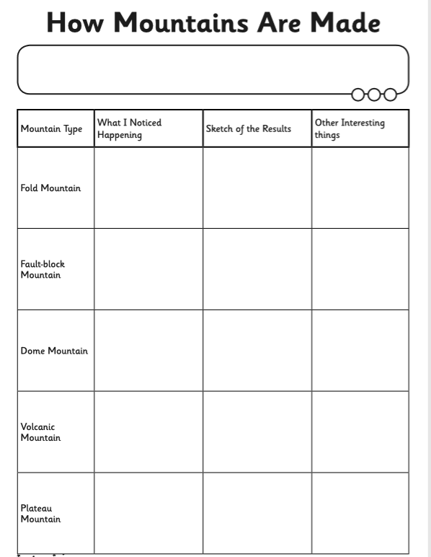
Mountain Type Activity
Using your knowledge of how mountains are made, complete the following table
You can check your answers by going back over the presentation

