Slide 1
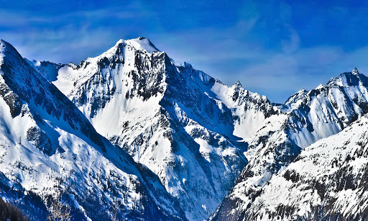

Year 5 Mountains
Session 2
Everest Challenge

Slide 2
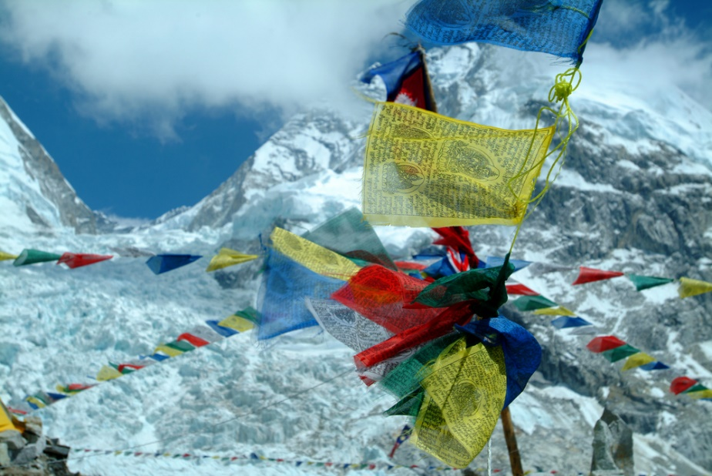
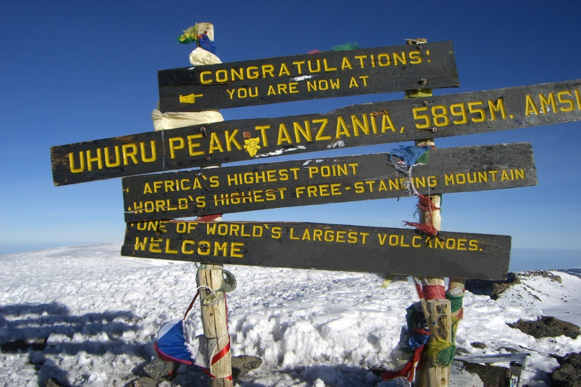
UP for a challenge?
The seven summits are the highest mountains in each of the seven continents.
For some intrepid and brave explorers, the ultimate challenge is to climb all seven peaks.
To date, approximately 275 climbers have been successful.

Slide 3
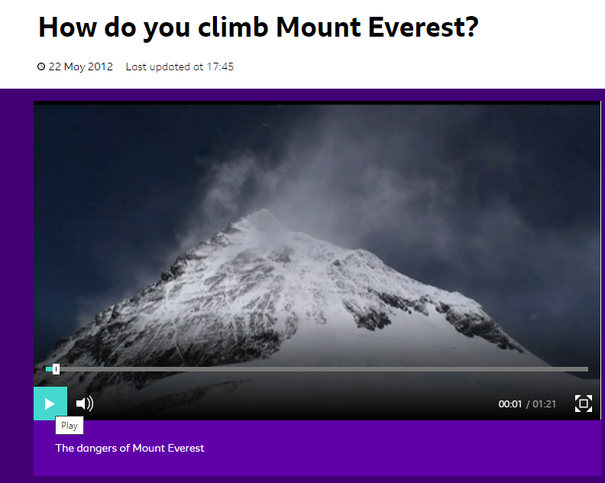
Click on this link to take you to a Newsround video about climbing Mount Everest

Slide 4
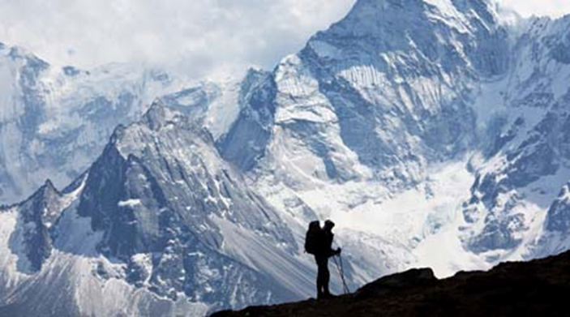
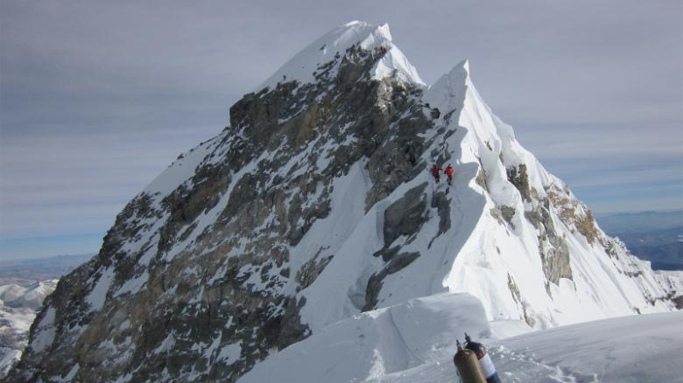
Your challenge
Although in current times, we can’t even get near any mountains it doesn’t mean that we can’t be intrepid explorers – of at least get ourselves into the mind set
TASK
Imagine you are a about to set off and climb Everest!

Slide 5
The intrepid explorer
Think about what you would need:
Think about the following questions:
• What kind of food would you take?
• What would you need to take with you to help you eat?
• What would your clothes need to be like?
• What would your footwear be like?
• What would you wear to prevent snow blindness?
• What kind of climbing equipment do you think you would need?
Type ‘climbing equipment’ into a search engine and have a look at the equipment that is sold to climbers. How has the equipment been designed to help them?
ACTIVITY: What Do Climbers Need?
1) Draw a climber.
2) Label the clothes and equipment that the climber will use and explain how everything has been designed to be as helpful as possible to the climber (e.g. equipment might be made of light materials so it is easy to carry).

