Slide 1
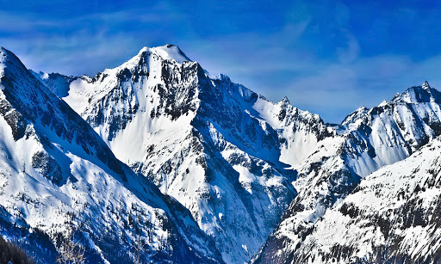

Year 5 Mountains
Session 1

Slide 2
Learning the Springfield way!
Lo | To describe what a mountain is and locate the world’s ‘Seven Summits’ on a map
T | Recap on Continents of the World and create your own clues to test your knowledge Identify Mountain Ranges and locate the 7 summits of the world Test your knowledge with a quick quiz
S | To be able to define a mountain To be able to locate the world’s largest mountain ranges To be able to locate the world’s ‘Seven Summits’

Slide 3
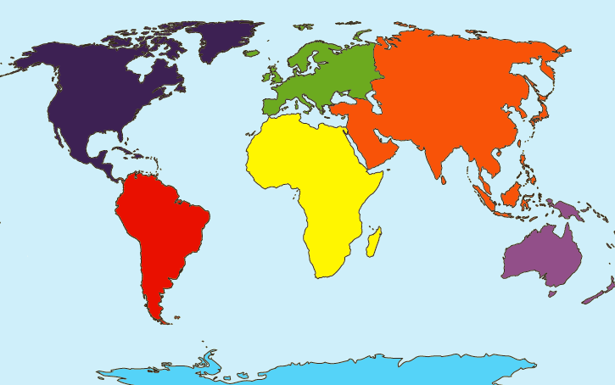
Recap
The world is made up of groups of countries which are called…?

Slide 4
Continents!
Can you place the continent names in the right place on the map?
Continent
Africa
Antarctica
Asia
Europe
North America
Oceania
South America

Slide 5
Continents!
Continent
Africa
Antarctica
Asia
Europe
North America
Oceania
South America

Slide 6
Which Continent am I?
Try to work out what I am with the least amount of clues!
I am the largest continent in the world.
I include China and India.
Now think of some clues for the other continents.
Record these, try them out on someone at home and hang on to them (we may use them later.)
I am one of three continents starting with A.
Asia

Slide 7
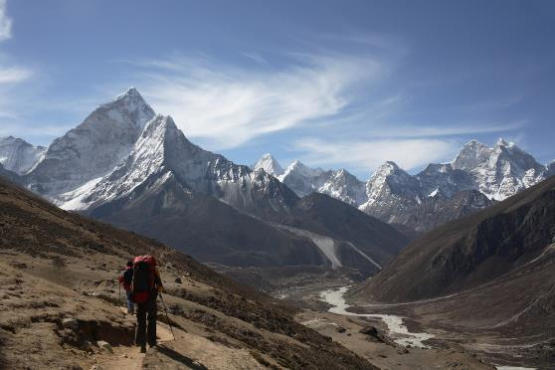
What is a mountain?
Use the image to help you define it.
A mountain is…
…a landform that sticks up, high above the surrounding land.
…much taller than a hill (600 metres or above, in the UK).
…a landform which is often found grouped with others in a mountain range.

Slide 8
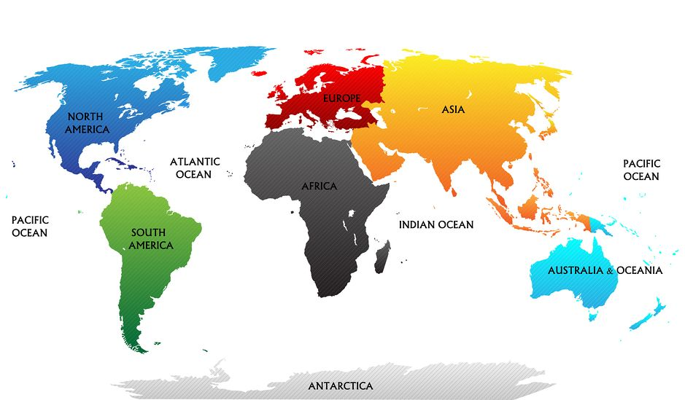
Can you name any mountain ranges across the world?
Pause here on the PowerPoint and do some Atlas research (if you have one) or look at the Internet

Slide 9
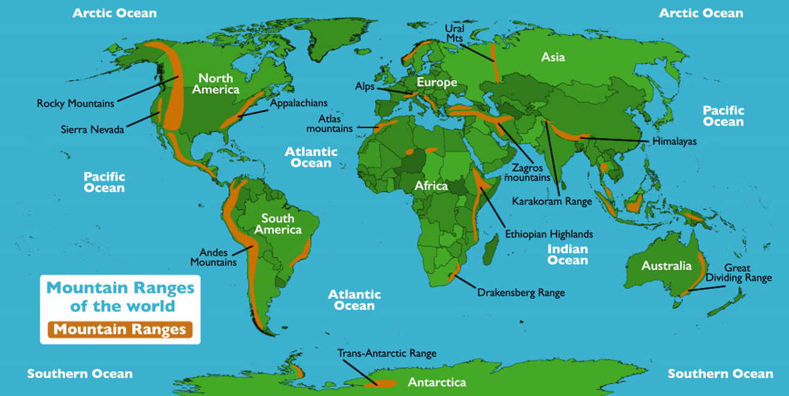


Slide 10
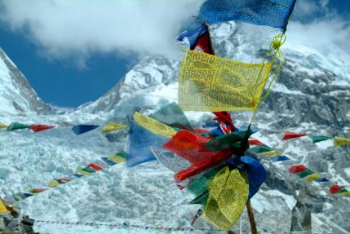
What are the Seven Summits?
These are the highest mountains in each of the seven continents.
© Oddizzi PowerPoints 2017

Slide 11
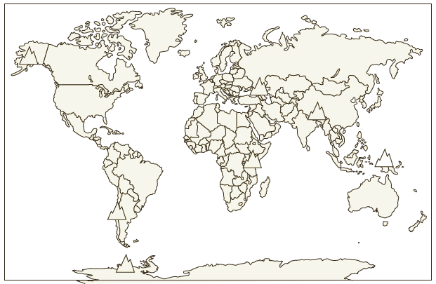
Challenge: Can you Locate the Seven Summits?
Using an atlas (if you have one) or the Internet, can you locate the seven summits?
Clue: there is a summit for each continent!
Aconcagua
Carstensz Pyramid
Mount Elbrus
Mount Everest
Mount Kilimanjaro
Denali
Vinson Massif

Slide 12
Locating the Seven Summits
How did you get on? Click for the answers
Aconcagua
Carstensz Pyramid
Mount Elbrus
Mount Everest
Mount Kilimanjaro
Denali
Vinson Massif

Slide 13
