Slide 1
Online Safety:
Parent Session
January 2024

Slide 2

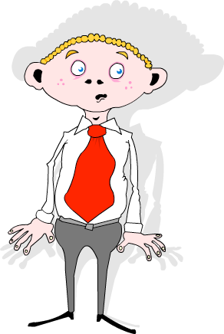
Introduction
Gary Melia
Schools IT Support Manager
0151 443 2155
gary.melia@knowsley.gov.uk
Notes:
My name is Gary Melia and I have the pleasure of managing the CLC team who have put this event on. As part of my role I have worked with schools on online safety for the past 15 years, its a passion of mine and I am excited by the day ahead we have planned for you.

Slide 3




Introduction
Notes:
Looking back at this slightly depressed me because with the exception of the apps that are named all of the issues highlighted still plague us today. This also make me think as educators we need to evaluate our performance and think about what we can do better so that in ten years time we are looking at different headlines.

Slide 4
What are your children doing online?
📱
💻
Home learning, home work or research.
Using Social Media
🙋🏿‍♂️
🎮
🎬
Playing Online Games
Creating or watching video

Slide 5
















Children’s Digital Playground (6-12)
What are your children doing online?
Watch videos on YouTube
Play a range of online games from Roblox and Fortnite to Toca Boca mobile games
Older children use apps such as Tik Tok to post videos online and live-stream
Some may also be using platforms like Snapchat and Instagram although minimum age is 13
Use educational apps to supplement learning

Slide 6


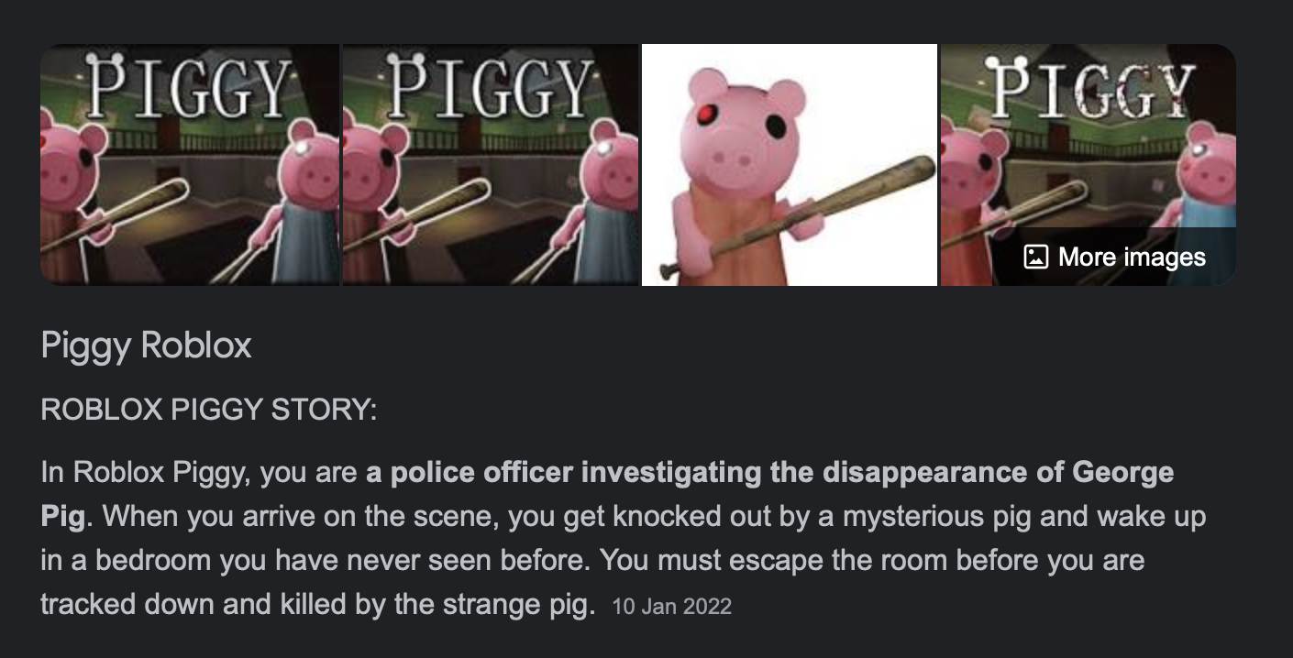
Have you ever played Roblox?

Slide 7
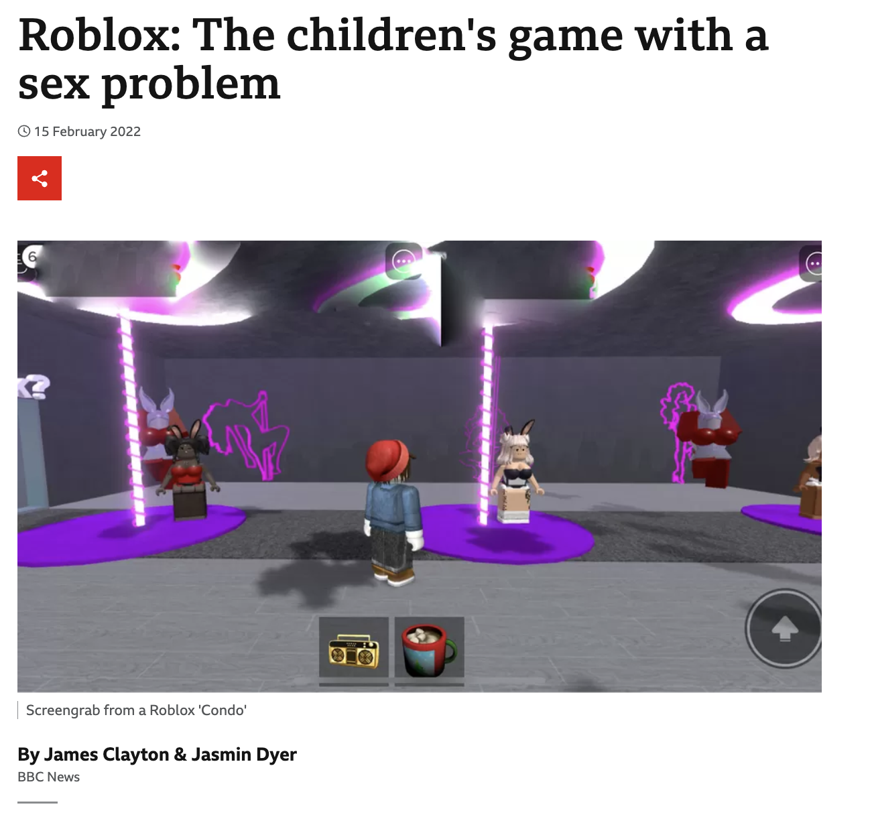


How well do you know Roblox?
Roblox PEGI Rating Now 13+
https://www.bbc.co.uk/news/technology-60314572

Slide 9
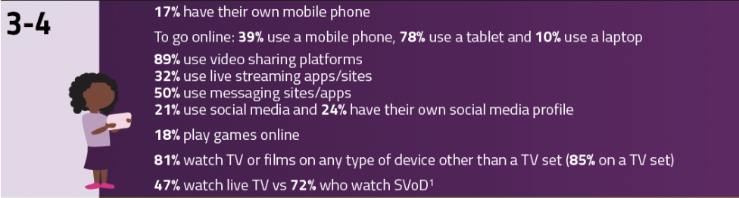
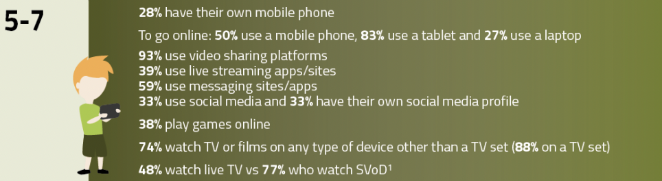
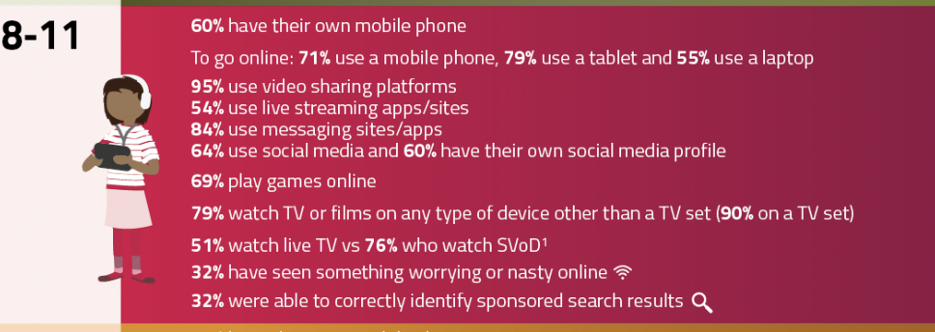
Latest Research
https://www.ofcom.org.uk/__data/assets/pdf_file/0024/234609/childrens-media-use-and-attitudes-report-2022.pdf

Slide 10
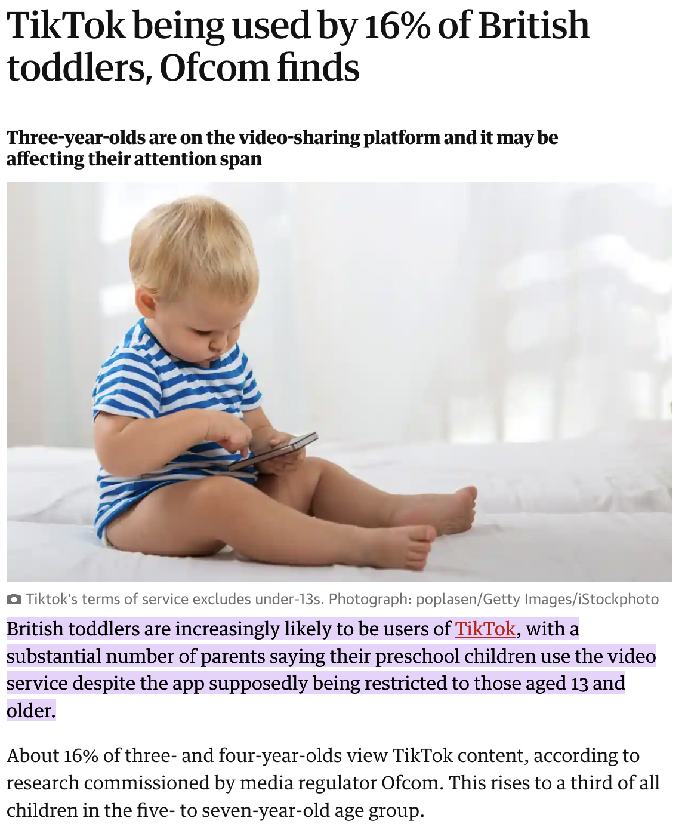
‘Tik Tots’
Table 1
23% of | 3+4 year olds
• 30% | of 5-7 year olds
• 63% | of 8-11 year olds
• 93% | of 12-15 year olds
• 97% | of 16+17 year olds

Slide 11
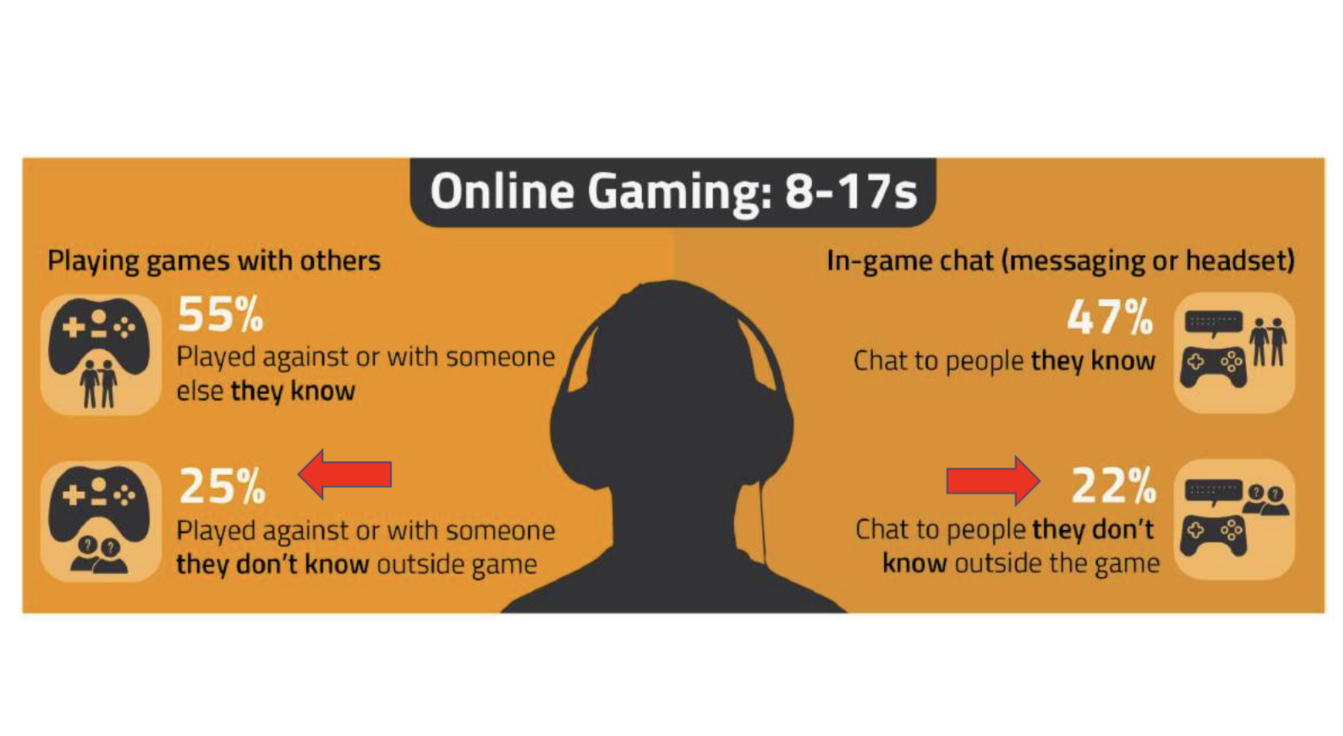
Contact

Slide 12








Platforms Flagged for
Severe Bullying
😢
The
Top 5
😢
👎🏻
Others to watch for:
Discord
Snapchat
Instagram
Kik
Tik Tok
Twitch
Hoop
Whatsapp

Slide 13
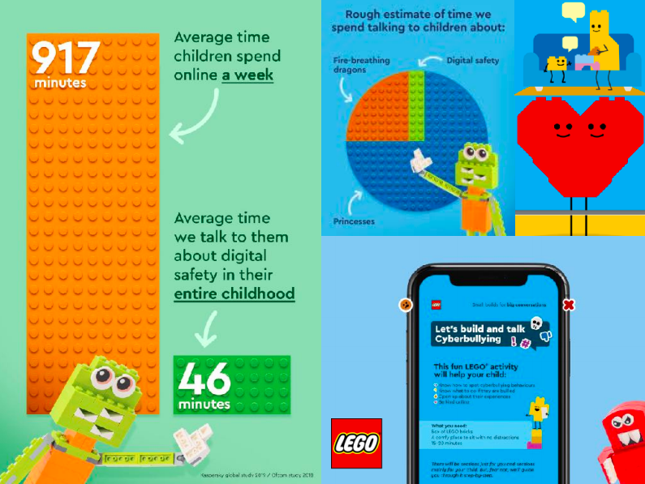

Slide 14
What can you do?
We don’t disclose because no one will help, and many will make it worse.

Slide 15
Do you know the online safety rules?
🤬
You smell
😢
Please stop
🤦🏻‍♂️
🤬
🙍🏼‍♀️
Everyone hates you
😢
I’ll tell
🤬
No one cares about you

Slide 16
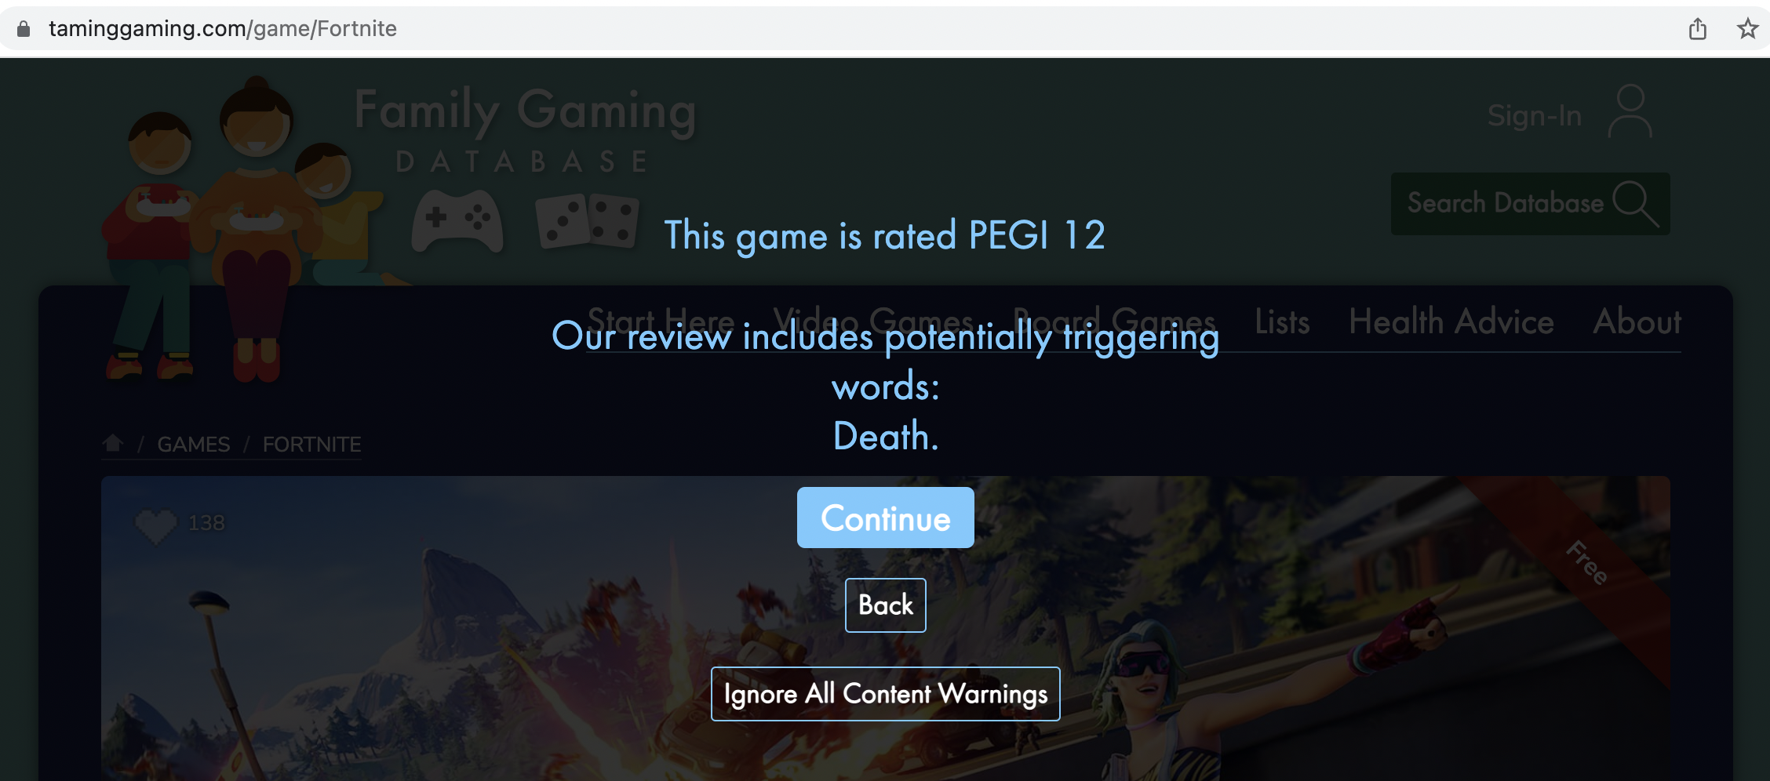
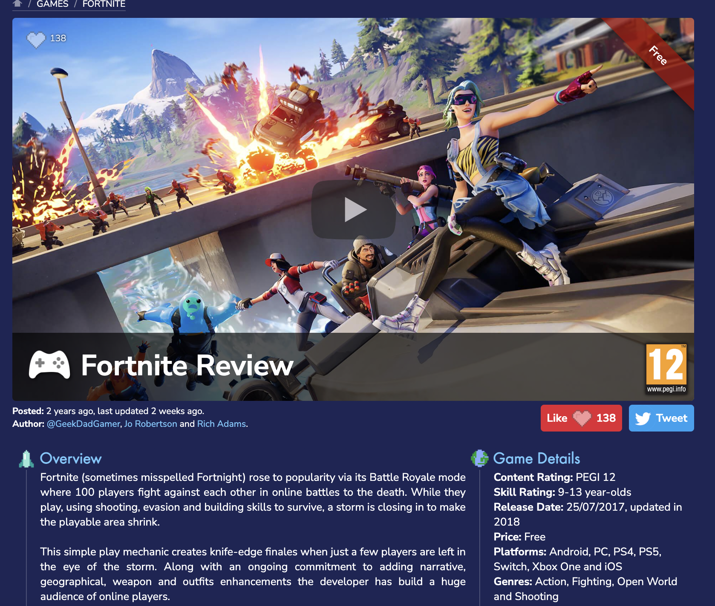
Taming Gaming

Slide 17
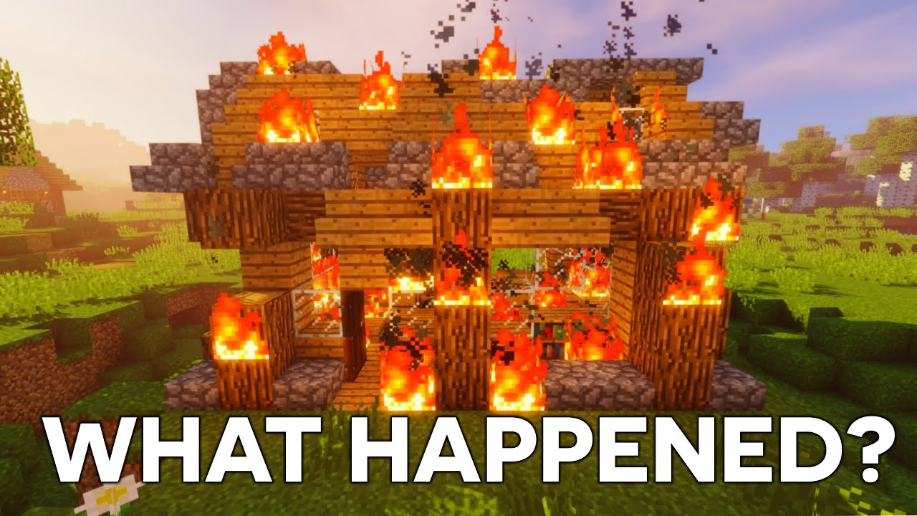
🎤
Griefing
Use the microphone to record your voice and add your answer.
Irritating or angering people in video games by being mean or destructive or cheating

Slide 18



Do you know who your influencers?
What do you know about the influencers your children are interested in?

Slide 19
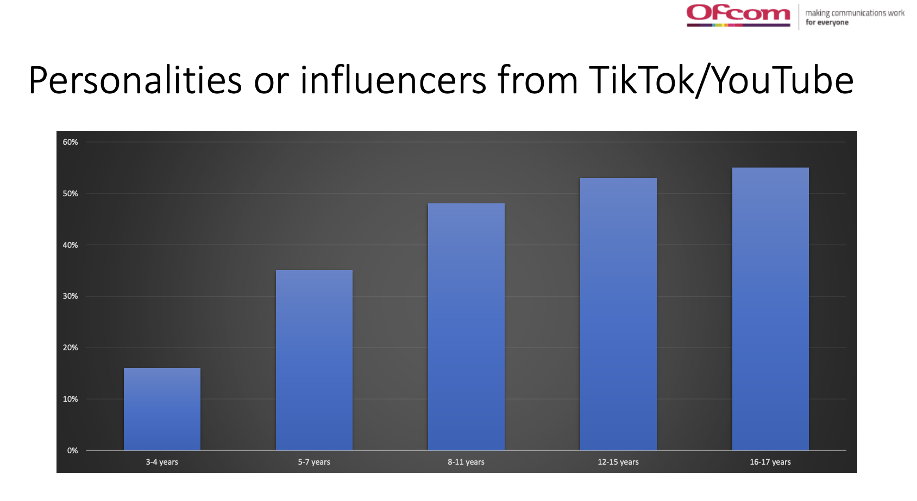
Do you know who your influencers?

Slide 20
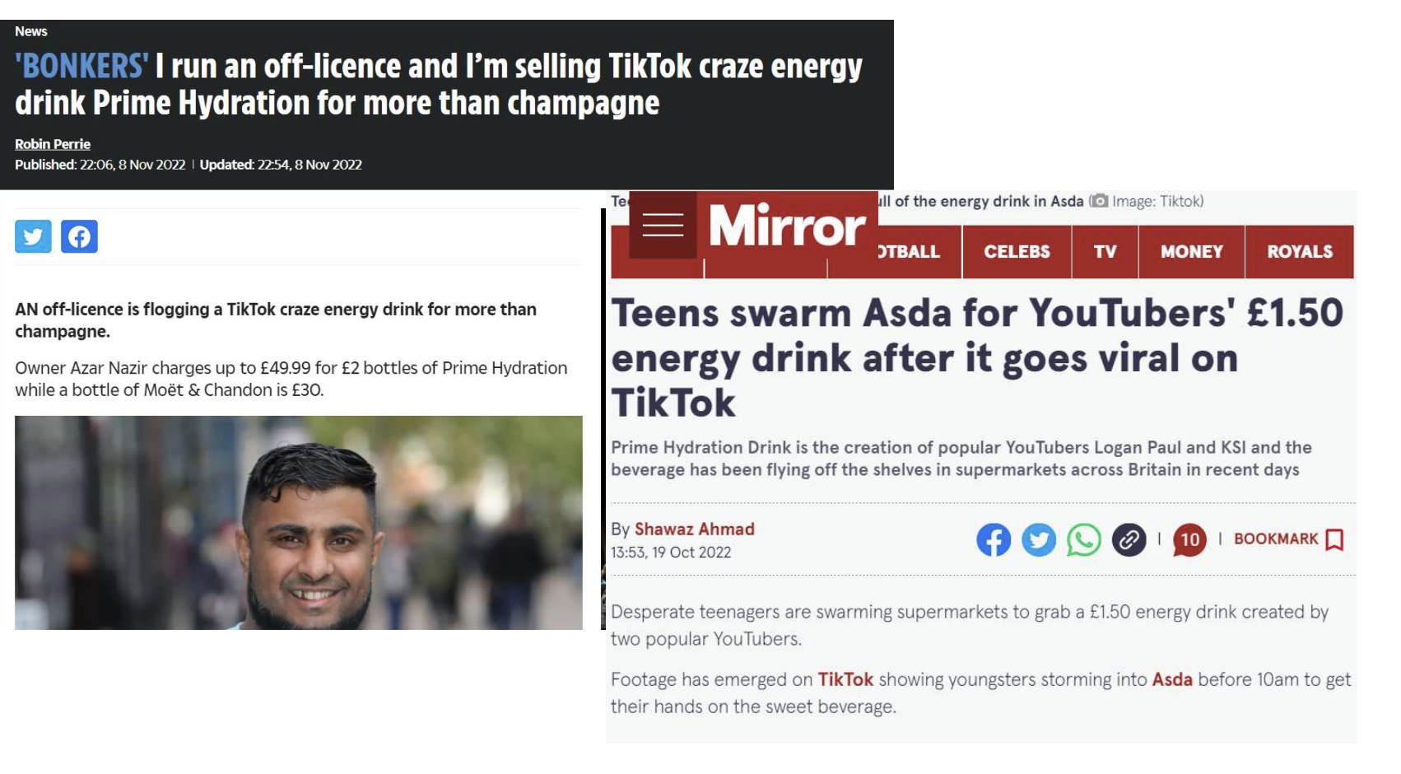
Do you know who your influencers?

Slide 21
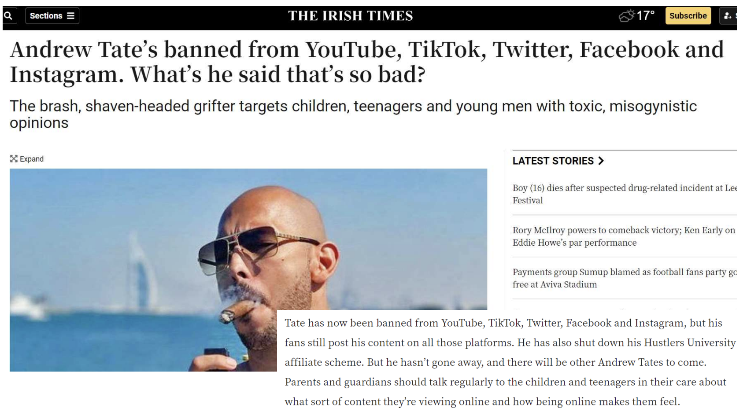
Do you know who your influencers?

Slide 22
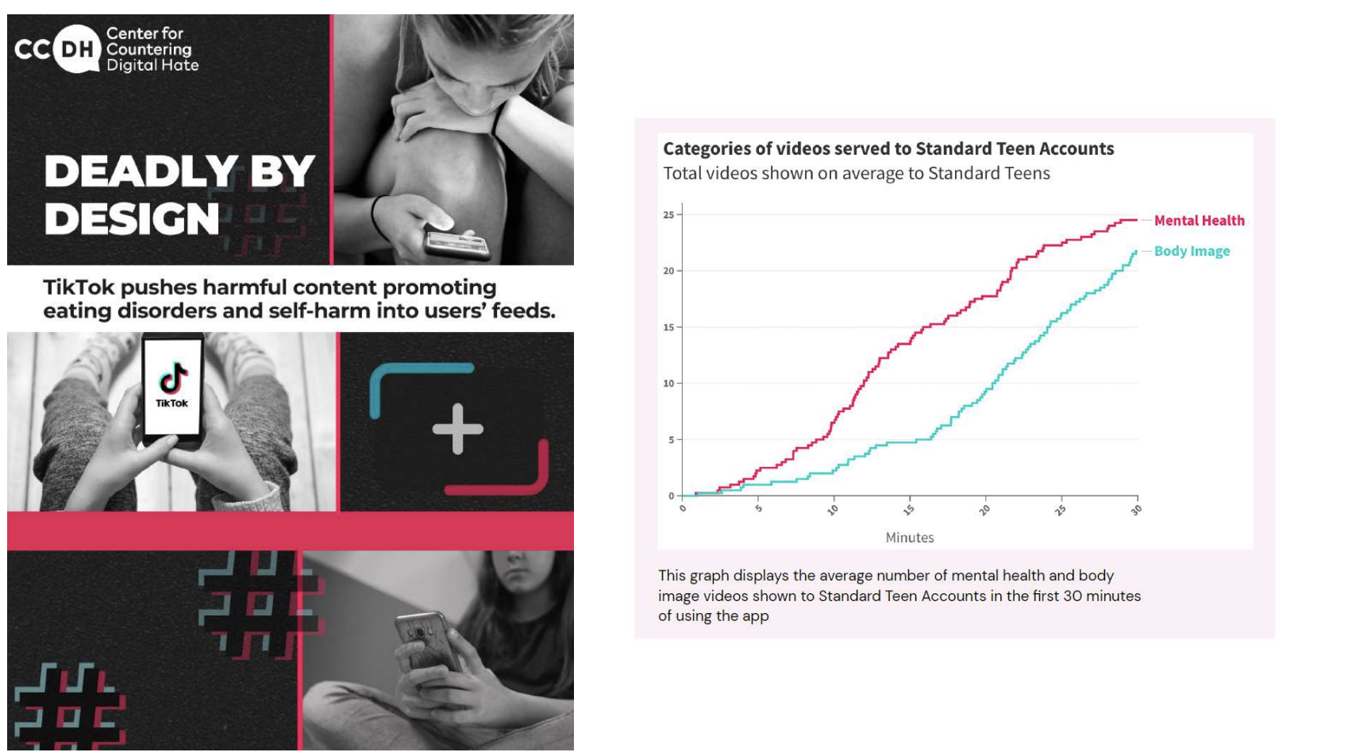

Slide 23
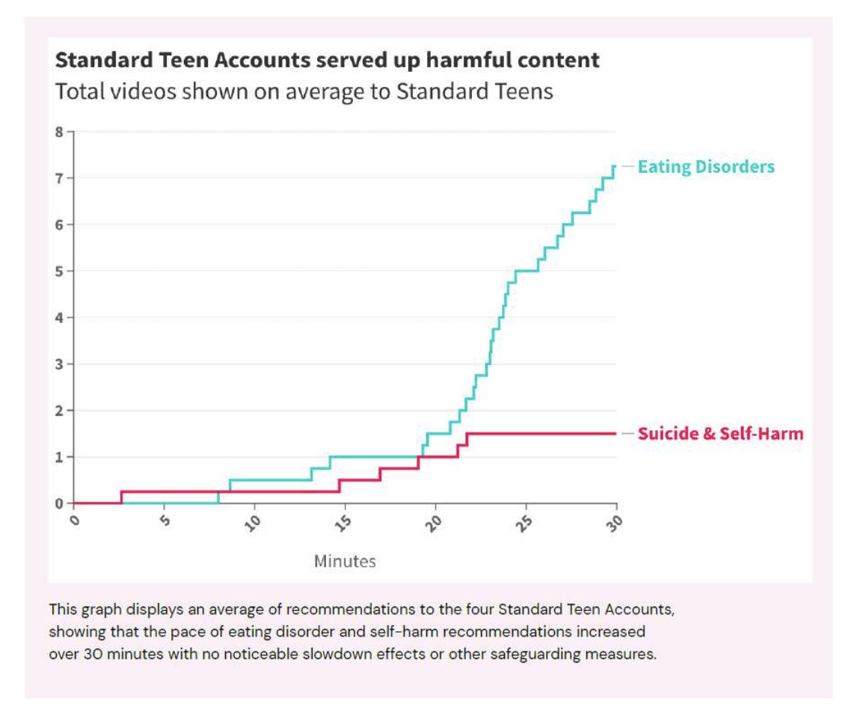

Slide 24
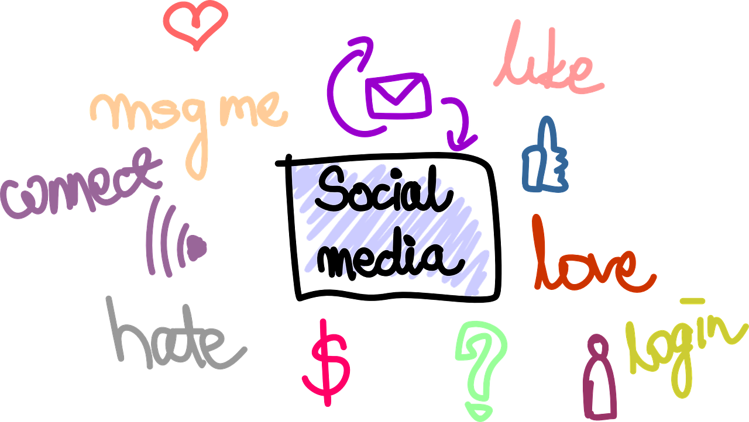
Supporting your son or daughter
Take an interest.
Listen and don’t judge.
Engage with them.
Use technology with them.
Do not become a ‘sharent’ - lead by example.
Talk to other parents about any issues - join social media parents groups.
Open minded to technology.

Slide 25
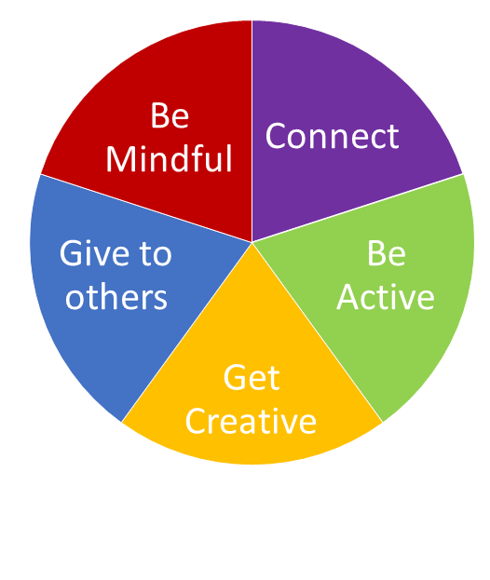
Digital Five a Day
Aims to provide practical steps to achieve a healthy and balanced digital diet.
Promotes positive behaviours and mental wellbeing.
https://www.childrenscommissioner.gov.uk/digital/5-a-day/

Slide 26
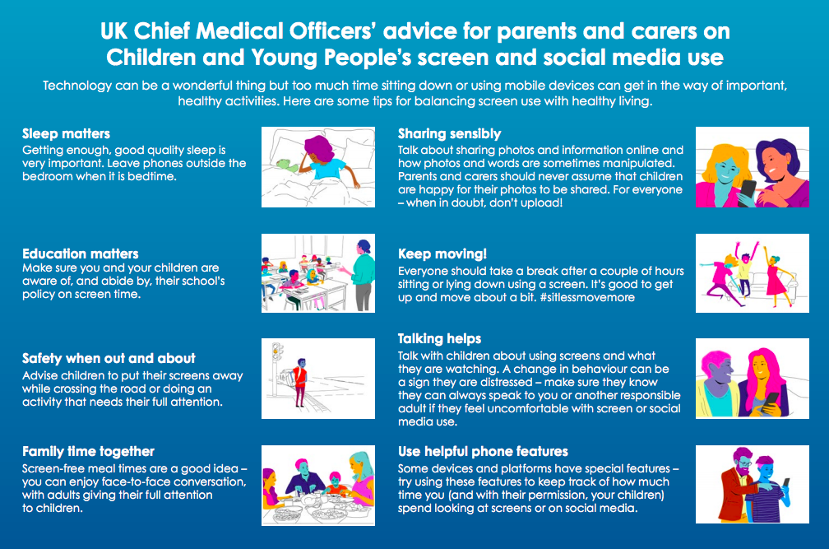
For access Click Here

Slide 27
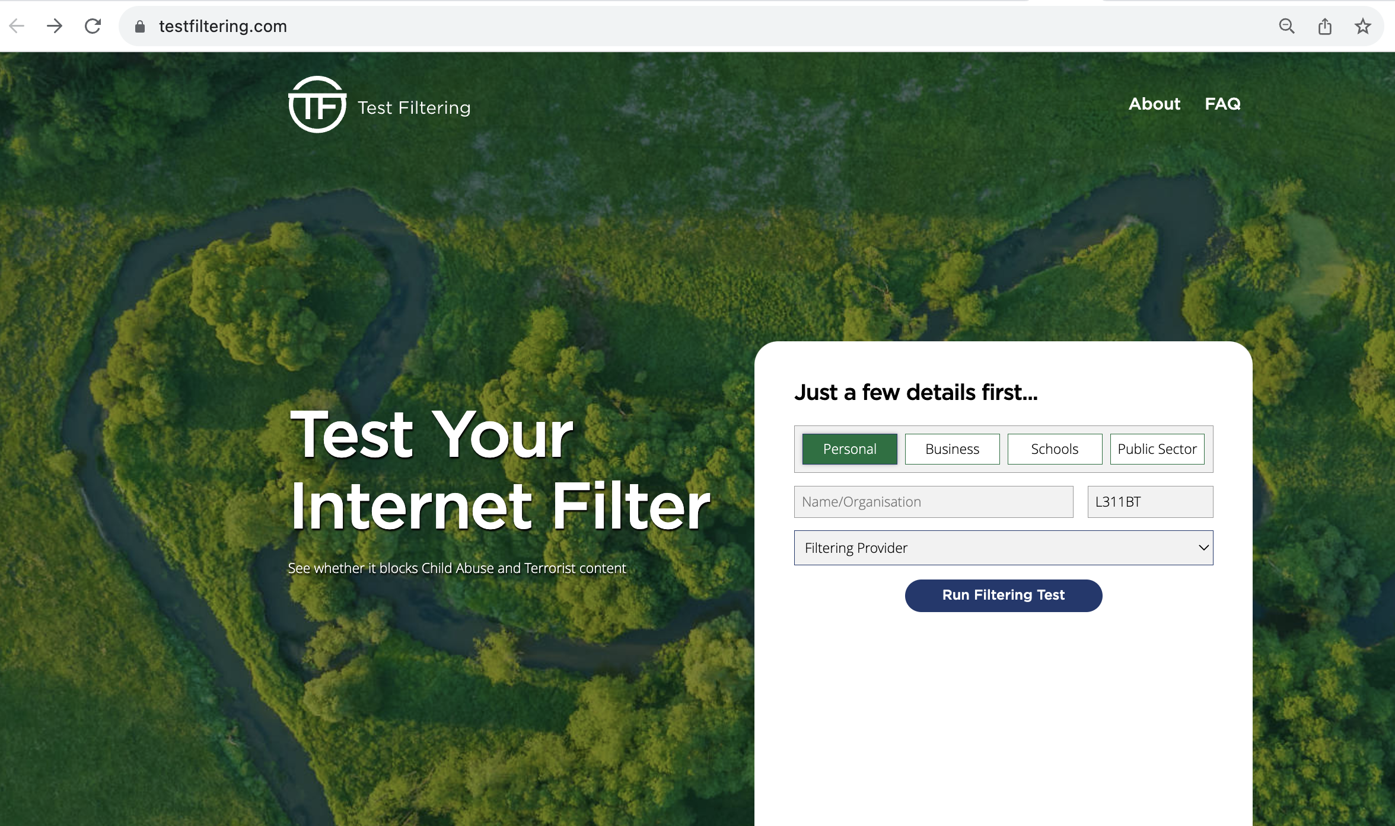
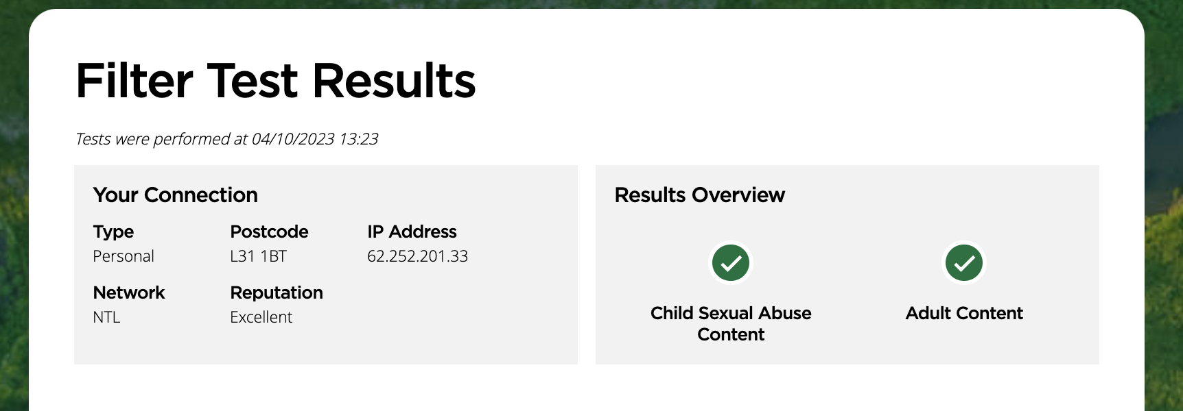
Test your Home Filtering
https://testfiltering.com/

Slide 28

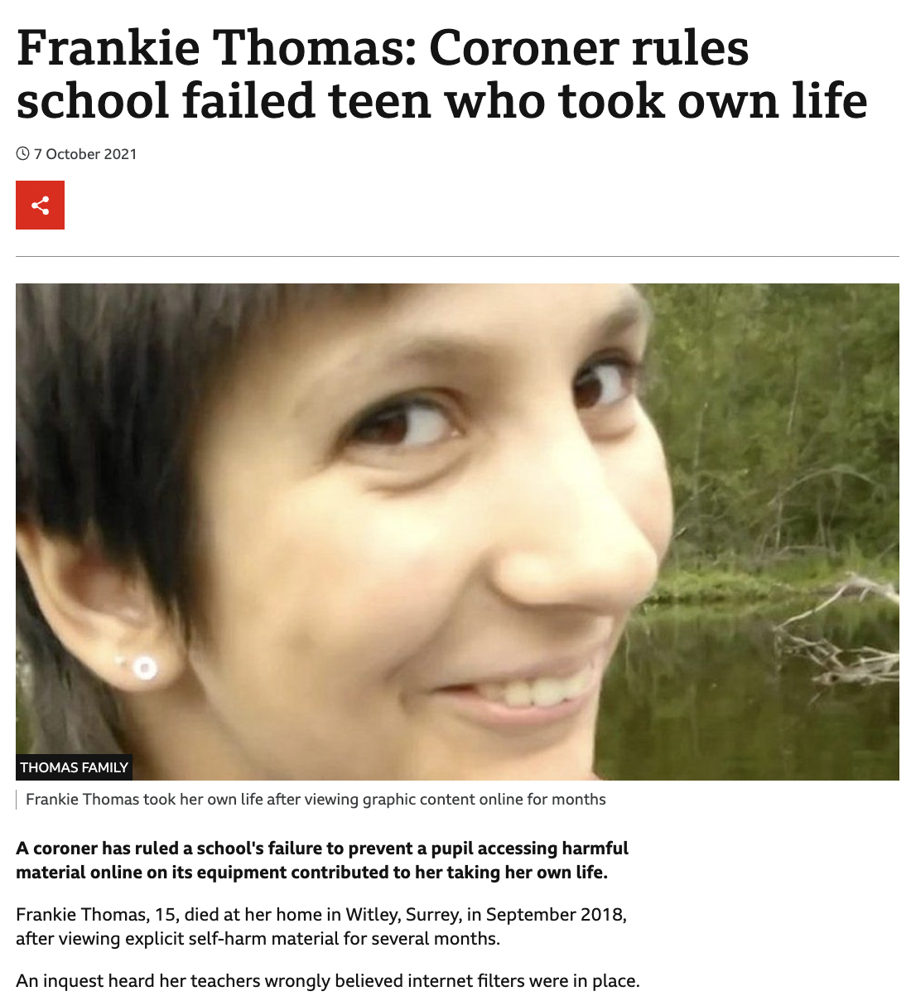
https://www.bbc.co.uk/news/uk-england-surrey-58817821
Notes:
In particular you should pay attention to the changes to the filtering and monitoring element of Keeping Children Safe, the case of Frankie Thomas last year should act as a reminder to us all that we should not just take the word of our technicians we should be testing filtering solutions ourselves or challenging our technical providers to evidence it is fit for purpose.

Slide 29
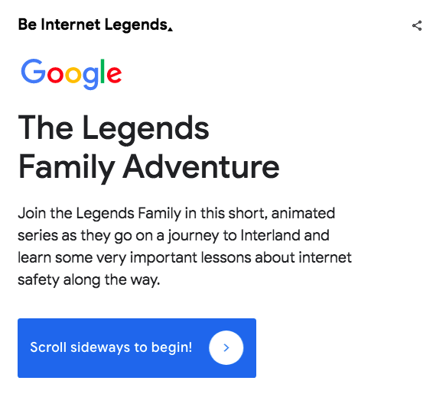
The Legends Family Adventure

Slide 30
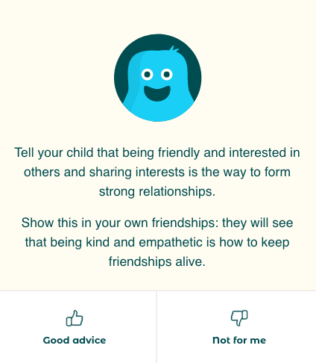
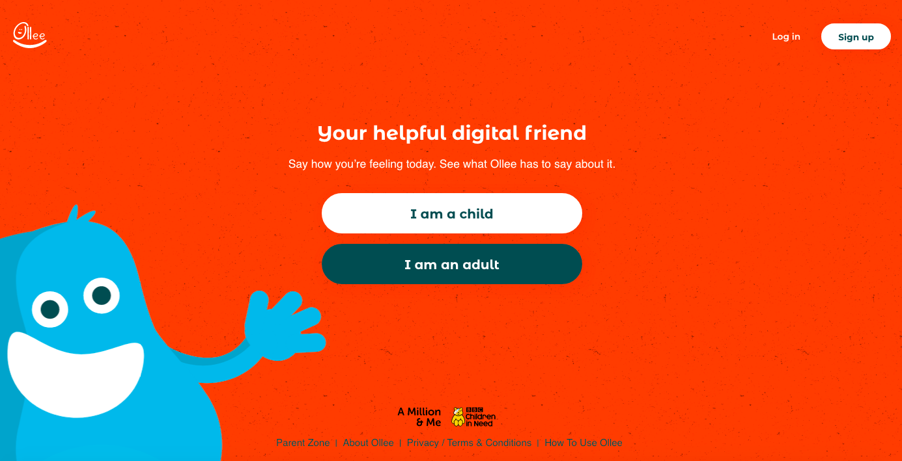
Ask Ollee
A virtual friend who is there to help you with your wellbeing!
https://app.ollee.org.uk/#/welcome

Slide 31






Online Safety Books

Slide 32
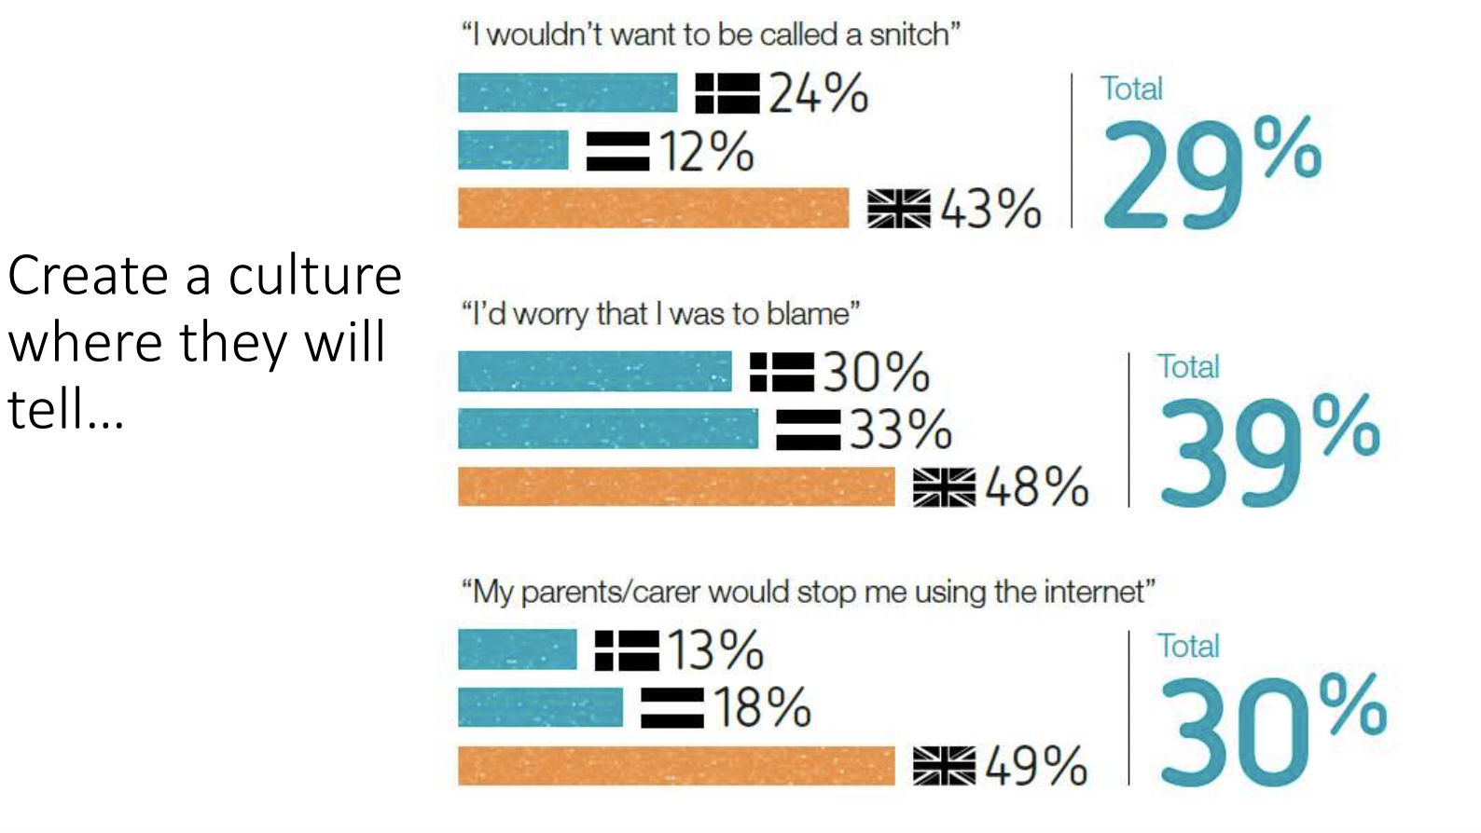
Children will make mistakes…

Slide 33

Parental Controls

Slide 34
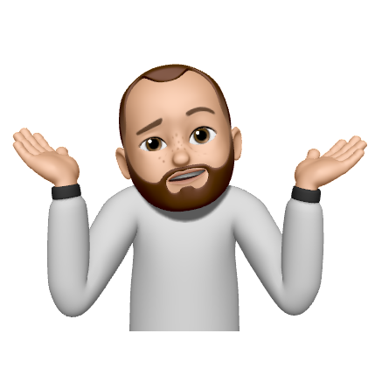



Did you know?
The average person spends 4.8 hours a day on their handset.
Have you ever thought about how much of your life is spent looking at the phone? Being constantly connected to lots of services creates a lot of distractions, and is a lot for the brain to process. About nine out of 10 people in the UK now own a smartphone, And we are glued to them - one recent study found that the average person spends 4.8 hours a day on their handset.
Fun
Risk

Slide 35
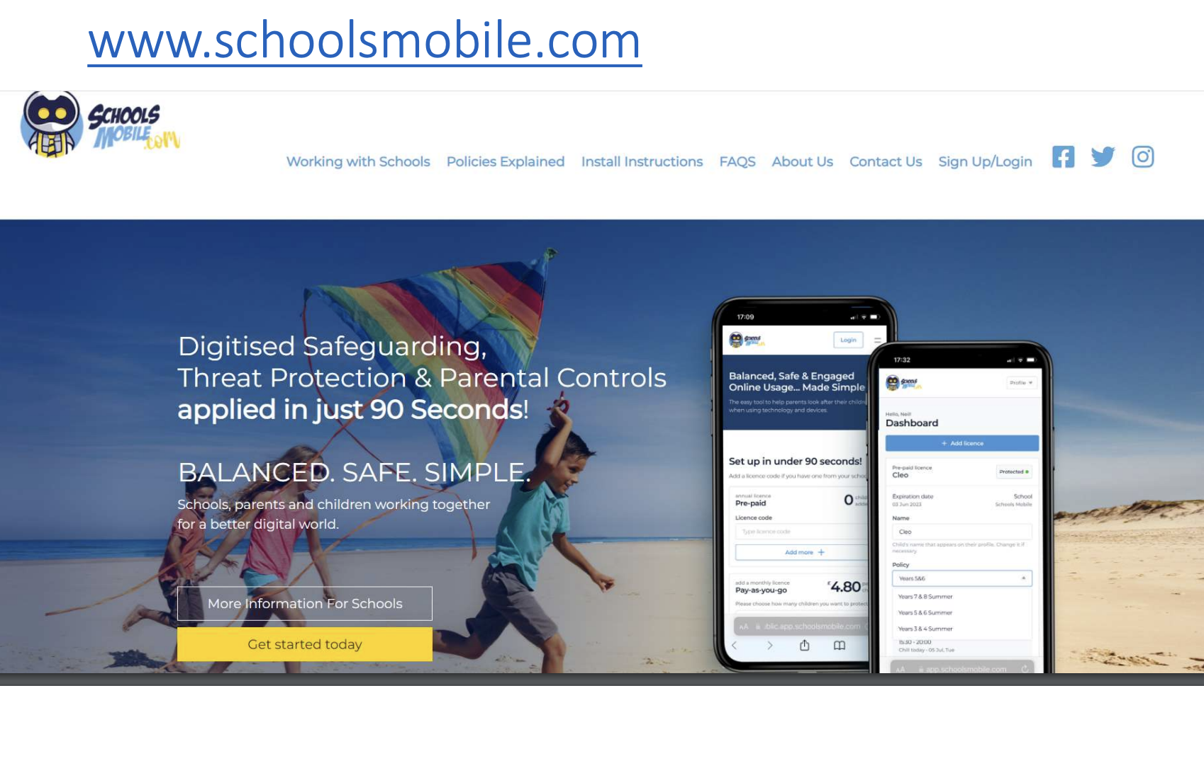

Slide 36

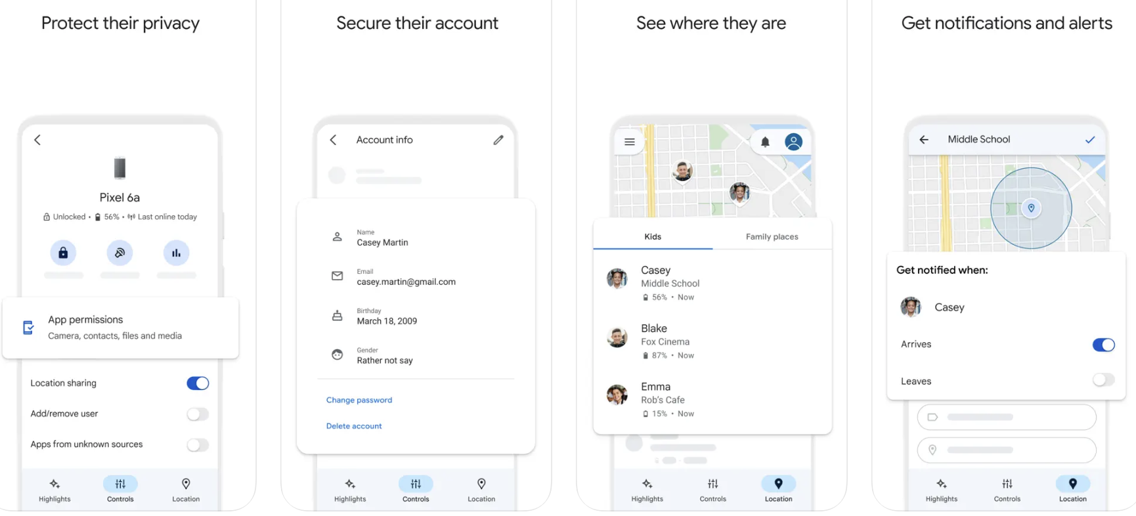
Google Family Link
Available on App and Android Stores.
Monitor Screen Time.
Manage Apps.
Set sleep time.
See where they are.

Slide 37
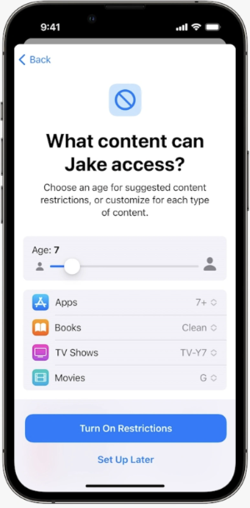
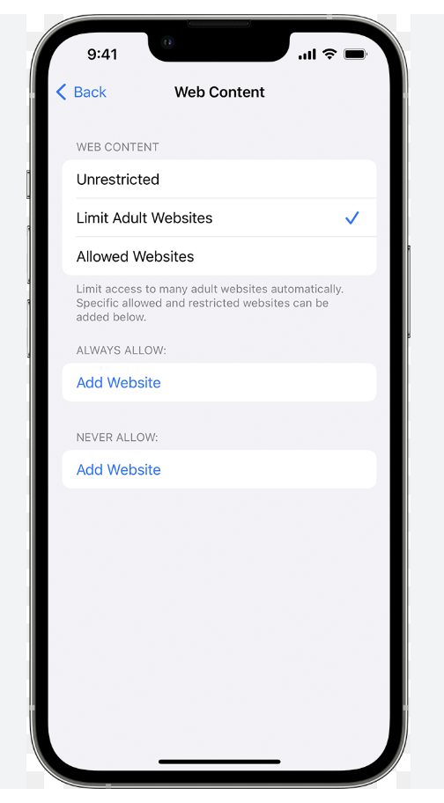
Apple Parental Control
Restrict Apps
Set time limits
Filter web content
Restrict the game centre.

Slide 38
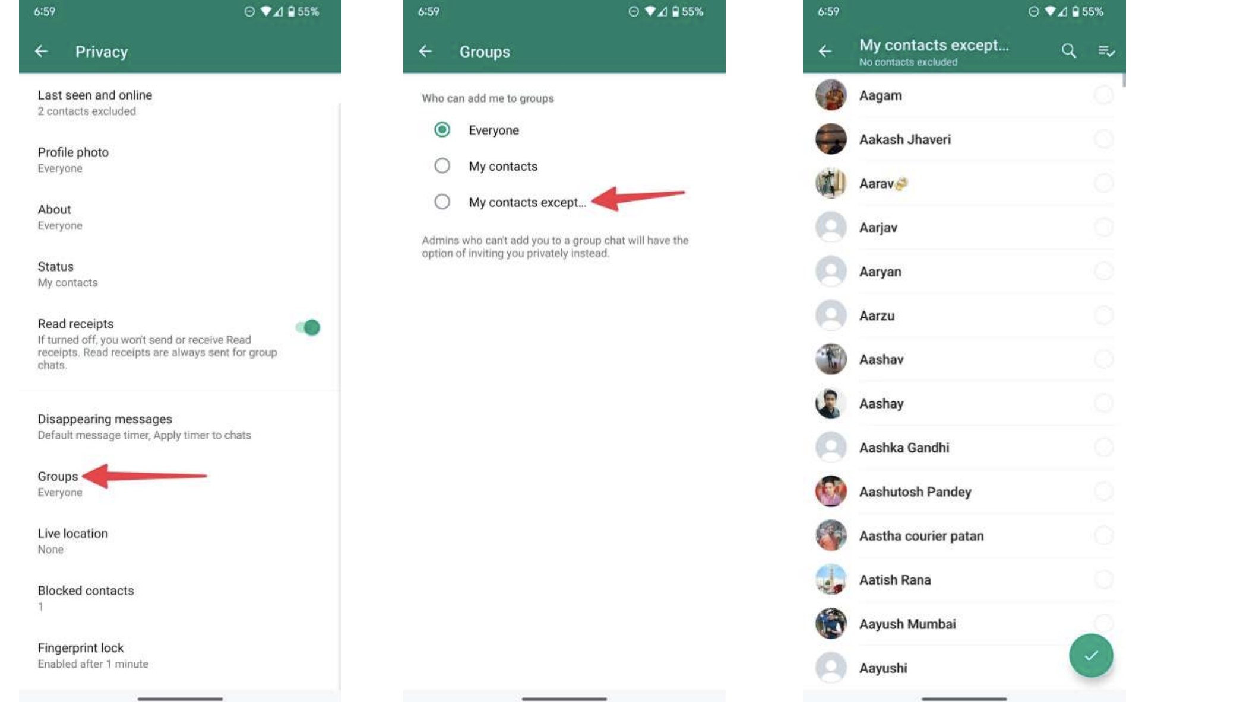

Slide 39
Support for you
You can alway speak to:
  CEOP
  NSPCC
  School
Or for more general information you can visit these sites:
  UK Safer Internet Centre (https://www.saferinternet.org.uk/)
  Internet Matters (https://www.internetmatters.org/)
  The Parent Zone (https://parentzone.org.uk/home)

Slide 40
Live Streaming
This part of the presentation is only suitable for over 18s and may upset some parents.

Slide 41
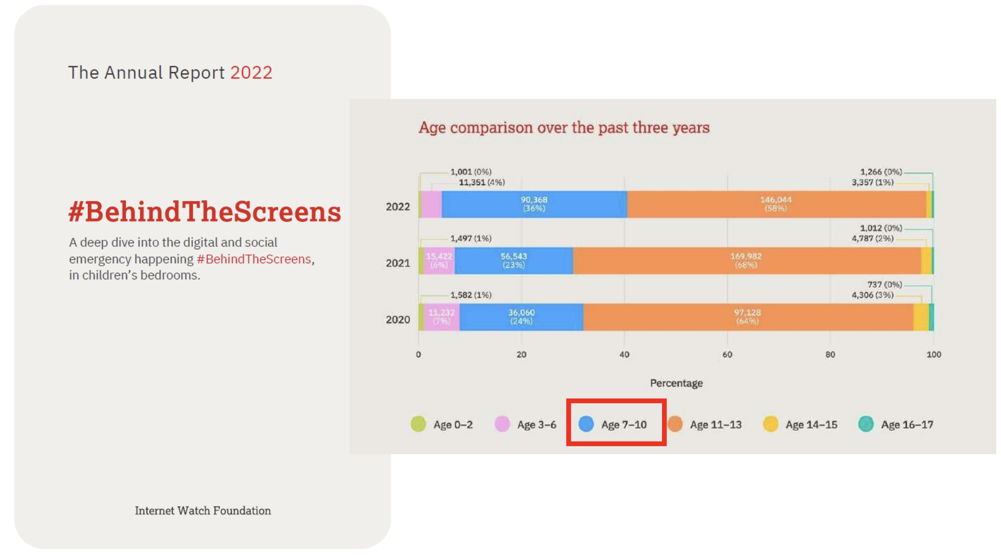

Slide 42
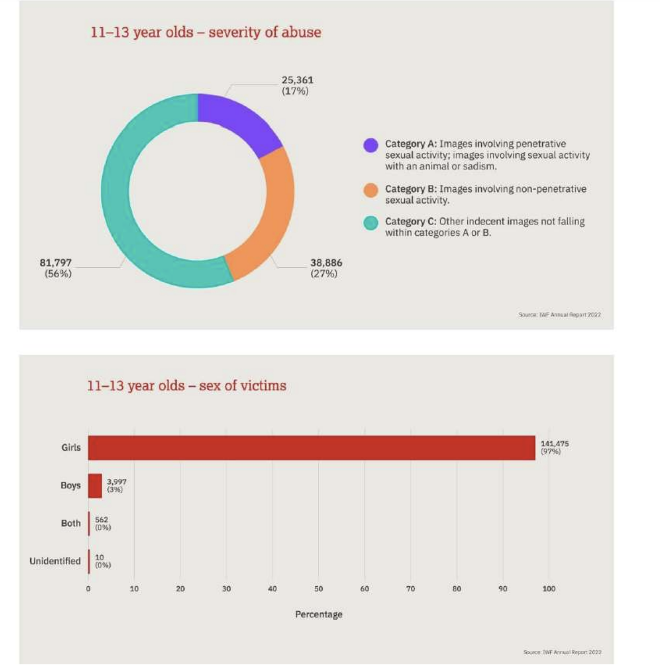

Slide 43
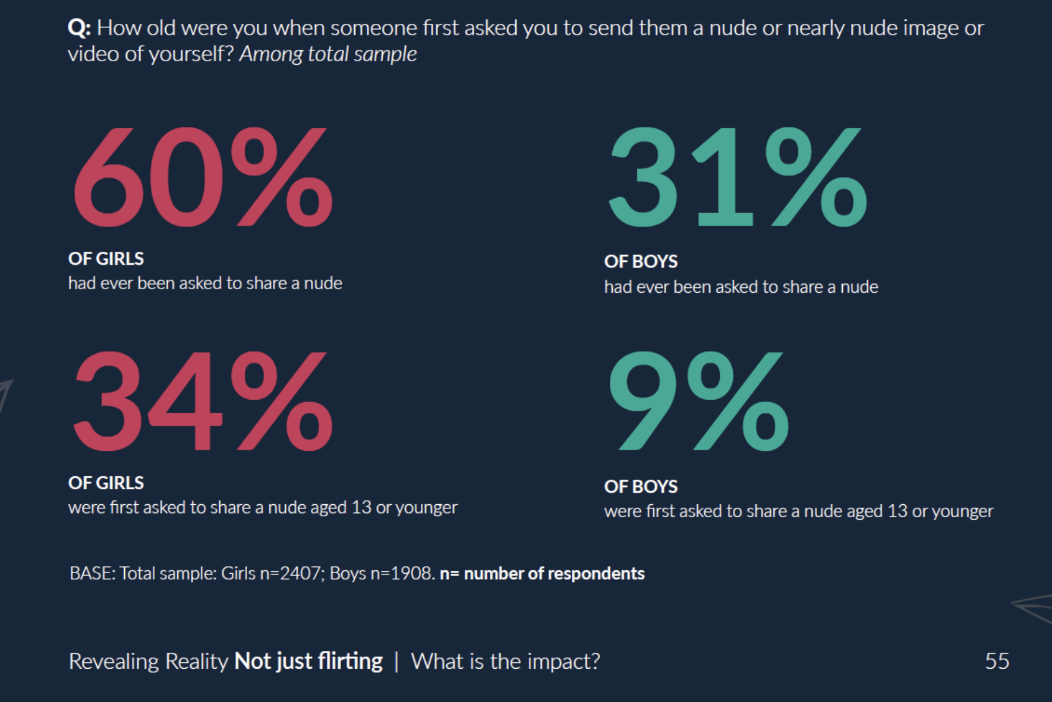

Slide 44

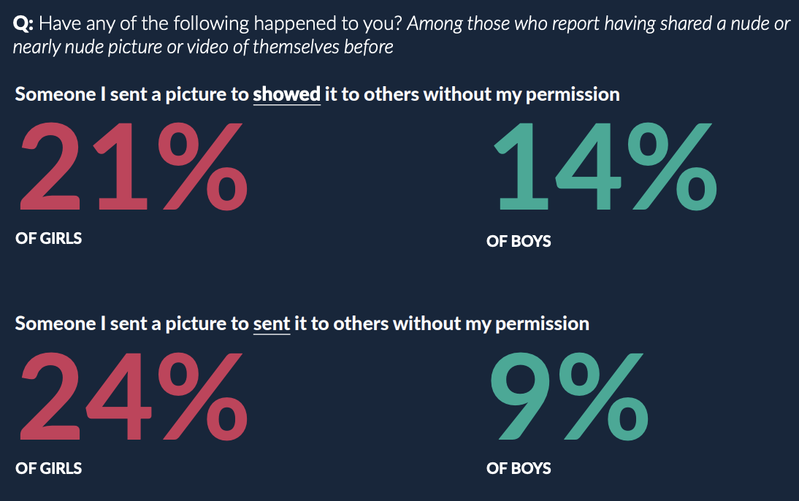

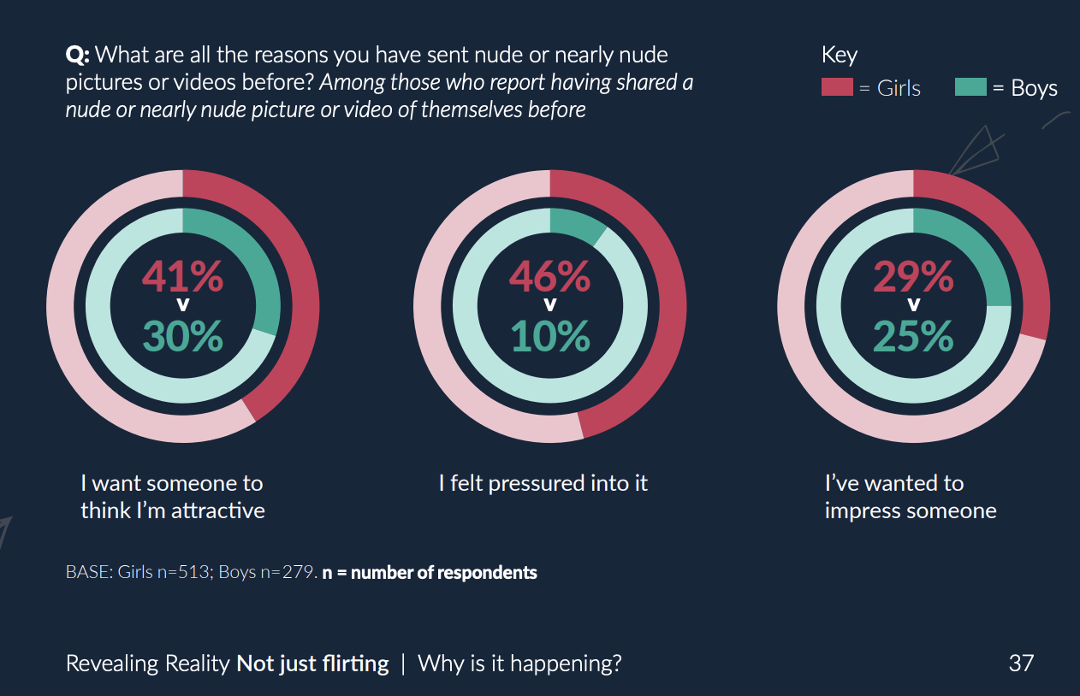

Slide 45
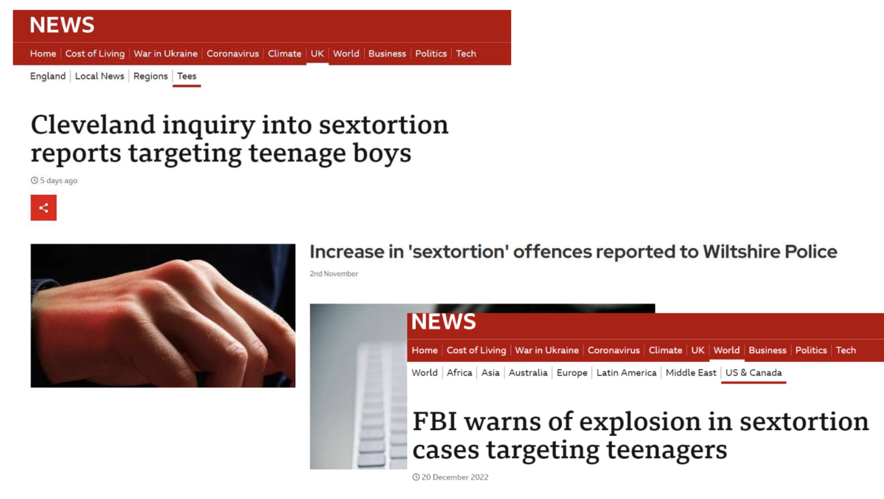
Contact

Slide 46
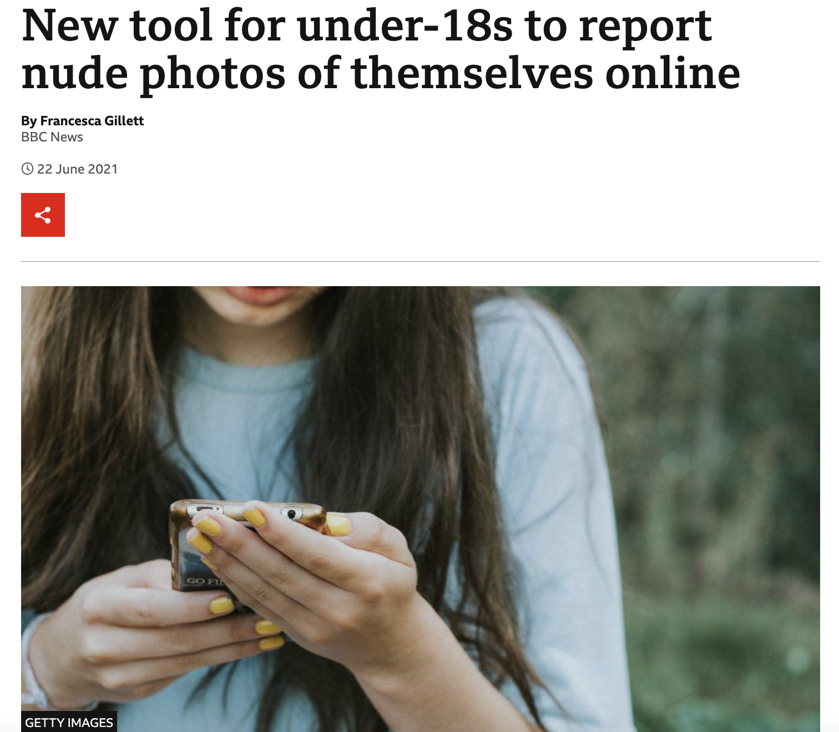
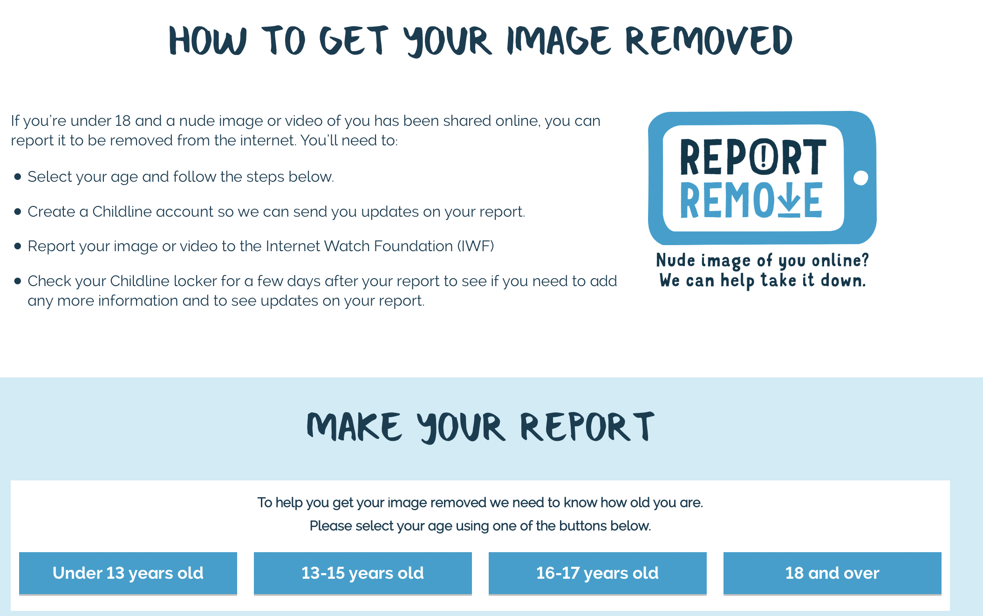
Report Remove

Slide 47

