Slide 1
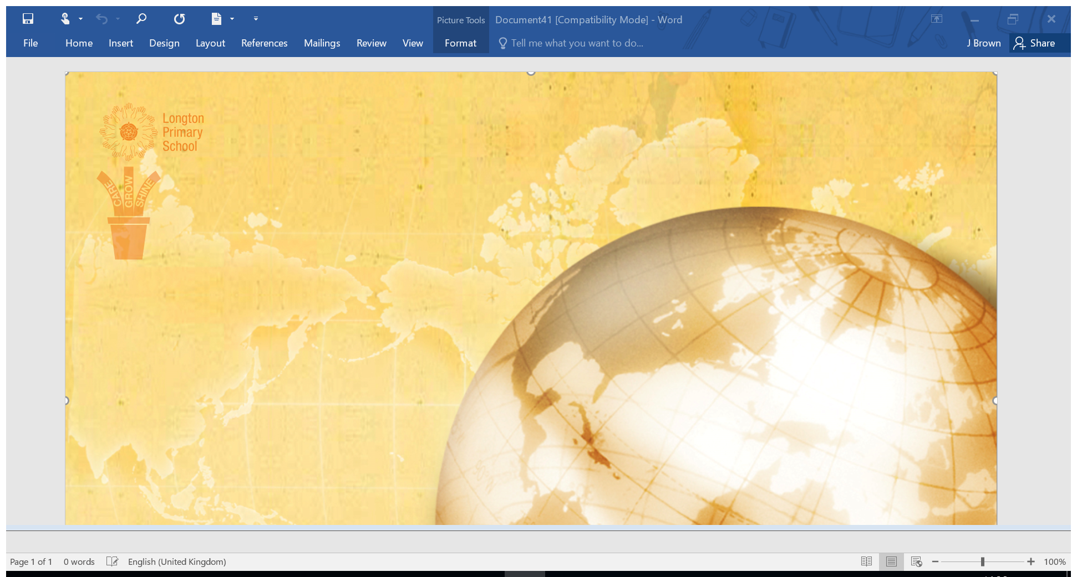
Key Stage 2
Spelling
YEAR 6
We choose the spelling words from the National Curriculum list. Each year group has their own list of words for every week of the year and their associated rules.

Slide 2
Week 1 | Week 2 | Week 3 | Week 4
To explain homophones A homophone is a word that is pronounced the same as another word, but differs in meaning, and may differ in spelling | To explain homophones A homophone is a word that is pronounced the same as another word, but differs in meaning, and may differ in spelling | To explain homophones A homophone is a word that is pronounced the same as another word, but differs in meaning, and may differ in spelling | To discuss grammatical terminology These terms are needed for the KS2 SATs.
father | council | course | subordinate
farther | counsel | coarse | preposition
affect | gorilla | foreword | adverbial
effect | guerrilla | forward | abstract
aloud | guessed | threw | synonym
allowed | guest | through | antonym
altar | morning | compliment | determiner
alter | mourning | complement | progressive
ascent | past | desert | conjunction
assent | passed | dessert | sentence
bridal | precede | wary
bridle | proceed | weary
High Frequency through been | High Frequency stop must | High Frequency door right | High Frequency these began
Year 6 Autumn First Term Weeks 1 to 4

Slide 3
Week 5 | Week 6 | Week 7
To identify words with the short vowel sound /i/ can be spelled with a ‘y’ Some words with the /i/ sound can be spelled with a ‘y’ | To identify words with the long vowel sound /i/ can be spelled with a ‘y’ Like with the short vowel sound /i/, words with the long vowel sound /i. can also be spelled with a ‘y’ | To identify silent letters Look out for the silent letters together – investigate the history of the words to see why they are there
rhythm | rhyme | artistically
system | occupy | acquire
physical | apply | government
symbol | hyphen | ascend
mystery | hygiene | plumber
lyrics | python | disciple
oxygen | supply | succumb
symptom | identify | yacht
typical | multiply | pneumonia
crystal | recycle | mortgage
High Frequency animals never | High Frequency first work | High Frequency that’s mouse
Year 6 Autumn First Term Weeks 5 to 7

Slide 4
Week 1 | Week 2 | Week 3 | Week 4
To identify silent letters Look out for the silent letters together – investigate the history of the words to see why they are there | To discuss the suffix ‘-er’ ‘-or’ and ‘-ar’ | To identify words ending with -ably’ ‘-able/-ably’ is used if there is a related word ending in ‘–ation’. ‘-able’ added straight on to words ending in –ce or –ge. ’-able/ably’ are used if the root word is hear before the ending. | To discuss words with the suffix ‘-ibly’ -ible/ibly is used if the root word is not heard completely before the ending.
receipt | computer | changeably | responsibly
asthma | superior | noticeably | possibly
plague | customer | dependably | horribly
sword | soldier | comfortably | terribly
drought | shoulder | reasonably | visibly
rhyme | interior | adorably | incredibly
knot | calendar | valuably | sensibly
subtle | popular | believably | forcibly
parliament | particular | considerably | legibly
 | radiator | tolerably
High Frequency something still | High Frequency found live | High Frequency soon night | High Frequency narrator small
Year 6 Autumn Second Term Weeks 1 to 4

Slide 5
Week 5 | Week 6 | Week 7
To discuss the suffix ‘-ible’ ‘-ible/-ibly’ is used if the root word is not heard completely before the ending. | To identify words with the prefix ‘over’ This prefix means too much or more than enough | To discuss the suffix ‘-ful’ ful is defined as full of or having a quantity that would fill something named
reversible | overbalance | merciful
incredible | overthrow | plentiful
possible | overturned | beautiful
horrible | overcoat | fearful
terrible | overslept | faithful
responsible | overcook | boastful
legible | overpaid | doubtful
sensible | overreact | thankful
forcible | overtired | pitiful
visible | overlooked | fanciful
High Frequency couldn’t three | High Frequency head king | High Frequency town I’ve
Year 6 Autumn Second Term
Weeks 5 to 7

Slide 6
Week 1 | Week 2 | Week 3 | Week 4
To identify words ending in “ious” If the root word ends in ’ce’ or a soft sound, it is usually ‘–cious’. If a hard sound, usually ‘-tious’ | To compare words ending in “cial” and “tial” ‘-cial’ is common after a vowel letter and ‘–tial’ after a consonant letter | To identify when we use ‘ent’, ‘ence’ or ‘ency’ ‘-ent’, ‘-ence’ and ‘–ency’ after a soft ‘c’ or soft ‘g’ or ‘qu’ | To discuss words ending /shul/ after a vowel letter Some words end with the /shul/ sounds after a vowel letter
ferocious | beneficial | Intelligence | antisocial
devious | influential | emergent | official
conscious | circumstantial | competence | superficial
nutritious | judicial | transparent | special
notorious | preferential | eloquence | artificial
amphibious | consequential | independent | social
repetitious | financial | independence | racial
curious | initial | obedient | crucial
fictitious | commercial | obedience | facial
infectious |  |  | beneficial
superstitious
anxious (exception)
High Frequency around every | High Frequency garden laughed | High Frequency let’s suddenly | High Frequency another great
Year 6 Spring First Term Weeks 1 to 4

Slide 7
Week 5 | Week 6
To discuss words ending /shul/ after a consonant letter Some words end with the /shul sound after a consonant letter. | To discuss words which contain ‘ei’ and ‘ie’ ‘i’ before ‘e’ except after ‘c’ – although there are some exceptions
influential | efficient
martial | proficient
spatial | pierce
partial | receipt
confidential | deceit
essential | conceit
substantial | experience
potential | achieve
sequential | thief
torrential | yield
High Frequency cried jumped | High Frequency because before
Year 6 Spring First Term
Weeks 5 to 6

Slide 8
Week 1 | Week 2 | Week 3 | Week 4
To identify spellings with double letters Look for the words that have two or three sets of doubles | To identify words with the /f/ sound that are spelled ph Look for the words that have two or three sets of doubles | To identify words with a soft ‘c’ sound can be spelled ce If the word makes a soft ‘c’ sound /s/ then it can be spelled with ce | To recognise silent letters Look at the history of these words – what languages have they evolved from?
brilliant | graph | prejudice | aplomb
annoyed | pheasant | nuisance | wrinkles
apparatus | phone | hindrance | physical
collection | photo | sacrifice | wreck
possessive | physical | cemetery | abscess
channel | alphabet | certificate | salmon
skiing | dolphin | celebrate | wrist
beginning | elephant | necessary | knuckle
aardvark | pamphlet | deceased | yolk
 | sphere | December | crumb
High Frequency clothes place | High Frequency mother window | High Frequency morning queen | High Frequency green different
Year 6 Spring Second Term Weeks 1 to 4

Slide 9
Week 5 | Week 6
To identify words which can be nouns and verbs Some words can be used as both nouns | To discuss words with an /o/ sound can be spelled ‘ou’ or ‘ow’
produce | shoulder
impact | smoulder
transport | mould
silence | thrown
permit | known
object | blown
contest | window
subject | shallow
increase | soul
freeze | poultry
High Frequency which friends | High Frequency there’s looking
Year 6 Spring Second Term
Weeks 5 to 7

Slide 10
Week 1 | Week 2 | Week 3 | Week 4
To compare a variety of suffixes Suffixes change the part of speech of a word – can the children discuss the change in form and spot the root word?NB Some root words are altered slightly for the spelling | To compare a variety of suffixes Suffixes change the part of speech of a word – can the children discuss the change in form and spot the root word?NB Some root words are altered slightly for the spelling | SATs Revision | SATs week
determined | opportunity |  | hoist
criticise | Sufficient |  | easel
curiosity | sincerely |  | restaurant
definite | signature |  | pyjamas
equipment | sacrifice |  | bungalow
equipped | pronunciation |  | veranda
explanation | Hindrance |  | ballet
existence | immediately |  | blizzard
government | dictionary |  | gymkhana
marvellous | competition |  | origin
lightning | frequently
High Frequency better across | High Frequency floppy real |  | High Frequency please thing
Year 6 Summer First Term Weeks 1 to 4

Slide 11
Week 5 | Week 6
Investigate word origins | To discuss the prefixes ‘dis-‘ ‘un-‘ ‘over-‘ and ‘im-‘
hoist | disappointed
easel | dissatisfied
restaurant | dissimilar
pyjamas | unsure
bungalow | unnecessary
veranda | unnatural
ballet | overseas
blizzard | overrule
gymkhana | overreact
origin | impatient
High Frequency Please thing | High Frequency stopped lived
Year 6 Summer First Term
Weeks 5 to 6

Slide 12
Week 1 | Week 2 | Week 3 | Week 4
To discuss adverbs synonymous with determination | Residential | To discuss words containing ‘ie’ and ‘ei’ Think about how some of these words go against the ‘i’ before ‘e’ except after ‘c’ rule – why? Look to the sounds or origin of words. | To compare the history of a range of spelling words Children look at the words from this week’s spellings and choose a couple to investigate – can they find the history of the words, similar words, similar meanings, similar spellings?
Intently |  | conceive | prejudice
diligently |  | cashier | recognise
repeatedly |  | transceiver | awkward
knavishly |  | perceive | category
determinedly |  | concierge | disastrous
resolutely |  | forfeit | identity
relentlessly |  | science | persuade
persistently |  |  | privilege
tenaciously |  |  | temperature
continually |  |  | twelfth
 |  |  | vegetable
 |  |  | vehicle
High Frequency suddenly Choices |  | High Frequency | High Frequency coming he’s
Year 6 Summer Second Term Weeks 1 to 4

Slide 13
Week 5 | Week 6
To compare the history of a range of spelling words Children look at the words from this week’s spellings and choose a couple to investigate – can they find the history of the words, similar words, similar meanings, similar spellings? | Week 6 To compare the history of a range of spelling words Children look at the words from this week’s spellings and choose a couple to investigate – can they find the history of the words, similar words, similar meanings, similar spellings?
available | occupy
average | occur
bargain | profession
cemetery | relevant
controversy | secretary
develop | signature
environment | suggest
especially | thorough
forty
individual
interfere
interrupt
High Frequency river liked | High Frequency giant looks
Year 6 Summer Second Term
Weeks 5 to 6

