Slide 1
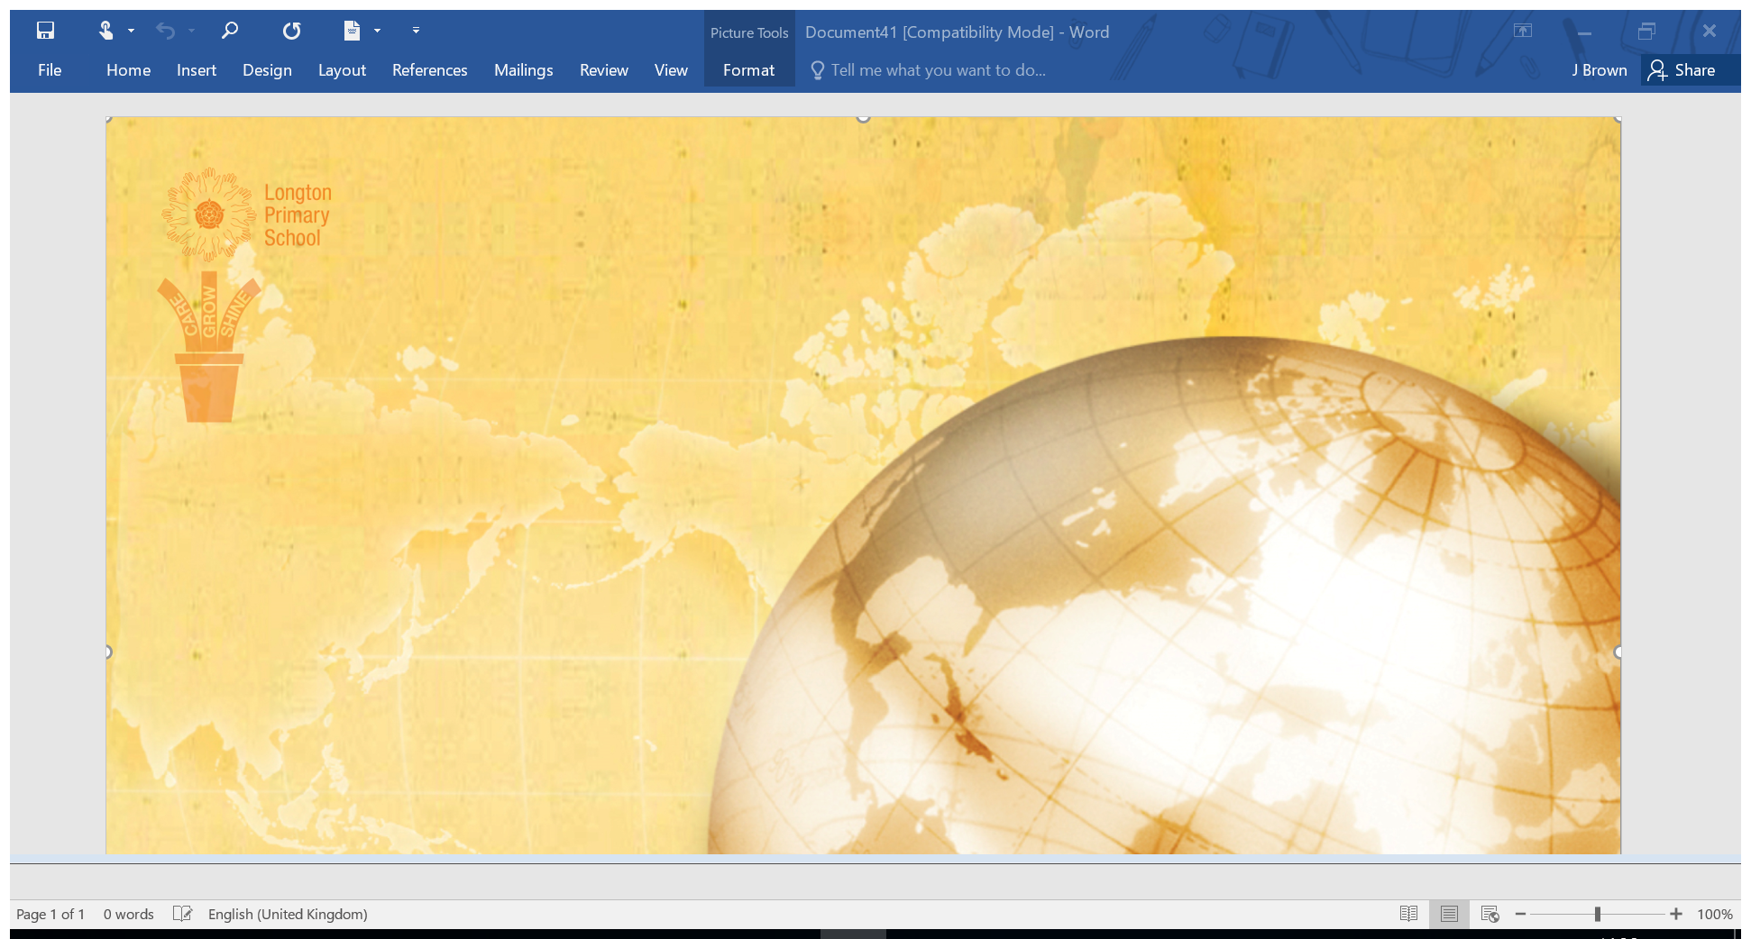
Key Stage 2
Spelling
YEAR 4
We choose the spelling words from the National Curriculum list. Each year group has their own list of words for every week of the year and their associated rules.
We choose the spelling words from the National Curriculum list. Each year group has their own list of words for every week of the year and their associated rules.

Slide 2
Week 1 | Week 2 | Week 3 | Week 4
To identify silent letters in words from different origins Silent letters in words – different origins | To compare which ‘w’ words have a silent ‘h’ and which do not (need to learn the specifics) Some ‘w’ words have a silent ‘h’; others do not – need to learn the specifics | To show the silent ‘e’ changes the sound of the vowel that precedes it (eg ‘rid’ to ‘ride’) The silent ‘e’ changes the sound of the vowel that precedes it, e.g. ‘rid’ to ‘ride’ | To recognise that ‘ate’ can also be spelt ‘eight’ ‘ate’ can also be spelt ‘eight’
honest | when | huge | calculate
write | where | complete | negate
wreck | what | handle | straight
wrong | which | describe | accurate
wrist | wheat | favourite | eight
gnaw | were | extreme | freight
rustle | white | opposite | educate
glisten | whistle | sentence | complicate
mortgage | whisper | separate | concentrate
mechanic |  | quite | evaporate
 |  |  | Weight
High Frequency said they | High Frequency that with | High Frequency what there | High Frequency this have
Year 4 Autumn First Term Weeks 1 to 4

Slide 3
Week 5 | Week 6 | Week 7
To recognise these words all contain double letters These words all contain double letters | To discuss plural nouns that have an ‘o’ after a consonant add ‘es’ Plural nouns that have an ‘o’ after a consonant add ‘es’ | To identify the soft ‘c’ sound If the ‘c’ comes before an ‘e’, ‘i’ or ‘y,’ it is pronounced ‘s’
occasion | Volcanoes | centre
classical | potatoes | century
scissors | tomatoes | certain
planned | heroes | circle
suppose | tornadoes | recent
attitude | tomatoes | medicine
shuffle | zeroes | special
mood | buffaloes | cyclist
blossom | grottoes | adjacent
accident | dominoes | accident
 |  | juicy
High Frequency went hello | High Frequency little were | High Frequency down when
Year 4 Autumn First Term Weeks 5 to 7

Slide 4
Week 1 | Week 2 | Week 3 | Week 4
To analyse the ‘ort’ sound There is more than one spelling for the sound “ort” | To compare the different sounds for the spelling ‘ough’ There is no specific spelling rule for the ‘ough’ string. Children could sort into the different sounds. | To analyse the ‘ar’ sound Discuss the odd ones out and why the sound is different (look at the stressed syllable) | To investigate spelling words Children look at the words from this week’s spellings and choose a couple to investigate – can they find similar words, similar meanings, similar spellings?
bought | enough | party | believe
brought | fought | library | experiment
thought | although | artist | famous
sought | drought | yard | group
consort | thoughtful | darken | history
slaughter | borough | garlic | important
distraught | plough | carton | length
daughter | doughnut | earth | increase
nought | tough | target | interest
 | cough | varnish | material
 |  |  | natural
 |  |  | often
High Frequency looked very | High Frequency don’t come | High Frequency will back | High Frequency into from
Year 4 Autumn Second Term Weeks 1 to 4

Slide 5
Week 5 | Week 6 | Week 7
To investigate spelling words Children look at the words from this week’s spellings and choose a couple to investigate – can they find similar words, similar meanings, similar spellings? | To recognise words starting ‘ch’ but with the sh sound These words mostly have a French origin | To recognise words with the digraph au
perhaps | champagne | caught
probably | chagrin | applaud
quarter | crochet | automatic
remember | moustache | fraught
strength | chauffer | audience
therefore | quiche | taught
woman | chaperone | author
women | chute | naughty
promise |  | astronaut
business |  | cause
peculiar
continue
calendar
High Frequency children just | High Frequency came about | High Frequency their people
Year 4 Autumn Second Term
Weeks 5 to 7

Slide 6
Week 1 | Week 2 | Week 3 | Week 4
To add suffixes beginning with vowels to polysyllabic words If the last syllable of a word is stressed & ends with one consonant letter (with just one vowel before it), the final consonant letter is doubled before any ending beginning with a vowel letter is added | To identify the ‘i’ sound in the middle of words spelt with a ‘y’ | To recognise that ‘u’ sound is also spelt ‘ou’ | To compare the prefixes: ‘un’, ‘dis’ and ‘mis’ ‘un’, ‘dis’ and ‘mis’ have negative meanings
permitted | physics | nourish | disappear
regretting | cycle | flourish | misfortune
inspiring | rhyme | ambitious | misprint
disobeyed | cylinder | country | displace
covering | dynasty | courage | mistreat
developing | cyclone | encourage | mistrust
propelled | oxygen | couple | uncertain
forbidden | gymnastics | enough | unsatisfactory
equipped | synonym | tough | unaware
listened | Egypt |  | unnecessary
High Frequency your could | High Frequency house made | High Frequency time I’m | High Frequency help called
Year 4 Spring First Term Weeks 1 to 4

Slide 7
Week 5 | Week 6
To analyse the “in”, il, im and ir prefixes ‘in’ can mean ‘not’ and ‘in into’; ‘in’ becomes ‘il’ before a root word beginning with ‘l’; ‘in’ becomes ‘im’ before a root word beginning with ‘m’ or ‘p’; ‘in’ becomes ‘ir’ before a root word beginning with ‘ir’ reinforce | To compare the prefixes: ‘re’, ‘sub’, ‘inter’ ‘re’ means ‘again’ or ‘back’; ‘sub’ means ‘under’; ‘inter’ means ‘between’ or ‘among’
Inoffensive | recycling
incorrect | retreat
inadequate | reaction
indefinite | revenge
immigrate | subvert
immortal | substandard
imperfect | subsidy
irresponsible | interference
irregular | intermediate
irrelevant
High Frequency here off | High Frequency asked make
Year 4 Spring First Term
Weeks 5 to 6

Slide 8
Week 1 | Week 2 | Week 3 | Week 4
To discuss the use of the suffixes: ‘ation’ The suffix ‘ation’ is added to verbs to form nouns | To discuss the use of the suffixes: ‘ation’ The suffix ‘ation’ is added to verbs to form nouns | To identify the use of the suffixes ‘ly’ The suffix ‘ly’ is added to an adjective to form an adverb | To compare the use of the suffixes: ‘ly’ and ‘ally’ If the root word ends in ‘y’, change to an ‘i’ before adding ‘ly’If the root word ends in ‘le’, the ‘le’ is changed to ‘ly’If the root word ends in ‘ic’, ‘ally’ is added instead of ‘ly’
admiration | exploration | modify | responsibly
combination | determination | fluently | durably
observation | mediation | fortunately | anxiously
detonation | alliteration | historically | accusingly
illustration | vegetation | completely | humbly
vibration | exaggeration | consequently | academically
decoration | cancellation | eventually | traditionally
coronation | discrimination | necessarily | sentimentally
generation | foundation | exceptionally | historically
population | fascination | exceedingly | maically
High Frequency water away | High Frequency good want | High Frequency over how | High Frequency going where
Year 4 Spring Second Term Weeks 1 to 4

Slide 9
Week 5 | Week 6
To compare the ending ‘sure’ + ‘ture’ Always ‘sure’ for ‘s’ sounding endings, ‘ture’ for nouns that can’t be verbs, e.g. teacher vs creature, catcher vs furniture | To compare the ending ‘sure’ + ‘ture’ Always ‘sure’ for ‘s’ and ‘ze’ sounding endings, ‘ture’ for nouns that can’t be verbs, e.g. teacher vs creature, catcher vs furniture
exposure | future
reassure | sculpture
enclosure | fracture
pleasure | mixture
treasure | pressure
overture | composure
furniture | leisure
moisture | measure
adventure | closure
puncture | disclosure
High Frequency would took | High Frequency school think
Year 4 Spring Second Term
Weeks 5 to 7

Slide 10
Week 1 | Week 2 | Week 3 | Week 4
To demonstrate the ‘s’ sound spelt ‘sc’ These words have originated from Latin – Romans | To identify the ‘ay’ sound spelt ‘ei’, ‘eigh’ or ‘ey’ No specific rule | To explain the possessive apostrophe The apostrophe is placed after the plural form of the word; ‘s’ is not added if the plural already ends in ‘s’, but is added if the plural does not end in ‘s’ (e.g. children’s) | To explain the homophones or near-homophones A homophone is a word that is pronounced the same as another word ,but differs in meaning, and may differ in spelling
science | vein | girls’ | grate
scene | weight | boys’ | great
discipline | eight | babies’ | groan
fascinate | neighbour | children’s | grown
crescent | they | men’s | missed
fascinate | obey | mice’s | mist
scissors | rein | parent’s | bury
scented | sleigh | teacher’s | berry
scenery | survey | helper’s | fairfare
descend | convey | auntie’s
High Frequency know bear | High Frequency can’t again | High Frequency long things | High Frequency after wanted
Year 4 Summer First Term Weeks 1 to 4

Slide 11
Week 5 | Week 6
To explain the homophones or near-homophones A homophone is a word that is pronounced the same as another word ,but differs in meaning, and may differ in spelling | To recognise the ‘ee’ sound can be spelled with an i
knot | happiness
not | happily
plain | silliness
plane | prettiest
peace | merriment
piece | pitiful
weather | beautiful
whether | nastiness
whose | penniless
who’s | plentiful
High Frequency everyone our | High Frequency two play
Year 4 Summer First Term
Weeks 5 to 6

Slide 12
Week 1 | Week 2 | Week 3 | Week 4
To compare the ‘ay’ sound spelt ‘ei’, ‘eigh’ or ‘ey’ If it has a long (a) sound then it is spelled ei | To discuss the ‘gue’ and ‘que’ sounds These words have originated from French words, so the spelling has stayed the same | To identify additional spellings + revision | To discuss the prefix bi The English prefixes bi-, derived from Latin, and its Greek variant di- both mean “two.”
grey | plague | breath | bilingual
osprey | fatigue | build | bicuspid
disobey | antique | extreme | biped
surveyor | unique | fruit | bicycle
conveyor | vague | height | biplane
reign | catalogue | notice | biceps
freight | plaque | purpose | bicentennial
veil | dialogue | strange | binoculars
eighteen | grotesque | surprise | bisect
neighbour | unique | consider | biannual
High Frequency two play | High Frequency take thought | High Frequency well find | High Frequency more I’ll
Year 4 Summer Second Term Weeks 1 to 4

Slide 13
Week 5 | Week 6
To analyse the spelling when the ending sounds like ‘shun’ If the ending of nouns sounds like ‘shun’, it is spelt ‘sion’ | Class revision session A mixture of words from lots of different spelling rules
invasion | separate
division | affect
confusion | unexpectedly
decision | potatoes
collision | circus
suppression | insoluble
explosion | microphone
corrosion | bicentennial
confession | brochure
progression | mathematical
illusion | completion
 | astronaut
High Frequency round tree | High Frequency magic shouted
Year 4 Summer Second Term
Weeks 5 to 6

