Slide 1
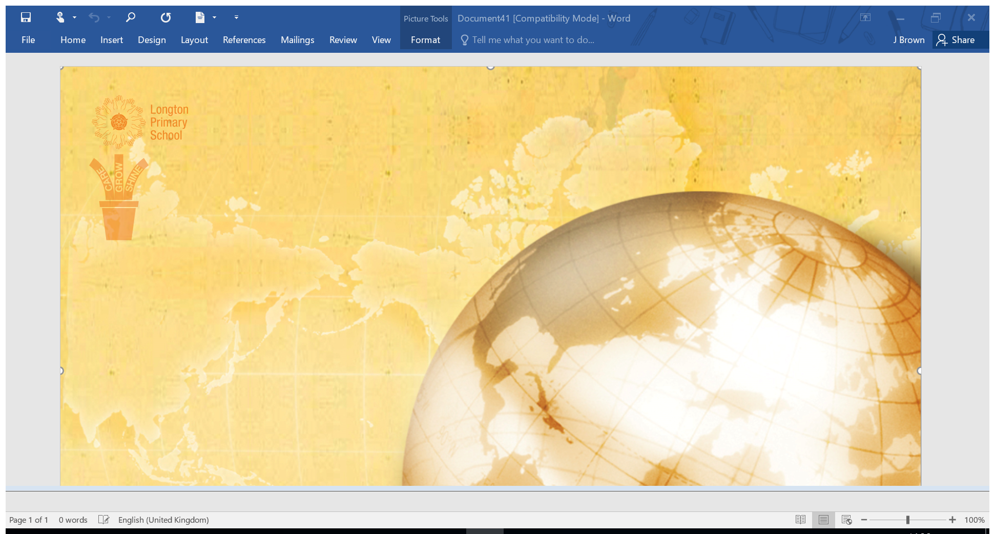
Key Stage 2
Spelling
YEAR 3

Slide 2
Key Stage 2
Spelling
YEAR 4

Slide 3
Key Stage 2
Spelling
YEAR 5

Slide 4
Key Stage 2
Spelling
YEAR 6

