Slide 1

Welcome to

Slide 2


Who will be teaching your children?
Miss Lynch
Mrs Pratten
Milk – is no longer free you have to order if you would like your children to have milk
Toast – is available as last year, again it needs ordering
Dinners – children choose in the morning or can bring a packed lunch

Slide 3

The school day 8:50 – 3:15
Morning work – spelling task
Maths Lesson
Playtime
Phonics
English Lesson
Guided reading
Lunchtime
Foundation Subjects
Story
Assemblies

Slide 4

Reading is very important and we appreciate the time and effort you as parents put in to supporting this at home.
Reading the words fluently and with expression is important but it is also important to ask your child questions about what they have read. Ask them why they think certain things have happened in the story and to give opinions about what they have read.
Please read every day, minimum 10 minutes and make comments in the reading records. Your children should be able to read the book almost fluently on the last read. Read it over and over throughout the week to improve fluency. Children may bring home a book they have already read – again helps with fluency
Reading books will be changed on a Monday

Slide 5


Handwriting is a whole school focus along with presentation of work.
Daily – the children will share a book as group with AT’s or with myself as a class.
In Year 1 , as in Reception , the children have a daily phonics session. Phonics is one strategy that helps children learn to read. In the Summer term there is a phonics screening check up that all Year 1 children have to undertake. The children will be well prepared and confident with the format so it will just be the norm and nothing to worry about.

Slide 6

.

Slide 7


Slide 8

Earrings must be taken out for PE or plasters provided from home if ears are newly pierced
Monday morning and Thursday mornings are our PE times with PE kits worn on a Monday.

Slide 9


Spellings – these will be put in reading records on a Monday, they will relate to the phonic sound for that week. They will be checked on Friday.
Weekly – Maths. A mixture of arithmetic questions and reasoning questions.
Weekly – English. Alternates between a Reading comprehension and a Grammar sheet.
It will be sent home on a Thursday and is to be returned by the following Tuesday. Please return it in their red homework bags along with the green folder.
All children will be receiving the same level of homework so you can clearly see the expectations of the Year 1 curriculum.
Holiday passport – this is sent home at the end of a half term, completed with holiday news and returned to school. It can be photos, leaflets, drawings pictures a bit like a scrap book.
Projects – Children can make a project connected to any of this half terms topics (see the subject organiser) or it can be about something they are interested in.
Send to school before the parents evening so they can be put on display in the hall.

Slide 10
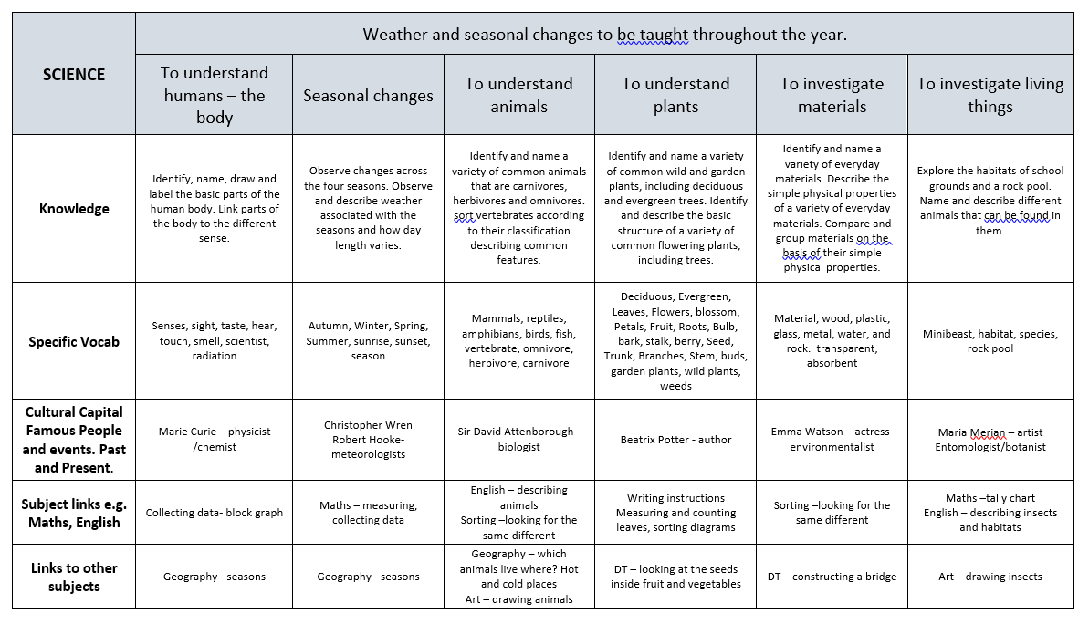
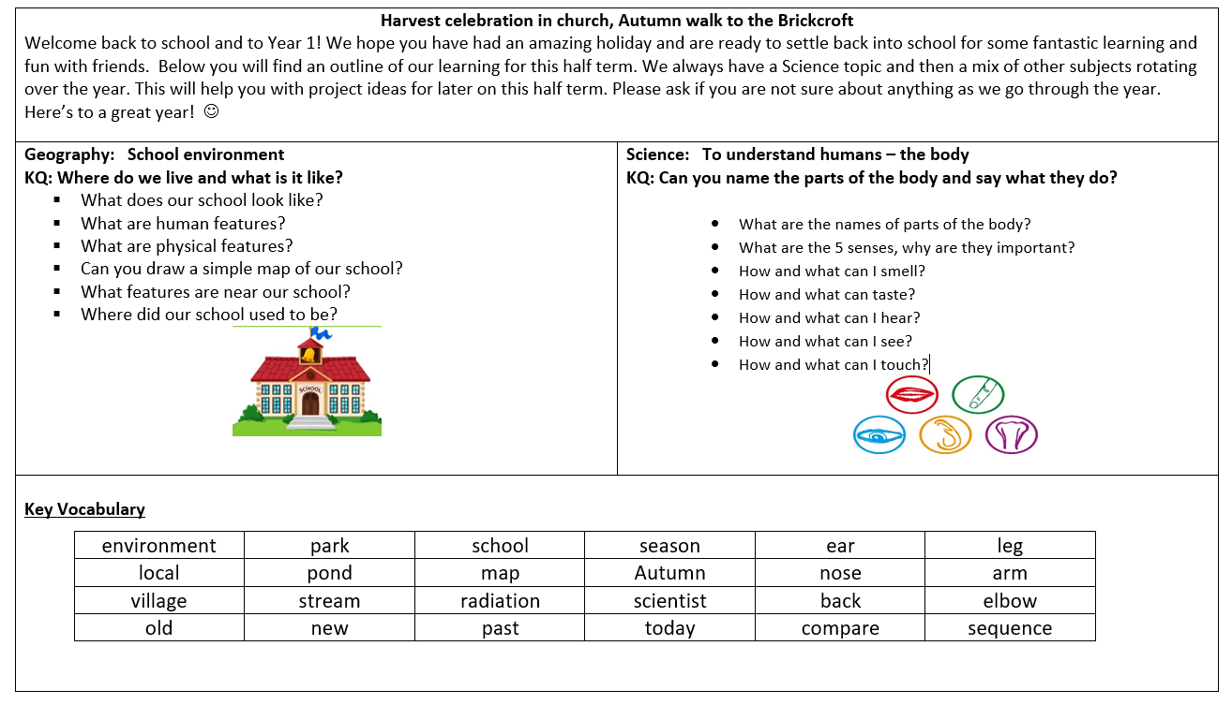
The Curriculum
Documents relating to what we will be learning are on the website.
Long term plan – the whole year.
Subject organisers – the half term.
Year 1 Autumn 1

Slide 11

Don’t forget - the school uniform now has a new addition – an arm band. These can be bought via the school office using the order form provided at a cost of £4.00 each. This also includes the cost of the tribe name badge. The arm bands will be worn on special occasions such as Celebration Assemblies. Please write your child’s name on these valuable possessions.
Through the LPS+ curriculum the children will be able to earn ‘character’ badges which can be sewn on to the arm band. The fabric badges cost £2 each. If a child earns a silver or gold star they can also purchase a fabric badge costing £1.50.

Slide 12


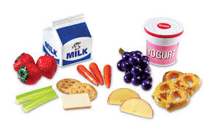
What can we bring to school?
Healthy snack- fruit, vegetables, cereal bars
Water bottle – it is a water bottle so please no juice!

Slide 13

Please can all uniform be named.
With over 200 children in school it is impossible to reunite nameless sweatshirts and cardigans with their owners. Remember to keep checking the pen has washed out!!

Slide 14


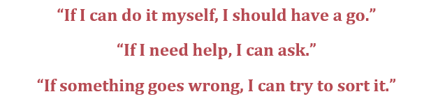

We have very high expectations of the children in terms of their behaviour and learning.

Slide 15

Hometime
Thank you for being patient at the moment whilst the building work is taking place.
Normal pick up is right round the school toward the field and through the little gate by the shed.
Safeguarding
Please can you let either the office, myself or Miss Lynch know if somebody different is collecting your child from school. If it is always Granny on a Thursday, just tell us once and then we know that is the routine. If it is a one off, we need to know, even if they are going home with a friend from school, we still need permission for them to go with someone else.
Thank you!

Slide 16


Medical records
Please can you update your child’s medical record on the My child at school app.
Data collection – medical form
Add any new information but please delete anything that no longer applies.

Slide 17

Our aim is to have happy children who are enjoying their learning.
If you want to find out what we have been doing – check out Instagram and the blog – Hippo page – a great way to talk to the children about their learning!

