Slide 1
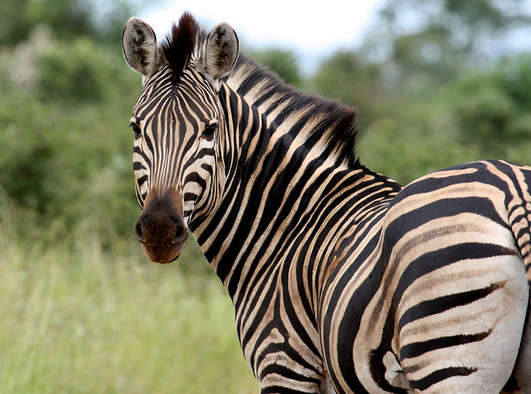
01
YEAR 6
Meet the Teacher
Welcome to a year of challenge, confidence and preparation for secondary school
Longton Primary School

Slide 2
Who will be teaching your children?
02
Class teachers
Additional teaching
Mr Pearson and Mrs Atkinson
• Mr Sumner – Drama
• Mrs Taylor – Computing
• Mrs Skinner – Art
• Mrs Darby – French / Music
Year 6 • Meet the Teacher

Slide 3
Our weekly timetable
03
A clear view of the core learning and wider curriculum
Day | 8:50 | 10:15 | 11:00 | 1:00 | Afternoon
Monday | Maths | Grammar / spelling | Reading → English | Reading | RE / PSHE • Singing • Assembly
Tuesday | Maths | Grammar / spelling | Reading → English | Reading | Geography • PE • Assembly
Wednesday | Maths | Grammar / spelling | Reading → English | Reading | Extended writing • DT • Knowledge Quiz
Thursday | Maths | Grammar / spelling | Reading → English | Reading | Science • Assembly
Friday | French / music • PPA cover | Art • PPA cover | Drama • PPA cover | Computing | Computing
Year 6 • Meet the Teacher

Slide 4

Reading every day & PE
04
Two routines to help children be ready to learn
Daily reading
30 minutes every day using the VIPERS approach.
The texts are challenging and prepare the children well for the SATs.
Year 6 • Meet the Teacher

Slide 5

Reading every day & PE
04
Two routines to help children be ready to learn
Navy jogging bottoms or shorts • no cycling shorts • plain black trainers
Year 6 • Meet the Teacher

Slide 6
Reading books
05
Building a strong daily reading habit
• Home reading books will be changed each Tuesday.
• Children choose books with Mrs Atkinson from the progressive book bands or our well-resourced library.
• Encourage children to read other books from home or the library.
• Please read for at least 20 minutes each night — “Every night a reader”.
A simple routine helps: after tea, before bed, or another consistent time.
Year 6 • Meet the Teacher

Slide 7
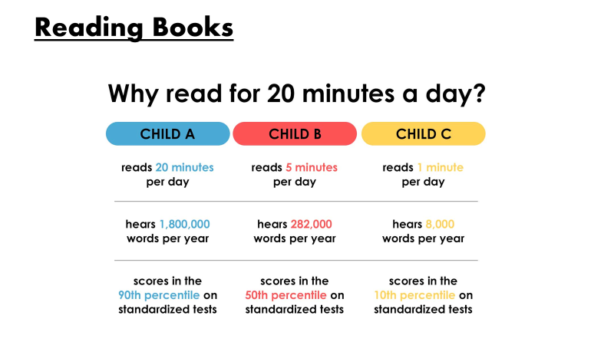
Why read for 20 minutes a day?
06
Small, consistent habits make a big difference
Year 6 • Meet the Teacher

Slide 8
Homework
07
Set on Thursday and completed by the following Tuesday
Maths
English
Reading comprehension
Grammar
Reading daily
Arithmetic questions
Reasoning questions.
Weekly practice
Spelling weekly – stapled in reading record book
Times Table Rock Stars
Year 6 • Meet the Teacher

Slide 9
Home support
08
Simple ways families can reinforce learning
Times tables
Practise them in every way possible.
Reading
Reading speed, fluency and understanding of vocabulary.
Spelling
Year 3/4 statutory words as well as Year 5/6 statutory words.
Weekly lists
Encourage children to look at weekly spelling lists and
revisit them throughout the year.
Year 6 • Meet the Teacher

Slide 10
Useful websites
09
Online practice and support
Spelling Shed
https://www.spellingshed.com/en-gb/
Times Table Rock Stars
https://ttrockstars.com/
BBC Bitesize
https://www.bbc.co.uk/bitesize/subjects/z4296rd
Year 6 • Meet the Teacher

Slide 11
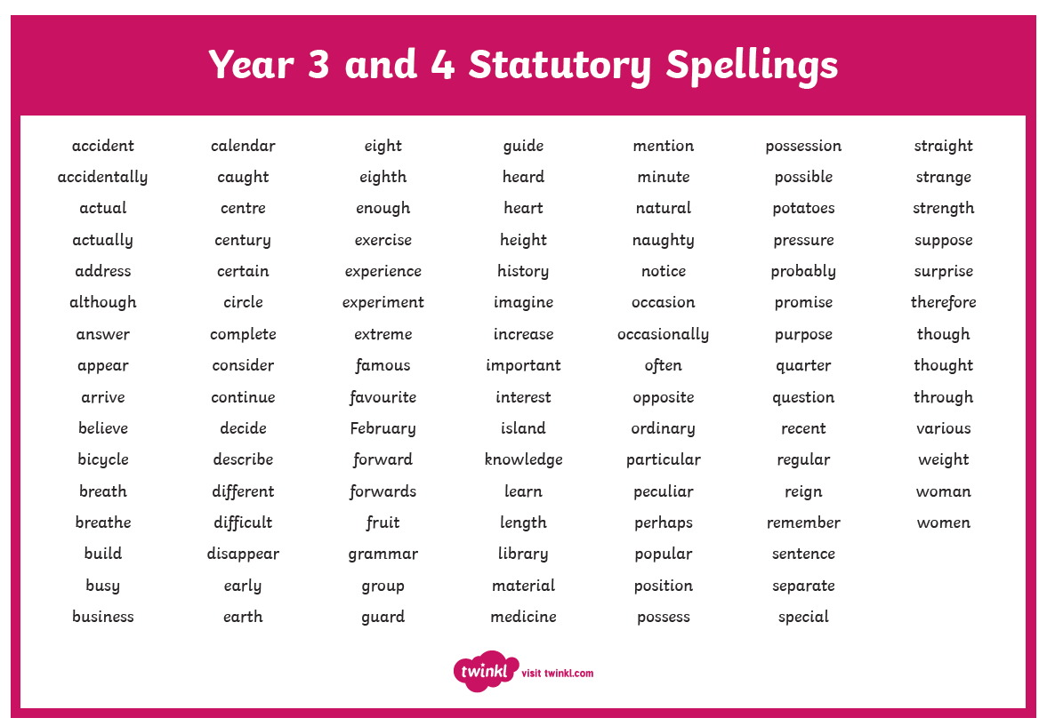
Statutory spellings: Years 3 & 4
10
Year 6 • Meet the Teacher

Slide 12
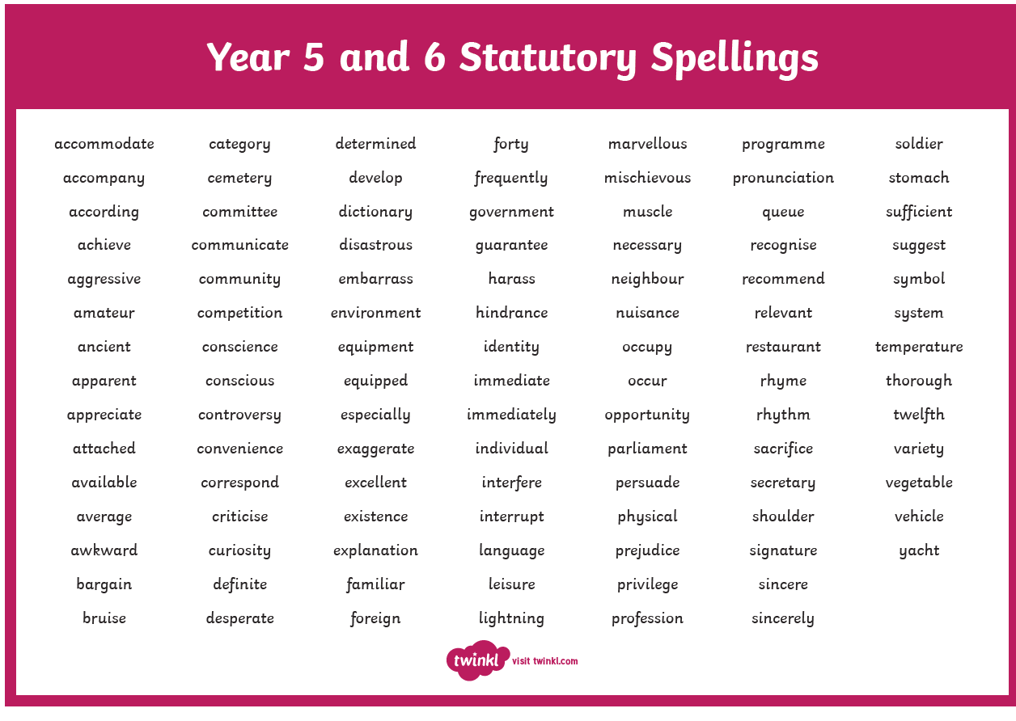
Statutory spellings: Years 5 & 6
11
Year 6 • Meet the Teacher

Slide 13
High expectations
12
Behaviour, learning and readiness for secondary school
We have very high expectations of the children in terms of their behaviour and learning.
Children understand that they have to achieve their best and be ready for starting at Secondary School.
Year 6 • Meet the Teacher

Slide 14

Aim for the stars
13
Confidence and calm as SATs approach
We will support children to work hard, understand their next steps and approach assessments positively.
Year 6 • Meet the Teacher

Slide 15
Assessment & SATs
14
Using assessment to identify gaps, prioritise teaching and organise support
Assessment
Key Stage 2 SATs (Year 6)
Baseline test completed week 2 Autumn term.
Monday 10 May 2027
English grammar, punctuation and
spelling
(SPaG) — Paper 1 (questions)
and Paper 2 (spelling)
Allows me to analyse gaps, prioritise teaching and organise interventions for children. Equally, demonstrates to the children end of year expectations.
Tuesday 11 May 2027
English reading test
Wednesday 12 May 2027
Mathematics — Paper 1 (arithmetic)
and Paper 2 (reasoning)
January 2026
2025 test will be given
February
Parents information meeting
Thursday 13 May 2027
Mathematics — Paper 3 (reasoning)
Year 6 • Meet the Teacher

Slide 16
School website
15
A useful place for information, updates and resources
www.longton.lancs.sch.uk
Blog • Letters • National curriculum – overview of the year
End of year expectations
Instagram: Longtonprimaryschool
Year 6 • Meet the Teacher

Slide 17
York residential
16
June • history, independence and memorable experiences
Where we are staying
We will be going on the residential to York 9 -11th June 2027.
We are staying at York Youth Hostel, which is a 20 minute walk away from the City Centre.
Looking at the city’s history while developing independence and teamwork.
Year 6 • Meet the Teacher

Slide 18
York: places we will visit
17
History brought to life across the city
York Minster
Tour of York
Walk along the City Walls
York Museum
Roman Baths
JORVIK Viking Centre
At the Youth Hostel
Making replica stained-glass windows • baking Roman bread • designing and making replica Roman shields
Year 6 • Meet the Teacher

