Slide 1


Safeguarding Policy Child Friendly Version
Longton Primary School
The right to be heard
The right to be treated fairly

Slide 2

What is this?
Your school has a Safeguarding
Policy for staff, families and
governors.
This ‘child friendly’ policy is designed for young people and this
should be read as a guide to the
main policy.
What is it for?
To help you decide what could be a ‘problem’
and where to get help and support.

Slide 3

Is someone bullying you?
You must tell someone at school so we can help you.
Bullying can be:
Emotional- hurting their feelings on purpose
Physical- hitting. Kicking, pushing, tripping over
Verbal- calling names, making fun of someone
Cyber- on a computer, tablet, phone, sending nasty messages or photographs
Prejudiced- bullying someone because of their culture, religion, colour of their skin, likes/dislikes or gender
Do NOT keep it a
Secret!
If you see someone else being bullied:
Do-
Ask them to stop (if you feel confident)
Tell an adult
Make sure that the person being bullied is okay
Don’t-
Join in
Try to sort it yourself

Slide 4


Saying funny things to you
Has someone said something to you or have you heard something that you do not like or upsets you?
You must tell someone at the school so we can help you
.
Touching you
Has someone touched you on a part of your body like your bottom, chest or anywhere else you do not like?
You must tell someone at school so we can help you.

Slide 5


Trying to give you tablets, cigarettes, drugs or alcohol
Has someone asked you if you want a tablet or to smoke a cigarette, or have a drink of something and you do not know what it is?
Do not eat, drink or smoke what they are giving you.
Hitting, punching or smacking you
Has someone hit, punched or smacked you or hurt you
in anyway? You must tell someone at the school so we can help you.
Do NOT keep it a Secret!

Slide 6
The four main areas of Child Protection concerns are:
Physical Abuse – hitting, smacking, shaking, throwing, burning, biting etc
2. Sexual Abuse – be aware this doesn’t always mean actually touching a child.
It could be someone making you watch things to do with sex or encouraging
you to act in an inappropriate way.
3. Neglect – this means things like not providing meals or warmth or clothing.
Or perhaps not taking you to the Doctors when you need to go. There may be
lots of different reasons why a child is neglected and it is really important
that we know so we can help.
4. Emotional Abuse – This means when someone upsets you or makes
you feel bad. If someone in your family says horrible things to you
and makes you feel sad and worthless.
These are just a few examples for you and if you think you may have a
problem that is similar to one of these then talk to someone

Slide 7
You must tell someone at the school so we can help you.
Examples of people you can tell are:
-Your Teacher
-Your Headteacher
-Relax Kids
-Your Assistant Teacher
-Your Dinner Lady
- The Office Staff
If in doubt, talk to someone. There are many staff at
school for you to talk to and they will help support you.
Don’’t be afraid to talk.!

Slide 8

How does your school work to protect children?
There are lots of different ways, but one of the main ways is making sure the staff here at your school know how to keep you safe and also make sure you have someone to talk to if you need to.
Your Headteacher is here to support young people
and their families if there is a Child Protection concern.
Safeguarding and Child Protection mean the same
thing and they mean that we look after children
and keep them safe.

Slide 9
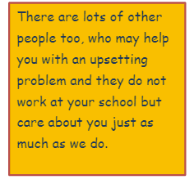

Talk to someone
What are the next steps?
Sometimes a member of staff at your school will need
to check things with your Headteacher and then if
they can deal with the issue themselves, they will.
There are times though when they may need to contact
some other agencies for support. These may
be Children’s Social Care (Social Workers) or Police.
There are lots of other agencies who support children
and their families as well.
Your Headteacher will talk to you and explain all of
this and you can always go and ask them questions
if you are unsure about anything.

Slide 10
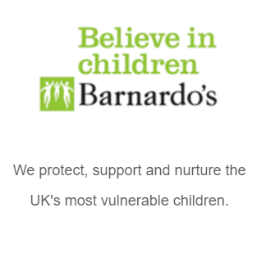
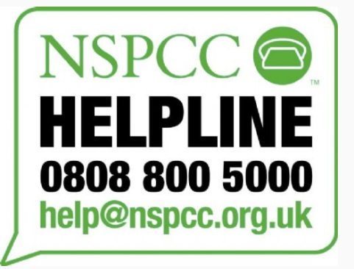
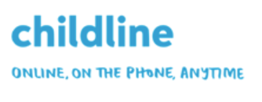
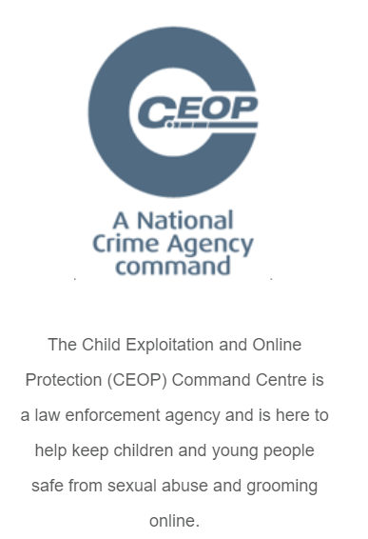
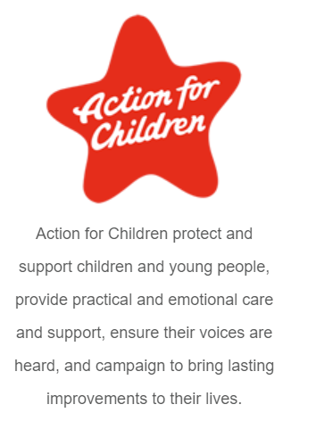
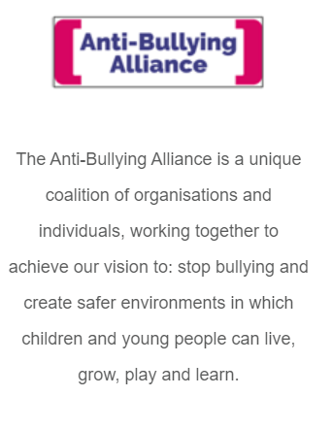
Freephone: 0800 1111 (24 hours)
Website: https://www.childline.org.uk/
Website: https://www.barnardos.org.uk/
Email: info@barnardos.org.uk
Tel: 0208 550 8822
Emergency Numbers:
Tel: 0800 11 11 (Childline)
Tel: 0808 800 5000 (NSPCC 24hr Child Protection Helpline)
CEOP Command is part of the National Crime Agency.
Tel: 0370 496 7622
Website: https://www.ceop.police.uk/safety-centre/
General Enquires Tel: 0300 123 2112
(Monday - Friday: 9:00 - 17:00)
Website: http://www.anti-bullyingalliance.org.uk/

