Slide 1

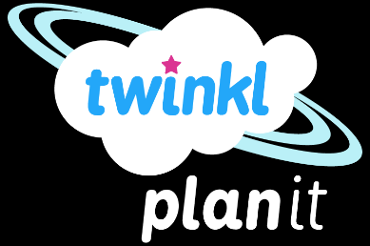
Computing
Online Safety
Year One
Computing | Year 1 | Online Safety | Staying SMART Online| Lesson 3

Slide 3
Aim
To understand how to communicate safely online.
Success Criteria
I can explain what each letter of SMART stands for.
I can spot when something online might not be safe.
I can explain what to do if something online is not safe or upsets me.
I can make links between the offline and online world.

Slide 4

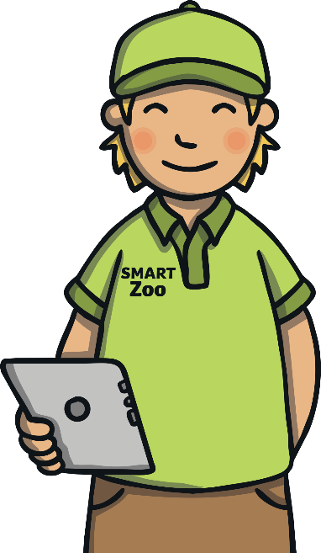
SMART Zoo
Welcome to SMART Zoo. This zoo is very special because all the animals love to go online and use the Internet!
This is Spud Smart. He's the zookeeper and it’s his job to remind all the animals to stay safe online.
To do this, Spud follows the SMART rules.

Slide 5
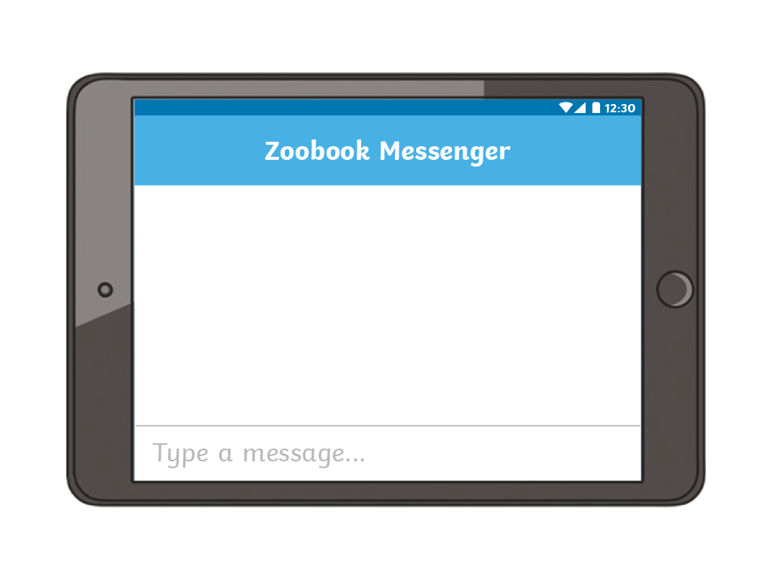

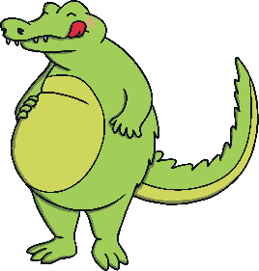


S for Safe
@CreepyCroc: Hi there. I like your picture. I know we haven't met but can you tell me where you live?
@Ella_Elephant: Thanks! Yes, of course. I live over at
@SpudSmart: Stop! Be SMART! Don't forget - S is for Safe. Keep details like your name, where you live and where you go to school away from strangers.
S is for Safe
What should Ella Elephant have done?

Slide 6

M for Meet
@CreepyCroc: Hi there. I enjoyed our chat the other day. Would you like to meet up?
@Lee_Lion: Yeah, me too. I don't really know you, but OK!
@SpudSmart: Stop! Be SMART! Don't forget - M is for Meet. Don't meet people that you only know online unless you're with a trusted adult.
M is for Meet
What should Lee Lion have done?

Slide 7
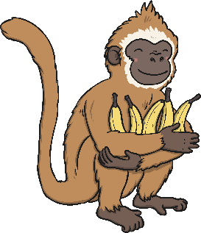
A for Accept
@CreepyCroc: Hi there. Click here if you want some
free bananas!
@MiaMonkey: Ok, I will - I love bananas!
@SpudSmart: Stop! Be SMART! Don't forget - A is for Accept. Don't click on any links that you're not sure about or that seem too good to be true. Ask a trusted adult if you are not sure.
A is for Accept
What should Mia Monkey have done?

Slide 8

R for Reliable
@CreepyCroc: I saw on the Internet that too many bananas gives you spots!
@MiaMonkey: Oh no! Bananas are my favourite food. Now what will I eat?
@SpudSmart: Stop! Be SMART! Don't forget - R is for Reliable. Don't believe everything people tell you. Check other websites to find out the truth.
R is for Reliable
What should Mia Monkey have done? Talk to your partner.

Slide 9
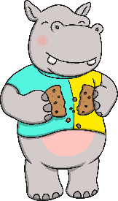

T for Tell
@CreepyCroc: I saw you swimming in your lake. You're looking a bit fat at the moment!
@HankHippo:
@SpudSmart: Stop! Be SMART! Don't forget - T is for Tell. If anything you do or see online upsets you, tell a trusted adult straight away!
T is for Tell

Slide 10
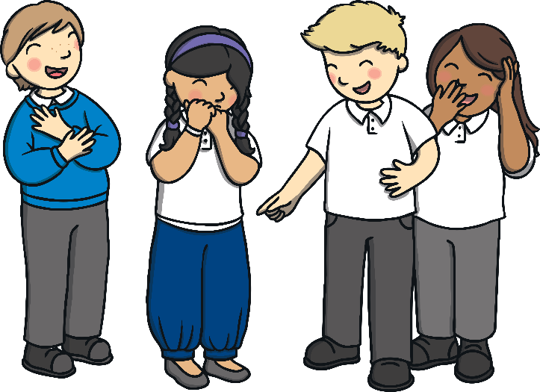

T for Tell
What would you do if someone hurt or upset you in the playground? Talk to your partner.
The online world is just the same.
If you see, hear or read something online that upsets you then tell a trusted adult straight away.

Slide 11


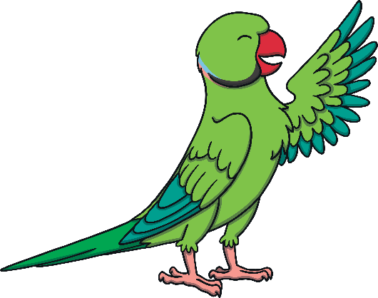
Welcome to Our New Animals
Two new animals have arrived at SMART zoo: Patty Parrot and Kia Kangaroo.
Can you help them to stay safe online?

Slide 12
Welcome to Our New Animals
Patty Parrot has received this message.
“
@CreepyCroc: Hi there. I heard you are new in town. I can show you around! Just tell me your address and I can come and meet you.

Slide 13
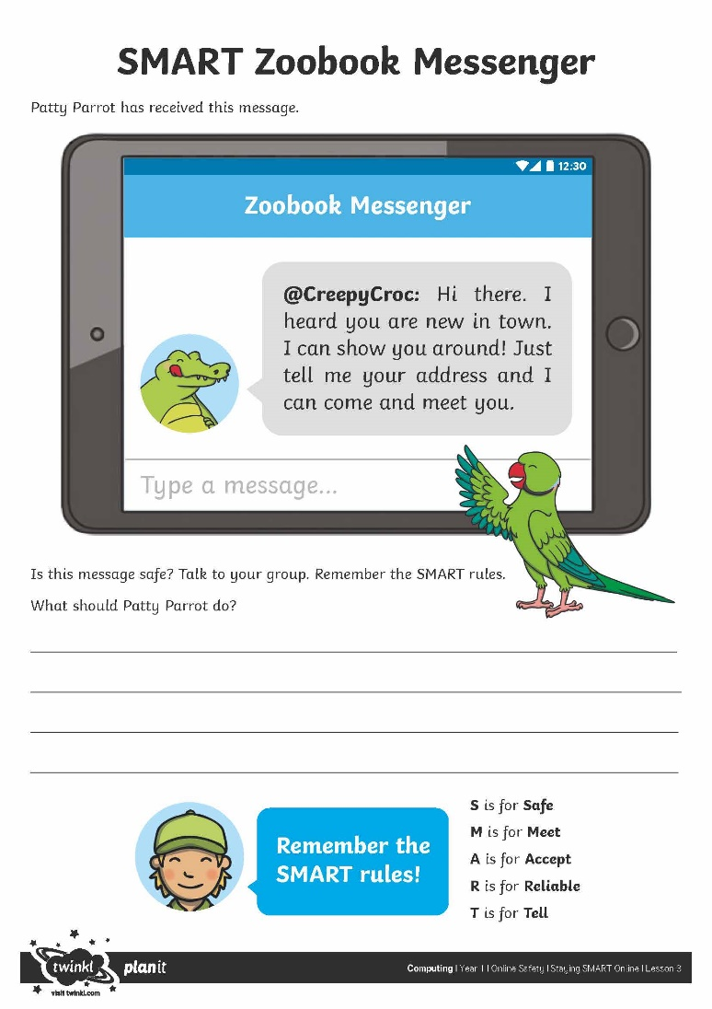
Welcome to Our New Animals
Talk to your group.
Is the message safe?
What should Patty Parrot do?
Remember the SMART rules!
S is for Safe
M is for Meet
A is for Accept
R is for Reliable
T is for Tell

Slide 14


Are You SMART Enough?
Can you remember what each letter is for?
afe
S
eet
M
ccept
A
eliable
R
ell
T
Can you explain what each word means?

Slide 15

Aim
To understand how to communicate safely online.
Success Criteria
I can explain what each letter of SMART stands for.
I can spot when something online might not be safe.
I can explain what to do if something online is not safe or upsets me.
I can make links between the offline and online world.

