Slide 1
Robinwood 2024
Information for parents

Slide 2
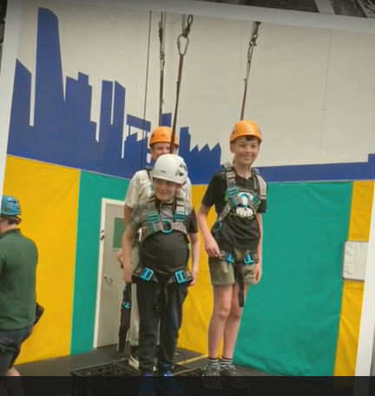
Friday 7th June 2024 – Sunday 9th June 2024

Slide 3
EVERYTHING YOU NEED IS IN THE PACK PROVIDED
BUT TONIGHT PLEASE ENSURE:
SOUVENIR FORMS HAVE BEEN HANDED IN AND ITEMS PAID FOR – BY FRIDAY THIS WEEK PLEASE
YOU TAKE A LUGGAGE LABEL
TALK TO US ABOUT ANYTHING SPECIFIC EG: MEDICAL NOTES, DIET ETC
YOU ASK QUESTIONS IF UNSURE!

Slide 4
FRIDAY 7TH JUNE
ARRIVE AT SCHOOL READY 9.00AM
PACK ACCORDING TO THE CLOTHING LIST AND KEEP IT LIGHT IF POSSIBLE. NO ‘HAND LUGGAGE’
CONSIDER THE WEATHER – HOT DAY? SUN CREAM APPLIED AND ALSO PACKED?
MEDICINES HANDED TO STAFF AND LOGGED - TRAVEL PILLS TAKEN OR NEEDED? LABEL ALL MEDICINE AND HAND OVER CLEAR INSTRUCTIONS PLEASE
ENSURE YOUR CHILD IS DRESSED, READY FOR THE WALK UP TO THE CASTLE ON ARRIVAL. PLEASE NOTE: NO ‘CROPPED TOPS’, ‘SHORT’ SHORTS – APPROPRIATE WALKING GEAR PLEASE. THE WALK IS APPROXIMATELY A MILE – MILE AND HALF UPHILL.
NO NEED TO STAY BEYOND THIS ‘HANDOVER’ TIME – WE LEAVE APPROX 9.45AM
ON ARRIVAL – UNPACK AND MAKE YOUR BED! PRACTISE DUVETS NOW!

Slide 5
Medicines ….
ALL medicines and inhalers must be in date and labelled.
Please note we do NOT take ‘spare’ inhalers – your child MUST have theirs with them on the day of departure.
Please take a form tonight (even for travel pills, anti-histamine etc) and ensure it is carefully completed.
On the day we leave, ensure you bring any medicines, listed on the form, and labelled – needs to be handed into staff.

Slide 6
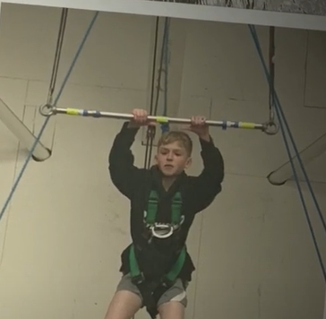
SUNDAY 9TH JUNE
COLLECT AT SCHOOL 2.30PM SHARP PLEASE
PLEASE LEAVE SPACE FOR THE COACH TO PARK AND DROP-OFF
ENSURE YOU TAKE MEDICINES AND INHALERS ETC FROM STAFF

Slide 7
CODE OF CONDUCT
WE EXPECT HIGH STANDARDS OF BEHAVIOUR – PLEASE READ THE CODE OF CONDUCT WITH YOUR CHILD – KEY POINTS:
Code of conduct for children at Robinwood:
1. Follow instructions.
2. Keep yourselves and everyone else safe.
3. Challenge yourself.
4. Be a good team member.
5. Take responsibility for your own property and jobs.
6. Be helpful to others.
7. Respect other peoples privacy and property.
8. Be a good ambassador for your school.

Slide 8
SAMPLE ITINERARY

Slide 9
CLOTHING AND KIT
PLEASE READ ALL THE INFORMATION CAREFULLY – IT IS ESSENTIAL
NO NEED TO BUY ANY SPECIAL CLOTHING – OLD CLOTHES ARE BEST! PREPARE FOR DIRTY CLOTHES THAT MAY ALSO GET DAMAGED OR RIPPED, OR DAMAGED IN THE WASHERS/DRYING ROOM. PLEASE DO NOT BRING ANY NEW OR EXPENSIVE ITEMS, OR ANY ITEMS WHICH CANNOT BE TUMBLE DRIED.
PLEASE PACK ACCORDING TO THE LIST PROVIDED – NOTABLY:
KNEE-LENGTH SHORTS, REGULAR T-SHIRTS (NOT VEST TYPE OR CROPPED) – YOUR CHILD NEEDS SPECIFIC ITEMS ON THE LIST (EG LONG SLEEVE TOPS) OTHERWISE STAFF AT ROBINWOOD WILL ASK THEM TO CHANGE INTO APPROPRIATE CLOTHING FOR THE ACTIVITIES AND THIS WILL CAUSE A DELAY.
Jeans are not suitable for the activities, as they are cold and restrictive
when wet and difficult to dry. Tracksuits or jogging bottoms are ideal, but
other trousers would also be fine
LABEL EVERYTHING!
NO SWEETS /SNACKS / WATER BOTTLES PLEASE – NOT ALLOWED IN DORMS.
NO AEROSOLS PLEASE – SMOKE DETECTORS!
NO HAND LUGGAGE FOR THE COACH
EACH CHILD CARRIES THEIR OWN CASE – DO NOT OVER-PACK!

Slide 10


Slide 11
DEVICES …
NO MOBILE PHONES OR DEVICES AT ALL PLEASE
NO EXPENSIVE WATCHES / SMART PHONES / IPODS /GAMES OR GADGETS
THIS IS ROBINWOOD’S POLICY AND IS FOR SAFEGUARDING REASONS.

Slide 12
AT NIGHT..
SECURITY IS PARAMOUNT
There is always at least one male and one female member of Robinwood staff
awake and on duty during the night. Members of staff will be allocated
rooms near to the children. The building is always secured overnight.
Emergency call button – in every room.
ST Mary's Staff also located on each dorm level - usually right next door -so be warned we don't want grumpy teachers due to lack of sleep !
Mr Grahame Benson- Chair of the governors will be contacted in the event of
an emergency and will follow the school ‘Critical Incident Plan’ if necessary.

Slide 13
SINCERE THANKS TO YOU FOR COMING ALONG TONIGHT……….FOR YOUR WONDERFUL CHILDREN …..
…AND TO THE STAFF WHO GIVE THEIR TIME TO COME ALONG ON THIS RESIDENTIAL visit.

Slide 14
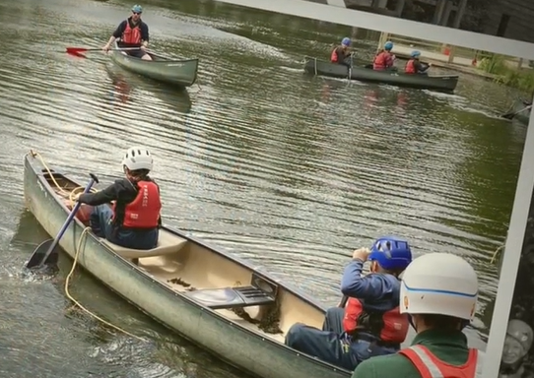
ANY QUESTIONS?

