Slide 1

Key Stage 2 National Curriculum
Assessments (SATs)
St. Mary’s CE Primary School
Presentation to Parents.
Notes:
1

Slide 2
Tonight’s Meeting
The purpose of tonight’s meeting is to provide parents with general information regarding the Government SAT’s in Year 6
Notes:
2

Slide 3
Why Assess ?
A core part of teaching and learning is continuous on going assessment and adaptation of tasks and approaches in response. This happens all day everyday but children will be unaware.
In addition summative assessment also takes place at key points in the school year, in all classes. This gives a measure of what children know, remember and apply at a point in time. This is how the English Education System has been designed by the Government from 4 – 18 years.
Notes:
3

Slide 4
Scaled Scores
What is meant by ‘scaled scores’?
It is planned that 100 will always represent the ‘national standard’.
Each pupil’s raw test score will therefore be converted into a score on the scale, either at, above or below 100.
The scale will have a lower end point somewhere below 100 and an upper end point above 100.
A child who achieves the ‘national standard’ (a score of 100) will be judged to have demonstrated sufficient knowledge in the areas assessed by the tests.
What is meant by ‘scaled scores’ ?
On each test pupils will receive a raw score .
Each pupil’s raw test score will then be converted into a score on a scale, provided by the DFE
Notes:
4

Slide 5
Scaled Scores
What is meant by ‘scaled scores’?
It is planned that 100 will always represent the ‘national standard’.
Each pupil’s raw test score will therefore be converted into a score on the scale, either at, above or below 100.
The scale will have a lower end point somewhere below 100 and an upper end point above 100.
A child who achieves the ‘national standard’ (a score of 100) will be judged to have demonstrated sufficient knowledge in the areas assessed by the tests.
What is meant by ‘scaled scores’ ?
100 will always represent the ‘National Standard’.
Each pupil’s raw test score will therefore be converted into a score on the scale, either at, above or below 100.
A child who achieves the ‘National Standard’ (a score of 100) will be judged to have demonstrated ‘expected knowledge’ in the areas assessed by the tests.
A child awarded a scaled score of less than 100 will be judged to have not yet met the ‘National Standard’ and performed below expectation (emerging) for their age.
In July 2024 each pupil will receive:
A raw score (number of raw marks awarded).
A scaled score in each tested subject.
Confirmation of whether or not they attained the ‘National Standard’.
Notes:
5

Slide 6
Scaled Scores
On publication of the test results in July 2016:
A child awarded a scaled score of 100 is judged to have met the ‘national standard’ in the area judged by the test.
A child awarded a scaled score of more than 100 is judged to have exceeded the national standard and demonstrated a higher than expected knowledge of the curriculum for their age.
A child awarded a scaled score of less than 100 is judged to have not yet met the national standard and performed below expectation for their age.
Marking guidance for KS1 tests will include conversion tables. Teachers will use these to translate pupil’s raw scores into scaled scores to see whether each pupil has met the national standard. Teachers will use the scaled scores to inform their teacher assessment judgements.
All pupils will experience the same paper unless exempt
Each test has scope for higher attaining pupils to show their strengths, however
equally this means there will be harder questions some children will find
challenging.
The Government for the last three years have released a scaled score threshold of 110 to indicate Greater Depth. We do not anticipate this to change.
Notes:
6

Slide 7
The Results and what next ….
On publication of the test results in July 2016:
A child awarded a scaled score of 100 is judged to have met the ‘national standard’ in the area judged by the test.
A child awarded a scaled score of more than 100 is judged to have exceeded the national standard and demonstrated a higher than expected knowledge of the curriculum for their age.
A child awarded a scaled score of less than 100 is judged to have not yet met the national standard and performed below expectation for their age.
Marking guidance for KS1 tests will include conversion tables. Teachers will use these to translate pupil’s raw scores into scaled scores to see whether each pupil has met the national standard. Teachers will use the scaled scores to inform their teacher assessment judgements.
Secondary Schools receive the Raw scores directly from the DFE
Secondary schools also receive all Teacher Assessment data
Most secondary schools will use both sets of information (alongside their own assessments) to stream pupils as they enter Year 7 and create GCSE predictions.
Notes:
7

Slide 8
The Year 6 Tests
Statutory tests will be administered in the following subjects:
Reading (60 minutes)
Spelling (approximately 15 minutes)
Punctuation, Vocabulary and Grammar (45 minutes)
Mathematics
- Paper 1: Arithmetic (30 minutes)
- Paper 2: Reasoning (40 minutes)
Paper 3: Reasoning (40 minutes)
All tests are externally marked
Writing – children’s writing will be assessed by the teacher. The children’s WRITING pieces will form the basis of this judgement alongside writing in other subjects.
At the end of Year 2, children will take SATS in:
Reading;
English grammar, punctuation and spelling;
Maths.
The tests are due to take place in May of each year.
Notes:
8

Slide 9
Year 6 Reading
The Reading Test consists of a single test paper with three unrelated reading texts which get progressively more complex.
Children are given 60 minutes in total, which includes reading the texts and answering the questions.
A total of 50 marks are available.
Questions are designed to assess the comprehension and understanding of a child’s reading.
Some questions are multiple choice or selected response, others require short answers and some require an extended response or explanation.
The Reading Test consists of two separate papers:
Paper 1 – Contains a selection of texts totalling between 400 and 700 words with questions about the text.
Paper 2 – Contains a reading booklet of a selection of passages totalling 800 to 1100 words. Children will write their answers to questions about the passage in a separate booklet.
Each paper is worth 50% of the marks and should take approximately 30 minutes to complete, although the children are not being assessed at working at speed so will not be strictly timed.
The texts will cover a range of poetry, fiction and non-fiction.
Questions are designed to assess the comprehension and understanding of a child’s reading.
Some questions are multiple choice or selected response, others require
short answers and some require an extended response or explanation.
Notes:
9

Slide 10

Year 6 Reading
The Reading Test consists of two separate papers:
Paper 1 – Contains a selection of texts totalling between 400 and 700 words with questions about the text.
Paper 2 – Contains a reading booklet of a selection of passages totalling 800 to 1100 words. Children will write their answers to questions about the passage in a separate booklet.
Each paper is worth 50% of the marks and should take approximately 30 minutes to complete, although the children are not being assessed at working at speed so will not be strictly timed.
The texts will cover a range of poetry, fiction and non-fiction.
Questions are designed to assess the comprehension and understanding of a child’s reading.
Some questions are multiple choice or selected response, others require
short answers and some require an extended response or explanation.
Notes:
10

Slide 11
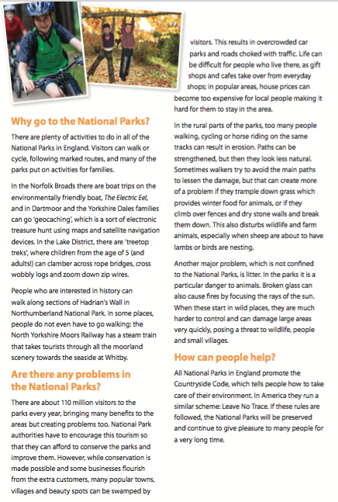
Year 6 Reading
The Reading Test consists of two separate papers:
Paper 1 – Contains a selection of texts totalling between 400 and 700 words with questions about the text.
Paper 2 – Contains a reading booklet of a selection of passages totalling 800 to 1100 words. Children will write their answers to questions about the passage in a separate booklet.
Each paper is worth 50% of the marks and should take approximately 30 minutes to complete, although the children are not being assessed at working at speed so will not be strictly timed.
The texts will cover a range of poetry, fiction and non-fiction.
Questions are designed to assess the comprehension and understanding of a child’s reading.
Some questions are multiple choice or selected response, others require
short answers and some require an extended response or explanation.
Notes:
11

Slide 12
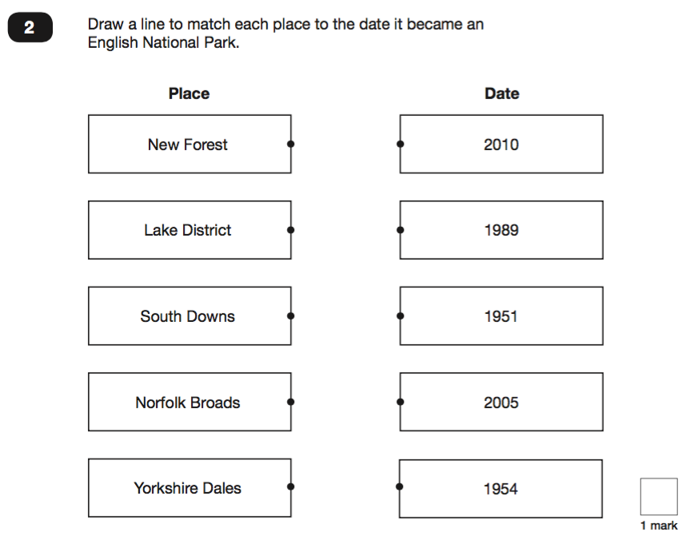
Year 6 Reading
The Reading Test consists of two separate papers:
Paper 1 – Contains a selection of texts totalling between 400 and 700 words with questions about the text.
Paper 2 – Contains a reading booklet of a selection of passages totalling 800 to 1100 words. Children will write their answers to questions about the passage in a separate booklet.
Each paper is worth 50% of the marks and should take approximately 30 minutes to complete, although the children are not being assessed at working at speed so will not be strictly timed.
The texts will cover a range of poetry, fiction and non-fiction.
Questions are designed to assess the comprehension and understanding of a child’s reading.
Some questions are multiple choice or selected response, others require
short answers and some require an extended response or explanation.
Notes:
12

Slide 13
Year 6 Reading
The Reading Test consists of two separate papers:
Paper 1 – Contains a selection of texts totalling between 400 and 700 words with questions about the text.
Paper 2 – Contains a reading booklet of a selection of passages totalling 800 to 1100 words. Children will write their answers to questions about the passage in a separate booklet.
Each paper is worth 50% of the marks and should take approximately 30 minutes to complete, although the children are not being assessed at working at speed so will not be strictly timed.
The texts will cover a range of poetry, fiction and non-fiction.
Questions are designed to assess the comprehension and understanding of a child’s reading.
Some questions are multiple choice or selected response, others require
short answers and some require an extended response or explanation.
Precision of answers are key to success in the new reading assessment.
Pupils must be concise and clear in their answers.
Re Mark:
Pupil: “ Because know one knew what they actually looked like”
Mark Scheme: They didn’t actually know what it looked like.
Response : The mark scheme has been applied correctly. The response is not sufficiently precise to meet the acceptable point and is not creditworthy.
Notes:
13

Slide 14
Year 6 Spelling, Punctuation and Grammar
A Spelling test is administered containing 20 words, lasting approximately 15 minutes.
A separate test is given on Punctuation, Vocabulary and Grammar which has significantly increased in difficulty.
This test lasts for 45 minutes and requires short answer questions, including some multiple choice.
Marks for these two tests are added together to give a total for Spelling, Punctuation and Grammar.
Notes:
14

Slide 15
Year 6 Spelling…
The 20 words tested are ALWAYS tricky or have some sort of unusual pattern.
It is important to re-visit the Y6 spelling lists (see school website) and to pick up and notice tricky/unusual spellings in wider reading.
A huge range of spellings and patterns were given to those of you who attended parents’ evening - please do get them out and encourage your child to work on them.
IXL.COM has LOTS on spellings - suffixes, prefixes, homophones, silent letters, root words etc etc - 5 -10 mins a day will make a huge difference.
Notes:
15

Slide 16
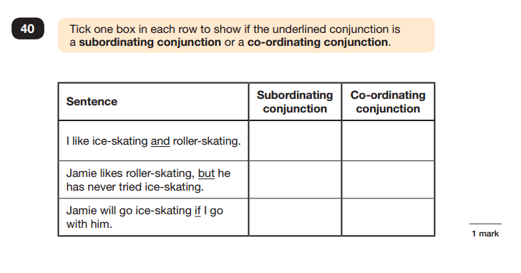
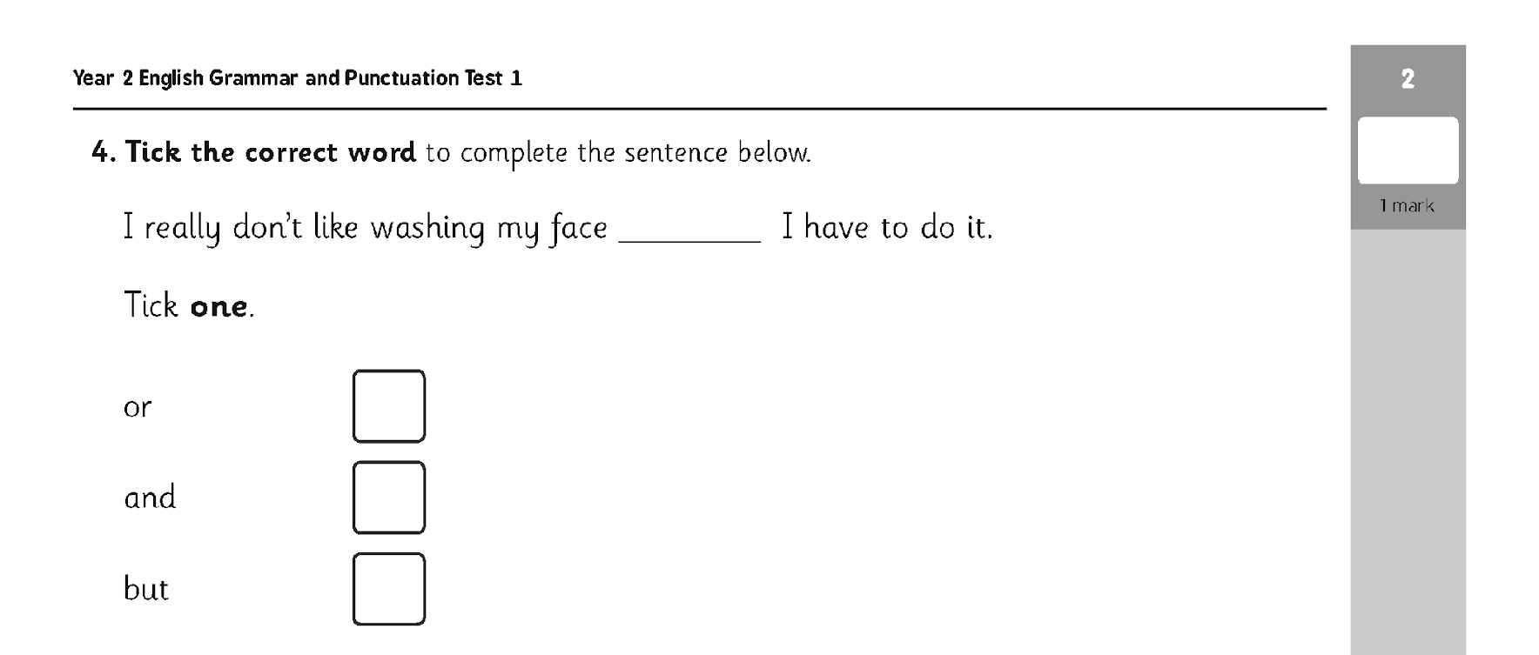
Year 6 Sample Questions
Grammar, Punctuation and Spelling Paper 1
Notes:
16

Slide 17
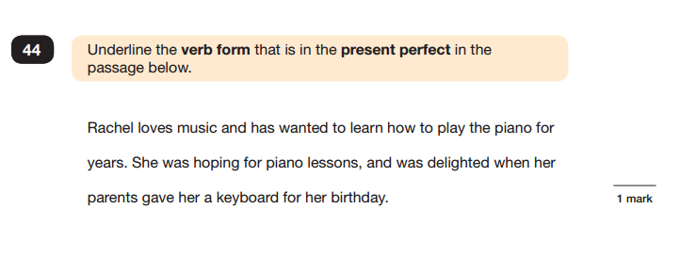
Year 6 Sample Questions
Grammar, Punctuation and Spelling Paper 1
Grammar, Punctuation and Spelling Paper 1
Notes:
17

Slide 18
Year 6 Mathematics
Children will sit two tests: Paper 1 and Paper 2:
Paper 1 is for arithmetic, lasting approximately 25 minutes and worth 25 marks. It covers calculation methods for all operations.
Paper 2 covers problem solving, reasoning and mathematical fluency, lasts for approximately 35 minutes and is worth 35 marks.
Pupils will still require calculation skills and questions will be varied including multiple choice, matching, true/false, completing a chart or table or drawing a shape. Some questions will also require children to show or explain their working out.
Children will sit three tests: Paper 1, Paper 2 and Paper 3.
Paper 1 is for ‘Arithmetic’ lasting for 30 minutes, covering calculation methods for all operations, including use of fractions, percentages and decimals.
Papers 2 and 3 cover ‘Problem Solving and Reasoning’, each lasting for 40 minutes.
Pupils will still require calculation skills for the reasoning papers but will need to answer questions in context and decide what is required to find a solution.
Questions gradually increase in difficulty. Not all children will be expected to access some of the more difficult questions later in the paper.
Notes:
18

Slide 19
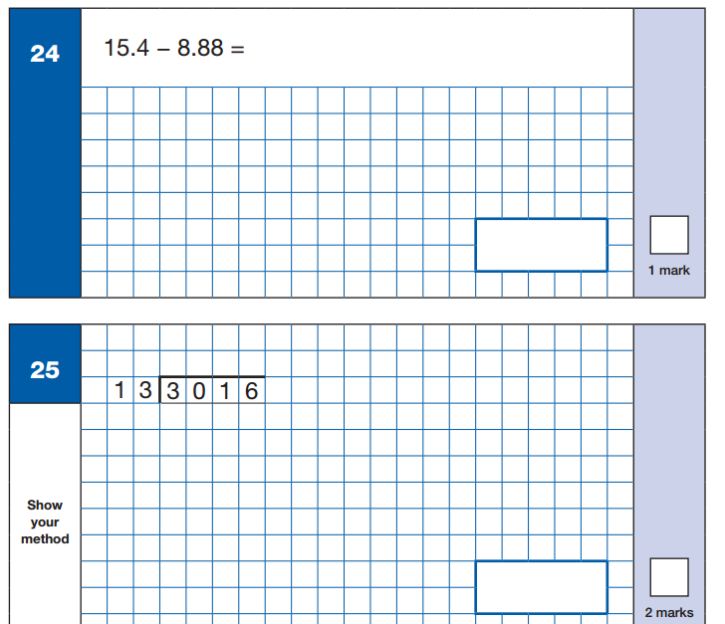
Year 6 Sample Questions
Maths Paper 1: Arithmetic
Notes:
19

Slide 20
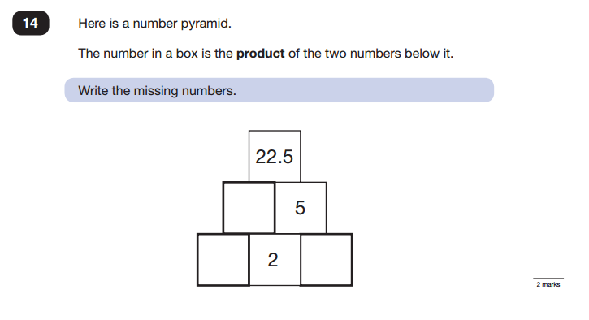
Year 6 Sample Questions
Maths Paper 2 / Paper 3 : Reasoning
Notes:
20

Slide 21
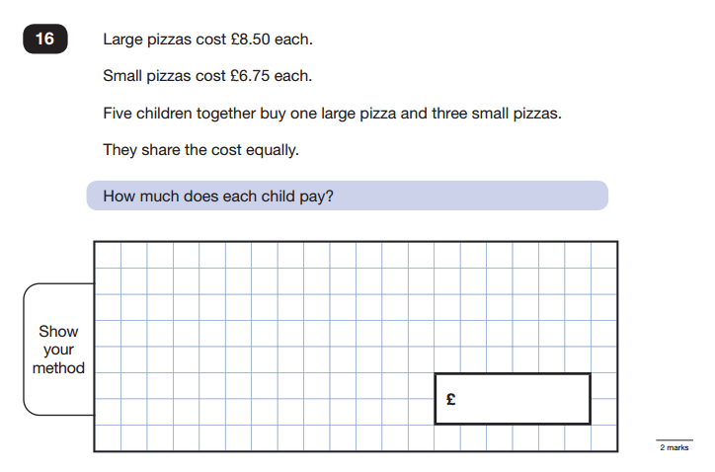
Year 6 SampleQuestions
Maths Paper 2 / Paper 3 : Reasoning
Notes:
21

Slide 22
Administration and Timing of Tests
Year 6
Tests administered during the week Monday 13th May - Thursday 16th May
Tests are marked by external agencies (apart from the writing which may be audited externally by LA moderators).
Results are sent back to schools.
Results will be reported to Parents in July.
IT IS ESSENTIAL ALL PUPILS ARE IN SCHOOL DURING THESE TIMES
First and foremost, support and reassure your child that there is nothing to worry about and that they should always just try their best. Praise and encourage!
Ensure your child has the best possible attendance at school.
Support your child with any homework tasks.
Reading, spelling and arithmetic (e.g. times tables) are always good to practise.
Talk to your child about what they have learnt at school and what book(s) they are reading (the character, the plot, their opinion).
Make sure your child has a good sleep and healthy breakfast every morning!
Notes:
22

Slide 23
Administration and Timing of Tests
Monday 13th May : Spelling and Grammar
Tuesday 14th May : Reading
Wednesday 15th May : Maths P1 arithmetic
Maths P2 reasoning
Thursday 16th May : Maths Arithmetic Paper 3
First and foremost, support and reassure your child that there is nothing to worry about and that they should always just try their best. Praise and encourage!
Ensure your child has the best possible attendance at school.
Support your child with any homework tasks.
Reading, spelling and arithmetic (e.g. times tables) are always good to practise.
Talk to your child about what they have learnt at school and what book(s) they are reading (the character, the plot, their opinion).
Make sure your child has a good sleep and healthy breakfast every morning!
Notes:
23

Slide 24
How to Help Your Child
First and foremost, support and reassure your child that there is nothing to worry about and that they should always just try their best. Praise and encourage!
Ensure your child has the best possible attendance at school. There will be ‘keep up’ sessions happening throughout the weeks leading up to the tests and these cannot be repeated.
Reading, spelling and arithmetic (e.g. times tables) are always good to practise.
Talk to your child about what they have learnt at school and what book(s) they are reading (the character, the plot, their opinion).
Before the tests ensure your child has a good sleep and healthy breakfast to get the best start to the day.
Please ensure all homework is done to the best of your child’s ability, is checked and is completed on time.
Notes:
24

Slide 25
How to Help Your Child
Spelling is huge and demanding. Check the Y6 class page for spellings. Making spelling a high priority helps so much in the SPAG test (and of course for life!)
In Year 6 Look out for arithmetic tests from our Friday lessons – correcting one or two each week helps massively.
Year 6 your child should be using IXL as an independent learning tool as well as Home Learning. Please ask your child about this.
Checking in on TT Rockstars with your child - look at their heatmaps and see how they are doing.
Have your child read to you and enjoy a book together.
The tests should be a POSITIVE EXPERIENCE for your child. Tests will never simply ‘go away’ and so to be well-prepared in advance will help your child to feel they have given it their ‘best shot’ - and therefore will not need to be scared of future tests at Secondary School and beyond.
Notes:
25

Slide 26
We are here to help
If you have any questions or worries at any time (not just about SAT’s) we are always available.
You can contact both staff in the following ways:
  Pop in before or after school
  A phone call
  An email
  We will always get back to you .
Notes:
26

Slide 27
Thank you for attending this evening
Notes:
27

