Slide 1
Welcome to Year 6

Slide 2
The Year 6 Team
Miss Wilding – class teacher
Mrs Parkinson (M, Tu, Th & Fr)
Mr C-A (W)
Miss Jervis (Th pm)

Slide 3
Routine of the day
8.40am – doors open
– registration
- morning task
9.00am – Guided Reading
9.30am – Spelling
9:45am – SPaG
10:00 – English
10.45am – playtime
11.00am – Maths
12.15pm – lunchtime
1.15pm – afternoon registration
– Afternoon session
2.45pm – Assembly (M & W)
3.15pm – Hometime

Slide 4
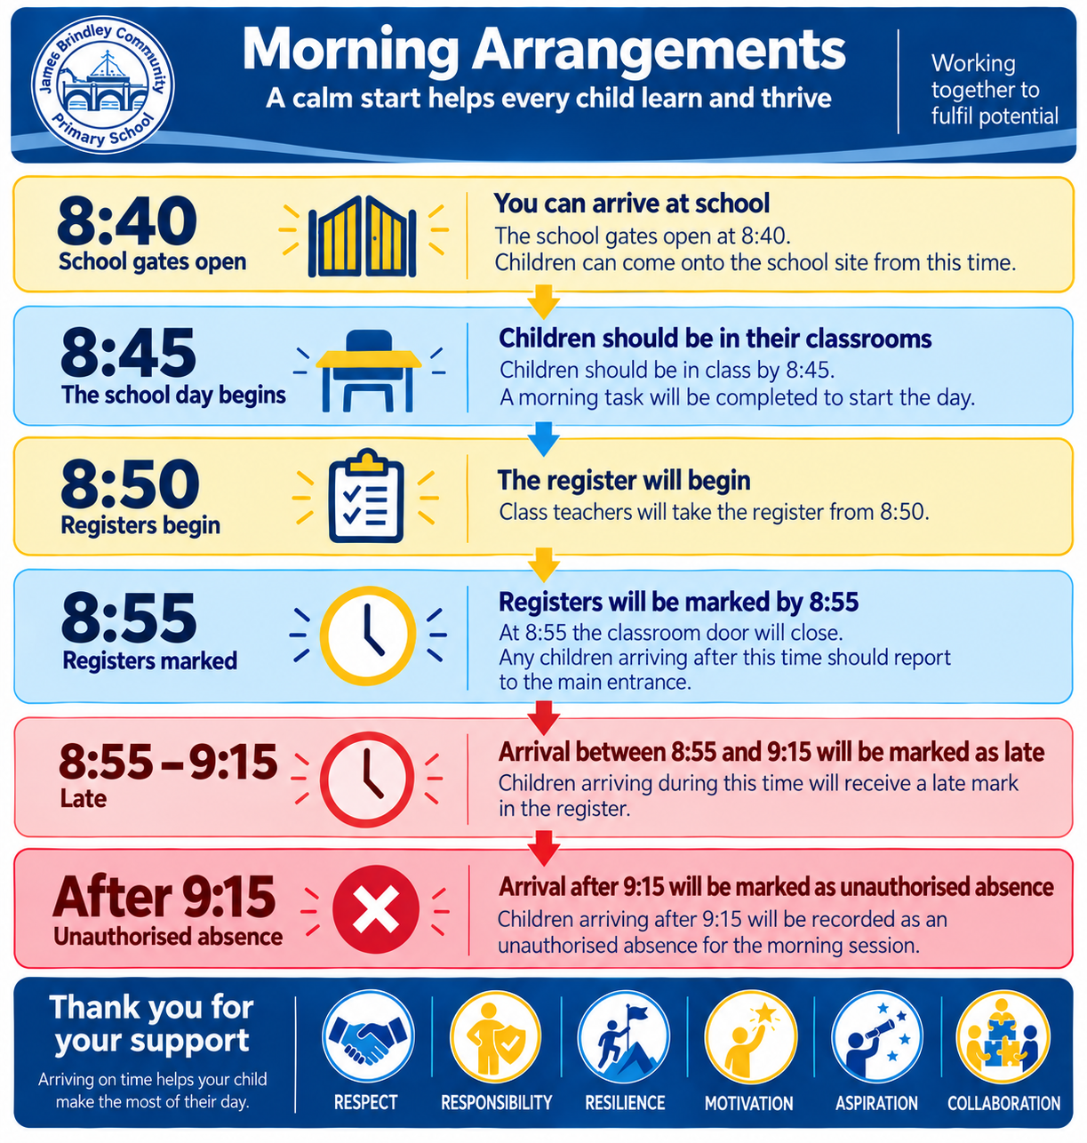

Slide 5
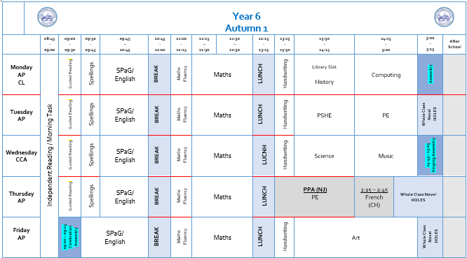
Weekly Timetable

Slide 6

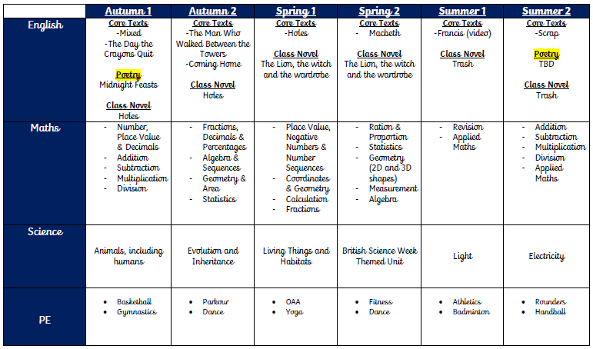
Curriculum

Slide 7
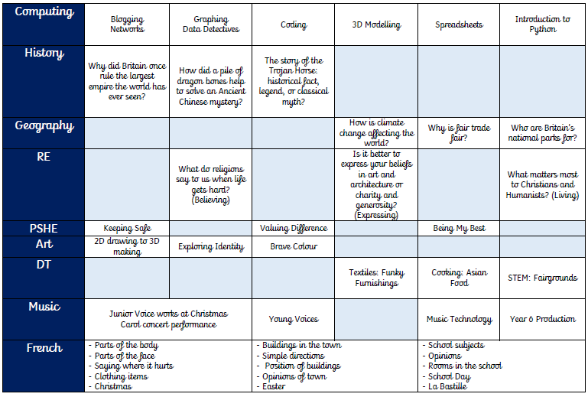

Slide 8
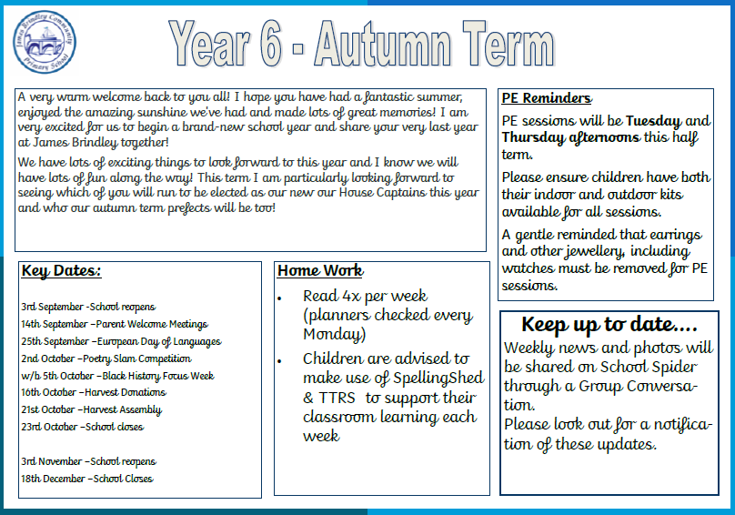
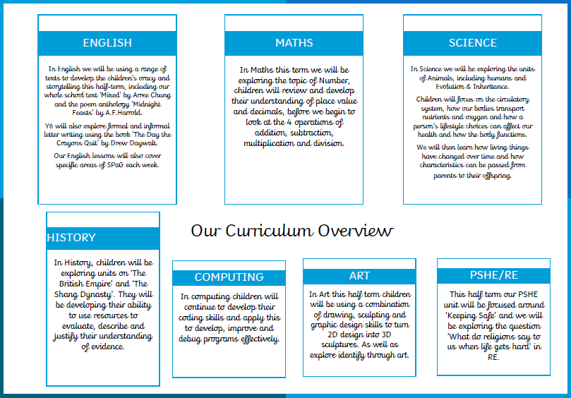
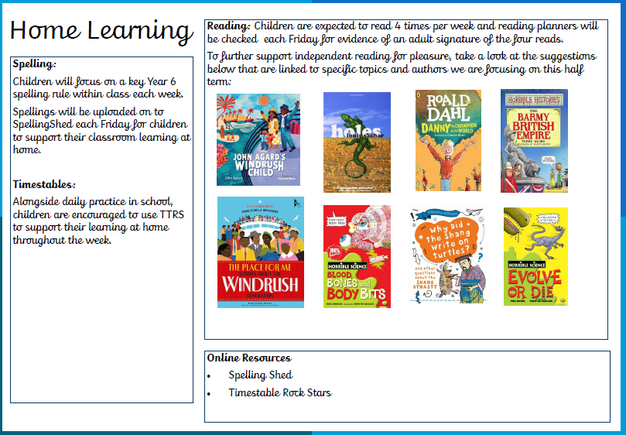
Newsletter

Slide 9
Newsletter
PE days
Tuesday and Thursday afternoon (indoor and outdoor kit)
No jewellery / watches
Clubs
Netball (Tuesday)
Football (Wednesday)
Key dates and trips
25th September –European Day of Languages
2nd October –Poetry Slam Competition
w/b 5th October –Black History Focus Week
16th October –Harvest Donations
21st October –Harvest Assembly

Slide 10
SATs
SATS Week
Monday 10th – Thursday 13th May 2027 (Summer 1)
Papers
Maths – P1, P2 and P3
Spelling and Grammar & Punctuation
Reading
Writing – teacher judgement
SATs Meeting
~February
Mock Week – w/b 22nd March

Slide 11
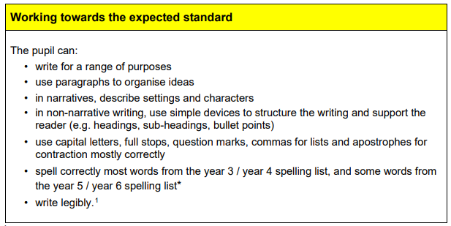
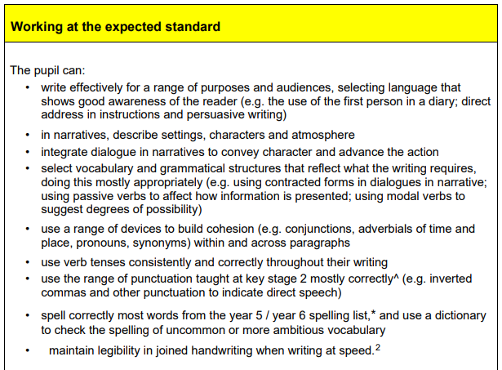
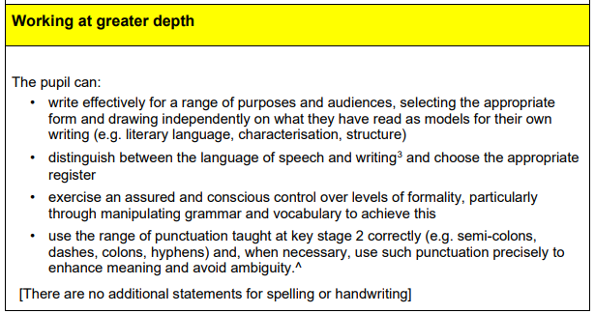
Year 6 expectation
English

Slide 12



Spellings, Reading and Timestables
Spelling lessons daily – reviewing KS2 rules
New spellings out on a Friday
Reading
4x per week (planner signed and checked each Monday).
Monday reading books will be changed.
Read a range of books from different genres and authors
Library books – reading for pleasure
Use of TTRS to support in class learning.

Slide 13
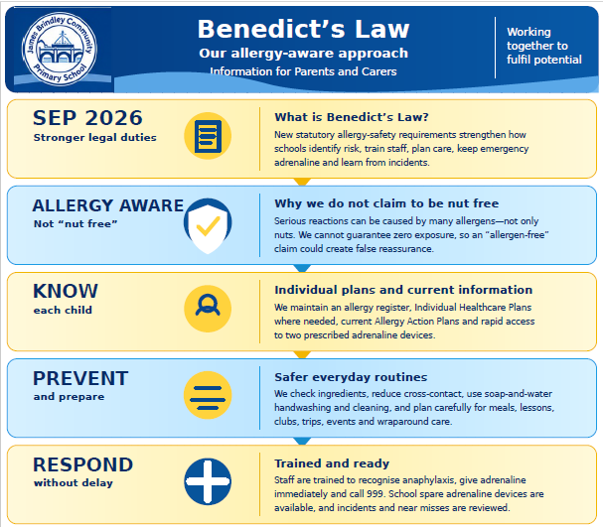

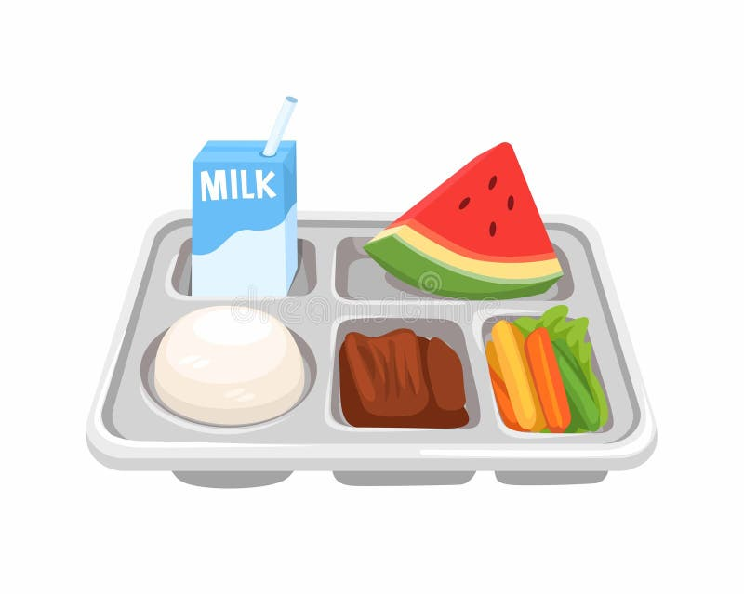


Dinners, Fruit, Toast and Milk
Cool Milk
School Spider
Healthy Snacks
and packed lunches

Slide 14
Parent Communication
School Spider App:
All communication from school will now be sent through the school spider app, so parents must have downloaded and logged in to this, in order to receive all relevant and important information. All information will be received as a message on the app as well as via email.
The app will also be used to book parents evening appointments, complete surveys and complete permissions slips.
Group Conversation – photo updates
Newsletters- you will receive monthly newsletters from Mrs Stokes, along with termly individual class newsletters. These can all also be found on the school website.
If you wish to speak to teachers about any issues/concerns please contact the office and teachers will get back to you to arrange a suitable time.

Slide 15
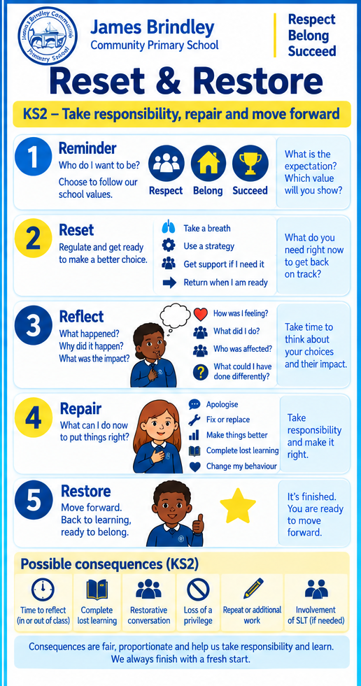
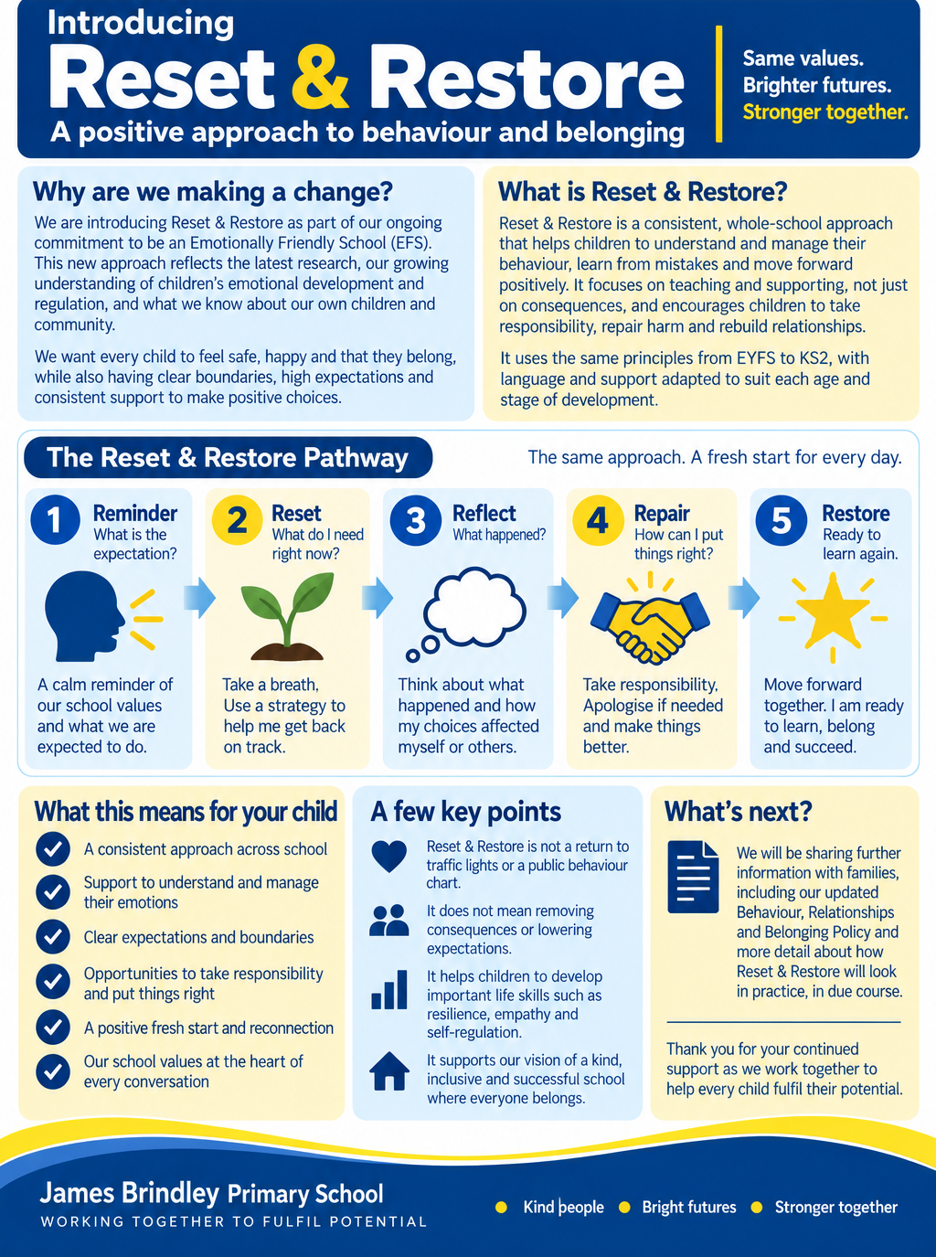
Behaviour Expectations

Slide 16
Whole School Rewards
This year, our weekly Celebration Assembly will have an even stronger focus on our school values: Respect, Responsibility, Resilience, Motivation, Aspiration and Collaboration.
Golden Award: Children who have been ‘living our value of the week’
Award of Merit: continue to recognise excellent learning and progress in children’s work.
House Teams:
Reception to Y6 can be awarded house points. These points are collected weekly by our Y6 House Captains. At the end of each half term the winning house will enjoy a special House Day, where they will be invited to wear non-uniform for that day.

Slide 17
Questions?

