Slide 1
Welcome to Reception

Slide 2
The Reception Team
Miss Evans – Class Teacher
Mrs O'Keefe – TA
Miss Burton– TA

Slide 3
Routine of the day
8.45am – Doors open
8.50am – Registration/Morning routine
9.00am – Phonics
9.30am – Continuous provision
10.10am – Milk and toast
10.20am – English
10:35am- Outdoor provision/English activity
11:30 am- Handwriting
11:45am - Lunchtime
12.45pm – Afternoon registration
1.00pm –Maths
1:15pm- Continuous provision/Maths activity
2.30pm – Topic
2:55pm- Ready for home
3.15pm – Home time!

Slide 4
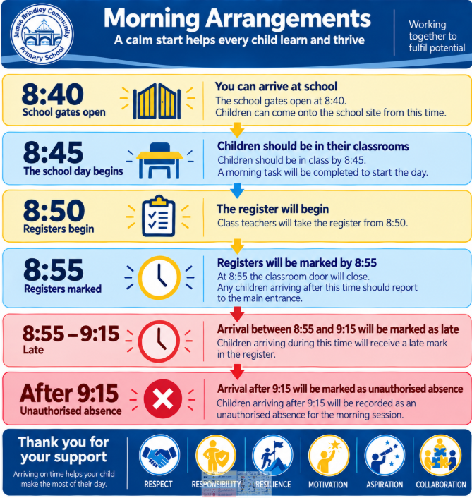

Slide 5
Curriculum
Personal Social and Emotional Development (PSED)
Communication and Language (C&L)
Physical Development (PD)
The first three are prime areas. These are very important because they lay the foundations for children’s success in all other areas of learning. Children need a good foundation in these prime areas before they can even access the specific areas.
Literacy (L)
Mathematics (M)
Understanding the World (UW)
Expressive Arts and Design (EAD)
Share:
Curriculum on a page- website

Slide 6
Curriculum
PSED- Each week we have SCARF lesson on our termly topic, these usually consist of circle time discussions.
MATHS- We use mastering number, daily interactive sessions to build mathematical foundations.
UTW- We have weekly science lessons on our termly topic, with exciting interactive experiments.
EAD- Art resources are readily available for the children to explore and we also have a weekly project we complete as a class.
PE- We have weekly lessons, building on skills in our different termly topics.
LITERACY- Each week we have a set text, which we explore and complete a range of writing tasks.
MUSIC- We have a weekly lesson, listening to different styles of music and exploring different sounds and instruments.

Slide 7

Phonics and Reading
Phonics sessions take place
daily from 9am in streamed
groups.
Your child’s reading books will link directly to their learning in Phonics.
All children will have a tricky word bookmark in their reading books of words they need to learn how to read and spell.
Each term, parents will receive a phonics newsletter that explains the sounds their child is covering this term in order to practice at home.

Slide 8

Phonics and Reading
Phonics and reading are central to our learning in Reception.
Please support your child in reading at home 4 times each week.
Encourage your child to read widely and for pleasure.
* Top Tips*
Read anything and everything!
Read out loud to them.
Let them read out loud to you.
Read a range of books from different authors and genres.
Let them see you read.
Help them to foster a love for reading.

Slide 9
Rainbow Challenges
In Reception, we use Rainbow challenges. Each week there will be 5 challenges. Literacy, Maths, UTW/PSED, Fine/Gross motor and EAD. From 9:30-10:00am the children will go to specific stations in the classroom and complete one of the challenges. When they complete the task the must show a grown up and then they will receive a sticker on their chart. By the end of the month if they have completed all their challenges each week they will receive a small prize.
We use this system to encourage children to access all areas of provision and apply learning to independent tasks.

Slide 10
Baseline
The Reception Baseline. This is something all children complete when they start Reception, usually within the first few weeks.
It’s a really simple, play-based assessment that helps us get a picture of what your child already knows and can do when they join us. It looks at things like communication, early reading and maths skills, as well as how they respond to different activities.
Most importantly, it isn’t something your child needs to prepare for, and there’s no pass or fail. We just use it as a starting point to help us understand each child as an individual and make sure we’re supporting them in the best way possible as they begin their school journey.

Slide 11

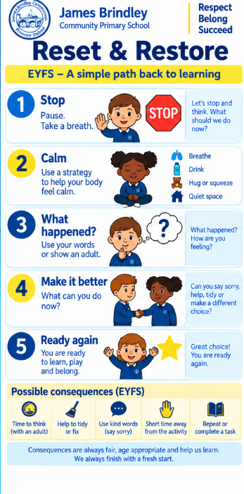
Behaviour Expectations

Slide 12
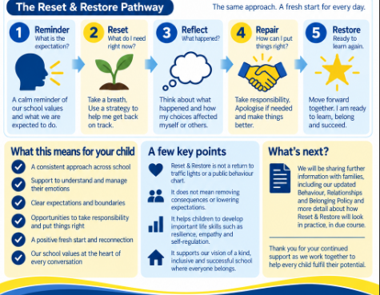
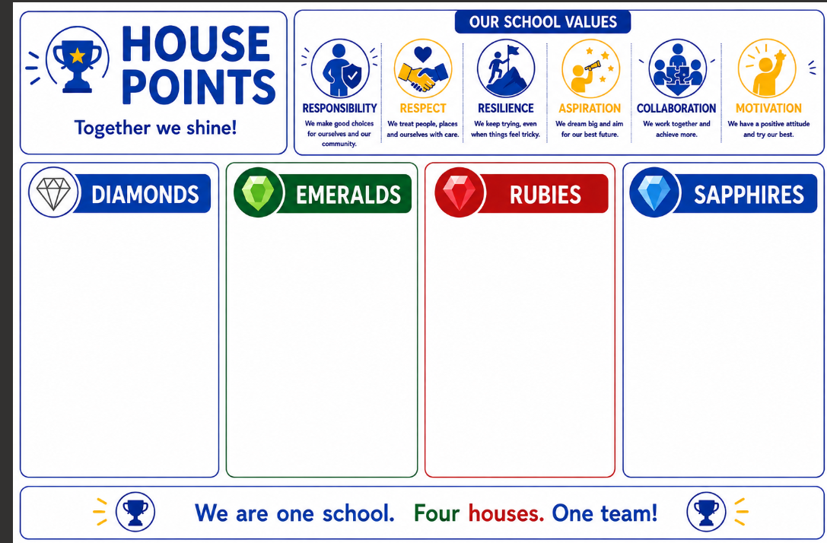
Behaviour

Slide 13
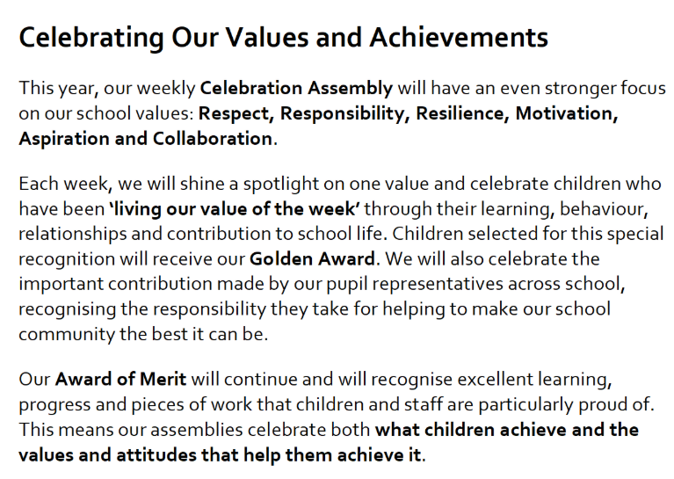
Whole School Rewards

Slide 14
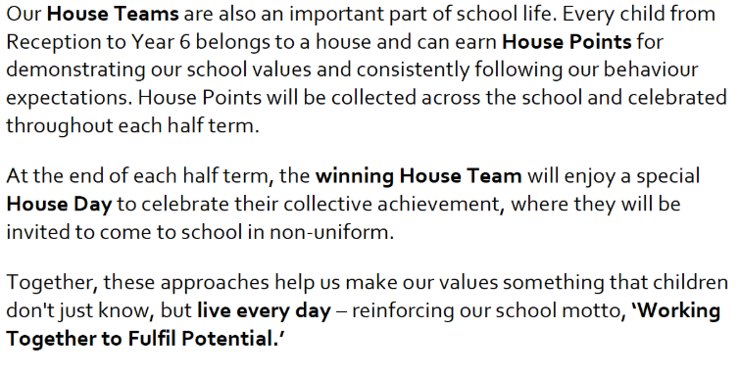
Whole School Rewards

Slide 15



Fruit, Toast and Milk
If you child wishes to have milk, payment is required via Cool Milk. Milk will be free for all children until their 5th birthday.
Fruit is available daily and is free for the children. The selection varies each day.
Toast is available to have at 10am. If your child wishes to have toast, a payment can be made via school spider.

Slide 16
Lunchtimes and Playtimes
Reception will play in the Nursery outdoor area during lunchtimes. They are allowed to use the scooters, the outdoor play equipment and the gym equipment.
Throughout the day, children have access to the Reception garden as we encourage free flow play during continuous provision.

Slide 17
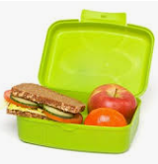
Lunchtime
Reception eat in the main hall and you can choose your child’s meals through school spider for the term.
Menus change every term and are available on our website or from the school office.
We are aware of all dietary requirements but please feel free to let us know of anything that you feel relevant with regards to your child’s lunch choices.
If your child is bringing a packed
lunch, please support us in working
towards our Healthy Schools
Award by providing a balanced lunch.

Slide 18


Slide 19
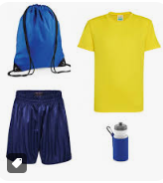
Things to remember
Label all items of clothing including P.E. kit.
Children with long hair should have it tied up daily.
Ensure reading books are in school every day.
Send a water bottled filled with fresh water (not juice) into school daily. Please clearly label water bottles with your child’s name.
P.E. day – Monday
Main reading day – Friday
Library day- Wednesday.

Slide 20
Parent Communication
Show our Reception page on the website
School Spider App:
All communication from school will now be sent through the school spider app, so parents must have downloaded and logged in to this, in order to receive all relevant and important information. All information will be received as a message on the app as well as via email.
The app will also be used to book parents evening appointments, complete surveys and complete permissions slips.
Newsletters- you will receive monthly newsletters from Mrs Stokes, along with half-termly individual class newsletters. These can all also be found on the school website.
If you wish to speak to teachers about any issues/concerns please contact the office and teachers will get back to you to arrange a suitable time.

Slide 21
How can you help us?
In Reception we’re always willing to accept donations of things you have at home that you may no longer use, such as:
Books
Toys
Jigsaws
Art and craft materials
We are also trying to improve our outdoor learning space and would be grateful of any items that may enhance our provision such as plants, bird feeders, gardening tools, buckets and spades etc.

Slide 22
How can you help your child at home?
For the first half term, the expectation will be for all children to read at home as often as possible They will also be given specific phonics words to practice and learn.
EYFS will retain a ‘pick & mix’ style of home learning, which focuses on phonics and hands-on learning experiences that can be shared back in class on our home learning celebration day at the end of terms. You will be able to share these on purple mash- your child will receive a login shortly.
Develop self help skills such as: getting dressed independently. zipping up coats, toileting and eating with a knife and fork.

