Slide 1
Welcome to Year 2

Slide 2
The Year 2 Team
Mrs Holt – class teacher
Mrs Hughes – TA
Miss Jervis – PPA Cover

Slide 3
Routine of the day
8.40am – doors open
8.50am – registration
9.00am – Phonics
9.30am – Maths
10.30am – playtime (milk and fruit)
10.45am – English
12.00pm – lunchtime
1.00pm – afternoon registration
Guided Reading
1.30pm – Afternoon session
History/Science/Art/Music/PE/Computing
2.45pm – Assembly or Class Novel
3.15pm – Home time!

Slide 4
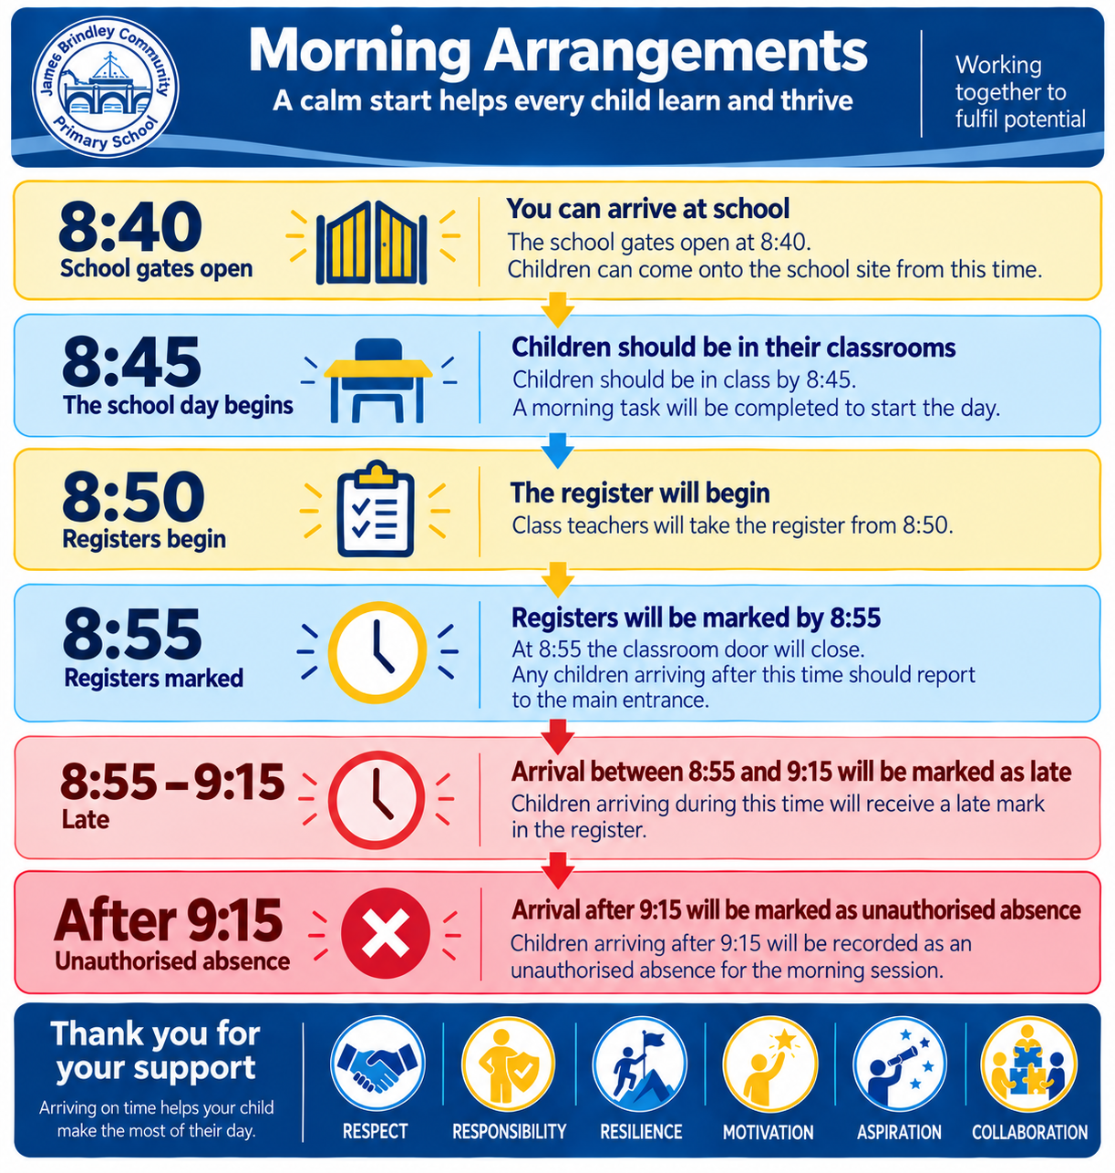

Slide 5
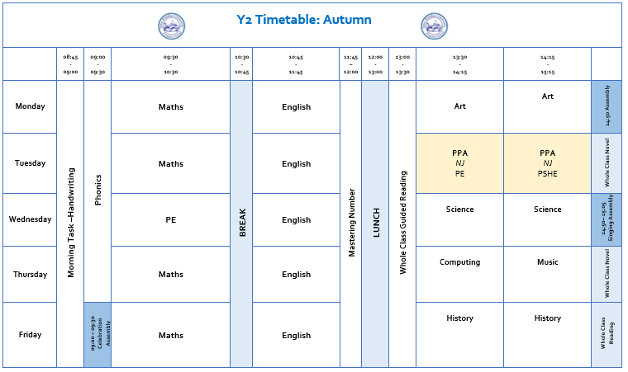
Weekly Timetable

Slide 6
Curriculum
Curriculum on a page is available on class webpage, as will any class updates.
Phonics will be daily, in groups as it was in Year 1.
Spellings will be sent out on a Friday, the following Friday we will play games with the words. No test scores will not be recorded, this is just an opportunity for you to help your child to remember and apply the spellings they have learnt. Spellings will be tested at the end of a half term to check progress.
PE days are Tuesdays and Wednesdays – please make sure indoor and outdoor kits are in school each week.

Slide 7
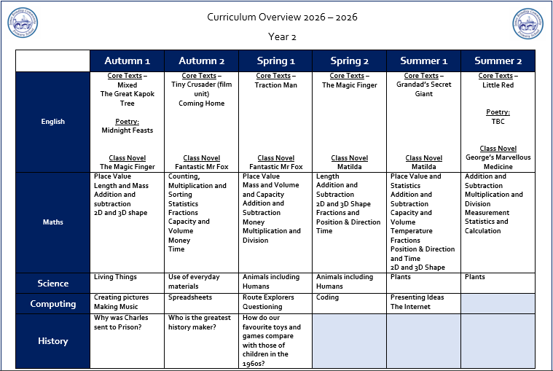
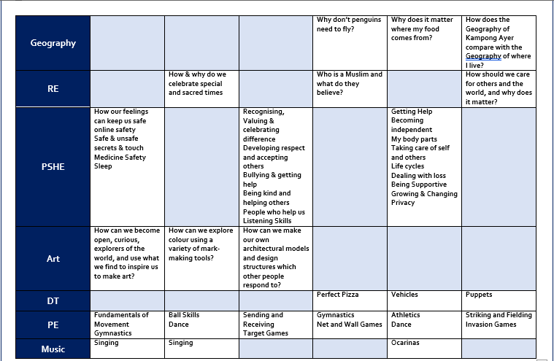
Curriculum

Slide 8

Phonics and Reading
Phonics sessions take place
daily from 9am in streamed
groups.
Weekly spellings and your child’s reading books will link directly to their learning in Phonics.
All children will have a tricky word bookmark in their reading books of words they need to learn how to read and spell.
On occasions we may send home
additional phonics sounds to
practise.

Slide 9

Phonics and Reading
Phonics and reading are central to our learning in Year 2.
Please support your child in reading at home 4 times each week.
Encourage your child to read widely and for pleasure.
Top Tips*
Read anything and everything!
Read out loud to them.
Let them read out loud to you.
Read a range of books from different authors and genres.
Let them see you read.
Help them to foster a love for reading.

Slide 10
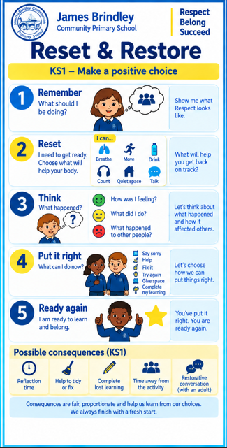
Behaviour Expectations

Slide 11
Whole School Rewards
Celebrating Our Values and Achievements
This year, our weekly Celebration Assembly will have an even stronger focus on our school values: Respect, Responsibility, Resilience, Motivation, Aspiration and Collaboration.
Each week, we will shine a spotlight on one value and celebrate children who have been ‘living our value of the week’ through their learning, behaviour, relationships and contribution to school life. Children selected for this special recognition will receive our Golden Award. We will also celebrate the important contribution made by our pupil representatives across school, recognising the responsibility they take for helping to make our school community the best it can be.
Our Award of Merit will continue and will recognise excellent learning, progress and pieces of work that children and staff are particularly proud of. This means our assemblies celebrate both what children achieve and the values and attitudes that help them achieve it.
Our House Teams are also an important part of school life. Every child from Reception to Year 6 belongs to a house and can earn House Points for demonstrating our school values and consistently following our behaviour expectations. House Points will be collected across the school and celebrated throughout each half term.
At the end of each half term, the winning House Team will enjoy a special House Day to celebrate their collective achievement, where they will be invited to come to school in non-uniform.
Together, these approaches help us make our values something that children don't just know, but live every day – reinforcing our school motto, ‘Working Together to Fulfil Potential.’

Slide 12



Fruit, Toast and Milk
If you child wishes to have milk, payment is required via Parentpay.
Fruit is available daily and is free for the children. The selection varies each day.
Toast is available to have at playtimes. If your child wishes to have toast, a payment can be made via Parentpay.
Snacks and milk are taken outside and eaten during playtime.

Slide 13
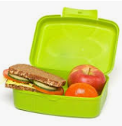
Lunchtime
Children in Key Stage 1 can receive a free school meal should they wish to.
Menus change every term.
You choose the meals via School Spider. Please make sure this is done for the following day, as a child can only choose a sandwich on the day.
We are aware of all dietary requirements but please feel free to let us know of anything that you feel relevant with regards to your child’s lunch choices.
If your child is bringing a packed
lunch, please support us in working
towards our Healthy Schools
Award by providing a balanced lunch. A reminder that we are a nut free school.

Slide 14
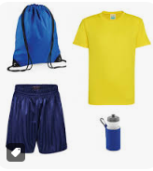
Things to remember
Label all items of clothing including P.E. kit.
Ensure reading books are in school every day.
Send a water bottled filled with fresh water (not juice) into school daily. Please clearly label water bottles with your child’s name.
P.E. days – Tuesday and Wednesday
Spellings – Friday
Library day - Wednesday

Slide 15
Parent Communication
School Spider App:
All communication from school will be sent through the school spider app, so parents must have downloaded and logged in to this, in order to receive all relevant and important information. All information will be received as a message on the app as well as via email.
The app will also be used to book parents evening appointments, complete surveys and complete permissions slips.
Newsletters- you will receive monthly newsletters from Mrs Stokes. Half-termly individual class newsletters can be found on the school website.
If you wish to speak to teachers about any issues/concerns please contact the office and teachers will get back to you to arrange a suitable time.
Group Conversations
All of our class updates and photographs will be shared through School Spider.

Slide 16
How can you help us?
In Year 2 we do not ask for class funds like in Reception, however we’re always willing to accept donations of things you have at home that you may no longer use, such as:
Books
Board games
Jigsaws
Card games (Dobble, Top Trumps)
Art and craft materials
We would also love boxes of tissues!

Slide 17
How can you help your child at home?
For the first half term, the expectation will be for all children to read at home every day. They will also be given specific phonics/spelling words to practice and learn.
A range of interactive games/opportunities will be shared on the class page directing children to independent learning with a focus on basic number and multiplications, alongside reading and grammar.
We will be sending homework out after Christmas. This will consist of a Reading Comprehension task and an arithmetic task. Please allow your child to complete these independently so we can see how they are getting on.

Slide 18
Thank you for coming ☺
Any questions?

