Slide 1
Welcome to Year 1

Slide 2
The Year 1 Team
Mrs Sharrock – class teacher
Mrs Smethurst – HLTA
Miss Jervis – HLTA
Mrs Gibson – TA

Slide 3
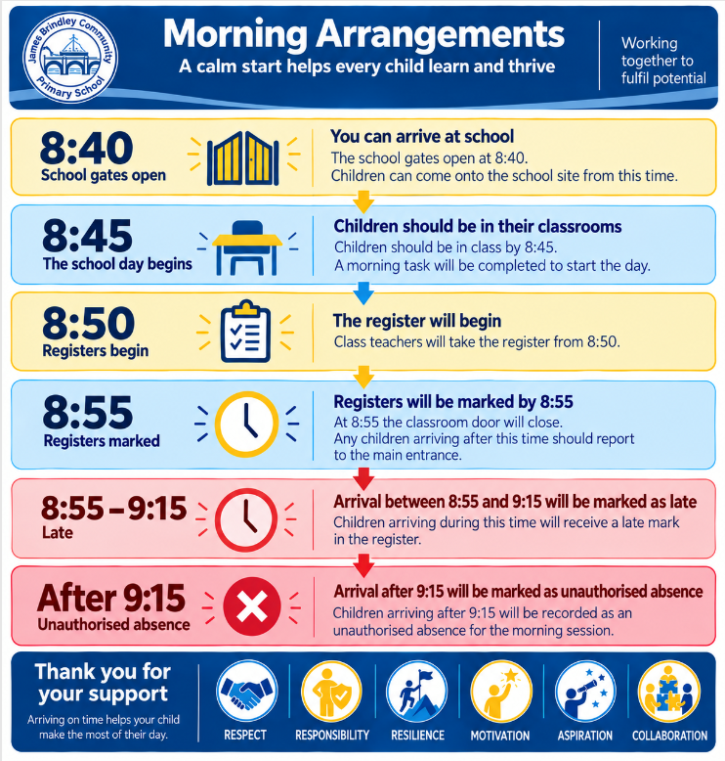

Slide 4
Routine of the day
8.40am – doors open
8.50am – registration
9.00am – Phonics
9.30am – maths
10.30am – playtime (milk and fruit)
10.45am – English
12.00pm – lunchtime
1.00pm – afternoon registration
Guided Reading
1.30pm – afternoon session
History/Science/Art/Music etc
2.45pm – Assembly
3.15pm – Hometime!

Slide 5
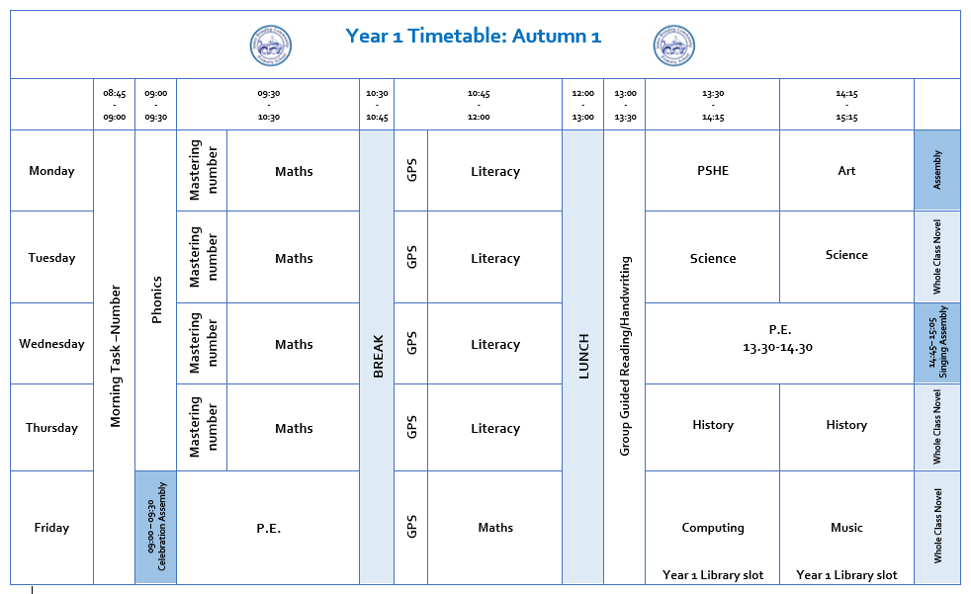
Weekly Timetable

Slide 6
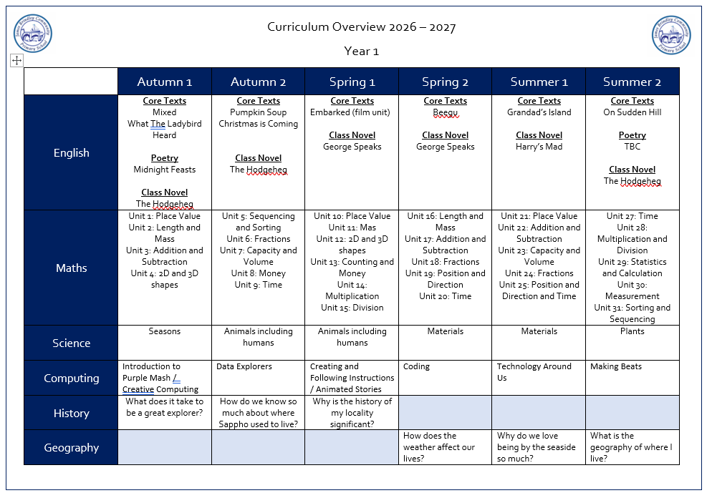
Curriculum

Slide 7
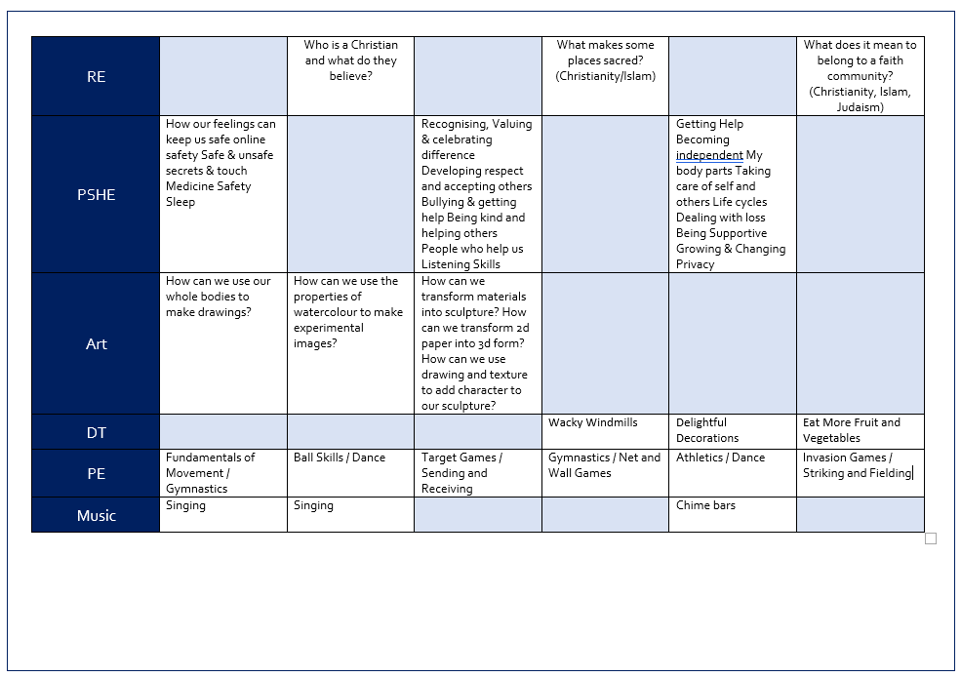
Curriculum

Slide 8

Phonics and Reading
Phonics sessions take place
daily from 9am in streamed
groups.
Weekly spellings and your child’s reading books will link directly to their learning in Phonics.
All children will have a tricky word bookmark in their reading books of words they need to learn how to read and spell.
Phonics newsletters will be sent home when your child begins to learn a new set of sounds.
Please note, your child will take a statutory Phonics Screening Assessment in June 2027

Slide 9

Phonics and Reading
Phonics and reading are central to our learning in Year 1.
Please support your child in reading at home 4 times each week.
Encourage your child to read widely and for pleasure.
* Top Tips*
Read anything and everything!
Read out loud to them.
Let them read out loud to you.
Read a range of books from different authors and genres.
Let them see you read.
Help them to foster a love for reading.

Slide 10
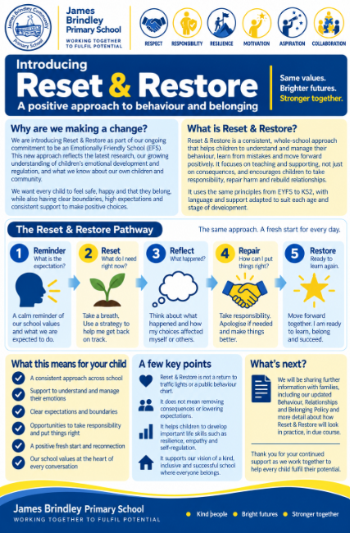
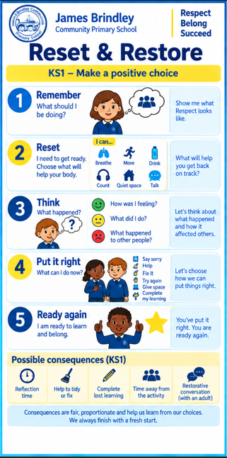
Behaviour and Expectations

Slide 11
Celebrating Our Values and Achievements
This year, our weekly Celebration Assembly will have an even stronger focus on our school values: Respect, Responsibility, Resilience, Motivation, Aspiration and Collaboration.
Each week, we will shine a spotlight on one value and celebrate children who have been ‘living our value of the week’ through their learning, behaviour, relationships and contribution to school life. Children selected for this special recognition will receive our Golden Award. We will also celebrate the important contribution made by our pupil representatives across school, recognising the responsibility they take for helping to make our school community the best it can be.
Our Award of Merit will continue and will recognise excellent learning, progress and pieces of work that children and staff are particularly proud of. This means our assemblies celebrate both what children achieve and the values and attitudes that help them achieve it.

Slide 12
Celebrating Our Values and Achievements
Our House Teams are also an important part of school life. Every child from Reception to Year 6 belongs to a house and can earn House Points for demonstrating our school values and consistently following our behaviour expectations. House Points will be collected across the school and celebrated throughout each half term.
At the end of each half term, the winning House Team will enjoy a special House Day to celebrate their collective achievement, where they will be invited to come to school in non-uniform.
Together, these approaches help us make our values something that children don't just know, but live every day – reinforcing our school motto, ‘Working Together to Fulfil Potential.’

Slide 13



Fruit, Toast and Milk
If you child wishes to have milk, payment is required. Information is available from the school office.
Fruit is available daily and is free for the children. The selection varies each day.
Toast is available to have at playtimes. If your child wishes to have toast, a payment can be made via School Spider.
Snacks and milk are taken outside and eaten during playtime.

Slide 14
Lunchtimes and Playtimes
Year 1 will play on the big playgrounds during playtimes and lunchtimes. They are allowed to use the scooters, the outdoor play equipment and the gym equipment.
Please ensure that your child always has a coat in school and if they can’t already, help them to learn how to fasten their zip or buttons.
Please put your child’s name in their coat, hat, scarf, gloves etc. ☺

Slide 15
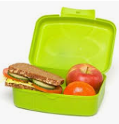
Lunchtime
Children in Key Stage 1 can receive a free school meal should they wish to.
Please pre order lunches via School Spider.
We are aware of all dietary requirements but please feel free to let us know of anything that you feel relevant with regards to your child’s lunch choices.
If your child is bringing a packed
lunch, please ensure it is a healthy, balanced lunch.

Slide 16


Slide 17
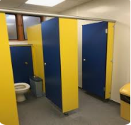
Toilet
The toilets for Year 1, unlike in Reception are based outside of the classroom.
Over the coming weeks and months we’ll be trying to train the children as much as possible to use them during playtimes and lunchtimes, although we know this isn’t easy!!
Please note we would never,
ever not allow a child to use
the toilet during lesson times,
we just try to reduce it as much
as possible.

Slide 18
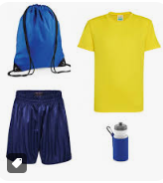
Things to remember
Label all items of clothing including P.E. kit.
Ensure reading books are in school every day.
Send a water bottled filled with fresh water (not juice) into school daily. Please clearly label water bottles with your child’s name.
P.E. days – Wednesday and Friday.
Spellings – Friday
Class library - Friday

Slide 19

Parent Communication
School Spider App:
All communication from school is sent through the school spider app. All information will be received as a message on the app as well as via email.
The app will also be used to book parents evening appointments, complete surveys and complete permissions slips.
Newsletters- you will receive monthly newsletters from Mrs Stokes, along with half-termly individual class newsletters. These can all also be found on the school website.

Slide 20
How can you help us?
We’re always willing to accept donations of things you have at home that you may no longer use, such as:
Books
Board games
Jigsaws
Card games (Dobble, Top Trumps)
Art and craft materials
Tissues

Slide 21
How can you help your child at home?
Read at home every day.
Help your child to learn any additional phonics or spellings that come home.
Practise cursive letter formation and support your child in learning how to spell their first and last names correctly.
Practise counting forwards and backwards to 20 ensuring they can record all numbers accurately.
Practise number bonds to 10.

