Slide 1
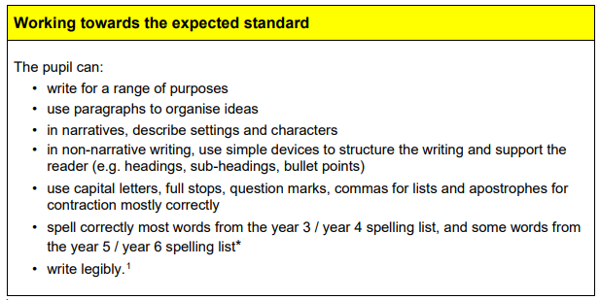
Year 6 Writing Assessment Framework

Slide 2
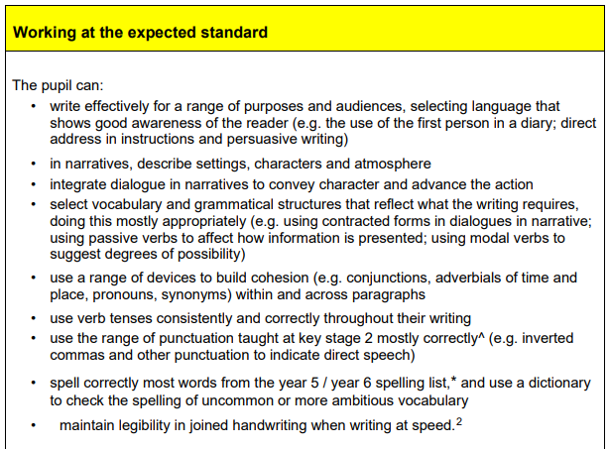

Slide 3
