Slide 1
Welcome to Year 6

Slide 2
The Year 6 Team
Miss Wilding – class teacher
Mrs Devney – TA
Miss Vaudrey – TA

Slide 3
Routine of the day
8.40am – doors open
– registration
- independent reading / AR
9.00am – Guided Reading
9.30am – Timestables focus
9:45am – Maths
10.45am – playtime
11.00am – Spellings
11.15am – Handwriting
11:30am – English
12.30pm – lunchtime
1.15pm – afternoon registration
– Afternoon session
2.45pm – Assembly
3.15pm – Hometime!

Slide 4
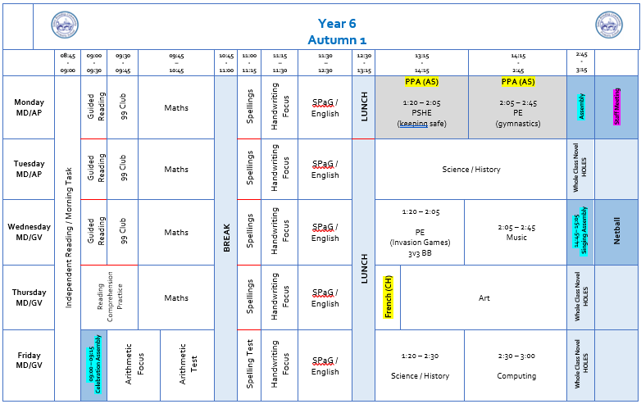
Weekly Timetable

Slide 5
Afternoon interventions
Interventions will begin from A2 – opportunity to support children who may need to review certain areas of learning.
Also have interventions to provide higher level of challenge for certain children as well.
After Christmas, intervention will have a SATs based focus – test support, how to answer questions, key areas of learning

Slide 6

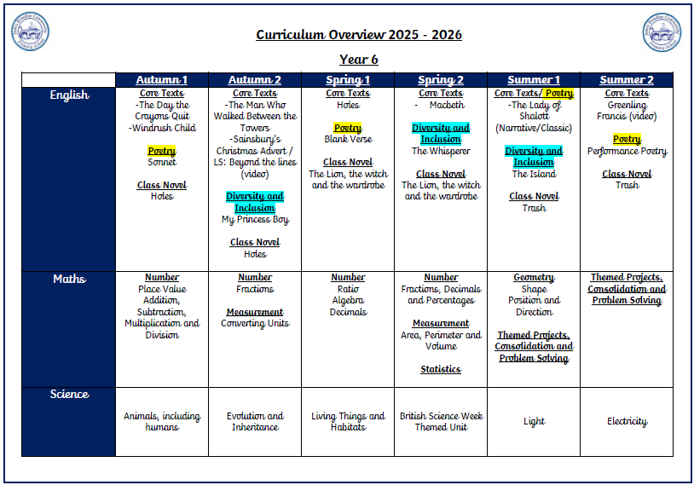
Curriculum

Slide 7
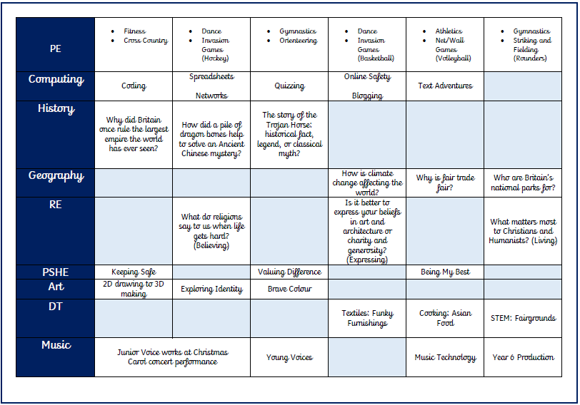


Slide 8
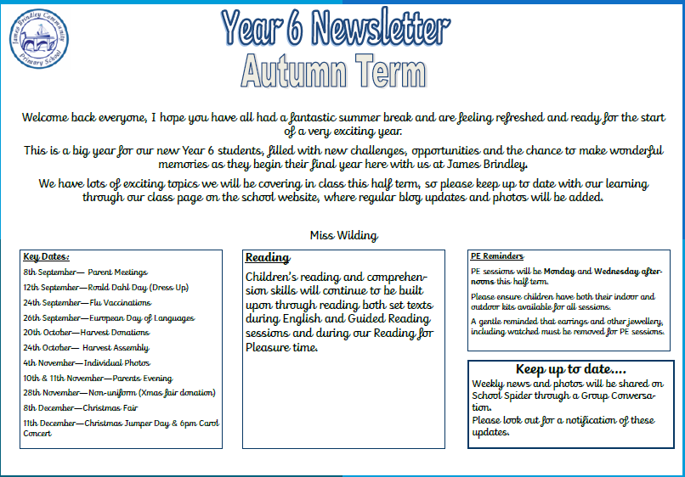
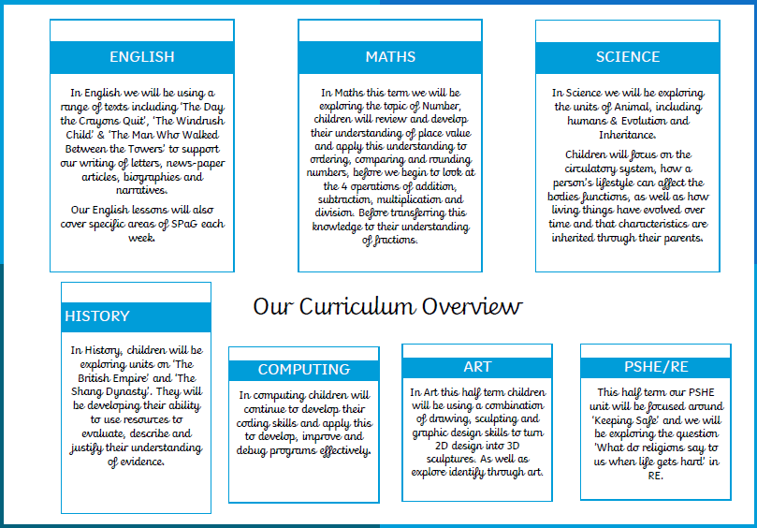
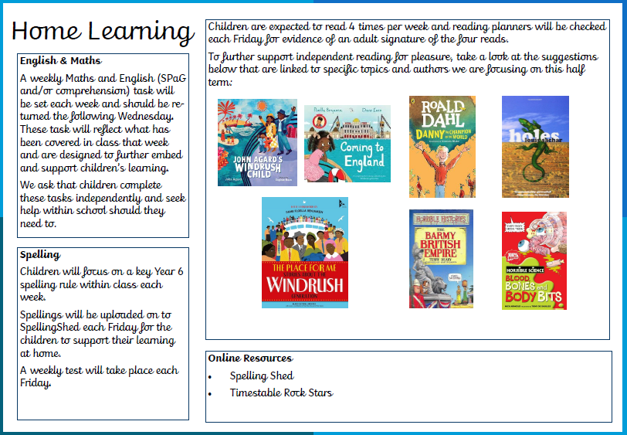
Newsletter

Slide 9
Newsletter
PE days
Monday and Wednesday afternoon (indoor and outdoor kit)
No jewellery / watches
Clubs
Netball
Football
Film Club
Tennis
Key dates and trips
12th September—Roald Dahl Day (Dress Up)
26th September—European Day of Languages
20th October—Harvest Donations
24th October— Harvest Assembly

Slide 10
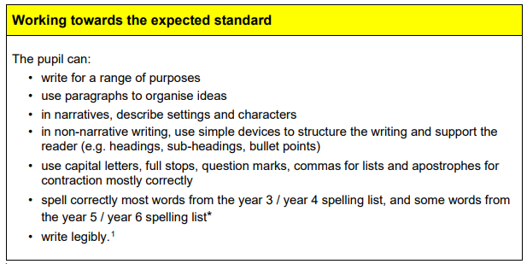
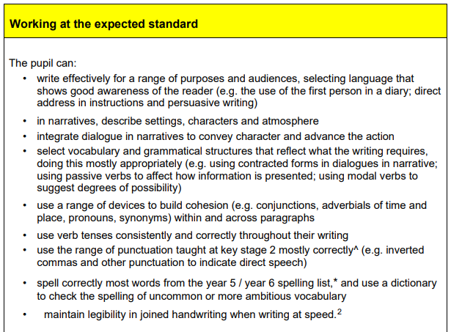
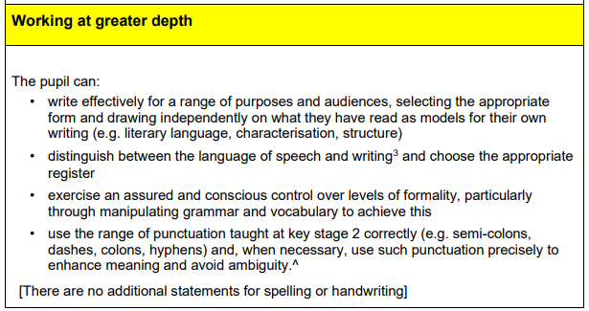
Year 6 expectation
English

Slide 11
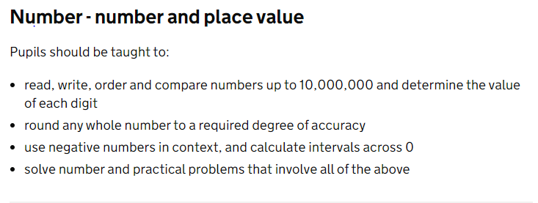
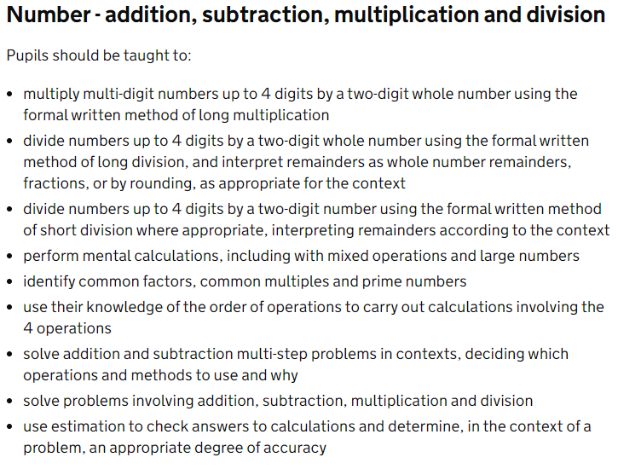
Year 6 expectation
Maths

Slide 12
Website
News
Blog
Calendar
Group Conversation

Slide 13
SATs
SATS Week
Monday 11th – Thursday 14th May
Papers
Maths – P1, P2 and P3
Spelling and Grammar & Punctuation
Reading
Writing – teacher judgement
SATs Meeting
~February

Slide 14


Spellings and Reading
Spelling lessons 3x week – reviewing KS2 rules
Spelling test every Friday
New spellings out on a Friday
Reading
4x per week (planner signed and checked each Friday)
Read a range of books from different genres and authors

Slide 15
Homework
Homework will be sent out each Friday and is due in the following Wednesday.
Maths and English (SPaG and/or comprehension)
New spellings (SpellingShed) each Friday and test on Friday
Reading 4x a week, planners checked each Friday
Timestable, TTRS
Autumn term homework will be an opportunity to review work looked at in class that week.
We encourage all children to tackle homework independently, and seek support from school if needed.
Children will stay in to complete incomplete homework during their own time.

Slide 16

Behaviour Expectations
Resilience, respect and independence
Whole School Approach
All children will begin each session on the sun.
A discreet approach will be taken if children are disrupting learning/not following behaviour expectations.
They will be given a warning and a chance to modify their behaviour. If unwanted behaviour continues children will be ‘moved down’ to the part sun & cloud, and be given the opportunity to think and modify. If this is evident, they will be moved back to the sunshine.
Following further disruption however, they will be moved to the grey cloud. This is the final opportunity to make the necessary changes. If behaviour continues however, children will receive a ‘time out’ from their break time.
Children who display exemplary behaviour will be moved to the rainbow. Any children on the rainbow at the end of each day will receive house points.

Slide 17
Whole School Rewards
House points will be collected weekly and totals will be displayed in the hall. The winning house team each half term will be rewarded – additional play time; a rounders afternoon; film afternoon…. Anything to celebrate their success!
Celebration Assembly will be the opportunity for us to celebrate both personal and academic successes. Awards of merit will be given to acknowledge and celebrate a specific aspect of learning. Children will receive a certificate to take home and a small prize. Their work and certificate will also be displayed over the next week in the hall, to inspire others to achieve. Golden Award will be awarded to those children who show resilience, respect and responsibility, and who show their skills in Collaboration, their motivation and those who aspire to learn and achieve. They will also receive a certificate to take home and display, and a ‘Star Pupil’ prize to collect.
Individuals or classes who impress with their attitude and behaviour during assemblies, class trips and whole school events will also be acknowledged and rewarded with additional play times and other rewards.

Slide 18
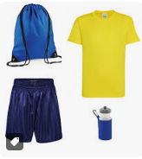
Things to remember
Label all items of clothing including P.E. kit.
Ensure reading books are in school every day.
Send a water bottled filled with fresh water (not juice) into school daily. Please clearly label water bottles with your child’s name.

Slide 19



Fruit, Toast and Milk
If you child wishes to have milk, payment is required via SchoolSpider
Toast is available to have at playtimes. If your child wishes to have toast, a payment can be made via SchoolSpider
Healthy snack.
Snacks and milk are taken outside and eaten during playtime.

Slide 20
Parent Communication
School Spider App:
All communication from school will now be sent through the school spider app, so parents must have downloaded and logged in to this, in order to receive all relevant and important information. All information will be received as a message on the app as well as via email.
The app will also be used to book parents evening appointments, complete surveys and complete permissions slips.
Newsletters- you will receive monthly newsletters from Mrs Simmons, along with termly individual class newsletters. These can all also be found on the school website.
If you wish to speak to teachers about any issues/concerns please contact the office and teachers will get back to you to arrange a suitable time.

Slide 21
Questions?

