Slide 1
Welcome to Year 1

Slide 2
The Year 1 Team
Mrs Sharrock – class teacher
Mrs Smethurst – HLTA
Mrs Gibson – TA
Miss Jervis - TA

Slide 3
Routine of the day
8.40am – doors open
8.50am – registration
9.00am – Phonics
9.30am – maths
10.30am – playtime (milk and fruit)
10.45am – English
12.00pm – lunchtime
1.00pm – afternoon registration
Guided Reading
1.30pm – afternoon session
History/Science/Art/Music etc
2.45pm – Assembly
3.15pm – Hometime!

Slide 4
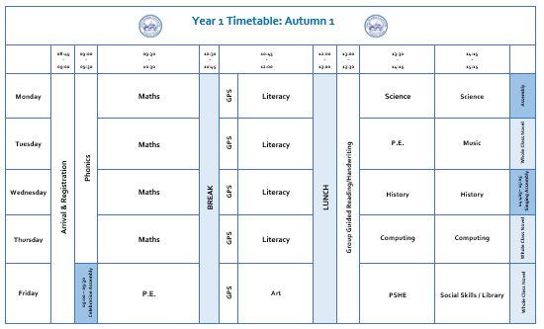
Weekly Timetable

Slide 5
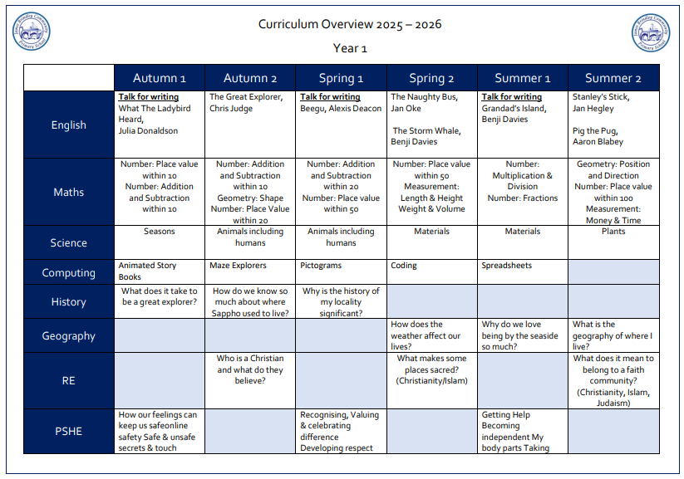
Curriculum

Slide 6
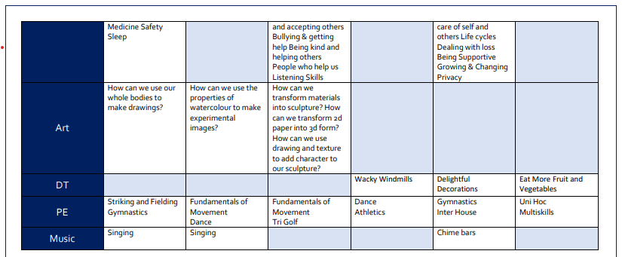
Curriculum

Slide 7

Phonics and Reading
Phonics sessions take place
daily from 9am in streamed
groups.
Weekly spellings and your child’s reading books will link directly to their learning in Phonics.
All children will have a tricky word bookmark in their reading books of words they need to learn how to read and spell.
On occasions we may send home
additional phonics sounds to
practise.
Please note, your child will take a statutory Phonics Screening Assessment in June 2025

Slide 8

Phonics and Reading
Phonics and reading are central to our learning in Year 1.
Please support your child in reading at home 4 times each week.
Encourage your child to read widely and for pleasure.
* Top Tips*
Read anything and everything!
Read out loud to them.
Let them read out loud to you.
Read a range of books from different authors and genres.
Let them see you read.
Help them to foster a love for reading.

Slide 9

Behaviour Expectations
Share your general expectations and the rules you have established with the children.
Whole School Approach
All children will begin each session on the sun. A discreet approach will be taken if children are disrupting learning/not following behaviour expectations. They will be given a warning and a chance to modify their behaviour. If unwanted behaviour continues children will be ‘moved down’ to the part sun & cloud, and be given the opportunity to think and modify. If this is evident, they will be moved back to the sunshine. Following further disruption however, they will be moved to the grey cloud. This is the final opportunity to make the necessary changes. If behaviour continues however, children will receive a ‘time out’ from their break time.
Children who display exemplary behaviour will be moved to the rainbow. Any children on the rainbow at the end of each day will receive house points.

Slide 10
Whole School Rewards
House points -
The winning house team each half term will be rewarded – additional play time; a rounders afternoon; film afternoon…. Anything to celebrate their success!
Celebration Assembly –
Awards of merit will be given to acknowledge and celebrate a specific aspect of learning. Children will receive a certificate to take home and a small prize.
Golden Award will be awarded to those children who show resilience, respect and responsibility, and who show their skills in Collaboration, their motivation and those who aspire to learn and achieve. They will also receive a certificate to take home and display, and a ‘Star Pupil’ prize to collect.

Slide 11



Fruit, Toast and Milk
If you child wishes to have milk, payment is required via School Spider.
Fruit is available daily and is free for the children. The selection varies each day.
Toast is available to have at playtimes. If your child wishes to have toast, a payment can be made via School Spider.
Snacks and milk are taken outside and eaten during playtime.

Slide 12
Lunchtimes and Playtimes
Year 1 will play on the big playgrounds during playtimes and lunchtimes. They are allowed to use the scooters, the outdoor play equipment and the gym equipment.
Please ensure that your child always has a coat in school and if they can’t already, help them to learn how to fasten their zip or buttons.

Slide 13
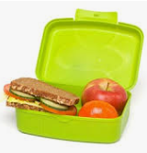
Lunchtime
Children in Key Stage 1 can receive a free school meal should they wish to.
Menus change every term and are available on our website or from the school office.
We are aware of all dietary requirements but please feel free to let us know of anything that you feel relevant with regards to your child’s lunch choices.
If your child is bringing a packed
lunch, please support us in working
towards our Healthy Schools
Award by providing a balanced lunch.

Slide 14
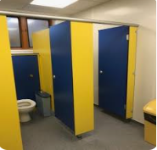
Toilet
The toilets for Year 1, unlike in Reception are based outside of the classroom.
Over the coming weeks and months we’ll be trying to train the children as much as possible to use them during playtimes and lunchtimes, although we know this isn’t easy!!
Please note we would never,
ever not allow a child to use
the toilet during lesson times,
we just try to reduce it as much
as possible.

Slide 15
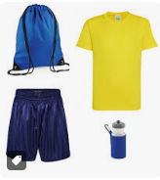
Things to remember
Label all items of clothing including P.E. kit.
Ensure reading books are in school every day.
Send a water bottled filled with fresh water (not juice) into school daily. Please clearly label water bottles with your child’s name.
P.E. days – Tuesday and Friday.
Spellings – Friday
Class library - Friday

Slide 16

Parent Communication
School Spider App:
All communication from school is sent through the school spider app. All information will be received as a message on the app as well as via email.
The app will also be used to book parents evening appointments, complete surveys and complete permissions slips.
Newsletters- you will receive monthly newsletters from Mrs Simmons/Mrs Stokes, along with half-termly individual class newsletters. These can all also be found on the school website.

Slide 17
How can you help us?
In Year 1 we do not ask for class funds like in Reception, however we’re always willing to accept donations of things you have at home that you may no longer use, such as:
Books
Board games
Jigsaws
Card games (Dobble, Top Trumps)
Art and craft materials
Tissues
We are also trying to improve our outdoor learning space and would be grateful of any items that may enhance our provision such as plants, wooden crates, tyres, bird feeders etc.

Slide 18
How can you help your child at home?
Read at home every day.
Help your child to learn any additional phonics or spellings that come home.
Practise cursive letter formation and support your child in learning how to spell their first and last names correctly.
Practise counting forwards and backwards to 20 ensuring they can record all numbers accurately.
Practise number bonds to 10.
We will be developing our approach to home learning over the coming weeks, where we will be considering the use of current tools within school – purple mash, google classroom and the website platform.

