Slide 1
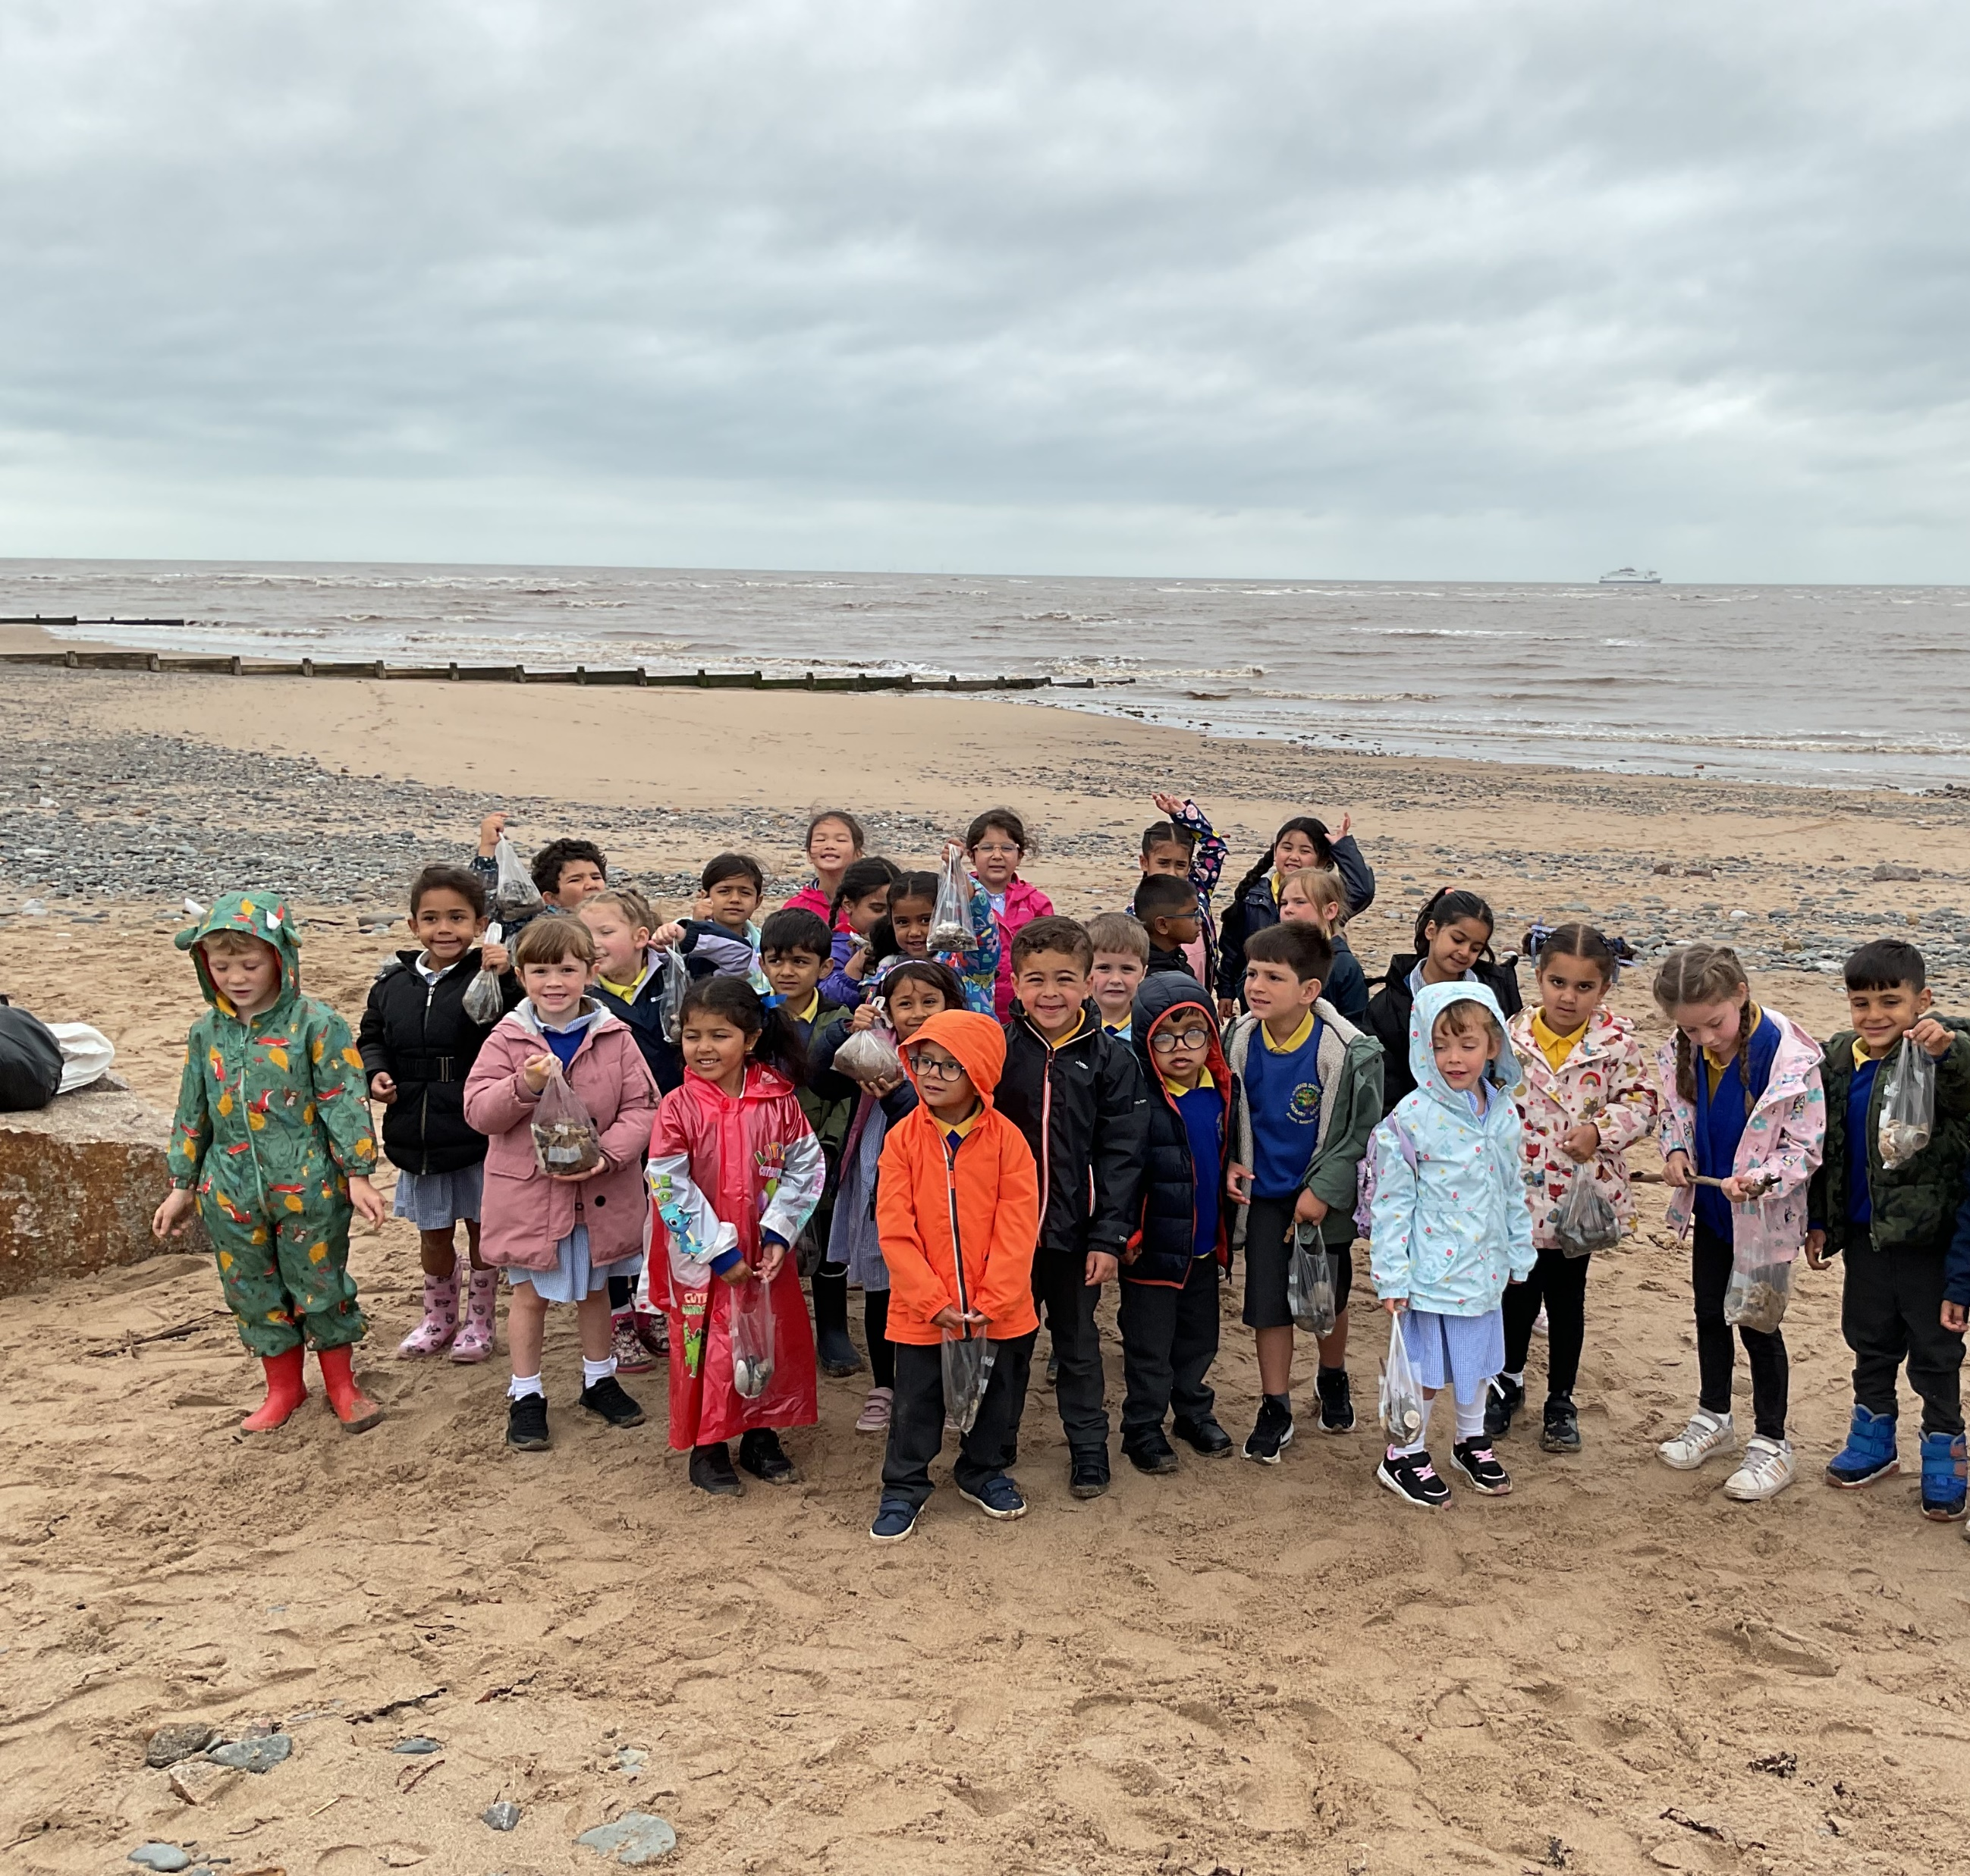
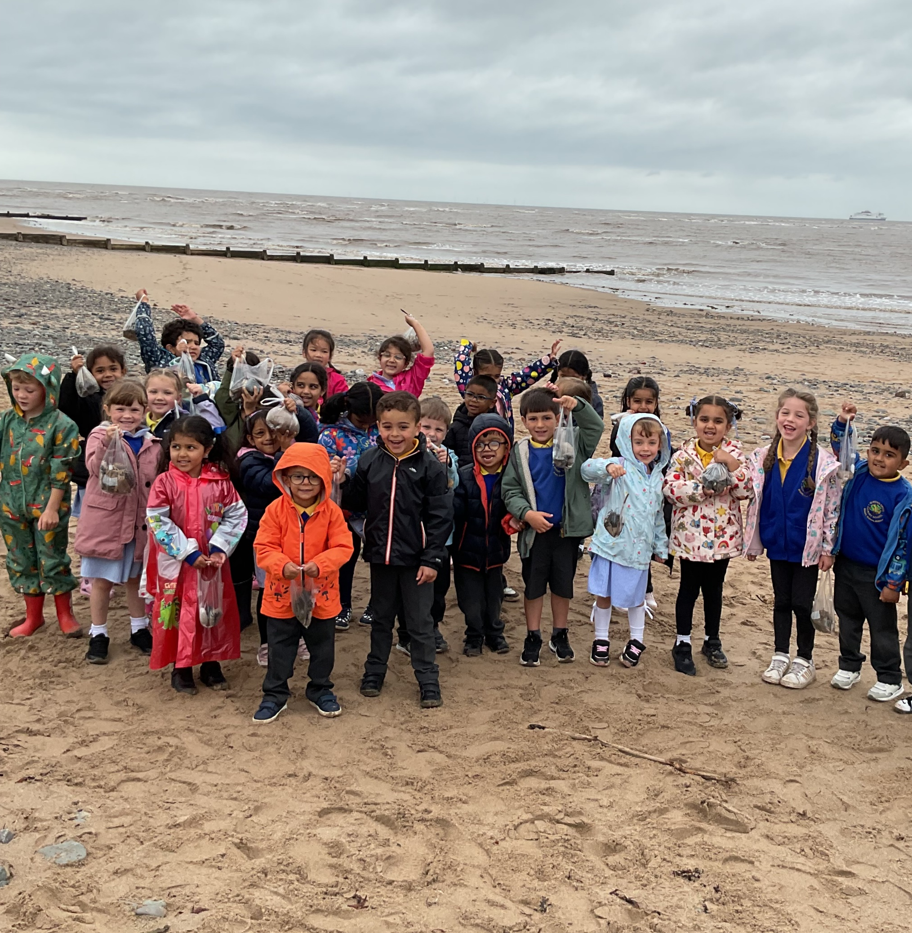
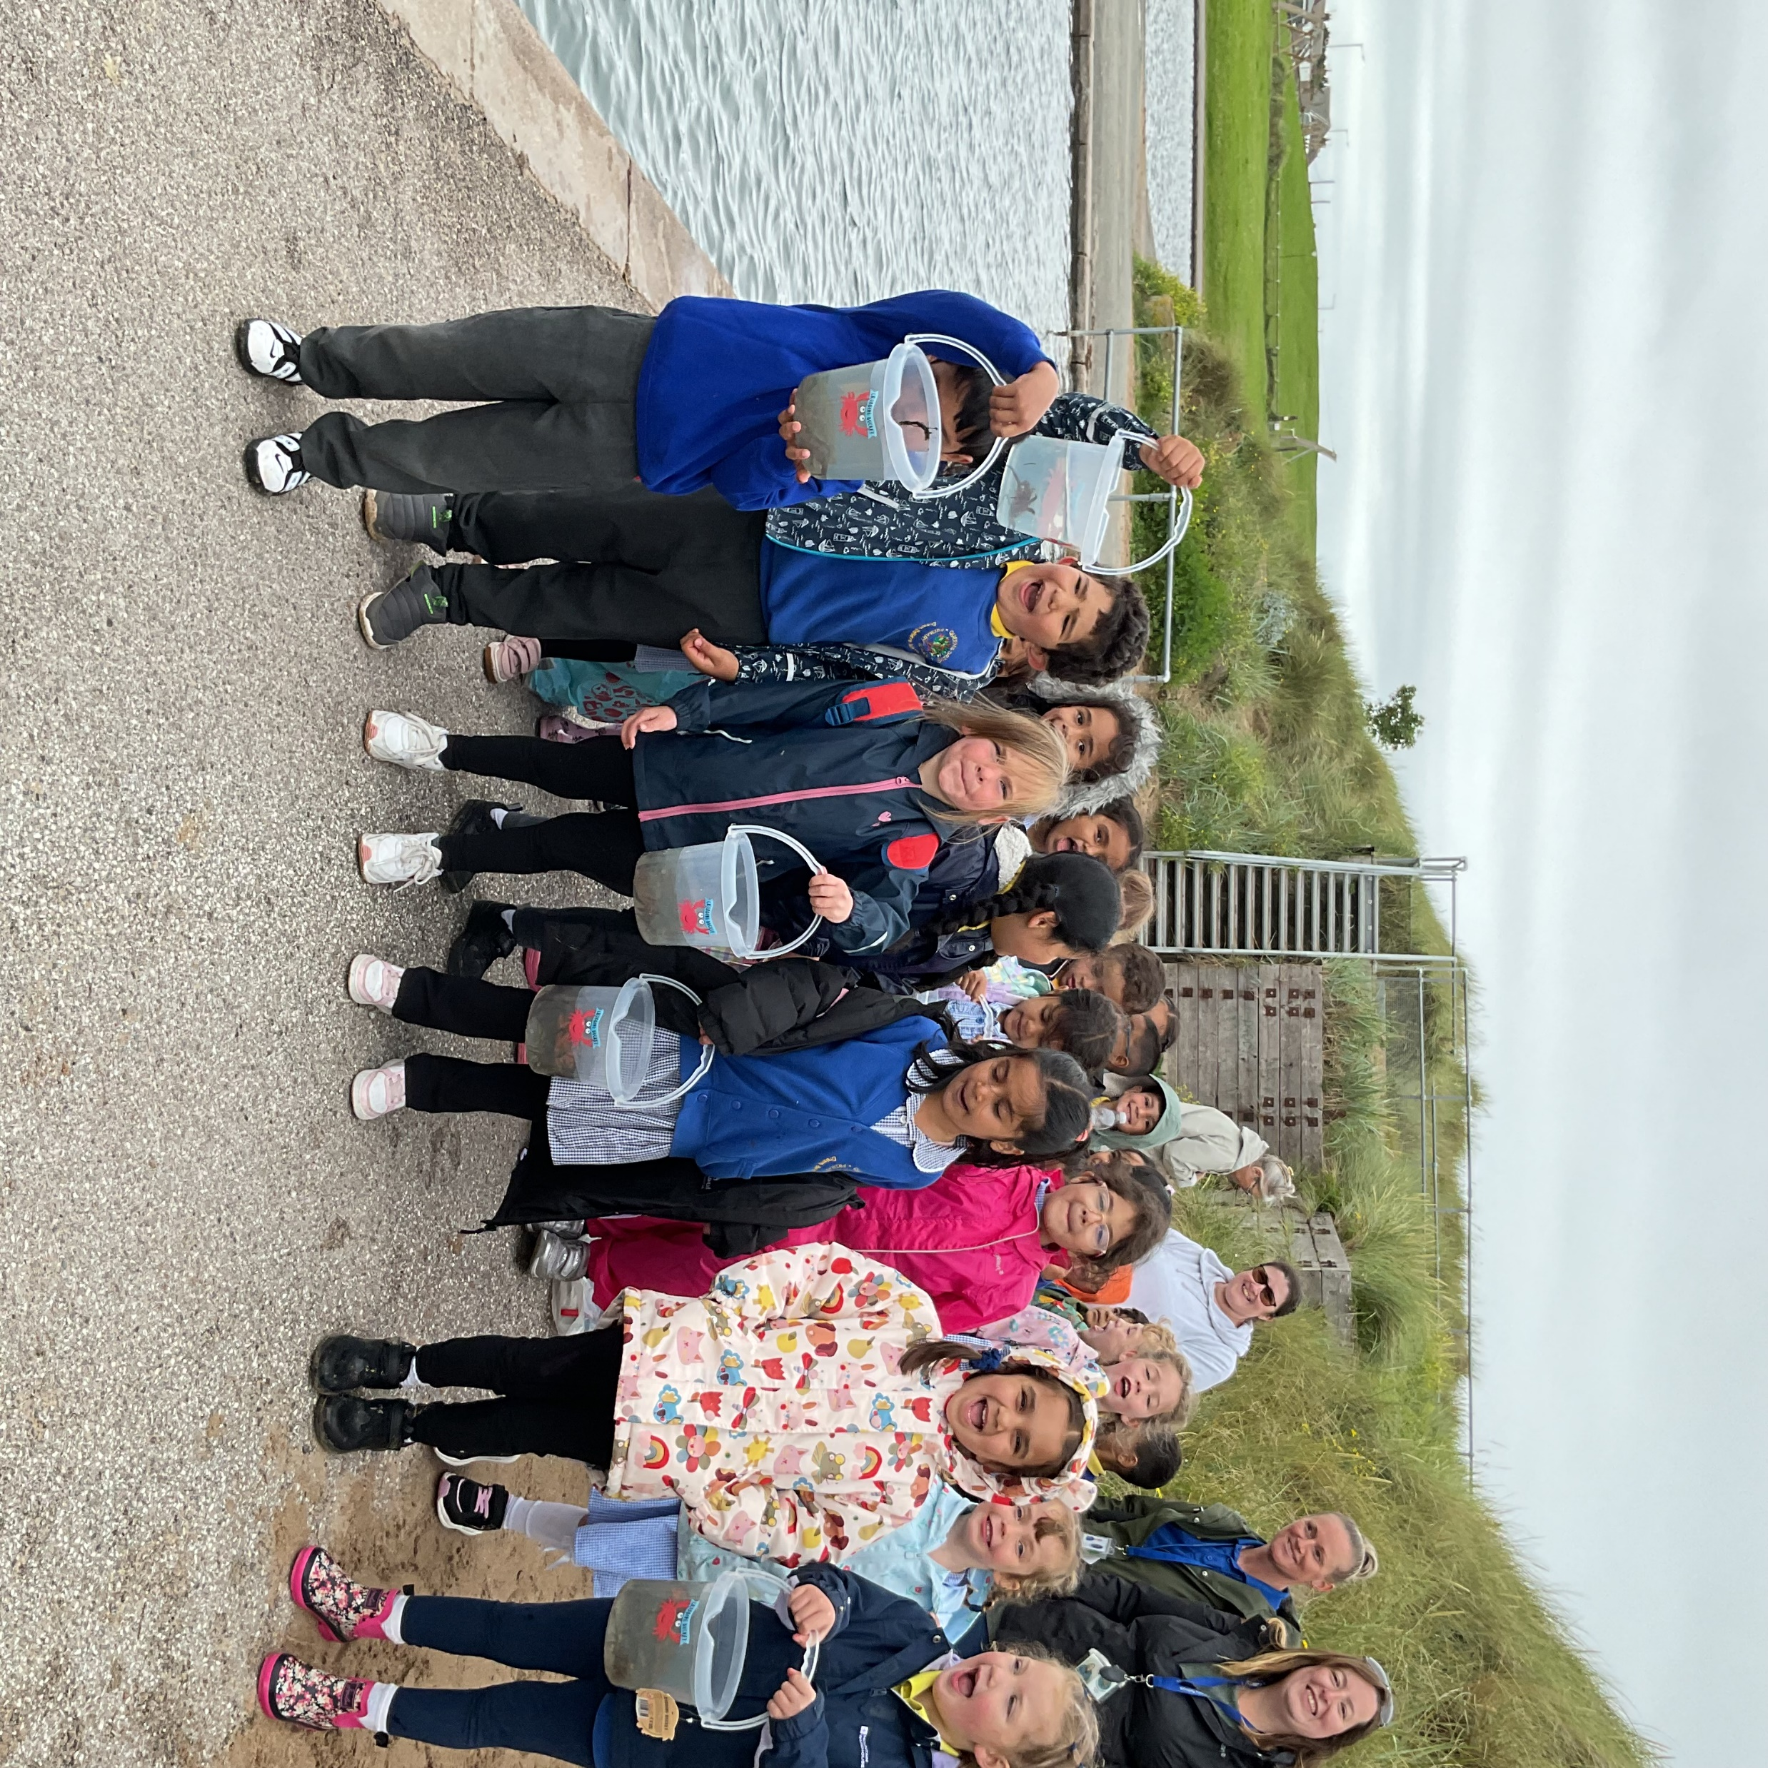
Crabbing at Fleetwood
We were very lucky to go and explore some real sea creatures at the seaside! We learnt all about crabs along with what they like to eat and how to catch them. We found lots of fabulous natural resource which we have brought back to further explore in our classroom this week. We caught many crabs and discussed why it is important to put them back. What a beautiful day!

Slide 2
