Slide 1
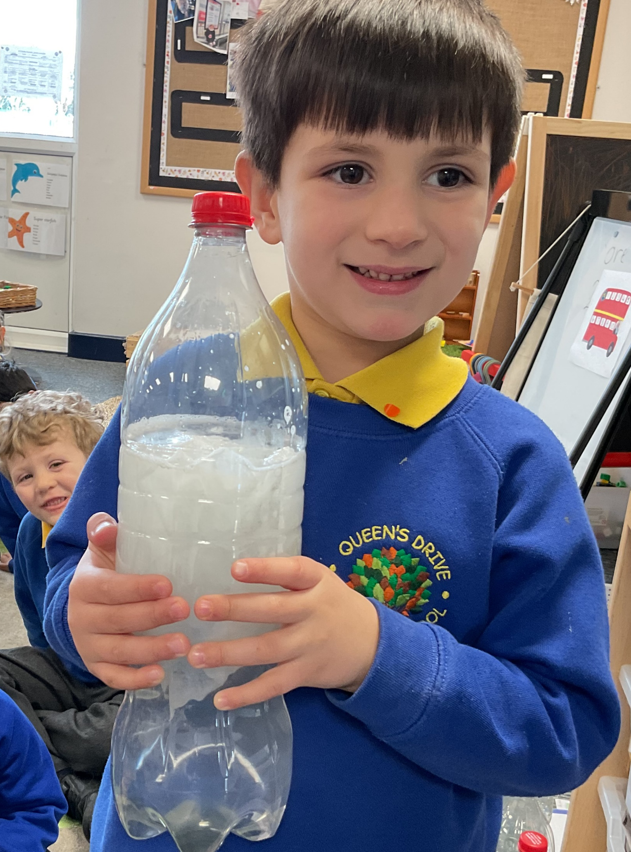
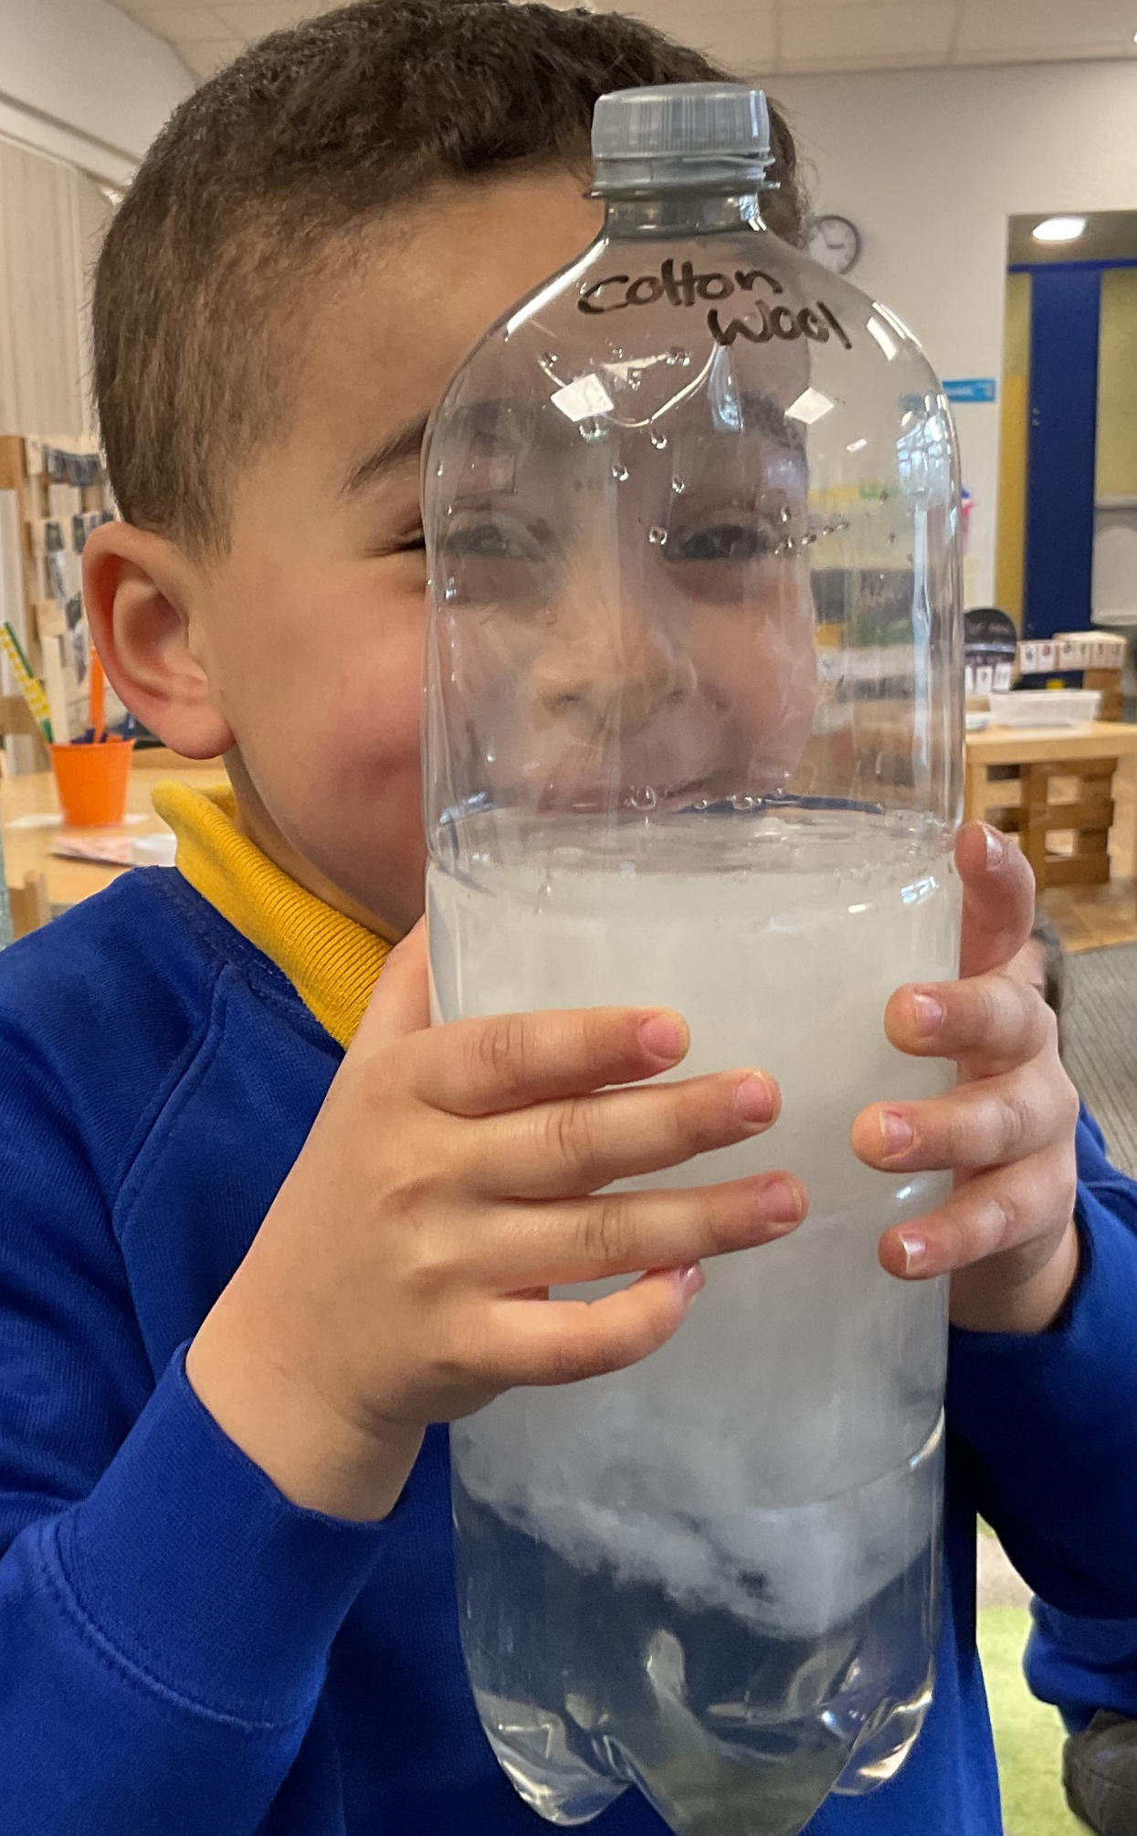
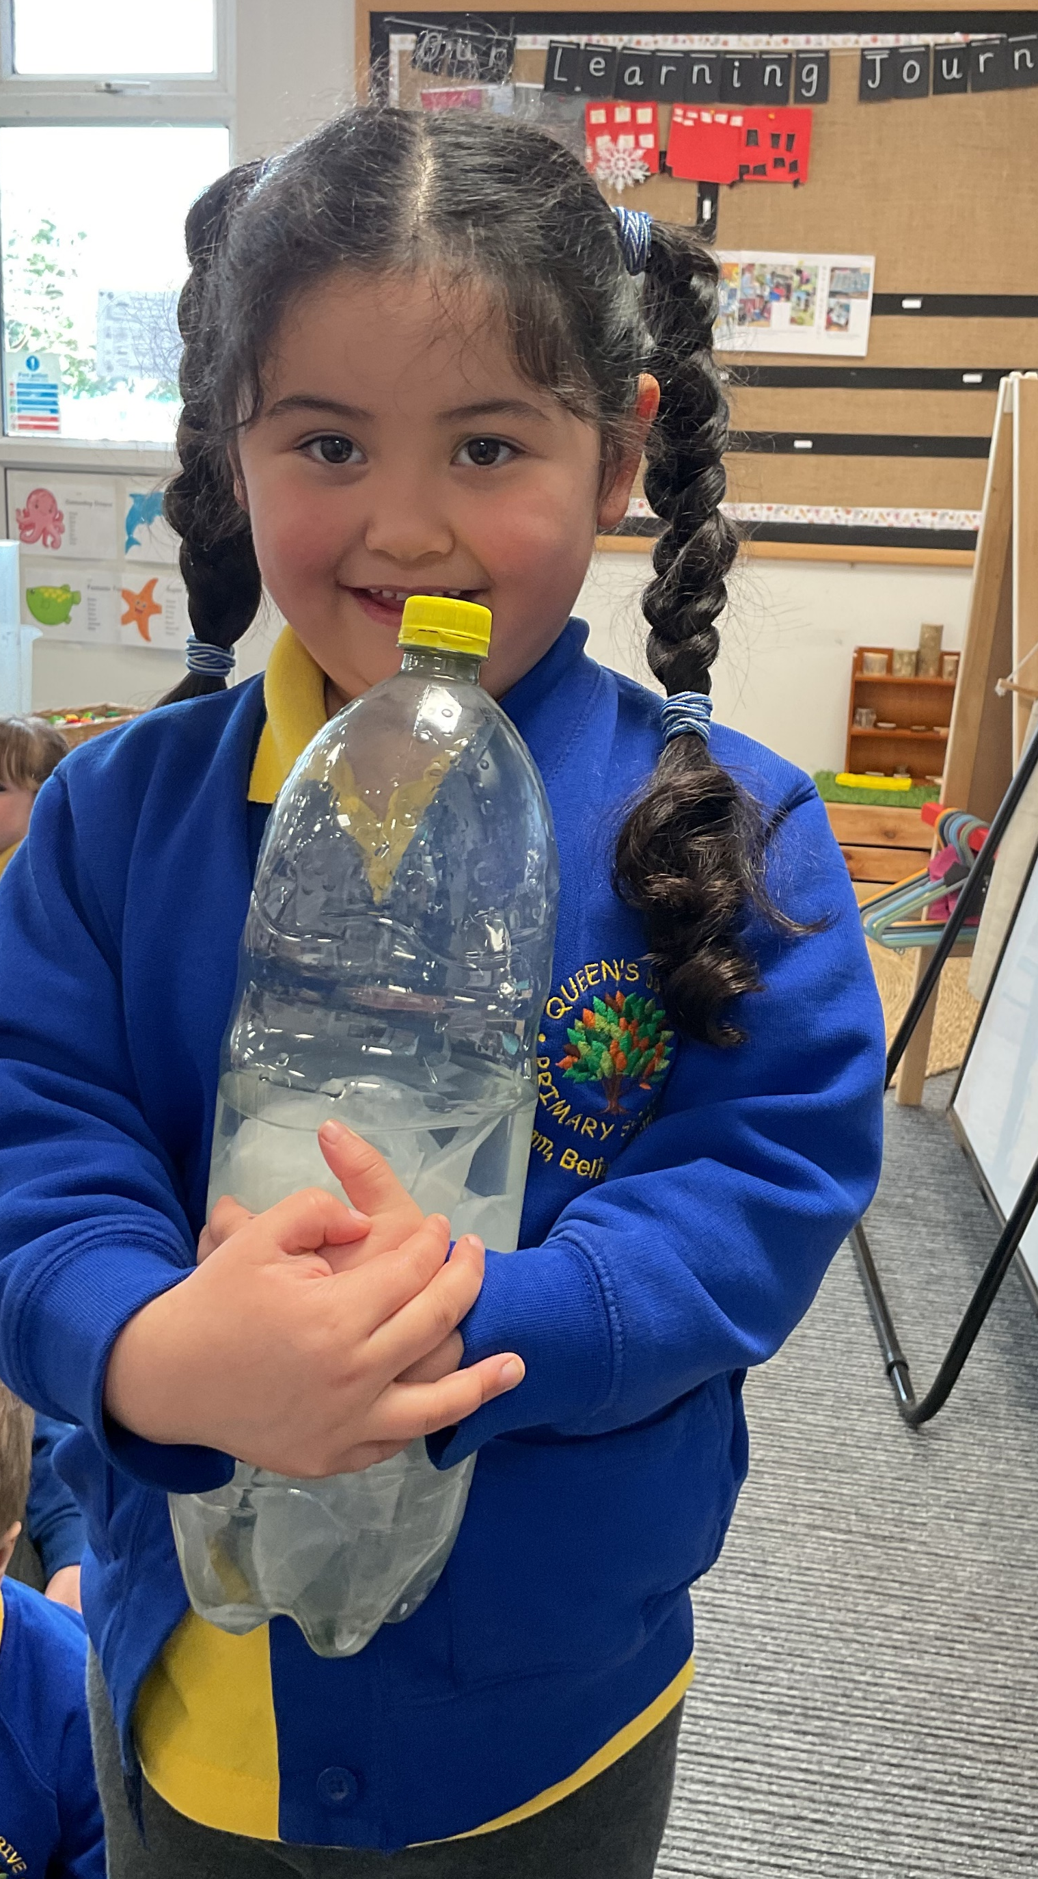
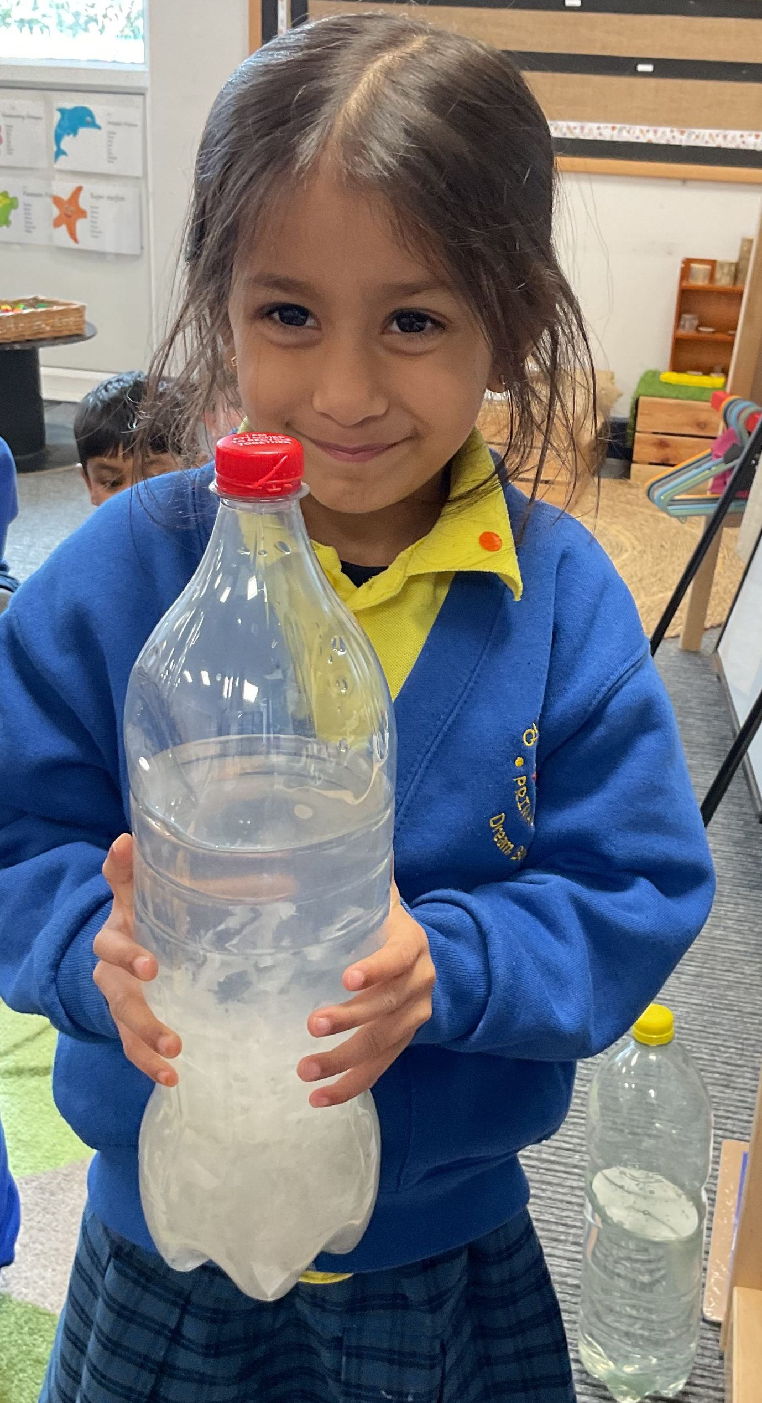
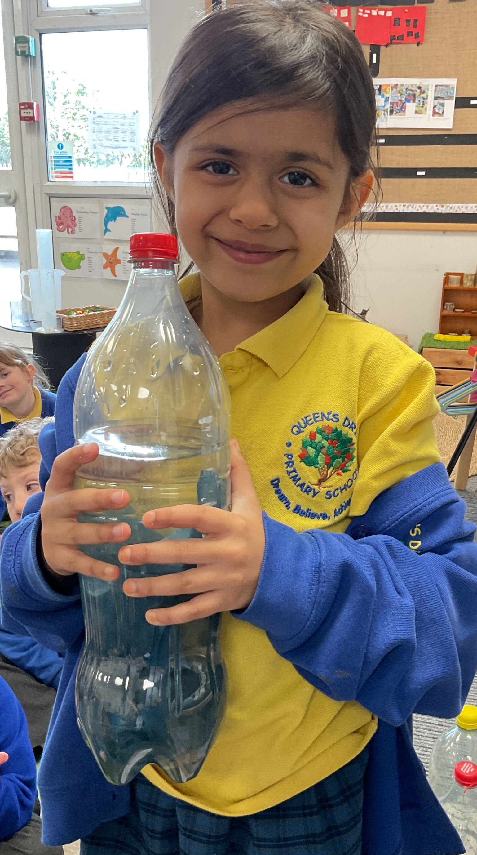
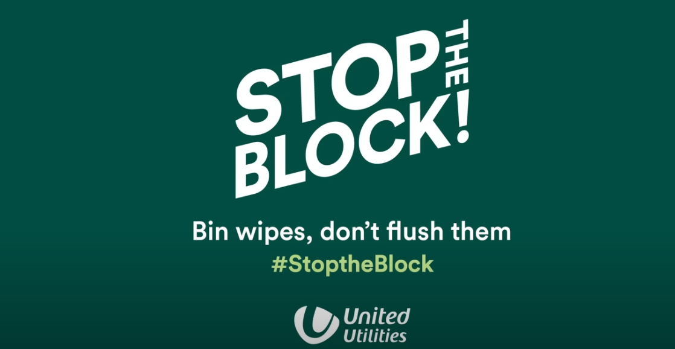
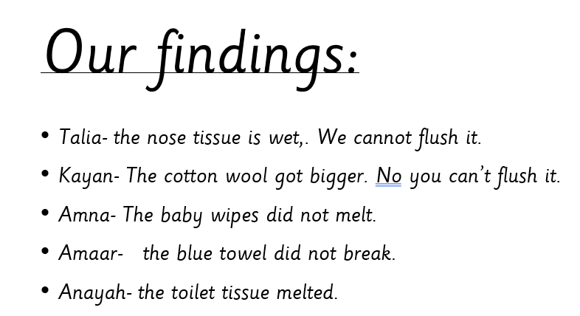
We did an experiment today where water bottles became toilets. We found that only toilet tissue dissolves properly in water.
Science week

Slide 2
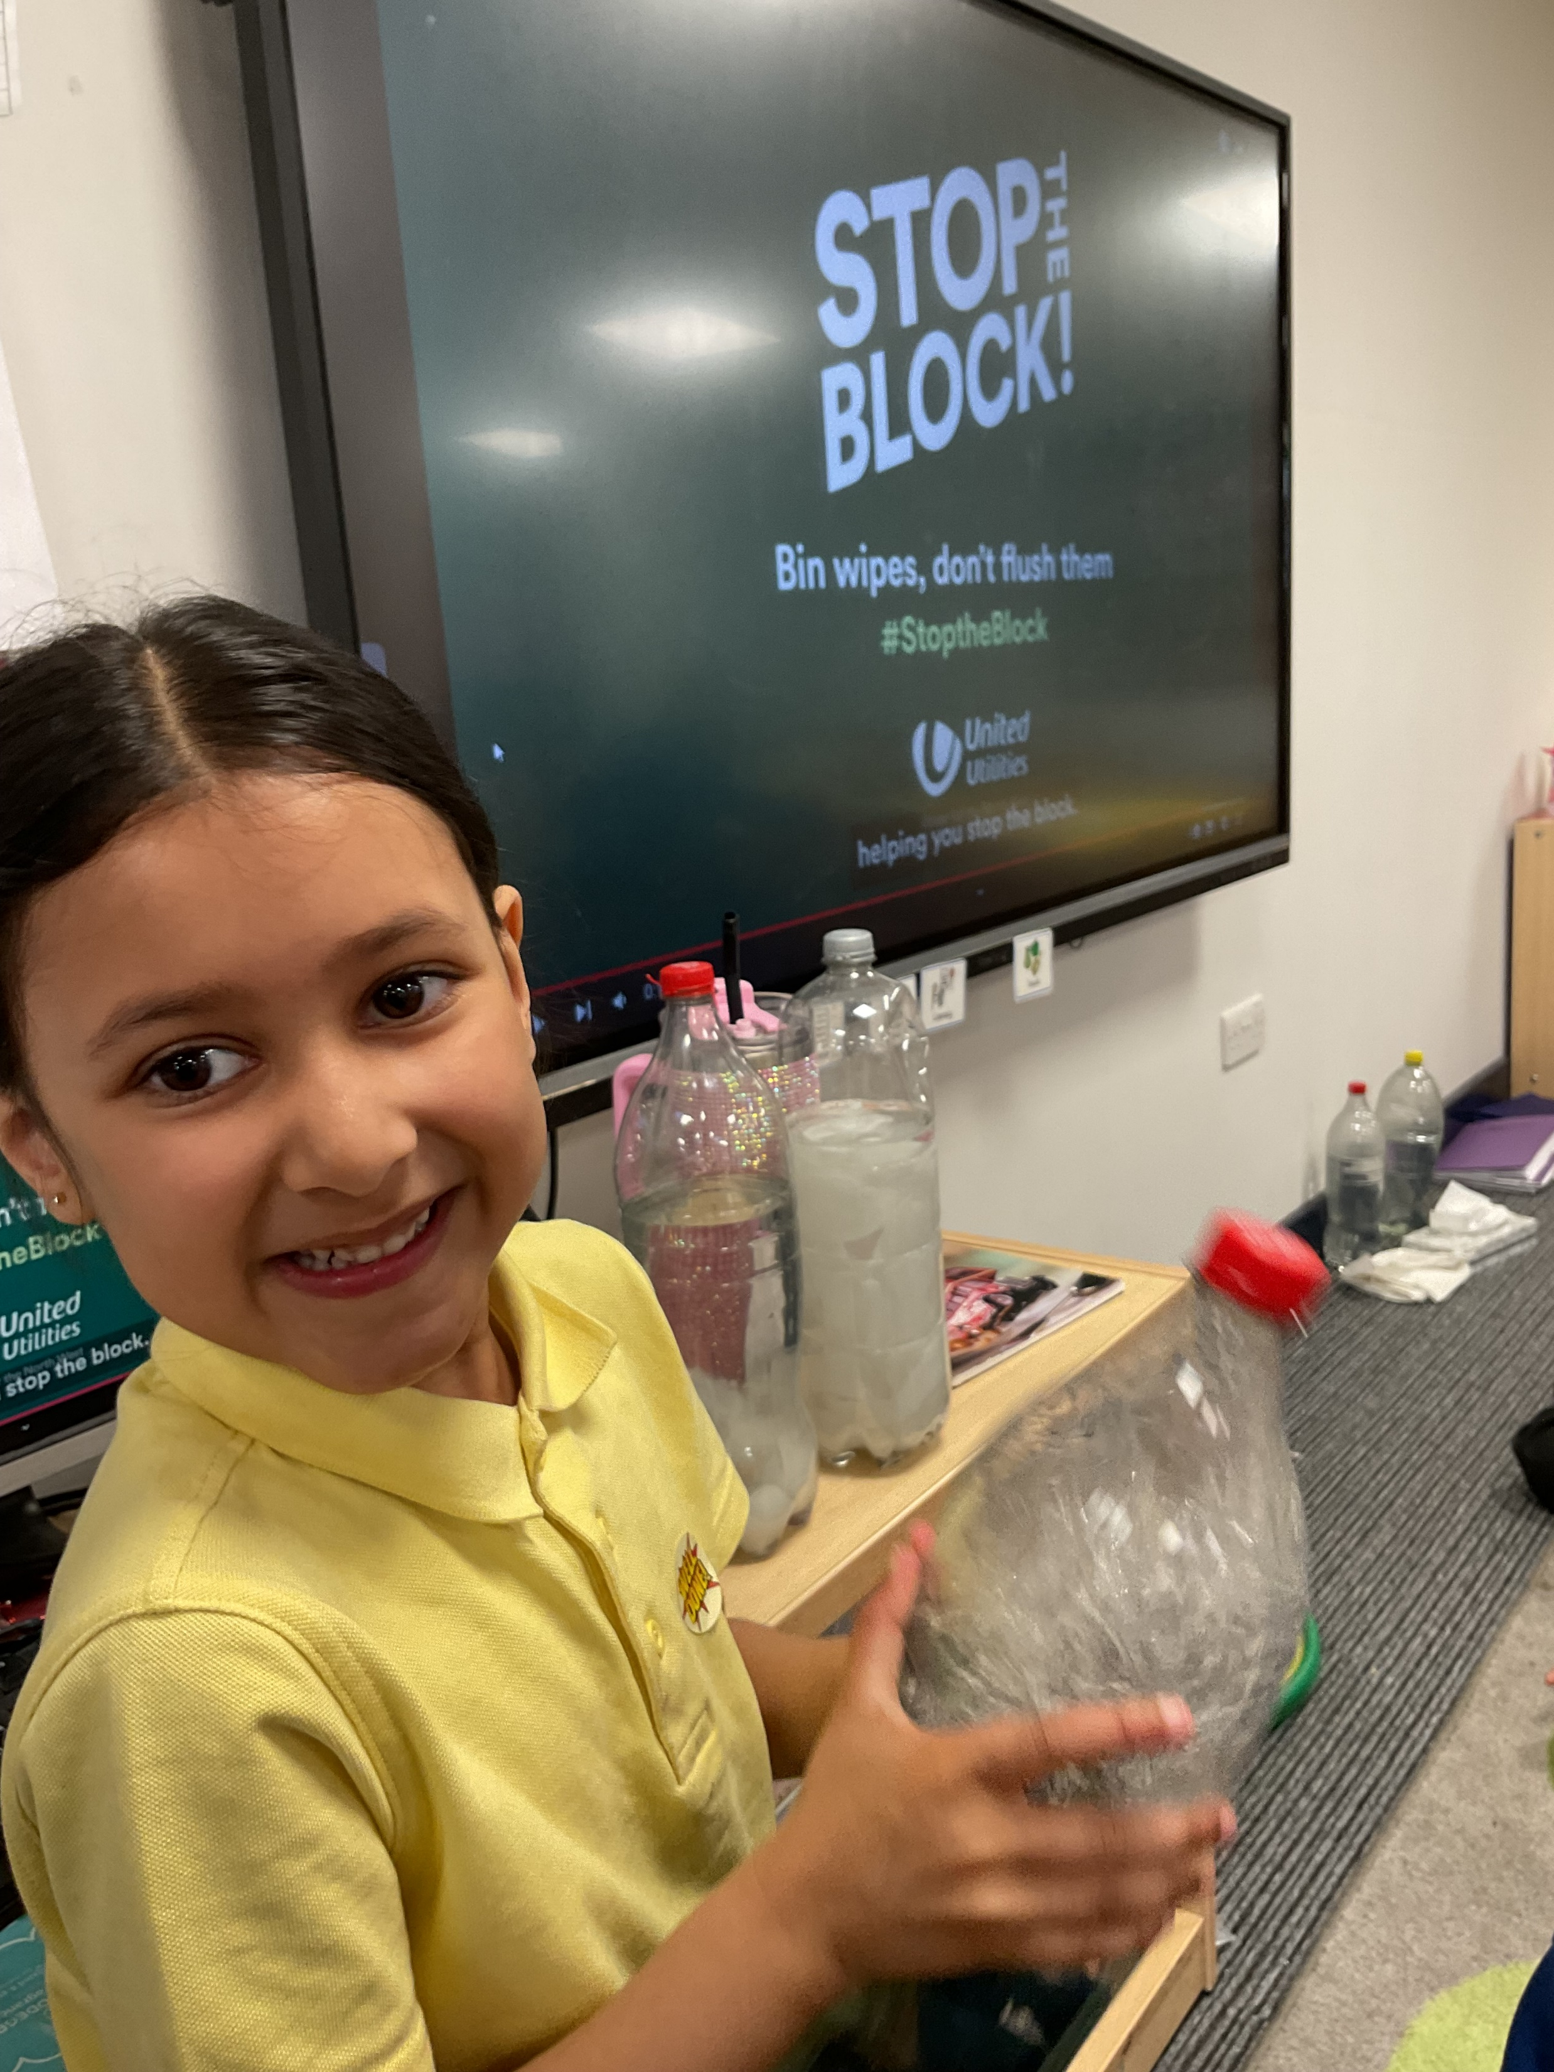
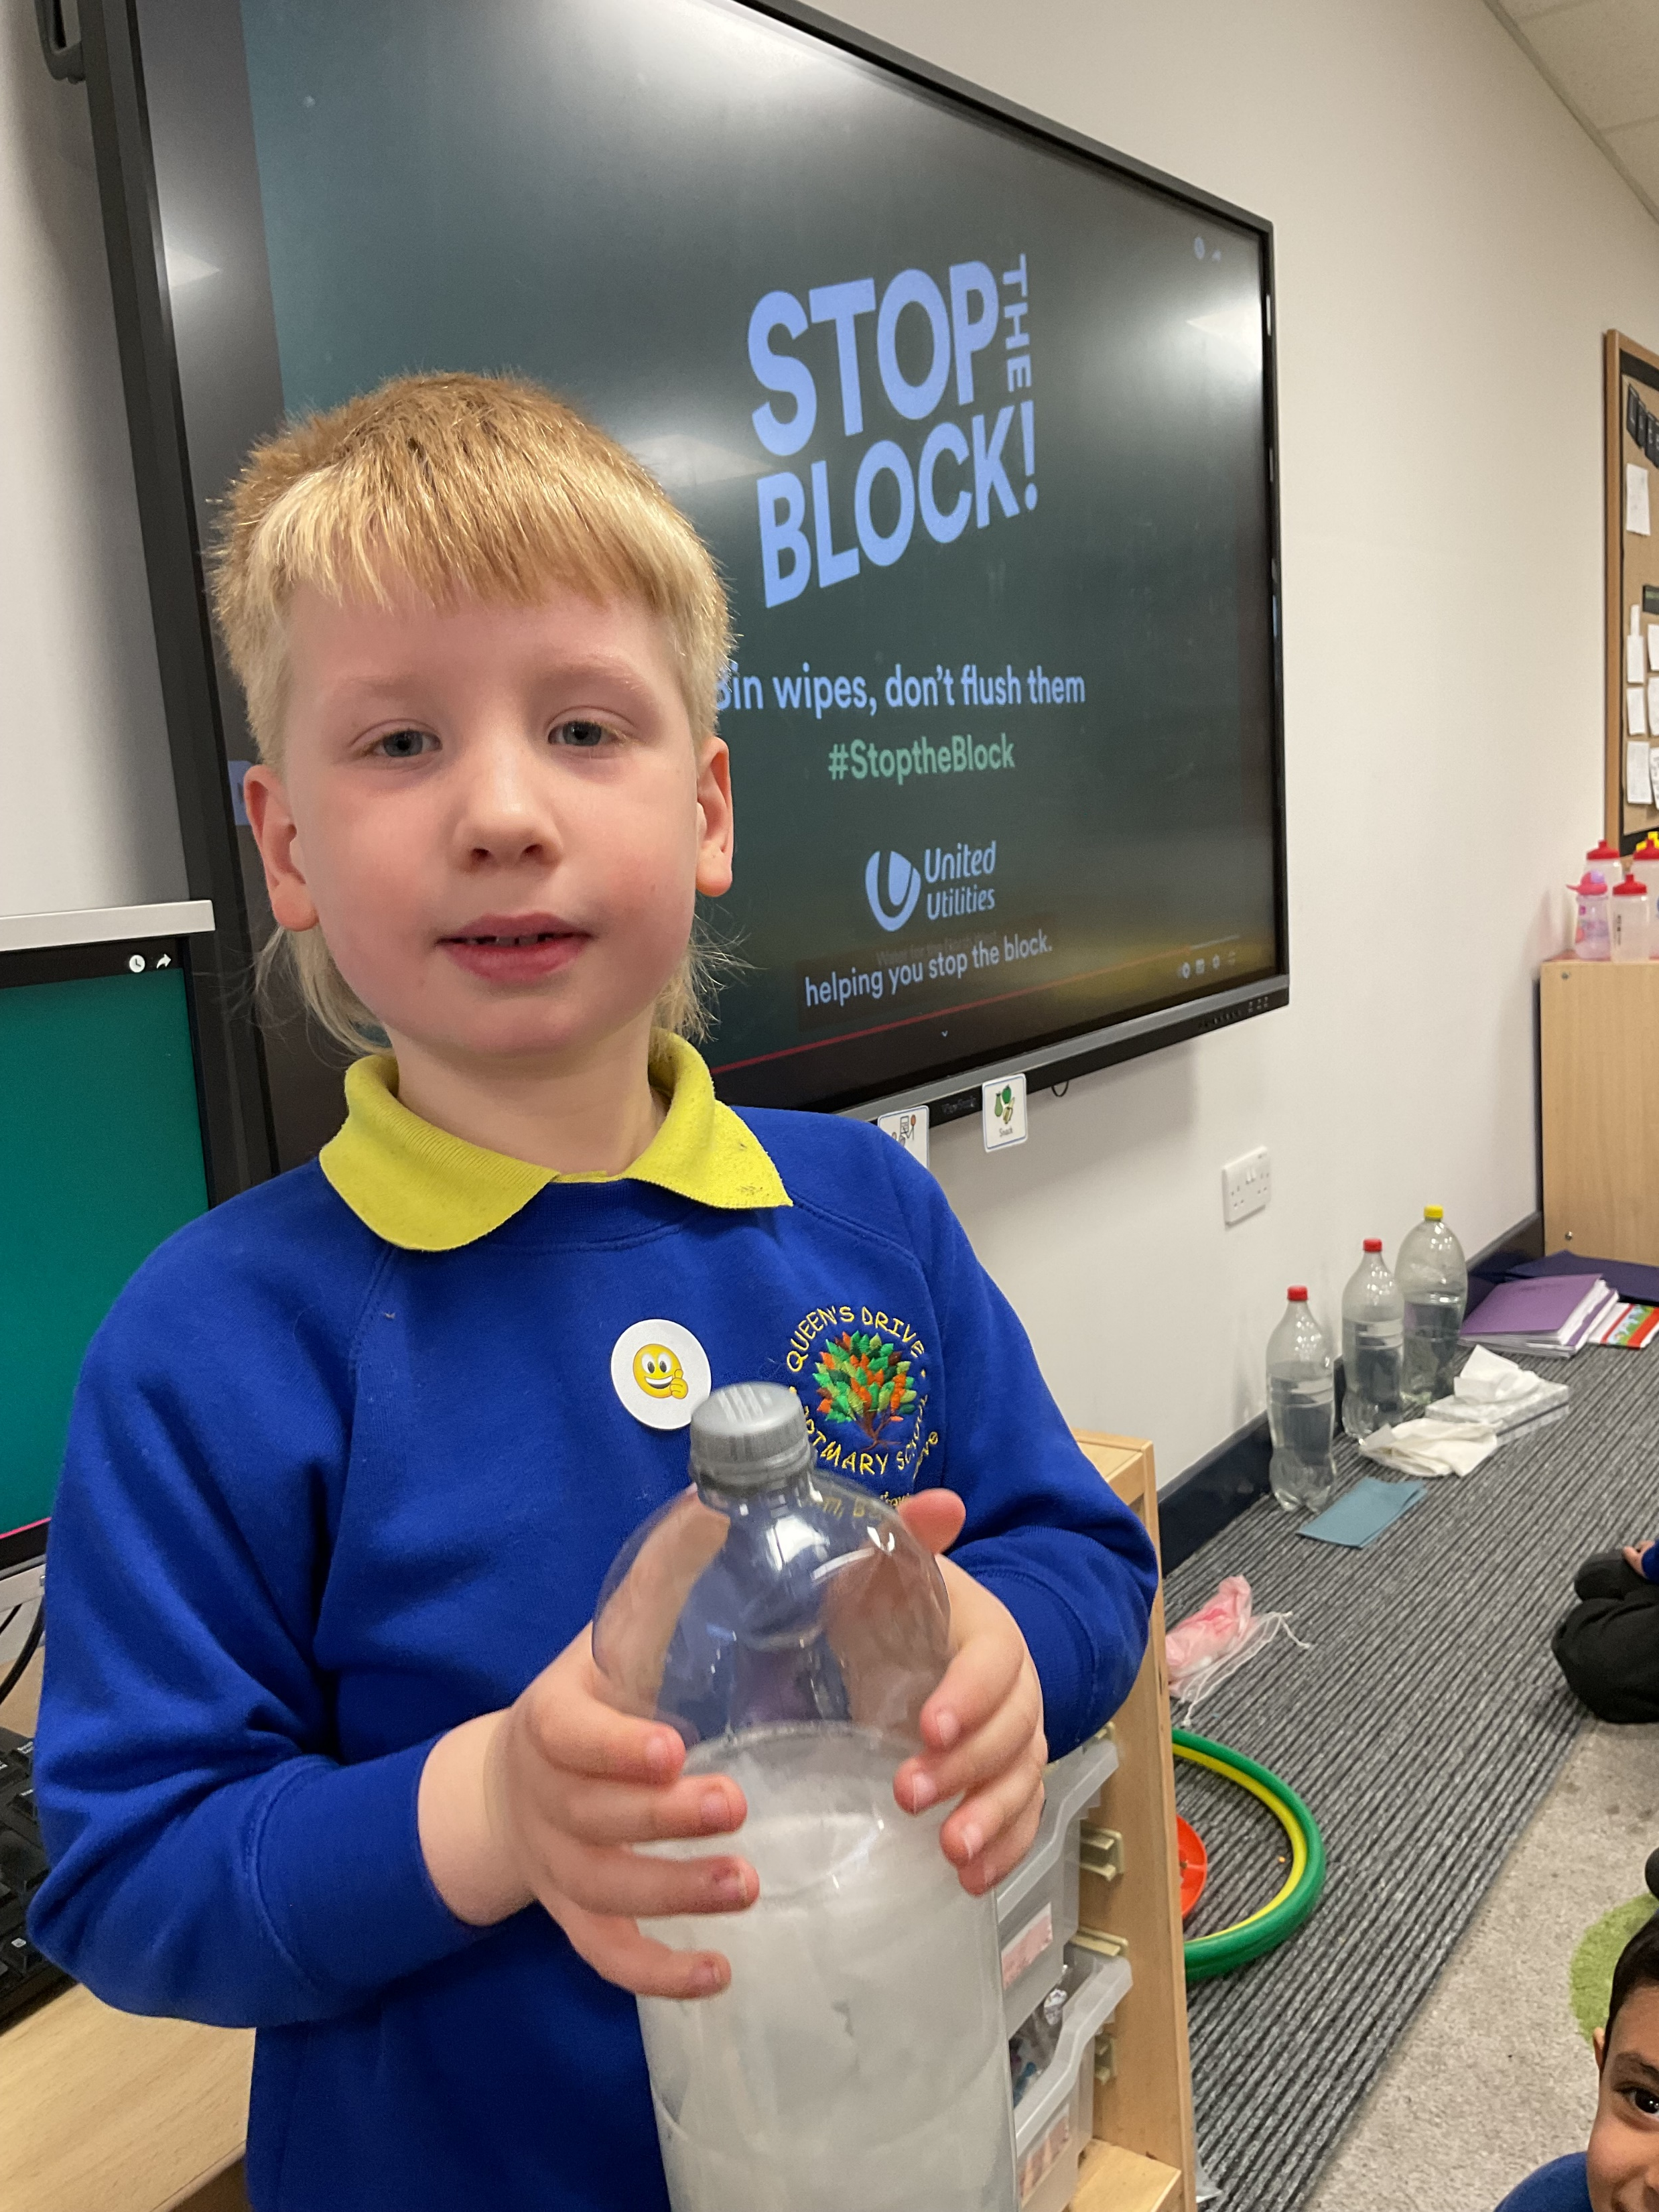
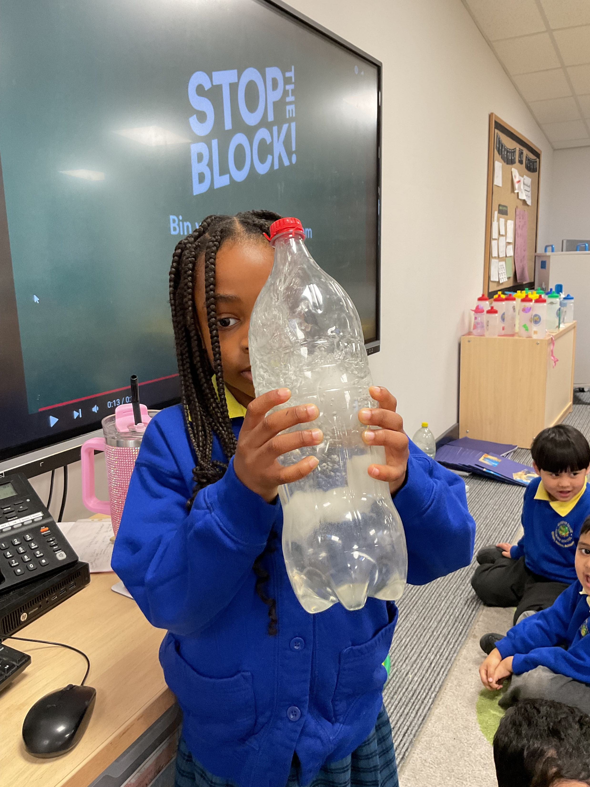
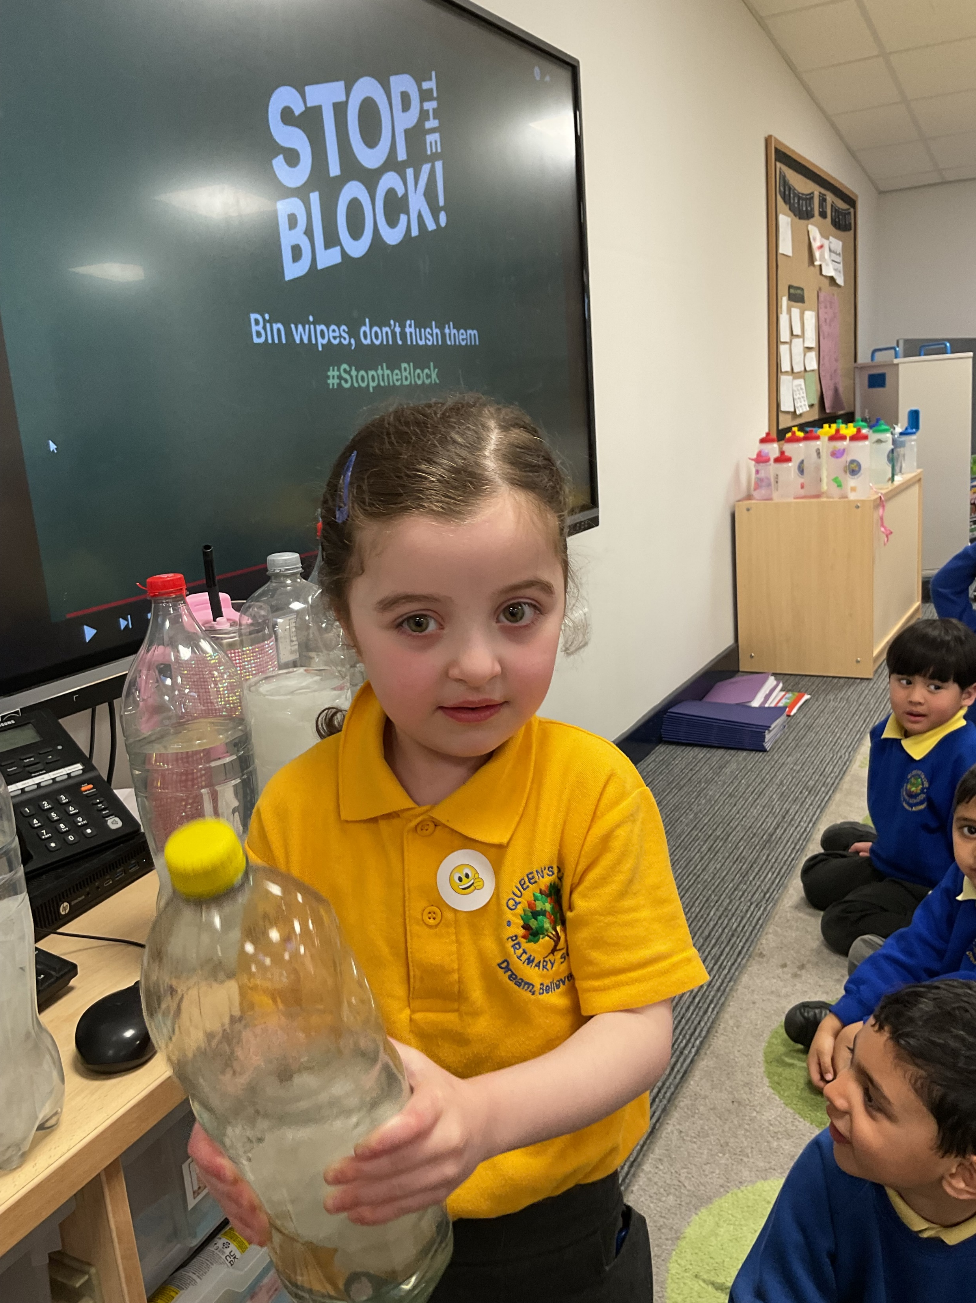
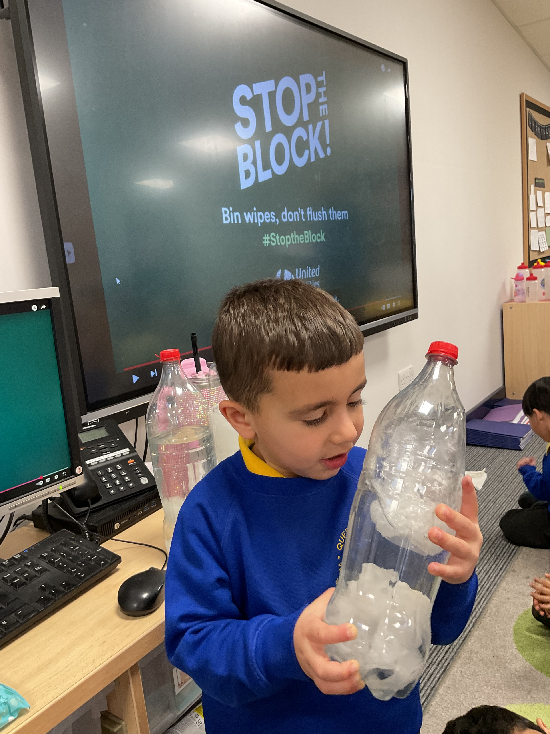
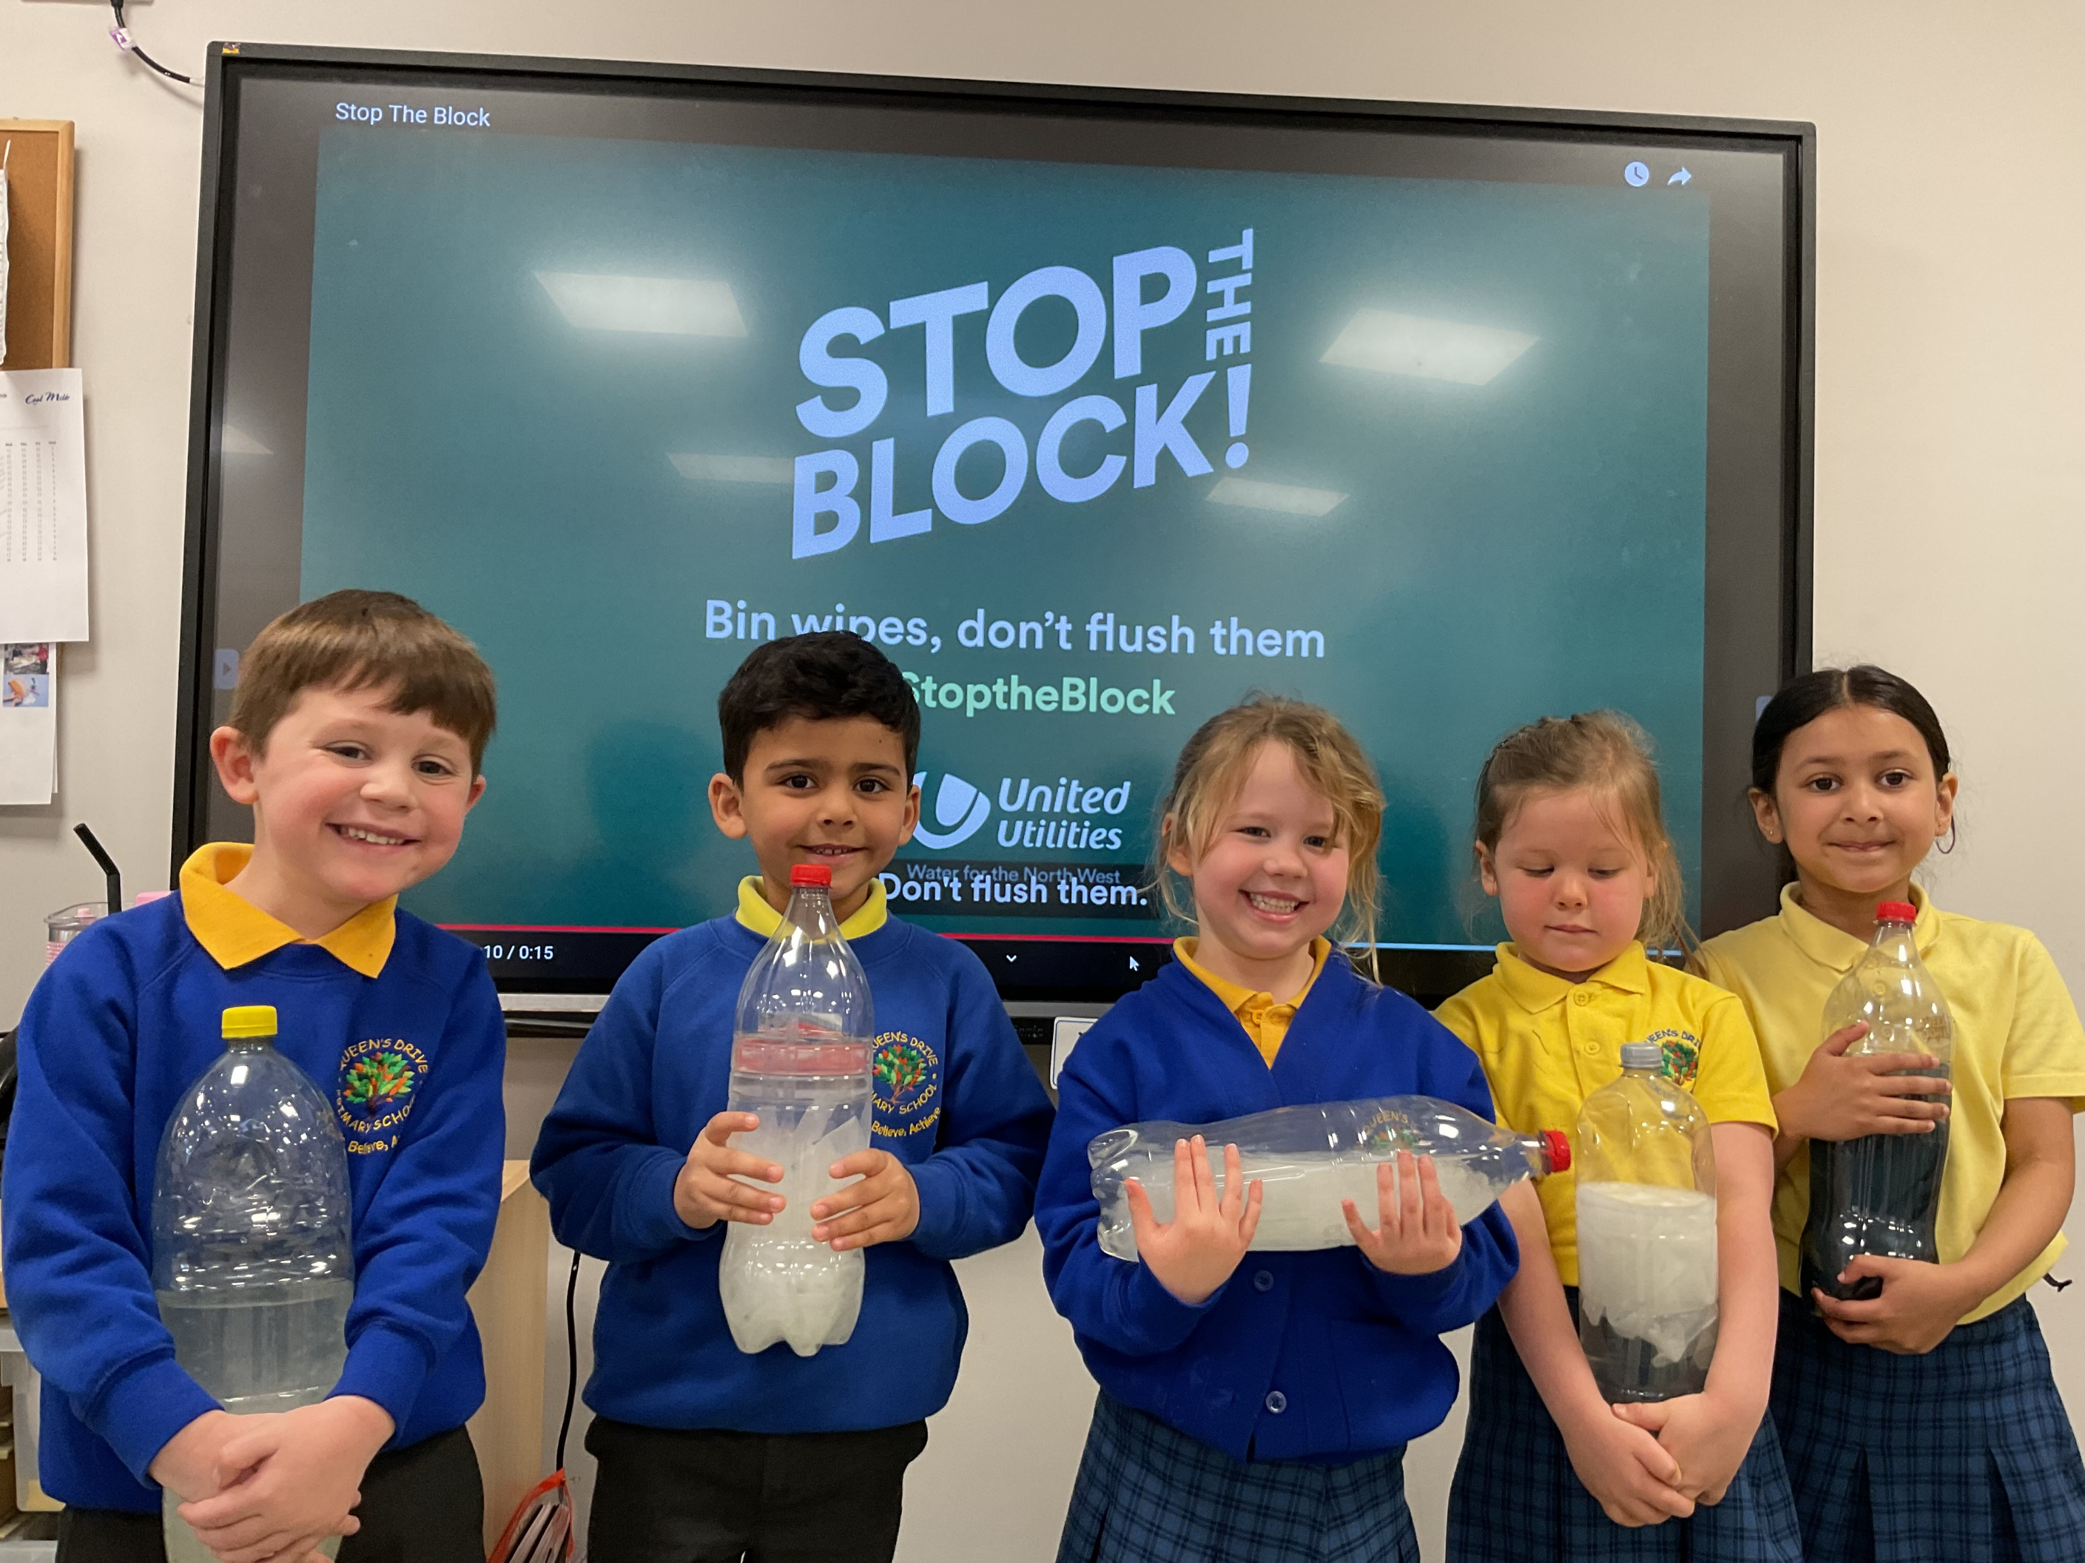
Science week
We did an experiment today where water bottles became toilets. We found that only toilet tissue dissolves properly in water.

Slide 3
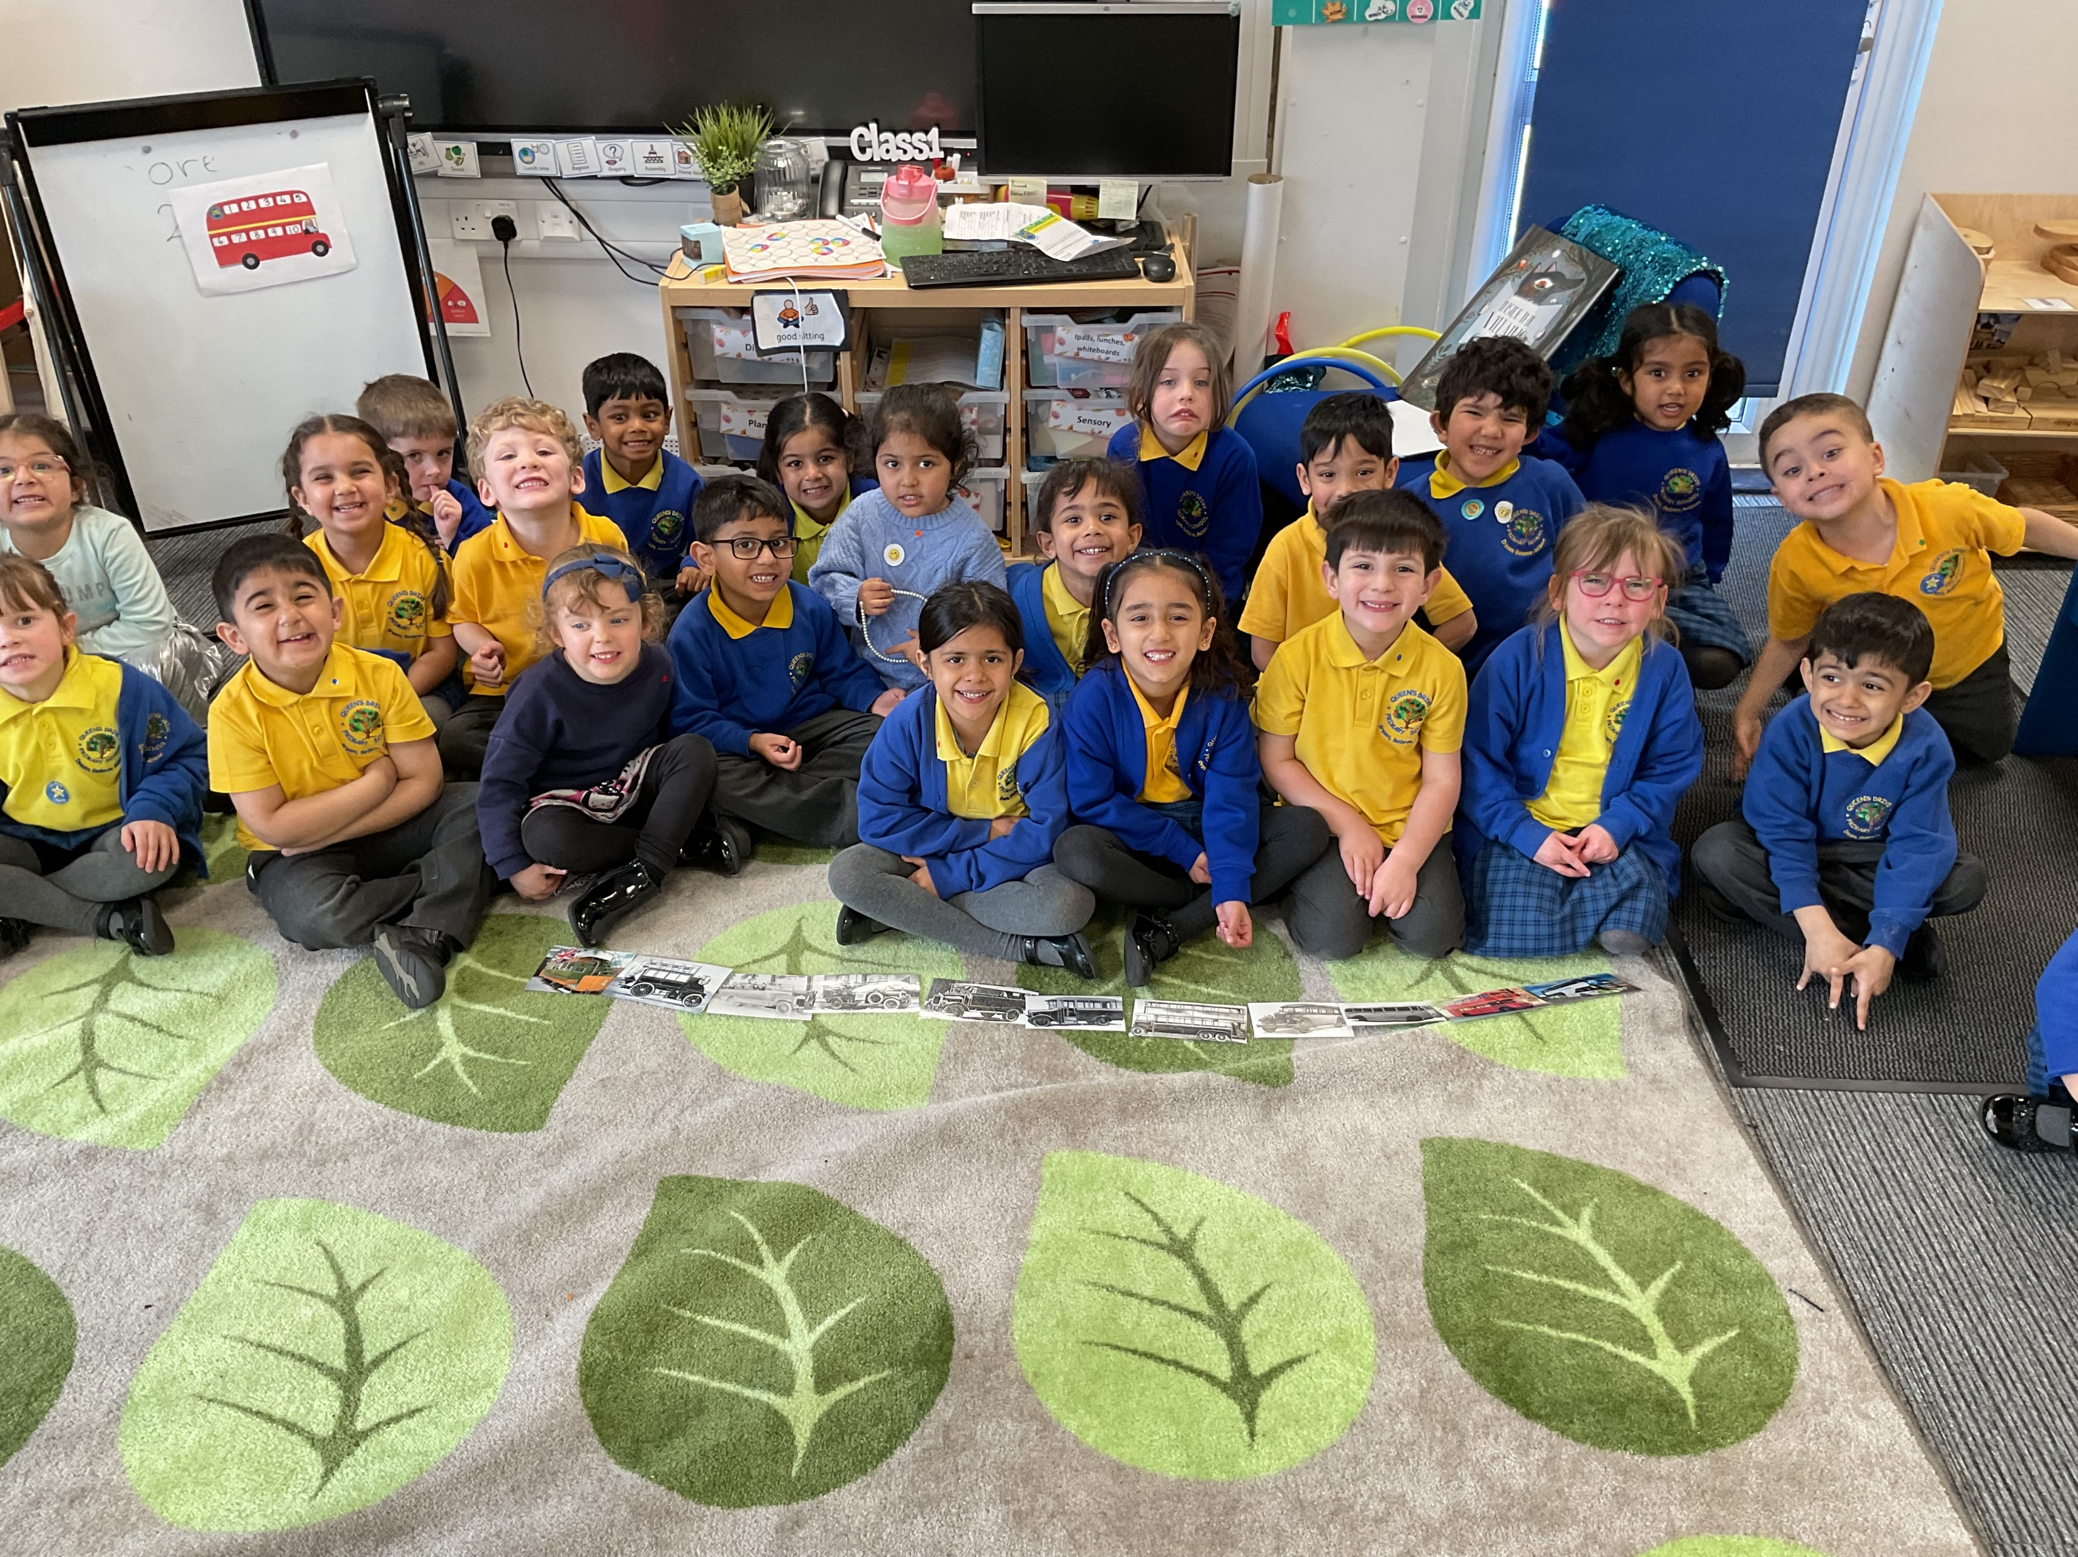
Buses through time
This week we have been fascinated by looking at a variety of vehicles and how they have changed from their original design to the modern vehicles we have now. We were particularly interested in buses which began like a horse and carriage and now we have fully eco buses which are electric!
Bobbie- “The bus did not have a roof! Now sometimes it has stairs”.
Raees- “This bus runs on a battery like my toy car”.
Nellie- “The black and white pictures are from the past”.

Slide 4
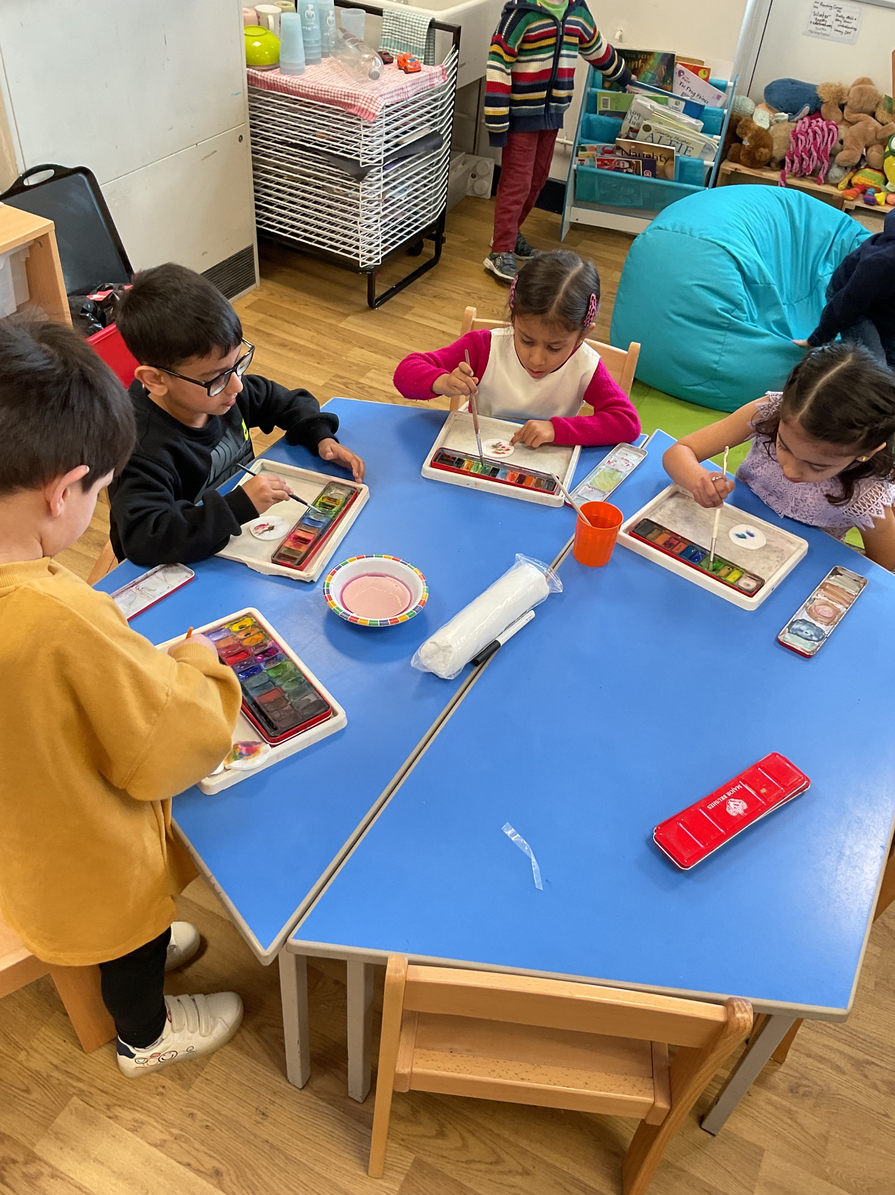
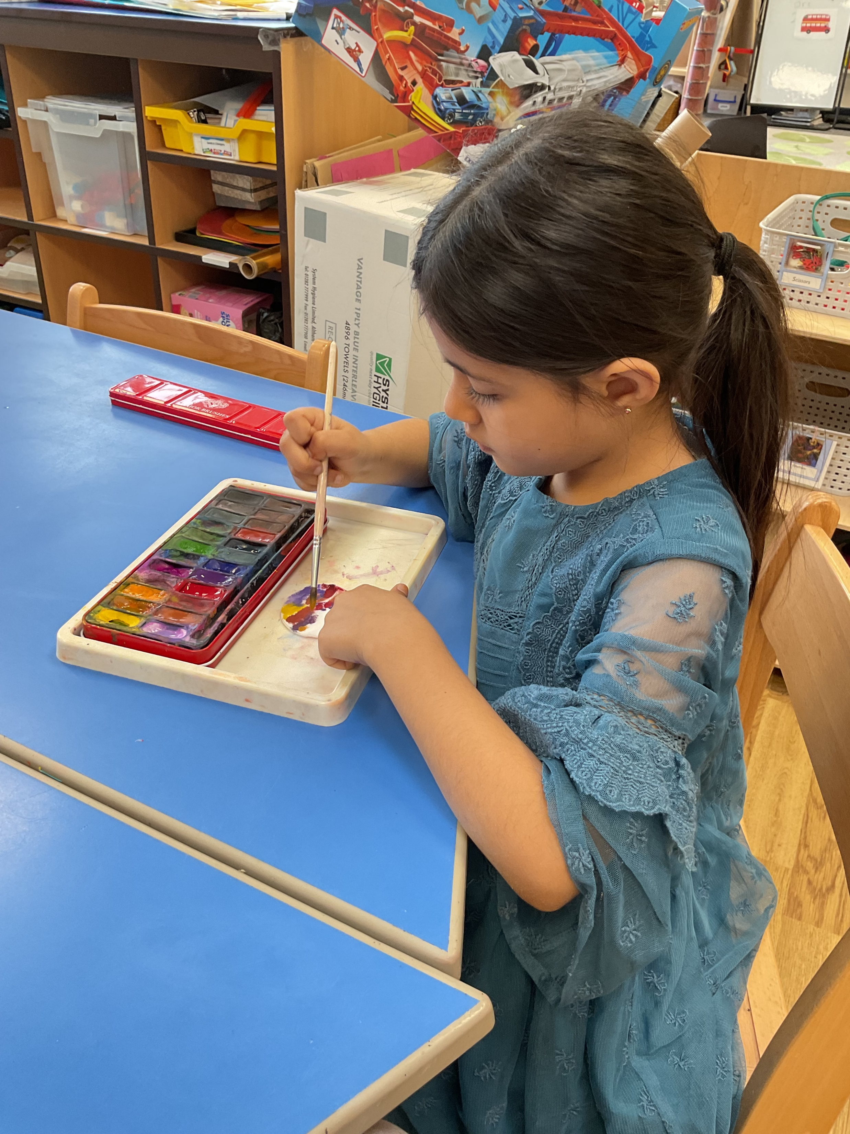
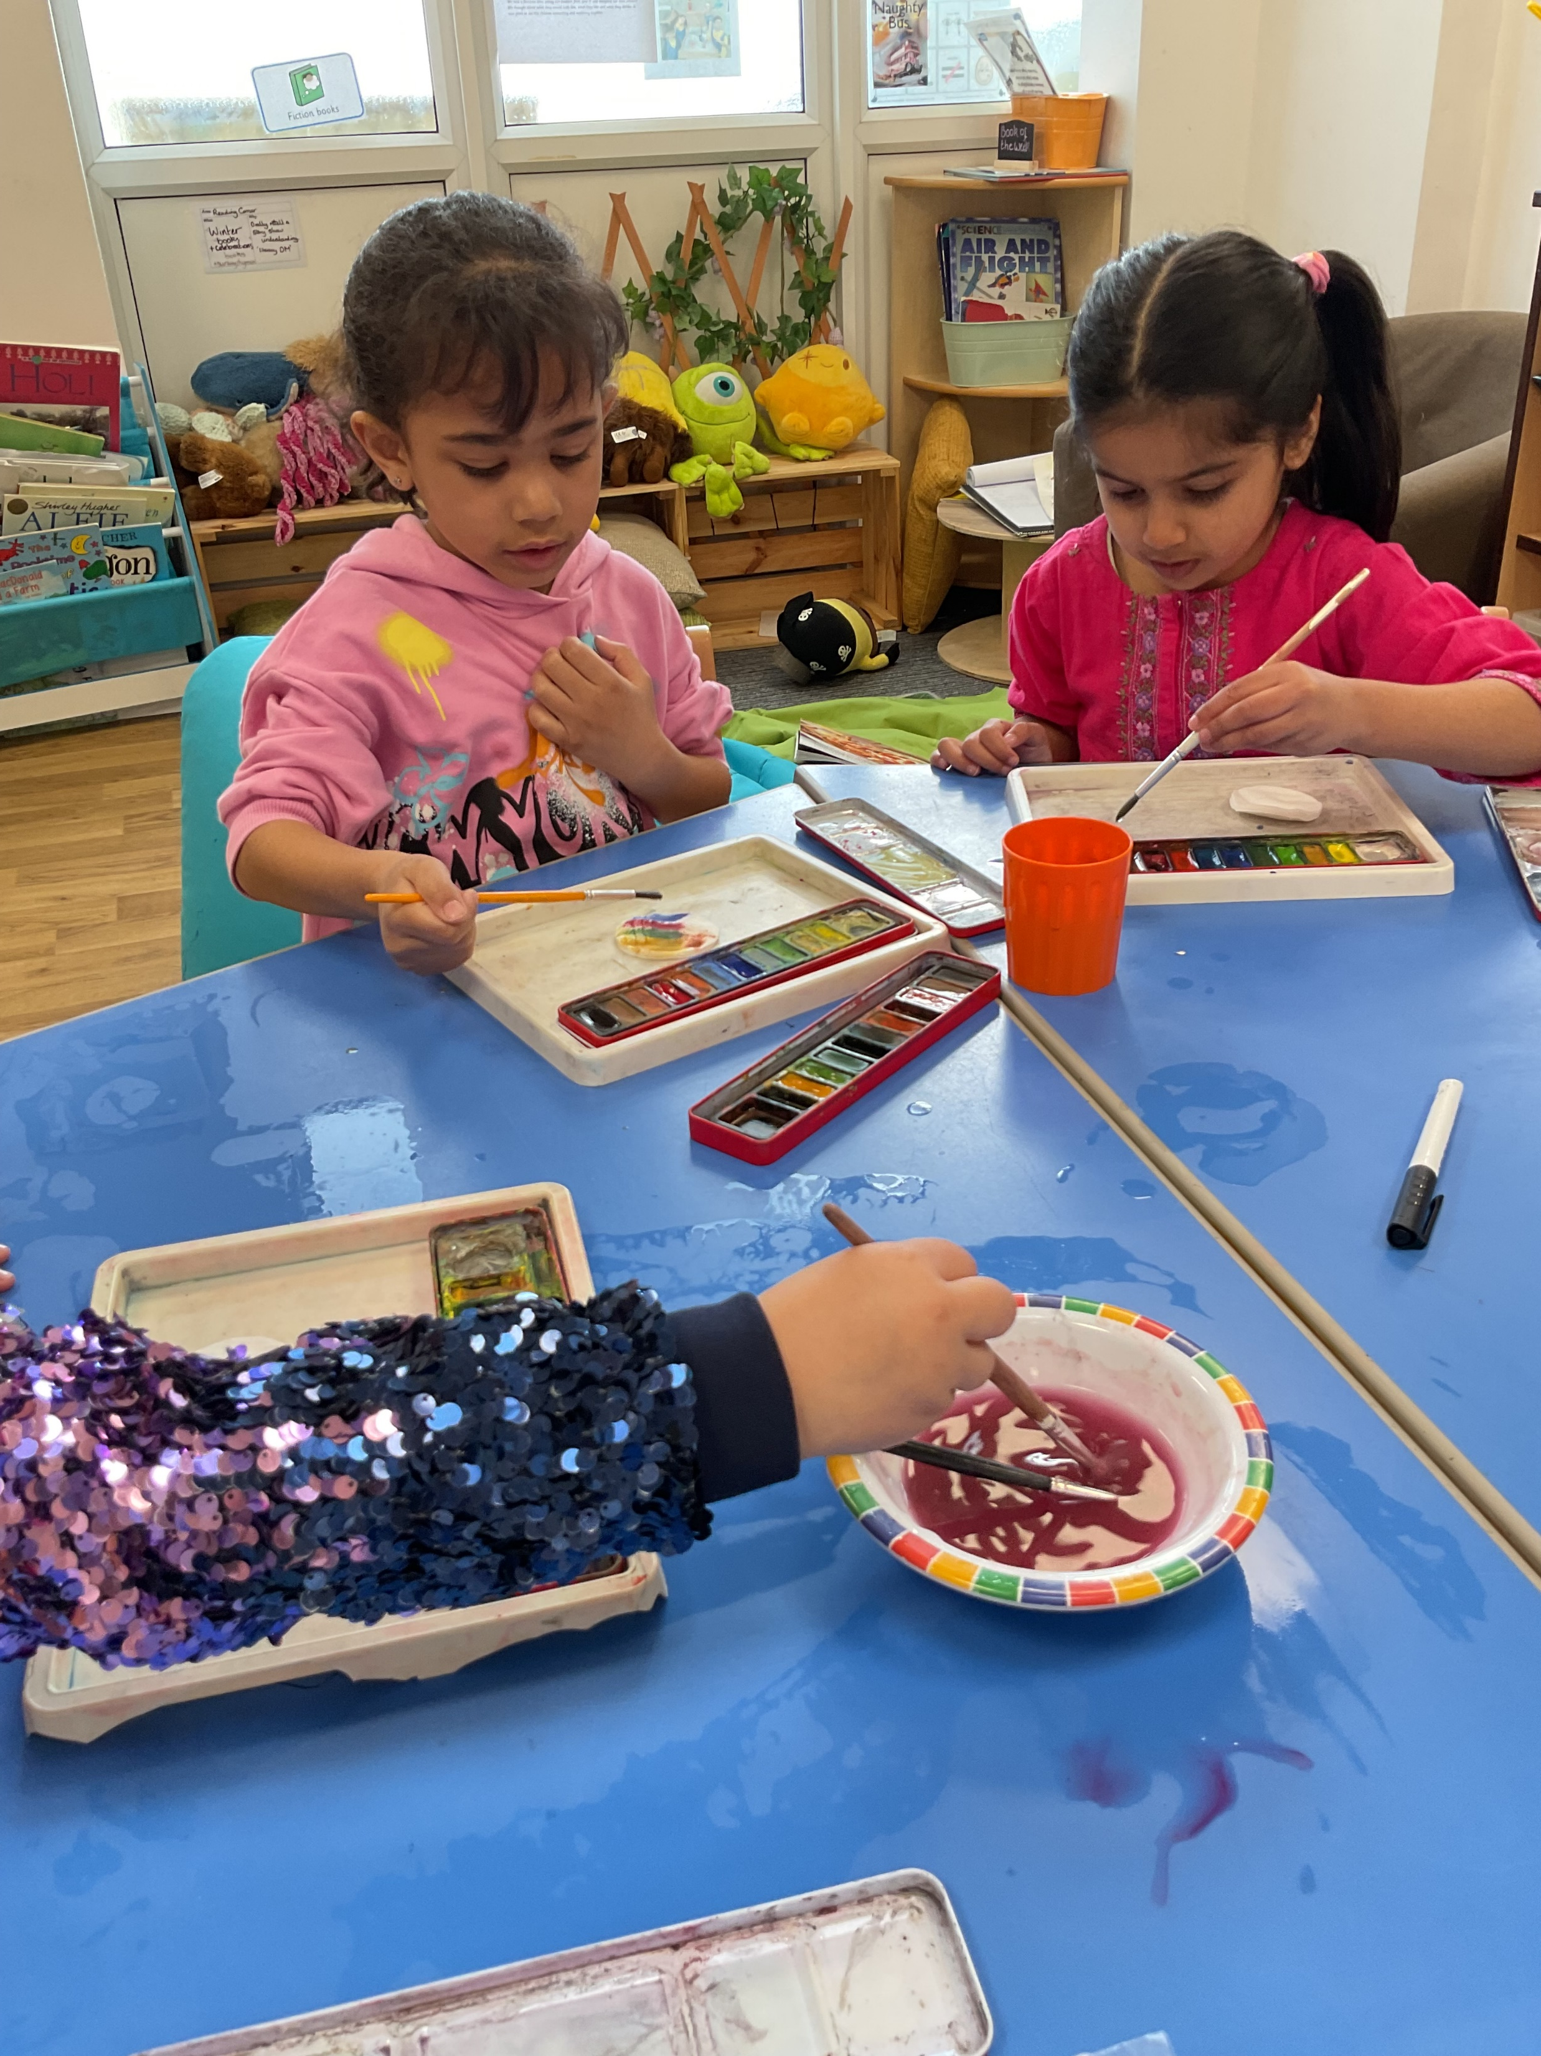
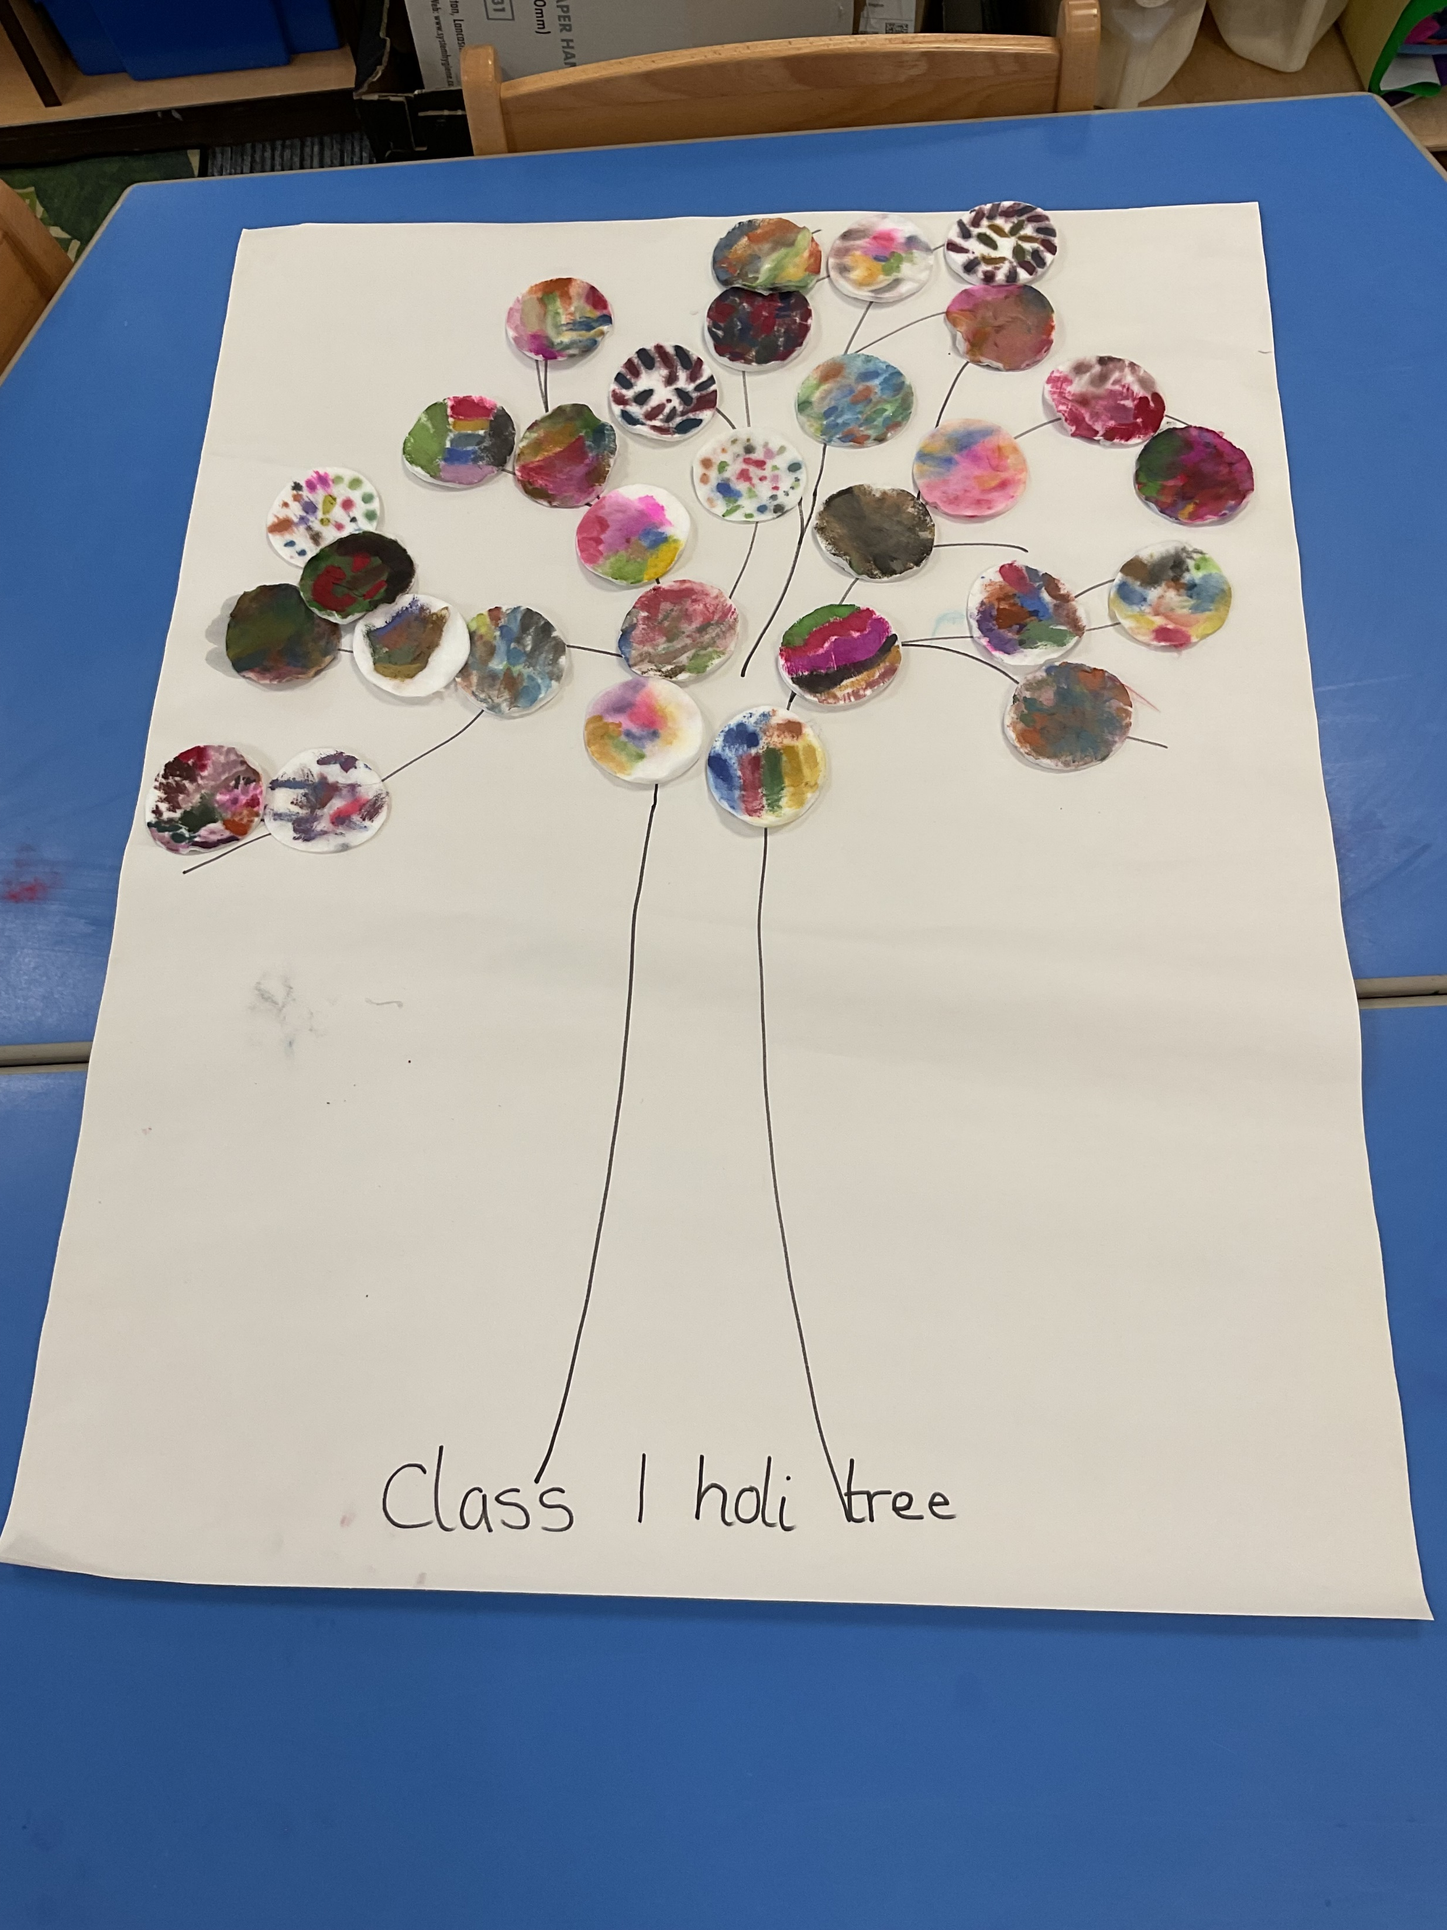
Holi:
We celebrated Holi as a school this week! We all dressed in our bright, colourful clothes and learnt about why we celebrate it and how it is traditionally celebrated.
We made a beautiful Holi tree using our favourite colours on cotton pads so we could observe the colours mixing.

Slide 5
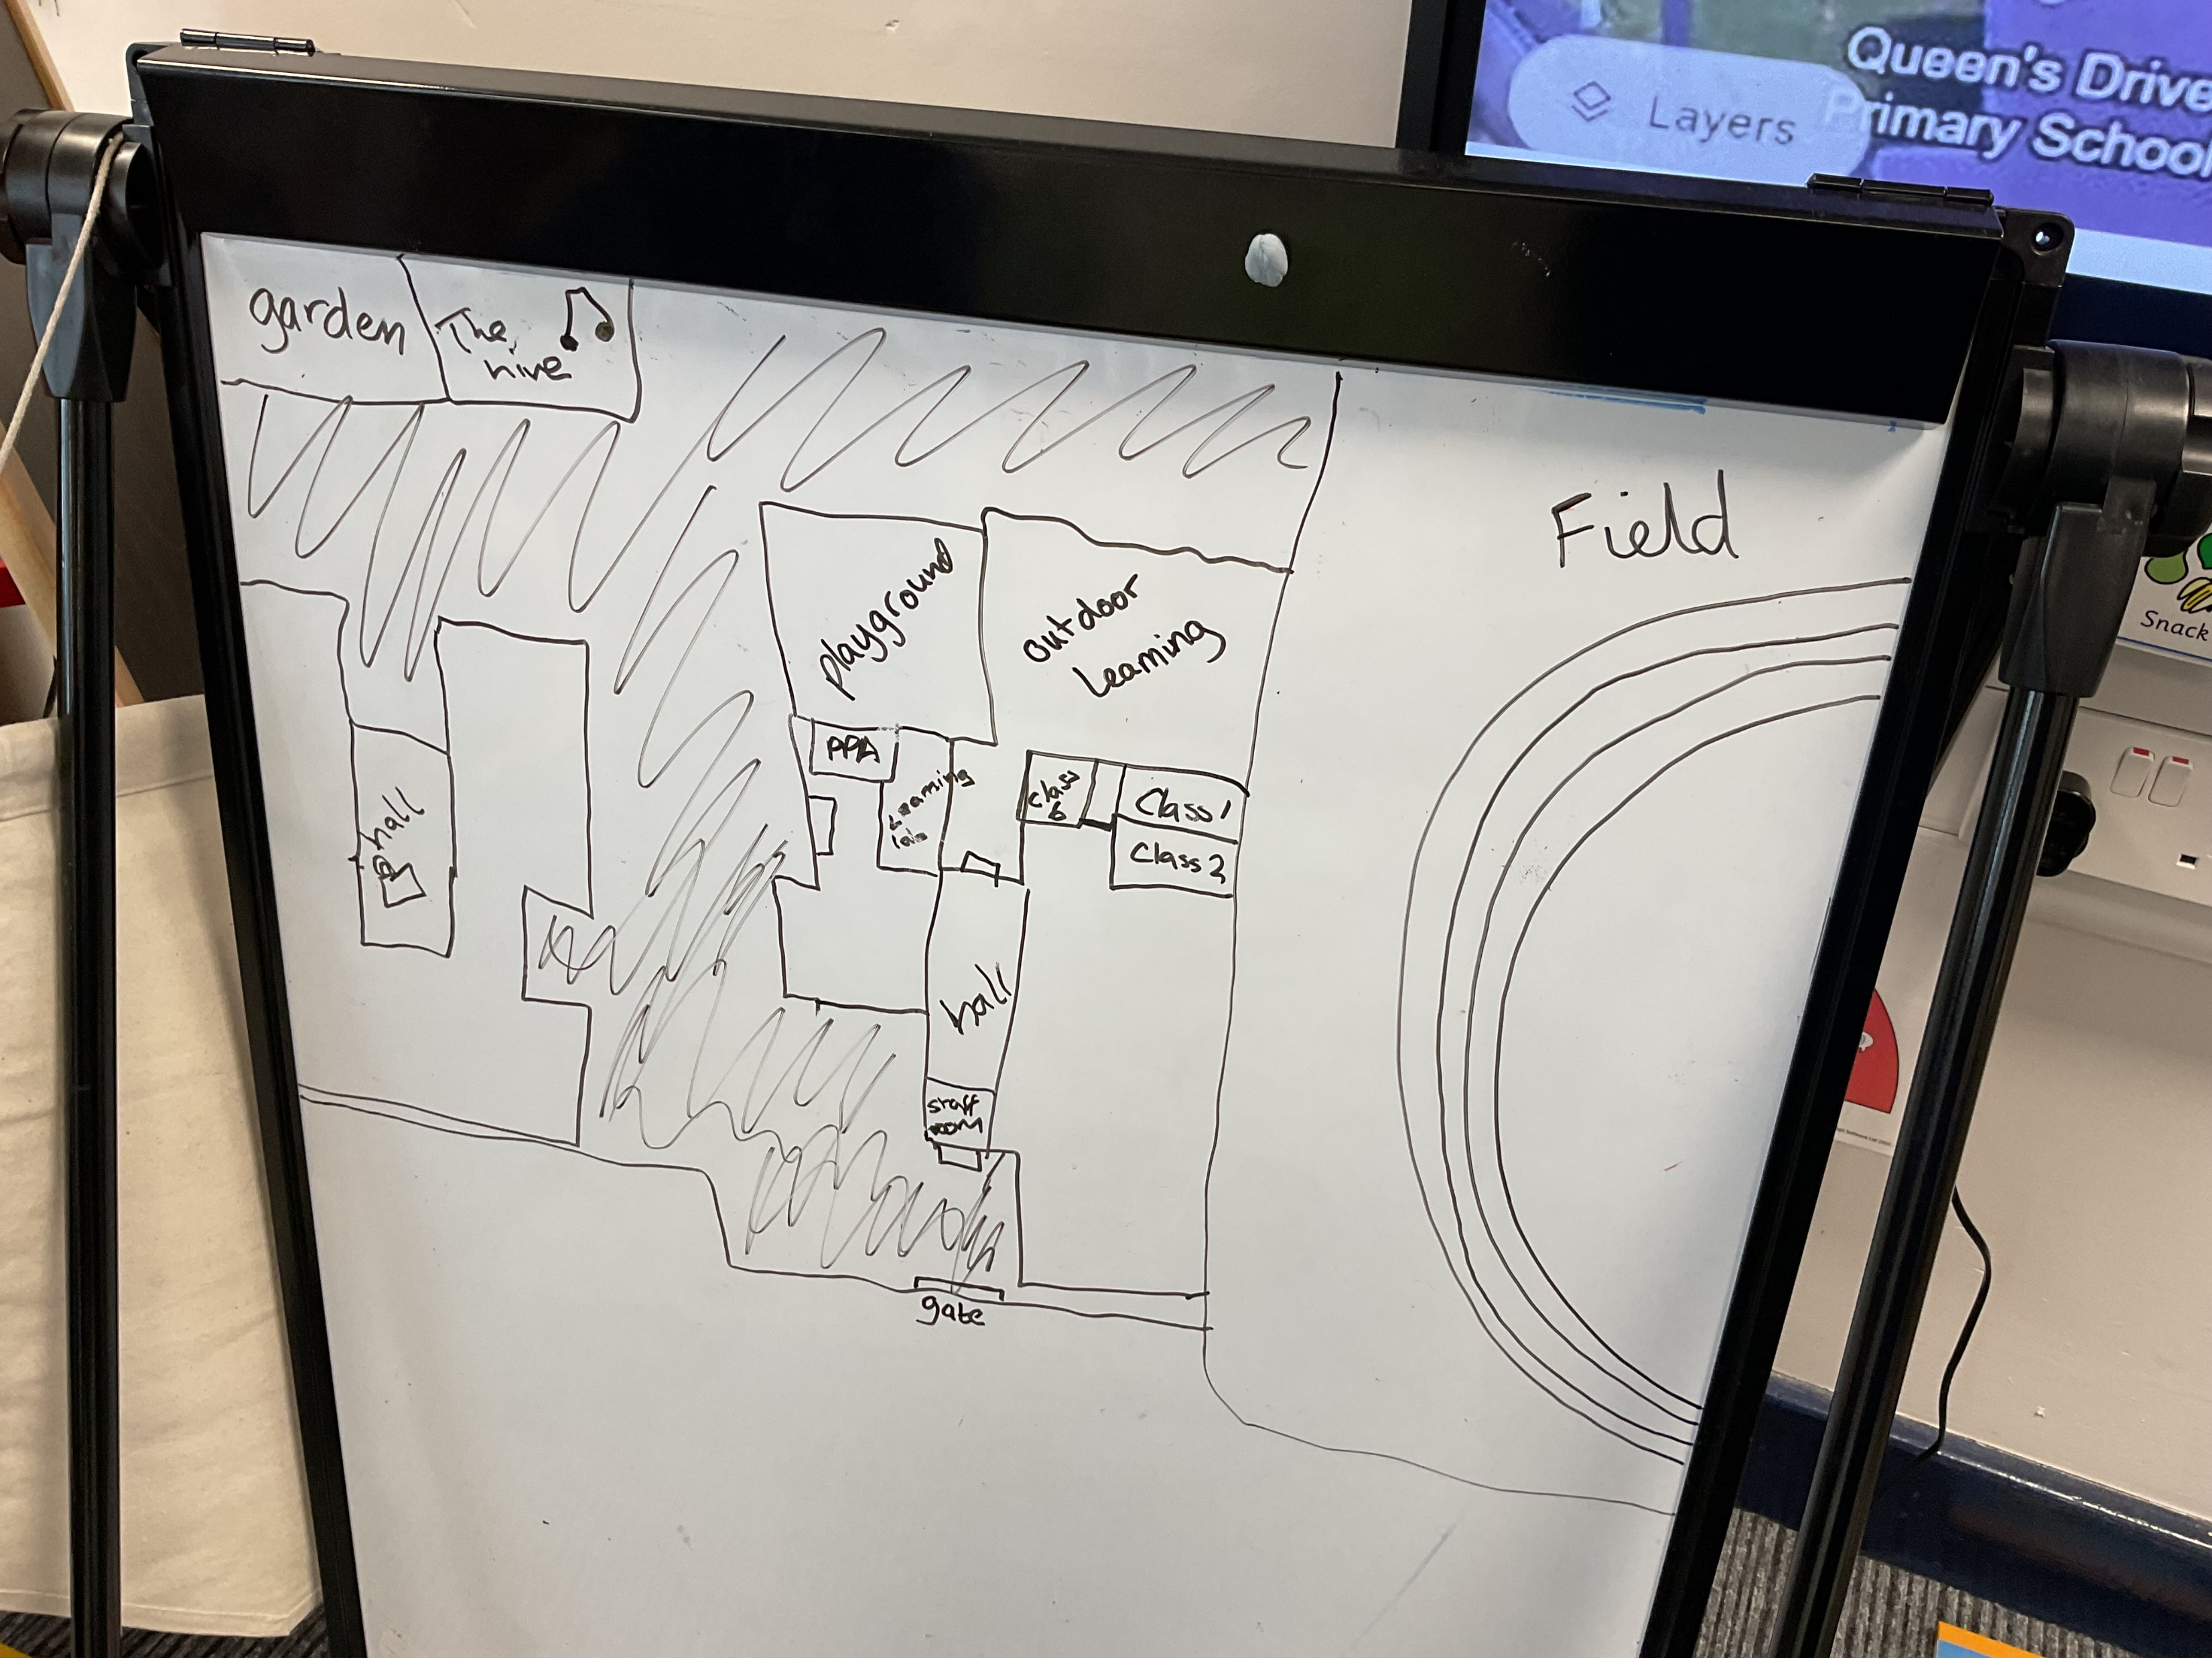
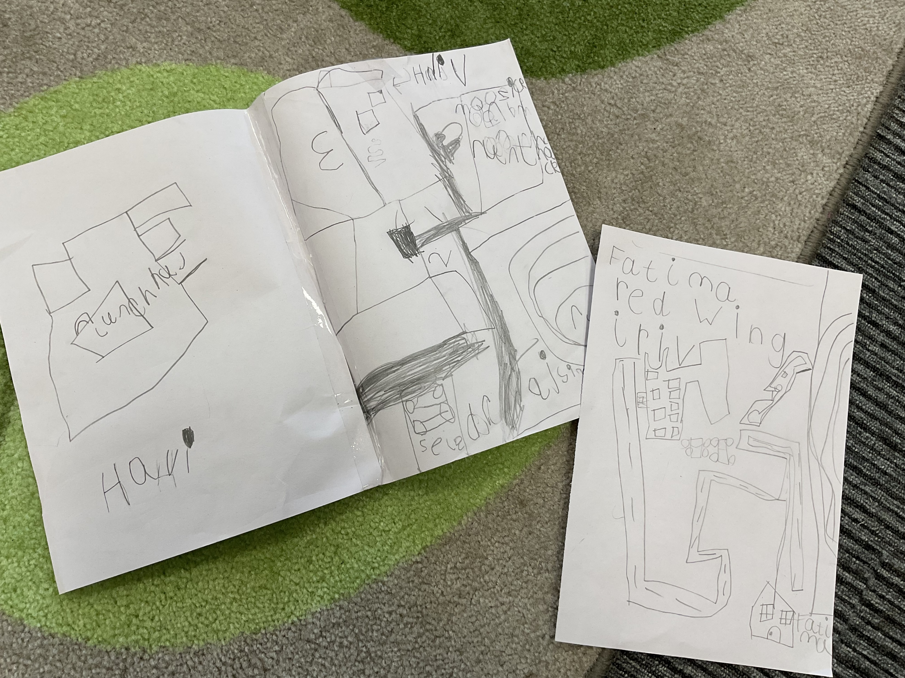
This week, we made a map of the school whilst imagining we were birds flying above. We considered the size of different areas such as our classroom in comparison to the rest of the school building and the field.
The children then took this and tried to make maps of inside the classroom in the same style. We found it challenging to draw the shape of the room and all of the smaller pieces of furniture.

Slide 6
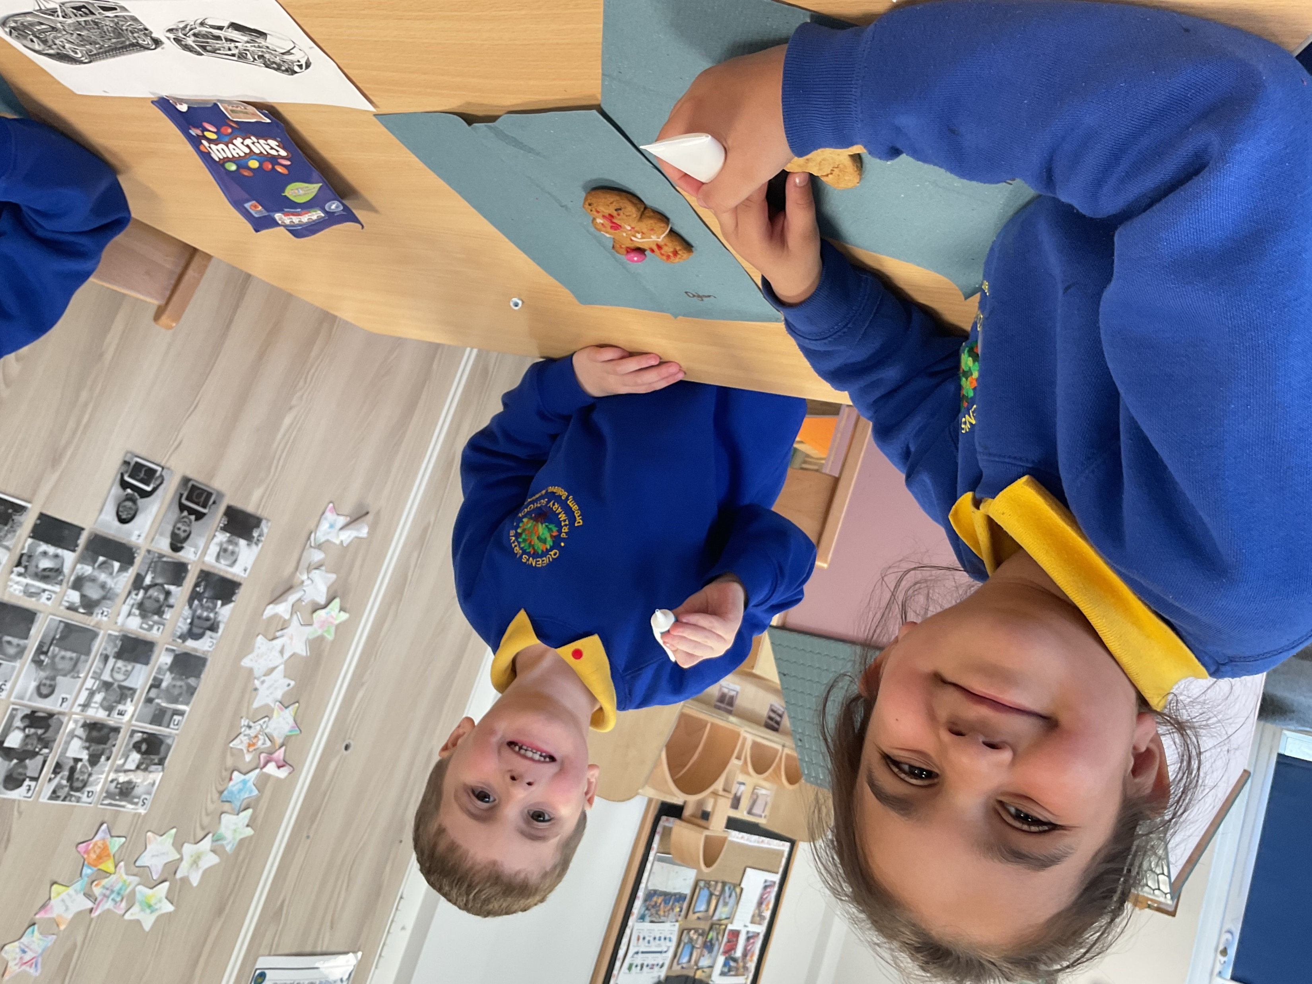
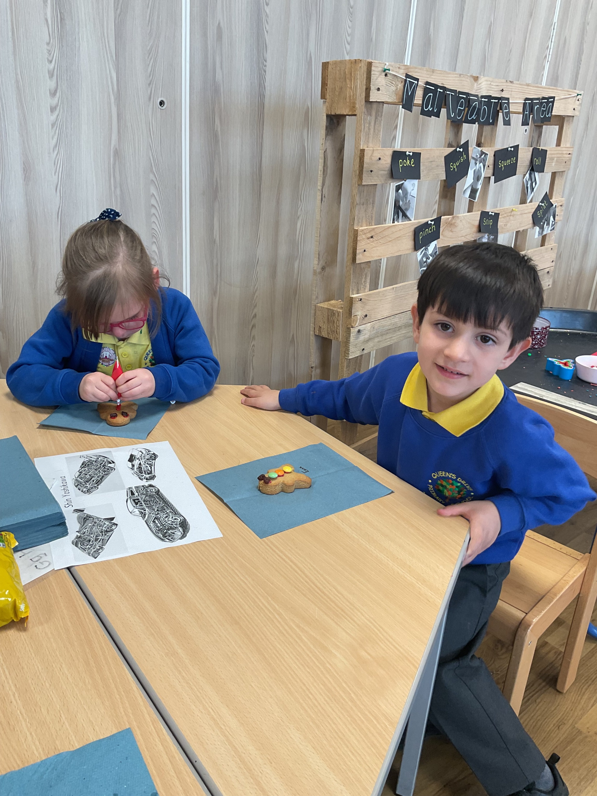
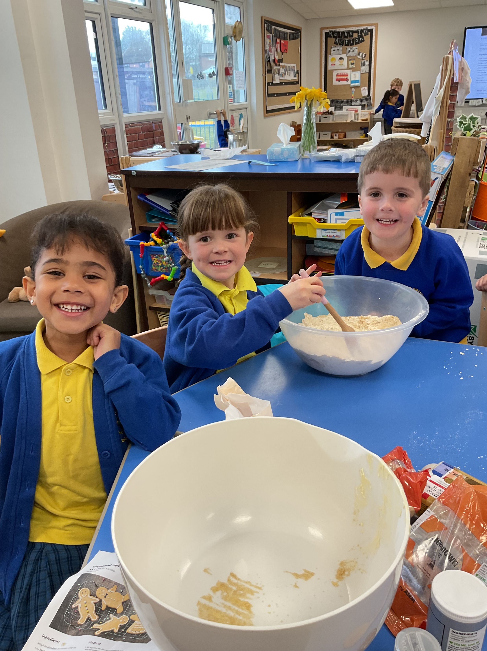
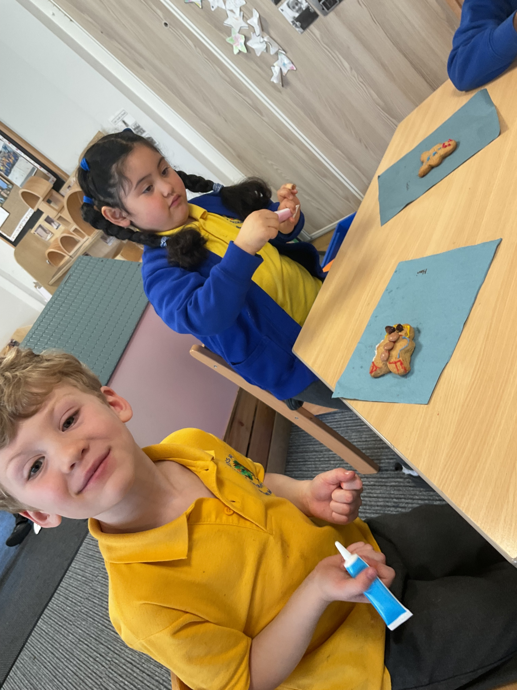
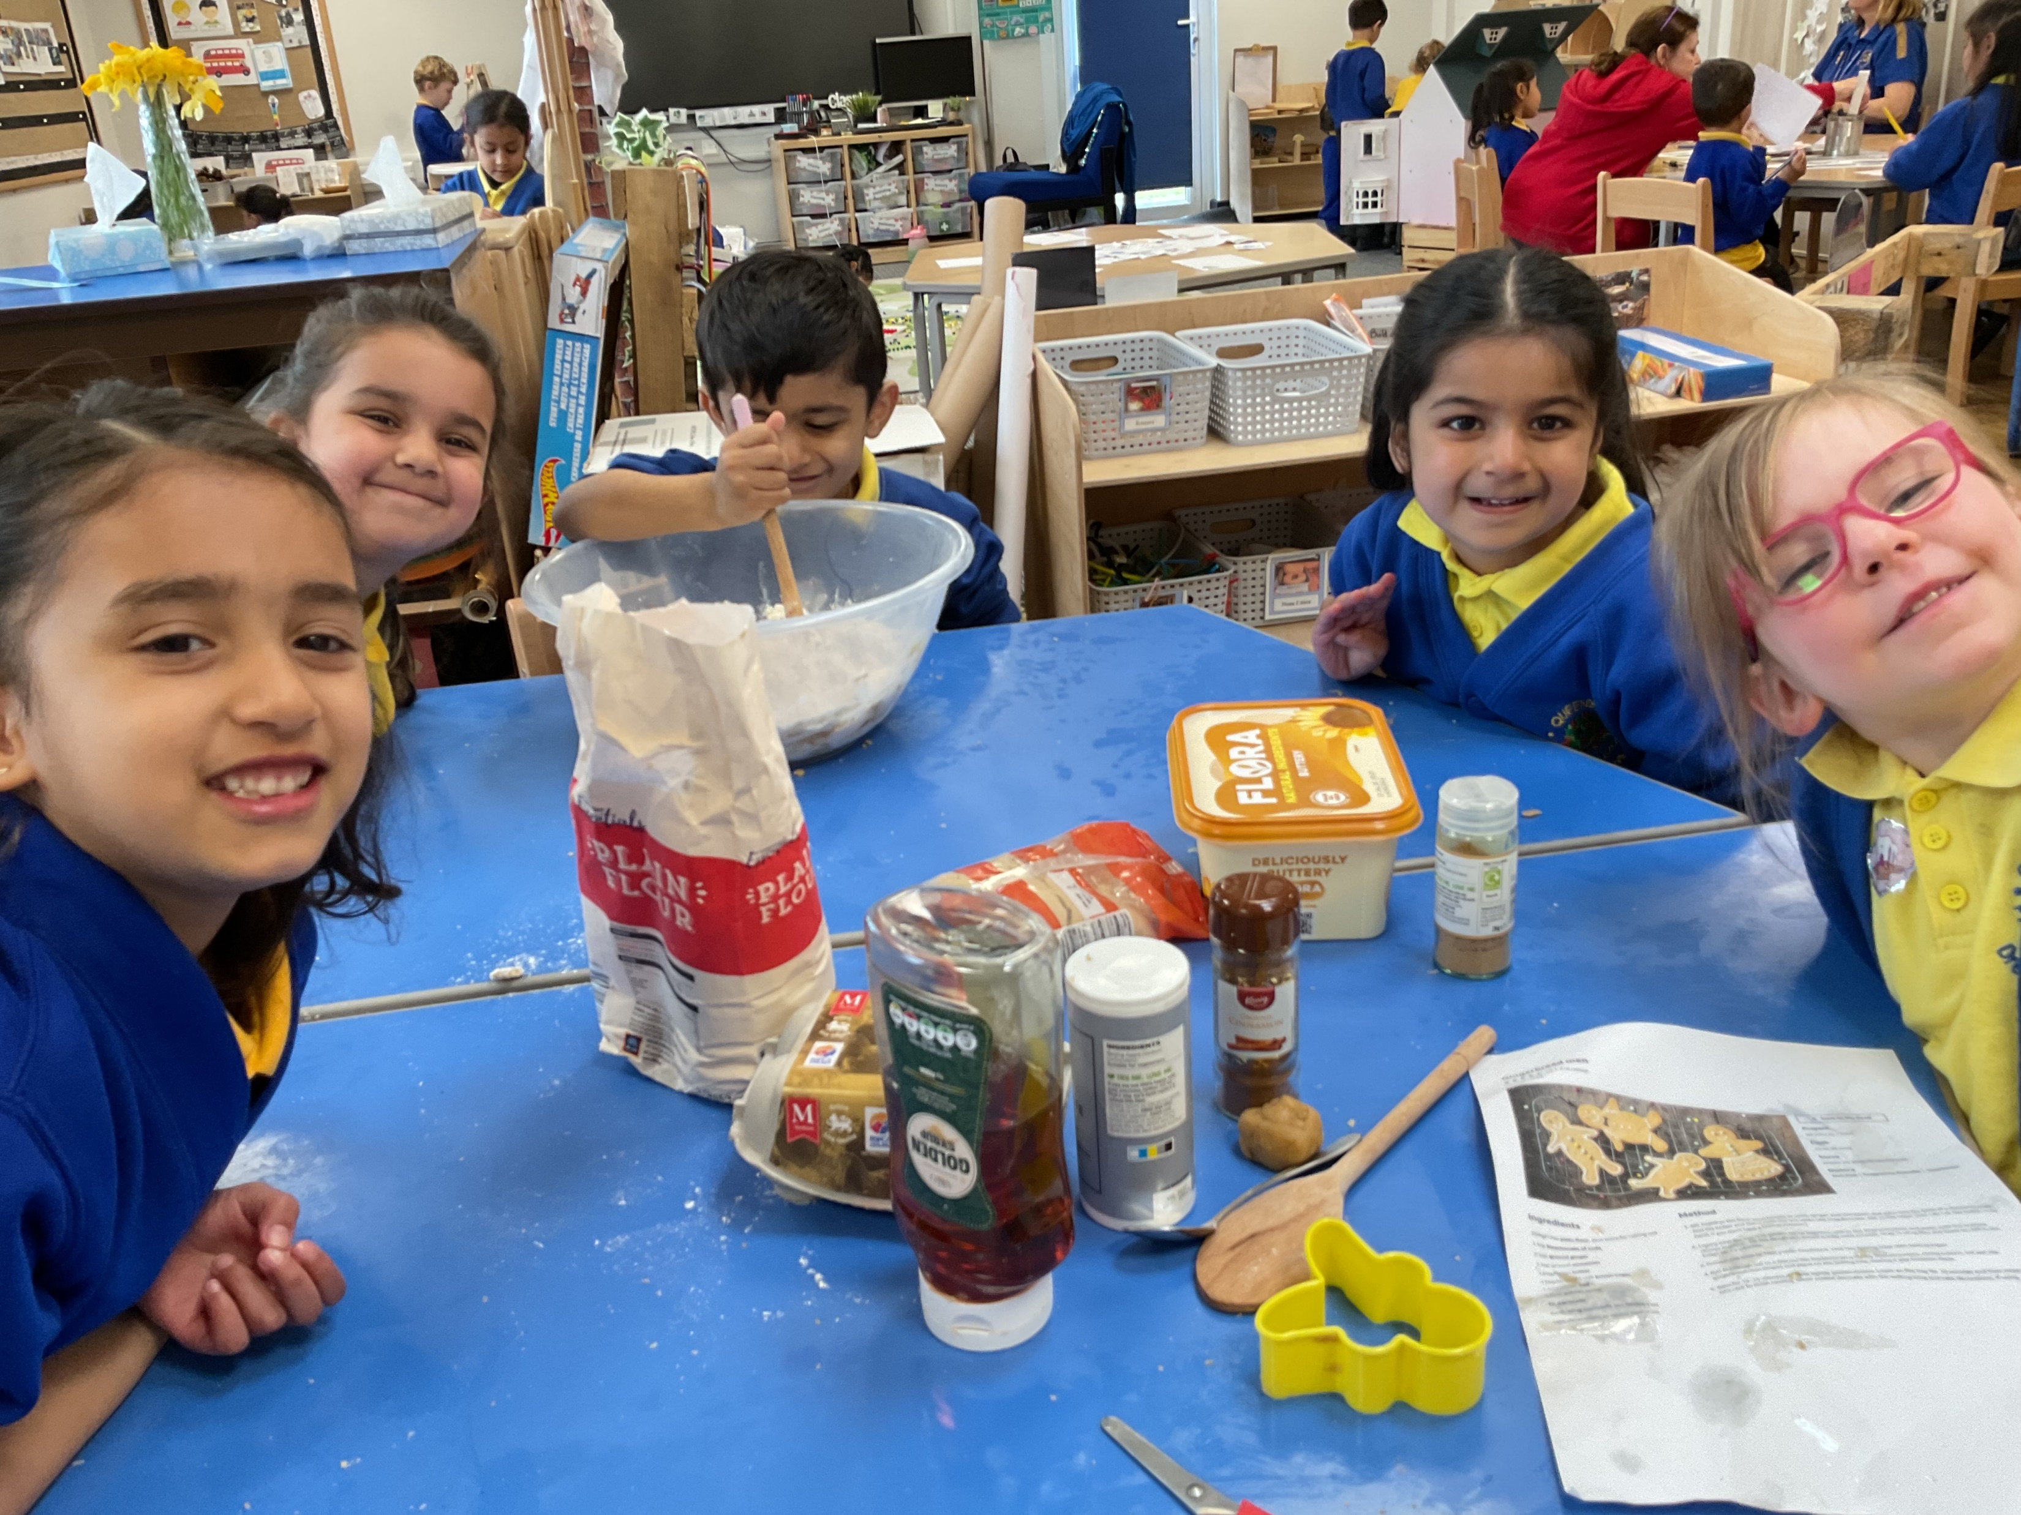
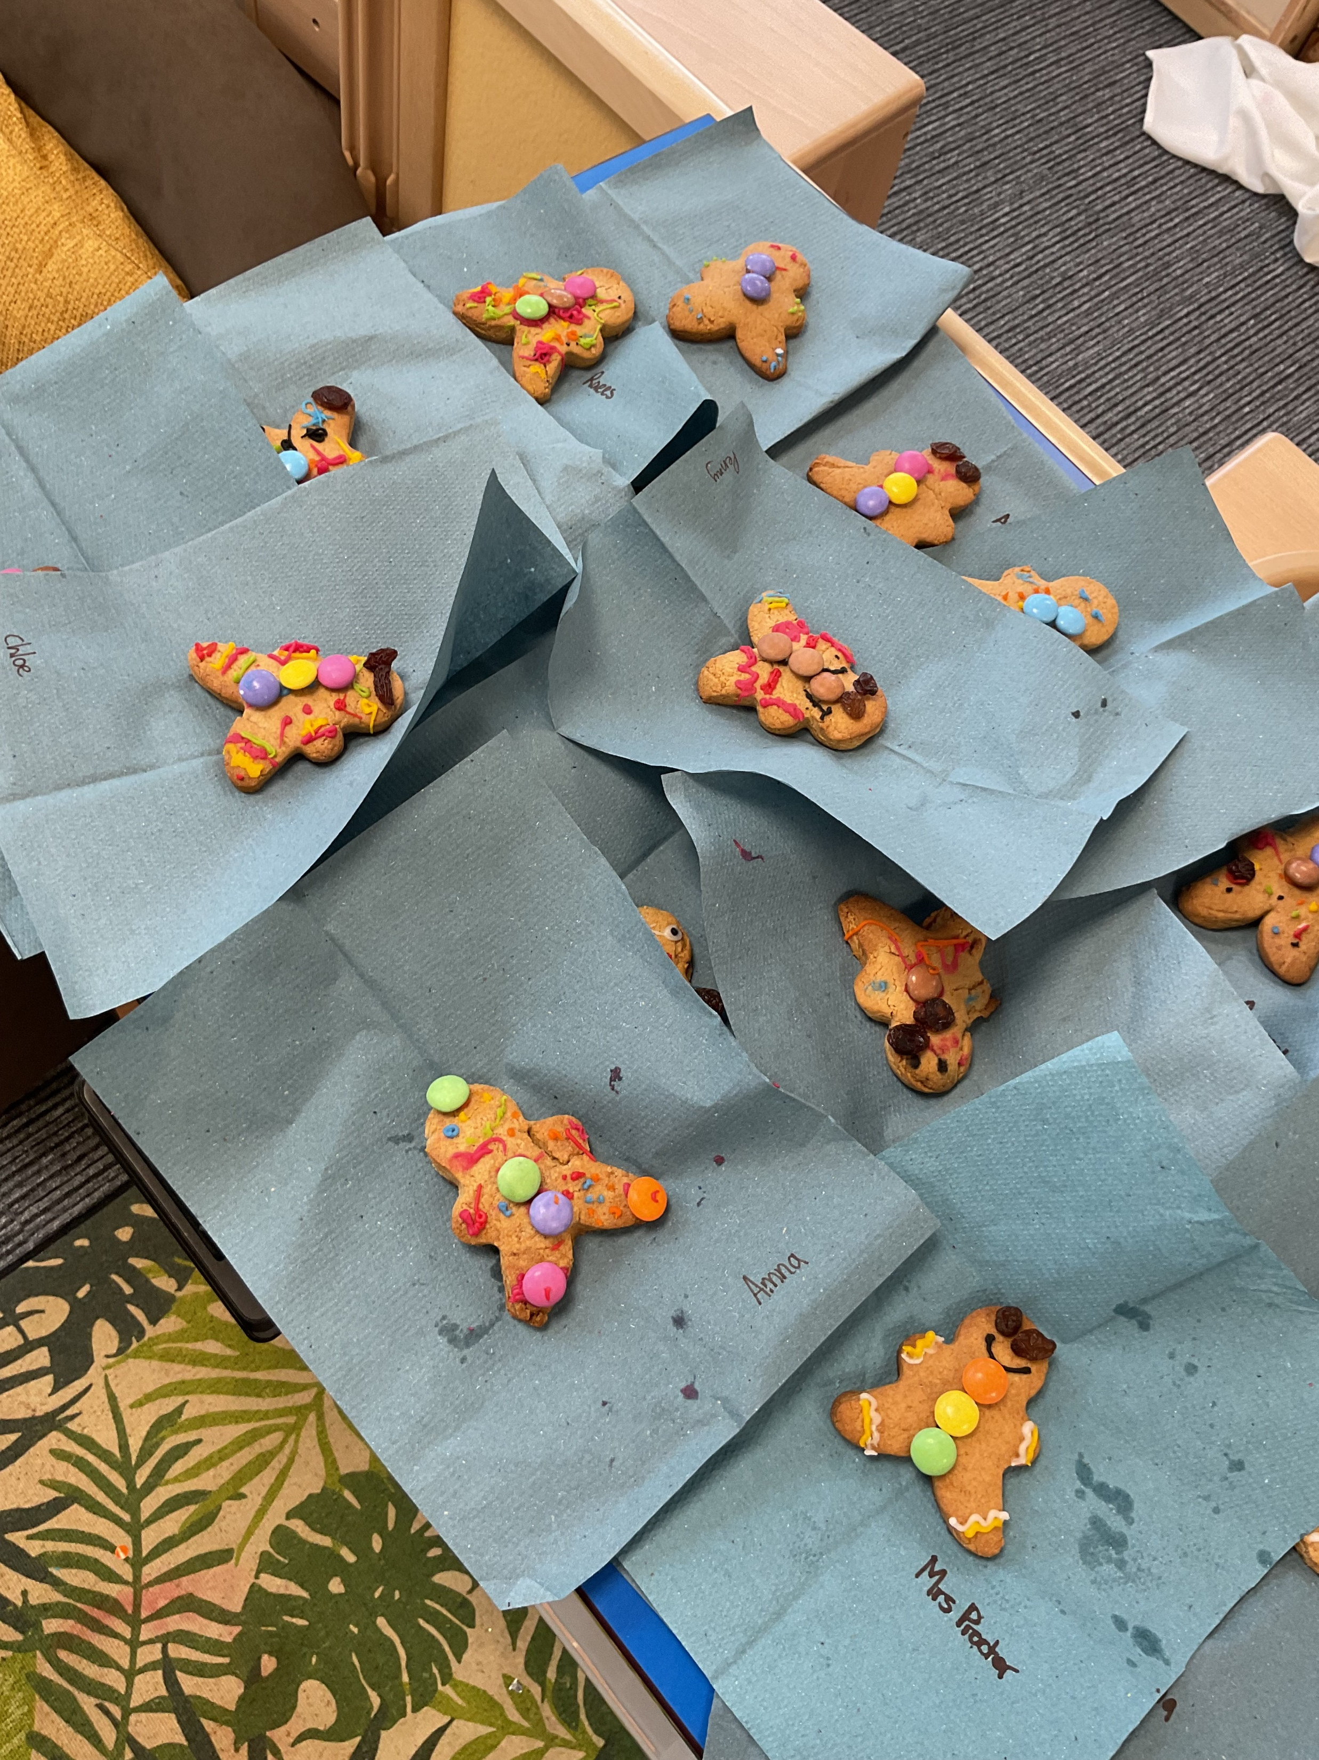
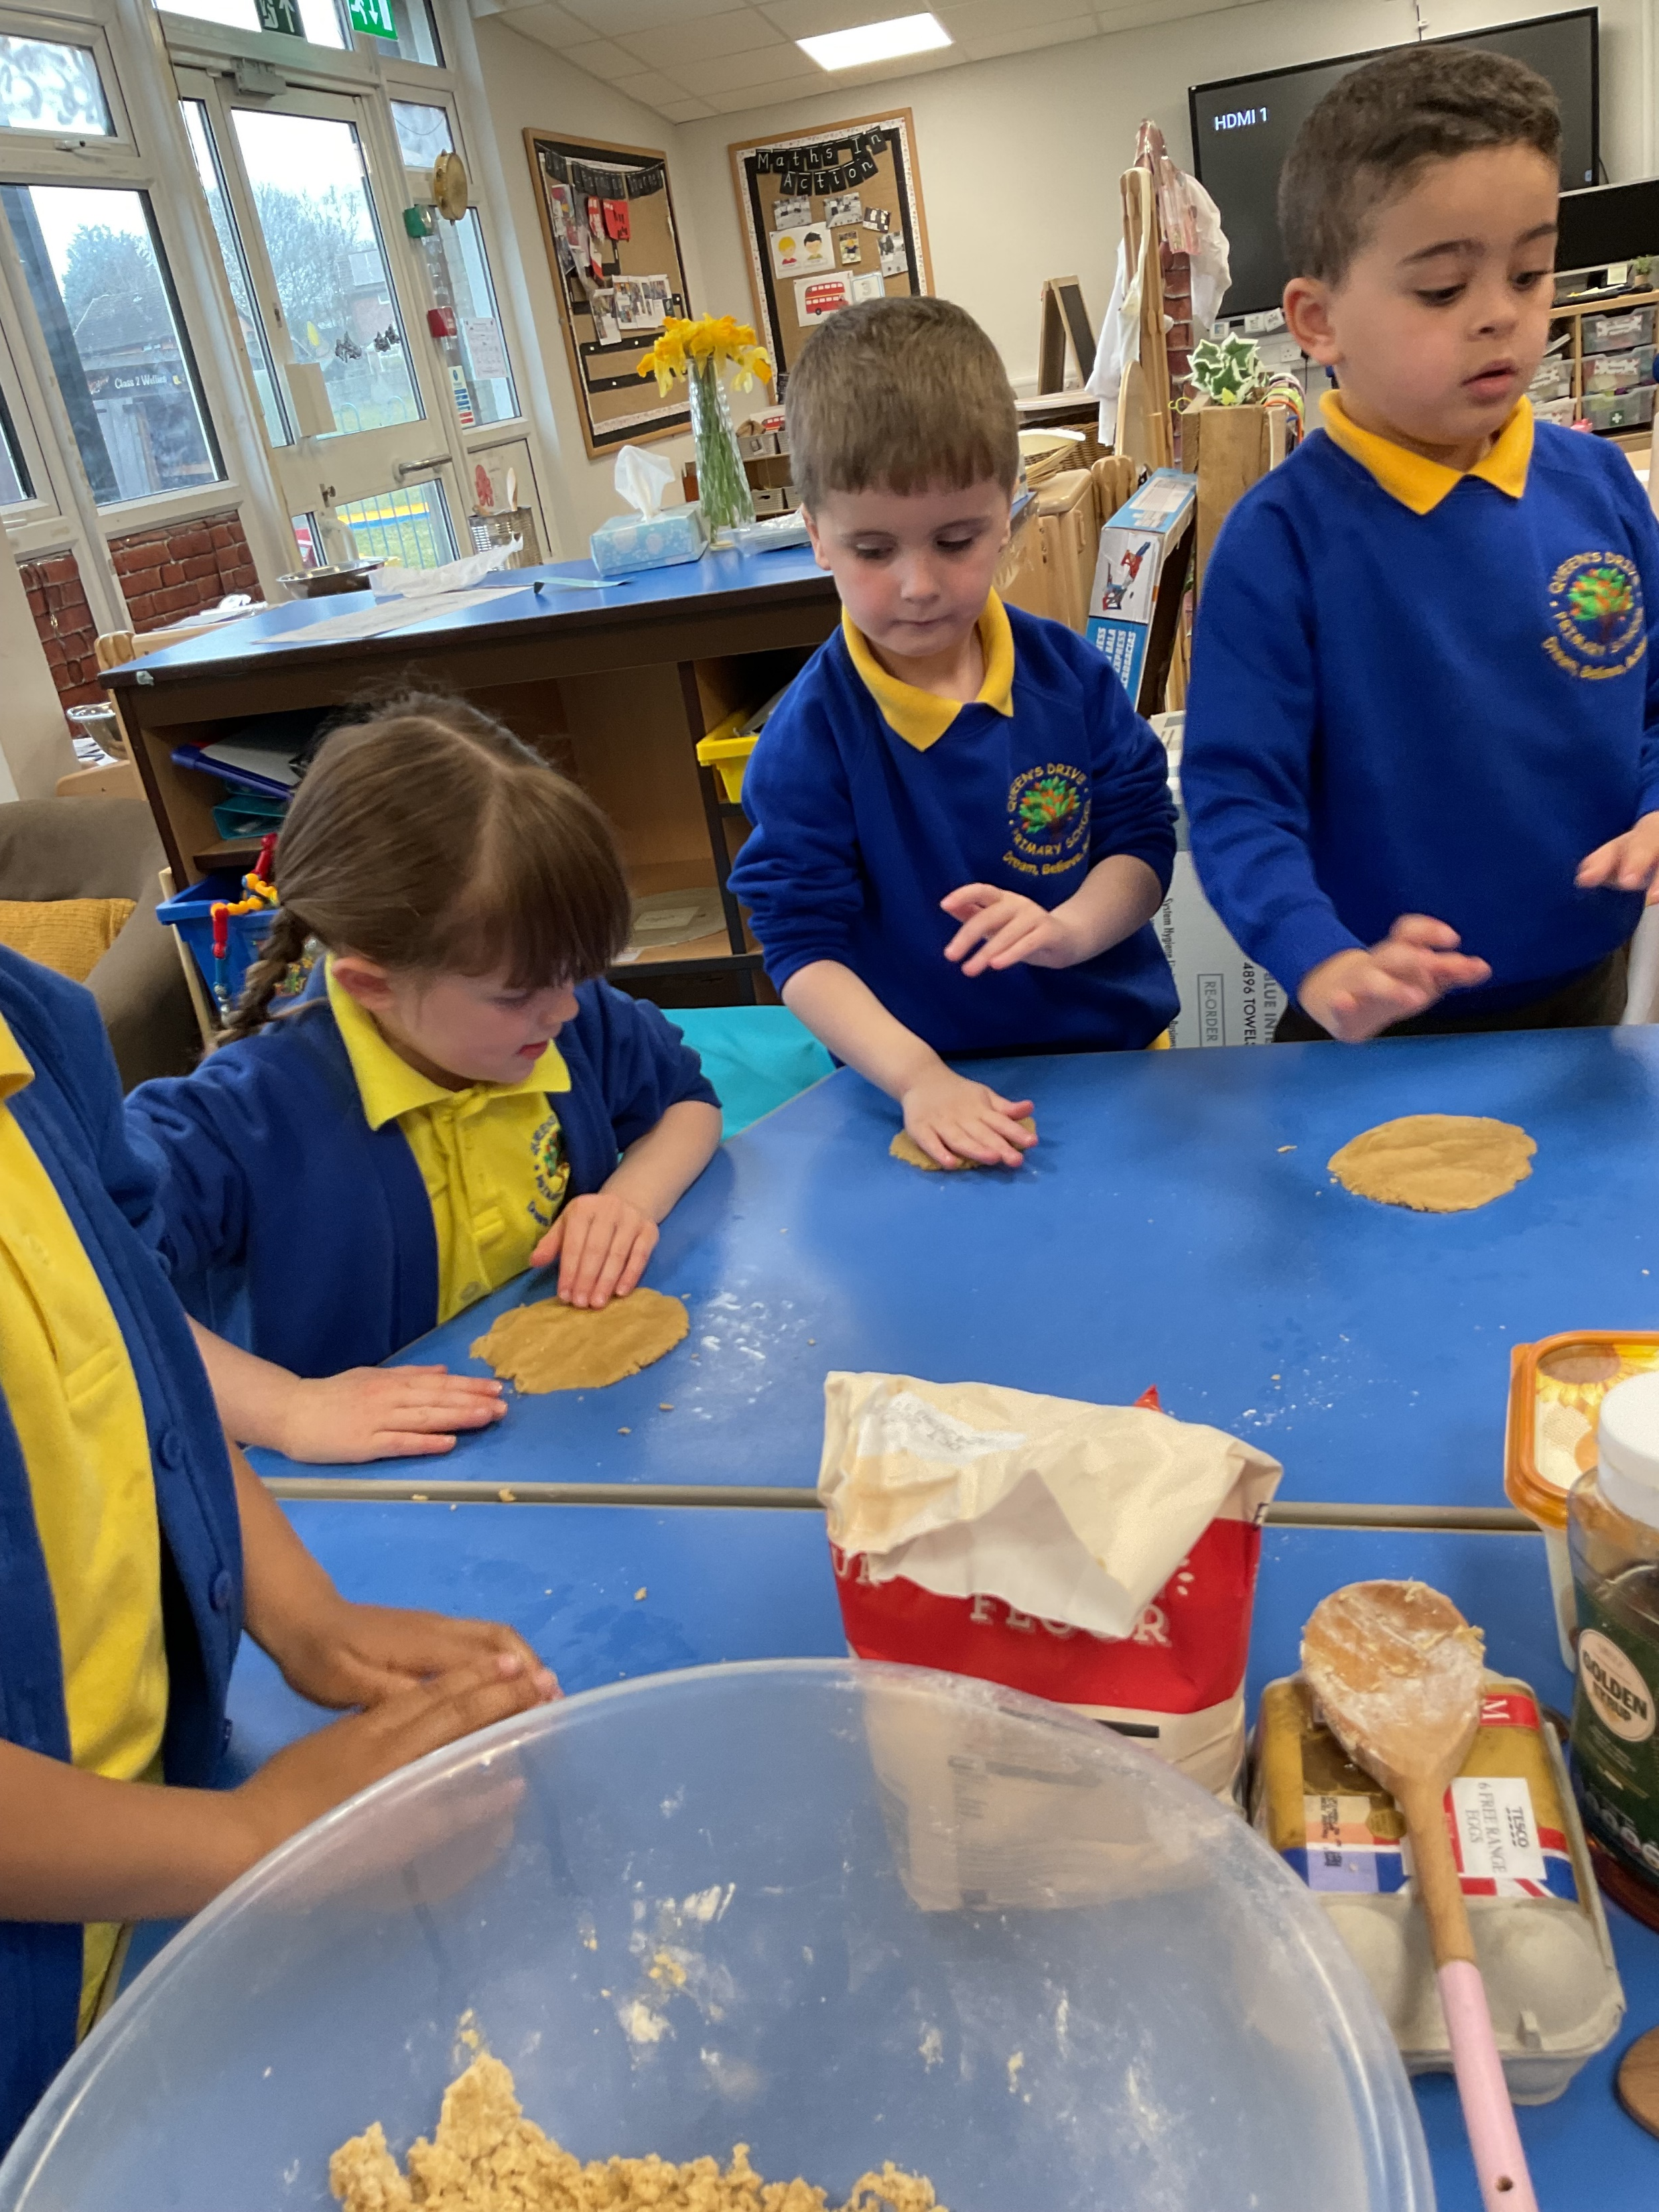
Making gingerbread men
We had an amazing time using a variety of skills to make our own gingerbread men this week. The children completed every step including weighing the ingredients, mixing, rolling, cutting, baking, and decorating. The children had a fantastic time and we thought about where our gingerbread man might go if it escapes.
Anayah: “ My man would jump outside in the sand”
Havi: “my gingerbread man would go to the moon”.

Slide 7
