Slide 1
Relationship and Sex Education at Queen’s Drive - 2026
What RSE looks like at Queen’s Drive
Optional withdrawal
Questions
Notes:
Welcome and thank you for coming.
In understand that stakeholders were consulted in 2019, just pre-COVID
Good idea to refresh in light of Relationship Education Part going statutory from September 2020 and COVID

Slide 2

The aim of Relationships Education?
‘Today’s children and young people are growing up in an increasingly complex world and living their lives seamlessly on and offline….children and young people need to know how to be safe and healthy, and how to manage their academic, personal and social lives in a positive way’
DfE Guidance on Relationships Education, Sex Education and Health Education 2019
Notes:
DfE quote

Slide 3

Relationships
Education
What should children know about relationships and why?
What a positive, healthy, caring, safe relationship looks and feels like
How to speak up and get help when a relationship does NOT feel healthy/positive/safe
How to make and maintain positive relationships
(Online and offline relationships)
Notes:
Emphasise that Relationships Education is not only about intimate relationships, it also includes learning about families and friendships, kindness and acceptance of others who are different from ourselves, how we treat and look after ourselves, the importance of community.
Use this slide as a lead into the new statutory guidance which is on the next slide.

Slide 4

Compulsory status of RSE and Health Education
In 2018 the government passed an amendment to the Children and Social Work Bill to make RSE and Health Education statutory from Sept 2020.
Supported by over 100 organisations, including Public Health England, Teaching Unions, NCB, etc)
Ratified by House of Lords 24 April 2019
Our curriculum meets all the expectations of the DfE guidance (published April 2019)
…it is delivered fully and well.
Notes:
Explain that before this document was issued, the last Gov guidance was published in the Year 2000 so is very out of date, considering the context we have discussed earlier. This old guidance is still active until September 2020, then the new guidance comes into force. This has implications for right of withdraw which we will be covered later.

Slide 5

Schools must comply with The Equalities Act 2010
‘Schools must not unlawfully discriminate against pupils because of their age, sex, race, disability, religion or belief, gender reassignment…or sexual orientation (protected characteristics)
‘Schools should be alert to issues such as everyday sexism, misogyny, homophobia and gender stereotypes and take positive action to build a culture where these are not tolerated’
PSHCE is a key part of this. All children are valued and included.
Notes:
These are direct quotes from page 13/14 of the DfE guidance 2019
Equalities Duty. Part 6 chapter 1 of Equalities Act applies to schools
This is the part of the presentation where there may be some tension if there are particularly held views by some parents/carers. E.g. about teaching LGBT issues.
Explain that schools are expected to take into account the views of parents and carers, however there are also legal obligations so that children and young people know there is an Equality Act in the UK and that it protects people from prejudice and discrimination. The DfE guidance also makes it explicitly clear that children should be taught to be understanding about others different from them. Therefore schools cannot pick and choose what equalities to include in the curriculum.
If LGBT issues arise, explain that there is a parent leaflet that the school can put on it’s website that explains how this is covered age-appropriately in the Jigsaw materials.
Try not to be drawn into an extended argument at this stage, keep referring back to the leaflet and move on when you can.
However, if there are some persistent people in the audience stress that Jigsaw does not teach about gay sex (this is a myth). In KS1 it simply acknowledges that some children may have two Mums or two Dads. In Year 3 there is a lesson about the word gay and why it should not be used in a hurtful or unkind way. In Year 6 there is lesson about prejudice where a transgender person is used as an example. Y6 children also learn what the word transgender means. Jigsaw does not encourage or promote LGBT+ people it simply acknowledges that these people are a part of UK society, and they should be treated with respect (as long as they are kind people) in the same way that we would expect everybody else to be… we have an Equality Act that is LAW. Ultimately if we don’t make our children aware of the rights of society, and they fall foul of the Equality Act when they are older by committing a hate crime or being prejudicial, we are not helping them understand the right of law and the consequences of their actions. When they are older they will mix with a range of people in their adult lives.

Slide 6
Part of the Science & PSHE National Curriculum
The different stages of growth in humans, from birth to old age
Puberty
How human bodies change during adolescence
Healthy and unhealthy relationships
Speaking to trusted adults about worries and concerns

Slide 7
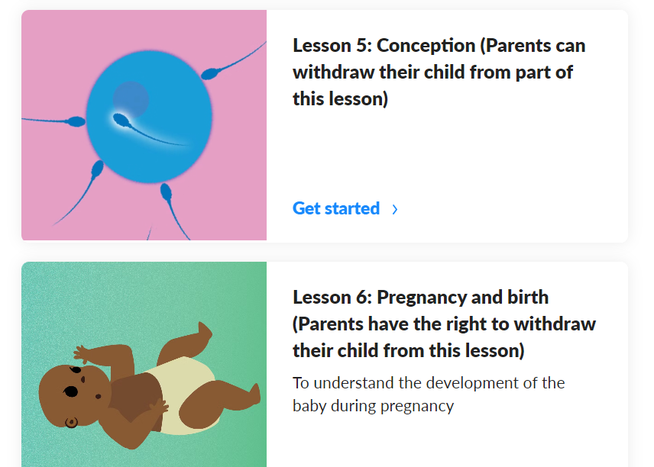
Parents have the right to withdraw from these lessons...
What do these lessons look like?
Why we feel it is important it is part of our coverage?
What will happen if you withdraw you child?

Slide 8
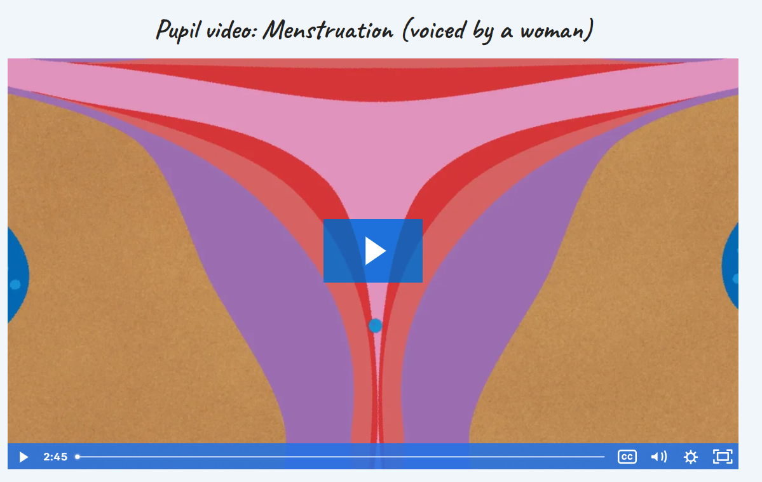
To understand the biology of conception https://www.kapowprimary.com/subjects/rse-pshe/upper-key-stage-2/year-6/safety-and-the-changing-body-year-6/lesson-5-conception/
Important to note:
The use of 'sexual intercourse'
As as a school we think it is important to recognise that same sex parents can become parents using things such as IVF and sperm donation.
Children know more than we think they do and they talk to each other.
WE DO NOT
Show any videos, images of what sexual intercourse looks like.

Slide 9
Where lesson may go and why we believe it is important...
Take any questions that the children have.
Explain to children that the age at which you can legally have intercourse in this country is 16 and this law is designed to protect us. Explain that 16 is sometimes called the age of consent. Ask children if they know what consent means.
Discuss the children’s answers and make sure they understand that it is giving permission, that a person needs to know what they are giving permission for and that someone can withdraw consent i.e. change their mind.
Consent does not just apply to intercourse but to other situations
Bring the conversation back to intercourse and emphasise that the children should never feel pressured or pressurise anyone else into having intercourse or doing anything else they don’t want to. Consent should be freely given.

Slide 10

To understand the development of the baby during pregnancy.- https://www.kapowprimary.com/subjects/rse-pshe/upper-key-stage-2/year-6/safety-and-the-changing-body-year-6/lesson-6-pregnancy-and-birth/
Important to note:
The use of 'sexual intercourse' to start conception
Vaginal births (most children have some awareness of a c-section and how they were born)

Slide 11
Answer any questions the children might have.
If the children do not ask any questions, explain that not every couple will be able to have a baby this way. This could be for medical reasons or because they are in a same-sex relationship. Explain that these couples may still want to have a baby and there are other options open to them such as: Adoption. Surrogacy, which is when someone else has the baby for the couple. IVF, which is where the sperm and egg are put together by a scientist and once the egg is fertilised, it is placed into the uterus to grow.
Explain that pregnancy and birth are only the start of being a parent and that being a parent is a long-term commitment.
Ask the children to talk to a partner about what a baby might need in the first nine months. Take some feedback and ensure they think about practical and emotional support as well as products.
Explain to the children that you would like them to create a piece of work that illustrates either how a baby develops during the nine months of pregnancy or what a baby needs during the first nine months of its life. This piece of work can include pictures and text and must show the children’s understanding of the aspect they have chosen. (closely linked to year 5 science).

Slide 12
Sex
Education is discretionary at Primary…what exactly does the guidance say?
The Department continues to recommend that all primary schools should have a sex education programme tailored to the age and physical and emotional maturity of the pupils…drawing on knowledge of the human life cycle set out in National Curriculum Science- how a baby is conceived and born’

Slide 13
What will happen if you withdraw your child...
They will go into another class for the session.
They may source their own understanding elsewhere:
Friends
Internet
Social media
Our PSHE scheme of learning has built up to this:
Children are equipped already with the key knowledge, vocabulary and mature attitude to access these 2 lessons.
It prepares children for the RSE curriculum in year 7.
It keeps our children safe.

Slide 14
Thank you
Any questions?
If you wish to withdraw your child from the conception element of the lesson, please do this in writing to Mrs. Gomersall by Friday 12th June.

