Slide 1

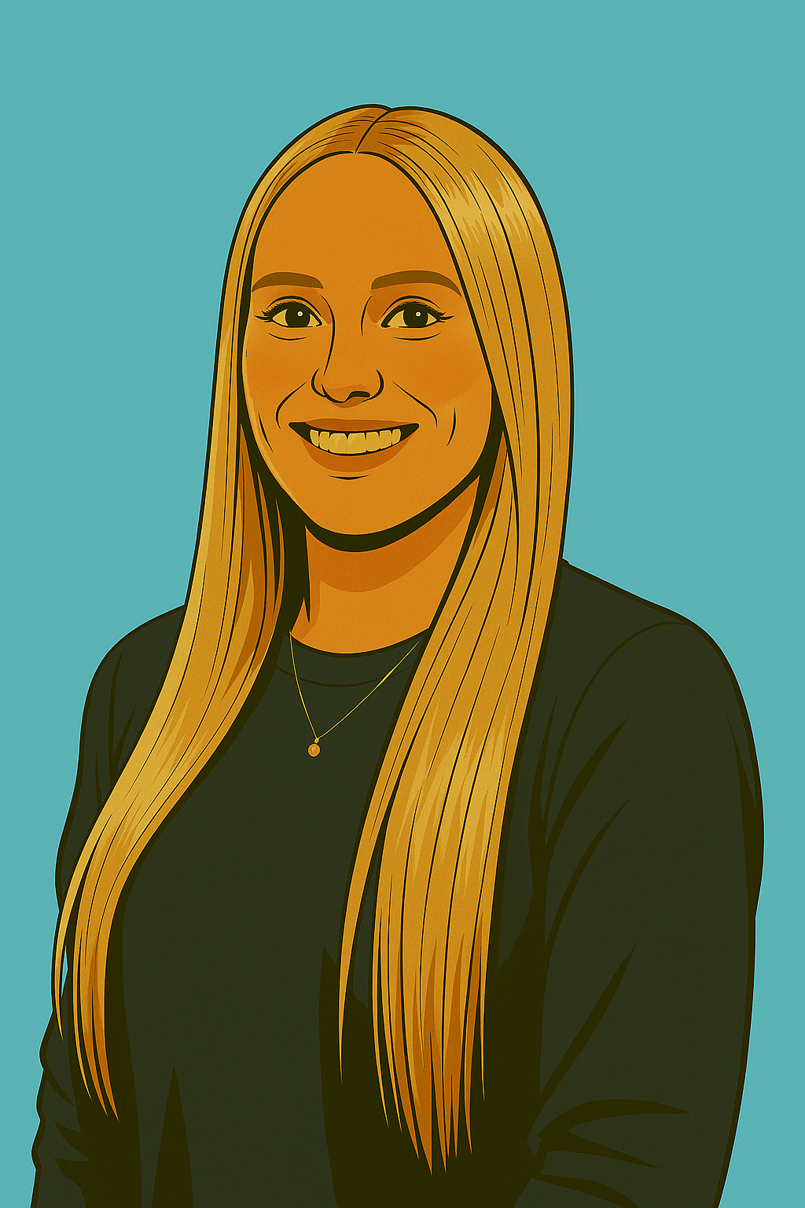
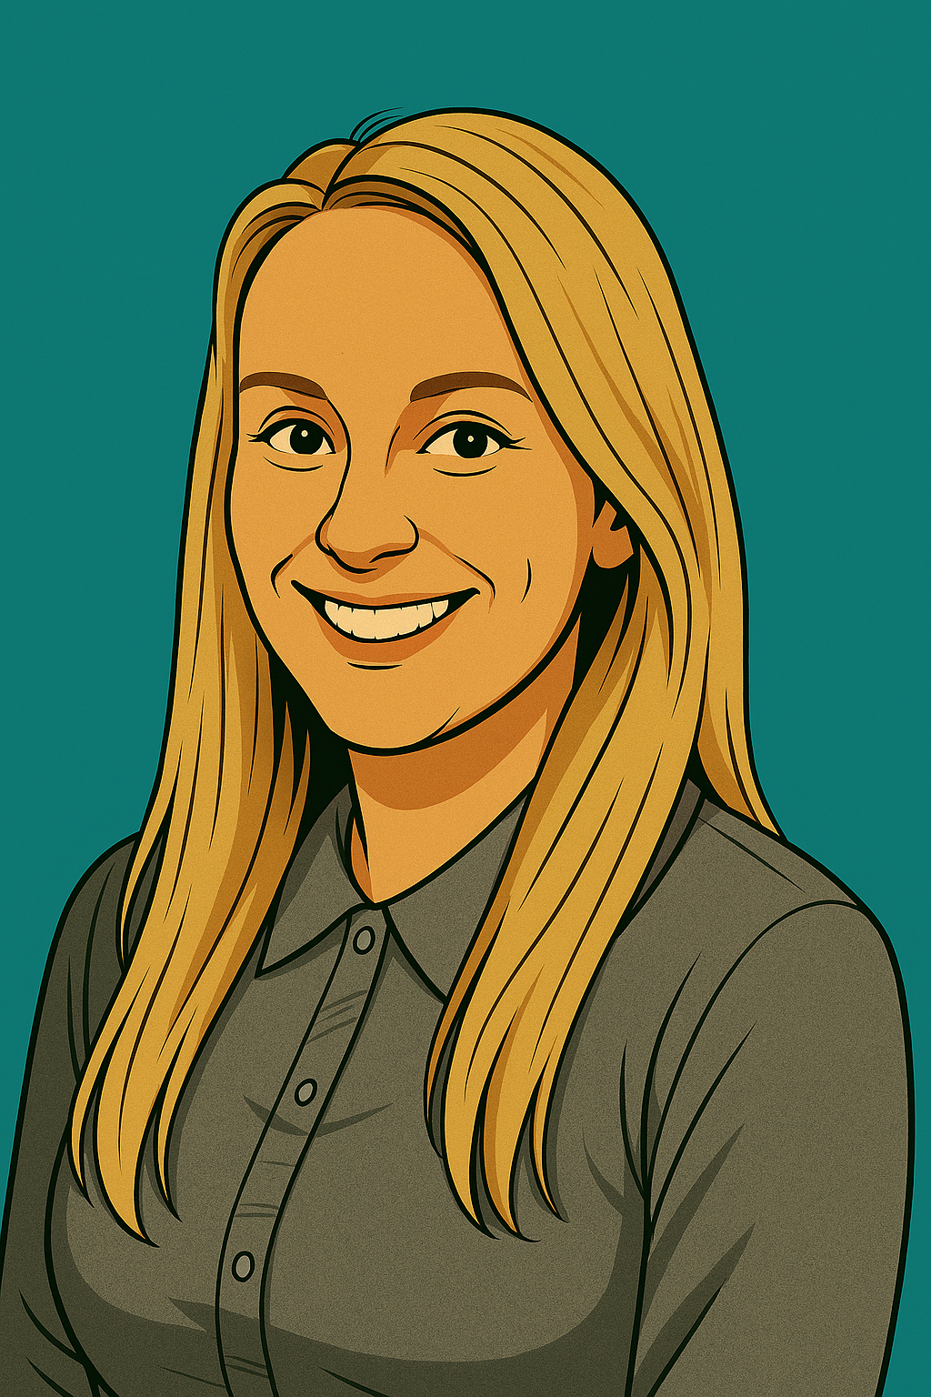
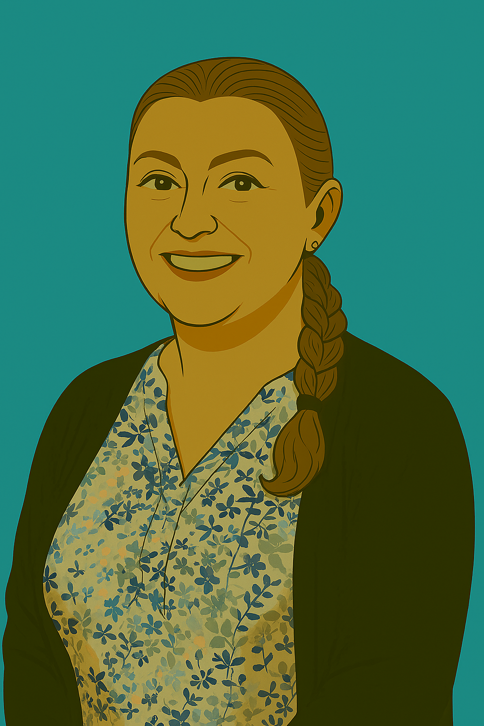
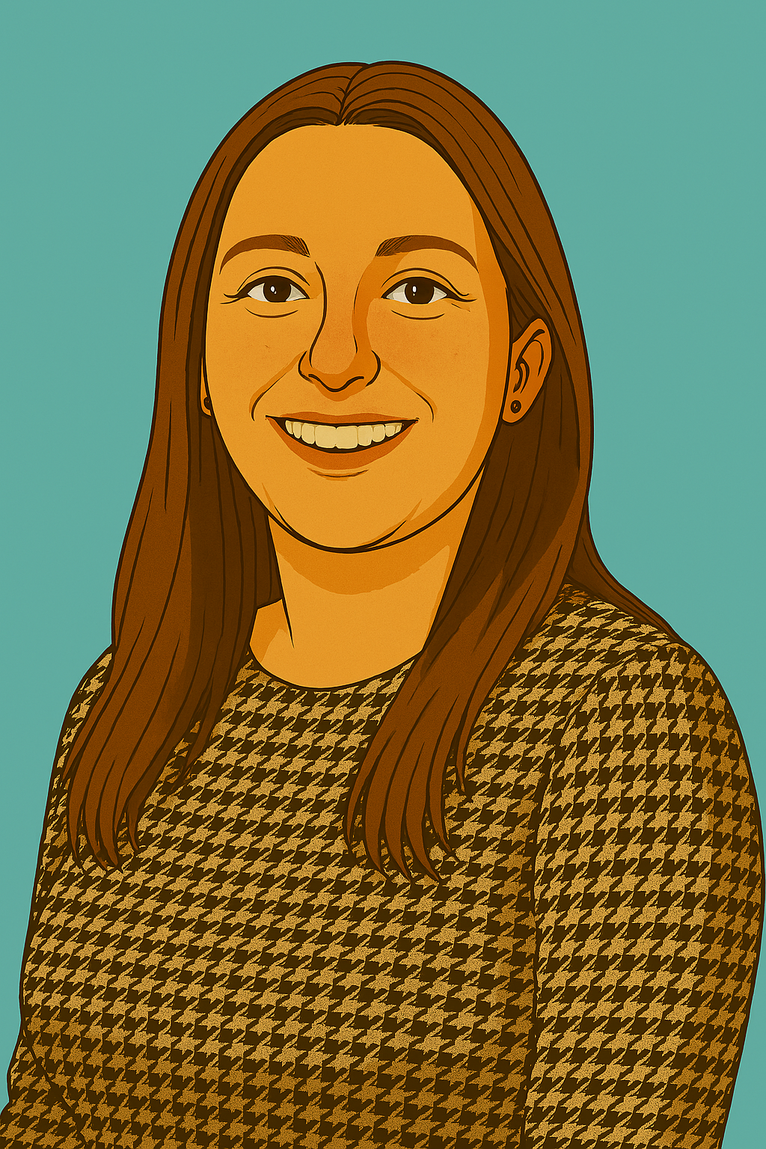
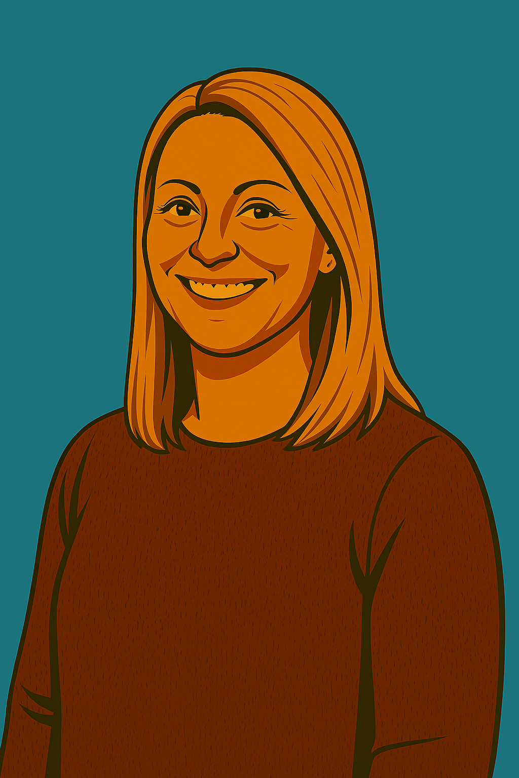
Welcome to Year 3
Meet the team
Class 7 Mrs Brame and Mrs Patel
Class 8 Miss Till, Miss Boyes (Tuesday), Miss Machin (mornings) and Mrs Mahoney.

Slide 2

Aims of the session:
What does the Year 3 curriculum look like?
2. What does a typical Year 3 day look like?
3. What can I do to support my child at home?
4. House keeping and questions.

Slide 3

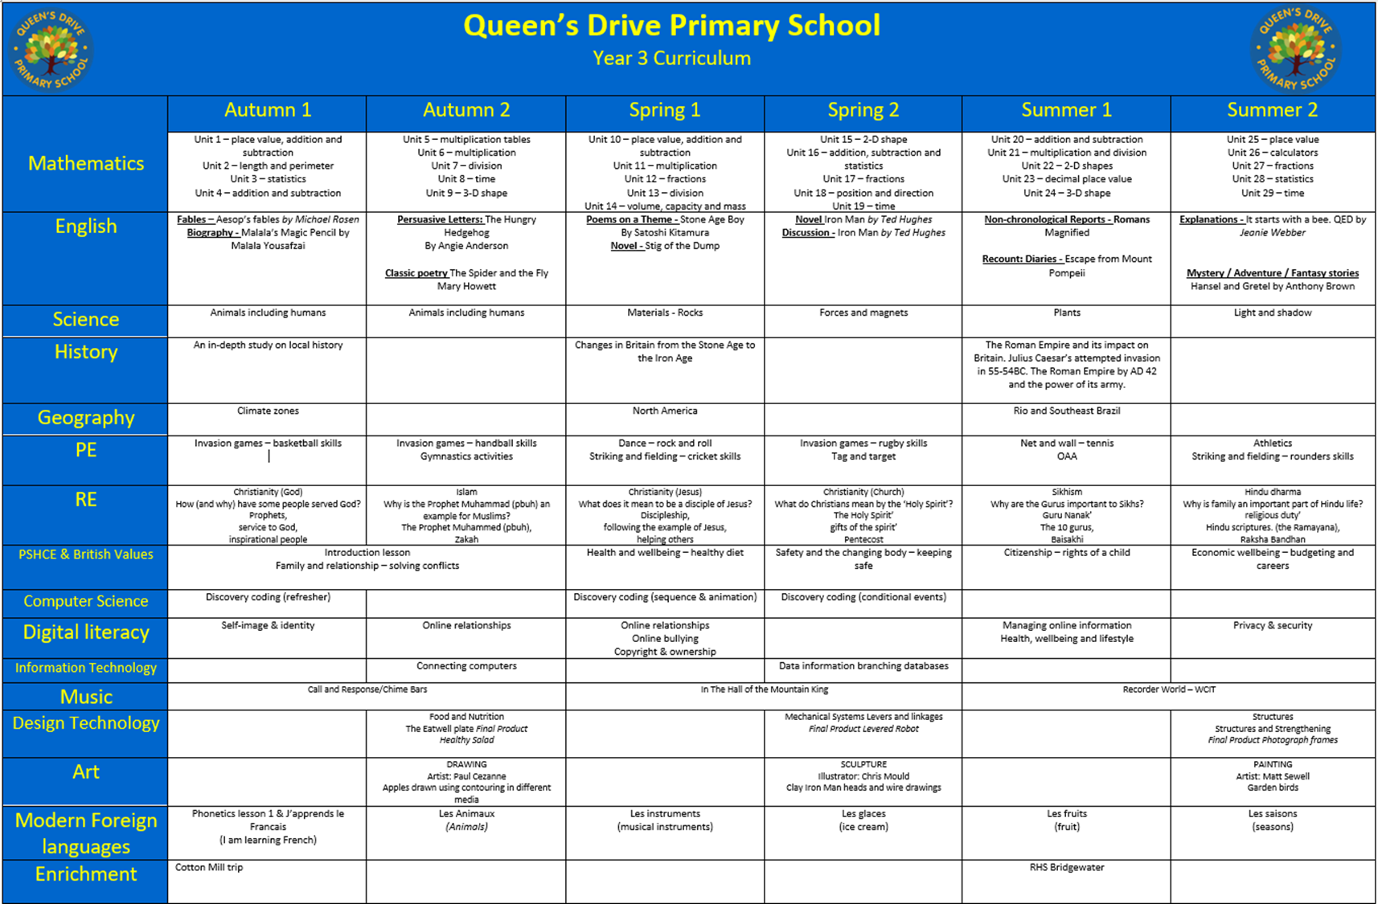
What does the Year 3 curriculum look like?

Slide 4





Core Texts To support our English unit this term, we will be reading Aesop’s Fables by Michael Rosen. We will be using this as a basis structure of a fable so we can innovate and write our own. We will also be reading Malala’s Magic Pencil By Malala Yusufzai. We will use our imaginations to decide what we would create to make the world a better place if we had a magic pencil. We will then write a biography of Malala. | English As writers, this term, we will be exploring a range of Fables based on Michael Rosen’s retelling of Aesop’s Fables. We will then write an innovated version of the fable: The Tortoise and the Hare. We will also enjoy reading Malala’s Magic Pencil. This will inspire us writing a biography of Malala Yuesefzai. |  | Maths Unit 1 – place value, addition and subtraction Unit 2 – length and perimeter Unit 3 – statistics Unit 4 – addition and subtraction
 | Curriculum Web Autumn 1 Welcome to the Autumn Term in Year 3! We have an exciting few months ahead that promise to enrich our learning with a variety of activities and experiences. |  | Science As scientists, this half term, we will be focusing animals including humans. We will learn that animals including humans need skeletons and muscles for support and movement. We will be sorting and categorising animals depending on their skeleton type.
History As historians, this half term, children will learn about the expansion of Preston in the 19th century and the consequences of this. We will be learning about why people migrated from rural Lancashire to Preston. We will put a particular focus on the growth of the cotton industry and it impact of Preston and the wider world. |  |  | Science
 |  |  | P.E Invasion games – basketball skills
Computing This term in computing, children will be thinking about different types of computer system along with what a network is. We will also be considering our image and online identity as well as doing a refresher on discovery coding. | M.F.L In French this term, we will be looking at the beginning phonetic sounds in French to support our reading of the language. | R.E In RE this term, we will be focused on Christianity and how people serve God. We will discuss how the prophets served to God.
 | Geography As Geographers we will be looking at identifying the lines of latitude and longitude and explain how latitude is linked to climate. We will look at different climate zones and explore the differences between the Northern and Southern Hemisphere. We will compare climates and explore weather patterns within a climate zone. | Curriculum Enrichment: During this half term, we will be enjoying swimming lessons. To enrich our history topic, we will be visiting Avenham and Miller Parks; and Winkley Square.
PSHE This half term, year 3 will be thinking about and discussing different families and relationships. We will be thinking about how to have positive relationships with the people around us. |  | Curriculum Enrichment: We are thrilled to finally venture off on our residential trip to Kingswood! This adventure will offer hands-on learning experiences in a fun, outdoor environment where teamwork, resilience, and independence will be fostered. Enhancing our understanding through a thought-provoking trip to the War Museum. This will provide us an opportunity to see historical artifacts and gain insights that will deepen our appreciation and understanding of history.

Slide 5
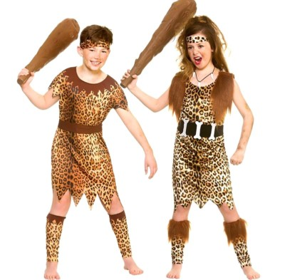
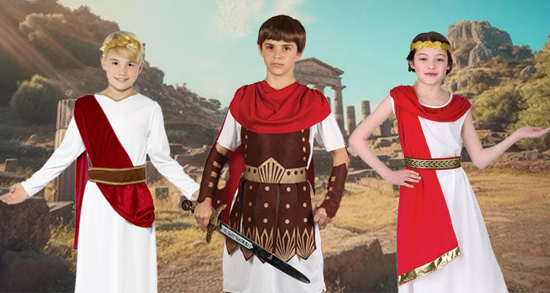
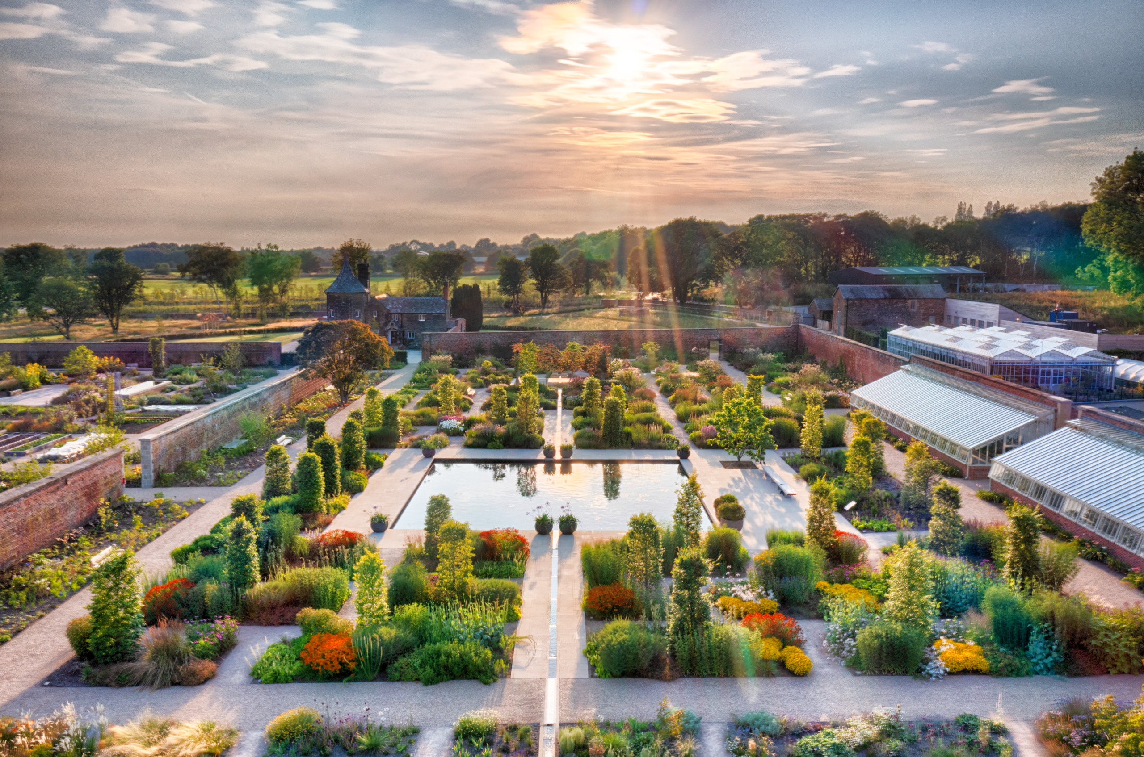
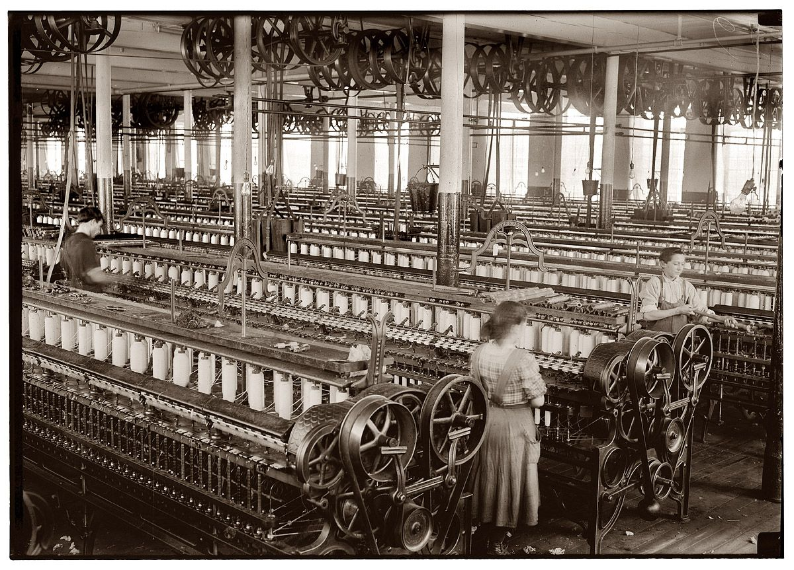
Trips and enrichment days
October-13th and15th October. A visit to Queen Street Cotton Mill in Burnley. This is our History link to see what life was like. Payment will be sent to you soon.
Spring 1- Stone age- we have a Stone Age day in school with an outside historian who brings in artefacts and we have an interactive afternoon. We do dress up. There is a small charge for the day (£4 approx to cover his fee)
Summer 1- Science – RHS Bridgwater in Manchester. A fabulous day out with a workshop and exploration time. This links in to our plants and bee unit.
Summer 1- Roman day. Same as Stone Age Day- historian in to deliver workshops and we dress up.

Slide 6
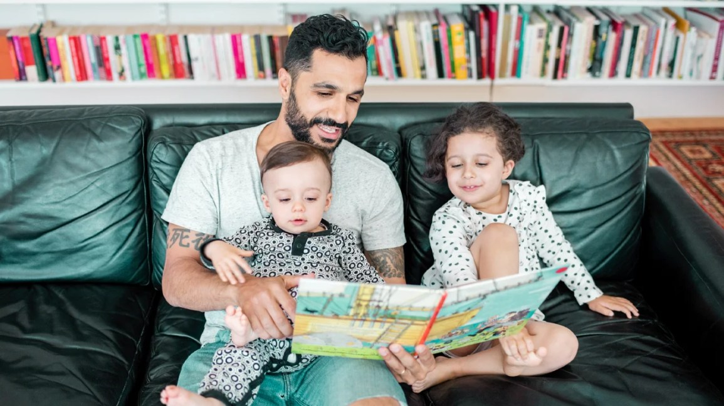
Home Reading in Year 3
In year 3, most children are secure in their phonics and are able to decode and read most words. Therefore, their reading books will no longer be based on a reading scheme but will be from a book band. Each child has recently been assessed and should be reading from a book band suitable for their ability.
Some children will still be receiving Phonics lessons. They will bring home a corresponding phonics level book.
Children should be taking these books home each night and returning them, along with a signed diary, each day. When reading at home, confident readers do not always need to read to an adult but we recommend at least once a week, with daily reading sessions being independent.
Less confident readers will benefit from reading to an adult who can help their child to decode words and discuss vocabulary and meaning. The greatest benefit will be to read to an adult daily.
Please sign their diary when they have read. Children whose diary is signed by an adult can change their book.

Slide 7
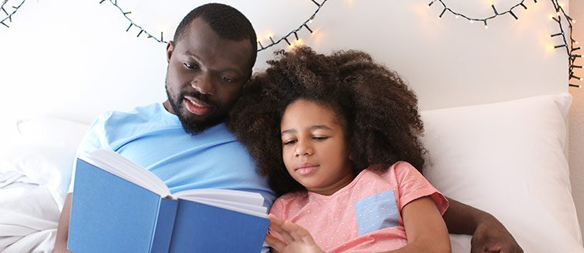
Reading for Pleasure.
We do a lot of work in year 3 encouraging children’s reading for pleasure.
In year 3, most children will be ready to independently read books with short chapters. Some will not be ready and this is fine. It is very important that children are exposed to a wide variety of books.
Reading to your child is still very beneficial.
You can find advice about reading from:
https://www.lovereading4kids.co.uk
https://home.oxfordowl.co.uk/reading/reading-age-7-8-year-3

Slide 8
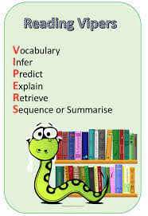
We use VIPERS questioning techniques to help children to understand the texts they are reading.

Slide 9
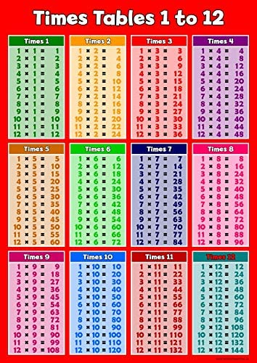
Times Tables Practice.
The year 2 expectation is that all children should be able to instantly recall 2, 5 and 10 times tables.
The year 3 expectation is that all children should be able to recall
3, 4 and 8 times tables.
In year 4 the children are expected to recall all times tables up to 12 x. There is a government multiplication check in year 4.
Each week, the children have the opportunity to earn their times tables badges. They are doing this at their own level and there is no pressure.
https://ttrockstars.com/
https://www.topmarks.co.uk/maths-games/hit-the-button

Slide 10

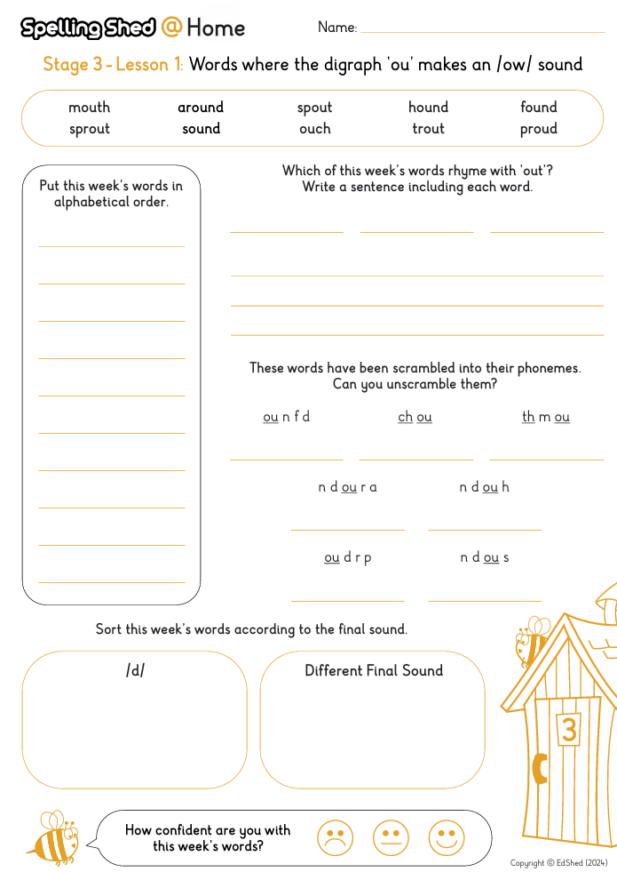

Spellings
We follow Spelling Shed Spellings. Each Friday, the children will be given a set of spellings to learn ( homework sheet) These words will be tested the following week (Friday am)
All children are taught the Year 3 spelling rules and each list of spelling conforms to that rule, however, some children will have individual spellings for their spelling test.

Slide 11
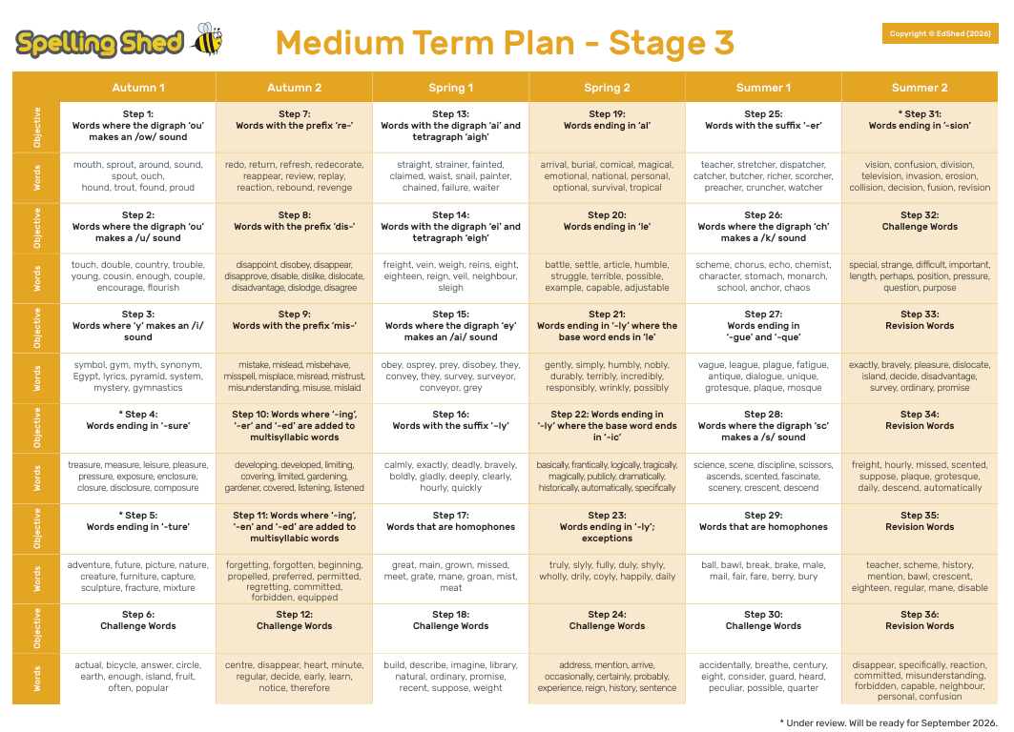

Slide 12

What does the Year 3 day look like?
Morning sessions include: An assembly, Maths, Guided Reading, Spellings, Handwriting Practice, Grammar and English.
Break time – 11am-11.15am (they may bring some fruit)
Lunch Time – 12.30-1.30pm
Afternoon sessions include: Science, PE, French, ICT, History, Geography, RE, PSHE, Art, Music, intervention groups and reading for pleasure. Forest school (Autumn 2)
Break time – Daily mile track when children are ready for a break.
Home time – 3.25pm from our classroom door

Slide 13
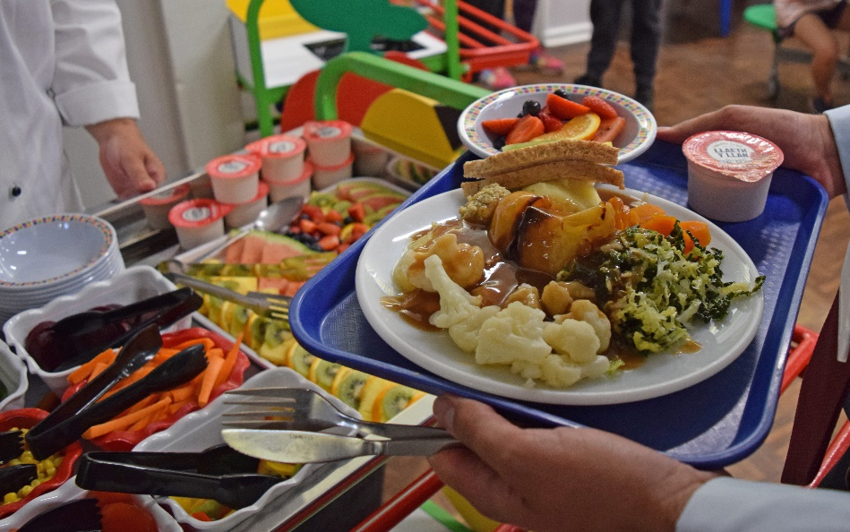
Lunches
Lunches are no longer free in KS2 but can be ordered for all small cost.
If your children requires a school lunch then they must be ordered and paid for via the App. Please help your child to choose to ensure they are happy and can remember what they have ordered.
Packed lunches – We kindly request that you ensure there are no nuts in your child’s lunch. This includes Nutella or any other nut based spread or treat. Sweets and fizzy drinks are not allowed.
A separate water bottle from their class water bottle must be in their lunch box.

Slide 14
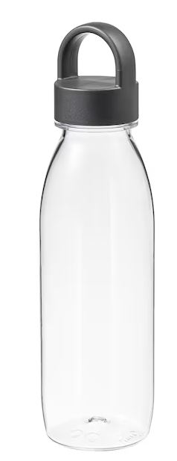
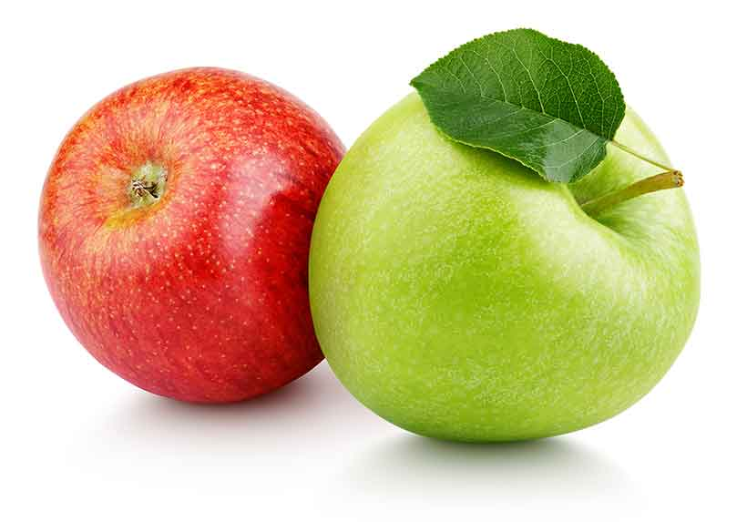
Snacks and water bottles
Children may bring in a piece of fruit only for morning break.
We respectfully ask that no nut products are brought in as we have a number of children / staff with severe allergies.
Children do get thirsty throughout the day so a water bottle is essential each day. This will then be taken each home each night to be washed and re-filled.

Slide 15
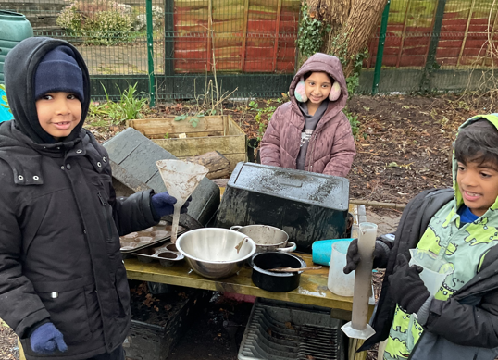
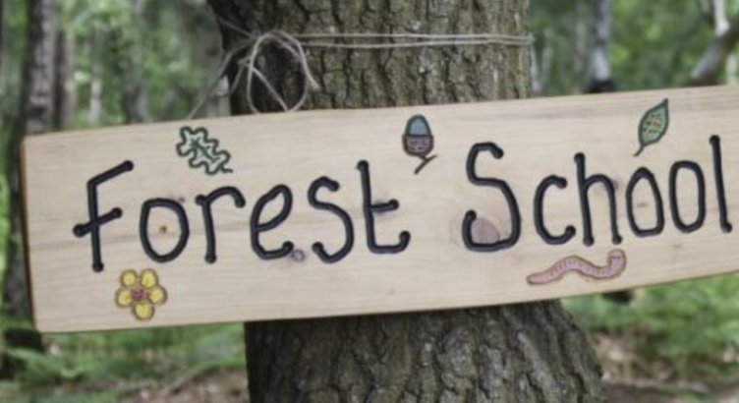
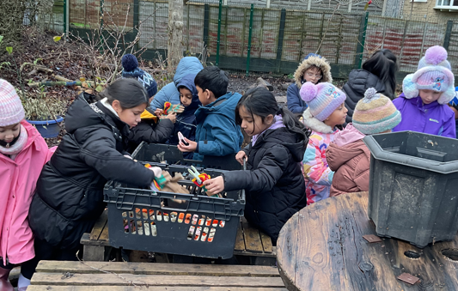
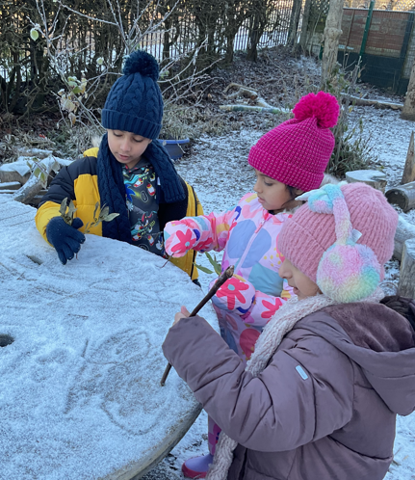
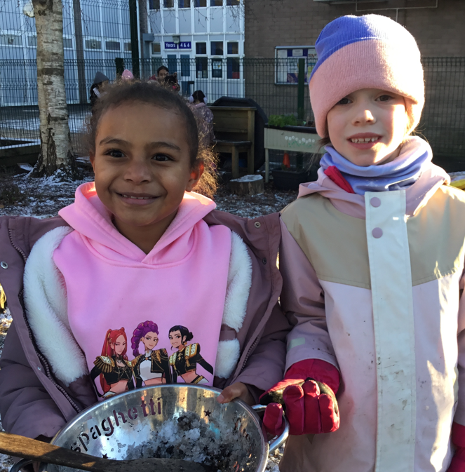
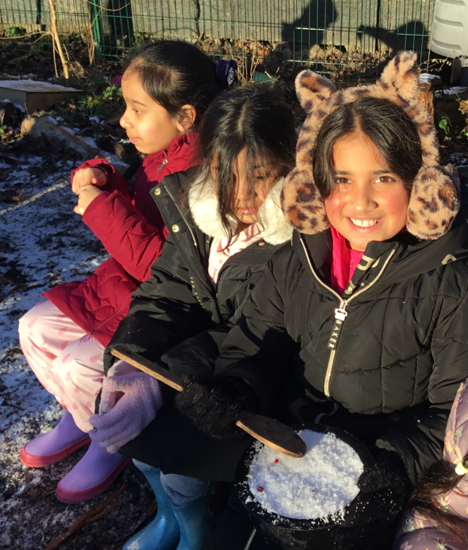
Forest School
Forest School will take place in the Autumn term ( Nov-Dec)
Waterproof clothing and wellies to be brought in on their session

Slide 16
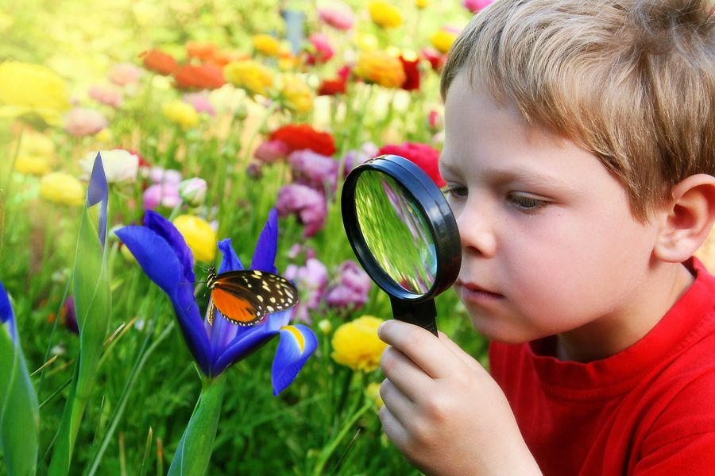
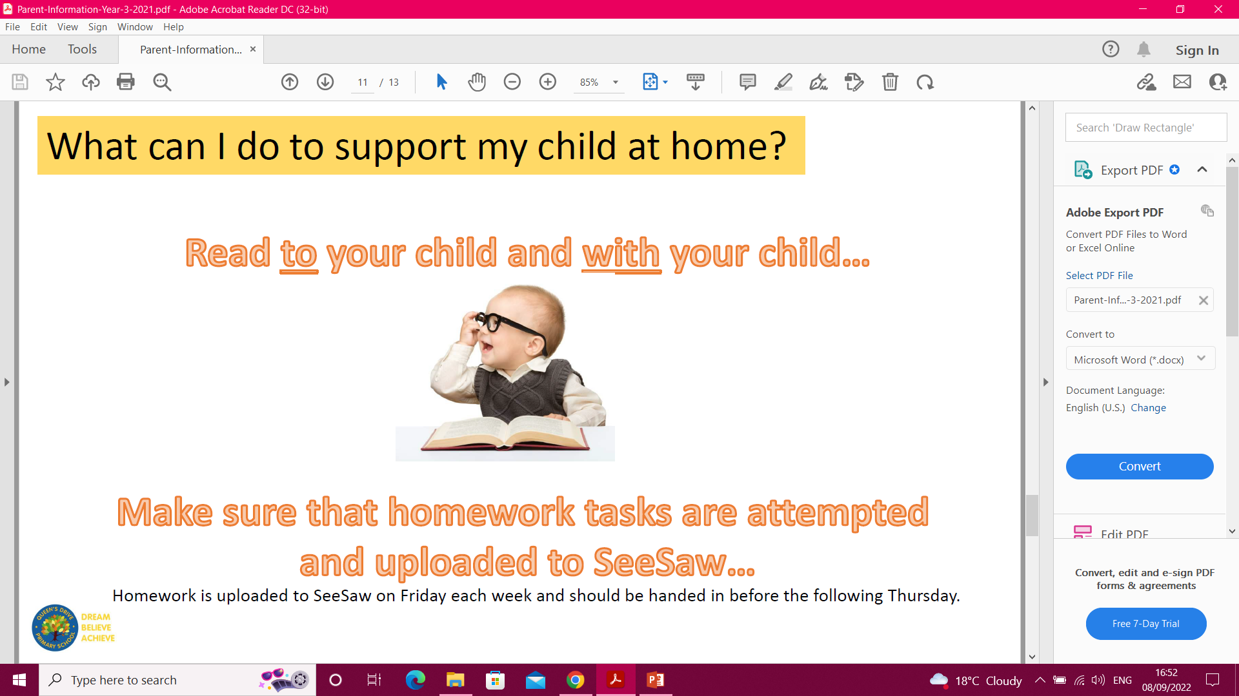
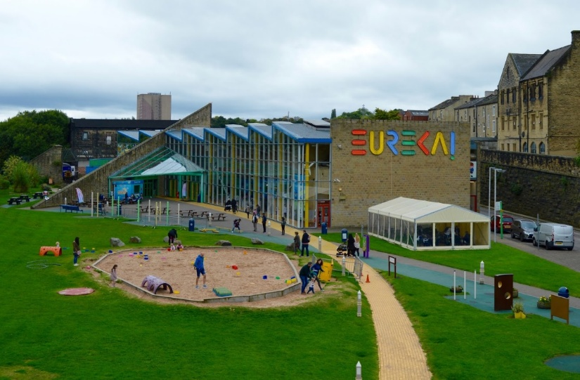
How can I support my child?
Reading
Spellings
Times tables practice.
A breadth of experiences.

Slide 17
House keeping and Question time
Bring your coat, reading book, diary, bag, fruit and water bottle everyday to be kept in class.
Lunches – Packed lunch or school dinner for a small charge Snacks – fruit only.
Please ensure ALL items of clothing are clearly labelled with uniform looking smart. It is your child's responsibility to look after their items.
Any questions?

