Slide 1


Meet the Teacher
Year One
The Year One teachers are…
Class 3 Miss Simmons (Monday-Thursday)
Mrs Farrell ( Friday)
Class 4 Mr Pearce
The Year One teaching assistants are…
Miss Best, Miss Gregson, Mrs Singh. We also have additional teacher assistants supporting some children with additional needs.

Slide 2

The Year One Curriculum
Yearly Curriculum Overview map
Half termly Curriculum webs
Website

Slide 3

Queen’s Drive Primary School Year 1 Curriculum
Mathematics | Autumn 1 | Autumn 2 | Spring 1 | Spring 2 | Summer 1 | Summer 2
 | Red Rose Maths Mastery Number and place value length/mass/weight addition/subtraction geometry | Red Rose Maths Mastery Sequencing and sorting Fractions Capacity and volume Money Time | Red Rose Maths Mastery Number and place value Mass/weight 2D/3D shape Counting and money Multiplication/division | Red Rose Maths Mastery Number and place value Addition/subtraction and statistics Capacity and volume Fractions 2D/3D shape Position and direction/time | Red Rose Maths Mastery Time Multiplication/division Subtraction (difference) Length/mass/weight Sorting and sequencing | Red Rose Maths Mastery Length/mass/weight Addition/subtraction Fractions Position/direction Time
English | Stories by the same author Lost and Found by Oliver Jeffers Learning poems off by heart - Animal Boogie Woogie | Stories with repetitive patterns Zog by Julia Donaldson Instructions – how to book | Traditional tales Little Red Riding Hood Traditional Rhymes/Nursery rhymes | Classic stories The Tale of Peter Rabbit by Beatrix Potter Recount Recount of visit to Beatrix Potter World | Stories from other cultures Handa’s Noisy Night Poems on a theme I am the seed that grew the tree by | Stories with fantasy setting Nobot the robot with no bottom by Information texts Information books about robots
Science | Animals including humans Seasonal change Throughout the year | Animals including humans Seasonal change Throughout the year | Plants Seasonal change Throughout the year | Plants Seasonal change Throughout the year | Everyday Materials Seasonal change Throughout the year | Animals including humans Seasonal change Throughout the year

Slide 4
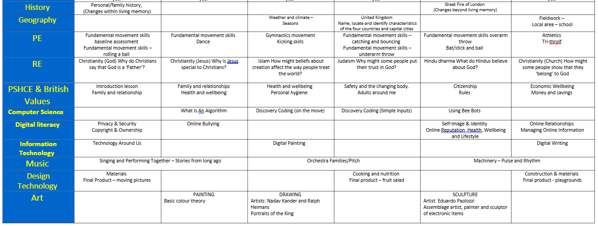
Foundation Subject Overview

Slide 5





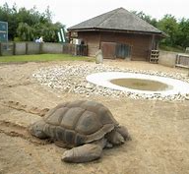
Core Texts The first text we will use this term will be Dear Zoo by Rod Campbell. This is a familiar text to the children which has been chosen to ease the transition from EYFS to Year 1. The second text we will be reading will be Lost and Found by Oliver Jeffers. We will look carefully at the themes in this book. The characters, setting and problems faced in the story. We read other stories by Oliver Jeffers such as Up and Down, The Way Back Home, The Day the crayons quit. | English Our English work during this term will link with our half term theme of ‘Animal Magic’. As we read our texts in class we will be developing our comprehension skills and will also be developing our understanding of adjectives and simple punctuation. In our English lessons we will also be: • Writing Labels, lists and captions • Writing sentences that use capital letters at the start, full stops at the end and use commas in a list • Writing letters using the Queens Drive handwriting style and remembering how to write on the line as well as remembering to leave gaps between our words • Retell a story orally then * Use a story map to write a story retell. |  | Maths Our Maths work follows Red Rose Maths Mastery. The units we will cover include: Unit 1 - Number and place value Unit 2 – Measurement (length and mass/weight) Unit 3 – Addition and subtraction
 | Curriculum Web Autumn 1 ‘Animal Magic’ Hello, and Welcome to Year 1! We hope you have had a relaxing summer holiday and are looking forward to all the exciting things we will be doing in Year 1 this half term! Class 3’s class teachers are Mrs Robertson (Monday-Thursday) and Friday Miss Rogers Class 4’s teachers are Miss Wood (Monday, Tuesday) and Miss Boyes (Wednesday-Friday) Year 1 Teaching Assistants are Miss Best, Mrs Singh and Miss Sheikh. Our topic this half term is called ‘Animal Magic!’ |  | Science During the whole of year one, we focus on the seasons and how they change. We will explore how the weather changes during the seasons and how it affects plant growth, looking at the particular changes in our school grounds. In each half term we have additional Science themes to cover. The Science theme for this half-term is ‘Animals’ which is part of our theme for the half term. The children will explore different animals such as farm animals, pets and animals around the world. They will identify, name and compare common animals and will be involved in classifying animals according to the group they belong to. We will be learning about mammals, fish, reptiles, amphibians and birds.
Geography We will learn about the hot and cold areas of the world.
Computing In computing this half-term we will be developing our understanding of Information Technology by looking at the technology around us. Our digital literacy will look at privacy and security as well as copyright and ownership. We learn the importance of using a password to protect information and why it is important to always ask a trusted adult before we share any information online. We will also look at how to save our work using a suitable title showing it belongs to me. | Music - Stories from long ago Sing/Perform – action songs, chants, rhymes, cumulative songs, simple canons Explore pulse, tempo and timbre – follow a graphic score, create sound effects. Explore/play untuned percussion instruments to accompany songs Listen/appraise – Identify musical features such as instruments used, loud/quiet, fast/slow. Explore music and instruments of the 1600s | R.E This half term we are looking at Christianity. Our key learning will focus on ‘What do people say about God?’ We will be looking in detail about why Christians say God is the Father.
 |  | Curriculum Enrichment: Our Year One learning journey will begin in the most exciting of ways! A visit to Blackpool Zoo. This will really help to engage and support our learning about animals. We will be able to have real life experiences which can relate to about the animals we are learning about.
PSHE We will be exploring how families can be different, the characteristics and impact of positive friendships; learning that issues can be overcome, that people show feelings differently and that stereotyping is unfair. | P.E In P.E. lessons we will practise and refine our games skills. In particular we will focus on rolling a ball and fundamental movement skills such as running, hopping jumping and skipping.

Slide 6
A typical Year One Day
Assembly or Singing assembly.
Maths
Playtime
Phonics
English
Lunchtime
Maths Mastery / Handwriting practice
Subject lesson (e.g Art, PE, History, Science, Computing, D.T. etc)
Playtime
Subject lesson
Story time
Home time or after school club

Slide 7


Grammar and punctuation is…
A big part of the English curriculum.
Children are taught to use correct terminology.
Expected to use full stops, capital letters, commas in a list, question marks, exclamation marks.
Specific grammar and spelling rules to be taught:
Nouns, verbs, adjectives
Plurals s or es
Past tense ed
Comparative language – using er or est

Slide 8
Year One Spellings include…
Days of week
Months of year
Number words
Common exception words
Grammar focus words
Weekly spelling quiz – linked to phonics learning.
Spellings will be given out on Monday and checked the following Monday.

Slide 9
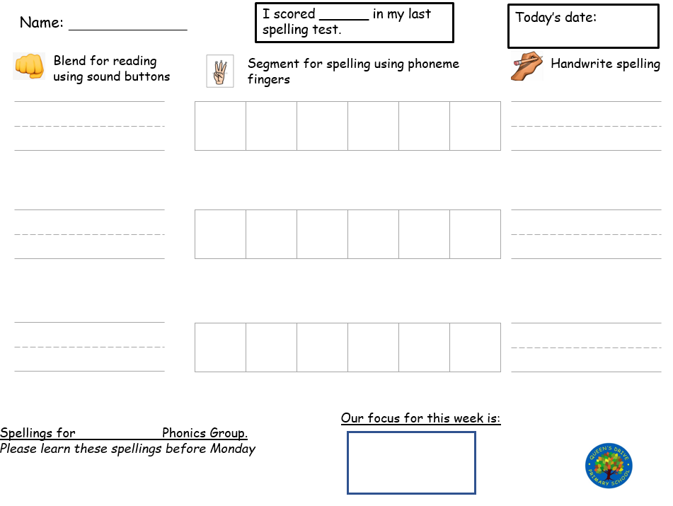

Slide 10
Handwriting
All children write using the Penpals Handwriting Style and are encouraged to:
Start and finish letters in the right place
Write capital letters correctly
Write letters on the line
Use spaces between words
Use memorable phrases to help them with their letter formation
Recognise the handwriting families
Form numbers correctly and learn number rhymes to help write numbers.

Slide 11
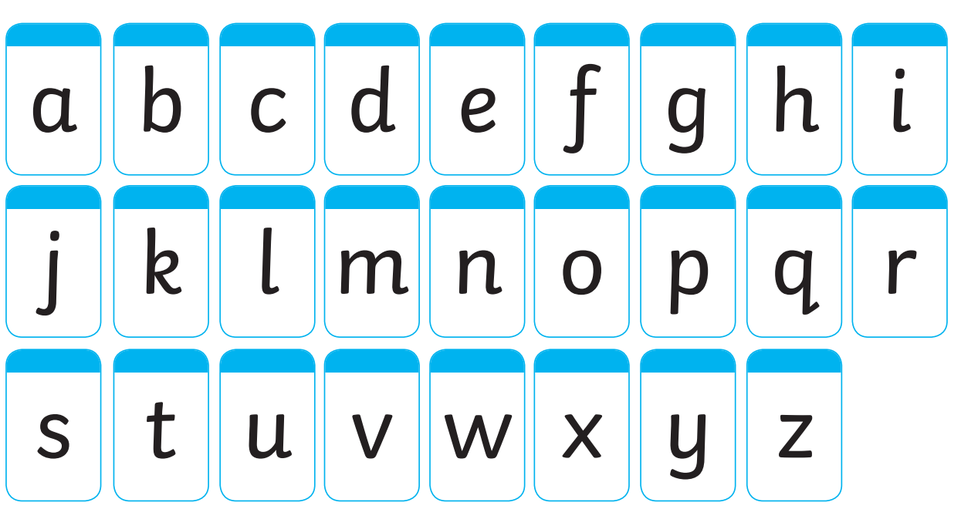
The Penpals handwriting style

Slide 12
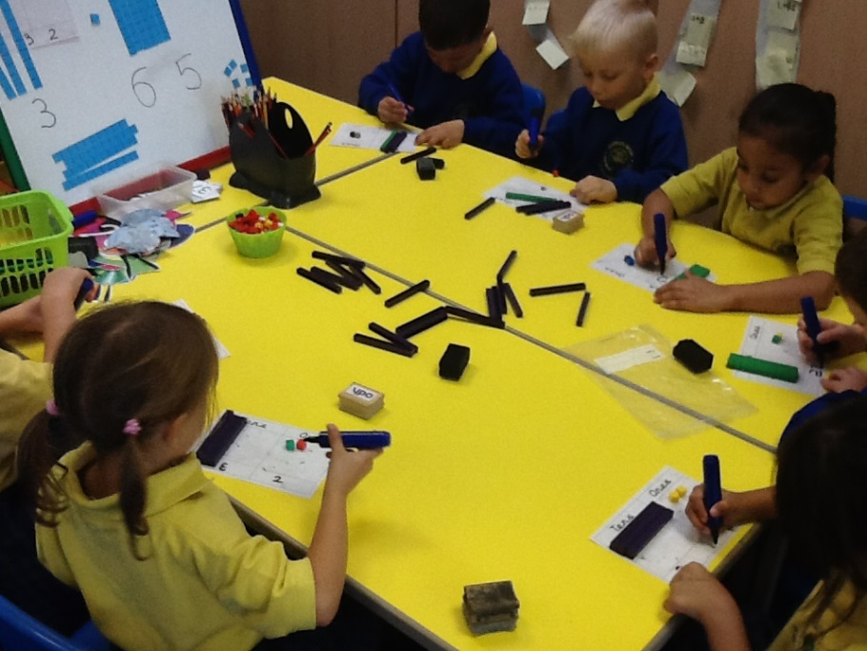
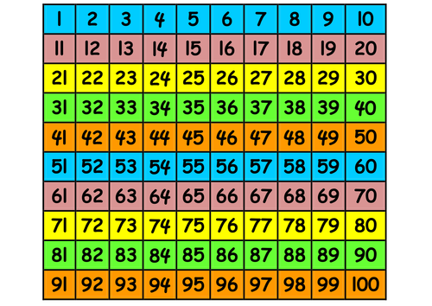
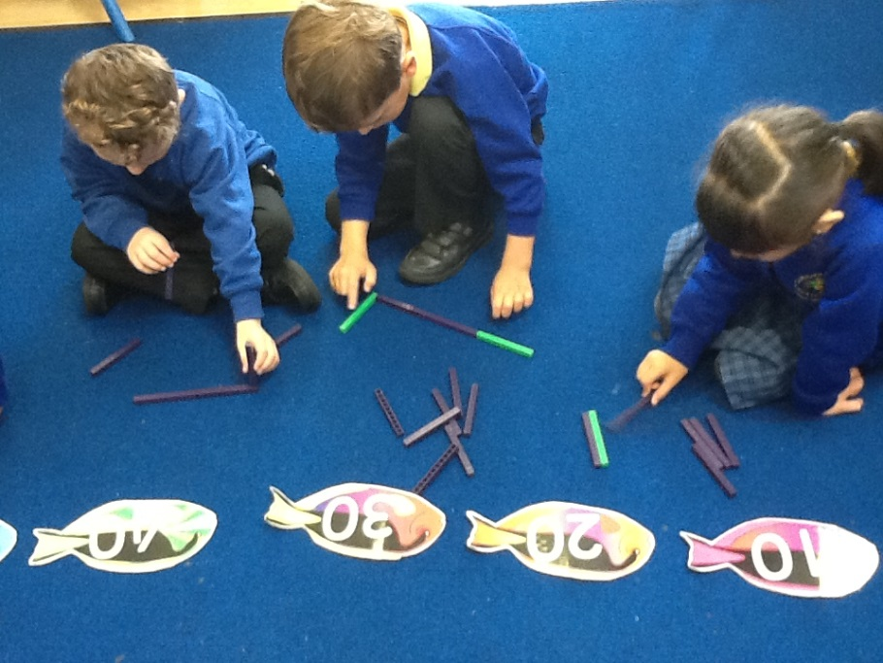
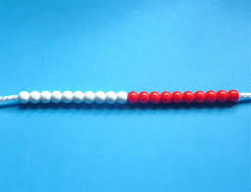
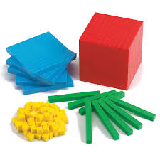
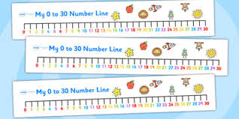
Maths

Slide 13


The Mathematics
Curriculum
Reading, writing and ordering numbers to 100.
Writing numbers in words to 20.
Using tens and ones (units) to add and subtract.
Adding numbers to 20. E.g 10 + 10, 15 + 5.
Counting using hundred squares, number lines, bead strings.
Counting forwards and backwards in 2’s, 5’s and 10’s.
Remember doubles, halves, pairs to 10.
Fractions – halves and quarters of shapes.
Money – recognising coins and their values.
Time – days of week, months of year.
Notes:
Counting forwards and backwards – on a numberline and to count in sequence in 2’s, 5’s and 10’s. The children gain lots of experience in recording addition and subtraction number facts (number bonds to 10 – (flip flop). We also look at odd and even numbers and become more familiar with bigger numbers using the 100 square.
We teach money in the concept of buying (adding coins/amounts together), giving change and equivalence.
We look at 2D and 3D shapes and their atttributes – naming and sorting.
The children will have further experience through games that develop their understanding including measuring using non-standard measures and capacity. We also look at time. The children learn how to tell the time using o’clock, half past and if they are ready we will extend them to quarter to and quarter past. We also look at digital time and how to read a digital clock.
The children will develop their problem solving skills by developing their thinking skills to solve a task.

Slide 14


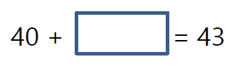




Arithmetic
Recall of addition and subtraction sums
Missing number sums
Notes:
Counting forwards and backwards – on a numberline and to count in sequence in 2’s, 5’s and 10’s. The children gain lots of experience in recording addition and subtraction number facts (number bonds to 10 – (flip flop). We also look at odd and even numbers and become more familiar with bigger numbers using the 100 square.
We teach money in the concept of buying (adding coins/amounts together), giving change and equivalence.
We look at 2D and 3D shapes and their atttributes – naming and sorting.
The children will have further experience through games that develop their understanding including measuring using non-standard measures and capacity. We also look at time. The children learn how to tell the time using o’clock, half past and if they are ready we will extend them to quarter to and quarter past. We also look at digital time and how to read a digital clock.
The children will develop their problem solving skills by developing their thinking skills to solve a task.

Slide 15
Reasoning
Problem solving
Word problems
Making links
Explaining how you worked answers out.
Notes:
Counting forwards and backwards – on a numberline and to count in sequence in 2’s, 5’s and 10’s. The children gain lots of experience in recording addition and subtraction number facts (number bonds to 10 – (flip flop). We also look at odd and even numbers and become more familiar with bigger numbers using the 100 square.
We teach money in the concept of buying (adding coins/amounts together), giving change and equivalence.
We look at 2D and 3D shapes and their atttributes – naming and sorting.
The children will have further experience through games that develop their understanding including measuring using non-standard measures and capacity. We also look at time. The children learn how to tell the time using o’clock, half past and if they are ready we will extend them to quarter to and quarter past. We also look at digital time and how to read a digital clock.
The children will develop their problem solving skills by developing their thinking skills to solve a task.

Slide 16
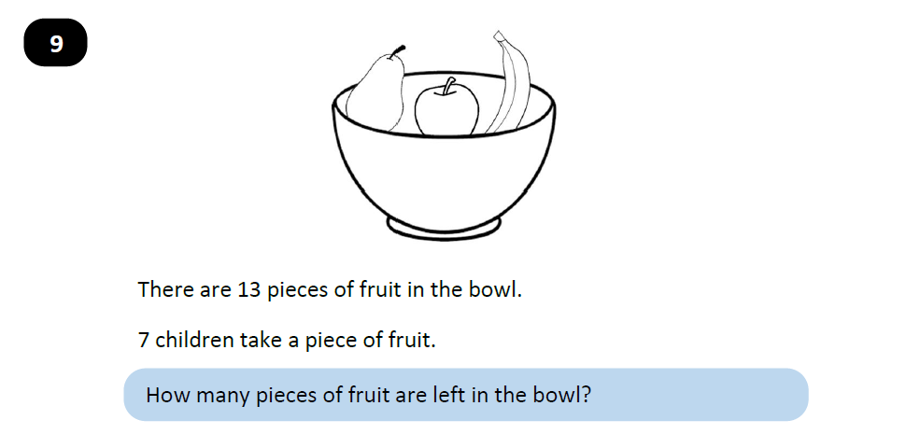
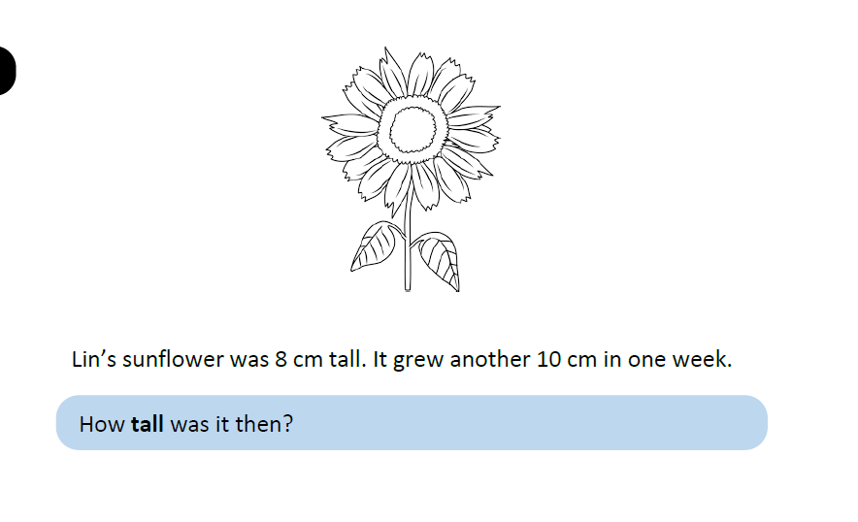
Problem solving

Slide 17
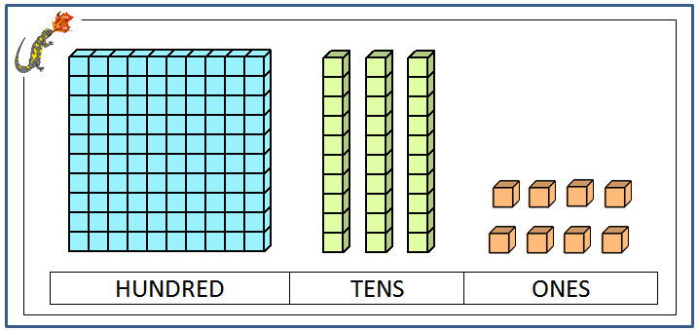
Base Ten

Slide 18


Foundation Subjects
Stand alone subjects that are taught include Maths, Geography, R.E, Computing, PSCHE and P.E.
This term Mrs Kearvell (specialist music teacher) will be teaching music.

Slide 19

Home Reading
The book your child has is determined by the phonics phase they are being taught. They will only move up to the next phase of reading book when they move through the phases.
Books will only be changed if signed by an adult to say the book has been completed.
If your child finishes their reading book – read it again or read a book from home. Read it once for word reading and again to develop understanding.
Encouraging reading for enjoyment
Books are changed on Monday, Wednesday and Friday.
Queens Drive has it’s own reading book system which matches the progression in Red Rose Letters and Sounds.

Slide 20
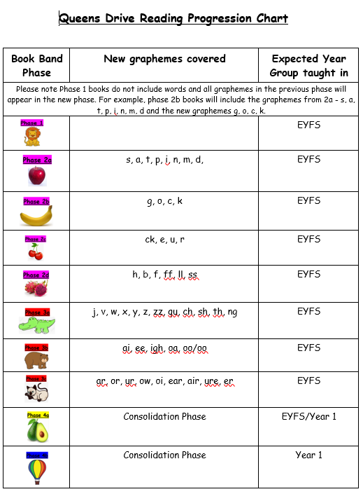

Slide 21
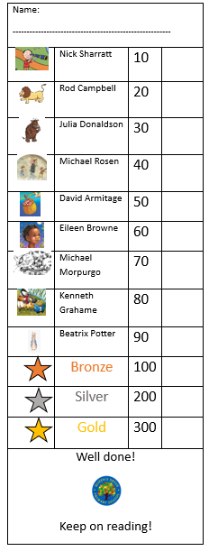
Reading Certificates.
As part of our missions to encourage children to read for pleasure.
When your child has read the requisite number of times, they will be awarded a small certificate to mark their achievement. We would love to get as many gold star readers as possible.

Slide 22
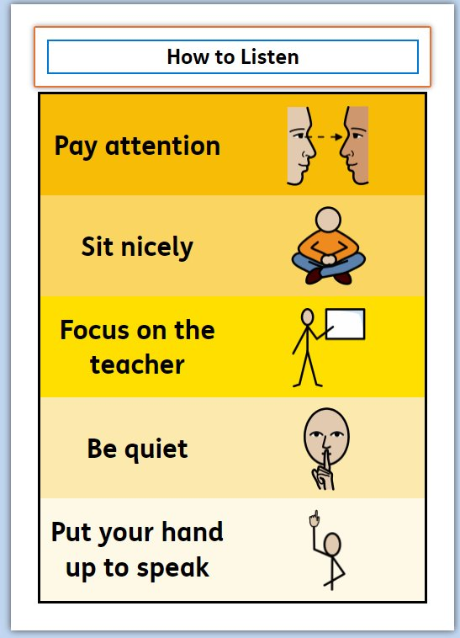
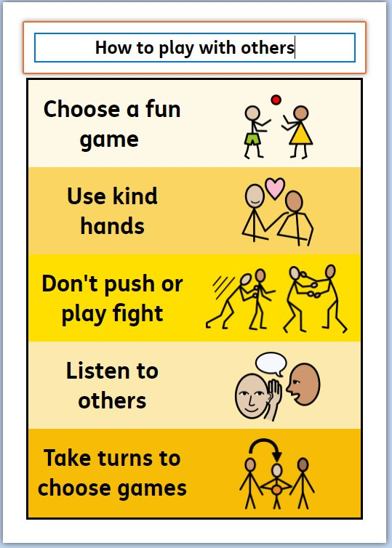
The Queen’s Drive Way

Slide 23
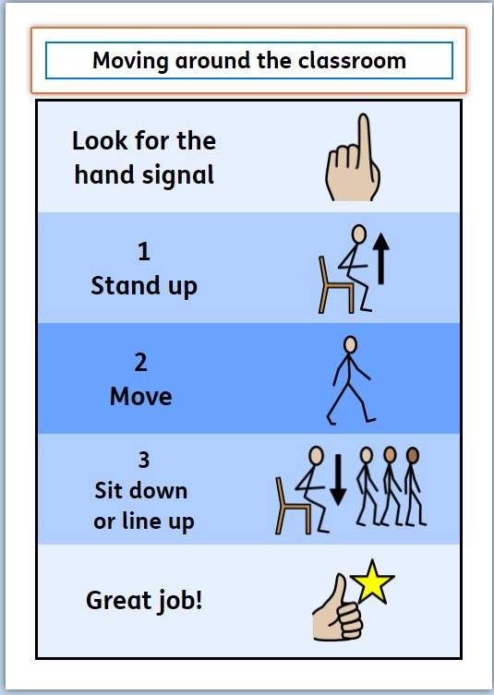
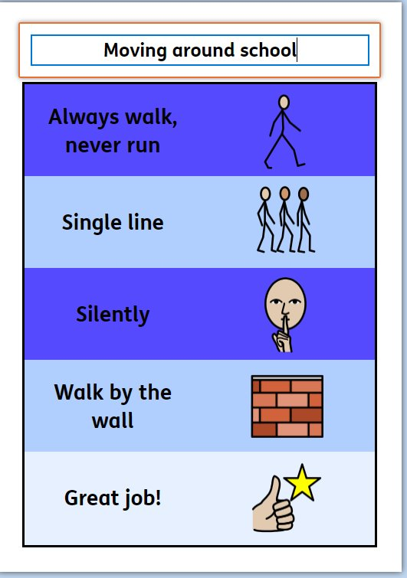
The Queen’s Drive Way

Slide 24
The Queen’s Drive Way
Respect

Slide 25
Admin
Attendance – phone the office know if your child won’t be in school or has an appointment.
Label all your child’s clothing.
Full water bottles each day please.
Nut free school.
No food for gifts.
Notes:
Monies – please ensure that any monies that are brought into school are put in a sealed envelope with the name and class of your child. Please also state what they monies are for.
Attendance – If you child is absent from school for any reason, please could you write in to inform us of the reason why.
Water bottles – all the children have brand new water bottles in school. We have decided to keep them in school so we can ensure that each child has access to a water bottle everyday.
Coats – we have recently had a few coats lost/misplaced by the children. Please ensure they are labelled clearly with your child’s name. Some of the children put their coats on at playtimes and take them off whilst playing and end up leaving them outside. If this happens the coats will generally be put into one of the lost property boxes in the infant building or the junior building.
End of the day – the children come out of the side door. If you for what ever reason are late to collect them, then they will be taken to the office to wait for you.
Questions – If you would like to see us during the week we are happy to discuss anything with you at the end of a day when the rest of the class has been dismissed and been collected. If we are unable to speak to you then we will arrange a time to speak with you that is convenient for both of us.

Slide 26
Admin
Correct uniform (summer dresses until end of September)
No earrings
Choose dinners beforehand
Encourage children to be as independent as possible.
No toys in school
Notes:
Monies – please ensure that any monies that are brought into school are put in a sealed envelope with the name and class of your child. Please also state what they monies are for.
Attendance – If you child is absent from school for any reason, please could you write in to inform us of the reason why.
Water bottles – all the children have brand new water bottles in school. We have decided to keep them in school so we can ensure that each child has access to a water bottle everyday.
Coats – we have recently had a few coats lost/misplaced by the children. Please ensure they are labelled clearly with your child’s name. Some of the children put their coats on at playtimes and take them off whilst playing and end up leaving them outside. If this happens the coats will generally be put into one of the lost property boxes in the infant building or the junior building.
End of the day – the children come out of the side door. If you for what ever reason are late to collect them, then they will be taken to the office to wait for you.
Questions – If you would like to see us during the week we are happy to discuss anything with you at the end of a day when the rest of the class has been dismissed and been collected. If we are unable to speak to you then we will arrange a time to speak with you that is convenient for both of us.

Slide 27
Admin
Communication
Messages will be sent out via School Spider.
If you need to get in touch with us then please email secretary@queensdrive.lancs.sch.uk this will then be forwarded on to ourselves.
Notes:
Monies – please ensure that any monies that are brought into school are put in a sealed envelope with the name and class of your child. Please also state what they monies are for.
Attendance – If you child is absent from school for any reason, please could you write in to inform us of the reason why.
Water bottles – all the children have brand new water bottles in school. We have decided to keep them in school so we can ensure that each child has access to a water bottle everyday.
Coats – we have recently had a few coats lost/misplaced by the children. Please ensure they are labelled clearly with your child’s name. Some of the children put their coats on at playtimes and take them off whilst playing and end up leaving them outside. If this happens the coats will generally be put into one of the lost property boxes in the infant building or the junior building.
End of the day – the children come out of the side door. If you for what ever reason are late to collect them, then they will be taken to the office to wait for you.
Questions – If you would like to see us during the week we are happy to discuss anything with you at the end of a day when the rest of the class has been dismissed and been collected. If we are unable to speak to you then we will arrange a time to speak with you that is convenient for both of us.

Slide 28
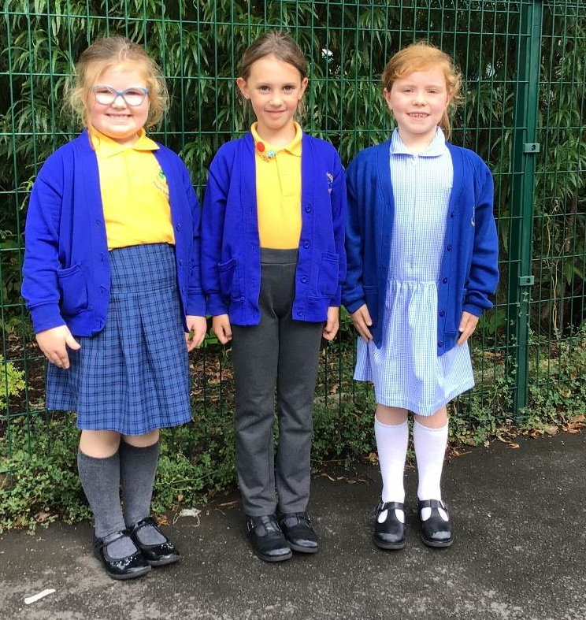

Summer dress – worn with cardigan. White socks or white tights
School Uniform 1
Checked skirt, logoed tee-shirt and either logoed sweatshirt or cardigan. Grey tights or socks
Grey trousers or shorts , logoed t-shirt and either logoed sweatshirt or cardigan. Grey socks

Slide 29
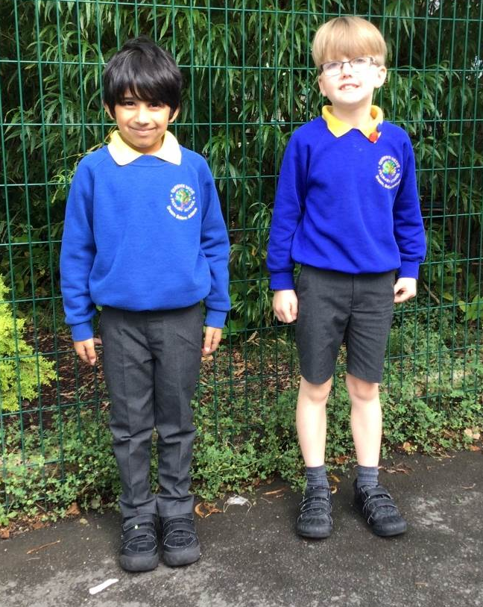
School Uniform 2
Other
1. Long hair tied back
2. No nail varnish
3. Hair accessories – black, brown or school colours of blue or yellow
4. Black shoes – no flashing please.
Grey trousers or shorts , logoed t-shirt and logoed sweatshirt.
Grey socks

Slide 30
Lost Property.
If your child does happen to lose an item of clothing or leave it out on the playground during break Lost Property is located in the entrance to the KS1 building (where we enter in a morning.)
This year, we will be building on the children’s independence skills to look after their own belongings.

Slide 31

Thank you for listening
Any questions?

