Slide 1
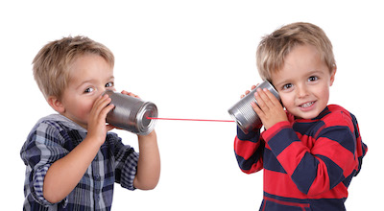

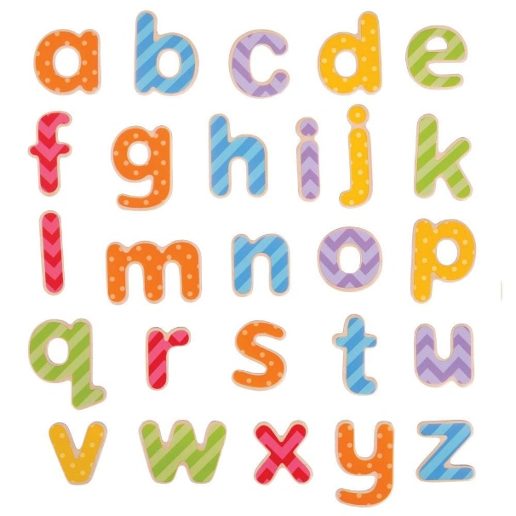
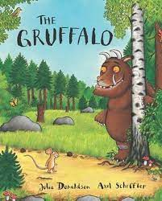

Reading & Phonics-
Early Years.

Slide 2
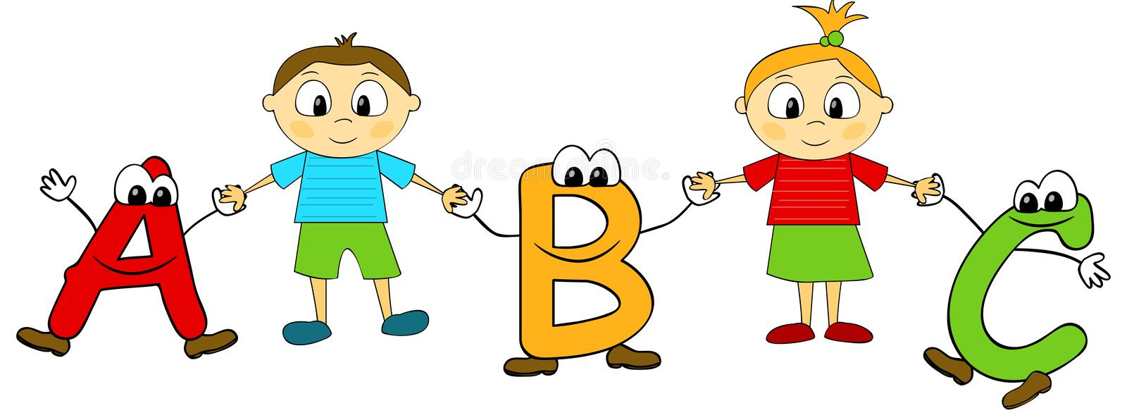
What is phonics?
Phonics is the process of learning to read using sounds and symbols.
These sounds and symbols combine to create a phonetic alphabet that can be used to blend words together.
There are 44 main sounds in the English Language. Each sound is represented by a grapheme (the written representation of a sound).

Slide 3
Phonics is taught in phases.
Phase 1- Nursery/ Pre-School.
Phase 2- Reception.
Phase 3- Reception.
Phase 4- Reception/ Year One.
Phase 5- Year One
Beyond Phase 5- Year One/Year Two.

Slide 4
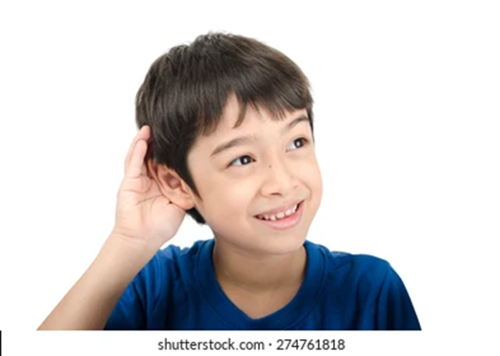
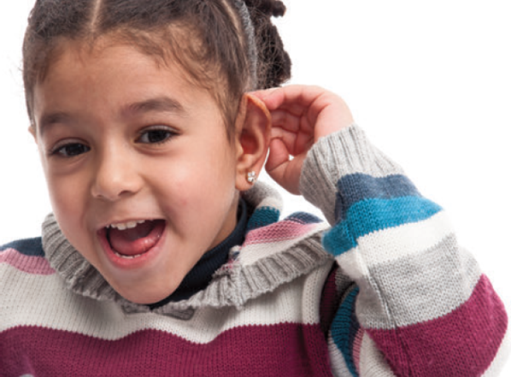
Phase 1 – Phonics.
(Nursery)

Slide 5

Phase 1.
In phase 1 there are 7 aspects that the children learn during their time in Nursery.

Slide 6


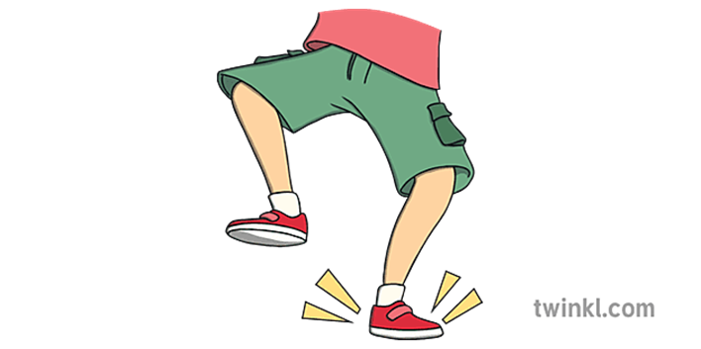
1-Exploring sounds around them.
In nursery, your child may learn all about different sounds in the world around them and begin to discover a wide variety of ways for making different sounds of their own.

Slide 7
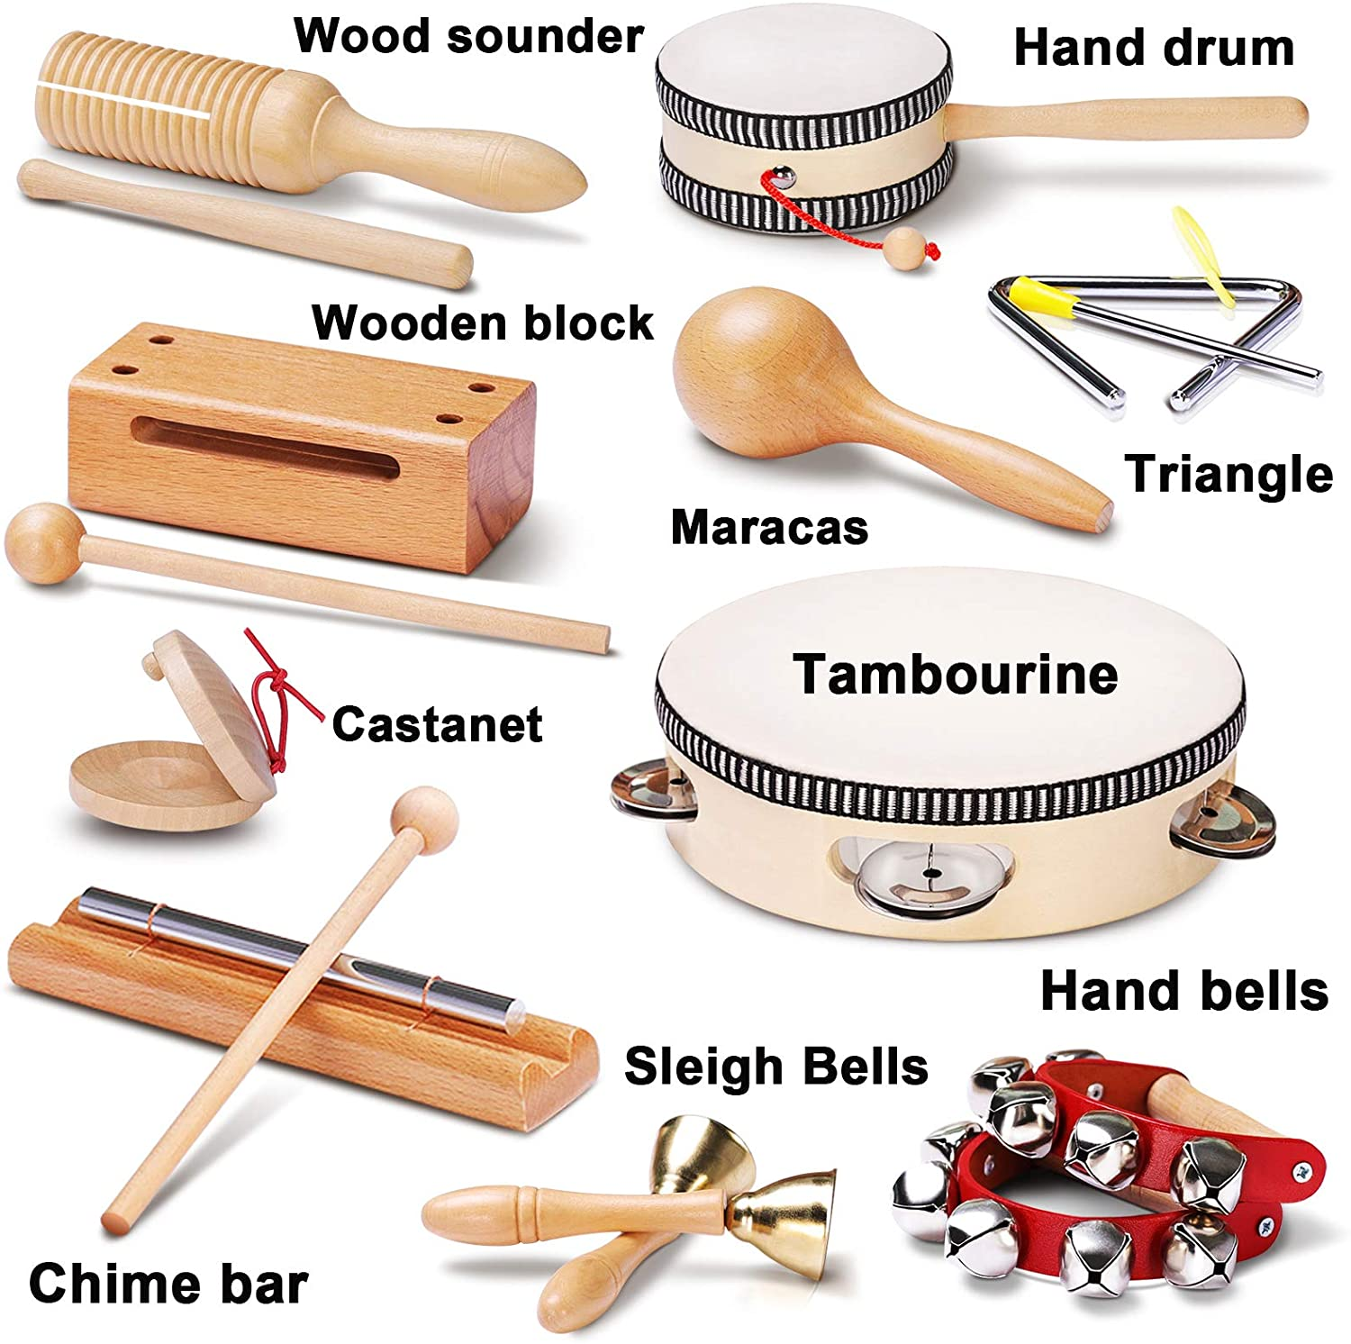
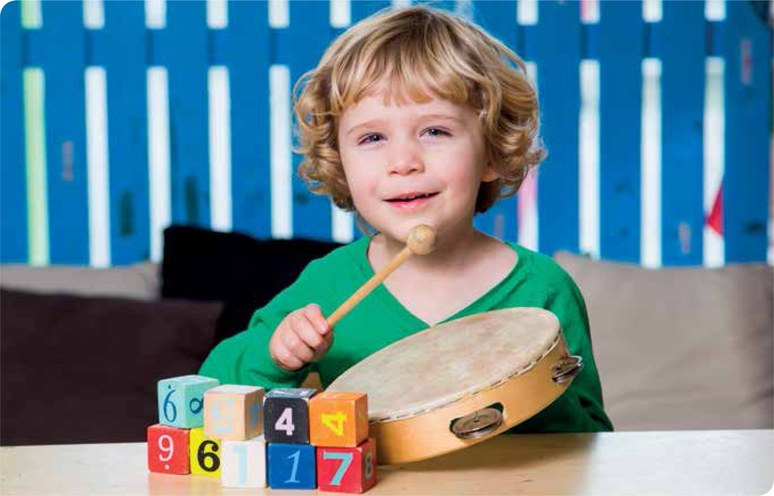
2/3 Instrumental and body sounds.
They will learn about environmental, instrumental and body percussion sounds. They will learn to name and identify some of these sounds, giving an opinion of which sounds they like or dislike.

Slide 8
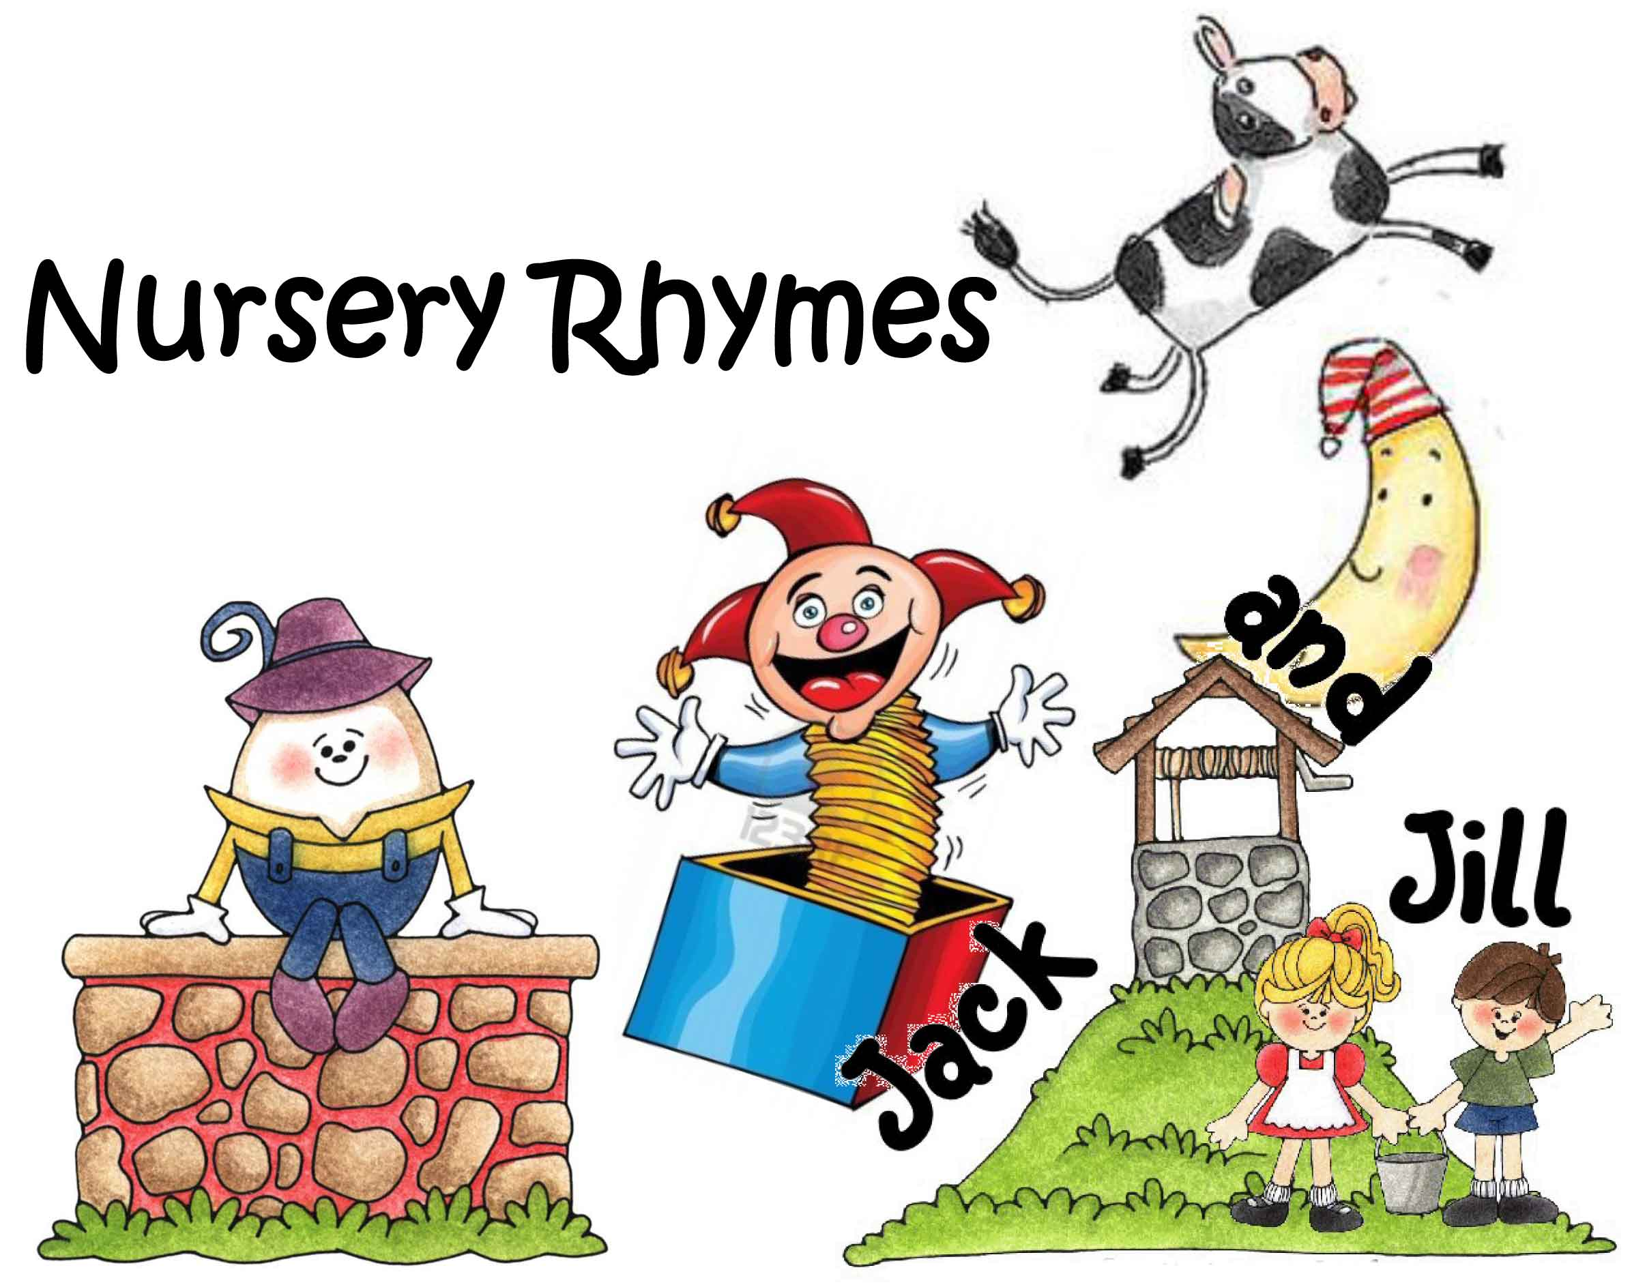
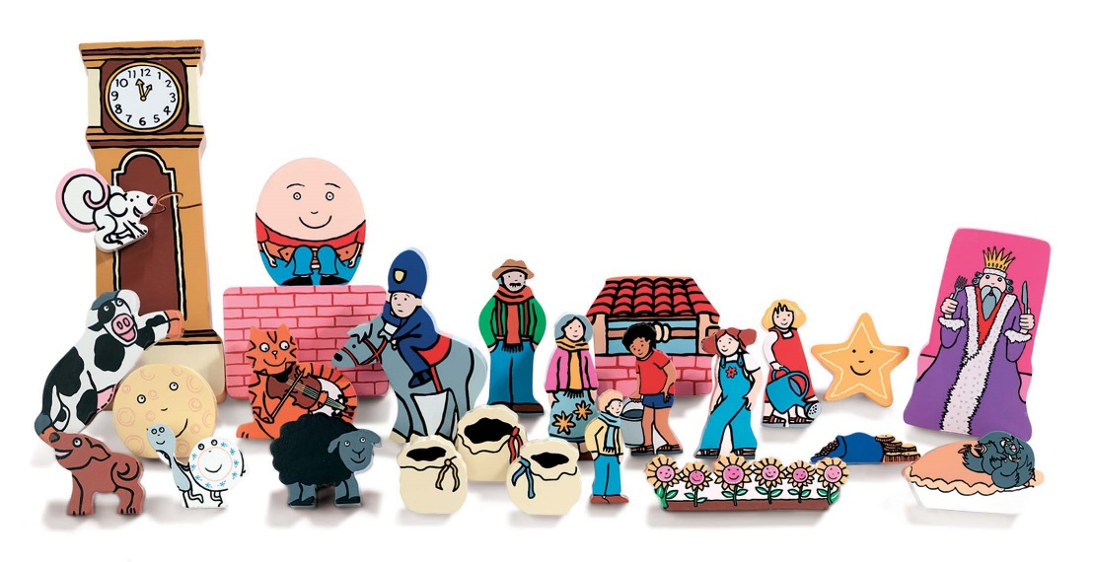
4- Rhythm and Rhyme.
Next the children will look at different rhymes. They will learn about words that contain the same stressed vowel sound, identifying different words that sound similar when given choices (for example, dog---- log, cat --- hat).
They will learn and join in with some repeating songs and nursery rhymes, moving in time with the beat and creating actions to go along with the words.

Slide 9
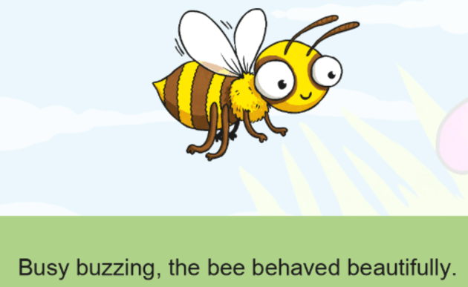
5-Alliteration.
Alliteration is when the same sound occurs at the beginning of a set of words (for example: busy, buzz, bee). This is called an initial sound. They will start to learn to match two items that have the same initial sound and spot which sound appears at the beginning of different words.

Slide 10

6- Voice Sounds
Voice sounds are when your child uses their mouth to create specific, targeted sounds. They will begin to practise forming different sounds using the shape of their mouth and position of their tongue, making sounds like ‘weeeee’, and making sounds louder or quieter by shouting or whispering. They will also begin to copy robot and sound talk (where the sounds, or phonemes, are said separately, e.g. c-a-t, p-i-n)

Slide 11
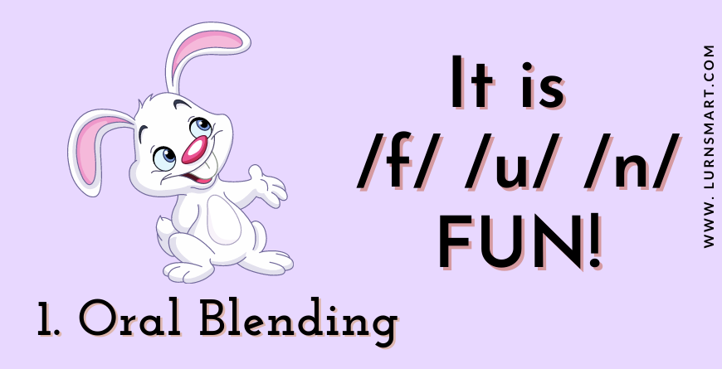
7- Oral Blending.
Once your child has started to use robot and sound talk, they may be ready to begin using oral blending of words. Blending is the process of joining sounds together to form words (for example, t-a-p → tap).

Slide 12
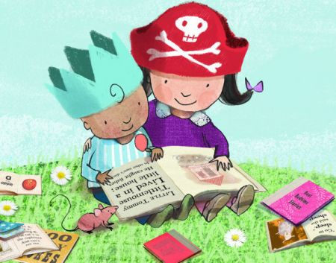
Phase 2-Phonics.
(Reception)

Slide 13
Your child will learn language specific to phonics learning.
Phoneme- a single sound- the smallest unit of sound. Eg. The word cat has 3 phonemes c-a-t.
Grapheme-written letters/ groups of letters that represent a sound.
Digraph- two letters that together make one sound. Eg ch in the word ‘chop’.
Trigraph-three letters that together make one sound. EG igh in the word ‘night’.
Split digraph: two vowel letters split but are split by one or more consonants. For example, /a-e/ in the word 'cake'.

Slide 14
How we teach phonics.
Essential Letters and Sounds (ELS) is our chosen phonics programme.
Children will experience the joy of books and language whilst rapidly acquiring the skills they need to become fluent independent readers and writers.

Slide 15
Phonics everyday.
We use a simple, consistent approach to teaching phonics across all classes.
We have mnemonics and rhymes to support learning and recall.
We teach phonics every single day from the first days of Reception.

Slide 16
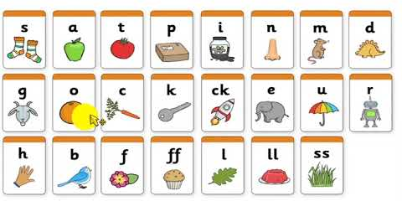
Phonics throughout the day to review new sounds & graphemes taught
Lots of opportunities for oral blending- c - oa - t
We teach the ‘code’ for reading, alongside teaching vocabulary.

Slide 17
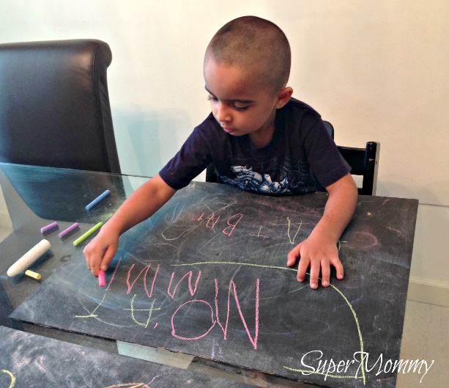
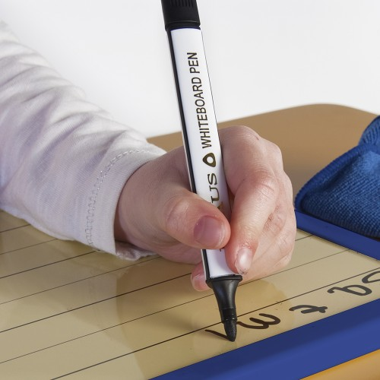
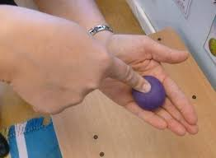

Phonics Activities.
Whiteboards & Pens.
Paint Brushes & Water.
Wiggle it.
Doh Disco.
Chalks Outside.
Sand Trays and Brushes.
Matching Games.
Word Building.
Sound Hunts.

Slide 18
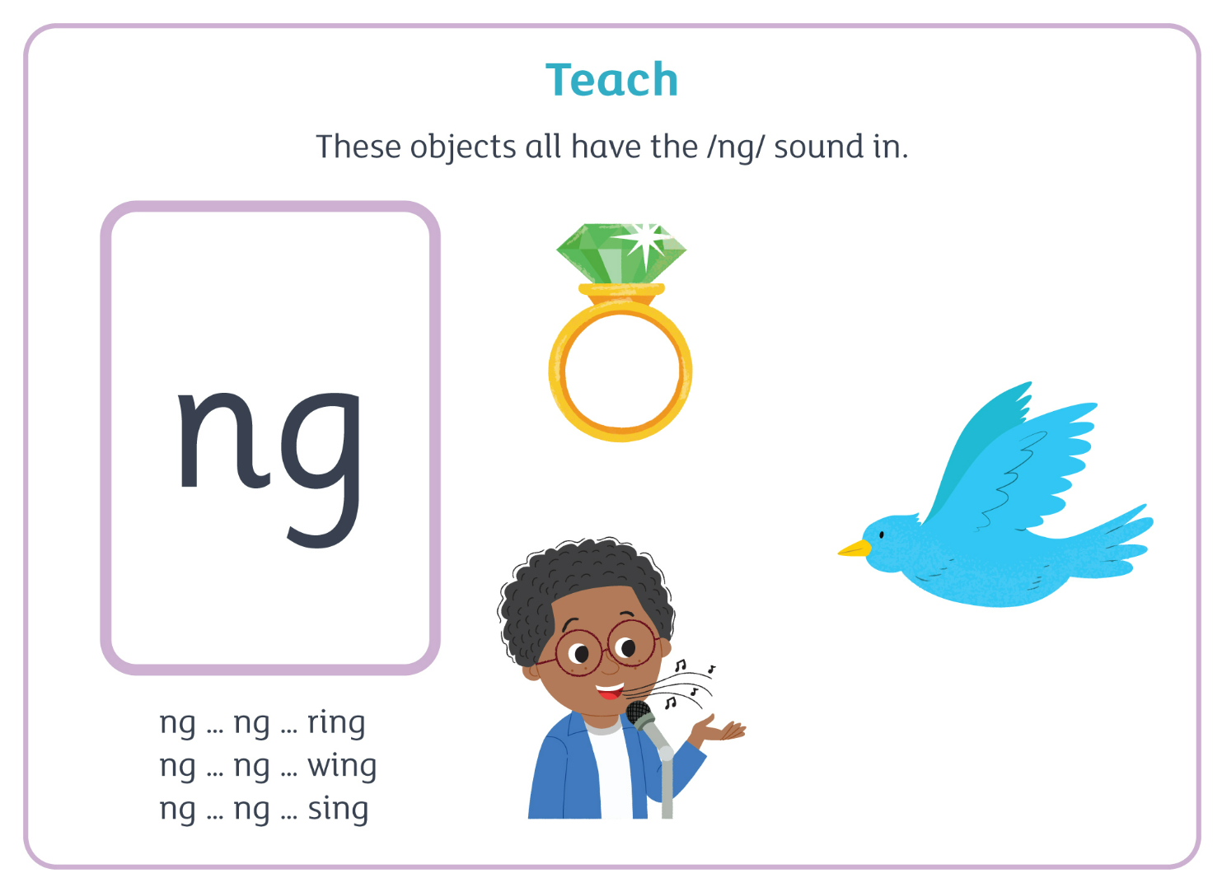

Slide 19
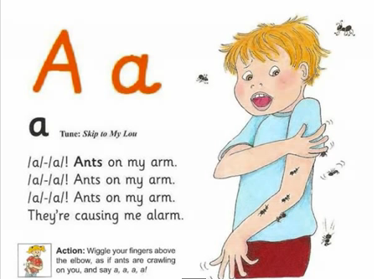
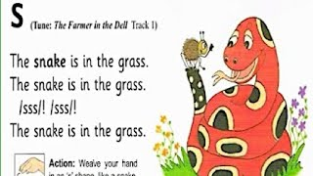
Jolly Phonics Songs and Actions.

Slide 20
Sounds taught in order.
1- s, a, t, p, i, n
2- c k, e, h, r, m, d
3- g, o, u, l, f, b
4- ai, j, oa, ie, ee, or
5- z, x, ch, sh, th, th
6- qu, ou, oi, ue, er, ar

Slide 21
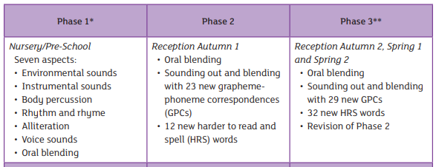
Progression

Slide 22
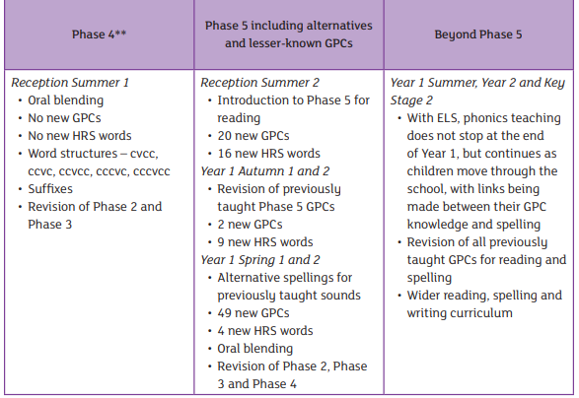

Slide 23

Regular Reading Practice
Shared Reading
Independent Reading
Home Reading
Guided Reading

Slide 24

Reading at Home.
Children are only reading from books that are entirely decodable.
Your child should be able to read their book confidently.
We only use pure sounds when decoding words (no ‘uh’ after the sound).
We want them to practise reading their book 4 times across the week working on these skills:
decode fluency expression
Reading is fun & enjoyable. Developing a love for reading.

Slide 25
H R S Words.
Harder to Read and Spell Words.
Taught in sequence.
Practiced throughout.
Sent home as taught- to practice.

Slide 26
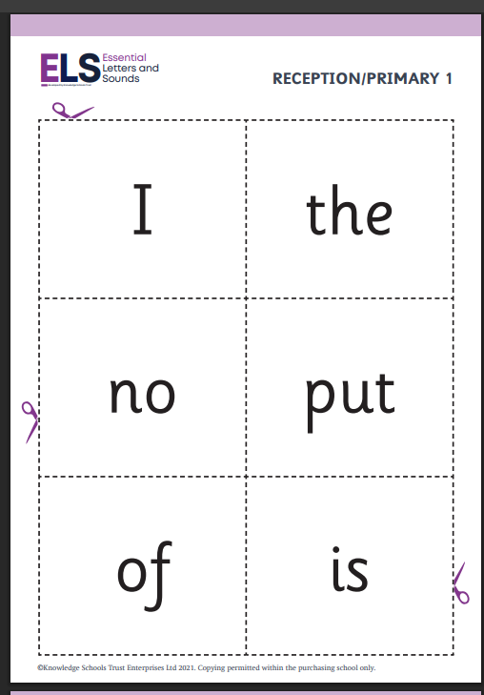

Slide 27
What you can do to help.
Read every day- a selection of different books.
Talk to your child about stories- beginning/ middle/ end.
Spot letters in the environment.
Provide opportunities to practice reading/writing.
Share writing- lists/ notes/ cards/messages- reading for a purpose.
Practice HRS words.
Enjoy reading and have fun- use silly voices/ laugh/ pretend/ use imaginations/ play/ model.

Slide 28
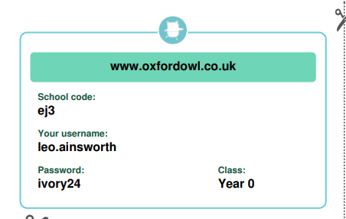
Oxford Owls.

Slide 29
Book Swap in Reception.
Choose a book from the swap box and take home to read- bring back and choose another or swap with a similar story.
Share a story from home- lunchtime storytime.
Visiting the library.
Walk and Talk Cards.

Slide 30
Other Things…..
Packed Lunches - Cut up into small pieces.
- Balanced meal- healthy choices.
- Suitable portion sizes.
Water Bottles - In school each day.
- Water only please.
Spare change of clothes- left in school please.
Parents Evening- Book on using the School Spider App.
(Wednesday 8^{th &} 15th October.)

Slide 31
Thanks for listening.
Any questions please ask- anytime. r.ironside@st-thomasmartyr.lancs.sch.uk

