Slide 1

Welcome
to
Key Stage Two

Slide 2
Puss Bank Promises…
Be Kind
Be Safe
Be Ambitious
Be Responsible

Slide 3
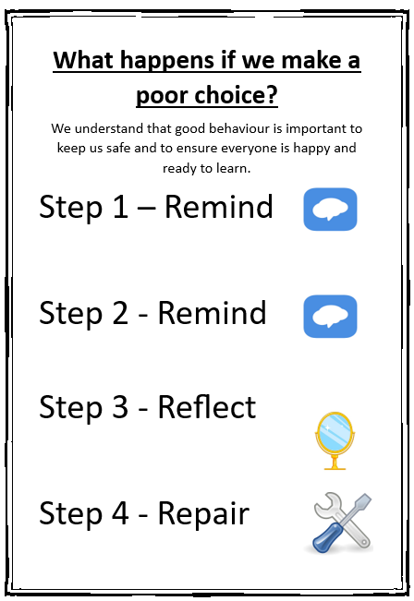

Slide 4


Slide 5

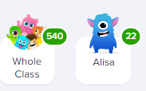

Bronze – 50
Silver – 100
Gold – 200
Diamond - 300
Outside achievements Friday Assembly

Slide 6
Arrival and Collection
Arrival is between 8:45 – 8:55am and collection is at 3:20pm
We ask that the children line up in the usual space for their class, until a teacher comes out to bring them in. Over the course of Year 3/4 your child may become more independent, and you may decide to wave them off as you walk past the staffroom building.
At the end of the day, we won’t let a child go until we see an adult for that child. Please help us by giving us a wave in these first few weeks while we get to know you.
Your child will need to bring a water bottle and their reading book and reading record every day.

Slide 7
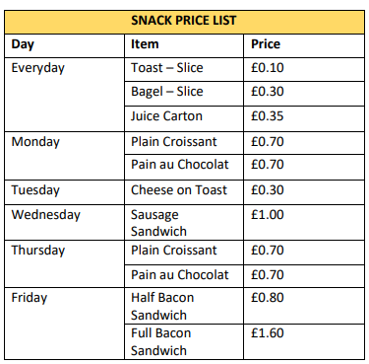
Lunches & Snack Trolley
Lunches in KS2 are not funded. Parents/Carers should pre-order lunches via the Arbor Portal/App up to a term in advance. Changes can be made up to 24 hours before the day.
Here is the snack price list. Please ensure that any snack money your child brings to school is in a zipped/sealed purse or wallet and named.

Slide 8
Getting in touch
If you have an important message to pass on in the morning, please speak to the adult on the playground. You can arrange longer meetings/phone calls after school.
You can use your child’s reading record to pass a message onto your child’s teacher, please ask your child to hand their reading record to their teacher, or it may get missed.
You can also contact us through our class email and we will respond within 72 hours. Please note, we may not see our emails on the day you send it.

Slide 9
Reading and times tables…
Reading should be enjoyable – listen to your child read, read with them and to them. Be a reading role model!
“Reading for pleasure is possibly the single-most important activity your child can do to improve achievement in school. Research has shown that reading helps cognitive development; a recent study revealed that students who read at home do ‘significantly better’ across the curriculum – including 9.9% better in maths – than students who don’t read. Linked to this is the fact that reading is the best way to improve vocabulary, essential for success in every subject.”
Learn the times tables relevant for your year group.

