Slide 1
Teach reading: change lives
Parent workshop: Foundations for Phonics
Notes:
Suggested resources:
Print out the Foundations for Phonics handout for parents to take home.
Nursery rhyme print-outs, if you are using Rhyme time.
Suggested script:
Welcome to this parent information session all about how we use Little Wandle Foundations in our Nursery to support your child to get ready for phonics and reading.

Slide 2

Reading floats
on a sea of talk
James Britton
Notes:
Suggested script:
This quote from James Britton, who was an influential educator, is a good place for us to start. We know that the best way we can develop your child's future reading is through developing their language.
Children cannot read if they cannot speak.
In Nursery, it is tempting to get children to learn to read early, but we must remember that the best foundations for learning to read are built through talking, songs and rhymes, and sharing books.

Slide 3

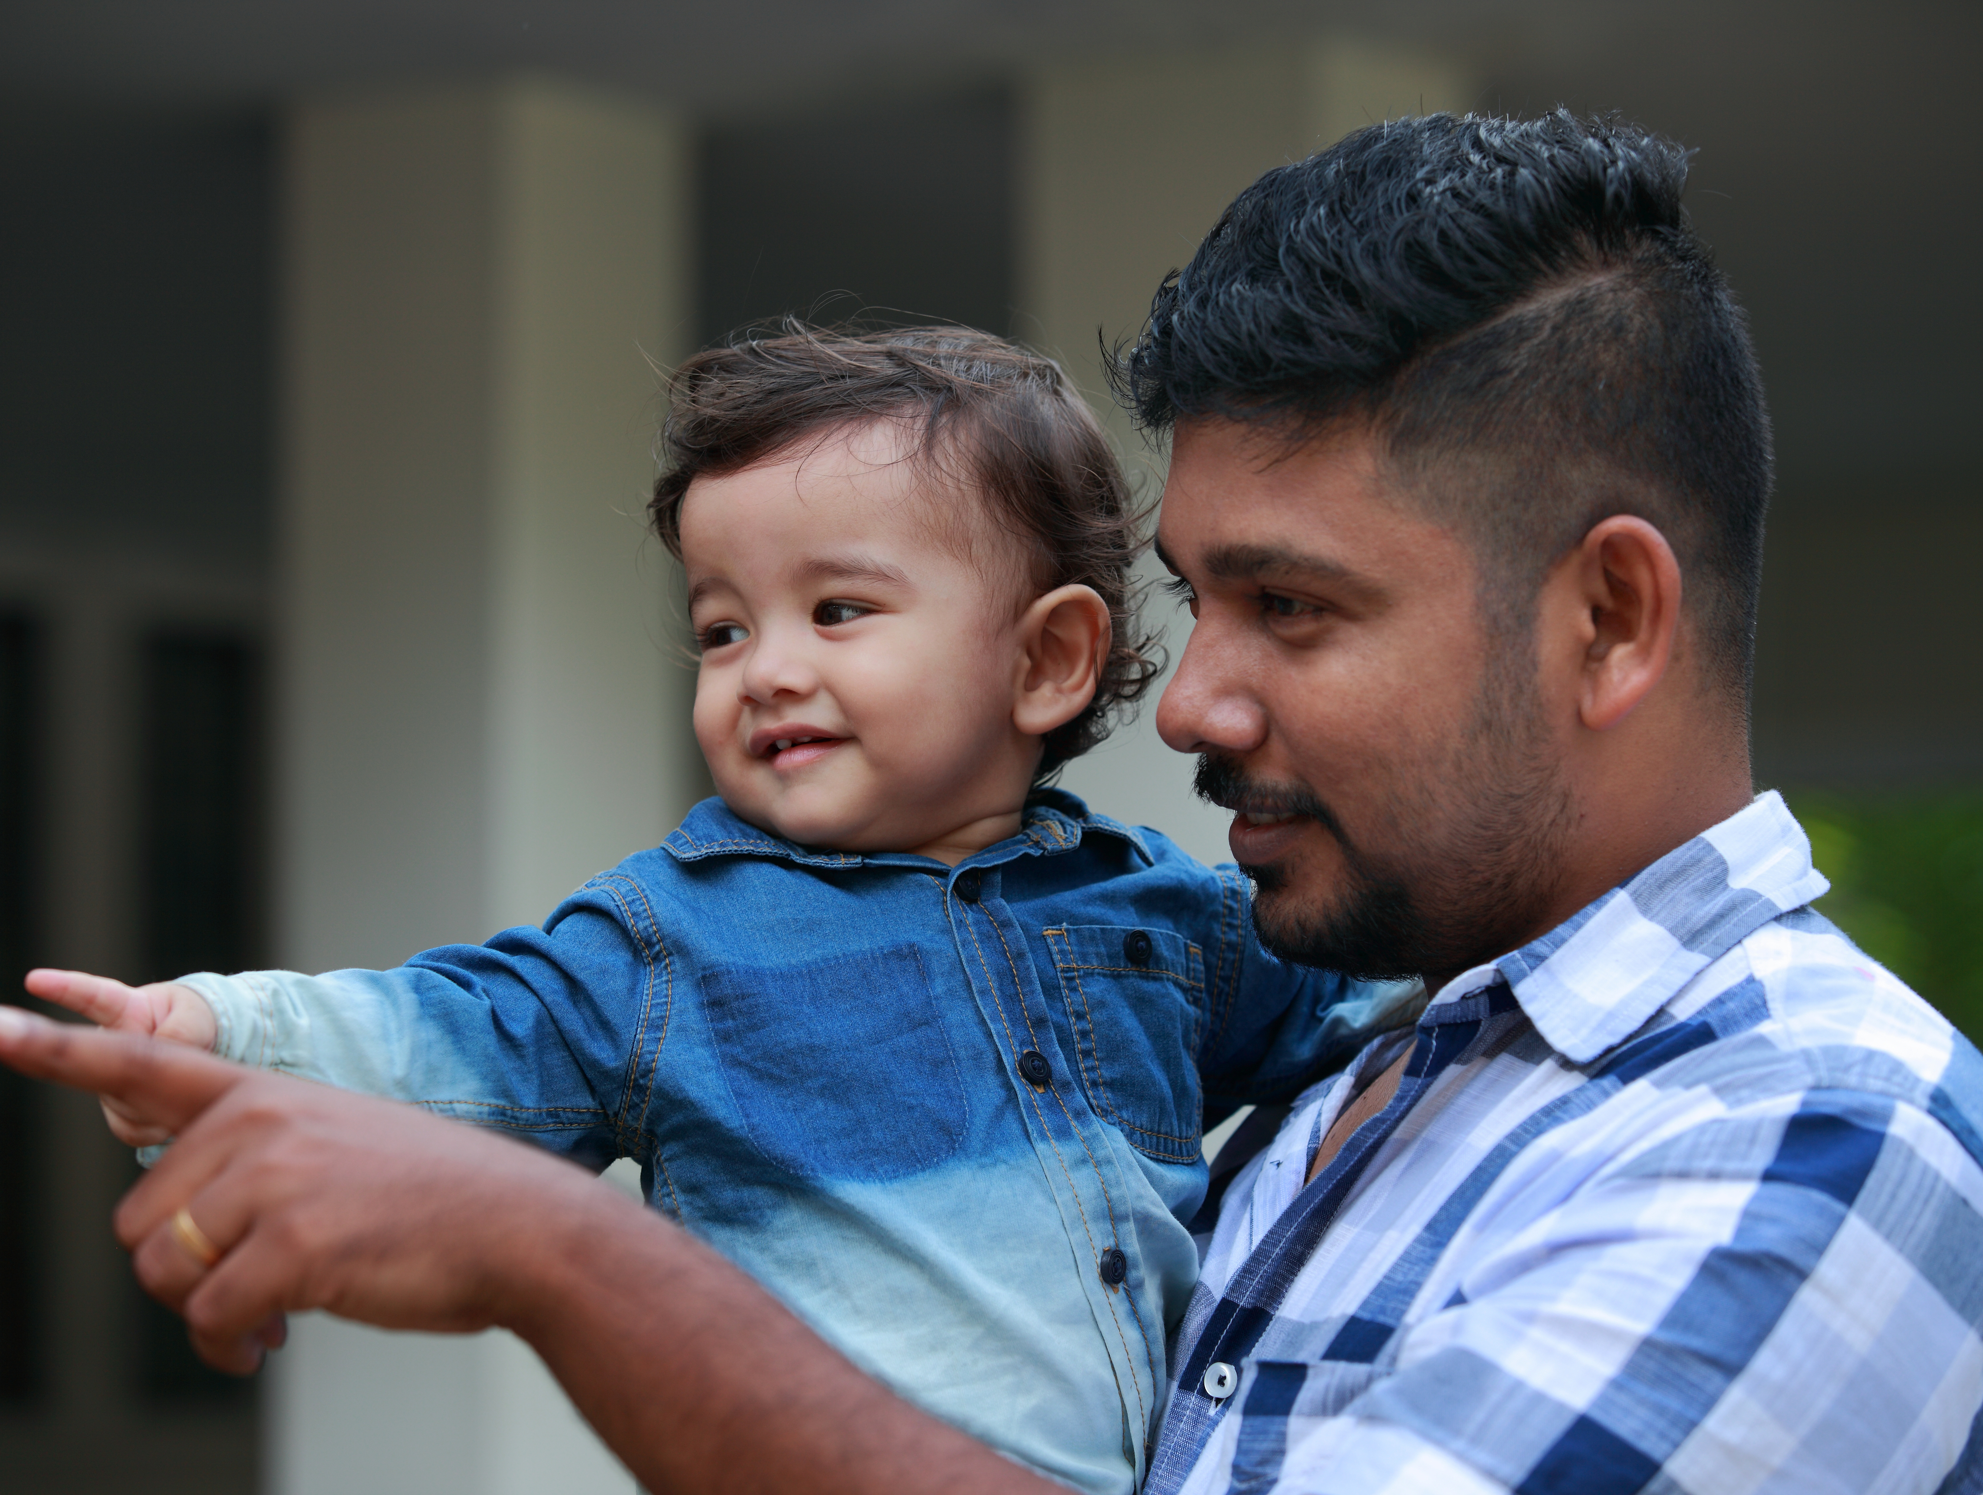
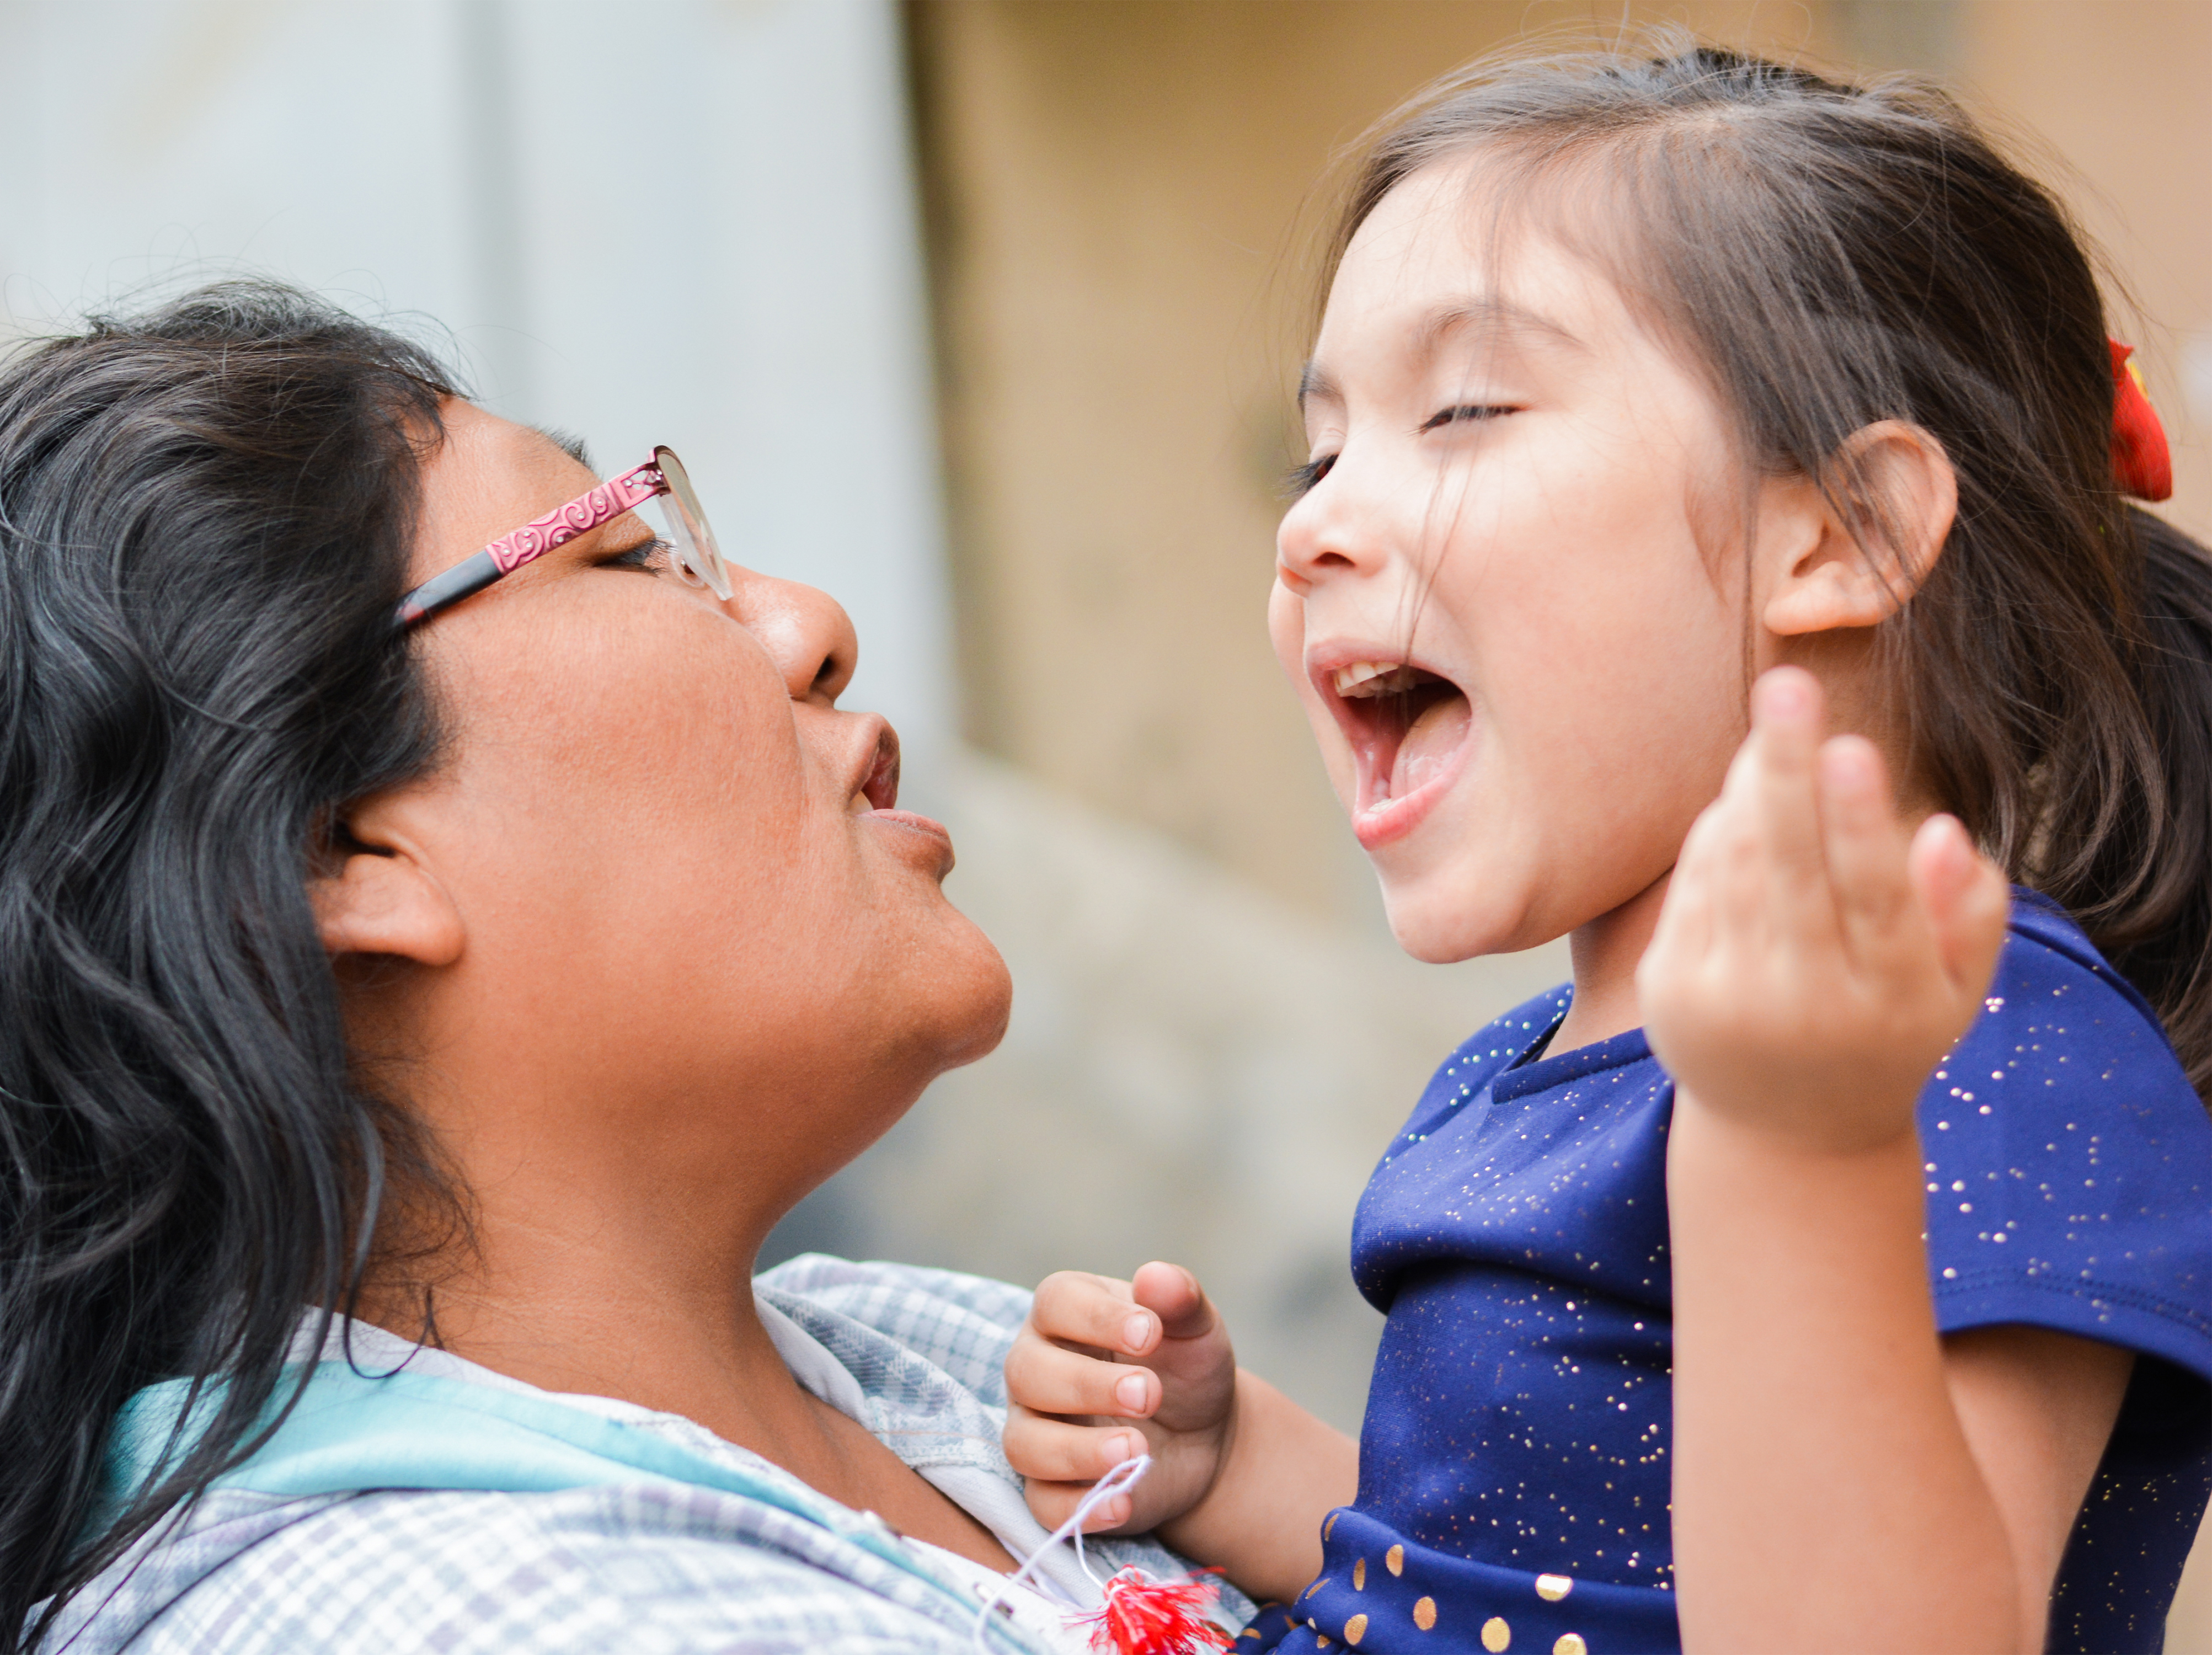
Which of these do you do with your child?
Notes:
Suggested script:
Today we are going to talk about how you can support your child to get ready for their phonics learning in Reception.
Ask: Which of these activities do you do with your child?
Perhaps you read stories? Point out words around you? Sing songs or rhymes?
Take feedback
If you are already doing these things, then you are well on your way to laying the foundations for your child's phonics learning!
Any time spent talking with your child helps grow their language and sets them up for future success at school.

Slide 4
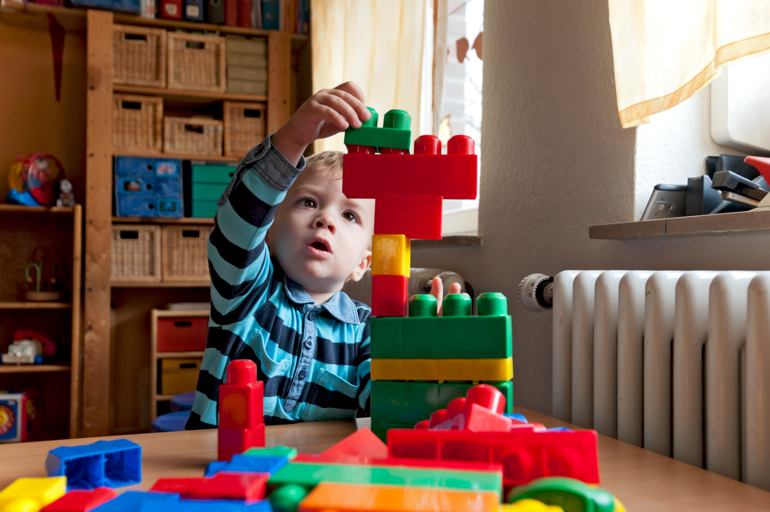
Little Wandle Foundations for Phonics
Our setting has chosen to use the
Little Wandle Foundations for Phonics programme to give every child the best possible start to their reading journey.
We build the foundations for children to succeed with phonics in Reception.
We do this using Little Wandle’s Tuning
into sounds and Rhyme time activities.
Notes:
Suggested script:
All early years settings follow the government's EYFS statutory framework. We provide learning for your children following the guidelines set out in the framework.
For one of the prime areas of learning, Communication and Language, we have chosen to use Little Wandle Foundations to support your child's learning.
Read the slide.

Slide 5
Phonics is:
making connections between the sounds (phonemes) of our spoken words and the letters that are used to write them down.
Notes:
Suggested script:
So what is phonics?
Read the slide.
It sounds complicated but it really isn’t!

Slide 6
What helps children get ready for phonics?
Research tells us that there are important skills that children need to practise to help them learn phonics.
Nursery is where we practise these skills. Formal phonics teaching begins in Reception.
Let’s look at what we focus on in Nursery and what you can do at home, too.
Notes:
Suggested script:
So, phonics involves children learning to connect sounds or phonemes to letters.
In order to prepare them for this, we need to help them recognise what a phoneme is.

Slide 7
Phonological awareness is:
being able to focus on the sounds in language, not just the meaning.
Notes:
Suggested script:
At first, when babies hear us talking, they only hear a stream of sound.
However, they quickly learn to focus on the meaning of what they hear.
To get children ready to read, we need to take their focus back to the sound.
Let's look at how we help children to hear different aspects of the sound of language.

Slide 8

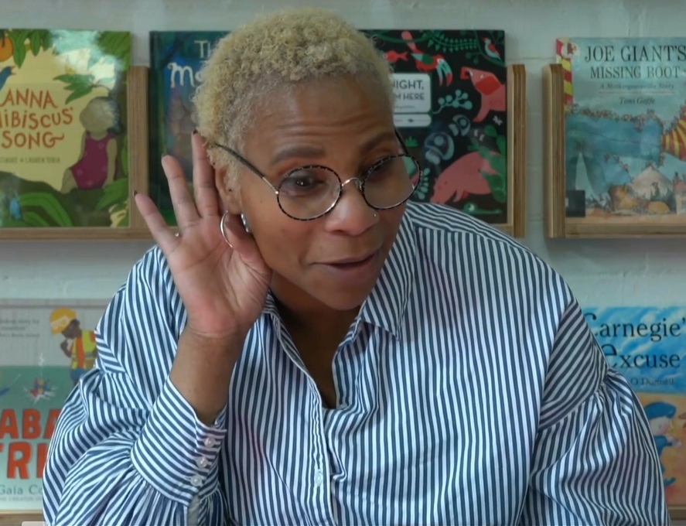
Listening games
In our setting, we:
talk about different types of sounds
play listening games,
for example, Voice sounds.
At home, you can:
draw your child’s attention to different sounds around them, for example, ‘Listen to the loud noise! It sounds like an engine.’
Notes:
Suggested script:
For children to learn anything well, they need to listen.
As you can imagine, this is particularly true for learning to hear sounds!
Let's watch a video of a game that we play with the children called Voice sounds.

Slide 9

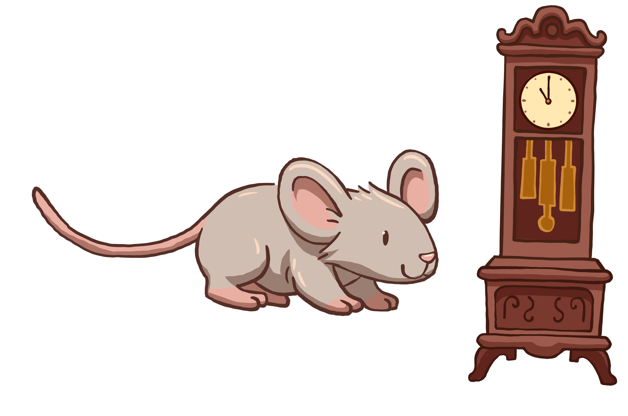
Songs and rhymes
In our setting, we:
sing rhymes regularly
leave gaps at the end of the line for children to complete the rhyme, for example, ‘Hickory dickory dock, the mouse ran up the ______.’
At home, you can:
read lots of rhymes and sing songs
pause for your child to complete the rhyme
make up silly rhymes, for example, ‘Get your coat,
you little goat! So we can leave the house, little mouse!’
Notes:
Suggested script:
Songs and rhymes are a great way to increase children's awareness of rhyming, which is a key part of phonological awareness.
What's more, research has shown that children who learn nursery rhymes with their caregivers go on to become better readers.
This is only true when they learn these rhymes with an adult – please avoid only letting your child watch nursery rhymes on screens as it doesn't have the same impact.

Slide 10


Hearing syllables
In our setting, we:
clap the number of syllables in different words
highlight long and short words.
At home, you can:
clap the syllables of words
talk about long words, for example,
‘Ooh, that’s a long word! Let’s clap it out.’
work out how many syllables
there are in your family names.
Notes:
Suggested script:
Another part of phonological awareness is syllables. Syllables are the smaller units within words.
For example, the word 'hello' has two syllables – clap as you say 'hel’ and 'lo’.
You can also explore the number of syllables in your names, for example, “My name has __ syllables.” (clap the syllables in your name). “How many syllables are there in your name?”
If children can hear the syllables within words, it will help them to read and write longer words when they get into Reception. So it is important to give them lots of practice.

Slide 11
Phonemic awareness is:
being able to focus on and play around with the sounds within words.
Notes:
Suggested script:
As we've discussed, in Reception, when children learn phonics, they need to be able to match sounds to letters.
For them to do this, they need to be able to identify the sounds in words.
This is called phonemic awareness.

Slide 12
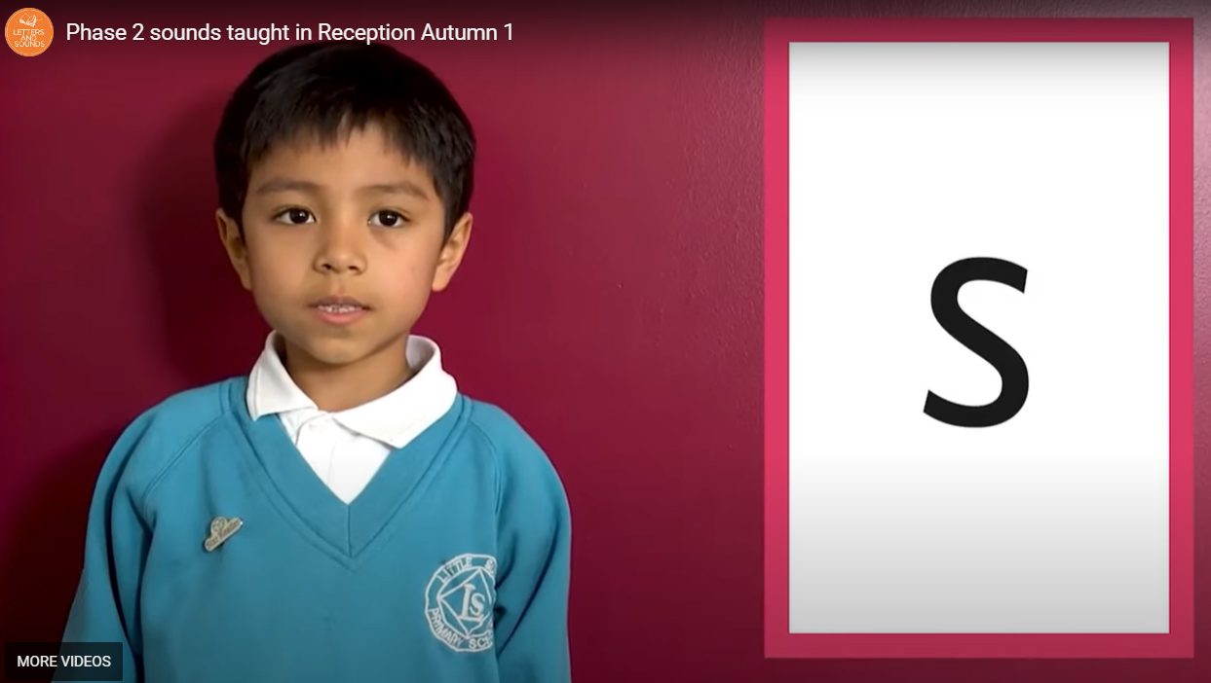
Helping your child with their phonemes
It is really important that you say the sounds clearly and correctly.
Let’s practise!
Please don’t show your
child the grapheme cards …
Notes:
Suggested script:
Let’s watch the video of Phase 2 sounds taught in Reception: For parents - Letters and Sounds (littlewandlelettersandsounds.org.uk)
Remember, please don't show your child the grapheme (letter) cards! This is just for you to practise your pronunciation.

Slide 13
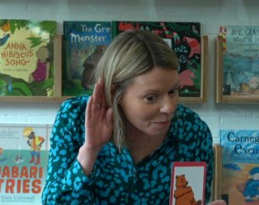
bus
Identify initial sounds
In our setting, we:
play games focusing on initial sounds, for example, Bertha the Bus.
At home, you can:
get your child to identify the first sound of words, for example, ‘Oh look, here is our bus. Bus starts with b.’
Notes:
Suggested script:
We help children develop their phonemic awareness by focusing on the first sound (or initial sound) in words.
Let's watch a video of one of the activities we do in class, Bertha the Bus.

Slide 14
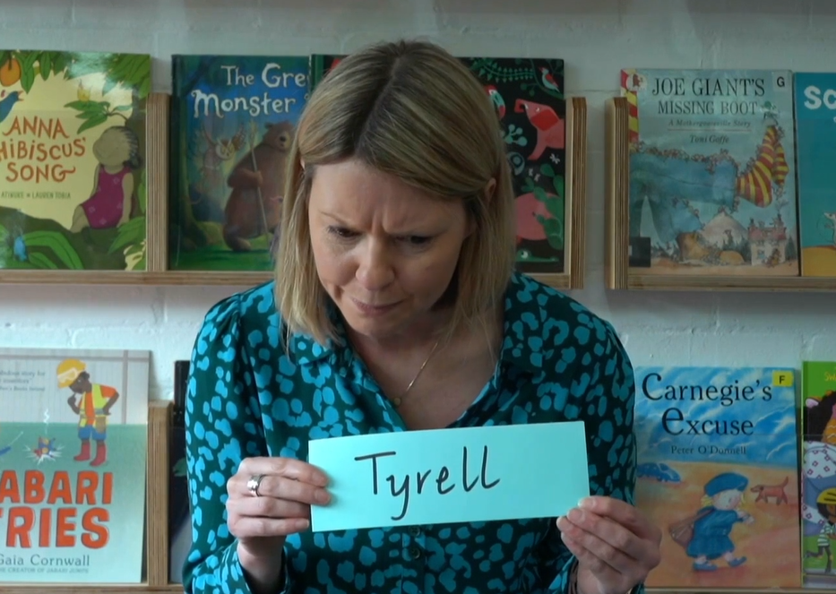
big bus
Alliteration
In our setting, we:
play alliteration games
use alliteration when we can, for example, ‘Would you like to play with the big bus or the long lorry?’
At home, you can:
try singing a nursery rhyme but change the words so they all start with the same sound, for example, ‘Binkle, binkle, bittle bar, bow by bunder bot boo baa!’
Notes:
Suggested script:
Alliteration is when words start with the same sound, for example, the big blue boat or the huge hungry horse.
Alliteration helps children hear the different sounds in words and can be a lot of fun!
Let's watch a video of one of the activities we play in class, Name play sounds from the website.

Slide 15
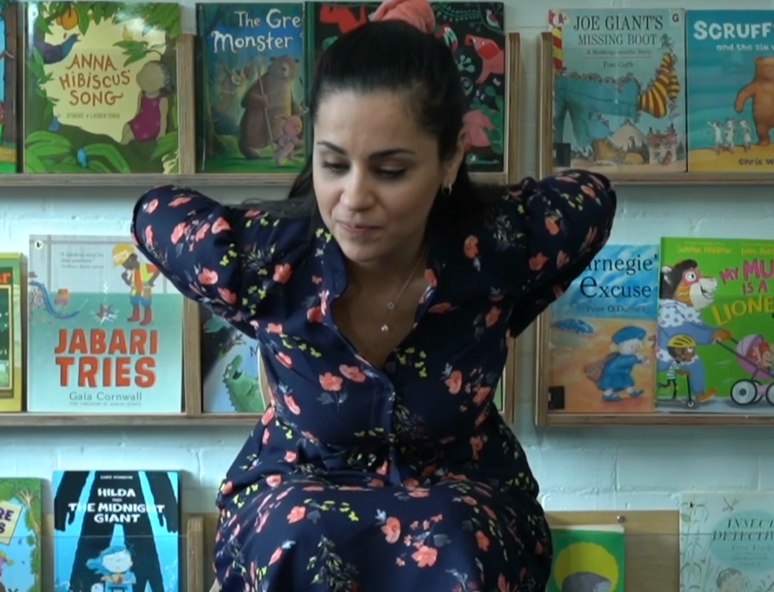
b-u-s
Oral blending
In our setting, we:
play lots of oral blending games, for example, ‘Can you touch your …?’
oral blend words throughout the day, for example, ‘Everyone put on your c-oa-t.’
At home, you can:
try sound-talking different words, for example, ‘Can you brush your t-ee-th?’
Notes:
Suggested script:
Oral blending is when we get children to put sounds together in their heads to make a word, for example, b – u – s (say it faster and faster until the parents can blend the word).
When children learn to read, they learn to do just this – to read the individual sounds and blend them together.
Oral blending is like the dress rehearsal for reading.
It is such an important skill that we do lots of practice in Nursery and would love you to practice at home.
Let’s watch a video of the activity ‘Can you touch your ... ‘ from the website.

Slide 16
Quick recap!
Phonological awareness
Listening games | Songs and rhymes | Hearing syllables
Phonemic awareness
Initial sounds | Alliteration | Oral blending
bus
big bus
b-u-s
Notes:
Suggested script:
Let's remind ourselves of some of the skills we teach your children in Nursery to get them ready for phonics in Reception.

Slide 17
Main take-aways
Nursery is where we lay the foundations for learning to read.
Little Wandle Foundations for Phonics focuses on the sounds of language to help children prepare for phonics in Reception.
You can help at home by:
  talking lots to your child
  reading aloud to them every day
  singing songs and rhymes
  playing some of our Tuning into sounds and Rhyme time games.
Notes:
Suggested script:
So, to recap...
Read the slide.
Remember to ask us if you have any questions – we will always be happy to help!

Slide 18
Early knowledge of nursery rhymes may play a considerable role in preparing the child for reading and spelling.
Bryant et al.
Notes:
Suggested script:
Let's end with this quote from an important piece of research that was carried out in the 1980s by a team of academics.
They found a strong link between how many nursery rhymes children know before starting school and their success at reading and writing in school.
As well as learning lots of nursery rhymes, we will help your child learn all the skills they need to set them up for phonics in Reception.

