Slide 1







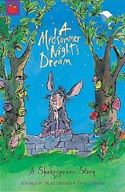
Salesbury Super 6 Knowledge Organiser for
Learning Focus: The History of Theatre
Learning Hero: William Shakespeare
Key knowledge to learn
The Greeks invented the theatre. Thousands of people packed the hillside arena of ancient Athens to watch plays by famous writers like Sophocles, Euripides and Aeschylus
The Greeks performed tragedies (sad, serious stories) and comedies (funny stories). Actors wore large masks and only men were allowed to act.
During the middle ages Churches helped bring performances back. Performances were sometimes outside, in market places or on travelling stages.
Elizabethan theatres were open air, performances took place in the day and all actors were male. The stage came out to the centre and the audience stood around it.
Shakespeare was the greatest ever playwright and wrote around 37 plays for the theatre and over 150 poems during the Tudor period.
In the 1900s new technology brought electric lighting, microphones and better stage effects.
Vocabulary
Tragedy | a serious play that ends with the death or suffering of the main character
Comedy | a dramatic or other work of light and amusing character
Amphitheatre | the outdoor theatre that Greek Theatre was performed in
Mime | a silent performance expressing an idea and representing a character by gestures and body movements without the use of words
Chorus | a group of masked performers who move and speak together
Narration | normally spoken to the audience, performers give information, tell the story or comment on the action
You can find out more by:-Visiting this site - Ancient Greece - KS2 History - BBC Bitesize A Midsummer Night's Dream | LearnEnglish Kids (britishcouncil.org) Greek Theatre backstage page | National Theatre

